Slide 1
Final Review
Instructor Dr. Jianhui Yue
Fall 2015 CSE, Miami Univ.

Slide 2
How to prepare for final
Reviewing/doing homework problems is a good way to study.
Reading related sections in textbook
Reading slides
Using the homework problem to test your understanding
You will write assembly code segment
Don’t memorize instruction format and architectural diagram and they will provided as necessary

Slide 3
Topics
Assembly programming
Slides, 2.6, 2.7, 2.8, A.6
Datapath
4.3, 4.4,
Pipeline Concepts
4.5
Pipelined Datapath
4.6
Data Hazards
4.7
Branch Hazards
4.8
C programming
Handout, pionters

Slide 4
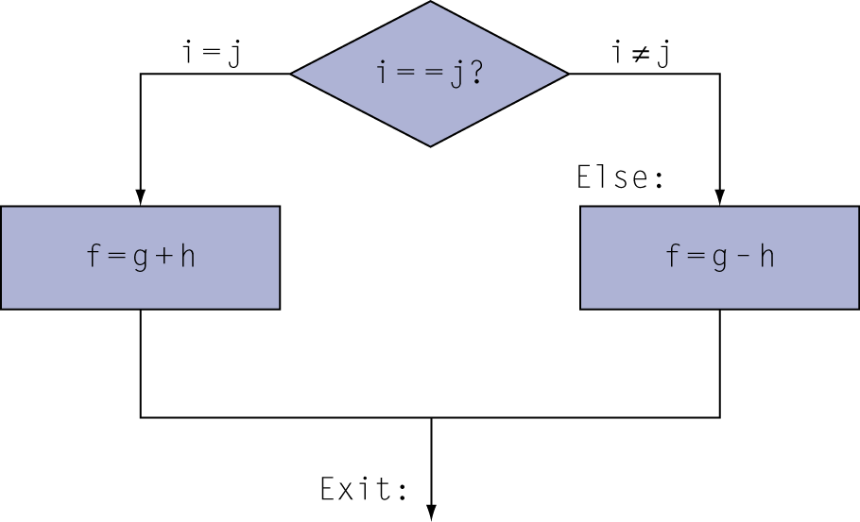
Translate if statement to assembly code
C code:
if (i==j) f = g+h; else f = g-h;
f, g, … in $s0, $s1, …
MIPS code:
bne $s3, $s4, Else add $s0, $s1, $s2 j Exit Else: sub $s0, $s1, $s2 Exit: …

Slide 5
Translate loop to assembly code
C code:
while (save[i] == k) i += 1;
i in $s3, k in $s5, address of save in $s6
Compiled MIPS code:
Loop: sll $t1, $s3, 2 # i<<2 = i*4 add $t1, $t1, $s6 # t1 = addr. Of save[i] lw $t0, 0($t1) # t0 = save[i] bne $t0, $s5, Exit # go to Exit if cond. false addi $s3, $s3, 1 # i = i+1 j Loop # go to Loop Exit: …

Slide 6
Procedure Call Instructions
Procedure call: jump and link
jal ProcedureLabel
Address of following instruction put in $ra
Jumps to target address
Procedure return: jump register
jr $ra
Copies $ra to program counter
Can also be used for computed jumps
e.g., for case/switch statements

Slide 7
Basic Parameter Passing
Jal saves the next instruction address, which is return address, to $ra.
.data
arg1: .word 22, 20, 16, 4
arg2: .word 33,34,45,8
.text
addi $t0, $0, 4
move $t3, $0
move $t1, $0
move $t2, $0
loop: beq $t0, $0, exit
addi $t0, $t0, -1
lw $a0, arg1($t1)
lw $a1, arg2($t2)
jal func
add $t3, $t3, $v0
addi $t1, $t1, 4
addi $t2, $t2, 4
j loop
func: sub $v0, $a0, $a1
jr $ra
exit: ---
Register usage
What about excess arguments?
PC
+
4
$31
PC
$31
Jal restore return address from $ra.

Slide 8
Register Usage
$a0 – $a3: arguments (reg’s 4 – 7)
$v0, $v1: result values (reg’s 2 and 3)
$t0 – $t9: temporaries
Can be overwritten by callee
$s0 – $s7: saved
Must be saved/restored by callee
$gp: global pointer for static data (reg 28)
$sp: stack pointer (reg 29)
$fp: frame pointer (reg 30)
$ra: return address (reg 31)

Slide 9
Leaf Procedure Example
C code:
int leaf_example (int g, h, i, j) { int f; f = (g + h) - (i + j); return f; }
Arguments g, …, j are passed in $a0, …, $a3
f in $s0 (we need to save $s0 on stack)
Results are returned in $v0, $v1
$a0
result registers
argument registers
$a1
procedure
$v0
$a2
$v1
$a3

Slide 10
Leaf Procedure Example
MIPS code:
leaf_example: addi $sp, $sp, -4 sw $s0, 0($sp) add $t0, $a0, $a1 add $t1, $a2, $a3 sub $s0, $t0, $t1 add $v0, $s0, $zero lw $s0, 0($sp) addi $sp, $sp, 4 jr $ra
Save $s0 on stack
Procedure body
Result
Restore $s0
Return

Slide 11
Leaf Procedure Example
$sp
High addr.
Low addr.
MIPS code:
leaf_example: addi $sp, $sp, -4 sw $s0, 0($sp) add $t0, $a0, $a1 add $t1, $a2, $a3 sub $s0, $t0, $t1 add $v0, $s0, $zero lw $s0, 0($sp) addi $sp, $sp, 4 jr $ra
Save $s0 on stack
$sp
$s0
High addr.
Procedure body
Low addr.
Result
Restore $s0
$sp
$s0
High addr.
Return
Low addr.

Slide 12
Template for a Procedure
Allocate stack frame (decrement stack pointer)
Save any registers (callee save registers)
Procedure body (remember some arguments may be on the stack!)
Restore registers (callee save registers)
Pop stack frame (increment stack pointer)
Return (jr $ra)

Slide 13
Pointer
A pointer is the address of a variable
Declare pointer variable
Put a star (*) before a variable name indicates that the variable is a pointer to the declared type
int * pter; //ptr is a variable that can hold the address of an integer
* operator dereferences a pointer, returning the value stored at the indicated memory address contained in the pointer
The & operator produces the memory address of the variable
being referenced.

Slide 14
Example
int salary1, salary2; // 32-bit numbers
int *ptr; // a pointer specifying the address of an int variable
salary1 = 67500; // salary1 = $67,500 = 0x000107AC
ptr = &salary1; // ptr = 0x0070, the address of salary1
salary2 = *ptr + 1000;
/* dereference ptr to give the contents of address 70 = $67,500,then add $1,000 and set salary2 to $68,500 */

Slide 15
Pointer as an argument
A function can modify an object defined outside of it.
A function can make the input a pointer to the object.
This is called passing an input variable by reference.
void quadruple(int *a)
{
*a = *a * 4;
}
int main(void)
{
int x = 5;
printf("x before: %d\n", x);
quadruple(&x);
printf("x after: %d\n", x);
return 0;
}

Slide 16
Pointers to Functions
Declaration
dataytpe (*p2fun)( parameter declaration list)
int (*ALU)(int, int)
ALU is a pointer to a function that has two int arguments and reutrn int
int add( int a, int b){
return a+b;
}
int sub( int a, int b){
return a-b;
}
int mul( int a, int b){
return a-b;
}
main( ){
…
int (*ALU)( int , int) = NULL;
ALU = add;
ALU(3,4); // call add( )
ALU = mul;
ALU(3,4); // call mul()
}

Slide 17
Arrays
An array is a group of similar variables stored in consecutive addresses in memory.
The elements are numbered from 0 to N−1, where N is the size of the array.
In C, the array variable is a pointer to the 1st element.
Array initialization using curly braces {} can only be performed at declaration,
and not afterward.
long scores[3]={93, 81, 97}; // scores[0]=93; scores[1]=81; scores[2]=97;

Slide 18
Array as an argument
In a function, an input argument of type int[] indicates that it is an array of integers.
float getMean(int arr[], int len) {
int i;
float mean, total = 0;
for (i=0; i < len; i++)
total += arr[i];
mean = total / len;
return mean;
}

Slide 19
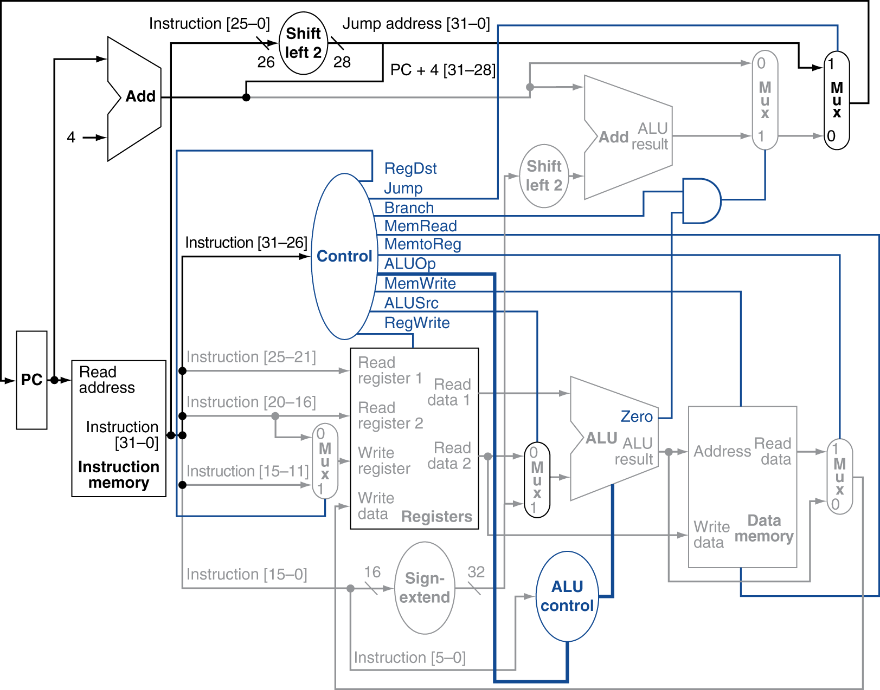
Datapath

Slide 20
Instruction Pipeline Representation
IF instruction fetch stage
ID instruction decode and register file read stage
EX execution stage
MEM memory access stage
WB write back stage
Shadow on right represents reading and shadow on left represents writing.

Slide 21
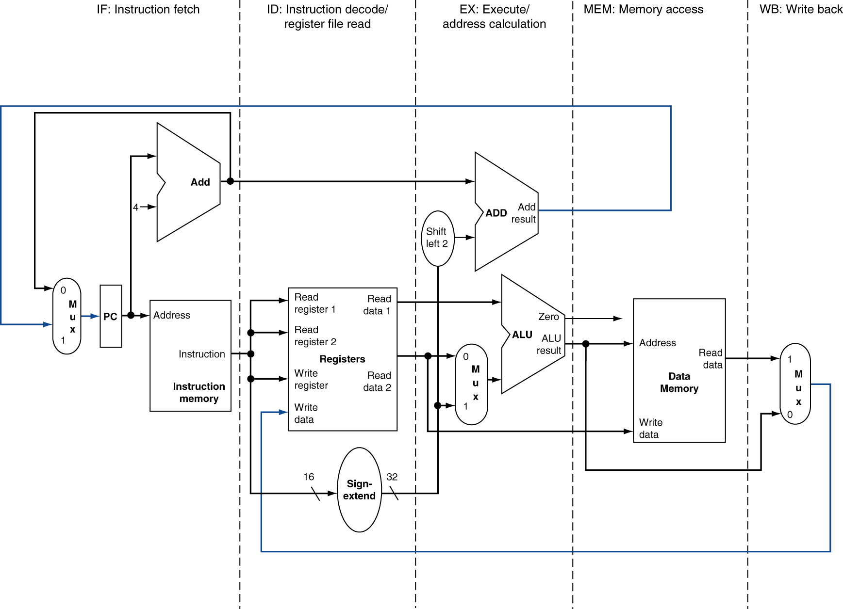
Simplified Pipeline Datapath

Slide 22
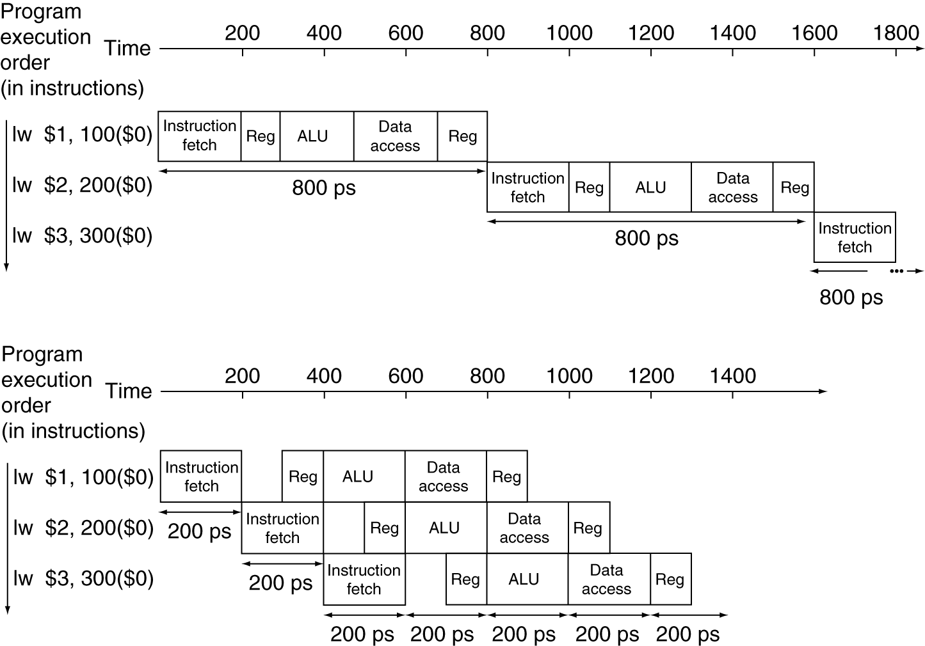
Pipeline Performance
Single-cycle (T_{c}= 800ps)
Pipelined (T_{c}= 200ps)

Slide 23
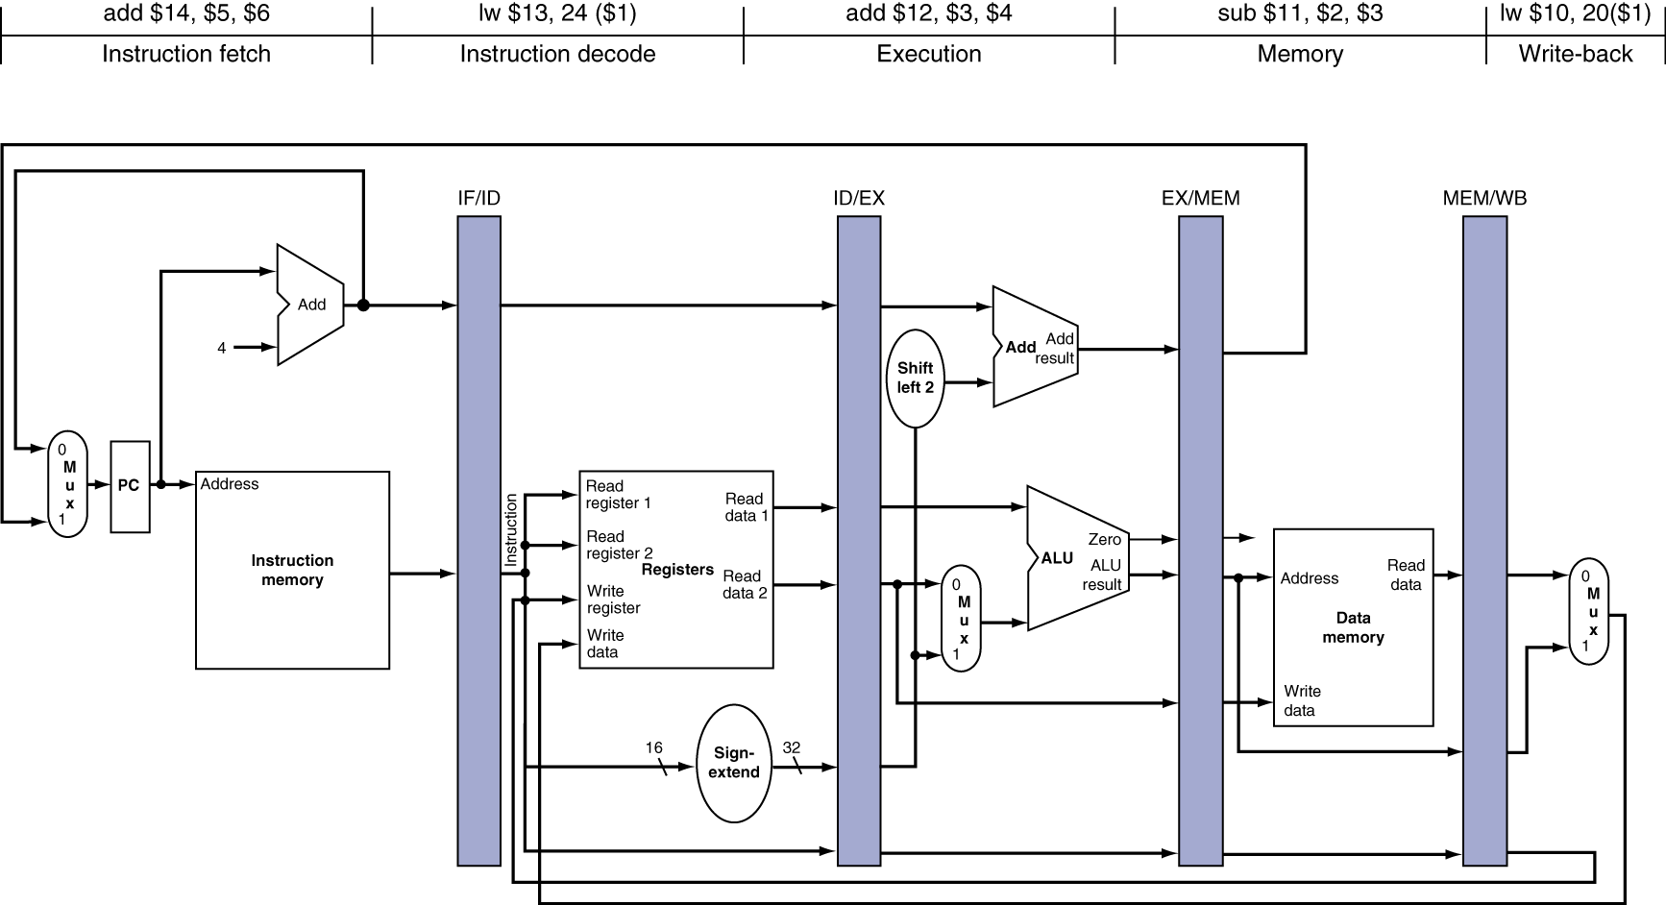
Motivation for pipeline register
Multiple instructions share a single datapath and each pipeline register holds information, such as rs,rt, PC+4 and so on, for individual instruction respectively.

Slide 24
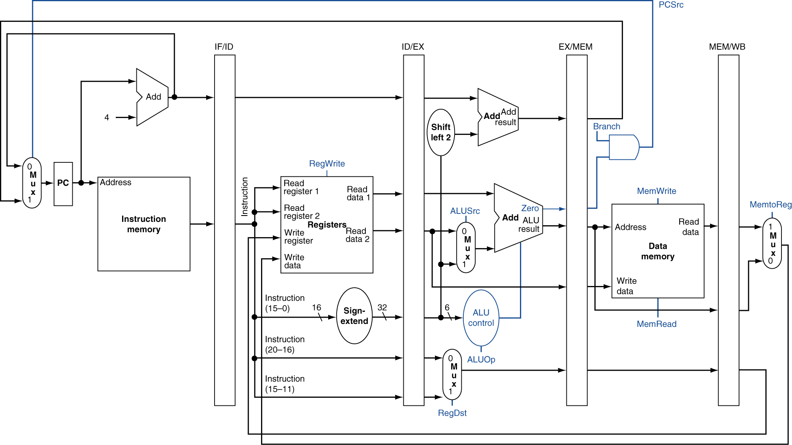
Store the controls in pipelined registers
Instruction fetch
ID/register file read
EX/address calculation
RegDst, ALUOp, ALUsrc
MEM
Branch, MemRead, MemWrite
WB
MemtoReg

Slide 25
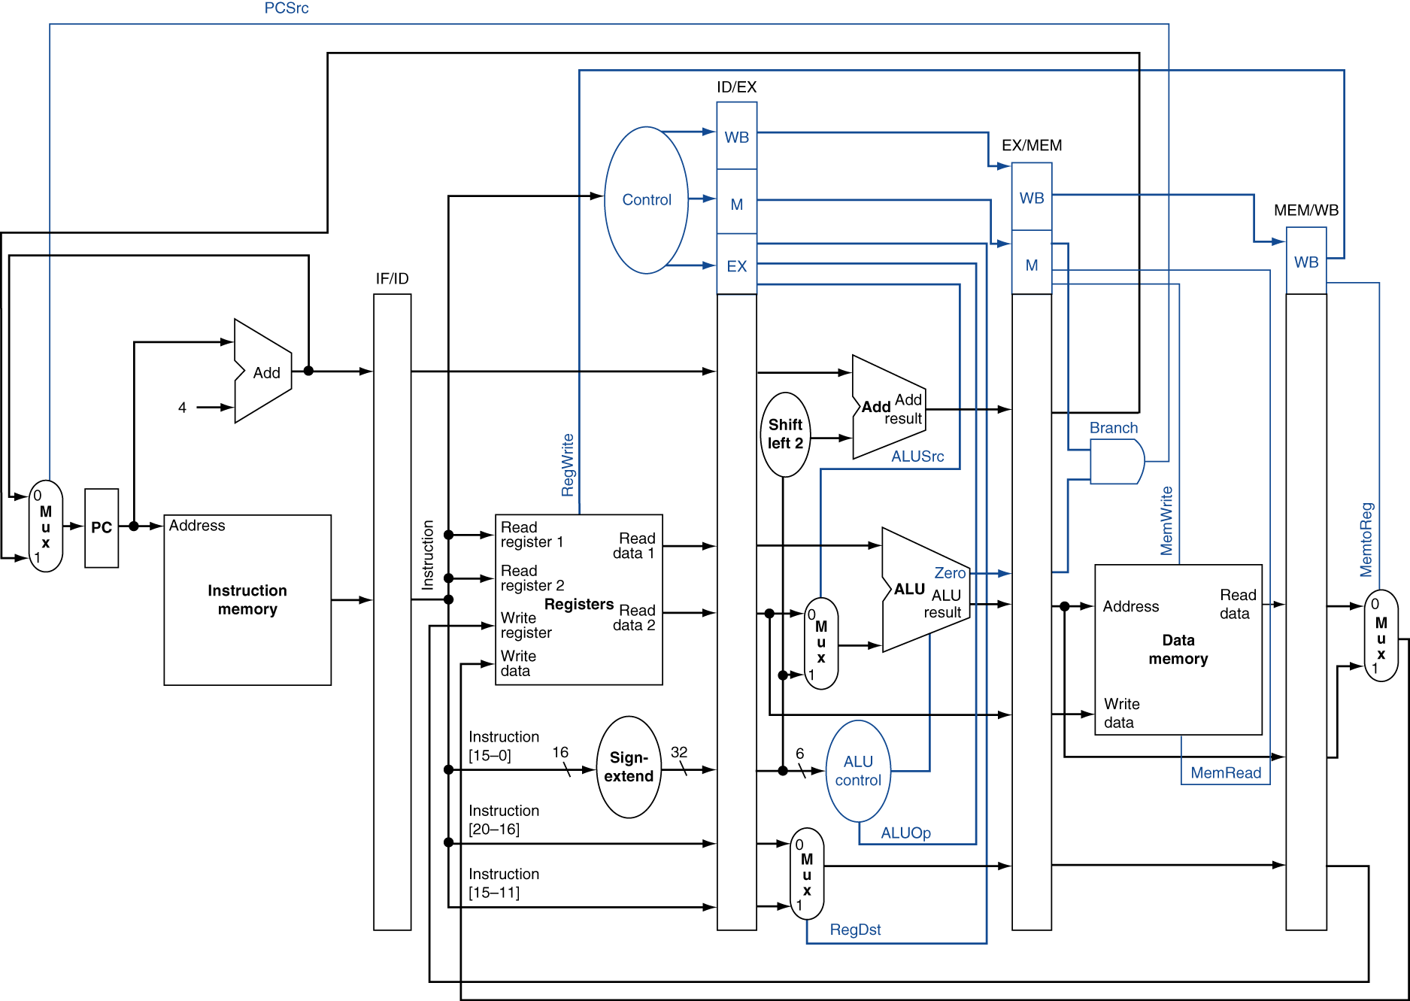
Pipelined Control

Slide 26
Hazards
Situations that prevent starting the next instruction in the next cycle
Structure hazards
A required resource is busy
Data hazard
Need to wait for previous instruction to complete its data read/write
Control hazard
Deciding on control action depends on previous instruction

Slide 27
P 4.10
IF ID EX MEM WB
IF ID EX MEM WB
IF ID EX MEM WB
STL STL IF ID MEM WB
IF ID MEM WB
SW R16, 12(R6)
LW R16, 8(R6)
BEQ R5,R4,Lb1
AND R5,R1,R4
SLT R5,R15,R4

Slide 28
P14 Control Hazards
lw r2, 0(r1)
label1: beq r2, r0, label2 # not taken once, then taken
lw r3, 0(r2)
beq r3, r0, label1 # taken
add r1, r3, r1
label2: sw r1,0(r2)
Draw pipeline execution diagram, assuming that branches execute in the EX stage.

Slide 29
P 4.11
LW R1,0(R1)
LW R1,0(R1)
BEQ R1,R0,Loop
LW R1,0(R1)
AND R1,R1,R2
LW R1,0(R1)
LW R1,0(R1)
BEQ R1,R0,Loop
WB
EX MEM WB
ID STL EX MEM WB
IF STL ID EX MEM WB
IF ID STL EX MEM WB
IF STL ID EX MEM
IF ID STL
IF STL
Loop: LW R1,0(R1)
AND R1,R1,R2
LW R1,0(R1)
LW R1,0(R1)
BEQ R1,R0,Loop

Slide 30
Identify the data hazards
ADD R5,R2,R1
LW R3,4(R5)
LW R2,0(R2)
OR R3,R5,R3
SW R3,0(R5)
Show pipeline execution diagram without forwarding
Show pipeline execution diagram forwarding

Slide 31
lw r2, 0(r1)
label1: beq r2, r0, label2 # not taken once, then taken
lw r3, 0(r2)
beq r3, r0, label1 # taken
add r1, r3, r1
label2: sw r1,0(r2)
Assume that branches execute in the EX stage

Slide 32
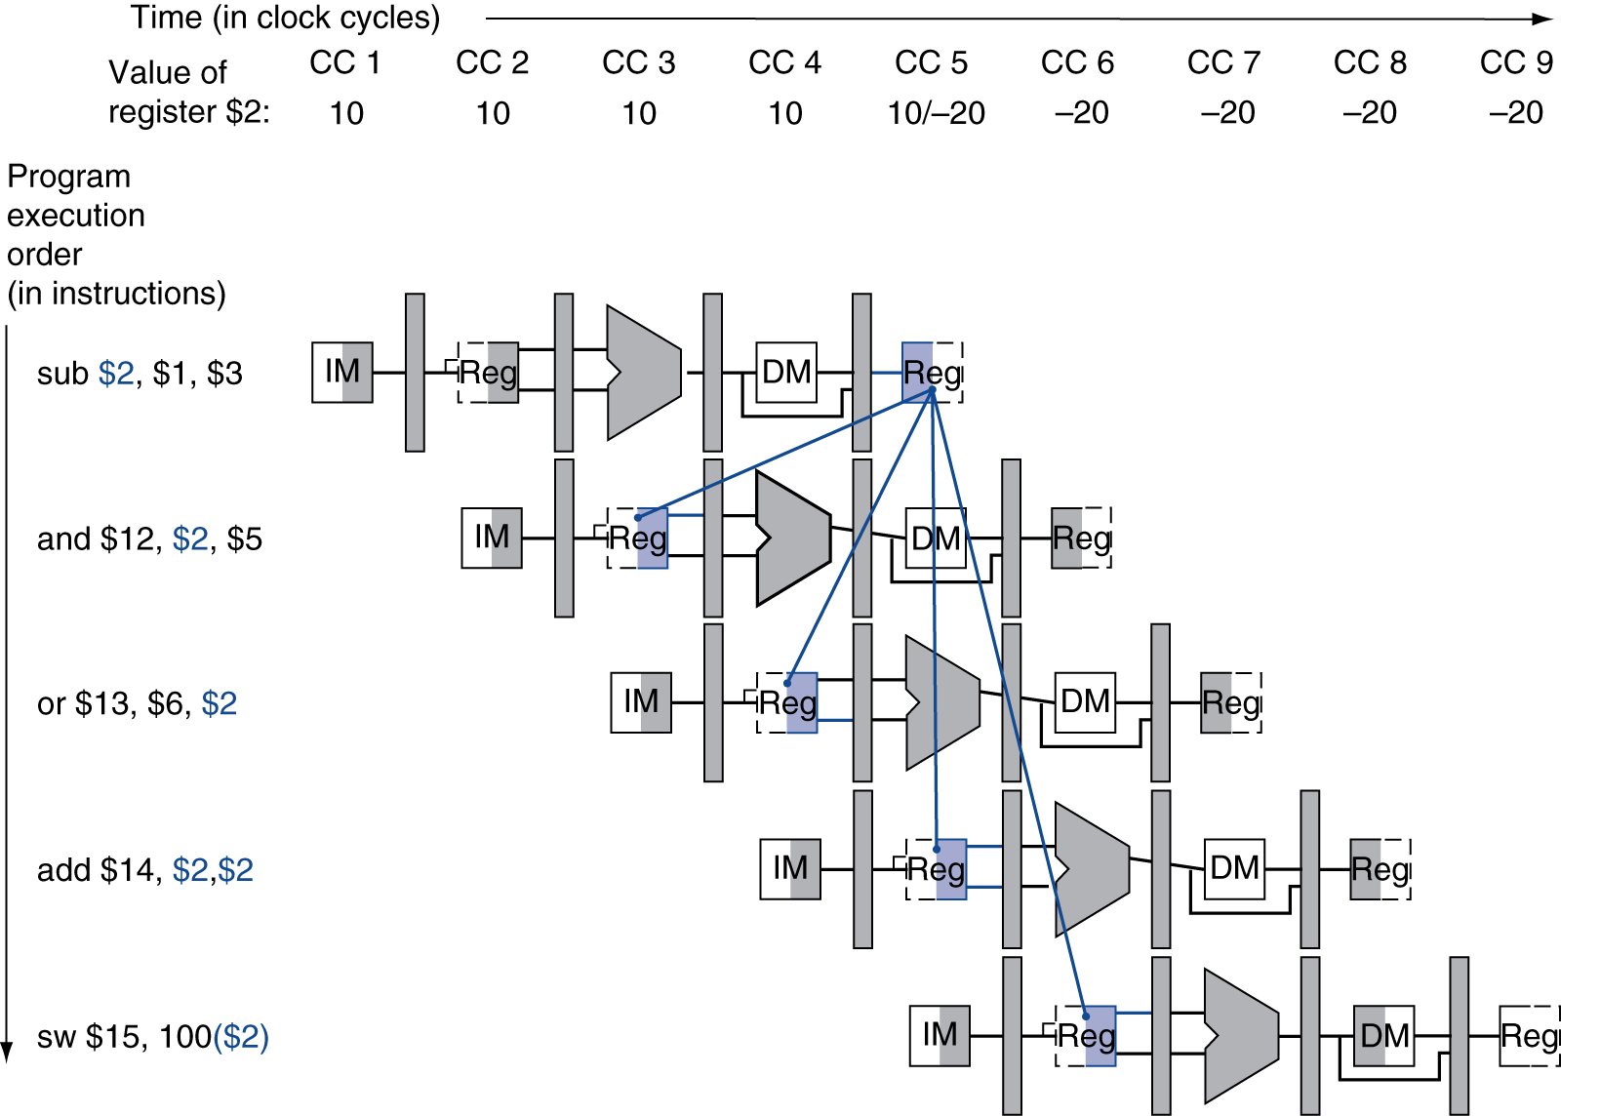
Dependencies & Forwarding

Slide 33
Detecting the Need to Forward
Pass register numbers along pipeline
e.g., ID/EX.RegisterRs = register number for Rs sitting in ID/EX pipeline register
ALU operand register numbers in EX stage are given by
ID/EX.RegisterRs, ID/EX.RegisterRt
Data hazards when
1a. EX/MEM.RegisterRd = ID/EX.RegisterRs
1b. EX/MEM.RegisterRd = ID/EX.RegisterRt
2a. MEM/WB.RegisterRd = ID/EX.RegisterRs
2b. MEM/WB.RegisterRd = ID/EX.RegisterRt
Fwd from EX/MEM pipeline reg
Fwd from MEM/WB pipeline reg

Slide 34
Forwarding Conditions
EX hazard
if (EX/MEM.RegWrite and (EX/MEM.RegisterRd ≠ 0) and (EX/MEM.RegisterRd = ID/EX.RegisterRs)) ForwardA = 10
if (EX/MEM.RegWrite and (EX/MEM.RegisterRd ≠ 0) and (EX/MEM.RegisterRd = ID/EX.RegisterRt)) ForwardB = 10
MEM hazard
if (MEM/WB.RegWrite and (MEM/WB.RegisterRd ≠ 0) and (MEM/WB.RegisterRd = ID/EX.RegisterRs)) ForwardA = 01
if (MEM/WB.RegWrite and (MEM/WB.RegisterRd ≠ 0) and (MEM/WB.RegisterRd = ID/EX.RegisterRt)) ForwardB = 01

Slide 35
Load-Use Hazard Detection
Check when using instruction is decoded in ID stage
ALU operand register numbers in ID stage are given by
IF/ID.RegisterRs, IF/ID.RegisterRt
Load-use hazard when
ID/EX.MemRead and ((ID/EX.RegisterRt = IF/ID.RegisterRs) or (ID/EX.RegisterRt = IF/ID.RegisterRt))
If detected, stall and insert bubble

Slide 36
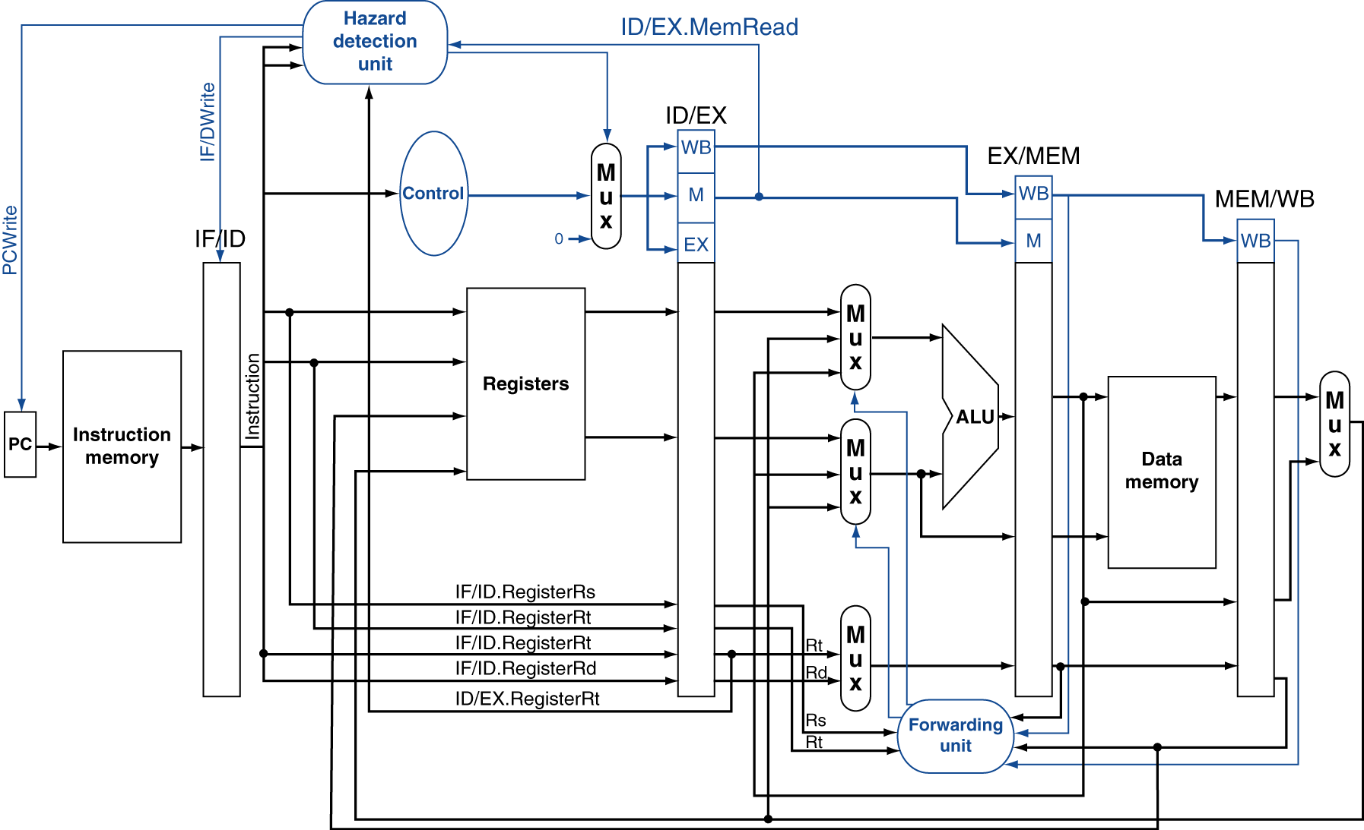
Datapath with Hazard Detection

Slide 37
Branch Prediction
Longer pipelines can’t readily determine branch outcome early
Stall penalty becomes unacceptable
Predict outcome of branch
Only stall if prediction is wrong
In MIPS pipeline
Can predict branches not taken
Fetch instruction after branch, with no delay

Slide 38
More-Realistic Branch Prediction
Static branch prediction
Based on typical branch behavior
Example: loop and if-statement branches
Predict backward branches taken
Predict forward branches not taken
Dynamic branch prediction
Hardware measures actual branch behavior
e.g., record recent history of each branch
Assume future behavior will continue the trend
When wrong, stall while re-fetching, and update history

