Slide 1
Logic Gates and Combinational Logic Circuits
Instructor Dr. Jianhui Yue
Fall 2015 CSE, Miami Univ.
Notes adapted from Hakim Weatherspoon
See: Textbook Appendix B.2 and B.3 (Also, see B.1)

Slide 2
Outline
From Switches to Logic Gates to Logic Circuits
Logic Gates
From switches
Truth Tables
Logic Circuits
Identity Laws
From Truth Tables to Circuits (Sum of Products)
Logic Circuit Minimization
Algebraic Manipulations
Truth Tables (Karnaugh Maps)
Transistors (electronic switch)

Slide 3
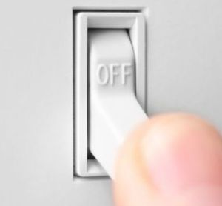
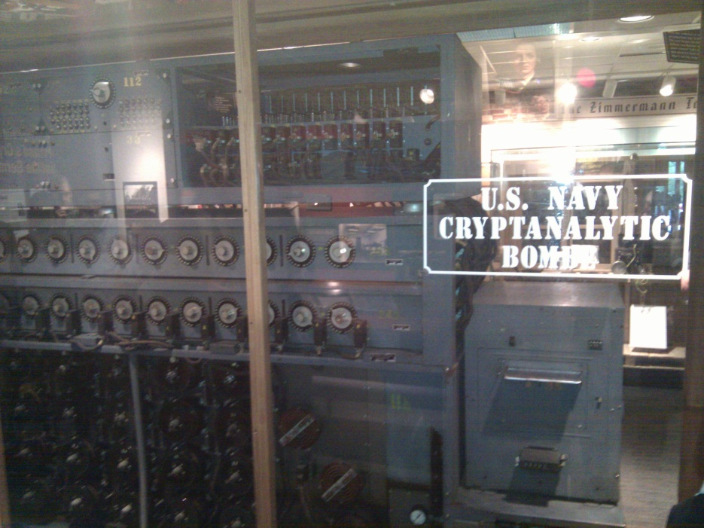

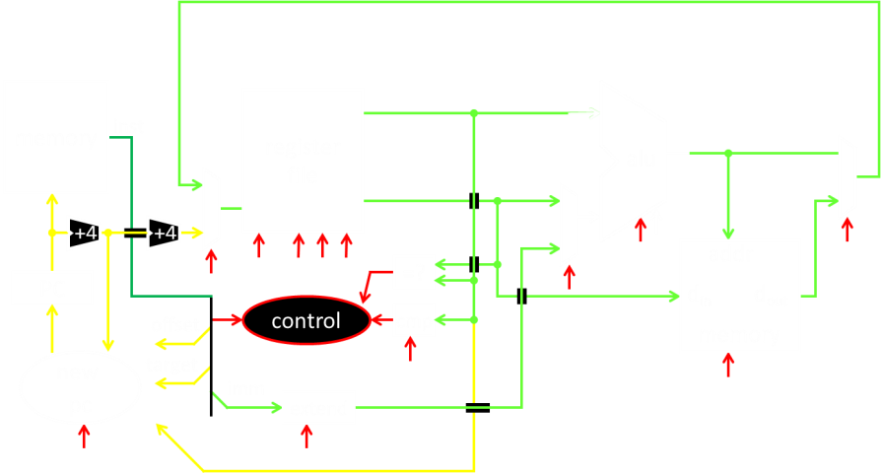
A switch
Acts as a conductor or insulator
Can be used to build amazing things…
The Bombe used to break the German
Enigma machine during World War II
Notes:
Pictures show the Bombe built by Alan Turing to break the enigma machine ciphers.
They were Fixed-Program Computers came before stored-program computers (general purpose)
The former required re-wiring (e.g. ENIAC took 3 weeks to “re-wire”).

Slide 4
Basic Building Blocks: Switches to Logic Gates
+
A
Truth Table
A | B | Light
OFF | OFF
A | B | Light
OFF | OFF
OFF | ON
A | B | Light
OFF | OFF
OFF | ON
ON | OFF
ON | ON
A | B | Light
-
A | B | Light
OFF | OFF
OFF | ON
ON | OFF
B
Notes:
Speed and size of a mechanical switch
Truth Table: defines the output for all possible combinations of values for input

Slide 5
Basic Building Blocks: Switches to Logic Gates
+
A
Truth Table
A | B | Light
OFF | OFF
A | B | Light
OFF | OFF
OFF | ON
A | B | Light
OFF | OFF
OFF | ON
ON | OFF
ON | ON
A | B | Light
-
A | B | Light
OFF | OFF | OFF
OFF | ON | ON
ON | OFF | ON
 |  | ON
B
+
A
A | B | Light
OFF | OFF
A | B | Light
OFF | OFF
OFF | ON
A | B | Light
OFF | OFF
OFF | ON
ON | OFF
A | B | Light
OFF | OFF
OFF | ON
ON | OFF
ON | ON
-
A | B | Light
B
Notes:
Speed and size of a mechanical switch

Slide 6
Basic Building Blocks: Switches to Logic Gates
+
A
Truth Table
A | B | Light
OFF | OFF
A | B | Light
OFF | OFF
OFF | ON
A | B | Light
OFF | OFF
OFF | ON
ON | OFF
ON | ON
A | B | Light
-
A | B | Light
OFF | OFF | OFF
OFF | ON | ON
ON | OFF | ON
 |  | ON
B
+
A
A | B | Light
OFF | OFF
A | B | Light
OFF | OFF
OFF | ON
A | B | Light
OFF | OFF
OFF | ON
ON | OFF
A | B | Light
OFF | OFF
OFF | ON
ON | OFF
ON | ON
-
A | B | Light
B
Notes:
Speed and size of a mechanical switch

Slide 7
Basic Building Blocks: Switches to Logic Gates
+
Either (OR)
Both (AND)
A
Truth Table
-
A | B | Light
OFF | OFF | OFF
OFF | ON | ON
ON | OFF | ON
ON | ON | ON
B
+
A
-
A | B | Light
OFF | OFF | OFF
OFF | ON | OFF
ON | OFF | OFF
ON | ON | ON
B
Notes:
Speed and size of a mechanical switch

Slide 8
Basic Building Blocks: Switches to Logic Gates
Either (OR)
Both (AND)
A
Truth Table
-
A | B | Light
OFF | OFF | OFF
OFF | ON | ON
ON | OFF | ON
ON | ON | ON
OR
B
A
-
A | B | Light
OFF | OFF | OFF
OFF | ON | OFF
ON | OFF | OFF
ON | ON | ON
AND
B
Notes:
Speed and size of a mechanical switch

Slide 9
Basic Building Blocks: Switches to Logic Gates
Either (OR)
Both (AND)
A
Truth Table
-
A | B | Light
0 | 0 | 0
0 | 1 | 1
1 | 0 | 1
1 | 1 | 1
OR
0 = OFF
1 = ON
B
A
-
A | B | Light
0 | 0 | 0
0 | 1 | 0
1 | 0 | 0
1 | 1 | 1
AND
B
Notes:
Speed and size of a mechanical switch

Slide 10
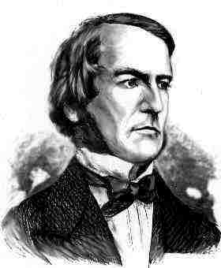
Basic Building Blocks: Switches to Logic Gates
A
OR
B
George Boole,(1815-1864)
A
Did you know?
George Boole Inventor of the idea of logic gates. He was born in Lincoln, England and he was the son of a shoemaker in a low class family.
AND
B
Notes:
E.g. logic statements:
“Jane will only go to the cinema tonight if a good film is on AND she has enough money.”
“Stuart will only go to the birthday party on Sunday if Katie OR Sujit is going too.”

Slide 11
Takeaway
Binary (two symbols: true and false) is the basis of Logic Design
Notes:
Add takeways at end of a block. Possibly build on takeaways throughout lecture

Slide 12
Building Functions: Logic Gates
A | Out
0 | 1
1 | 0
NOT:
AND:
OR:
Logic Gates
digital circuit that either allows a signal to pass through it or not.
Used to build logic functions
There are seven basic logic gates:
AND, OR, NOT
A
A | B | Out
0 | 0 | 0
0 | 1 | 0
1 | 0 | 0
1 | 1 | 1
A
B
A | B | Out
0 | 0 | 0
0 | 1 | 1
1 | 0 | 1
1 | 1 | 1
A
B
Notes:
Flash Drives
Create truth table of AND or OR: state what they do

Slide 13
Building Functions: Logic Gates
NOT:
AND:
OR:
Logic Gates
digital circuit that either allows a signal to pass through it or not.
Used to build logic functions
There are seven basic logic gates:
AND, OR, NOT,
NAND (not AND), NOR (not OR), XOR, and XNOR (not XOR) [later]
A | Out
0 | 1
1 | 0
A
A | B | Out
0 | 0 | 0
0 | 1 | 0
1 | 0 | 0
1 | 1 | 1
A
B
A | B | Out
0 | 0 | 0
0 | 1 | 1
1 | 0 | 1
1 | 1 | 1
A
B
Notes:
Flash Drives
Create truth table of AND or OR: state what they do
Did you know? Logic gates allow the computer to do things such as add, divide, multiply, do simple yes and no reasoning in certain situations along with other things.

Slide 14
Building Functions: Logic Gates
NOT:
AND:
OR:
Logic Gates
digital circuit that either allows a signal to pass through it or not.
Used to build logic functions
There are seven basic logic gates:
AND, OR, NOT,
NAND (not AND), NOR (not OR), XOR, and XNOR (not XOR) [later]
A | Out
0 | 1
1 | 0
A
A | B | Out
0 | 0 | 0
0 | 1 | 0
1 | 0 | 0
1 | 1 | 1
A | B | Out
0 | 0 | 1
0 | 1 | 1
1 | 0 | 1
1 | 1 | 0
NAND:
A
A
B
B
NOR:
A | B | Out
0 | 0 | 0
0 | 1 | 1
1 | 0 | 1
1 | 1 | 1
A | B | Out
0 | 0 | 1
0 | 1 | 0
1 | 0 | 0
1 | 1 | 0
A
A
B
B
Notes:
Flash Drives
Create truth table of AND or OR: state what they do
Did you know? Logic gates allow the computer to do things such as add, divide, multiply, do simple yes and no reasoning in certain situations along with other things.

Slide 15
Activity#1: Logic Gates
Fill in the truth table, given the following Logic Circuit made from Logic AND, OR, and NOT gates.
What does the logic circuit do?
a | b | Out
a
b
Out
Notes:
Fill out table
Put, NOT, AND, OR labels in box

Slide 16
Activity#1: Logic Gates
XOR: out = 1 if a or b is 1, but not both;
out = 0 otherwise.
out = 1, only if a = 1 AND b = 0
OR a = 0 AND b = 1
a | b | Out
0 | 0 | 0
0 | 1 | 1
1 | 0 | 1
1 | 1 | 0
a
b
Out
Notes:
Fill out table

Slide 17
Activity#1: Logic Gates
XOR: out = 1 if a or b is 1, but not both;
out = 0 otherwise.
out = 1, only if a = 1 AND b = 0
OR a = 0 AND b = 1
a | b | Out
0 | 0 | 0
0 | 1 | 1
1 | 0 | 1
1 | 1 | 0
a
Out
b
Notes:
Fill out table
Remove instructions

Slide 18
Activity#2: Logic Gates
Fill in the truth table, given the following Logic Circuit made from Logic AND, OR, and NOT gates.
What does the logic circuit do?
a | b | d | Out
0 | 0 | 0
0 | 0 | 1
0 | 1 | 0
0 | 1 | 1
1 | 0 | 0
1 | 0 | 1
1 | 1 | 0
1 | 1 | 1
a
d
Out
b
Notes:
Fill out table

Slide 19
Activity#2: Logic Gates
Multiplexor: select (d) between two inputs (a and b) and set one as the output (out)?
out = a, if d = 0
out = b, if d = 1
a | b | d | Out
0 | 0 | 0 | 0
0 | 0 | 1 | 0
0 | 1 | 0 | 0
0 | 1 | 1 | 1
1 | 0 | 0 | 1
1 | 0 | 1 | 0
1 | 1 | 0 | 1
1 | 1 | 1 | 1
a
d
Out
b
Notes:
Fill out table
Ask rows in audience to fill in different rows of tabel

Slide 20
Outline
From Switches to Logic Gates to Logic Circuits
Logic Gates
From switches
Truth Tables
Logic Circuits
Identity Laws
From Truth Tables to Circuits (Sum of Products)
Logic Circuit Minimization
Algebraic Manipulations
Truth Tables (Karnaugh Maps)
Transistors (electronic switch)

Slide 21
Next Goal
Given a Logic function, create a Logic Circuit that implements the Logic Function…
…and, with the minimum number of logic gates
Fewer gates: A cheaper ($$$) circuit!
Notes:
Can get logic circuit from truth table
Minimize logic circuit through algebraic reductions or Karnaugh Maps

Slide 22
Logic Gates
A | Out
0 | 1
1 | 0
NOT:
AND:
OR:
XOR:
.
A
A | B | Out
0 | 0 | 0
0 | 1 | 0
1 | 0 | 0
1 | 1 | 1
A
B
A | B | Out
0 | 0 | 0
0 | 1 | 1
1 | 0 | 1
1 | 1 | 1
A
B
A | B | Out
0 | 0 | 0
0 | 1 | 1
1 | 0 | 1
1 | 1 | 0
A
B
Notes:
XOR is not a basic Logic Gate since it can be created from AND and OR gates, but it is often used as a basic Logic Operator

Slide 23
Logic Gates
A | Out
0 | 1
1 | 0
NOT:
AND:
OR:
XOR:
.
A
A | B | Out
0 | 0 | 0
0 | 1 | 0
1 | 0 | 0
1 | 1 | 1
A | B | Out
0 | 0 | 1
0 | 1 | 1
1 | 0 | 1
1 | 1 | 0
NAND:
A
A
B
B
NOR:
A | B | Out
0 | 0 | 0
0 | 1 | 1
1 | 0 | 1
1 | 1 | 1
A | B | Out
0 | 0 | 1
0 | 1 | 0
1 | 0 | 0
1 | 1 | 0
A
A
B
B
XNOR:
A | B | Out
0 | 0 | 0
0 | 1 | 1
1 | 0 | 1
1 | 1 | 0
A | B | Out
0 | 0 | 1
0 | 1 | 0
1 | 0 | 0
1 | 1 | 1
A
A
B
B
Notes:
XOR is not a basic Logic Gate since it can be created from AND and OR gates, but it is often used as a basic Logic Operator

Slide 24
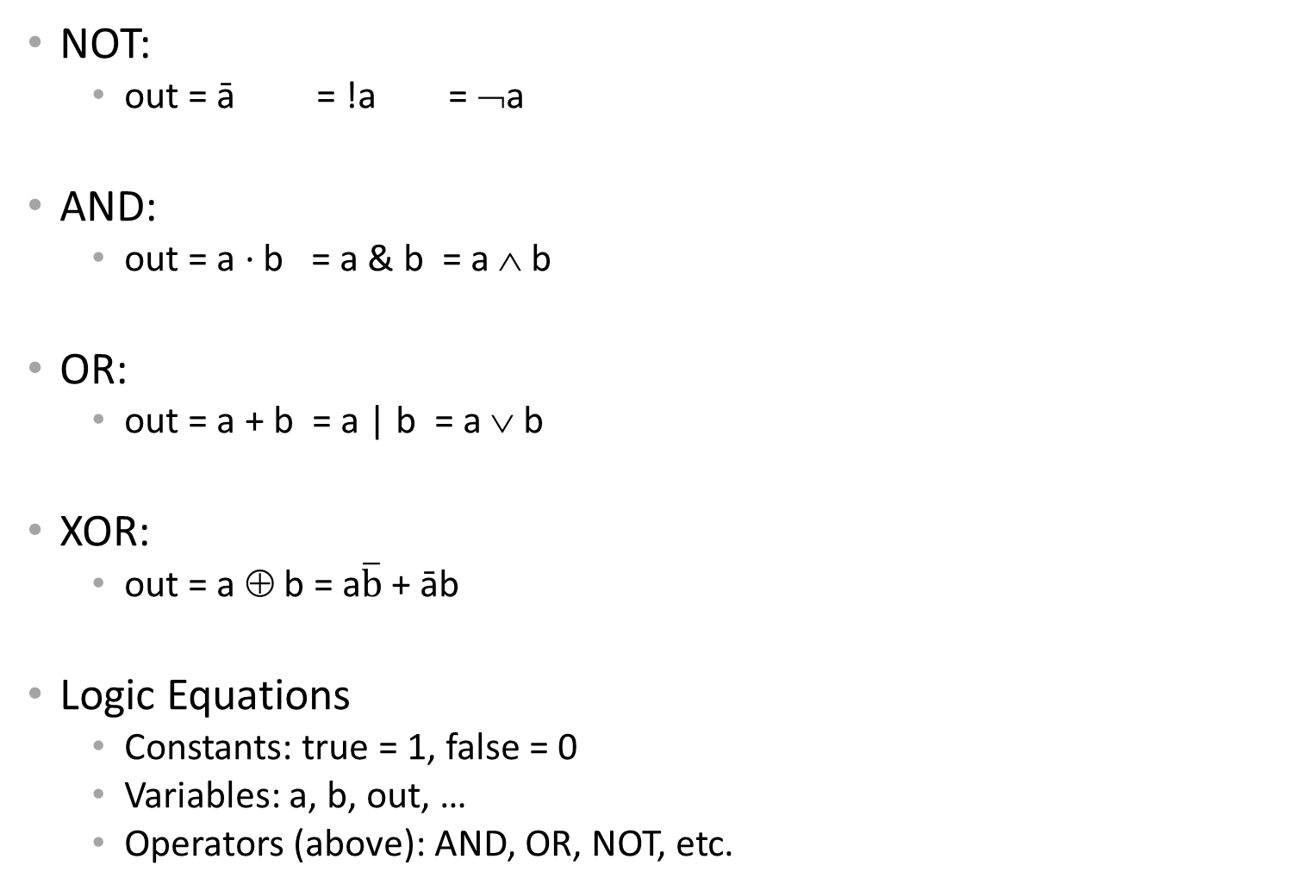
Logic Equations
NOT:
out = ā = !a = ¬a
AND:
out = a ∙ b = a & b = a ∧ b
OR:
out = a + b = a | b = a ∨ b
XOR:
out = a ⊕ b = a$\overline{b}$ + āb
Logic Equations
Constants: true = 1, false = 0
Variables: a, b, out, …
Operators (above): AND, OR, NOT, etc.
Notes:
Apologize that there are three ways to represent the same logic equation
XOR is not a basic Logic Gate since it can be created from AND and OR gates, but it is often used as a basic Logic Operator
AND is “product”
OR is “sum”
Read outloud

Slide 25
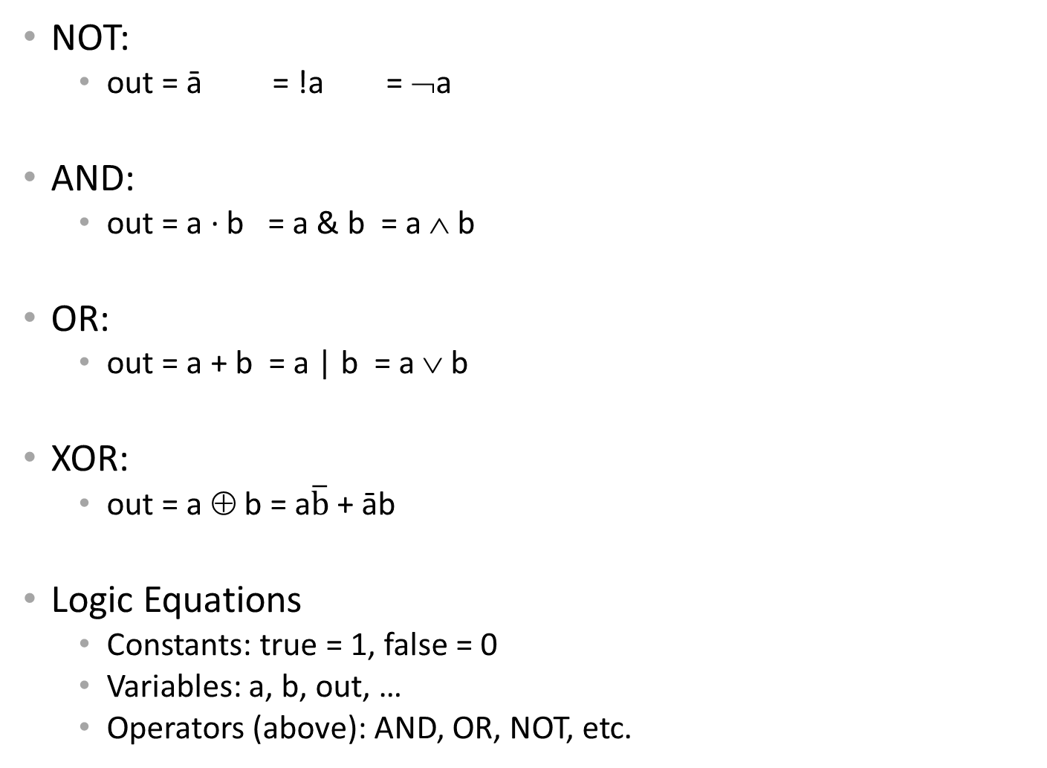

Logic Equations
NOT:
out = ā = !a = ¬a
AND:
out = a ∙ b = a & b = a ∧ b
OR:
out = a + b = a | b = a ∨ b
XOR:
out = a ⊕ b = a$\overline{b}$ + āb
Logic Equations
Constants: true = 1, false = 0
Variables: a, b, out, …
Operators (above): AND, OR, NOT, etc.
NAND:
out = $\overline{a \text{∙} b}$ = !(a & b) = ¬ (a ∧ b)
NOR:
out = $\overline{a+b}$ = !(a | b) = ¬ (a ∨ b)
XNOR:
out = $\overline{a \text{⊕} b}$ = ab + $\overline{ab}$
.
Notes:
Apologize that there are three ways to represent the same logic equation
XOR is not a basic Logic Gate since it can be created from AND and OR gates, but it is often used as a basic Logic Operator
AND is “product”
OR is “sum”
Read outloud

Slide 26
Identities
Identities useful for manipulating logic equations
For optimization & ease of implementation
a + 0 =
a + 1 =
a + ā =
a ∙ 0 =
a ∙ 1 =
a ∙ ā =
Notes:
Minimization activity
Maybe use picture to go through
Complement a+ā=1 and aā=0

Slide 27
Identities
Identities useful for manipulating logic equations
For optimization & ease of implementation
a + 0 =
a + 1 =
a + ā =
a ∙ 0 =
a ∙ 1 =
a ∙ ā =
a
1
1
0
a
0
a
b
a
b
Notes:
Minimization activity
Maybe use picture to go through
Complement a+ā=1 and aā=0

Slide 28

Identities
Identities useful for manipulating logic equations
For optimization & ease of implementation
$\overline{(a+b)}$ =
$\overline{(a ∙b)}$ =
a + a b =
a(b+c) =
$\overline{a(b+c)}$ =
Notes:
Minimization activity
Maybe use picture to go through
De Morgan’s Law: $\overline{(a+b)}$ = $\overline{a}$ ∙ $\overline{b}$ and $\overline{(a ∙b)}$ = $\overline{a}$ + $\overline{b}$

Slide 29




De Morgan’s Law
x | y | z
0 | 0 | 0
0 | 1 | 1
1 | 0 | 1
1 | 1 | 1
x | y | z
0 | 0
0 | 1
1 | 0
1 | 1
x | y | z
0 | 0 | 1
0 | 1 | 0
1 | 0 | 0
1 | 1 | 0
x | y | z
0 | 0
0 | 1
1 | 0
1 | 1
x | y | z
0 | 0 | 1
0 | 1 | 1
1 | 0 | 1
1 | 1 | 0
x | y | z
0 | 0
0 | 1
1 | 0
1 | 1
x | y | z
0 | 0 | 0
0 | 1 | 0
1 | 0 | 0
1 | 1 | 1
x | y | z
0 | 0
0 | 1
1 | 0
1 | 1
x | y | z
0 | 0 | 0
0 | 1 | 0
1 | 0 | 0
1 | 1 | 1
x | y | z
0 | 0 | 0
0 | 1 | 1
1 | 0 | 1
1 | 1 | 1
x | y | z
0 | 0
0 | 1
1 | 0
1 | 1
x | y | z
0 | 0
0 | 1
1 | 0
1 | 1
x | y | z
0 | 0 | 1
0 | 1 | 0
1 | 0 | 0
1 | 1 | 0
x | y | z
0 | 0
0 | 1
1 | 0
1 | 1
x | y | z
0 | 0 | 1
0 | 1 | 1
1 | 0 | 1
1 | 1 | 0
x | y | z
0 | 0
0 | 1
1 | 0
1 | 1

Slide 30


Identities
Identities useful for manipulating logic equations
For optimization & ease of implementation
$\overline{(a+b)}$ =
$\overline{(a ∙b)}$ =
a + a b =
a(b+c) =
$\overline{a(b+c)}$ =
A
↔
A
B
B
$\overline{a}$ ∙ $\overline{b}$
$\overline{a}$ + $\overline{b}$
a
ab + ac
$\overline{a}$ + $\overline{b}$∙$\overline{c}$
A
↔
A
B
B
Notes:
Minimization activity
Maybe use picture to go through
De Morgan’s Law: $\overline{(a+b)}$ = $\overline{a}$ ∙ $\overline{b}$ and $\overline{(a ∙b)}$ = $\overline{a}$ + $\overline{b}$

Slide 31
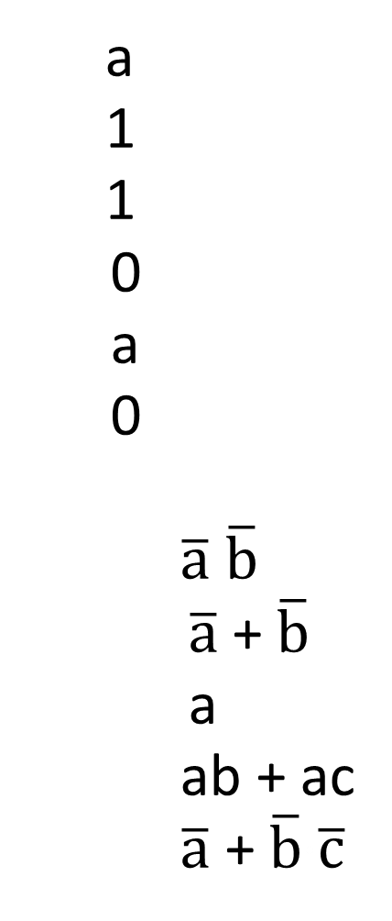

Activity #3: Identities
a + 0 =
a + 1 =
a + ā =
a 0 =
a 1 =
a ā =
$\overline{(a+b)}$ =
$\overline{(a b)}$ =
a + a b =
a(b+c) =
$\overline{a(b+c)}$ =
a
1
1
0
a
0
$\overline{a}$ $\overline{b}$
$\overline{a}$ + $\overline{b}$
a
ab + ac
$\overline{a}$ + $\overline{b}$∙$\overline{c}$
Show that the Logic equations
below are equivalent.
(a+b)(a+c) = a + bc
(a+b)(a+c) =
Notes:
Minimization activity

Slide 32

Activity #3: Identities
Show that the Logic equations
below are equivalent.
(a+b)(a+c) = a + bc
(a+b)(a+c) = aa + ab + ac + bc
= a + a(b+c) + bc
= a(1 + (b+c)) + bc
= a + bc
a + 0 =
a + 1 =
a + ā =
a 0 =
a 1 =
a ā =
$\overline{(a+b)}$ =
$\overline{(a b)}$ =
a + a b =
a(b+c) =
$\overline{a(b+c)}$ =
a
1
1
0
a
0
$\overline{a}$ $\overline{b}$
$\overline{a}$ + $\overline{b}$
a
ab + ac
$\overline{a}$ + $\overline{bc}$
Notes:
Minimization activity

Slide 33
Logic Manipulation
functions: gates ↔ truth tables ↔ equations
Example: (a+b)(a+c) = a + bc
a | b | c
0 | 0 | 0
0 | 0 | 1
0 | 1 | 0
0 | 1 | 1
1 | 0 | 0
1 | 0 | 1
1 | 1 | 0
1 | 1 | 1
Notes:
(a+b)(a+c)
= aa + ab + ac + bc
= a + a(b+c) + bc
= a(1 + (b+c)) + bc
= a + bc

Slide 34
Logic Manipulation
functions: gates ↔ truth tables ↔ equations
Example: (a+b)(a+c) = a + bc
a | b | c
0 | 0 | 0
0 | 0 | 1
0 | 1 | 0
0 | 1 | 1
1 | 0 | 0
1 | 0 | 1
1 | 1 | 0
1 | 1 | 1
 |  |  |  |  |  | bc | RHS
 |  |  |  |  |  | 0 | 0
 |  |  |  |  |  | 0 | 0
 |  |  |  |  |  | 0 | 0
 |  |  |  |  |  | 1 | 1
 |  |  |  |  |  | 0 | 1
 |  |  |  |  |  | 0 | 1
 |  |  |  |  |  | 0 | 1
 |  |  |  |  |  | 1 | 1
 |  |  | a+b | a+c | LHS
 |  |  | 0 | 0 | 0
 |  |  | 0 | 1 | 0
 |  |  | 1 | 0 | 0
 |  |  | 1 | 1 | 1
 |  |  | 1 | 1 | 1
 |  |  | 1 | 1 | 1
 |  |  | 1 | 1 | 1
 |  |  | 1 | 1 | 1
Notes:
(a+b)(a+c)
= aa + ab + ac + bc
= a + a(b+c) + bc
= a(1 + (b+c)) + bc
= a + bc

Slide 35
Takeaway
Binary (two symbols: true and false) is the basis of Logic Design
More than one Logic Circuit can implement same Logic function. Use Algebra (Identities) or Truth Tables to show equivalence.
Notes:
Add takeways at end of a block. Possibly build on takeaways throughout lecture

Slide 36
Outline
From Switches to Logic Gates to Logic Circuits
Logic Gates
From switches
Truth Tables
Logic Circuits
Identity Laws
From Truth Tables to Circuits (Sum of Products)
Logic Circuit Minimization
Algebraic Manipulations
Truth Tables (Karnaugh Maps)
Transistors (electronic switch)

Slide 37
Next Goal
How to standardize minimizing logic circuits?

Slide 38
Logic Minimization
How to implement a desired logic function?
a | b | c | out
0 | 0 | 0 | 0
0 | 0 | 1 | 1
0 | 1 | 0 | 0
0 | 1 | 1 | 1
1 | 0 | 0 | 0
1 | 0 | 1 | 1
1 | 1 | 0 | 0
1 | 1 | 1 | 0
Notes:
Draw circuit and go through out=true cases
Have not done cheaply yet

Slide 39
Logic Minimization
How to implement a desired logic function?
a | b | c | out
0 | 0 | 0 | 0
0 | 0 | 1 | 1
0 | 1 | 0 | 0
0 | 1 | 1 | 1
1 | 0 | 0 | 0
1 | 0 | 1 | 1
1 | 1 | 0 | 0
1 | 1 | 1 | 0
minterm
a b c
a b c
a b c
a b c
a b c
a b c
a b c
a b c
Write minterms
sum of products:
OR of all minterms where out=1
Notes:
Show what out equals

Slide 40
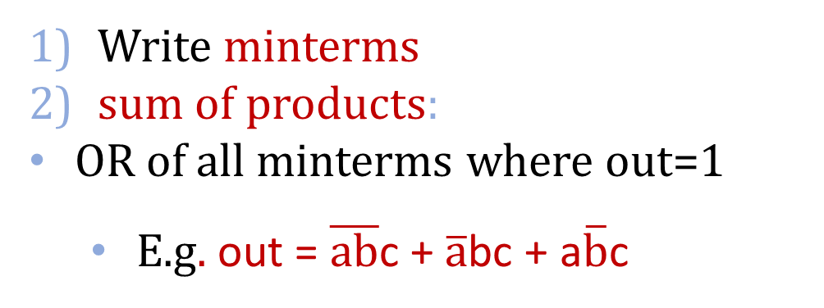
Logic Minimization
How to implement a desired logic function?
Write minterms
sum of products:
OR of all minterms where out=1
E.g. out = $\overline{ab}$c + $\overline{a}$bc + a$\overline{b}$c
a | b | c | out
0 | 0 | 0 | 0
0 | 0 | 1 | 1
0 | 1 | 0 | 0
0 | 1 | 1 | 1
1 | 0 | 0 | 0
1 | 0 | 1 | 1
1 | 1 | 0 | 0
1 | 1 | 1 | 0
minterm
a b c
a b c
a b c
a b c
a b c
a b c
a b c
a b c
a
b
c
out
corollary: any combinational circuit can be implemented in two levels of logic (ignoring inverters)
Notes:
Show what out equals

Slide 41
Karnaugh Maps
How does one find the most efficient equation?
Manipulate algebraically until…?
Use Karnaugh maps (optimize visually)
Use a software optimizer
For large circuits
Decomposition & reuse of building blocks

Slide 42
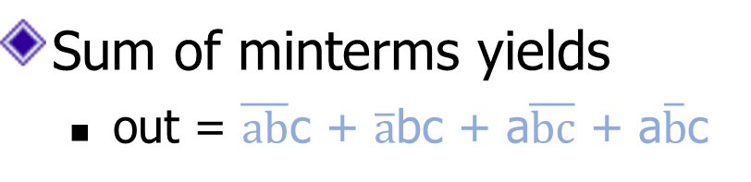
Minimization with Karnaugh maps (1)
Sum of minterms yields
out = $\overline{ab}$c + $\overline{a}$bc + a$\overline{bc}$ + a$\overline{b}$c
a | b | c | out
0 | 0 | 0 | 0
0 | 0 | 1 | 1
0 | 1 | 0 | 0
0 | 1 | 1 | 1
1 | 0 | 0 | 1
1 | 0 | 1 | 1
1 | 1 | 0 | 0
1 | 1 | 1 | 0

Slide 43
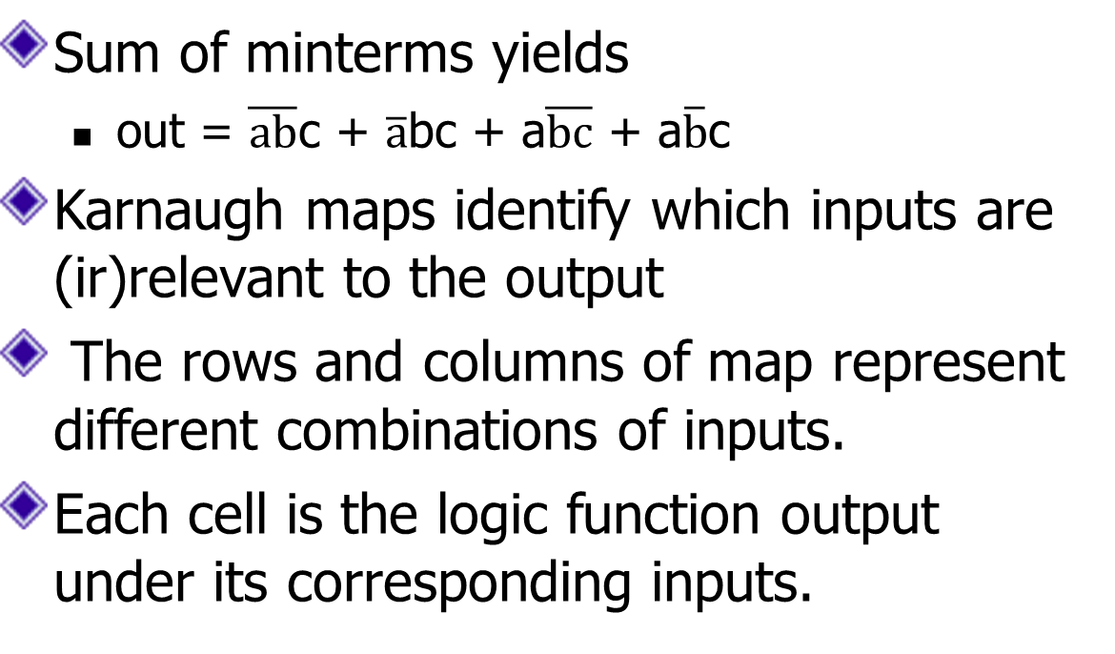
Minimization with Karnaugh maps (2)
Sum of minterms yields
out = $\overline{ab}$c + $\overline{a}$bc + a$\overline{bc}$ + a$\overline{b}$c
Karnaugh maps identify which inputs are (ir)relevant to the output
The rows and columns of map represent different combinations of inputs.
Each cell is the logic function output under its corresponding inputs.
a | b | c | out
0 | 0 | 0 | 0
0 | 0 | 1 | 1
0 | 1 | 0 | 0
0 | 1 | 1 | 1
1 | 0 | 0 | 1
1 | 0 | 1 | 1
1 | 1 | 0 | 0
1 | 1 | 1 | 0
ab
c
00 01 11 10
The ordering of col.s/rows : the col.s/rows are numbered so that the binary representations for the numbers of two adjacent col.s/rows differ in exactly one position.
0
0 | 0 | 0 | 1
1 | 1 | 0 | 1
1

Slide 44
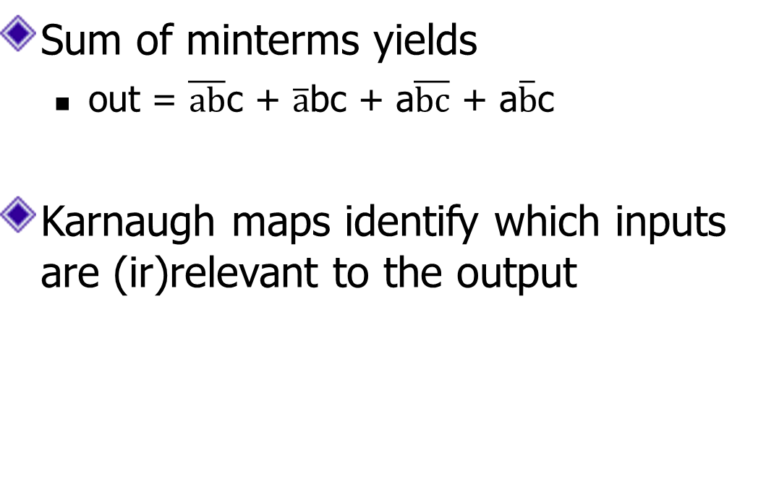
Minimization with Karnaugh maps (2)
Sum of minterms yields
out = $\overline{ab}$c + $\overline{a}$bc + a$\overline{bc}$ + a$\overline{b}$c
Karnaugh maps identify which inputs are (ir)relevant to the output
a | b | c | out
0 | 0 | 0 | 0
0 | 0 | 1 | 1
0 | 1 | 0 | 0
0 | 1 | 1 | 1
1 | 0 | 0 | 1
1 | 0 | 1 | 1
1 | 1 | 0 | 0
1 | 1 | 1 | 0
ab
c
00 01 11 10
0
0 | 0 | 0 | 1
1 | 1 | 0 | 1
1

Slide 45
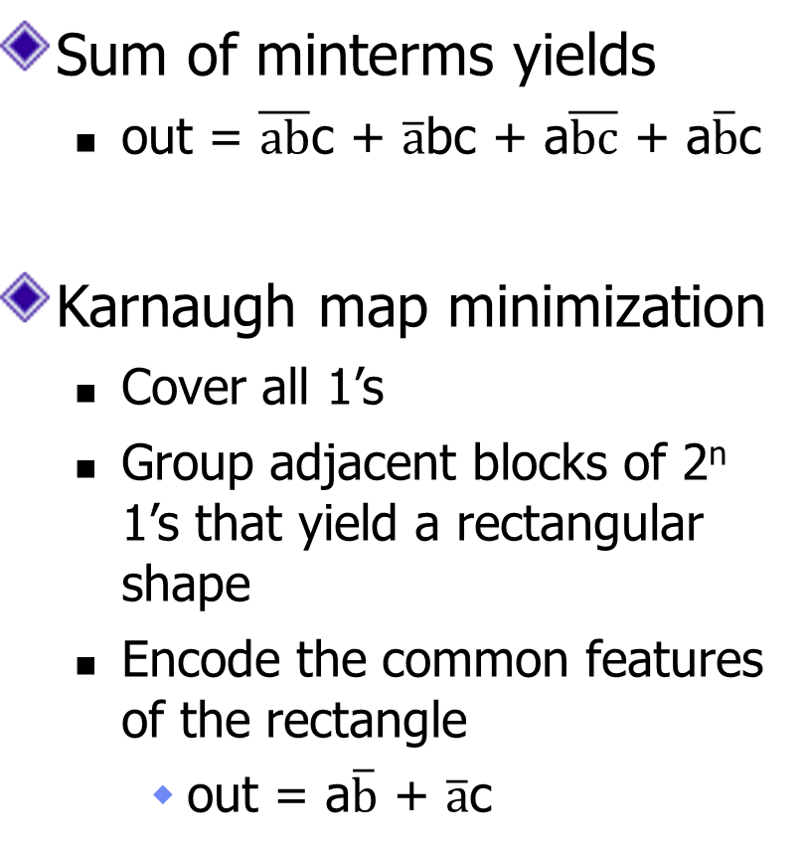
Minimization with Karnaugh maps (2)
Sum of minterms yields
out = $\overline{ab}$c + $\overline{a}$bc + a$\overline{bc}$ + a$\overline{b}$c
Karnaugh map minimization
Cover all 1’s
Group adjacent blocks of 2^{n} 1’s that yield a rectangular shape
Encode the common features of the rectangle
out = a$\overline{b}$ + $\overline{a}$c
a | b | c | out
0 | 0 | 0 | 0
0 | 0 | 1 | 1
0 | 1 | 0 | 0
0 | 1 | 1 | 1
1 | 0 | 0 | 1
1 | 0 | 1 | 1
1 | 1 | 0 | 0
1 | 1 | 1 | 0
ab
c
00 01 11 10
0
0 | 0 | 0 | 1
1 | 1 | 0 | 1
1

Slide 46
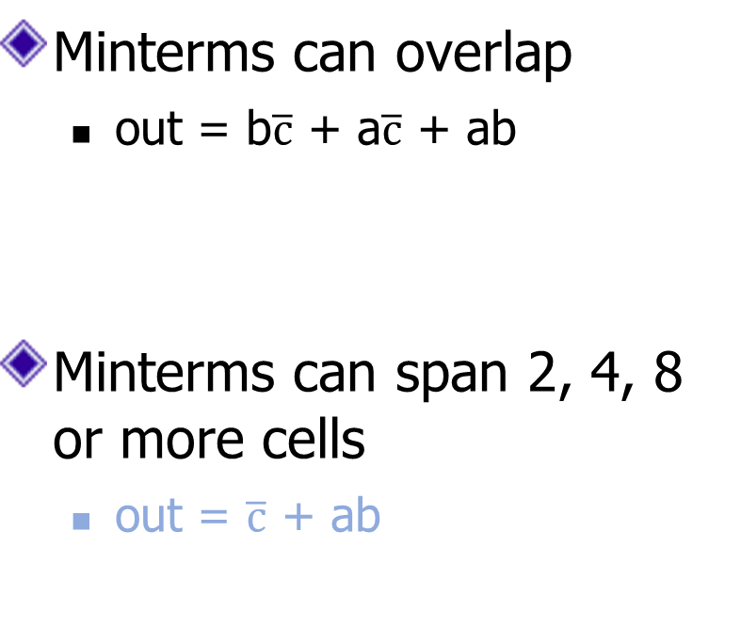
Karnaugh Minimization Tricks (1)
ab
c
00 01 11 10
Minterms can overlap
out = b$\overline{c}$ + a$\overline{c}$ + ab
Minterms can span 2, 4, 8 or more cells
out = $\overline{c}$ + ab
0
0 | 1 | 1 | 1
0 | 0 | 1 | 0
1
ab
c
00 01 11 10
0
1 | 1 | 1 | 1
0 | 0 | 1 | 0
1

Slide 47
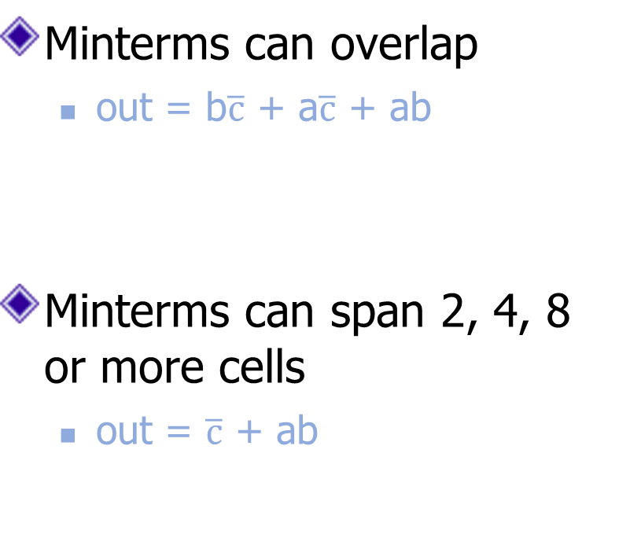
Karnaugh Minimization Tricks (1)
ab
c
00 01 11 10
Minterms can overlap
out = b$\overline{c}$ + a$\overline{c}$ + ab
Minterms can span 2, 4, 8 or more cells
out = $\overline{c}$ + ab
0
0 | 1 | 1 | 1
0 | 0 | 1 | 0
1
ab
c
00 01 11 10
0
1 | 1 | 1 | 1
0 | 0 | 1 | 0
1

Slide 48

Karnaugh Minimization Tricks (2)
ab
cd
00 01 11 10
The map wraps around
out = $\overline{b}$d
out = $\overline{b}$ $\overline{d}$
00
0 | 0 | 0 | 0
1 | 0 | 0 | 1
1 | 0 | 0 | 1
0 | 0 | 0 | 0
01
11
10
ab
cd
00 01 11 10
00
1 | 0 | 0 | 1
0 | 0 | 0 | 0
0 | 0 | 0 | 0
1 | 0 | 0 | 1
01
11
10

Slide 49

Karnaugh Minimization Tricks (2)
ab
cd
00 01 11 10
00
0 | 0 | 0 | 0
1 | 0 | 0 | 1
1 | 0 | 0 | 1
0 | 0 | 0 | 0
The map wraps around
out = $\overline{b}$d
out = $\overline{b}$ $\overline{d}$
01
11
10
ab
cd
00 01 11 10
00
1 | 0 | 0 | 1
0 | 0 | 0 | 0
0 | 0 | 0 | 0
1 | 0 | 0 | 1
01
11
10

Slide 50

Karnaugh Minimization Tricks (3)
ab
cd
00 01 11 10
00
0 | 0 | 0 | 0
1 | x | x | x
1 | x | x | 1
0 | 0 | 0 | 0
“Don’t care” values can be interpreted individually in whatever way is convenient
assume all x’s = 1
out = d
assume middle x’s = 0
assume 4th column x = 1
out = $\overline{b}$ $\overline{d}$
01
11
10
ab
cd
00 01 11 10
00
1 | 0 | 0 | x
0 | x | x | 0
0 | x | x | 0
1 | 0 | 0 | 1
01
11
10

Slide 51
Karnaugh Minimization Tricks (3)
ab
cd
00 01 11 10
00
0 | 0 | 0 | 0
1 | x | x | x
1 | x | x | 1
0 | 0 | 0 | 0
“Don’t care” values can be interpreted individually in whatever way is convenient
assume all x’s = 1
out = d
assume middle x’s = 0
assume 4th column x = 1
out = $\overline{b}$ $\overline{d}$
01
11
10
ab
cd
00 01 11 10
00
1 | 0 | 0 | x
0 | x | x | 0
0 | x | x | 0
1 | 0 | 0 | 1
01
11
10

Slide 52
Karnaugh Map Group Rules
All groups in the entire grid must be made up with all 1’s.
Groups can not be made diagonally.
Groups can only be made as a power of 2 (2⁰, 2¹, 2², 2³, …) ie (1,2,4,8,…)
Groups should be as large as possible
All 1’s on the grid must be grouped
You are allowed to overlap groups and always attempt to do so
You are allowed to wrap around the grid

Slide 53
Multiplexer
A multiplexer selects between multiple inputs
out = a, if d = 0
out = b, if d = 1
Build truth table
Minimize diagram
Derive logic diagram
a
b
d
a | b | d | out
0 | 0 | 0
0 | 0 | 1
0 | 1 | 0
0 | 1 | 1
1 | 0 | 0
1 | 0 | 1
1 | 1 | 0
1 | 1 | 1
Notes:
What is the truth table

Slide 54
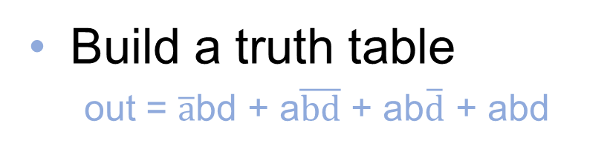
Multiplexer Implementation
a
b
Build a truth table
out = $\overline{a}$bd + a$\overline{bd}$ + ab$\overline{d}$ + abd
d
a | b | d | out
0 | 0 | 0 | 0
0 | 0 | 1 | 0
0 | 1 | 0 | 0
0 | 1 | 1 | 1
1 | 0 | 0 | 1
1 | 0 | 1 | 0
1 | 1 | 0 | 1
1 | 1 | 1 | 1

Slide 55
Multiplexer Implementation
a
b
Build the Karnaugh map
d
ab
d
00 01 11 10
a | b | d | out
0 | 0 | 0 | 0
0 | 0 | 1 | 0
0 | 1 | 0 | 0
0 | 1 | 1 | 1
1 | 0 | 0 | 1
1 | 0 | 1 | 0
1 | 1 | 0 | 1
1 | 1 | 1 | 1
0
1

Slide 56
Multiplexer Implementation
a
b
Build the Karnaugh map
d
ab
d
00 01 11 10
a | b | d | out
0 | 0 | 0 | 0
0 | 0 | 1 | 0
0 | 1 | 0 | 0
0 | 1 | 1 | 1
1 | 0 | 0 | 1
1 | 0 | 1 | 0
1 | 1 | 0 | 1
1 | 1 | 1 | 1
0
0 | 0 | 1 | 1
0 | 1 | 1 | 0
1

Slide 57
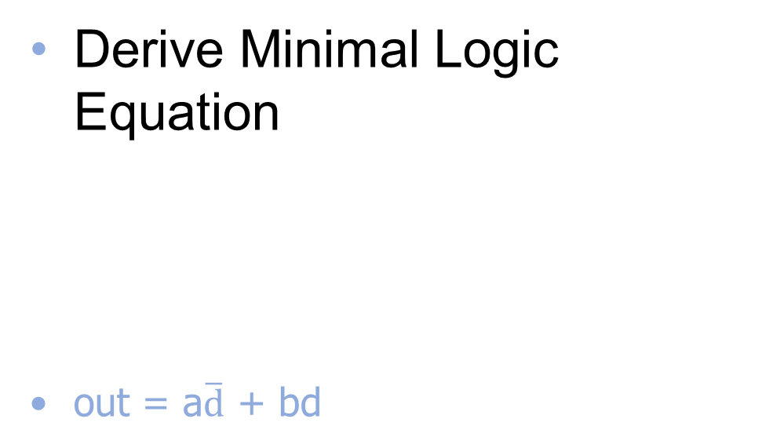
Multiplexer Implementation
a
b
Derive Minimal Logic Equation
out = a$\overline{d}$ + bd
d
ab
d
00 01 11 10
a | b | d | out
0 | 0 | 0 | 0
0 | 0 | 1 | 0
0 | 1 | 0 | 0
0 | 1 | 1 | 1
1 | 0 | 0 | 1
1 | 0 | 1 | 0
1 | 1 | 0 | 1
1 | 1 | 1 | 1
0
0 | 0 | 1 | 1
0 | 1 | 1 | 0
1
a
d
out
b

Slide 58
Takeaway
Binary (two symbols: true and false) is the basis of Logic Design
More than one Logic Circuit can implement same Logic function. Use Algebra (Identities) or Truth Tables to show equivalence.
Any logic function can be implemented as “sum of products”. Karnaugh Maps minimize number of gates.
Notes:
Add takeways at end of a block. Possibly build on takeaways throughout lecture

Slide 59
Outline
From Transistors to Gates to Logic Circuits
Logic Gates
From transistors
Truth Tables
Logic Circuits
Identity Laws
From Truth Tables to Circuits (Sum of Products)
Logic Circuit Minimization
Algebraic Manipulations
Truth Tables (Karnaugh Maps)
Desing Adder

Slide 60
Binary Addition
Binary addition requires
Add of two bits PLUS carry-in
Also, carry-out if necessary
Notes:
Talk about Cin (carry in) and Cout (carry out)
Animate this better
Add another slide
So we need two numbers, the sum, carry in, and carry out

Slide 61
1-bit Adder
A
B
Half Adder
Adds two 1-bit numbers
Computes 1-bit result and 1-bit carry
No carry-in
C_{out}
S
A | B | C_{out} | S
0 | 0
0 | 1
1 | 0
1 | 1
Notes:
Adds two 1-bit numbers, computes 1-bit result and carry out
Useful for the rightmost binary digit, not much else

Slide 62
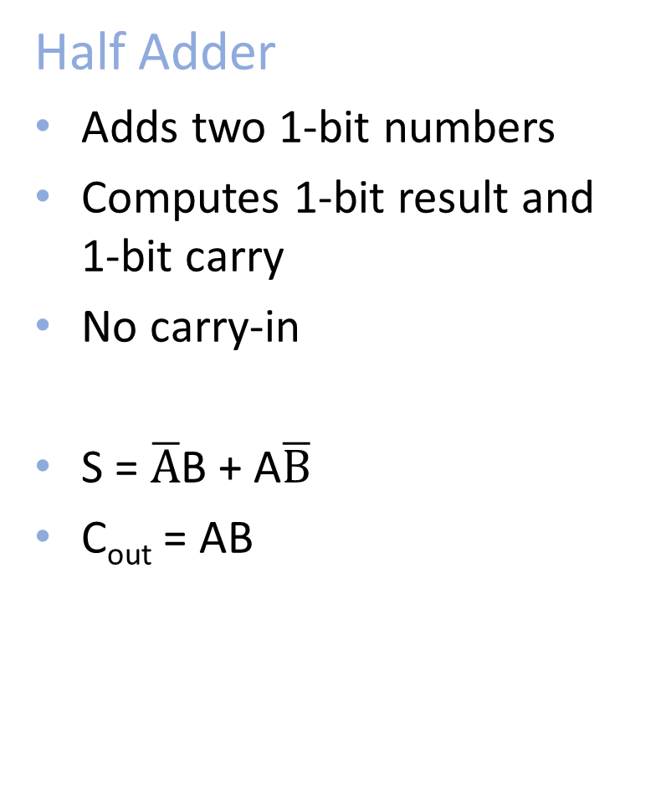
1-bit Adder
A
A
B
Half Adder
Adds two 1-bit numbers
Computes 1-bit result and 1-bit carry
No carry-in
S = $\overline{A}$B + A$\overline{B}$
C_{out} = AB
C_{out}
S
S
A | B | C_{out} | S
0 | 0 | 0 | 0
0 | 1 | 0 | 1
1 | 0 | 0 | 1
1 | 1 | 1 | 0
A
B
C_{out}
S
Notes:
Adds two 1-bit numbers, computes 1-bit result and carry out
Useful for the rightmost binary digit, not much else

Slide 63
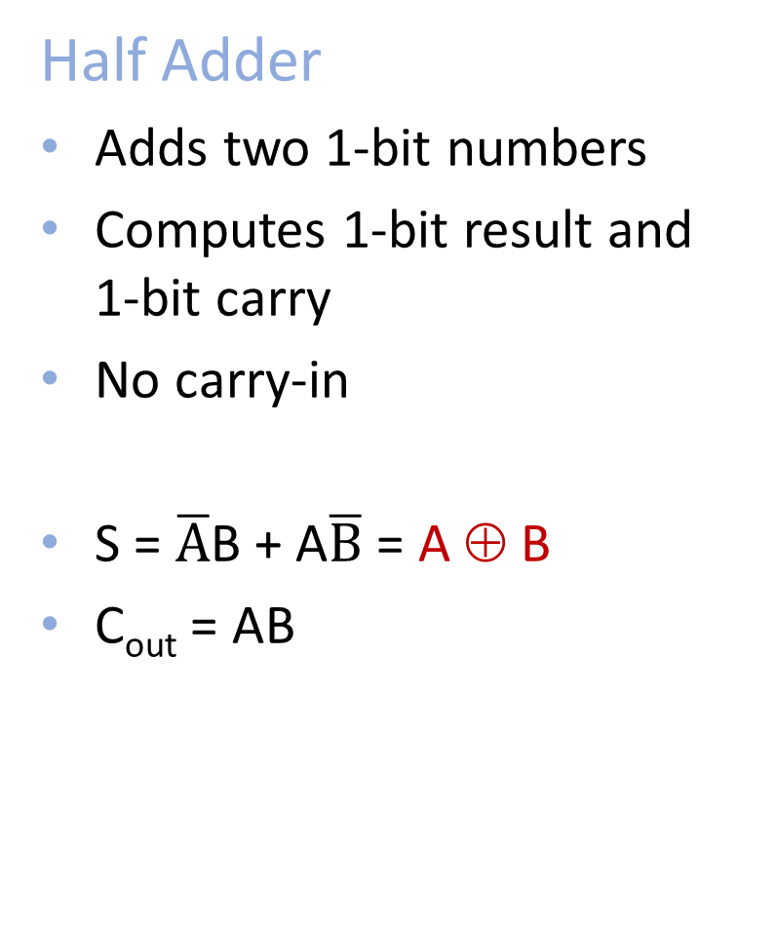
1-bit Adder
A
A
B
Half Adder
Adds two 1-bit numbers
Computes 1-bit result and 1-bit carry
No carry-in
S = $\overline{A}$B + A$\overline{B}$ = A ⊕ B
C_{out} = AB
C_{out}
S
S
A | B | C_{out} | S
0 | 0 | 0 | 0
0 | 1 | 0 | 1
1 | 0 | 0 | 1
1 | 1 | 1 | 0
A
B
C_{out}
S
Notes:
Adds two 1-bit numbers, computes 1-bit result and carry out
Useful for the rightmost binary digit, not much else

Slide 64
1-bit Adder with Carry
A
B
Full Adder
Adds three 1-bit numbers
Computes 1-bit result and 1-bit carry
Can be cascaded
Activity: Truth Table and Sum-of-Product.
Logic minimization via Karnaugh Maps and algebraic minimization.
Draw Logic Circuits
C_{out}
C_{in}
S
A | B | C_{in} | C_{out} | S
0 | 0 | 0
0 | 0 | 1
0 | 1 | 0
0 | 1 | 1
1 | 0 | 0
1 | 0 | 1
1 | 1 | 0
1 | 1 | 1

Slide 65
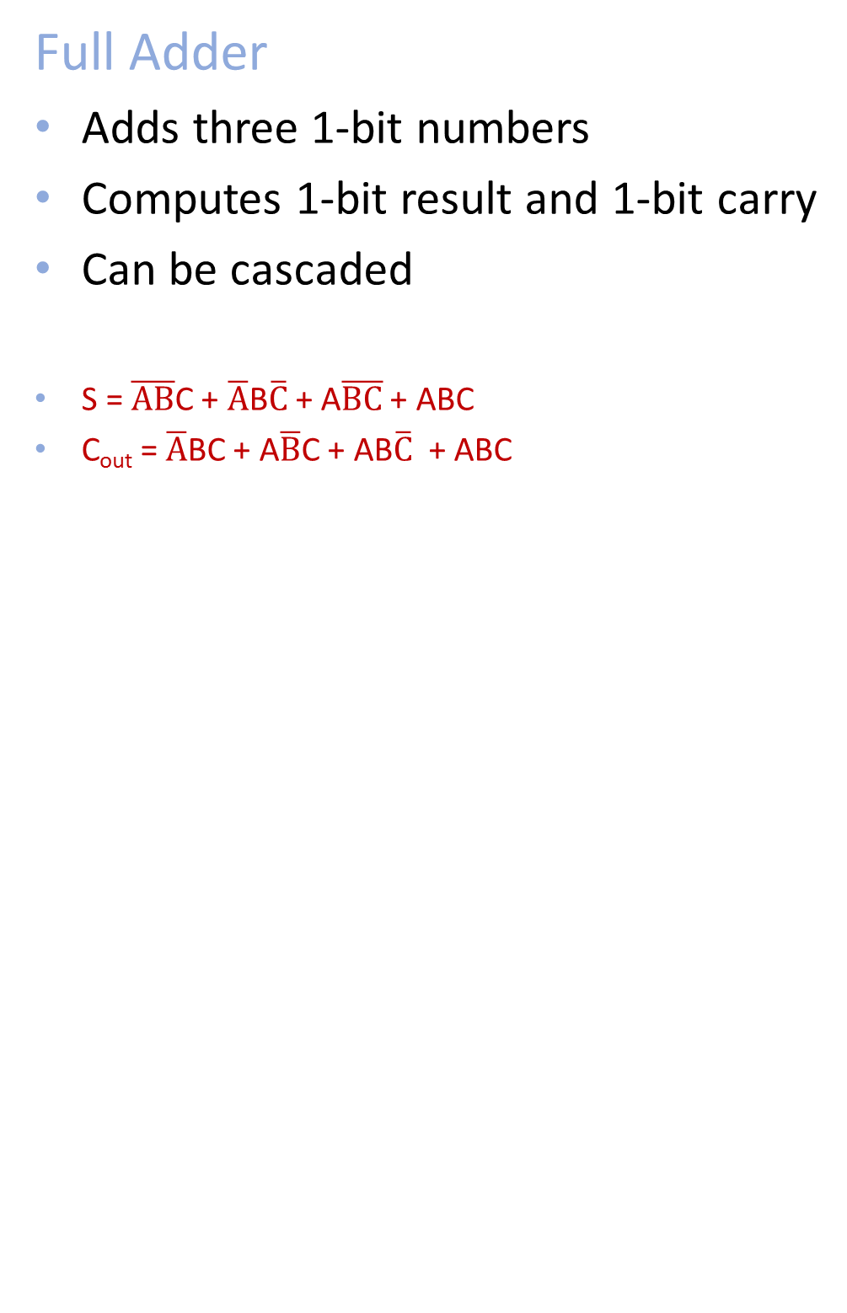
1-bit Adder with Carry
A
B
Full Adder
Adds three 1-bit numbers
Computes 1-bit result and 1-bit carry
Can be cascaded
S = $\overline{AB}$C + $\overline{A}$B$\overline{C}$ + A$\overline{BC}$ + ABC
C_{out} = $\overline{A}$BC + A$\overline{B}$C + AB$\overline{C}$ + ABC
C_{out}
C_{in}
S
A
B
B
C_{out}
C_{in}
A | B | C_{in} | C_{out} | S
0 | 0 | 0 | 0 | 0
0 | 0 | 1 | 0 | 1
0 | 1 | 0 | 0 | 1
0 | 1 | 1 | 1 | 0
1 | 0 | 0 | 0 | 1
1 | 0 | 1 | 1 | 0
1 | 1 | 0 | 1 | 0
1 | 1 | 1 | 1 | 1
S
Notes:
Draw circuits

Slide 66
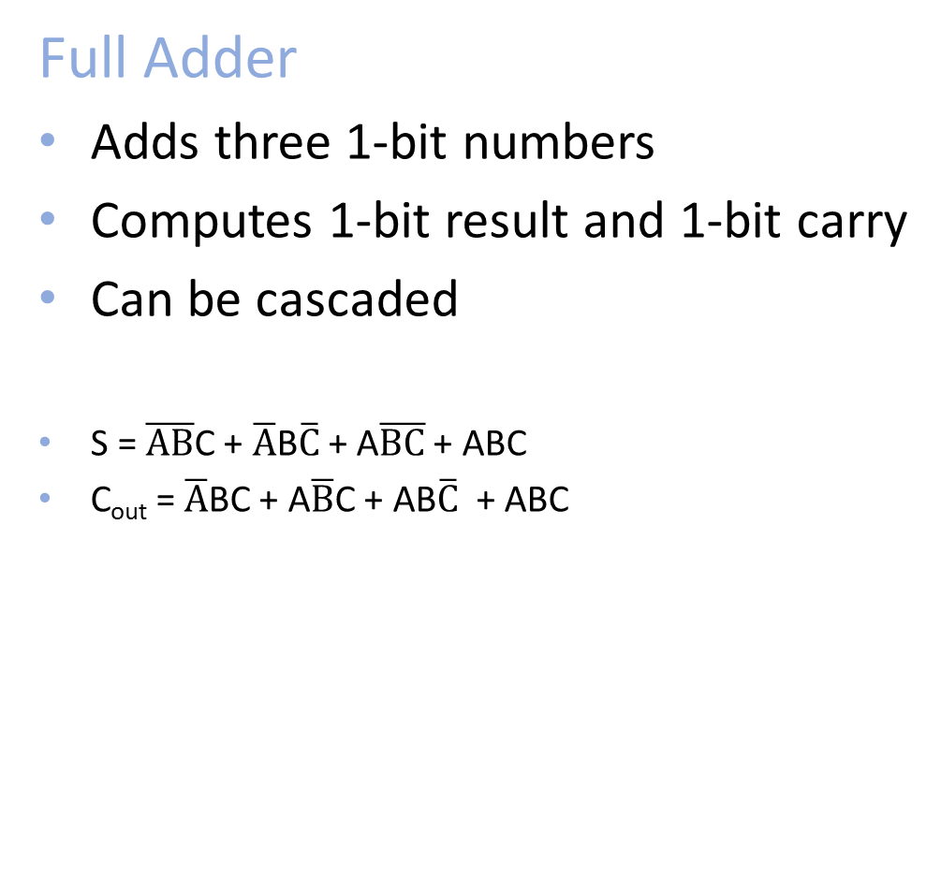
1-bit Adder with Carry
A
B
A
B
Full Adder
Adds three 1-bit numbers
Computes 1-bit result and 1-bit carry
Can be cascaded
S = $\overline{AB}$C + $\overline{A}$B$\overline{C}$ + A$\overline{BC}$ + ABC
C_{out} = $\overline{A}$BC + A$\overline{B}$C + AB$\overline{C}$ + ABC
C_{i}
C_{out}
C_{in}
A
B
S
B
S
C_{out}
C_{in}
A | B | C_{in} | C_{out} | S
0 | 0 | 0 | 0 | 0
0 | 0 | 1 | 0 | 1
0 | 1 | 0 | 0 | 1
0 | 1 | 1 | 1 | 0
1 | 0 | 0 | 0 | 1
1 | 0 | 1 | 1 | 0
1 | 1 | 0 | 1 | 0
1 | 1 | 1 | 1 | 1
AB
S
AB
C_{out}
C_{in}
C_{in}
00 01 11 10
00 01 11 10
0
0
S
1
1
S

Slide 67
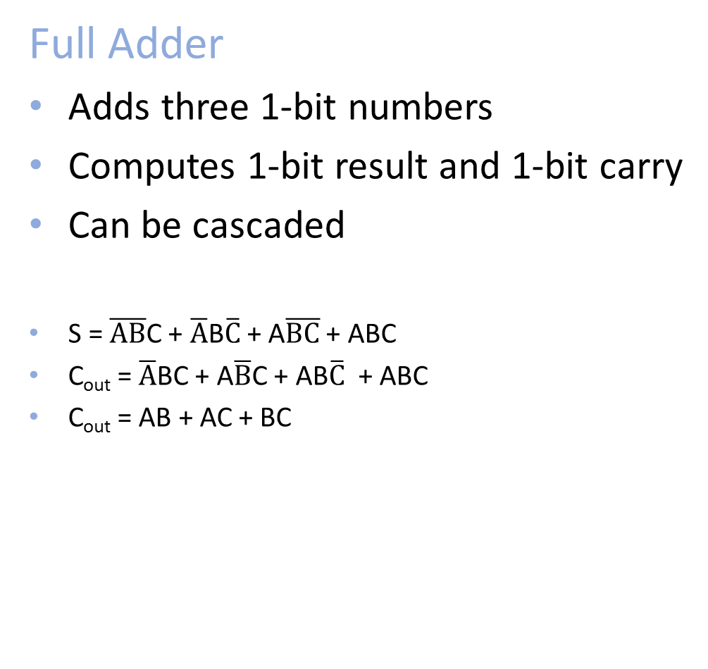
1-bit Adder with Carry
A
B
A
B
Full Adder
Adds three 1-bit numbers
Computes 1-bit result and 1-bit carry
Can be cascaded
S = $\overline{AB}$C + $\overline{A}$B$\overline{C}$ + A$\overline{BC}$ + ABC
C_{out} = $\overline{A}$BC + A$\overline{B}$C + AB$\overline{C}$ + ABC
C_{out} = AB + AC + BC
C_{i}
C_{out}
C_{in}
A
B
S
B
S
C_{out}
C_{in}
A | B | C_{in} | C_{out} | S
0 | 0 | 0 | 0 | 0
0 | 0 | 1 | 0 | 1
0 | 1 | 0 | 0 | 1
0 | 1 | 1 | 1 | 0
1 | 0 | 0 | 0 | 1
1 | 0 | 1 | 1 | 0
1 | 1 | 0 | 1 | 0
1 | 1 | 1 | 1 | 1
AB
S
AB
C_{out}
C_{in}
C_{in}
00 01 11 10
00 01 11 10
0
0 | 1 | 0 | 1
1 | 0 | 1 | 0
0
0 | 0 | 1 | 0
0 | 1 | 1 | 1
S
1
1
S

Slide 68
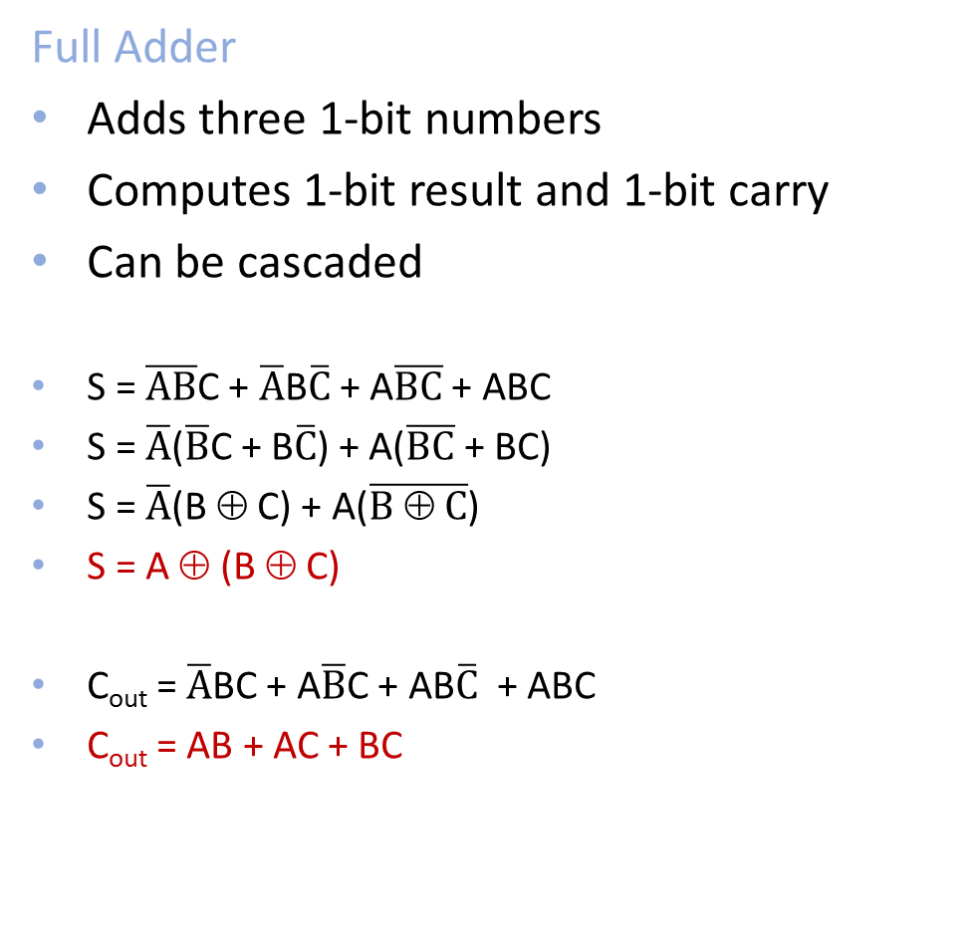
1-bit Adder with Carry
Full Adder
Adds three 1-bit numbers
Computes 1-bit result and 1-bit carry
Can be cascaded
S = $\overline{AB}$C + $\overline{A}$B$\overline{C}$ + A$\overline{BC}$ + ABC
S = $\overline{A}$($\overline{B}$C + B$\overline{C}$) + A($\overline{BC}$ + BC)
S = $\overline{A}$(B ⊕ C) + A($\overline{B ⊕ C}$)
S = A ⊕ (B ⊕ C)
C_{out} = $\overline{A}$BC + A$\overline{B}$C + AB$\overline{C}$ + ABC
C_{out} = AB + AC + BC
A
B
C_{out}
C_{in}
S
S
A
B
A | B | C_{in} | C_{out} | S
0 | 0 | 0 | 0 | 0
0 | 0 | 1 | 0 | 1
0 | 1 | 0 | 0 | 1
0 | 1 | 1 | 1 | 0
1 | 0 | 0 | 0 | 1
1 | 0 | 1 | 1 | 0
1 | 1 | 0 | 1 | 0
1 | 1 | 1 | 1 | 1
C_{out}
C_{in}
AB
S
AB
C_{out}
C_{in}
C_{in}
S
00 01 11 10
00 01 11 10
0
0 | 1 | 0 | 1
1 | 0 | 1 | 0
0
0 | 0 | 1 | 0
0 | 1 | 1 | 1
1
1

Slide 69
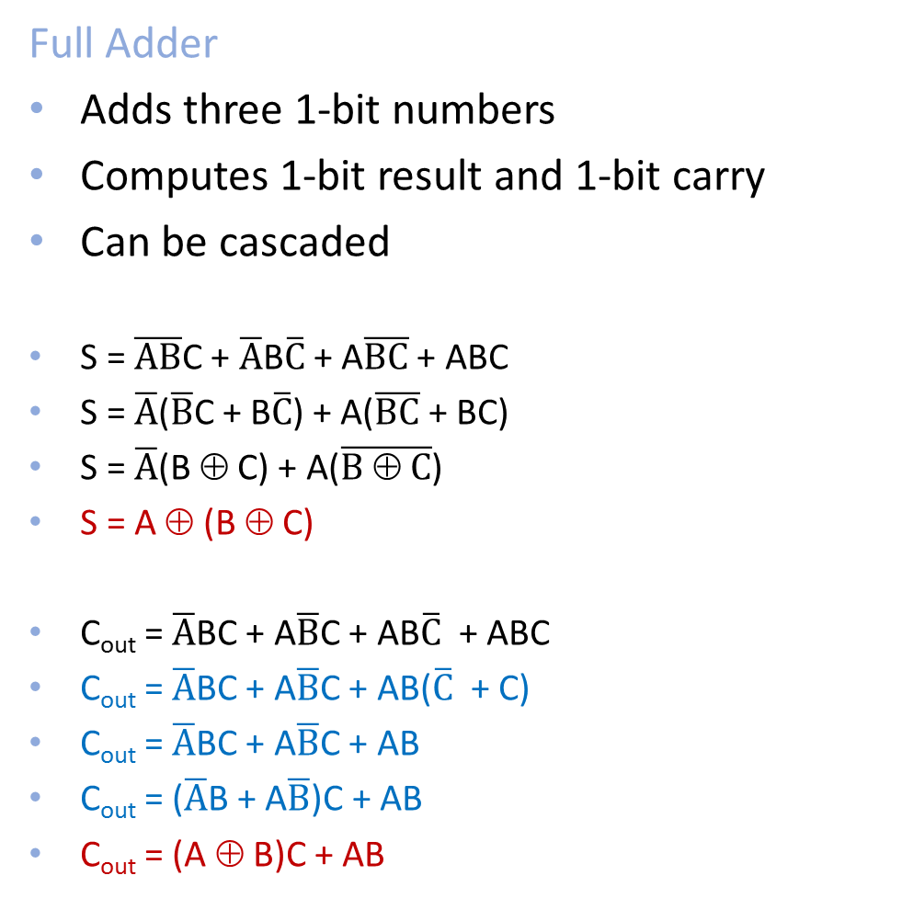
1-bit Adder with Carry
Full Adder
Adds three 1-bit numbers
Computes 1-bit result and 1-bit carry
Can be cascaded
S = $\overline{AB}$C + $\overline{A}$B$\overline{C}$ + A$\overline{BC}$ + ABC
S = $\overline{A}$($\overline{B}$C + B$\overline{C}$) + A($\overline{BC}$ + BC)
S = $\overline{A}$(B ⊕ C) + A($\overline{B ⊕ C}$)
S = A ⊕ (B ⊕ C)
C_{out} = $\overline{A}$BC + A$\overline{B}$C + AB$\overline{C}$ + ABC
C_{out} = $\overline{A}$BC + A$\overline{B}$C + AB($\overline{C}$ + C)
C_{out} = $\overline{A}$BC + A$\overline{B}$C + AB
C_{out} = ($\overline{A}$B + A$\overline{B}$)C + AB
C_{out} = (A ⊕ B)C + AB
A
B
C_{out}
C_{in}
S
S
A
B
A | B | C_{in} | C_{out} | S
0 | 0 | 0 | 0 | 0
0 | 0 | 1 | 0 | 1
0 | 1 | 0 | 0 | 1
0 | 1 | 1 | 1 | 0
1 | 0 | 0 | 0 | 1
1 | 0 | 1 | 1 | 0
1 | 1 | 0 | 1 | 0
1 | 1 | 1 | 1 | 1
C_{out}
C_{in}
S

Slide 70
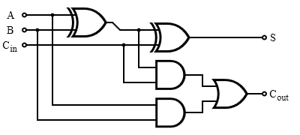
1-bit Adder with Carry
Full Adder
Adds three 1-bit numbers
Computes 1-bit result and 1-bit carry
Can be cascaded
S = $\overline{AB}$C + $\overline{A}$B$\overline{C}$ + A$\overline{BC}$ + ABC
S = $\overline{A}$($\overline{B}$C + B$\overline{C}$) + A($\overline{BC}$ + BC)
S = $\overline{A}$(B ⊕ C) + A($\overline{B ⊕ C}$)
S = A ⊕ (B ⊕ C)
C_{out} = $\overline{A}$BC + A$\overline{B}$C + AB$\overline{C}$ + ABC
C_{out} = $\overline{A}$BC + A$\overline{B}$C + AB($\overline{C}$ + C)
C_{out} = $\overline{A}$BC + A$\overline{B}$C + AB
C_{out} = ($\overline{A}$B + A$\overline{B}$)C + AB
C_{out} = (A ⊕ B)C + AB
A
B
C_{out}
C_{in}
S
S
A | B | C_{in} | C_{out} | S
0 | 0 | 0 | 0 | 0
0 | 0 | 1 | 0 | 1
0 | 1 | 0 | 0 | 1
0 | 1 | 1 | 1 | 0
1 | 0 | 0 | 0 | 1
1 | 0 | 1 | 1 | 0
1 | 1 | 0 | 1 | 0
1 | 1 | 1 | 1 | 1

Slide 71
4-bit Adder (Assignment)
A[4]
B[4]
4-Bit Full Adder
Adds two 4-bit numbers and carry in
Computes 4-bit result and carry out
Can be cascaded
C_{out}
C_{in}
S[4]
Notes:
Adds two 1-bit numbers, along with carry-in, computes 1-bit result and carry out
Can be cascaded to add N-bit numbers

Slide 72
4-bit Adder (Assignment)
Adds two 4-bit numbers, along with carry-in
Computes 4-bit result and carry out
Carry-out = overflow indicates result does not fit in 4 bits

Slide 73

Binary Subtraction
Two’s Complement Subtraction
Subtraction is simply addition,
where one of the operands has been negated
Negation is done by inverting all bits and adding one
A – B = A + (-B) = A + ($\overline{B}$ + 1)
Notes:
a – b, where b is so large that –B overflows
B must be -8, so that –B = -8
last bit will change
if a >= 0, will correctly signal overflow
if a < 0, will correctly subtract and not signal overflow

Slide 74
Activity#4 How do we build electronic switches?
Transistors:
6:10 minutes (watch from from 41s to 7:00)
http://www.youtube.com/watch?v=QO5FgM7MLGg
Fill our Transistor Worksheet with info from Video
Notes:
Everything that we have shown them can be constructed in silicon.

Slide 75
NMOS and PMOS Transistors
NMOS Transistor
Connect source to drain when gate = 1
N-channel
PMOS Transistor
Connect source to drain when gate = 0
P-channel
V_{D}
V_{S}= 0 V
V_{G}
V_{G} = V_{S}
V_{G}
V_{G} = V_{S}
V_{G} = 0 V
V_{G} = 0 V
V_{S} = 0 V
V_{D}

Slide 76
NMOS and PMOS Transistors
NMOS Transistor
Connect source to drain when gate = 1
N-channel
PMOS Transistor
Connect source to drain when gate = 0
P-channel
V_{D}
V_{S}= 0 V
V_{G}
V_{G} = 1
V_{G}
V_{G} = 1
V_{G} = 0
V_{G} = 0
V_{S} = 0 V
V_{D}

Slide 77
Inverter

Slide 78
Inverter

Slide 79
NAND Gate

Slide 80
NOR Gate

Slide 81
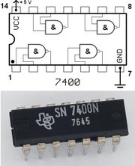
Logic Gates
One can buy gates separately
ex. 74xxx series of integrated circuits
cost ~$1 per chip, mostly for packaging and testing
Cumbersome, but possible to build devices using gates put together manually

Slide 82
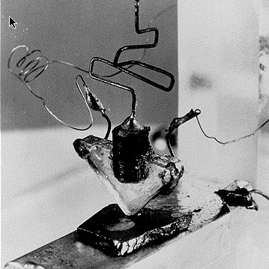
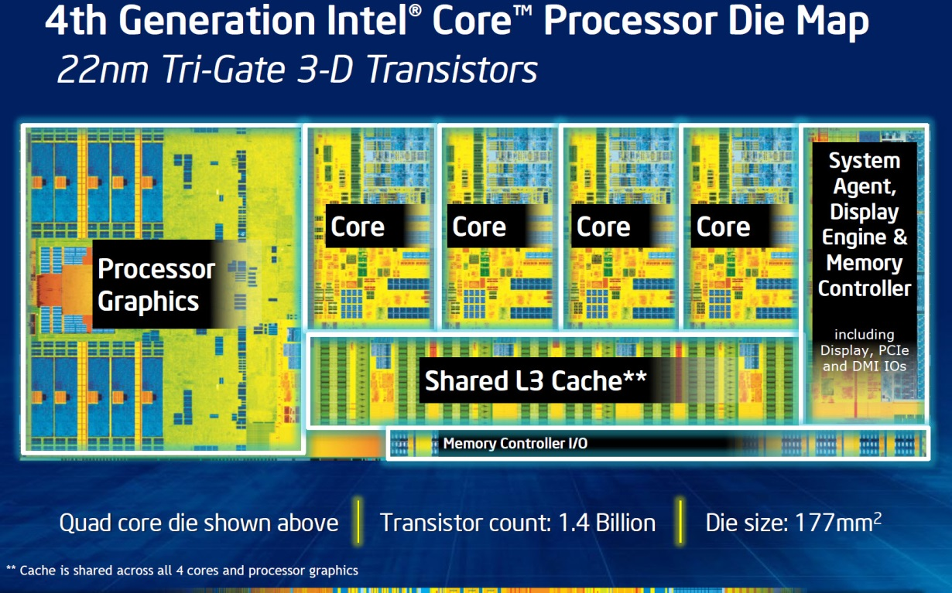
Then and Now
http://techguru3d.com/4th-gen-intel-haswell-processors-architecture-and-lineup/
The first transistor
on a workbench at
AT&T Bell Labs in 1947
Bardeen, Brattain, and Shockley
An Intel Haswell
1.4 billion transistors
177 square millimeters
Four processing cores
Notes:
John Bardeen
Walter Brattain
William Shockley

Slide 83
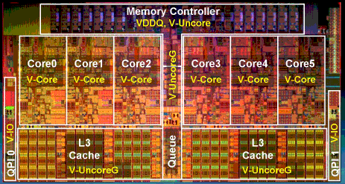
Then and Now
http://www.theregister.co.uk/2010/02/03/intel_westmere_ep_preview/
The first transistor
on a workbench at
AT&T Bell Labs in 1947
Bardeen, Brattain, and Shockley
An Intel Westmere
1.17 billion transistors
240 square millimeters
Six processing cores
Notes:
John Bardeen
Walter Brattain
William Shockley

Slide 84
Summary
Most modern devices are made from billions of on /off switches called transistors
We will build a processor in this course!
Transistors made from semiconductor materials:
MOSFET – Metal Oxide Semiconductor Field Effect Transistor
NMOS, PMOS – Negative MOS and Positive MOS
CMOS – complementary MOS made from PMOS and NMOS transistors
Transistors used to make logic gates and logic circuits
We can now implement any logic circuit
Can do it efficiently, using Karnaugh maps to find the minimal terms required
Can use either NAND or NOR gates to implement the logic circuit
Can use P- and N-transistors to implement NAND or NOR gates

