Slide 1
Sequential Logic Circuits
Instructor Dr. Jianhui Yue
Adopted notes from Hakim Weatherspoon
See P&H Appendix B.7. B.8, B.10, B.11

Slide 2
Hint1 for Project 1
1 Hash Table instructionTypeTable
Hashtable<String, Integer> instructionTypeTable
= new Hashtable<String, Integer>();
instructionTypeTable.put(“lw", 2);
instructionTypeTable.put(“sw", 2);
instructionTypeTable.put(“add", 1);
2 To retrieve an instruction type
Integer InstFmt = instructionTypeTable.get(“lw");

Slide 3
Hint2 for Project 1
Framework
inst = getInst( line );
instType = instructionTypeTable.get(inst) ;
switch( instType )
{
case 1: // R-format
do_R_foramat( line );
break;
case 2: // I-format
do_I_foramat( line );
break;
case 3: // J-format
do_J_format( line );
break;
default :
report_error( line );
}

Slide 4
Hint3 for Project 1
add $1 , $2 , $3
Do_R_format( string line )
{
Scanner s = new Scanner( line );
string inst = s.next();
if( inst != “sll” ){
rs = s.next( );
s.next();
rt = s.next();
s.next();
rd = s.next( );
encoding_R_Inst( inst, rs, rt, rd);
}else{
…
encoding_R_Inst_shamt( inst, rs, rt, rd, shamt);
}
…
}

Slide 5
Big Picture: Building a Processor
memory
register file
inst
alu
+4
+4
addr
=?
PC
d_{in}
d_{out}
control
cmp
offset
memory
new pc
target
imm
extend
A Single cycle processor

Slide 6
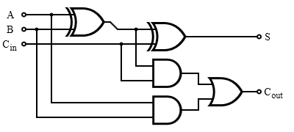
Review
1-bit adder
We can generalize 1-bit Full Adders to 32 bits, 64 bits …
A₃ B₃
A₂ B₂
A₁ B₁
A₀ B₀
C₀
S₃
S₂
S₁
S₀

Slide 7
Review
We can generalize 1-bit Full Adders to 32 bits, 64 bits …
B₃
B₂
B₁
B₀
A₃
mux
A₂
mux
A₁
mux
A₀
mux
0=add
1=sub
S₃
S₂
S₁
S₀

Slide 8
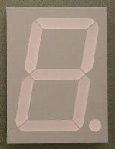
Example: A Calculator
8
A
8
decoder
8
B
S
0=add
1=sub
Notes:
red herring? constants into mux

Slide 9
Example: A Calculator
8
A
8
8
adder
decoder
8
8
B
mux
8
S
0=add
1=sub
Notes:
red herring? constants into mux

Slide 10
Example: A Calculator
8
128
A
0b1000 0000
8
8
adder
decoder
8
8
128
B
mux
0b1000 0000
8
S
0=add
1=sub
Notes:
red herring? constants into mux

Slide 11
Example: A Calculator
8
128
A
0b1000 0000
8
8
adder
decoder
8
8
128
B
mux
0b1000 0000
8
S
0=add
1=sub
Notes:
red herring? constants into mux

Slide 12
Review: Efficiency and Generality
We can generalize 1-bit Full Adders to 32 bits, 64 bits …
How long does it take to compute a result?
B₃
B₂
B₁
B₀
A₃
mux
A₂
mux
A₁
mux
A₀
mux
0=add
1=sub
S₃
S₂
S₁
S₀

Slide 13
Review: Efficiency and Generality
We can generalize 1-bit Full Adders to 32 bits, 64 bits …
How long does it take to compute a result?
Assume each 1-bit full adder delay is 2 ns

Slide 14
Review: Efficiency and Generality
We can generalize 1-bit Full Adders to 32 bits, 64 bits …
How long does it take to compute a result?
B₃
B₂
B₁
B₀
A₃
mux
A₂
mux
A₁
mux
A₀
mux
0=add
1=sub
t=8
S₃
t=6
S₂
t=4
S₁
t=2
S₀
t=0

Slide 15
Review: Efficiency and Generality
We can generalize 1-bit Full Adders to 32 bits, 64 bits …
How long does it take to compute a result?
Can we store the result?
B₃
B₂
B₁
B₀
A₃
mux
A₂
mux
A₁
mux
A₀
mux
0=add
1=sub
t=8
S₃
t=6
S₂
t=4
S₁
t=2
S₀
t=0

Slide 16
Performance
Speed of a circuit is affected by the number of gates in series (on the critical path or the deepest level of logic)
inputs arrive
Combinational
Logic
outputs expected
t_{combinational}

Slide 17
4-bit Ripple Carry Adder
A₃
B₃
A₂
B₂
A₁
B₁
A₀
B₀
C₃
C₂
C₁
C₄
C₀
S₃
S₂
S₁
S₀
Carry ripples from lsb to msb
First full adder, 2 ns delay
Second full adder, 2 ns delay
…
Notes:
Carry-lookahead adders would be more efficient performance wise (i.e. lower gate delay), but more expense hardware wise (i.e. more logic gates)

Slide 18
Motivations for Stateful Components
Until now is combinationial logic
Output is computed when inputs are present
System has no internal state
Nothing computed in the present can depend on what happened in the past!
Need a way to record data
Need a way to build stateful circuits
Need a state-holding device
Finite State Machines
Inputs
Combinational circuit
Outputs
N
M
Notes:
How are we going to stably store state

Slide 19
Goals
State
How do we store one bit?
Attempts at storing (and changing) one bit
Set-Reset Latch
D Latch
D Flip-Flops
Master-Slave Flip-Flops
Register: storing more than one bit, N-bits
Basic Building Blocks
Decoders and Encoders
Finite State Machines (FSM)
How do we design logic circuits with state?
Types of FSMs: Mealy and Moore Machines
Examples: Serial Adder and a Digital Door Lock

Slide 20
Goal
How do we store store one bit?

Slide 21
First Attempt: Unstable Devices
B
C
A

Slide 22
First Attempt: Unstable Devices
B
B
0
1
1
1
C
C
0
0
1
0
0
0
1
1
A
A
A = 1 → B = 0 → C = 1
C = 1 → A = 0 → B = 1
Does not work!
Unstable
Oscillates wildly!

Slide 23
Second Attempt: Bistable Devices
Stable and unstable equilibria?
A
B
A Simple Device
In stable state, A = B
How do we change the state?
0
1
1
0
A
B
A
B
Notes:
How to create state? Feedback.
Show how the signal works

Slide 24

Third Attempt: Set-Reset Latch
S
A
$$\overline{Q}$$
Q
B
R
Notes:
Can you store a value (with this circuit)?
Can you change its value?
Q is comes from Latin language "quiscens" or "the present particle" or "what is present available" or "present output"
How to create state? Feedback.
Show how the signal works

Slide 25


Third Attempt: Set-Reset Latch
S
$$\overline{Q}$$
Either of inputs is 1, NOR is 0
A | B | OR | NOR
0 | 0 | 0 | 1
0 | 1 | 1 | 0
1 | 0 | 1 | 0
1 | 1 | 1 | 0
Q
R
S | R | Q | $$\overline{Q}$$
0 | 0
0 | 1
1 | 0
1 | 1
Set-Reset (S-R) Latch
Stores a value Q and its complement

Slide 26
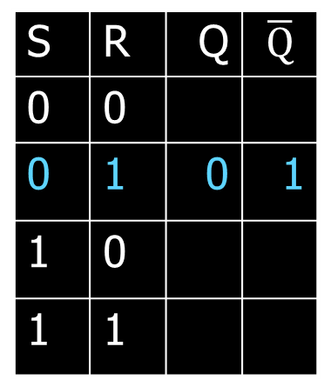

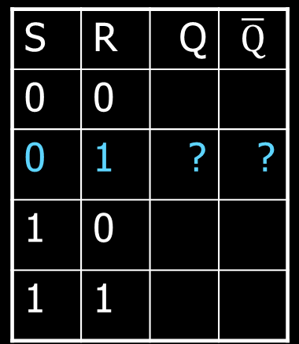
Third Attempt: Set-Reset Latch
0
S
$$\overline{Q}$$
A | B | OR | NOR
0 | 0 | 0 | 1
0 | 1 | 1 | 0
1 | 0 | 1 | 0
1 | 1 | 1 | 0
0
1
Q will be 0 if R is 1
Q
R
$\overline{Q}$will be 1
1
S | R | Q | $$\overline{Q}$$
0 | 0
0 | 1 | ? | ?
1 | 0
1 | 1
S | R | Q | $$\overline{Q}$$
0 | 0
0 | 1 | 0 | 1
1 | 0
1 | 1
Set-Reset (S-R) Latch
Stores a value Q and its complement
Q = (R+Q) = RQ
If R = 1, Q = 0
If Q= 0 and S = 0, Q = 1

Slide 27
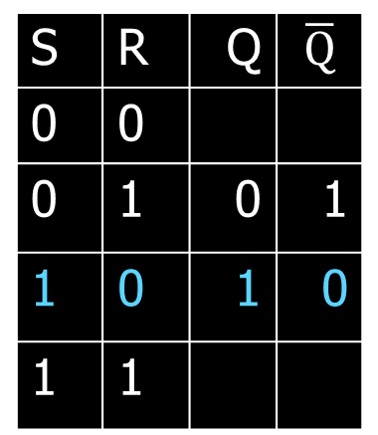

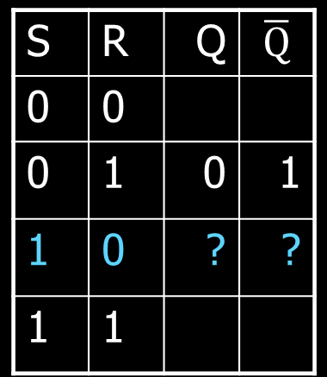
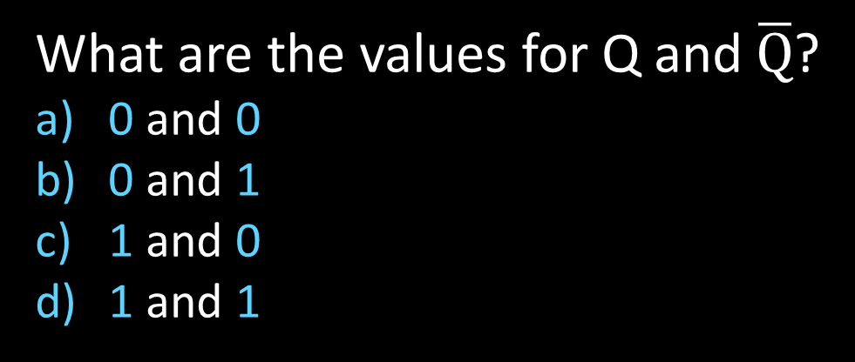
Third Attempt: Set-Reset Latch
1
S
$$\overline{Q}$$
A | B | OR | NOR
0 | 0 | 0 | 1
0 | 1 | 1 | 0
1 | 0 | 1 | 0
1 | 1 | 1 | 0
1
0
Q will be 1
Q
R
$\overline{Q}$will be 0 if S is 1
0
S | R | Q | $$\overline{Q}$$
0 | 0
0 | 1 | 0 | 1
1 | 0 | ? | ?
1 | 1
S | R | Q | $$\overline{Q}$$
0 | 0
0 | 1 | 0 | 1
1 | 0 | 1 | 0
1 | 1
Set-Reset (S-R) Latch
Stores a value Q and its complement
What are the values for Q and $\overline{Q}$?
0 and 0
0 and 1
1 and 0
1 and 1

Slide 28
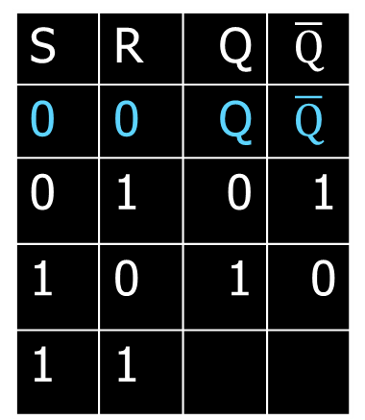
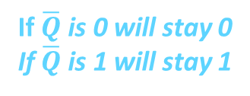

Third Attempt: Set-Reset Latch
1
→
S
0
$$\overline{Q}$$
A | B | OR | NOR
0 | 0 | 0 | 1
0 | 1 | 1 | 0
1 | 0 | 1 | 0
1 | 1 | 1 | 0
1
0
If Q is 1, will stay 1
if Q is 0, will stay 0
Q
R
If $\overline{Q}$ is 0 will stay 0
If $\overline{Q}$ is 1 will stay 1
0
S | R | Q | $$\overline{Q}$$
0 | 0 | ? | ?
0 | 1 | 0 | 1
1 | 0 | 1 | 0
1 | 1
S | R | Q | $$\overline{Q}$$
0 | 0 | Q | $$\overline{Q}$$
0 | 1 | 0 | 1
1 | 0 | 1 | 0
1 | 1
Set-Reset (S-R) Latch
Stores a value Q and its complement
Q = (R+Q) = RQ = Q (if R = 0)
Q = (S+Q) = SQ = Q (if S = 0)
Notes:
Since the set and reset input are both 0, the Q and !Q determine the output, which will hold.

Slide 29

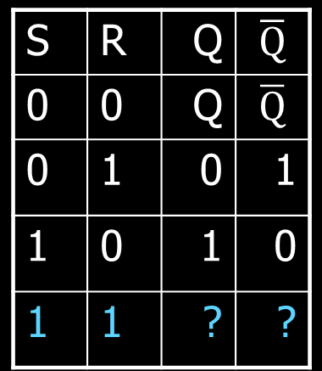
Third Attempt: Set-Reset Latch
S
1
$$\overline{Q}$$
Either of inputs is 1, NOR is 0
A | B | OR | NOR
0 | 0 | 0 | 1
0 | 1 | 1 | 0
1 | 0 | 1 | 0
1 | 1 | 1 | 0
0
0
Q will be 0 since R is 1
R
$\overline{Q}$ will be 0 since S is 1
Q
1
S | R | Q | $$\overline{Q}$$
0 | 0 | Q | $$\overline{Q}$$
0 | 1 | 0 | 1
1 | 0 | 1 | 0
1 | 1 | ? | ?
Set-Reset (S-R) Latch
Stores a value Q and its complement
What happens when S,R changes from 1,1 to 0,0?
Notes:
Start with 0, 1 => 0, 1
then 0, 0 => 0, 1
then 1, 0 => 1, 0
then 0, 0 => 1, 0, better yet “stay”
1, 1 is forbidden, b/c going to 0, 0 after goes haywire
i.e.
Start 1,1 => 0,0
Alright. Now change S,R to 0, 0, what happens.
1, 1=>0, 0 -> 0, 0=> 0, 0 -> 0, 0=>1, 1 -> 0, 0=> 0, 0 -> oscillations.
S R=>Q,!Q -> S,R=>Q,!Q -> S, R=>Q,!Q -> S,R => Q,!Q

Slide 30

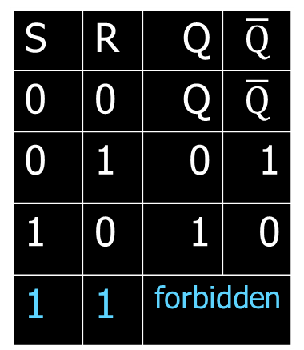
Third Attempt: Set-Reset Latch
S
1→0
$$\overline{Q}$$
A | B | OR | NOR
0 | 0 | 0 | 1
0 | 1 | 1 | 0
1 | 0 | 1 | 0
1 | 1 | 1 | 0
0 →1
0 →1 →0
0 →1 →0 →1
0→1
0
0→1 →0
0→1 →0 →1
0
Q
R
1 →0
S | R | Q | $$\overline{Q}$$
0 | 0 | Q | $$\overline{Q}$$
0 | 1 | 0 | 1
1 | 0 | 1 | 0
1 | 1 | ? | ?
S | R | Q | $$\overline{Q}$$
0 | 0 | Q | $$\overline{Q}$$
0 | 1 | 0 | 1
1 | 0 | 1 | 0
1 | 1 | forbidden
Set-Reset (S-R) Latch
Stores a value Q and its complement
What happens when S,R changes from 1,1 to 0,0?
Q and $\overline{Q}$ become unstable and will oscillate wildly
between values 0,0 to 1,1 to 0,0 to 1,1 …
Notes:
Start with 0, 1 => 0, 1
then 0, 0 => 0, 1
then 1, 0 => 1, 0
then 0, 0 => 1, 0, better yet “stay”
1, 1 is forbidden, b/c going to 0, 0 after goes haywire
i.e.
Start 1,1 => 0,0
Alright. Now change S,R to 0, 0, what happens.
1, 1=>0, 0 -> 0, 0=> 0, 0 -> 0, 0=>1, 1 -> 0, 0=> 0, 0 -> oscillations.
S R=>Q,!Q -> S,R=>Q,!Q -> S, R=>Q,!Q -> S,R => Q,!Q

Slide 31

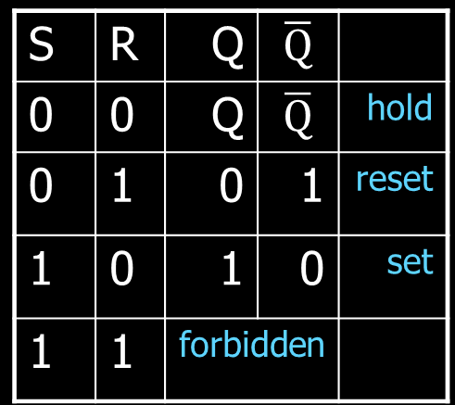

Third Attempt: Set-Reset Latch
S
Q
S
R
$$\overline{Q}$$
$$\overline{Q}$$
Q
R
S | R | Q | $$\overline{Q}$$
0 | 0 | Q | $$\overline{Q}$$
0 | 1 | 0 | 1
1 | 0 | 1 | 0
1 | 1 | forbidden
S | R | Q | $$\overline{Q}$$
0 | 0 | Q | $$\overline{Q}$$ | hold
0 | 1 | 0 | 1 | reset
1 | 0 | 1 | 0 | set
1 | 1 | forbidden
Set-Reset (S-R) Latch
Stores a value Q and its complement
Notes:
Start with 0, 1 => 0, 1
then 0, 0 => 0, 1
then 1, 0 => 1, 0
then 0, 0 => 1, 0, better yet “stay”
1, 1 is forbidden, b/c going to 0, 0 after goes haywire
i.e.
Start 1,1 => 0,0
Alright. Now change S,R to 0, 0, what happens.
1, 1=>0, 0 -> 0, 0=> 0, 0 -> 0, 0=>1, 1 -> 0, 0=> 0, 0 -> oscillations.
S R=>Q,!Q -> S,R=>Q,!Q -> S, R=>Q,!Q -> S,R => Q,!Q

Slide 32
Takeaway
Set-Reset (SR) Latch can store one bit and we can change the value of the stored bit. But, SR Latch has a forbidden state.

Slide 33
Next Goal
How do we avoid the forbidden state of S-R Latch?

Slide 34

Fourth Attempt: (Unclocked) D Latch
D
S
Q
D
S
R
Q
$$\overline{Q}$$
R
Q
D | Q | $$\overline{Q}$$
0
1
Fill in the truth table?
A | B | OR | NOR
0 | 0 | 0 | 1
0 | 1 | 1 | 0
1 | 0 | 1 | 0
1 | 1 | 1 | 0
Notes:
Start in 0, 0, 1
Change to D = 1
After NOT gate, R = 0
After OR+NOT gates, /Q = 0 (R is already ready then), Q goes to 1
Problem: No way to hold state

Slide 35
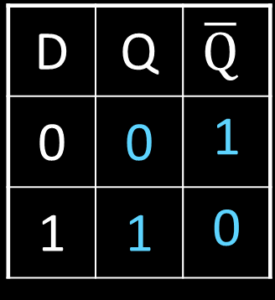
Fourth Attempt: (Unclocked) D Latch
D
S
Q
D
S
R
Q
$$\overline{Q}$$
R
Q
D | Q | $$\overline{Q}$$
0 | 0 | 1
1 | 1 | 0
Fill in the truth table?
Data (D) Latch
Easier to use than an SR latch
No possibility of entering an undefined state
When D changes, Q changes
… immediately (…after a delay of 2 Ors and 2 NOTs)
Need to control when the output changes
A | B | OR | NOR
0 | 0 | 0 | 1
0 | 1 | 1 | 0
1 | 0 | 1 | 0
1 | 1 | 1 | 0
Notes:
Start in 0, 0, 1
Change to D = 1
After NOT gate, R = 0
After OR+NOT gates, /Q = 0 (R is already ready then), Q goes to 1
Problem: No way to hold state

Slide 36
Takeaway
Set-Reset (SR) Latch can store one bit and we can change the value of the stored bit. But, SR Latch has a forbidden state.
(Unclocked) D Latch can store and change a bit like an SR Latch while avoiding the forbidden state.

Slide 37
Next Goal
How do we coordinate state changes to a D Latch?

Slide 38
Clocks
Clock helps coordinate state changes
Usually generated by an oscillating crystal
Fixed period; frequency = 1/period
clock
high
falling edge
rising edge
rising edge
falling edge
1
0
period
low
high
clock
period
clock
low

Slide 39
Clock Disciplines
Level sensitive
State changes when clock is high (or low)
Edge triggered
State changes at clock edge
positive edge-triggered
negative edge-triggered

Slide 40
Clock Methodology
Clock Methodology
Negative edge, synchronous
Edge-Triggered: Signals must be stable near falling clock edge
Positive edge synchronous
clk
t_{combinational}
t_{setup}
t_{hold}
compute
save
compute
save
compute

Slide 41

Fifth Attempt: D Latch with Clock
D
S
Q
R
$$\overline{Q}$$
Notes:
Any forbidden S=R=1 inputs? No
Need both truth tables

Slide 42

Fifth Attempt: D Latch with Clock
D
S
Q
clk
R
$$\overline{Q}$$
Fill in the truth table
clk | D | Q | $$\overline{Q}$$
0 | 0
0 | 1
1 | 0
1 | 1
Notes:
Any forbidden S=R=1 inputs? No
Need both truth tables

Slide 43


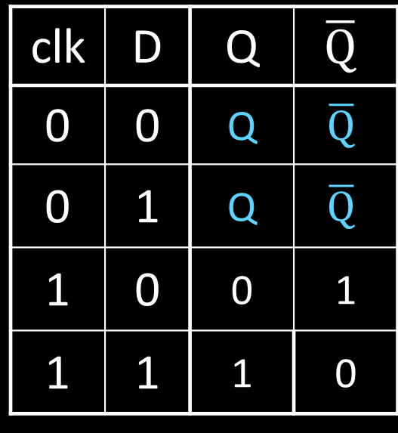
Fifth Attempt: D Latch with Clock
D
S
Q
clk
R
$$\overline{Q}$$
Fill in the truth table
clk | D | Q | $$\overline{Q}$$
0 | 0
0 | 1
1 | 0
1 | 1
S | R | Q | $$\overline{Q}$$
0 | 0 | Q | $$\overline{Q}$$ | hold
0 | 1 | 0 | 1 | reset
1 | 0 | 1 | 0 | set
1 | 1 | forbidden
clk | D | Q | $$\overline{Q}$$
0 | 0 | Q | $$\overline{Q}$$
0 | 1 | Q | $$\overline{Q}$$
1 | 0 | 0 | 1
1 | 1 | 1 | 0
Notes:
Any forbidden S=R=1 inputs? No
Need both truth tables

Slide 44
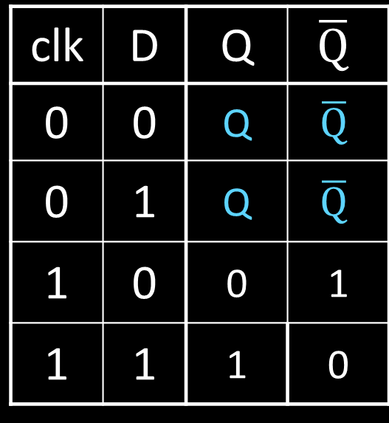
Fifth Attempt: D Latch with Clock
Level Sensitive D Latch
Clock high: set/reset (according to D)
Clock low: keep state (ignore D)
D
S
Q
clk
R
$$\overline{Q}$$
clk | D | Q | $$\overline{Q}$$
0 | 0 | Q | $$\overline{Q}$$
0 | 1 | Q | $$\overline{Q}$$
1 | 0 | 0 | 1
1 | 1 | 1 | 0
clk
D
Q
Notes:
Any forbidden S=R=1 inputs? No
Need both truth tables

Slide 45



Sixth Attempt: Edge-Triggered D Flip-Flop
D Flip-Flop
Edge-Triggered
Data captured when clock is high
Output changes only on falling edges
D
1
D
Q
0
D
Q
0
Q
X
clk
0
L
$$\overline{Q}$$
1
L
$$\overline{Q}$$
$$\overline{Q}$$
c
c
Activity#1: Fill in timing graph and values for X and Q
clk
D
X
Q
Notes:
Master-Slave Flip Flop
- Outputs change only on falling edges
- Data is captured on rising edges
1 cycle delay
but works out perfectly – data for the next stage is ready 1 cycle ahead of time

Slide 46
Sixth Attempt: Edge-Triggered D Flip-Flop
D Flip-Flop
Edge-Triggered
Data captured when clock is high
Output changes only on falling edges
1
0
0
1
0
D
D
Q
D
Q
1
Q
X
0
1
L
$$\overline{Q}$$
0
L
$$\overline{Q}$$
clk
1
$$\overline{Q}$$
c
c
clk
D
X
Q
Notes:
Master-Slave Flip Flop
- Outputs change only on falling edges
- Data is captured on rising edges
1 cycle delay
but works out perfectly – data for the next stage is ready 1 cycle ahead of time

Slide 47
Takeaway
Set-Reset (SR) Latch can store one bit and we can change the value of the stored bit. But, SR Latch has a forbidden state.
(Unclocked) D Latch can store and change a bit like an SR Latch while avoiding a forbidden state.
An Edge-Triggered D Flip-Flop (aka Master-Slave D Flip-Flop) stores one bit. The bit can be changed in a synchronized fashion on the edge of a clock signal.

Slide 48
Next Goal
How do we store more than one bit, N bits?

Slide 49
Registers
D0
Register
D flip-flops in parallel
shared clock
extra clocked inputs: write_enable, reset, …
D1
D2
D3
4-bit
reg
4
4
clk
clk

Slide 50
Takeaway
Set-Reset (SR) Latch can store one bit and we can change the value of the stored bit. But, SR Latch has a forbidden state.
(Unclocked) D Latch can store and change a bit like an SR Latch while avoiding a forbidden state.
An Edge-Triggered D Flip-Flip (aka Master-Slave D Flip-Flip) stores one bit. The bit can be changed in a synchronized fashion on the edge of a clock signal.
An N-bit register stores N-bits. It is created with N D-Flip-Flops in parallel along with a shared clock.

Slide 51
An Example: What will this circuit do?
4
16
Decoder
4
4
4-bit
reg
+1
Clk
4

Slide 52
An Example: What will this circuit do?
Reset
Run
WE
R
4
16
Decoder
4
4
A[4]
1 = 0001 =B[4]
4-bit
reg
C_{out}
+1
S[4]
Clk
4

Slide 53

Decoder Example: 7-Segment LED
d7
d6
d5
d4
7-Segment LED
photons emitted when electrons fall into holes
d3
d2
d1
d0
Notes:
Previous slide would need to display up to 16, so would need a 16-segment LED decoder

Slide 54
Decoder Example: 7-Segment LED
d7
d6
d5
d4
7-Segment LED
photons emitted when electrons fall into holes
d3
d2
d1
d0

Slide 55
Decoder Example: 7-Segment LED Decoder
3 inputs
encode 0 – 7 in binary
7 outputs
one for each LED
7LED decode

Slide 56
7 Segment LED Decoder Implementation
b2 | b1 | b0 | d6 | d5 | d4 | d3 | d2 | d1 | d0
0 | 0 | 0
0 | 0 | 1
0 | 1 | 0
0 | 1 | 1
1 | 0 | 0
1 | 0 | 1
1 | 1 | 0
1 | 1 | 1
b2 | b1 | b0 | d6 | d5 | d4 | d3 | d2 | d1 | d0
0 | 0 | 0
0 | 0 | 1
0 | 1 | 0
0 | 1 | 1
1 | 0 | 0
1 | 0 | 1
1 | 1 | 0
1 | 1 | 1 | 1 | 0 | 0 | 0 | 0 | 1 | 1
d1
d2
d0
d3
d4
d6
d5

Slide 57
7 Segment LED Decoder Implementation
b2 | b1 | b0 | d6 | d5 | d4 | d3 | d2 | d1 | d0
0 | 0 | 0
0 | 0 | 1
0 | 1 | 0
0 | 1 | 1
1 | 0 | 0
1 | 0 | 1
1 | 1 | 0
1 | 1 | 1
1 | 1 | 1 | 0 | 1 | 1 | 1
1 | 0 | 0 | 0 | 0 | 0 | 1
0 | 1 | 1 | 1 | 0 | 1 | 1
1 | 1 | 0 | 1 | 0 | 1 | 1
1 | 0 | 0 | 1 | 1 | 0 | 1
1 | 1 | 0 | 1 | 1 | 1 | 0
1 | 1 | 1 | 1 | 1 | 1 | 0
1 | 0 | 0 | 0 | 0 | 1 | 1
d1
d2
d0
d3
d4
d6
d5

Slide 58
Basic Building Blocks We have Seen
N
2^{N}
0
N
binary
encoder
1
N
N
2
N
N
Multiplexor
binary
decoder
. . .
2^{N}
N
2^{M}-1
M

Slide 59
Encoders
0
1
2
3
N Input wires
4
Log₂(N) outputs wires
encoder
5
. . .
6
7
e.g. Voting:
Can only vote for one out of N
candidates, so N inputs.
But can encode vote efficiently
with binary encoding.
. . .
N
Notes:
N possible inputs -> log2(N) wires to encode

Slide 60
Example Encoder Truth Table
a | b | c | d
0 | 0 | 0 | 0
1 | 0 | 0 | 0
0 | 1 | 0 | 0
0 | 0 | 1 | 0
0 | 0 | 0 | 1
a
1
o₀
b
2
o₁
o₁
c
3
o₂
d
4
A 3-bit
encoder
with 4 inputs for simplicity
Notes:
Implementation . . .
assume 8 choices, exactly one mark detected

Slide 61
Example Encoder Truth Table
a | b | c | d |  | o₂ | o₁ | o₀
0 | 0 | 0 | 0 |  | 0 | 0 | 0
1 | 0 | 0 | 0 |  | 0 | 0 | 1
0 | 1 | 0 | 0 |  | 0 | 1 | 0
0 | 0 | 1 | 0 |  | 0 | 1 | 1
0 | 0 | 0 | 1 |  | 1 | 0 | 0
a
1
o₀
b
2
o₁
o₁
c
3
o₂
d
4
o₂ = abcd
o₁ = abcd + abcd
o₀ = abcd + abcd
A 3-bit
encoder
with 4 inputs for simplicity
Notes:
Implementation . . .
assume 8 choices, exactly one mark detected

Slide 62
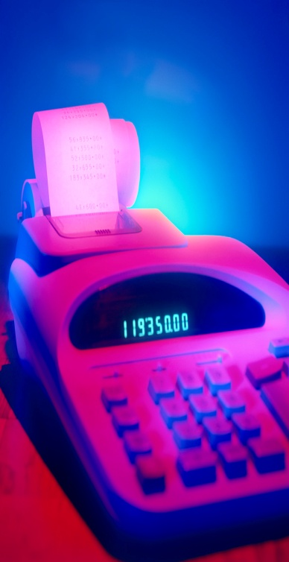
Basic Building Blocks Example: Voting
enc
7LED decode
detect
8
3
7
Ballots
The 3410 optical scan
vote reader
machine

Slide 63
Basic Building Blocks We have Seen
N
2^{N}
0
N
binary
encoder
1
N
N
2
N
N
Multiplexor
binary
decoder
. . .
2^{N}
N
2^{M}-1
M

Slide 64
Recap
We can now build interesting devices with sensors
Using combinationial logic
We can also store data values (aka Sequential Logic)
In state-holding elements
Coupled with clocks

Slide 65
Goals for Today
State
How do we store one bit?
Attempts at storing (and changing) one bit
Set-Reset Latch
D Latch
D Flip-Flops
Master-Slave Flip-Flops
Register: storing more than one bit, N-bits
Basic Building Blocks
Decoders and Encoders
Finite State Machines (FSM)
How do we design logic circuits with state?
Types of FSMs: Mealy and Moore Machines
Examples: Serial Adder and a Digital Door Lock

Slide 66
Goals for Today
State
How do we store one bit?
Attempts at storing (and changing) one bit
Set-Reset Latch
D Latch
D Flip-Flops
Master-Slave Flip-Flops
Register: storing more than one bit, N-bits
Basic Building Blocks
Decoders and Encoders
Finite State Machines (FSM)
How do we design logic circuits with state?
Types of FSMs: Mealy and Moore Machines
Examples: Serial Adder and a Digital Door Lock

Slide 67
Finite State Machines

Slide 68
Next Goal
How do we design logic circuits with state?

Slide 69
Finite State Machines
An electronic machine which has
external inputs
externally visible outputs
internal state
Output and next state depend on
inputs
current state

Slide 70
Abstract Model of FSM
Machine is
M = ( S, I, O, δ )
S: Finite set of states
I: Finite set of inputs
O: Finite set of outputs
δ: State transition function
Next state depends on present input and present state

Slide 71
Automata Model
Finite State Machine
inputs from external world
outputs to external world
internal state
combinational logic Clock edge triggers the state transitions
Registers
Current State
Comb. Logic
Output
Input
Next State
Clock
Notes:
Put sequential logic term on slide

Slide 72
FSM Example
down/on
input/output
up/off
down/on
A
B
state
start state
up/off
up/off
Legend
up/off
C
D
down/off
Input: up or down
Output: on or off
States: A, B, C, or D
down/off

Slide 73
FSM Example
down/on
input/output
up/off
down/on
A
B
state
start state
up/off
up/off
Legend
up/off
C
D
down/off
Input: = up or = down
Output: = on or = off
States: = A, = B, = C, or = D
down/off
Notes:
Say left of slash is input and right is output

Slide 74
FSM Example
1/1
1/1
i₀i₁i₂…/o₀o₁o₂…
0/0
00
01
S₁S₀
S₁S₀
0/0
0/0
Legend
0/0
10
11
1/0
Input: 0=up or 1=down
Output: 1=on or 0=off
States: 00=A, 01=B, 10=C, or 11=D
1/0

Slide 75
Mealy Machine
General Case: Mealy Machine
Outputs and next state depend on both current state and input
Registers
Current State
Comb. Logic
Output
Input
Next State
Clock

Slide 76
Moore Machine
Special Case: Moore Machine
Outputs depend only on current state
Registers
Current State
Comb. Logic
Output
Comb. Logic
Input
Next State
Clock

Slide 77
Moore Machine FSM Example
down
input
up
down
A off
B on
state out
startout
up
down
Legend
up
C off
D off
up
Input: up or down
Output: on or off
States: A, B, C, or D
down
Notes:
Also show a mealy machine

Slide 78
Mealy Machine FSM Example
down/on
input/output
up/off
down/on
A
B
state
start state
up/off
down/off
Legend
up/off
C
D
up/off
Input: up or down
Output: on or off
States: A, B, C, or D
down/off

Slide 79
Example 1
Draw a state transition diagram for a decimal counter which counts from 0~9 and carry 1 when meeting 10_{(decimal)}

Slide 80
Analysis
There is no input : when power on, it will count automatically.
Output : when meeting 10(decimal), the output is 1.
Binary code assignment
Q₃Q₂Q₁Q₀ ( but actual state is from 0~9)
0000
0001
/0
0010
0011
0100
/0
/0
/0
/1
/0
1001
/0
1000
/0
0111
/0
0110
/0
0101

Slide 81
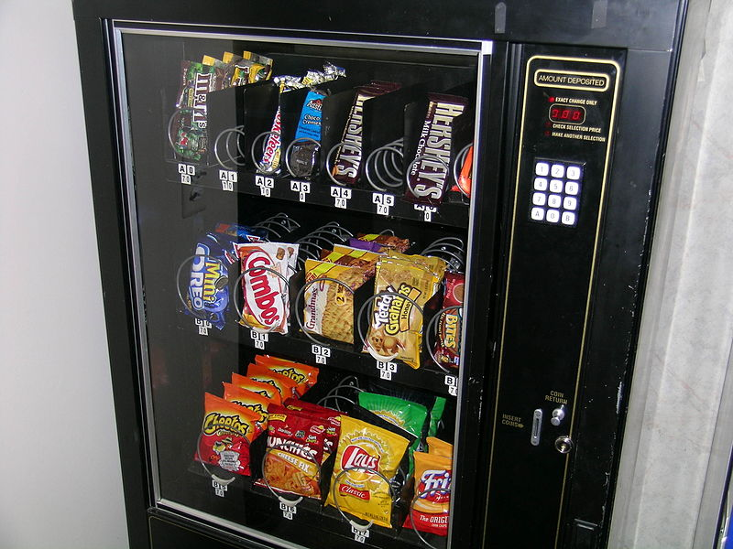
Example 2
A vending machine selling a 20 cent item
Input could be 5 , 10 cents
– Input
– Output
– State ?
cents already in the machine

Slide 82
State Machine
States
00 – 0 cents, 01 – 5cents, 10 – 10cents, 11 – 15cents
Input x
‘0’ – 5 cents ‘1’, – 10 cents
Output : ‘0’ - no item, ‘1’ – dispense item
01
00
0/0
0/0
1/0
1/0
1/1
10
0/1
11
1/1
0/0

Slide 83
Activity#2: Create a Logic Circuit for a Serial Adder
Add two infinite input bit streams
streams are sent with least-significant-bit (lsb) first
…10110
Sum: output
…00101
…01111
Notes:
Ask as a clicker question

Slide 84
Activity#2: Create a Logic Circuit for a Serial Adder
Add two infinite input bit streams
streams are sent with least-significant-bit (lsb) first
Carry-out
1
…10110
Sum: output
…00101
…01111
Notes:
Ask as a clicker question

Slide 85
Activity#2: Create a Logic Circuit for a Serial Adder
Add two infinite input bit streams
streams are sent with least-significant-bit (lsb) first
Carry-in
1
…10110
Sum: output
…00101
…01111
Notes:
Ask as a clicker question

Slide 86
Activity#2: Create a Logic Circuit for a Serial Adder
Add two infinite input bit streams
streams are sent with least-significant-bit (lsb) first
Carry-out
1
1
…10110
Sum: output
…00101
…01111
Notes:
Ask as a clicker question

Slide 87
Activity#2: Create a Logic Circuit for a Serial Adder
Add two infinite input bit streams
streams are sent with least-significant-bit (lsb) first
How many states are needed to represent FSM?
Draw and Fill in FSM diagram
…10110
Sum: output
…00101
…01111
Strategy:
(1) Draw a state diagram (e.g. Mealy Machine)
(2) Write output and next-state tables
(3) Encode states, inputs, and outputs as bits
(4) Determine logic equations for next state and outputs
Notes:
Ask as a clicker question

Slide 88
FSM: State Diagram
…10110
…00101
…01111
states:
Inputs: ??? and ???
Output: ???
.
Notes:
Is this a mealy or moore machine, maybe clicker

Slide 89
FSM: State Diagram
a
…10110
…00101
z
b
…01111
Two states: S0 (no carry in), S1 (carry in)
Inputs: a and b
Output: z
z is the sum of inputs a, b, and carry-in (one bit at a time)
A carry-out is the next carry-in state.
.

Slide 90
FSM: State Diagram
__/_
__/_
__/_
S0
__/_
S1
__/_
__/_
__/_
__/_
a
…10110
…00101
z
b
…01111
Two states: S0 (no carry in), S1 (carry in)
Inputs: a and b
Output: z
z is the sum of inputs a, b, and carry-in (one bit at a time)
A carry-out is the next carry-in state.
Arcs labeled with input bits a and b, and output z
Notes:
Is this a mealy or moore machine, maybe clicker

Slide 91
FSM: State Diagram
11/0
00/0
11/1
S0
00/1
S1
10/1
01/1
10/0
01/0
a
…10110
…00101
z
b
…01111
Two states: S0 (no carry in), S1 (carry in)
Inputs: a and b
Output: z
z is the sum of inputs a, b, and carry-in (one bit at a time)
A carry-out is the next carry-in state.
Arcs labeled with input bits a and b, and output z (Mealy Machine)

Slide 92
Serial Adder: State Table
11/0
00/0
11/1
S0
00/1
S1
10/1
01/1
10/0
01/0
a | b | Current state | z | Next state
(2) Write down all input and state combinations

Slide 93
Serial Adder: State Table
11/0
00/0
11/1
S0
00/1
S1
10/1
01/1
10/0
01/0
a | b | Current state | z | Next state
0 | 0 | S0 | 0 | S0
0 | 1 | S0 | 1 | S0
1 | 0 | S0 | 1 | S0
1 | 1 | S0 | 0 | S1
0 | 0 | S1 | 1 | S0
0 | 1 | S1 | 0 | S1
1 | 0 | S1 | 0 | S1
1 | 1 | S1 | 1 | S1
(2) Write down all input and state combinations

Slide 94
Serial Adder: State Assignment
11/0
00/0
11/1
0
00/1
1
10/1
01/1
10/0
01/0
a | b | s | z | s'
0 | 0 | 0 | 0 | 0
0 | 1 | 0 | 1 | 0
1 | 0 | 0 | 1 | 0
1 | 1 | 0 | 0 | 1
0 | 0 | 1 | 1 | 0
0 | 1 | 1 | 0 | 1
1 | 0 | 1 | 0 | 1
1 | 1 | 1 | 1 | 1
(3) Encode states, inputs, and outputs as bits
Two states, so 1-bit is sufficient
A single flip-flop will encode the state

Slide 95

Serial Adder: Circuit
Next State
Current State
Output
Comb. Logic
z
s'
s
D
Q
a
Next State
b
Input
s'
a | b | s | z | s'
0 | 0 | 0 | 0 | 0
0 | 1 | 0 | 1 | 0
1 | 0 | 0 | 1 | 0
1 | 1 | 0 | 0 | 1
0 | 0 | 1 | 1 | 0
0 | 1 | 1 | 0 | 1
1 | 0 | 1 | 0 | 1
1 | 1 | 1 | 1 | 1
(4) Determine logic equations for next state and outputs
Combinational Logic Equations
z = $\overline{a}$b$\overline{s}$ + a$\overline{bs}$ + $\overline{ab}$s + abs
s’ = ab$\overline{s}$ + $\overline{a}$bs + a$\overline{b}$s + abs
Notes:
Practice minimizing circuit w/a Karnaugh map

Slide 96

Sequential Logic Circuits
Next State
Current State
Output
Comb. Logic
z
s'
s
D
Q
a
Next State
b
Input
s'
z = $\overline{a}$b$\overline{s}$ + a$\overline{bs}$ + $\overline{ab}$s + abs
s’ = ab$\overline{s}$ + $\overline{a}$bs + a$\overline{b}$s + abs
.
.
.
Strategy:
(1) Draw a state diagram (e.g. Mealy Machine)
(2) Write output and next-state tables
(3) Encode states, inputs, and outputs as bits
(4) Determine logic equations for next state and outputs

Slide 97
Summary
We can now build interesting devices with sensors
Using combinational logic
We can also store data values
Stateful circuit elements (D Flip Flops, Registers, …)
Clock to synchronize state changes
State Machines or Ad-Hoc Circuits

