Slide 1
Garage App
ASP.NET + React
Kim Kozlov

Slide 2
Technologies
Asp.Net, React, Postgres
ASP.NET Core 3.1
JWT (with refresh)
EF Core (use Migrations)
Postgres
React (typescript) + Redux
QuartzNet
Automapper
XUnit
GIT

Slide 3
Architecture
Microservices
Auth.API
Client
Garage.Types.API
Postgres
Database
Garage.API

Slide 4
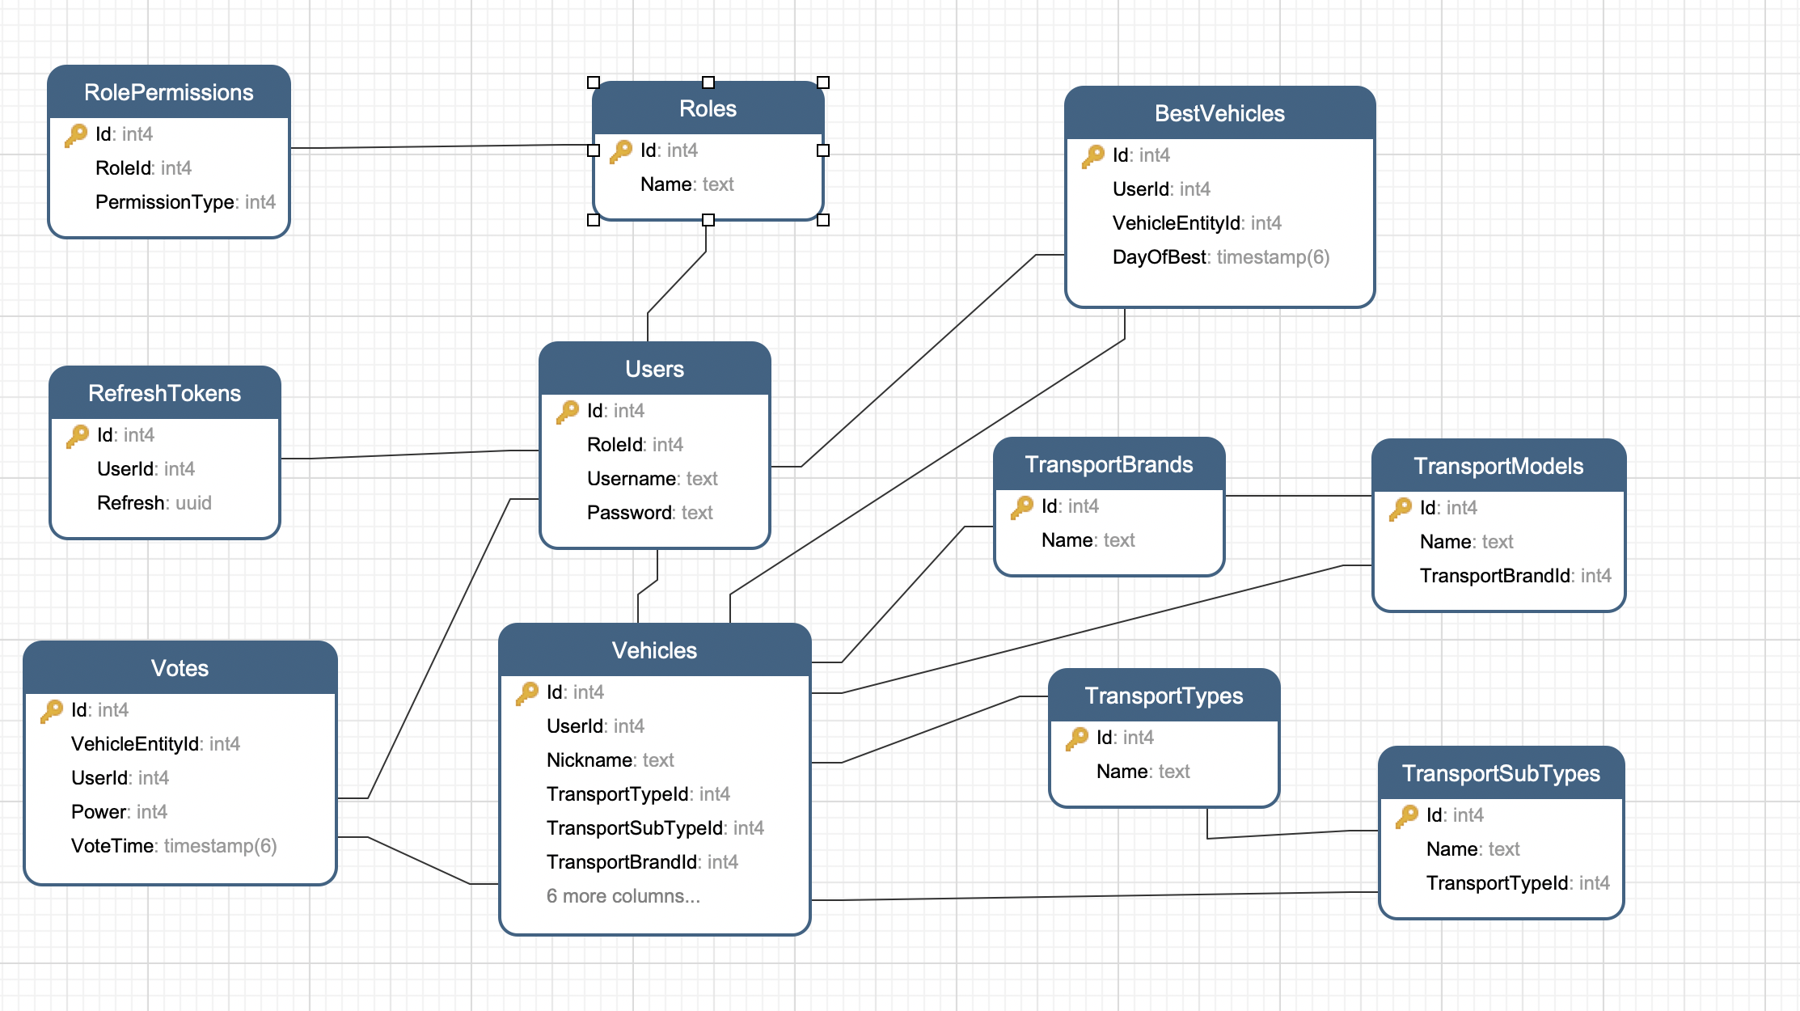
Database Schema

Slide 5
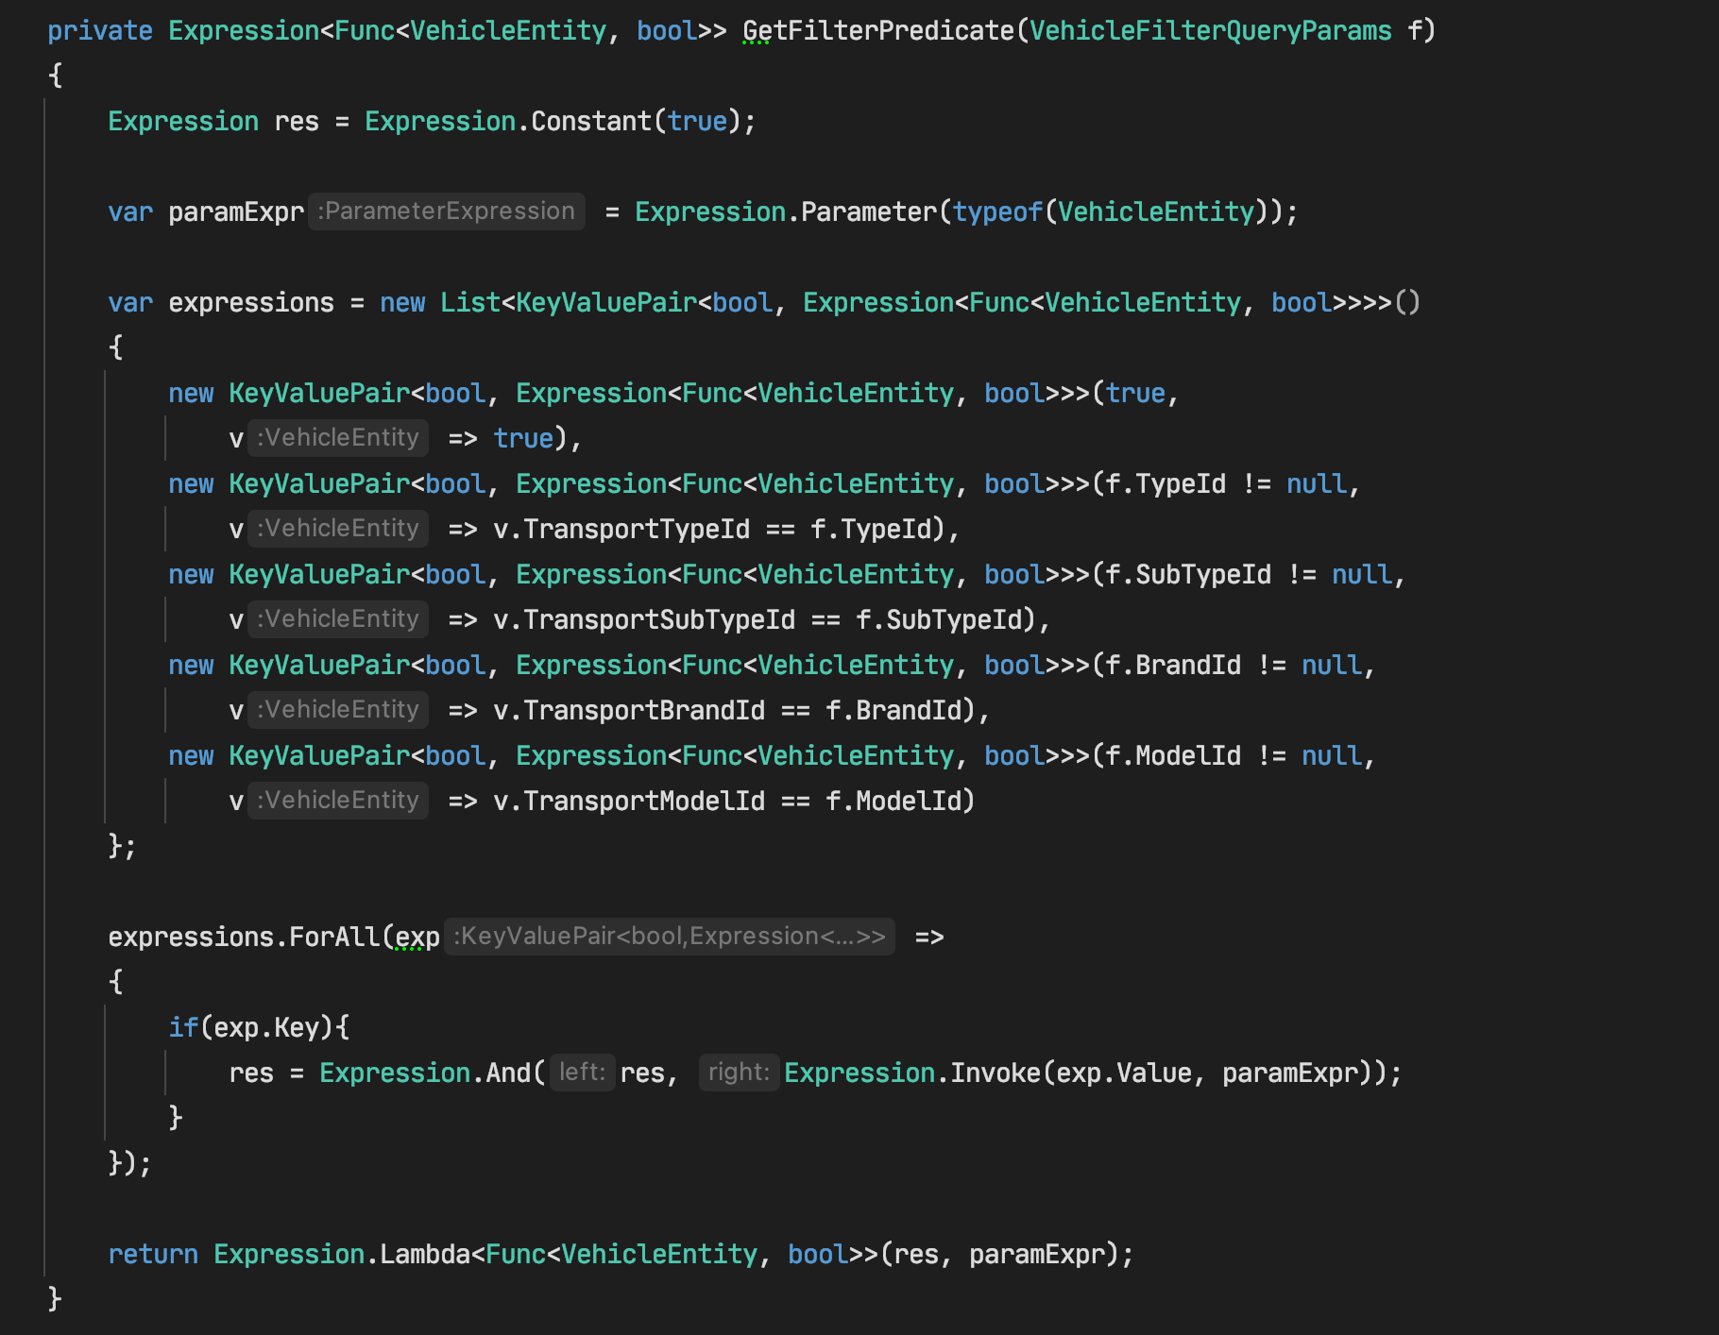
Filtering

Slide 6
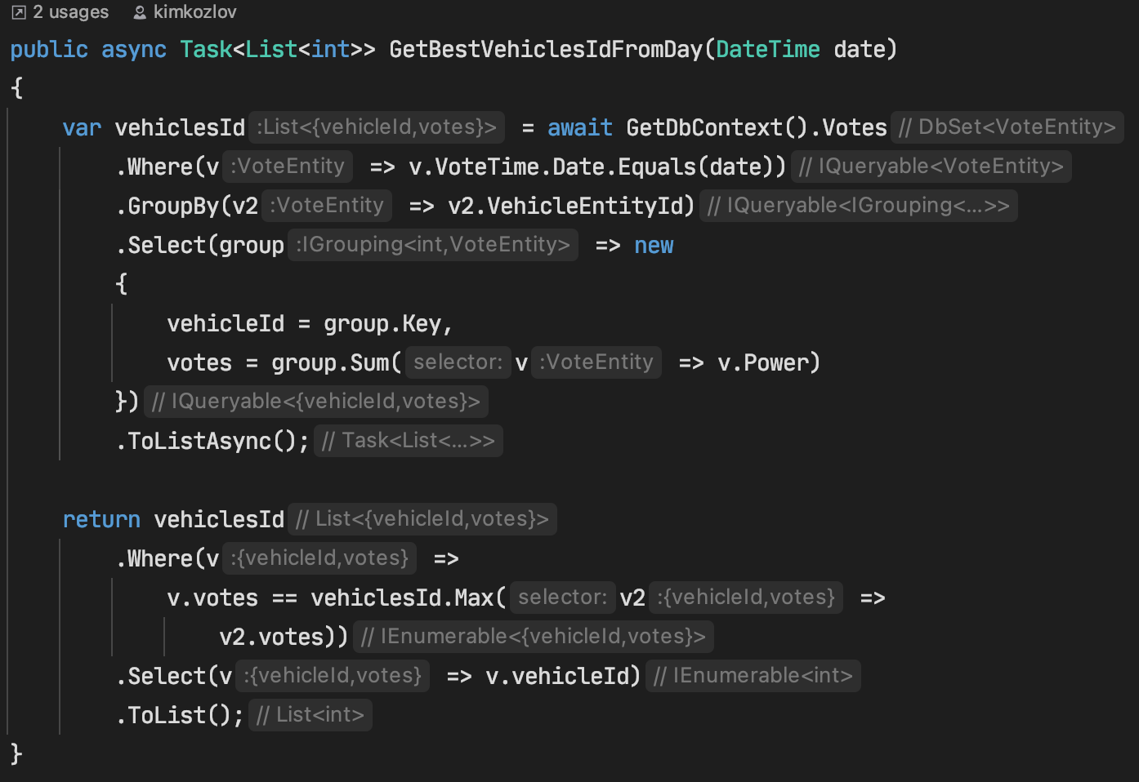
Best Vehicles Calculation
using database

Slide 7
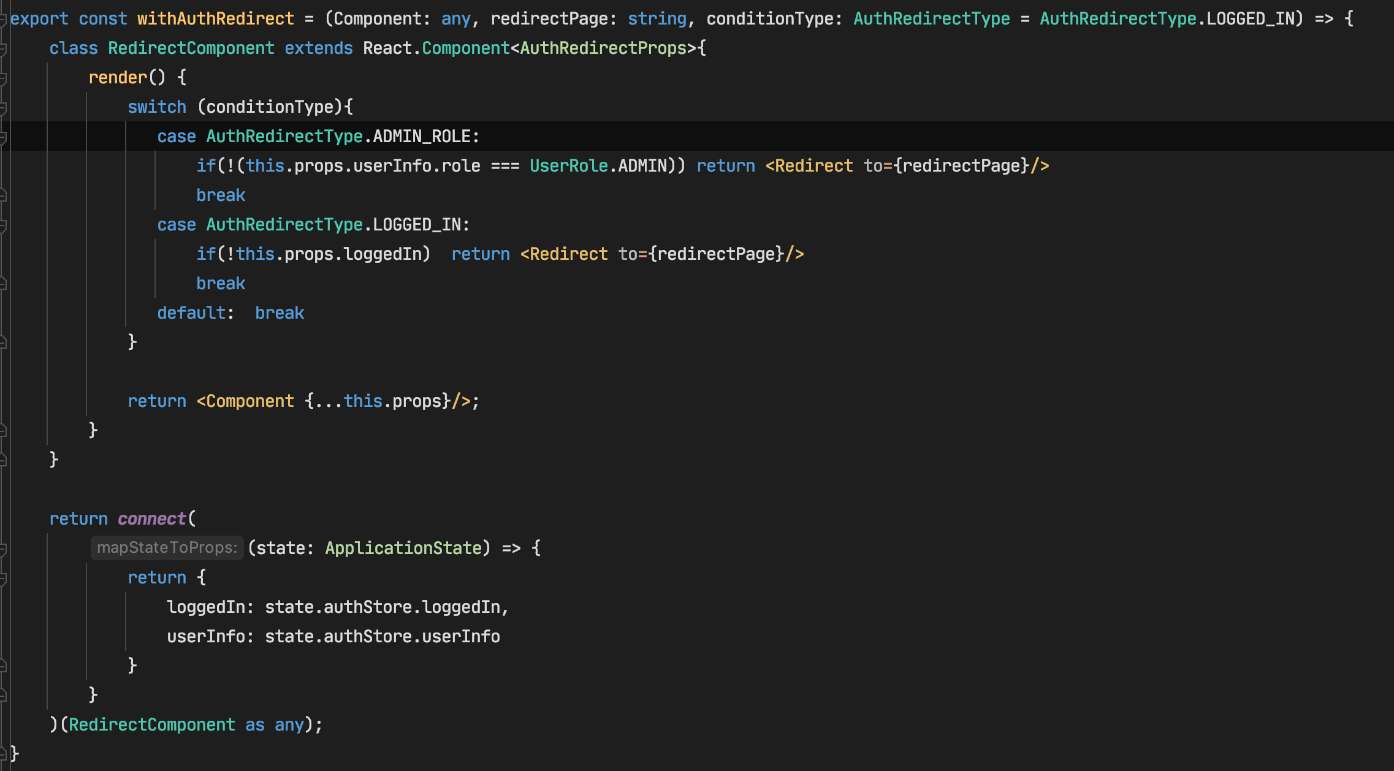
HOC
auth and role checking

Slide 8
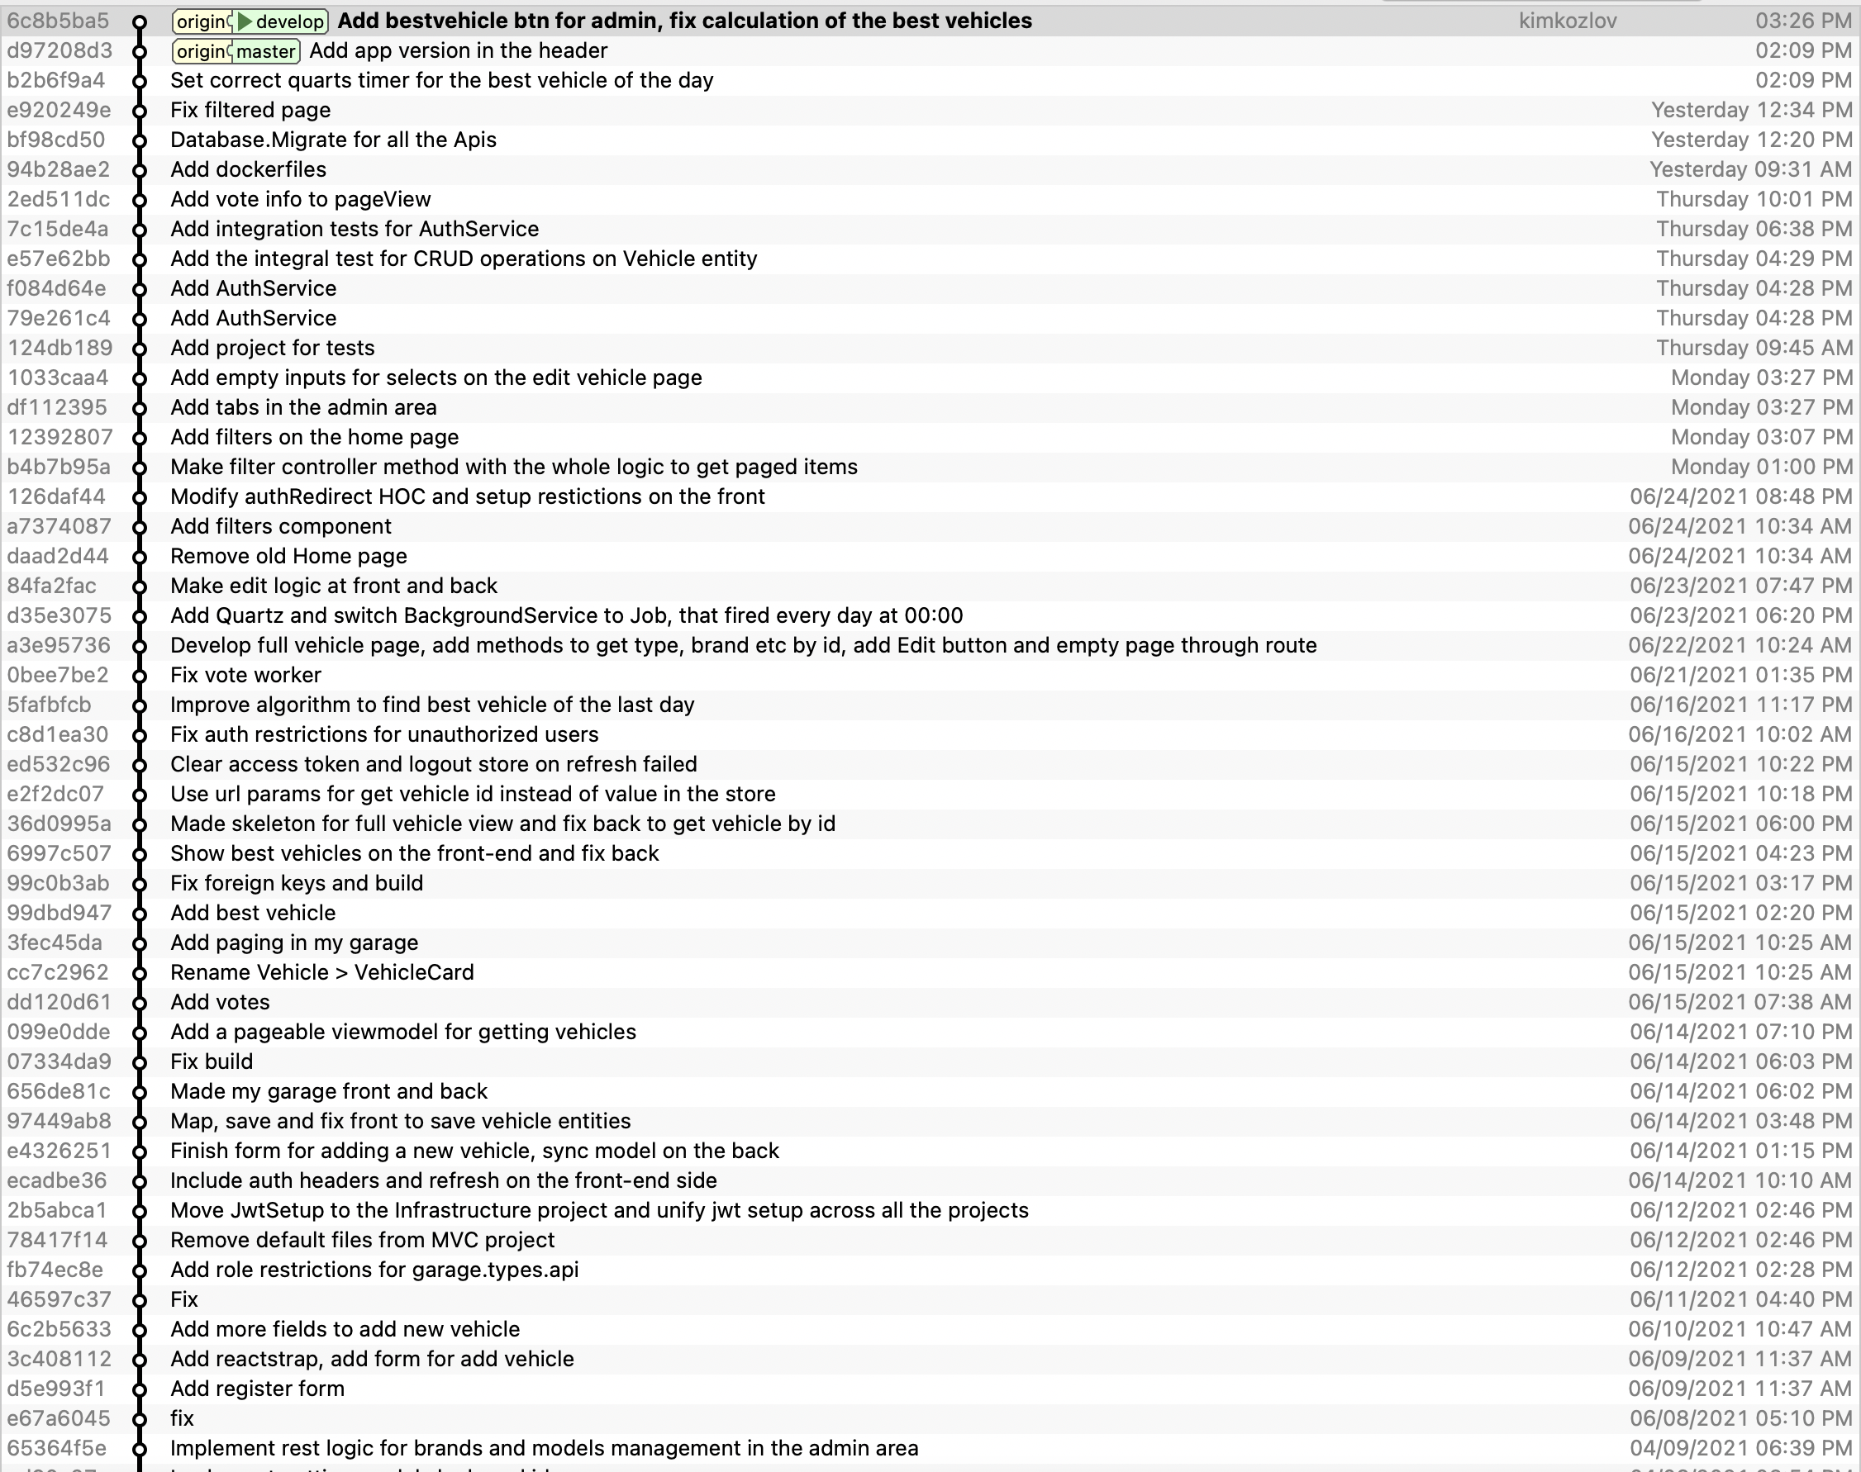
GIT history

Slide 9
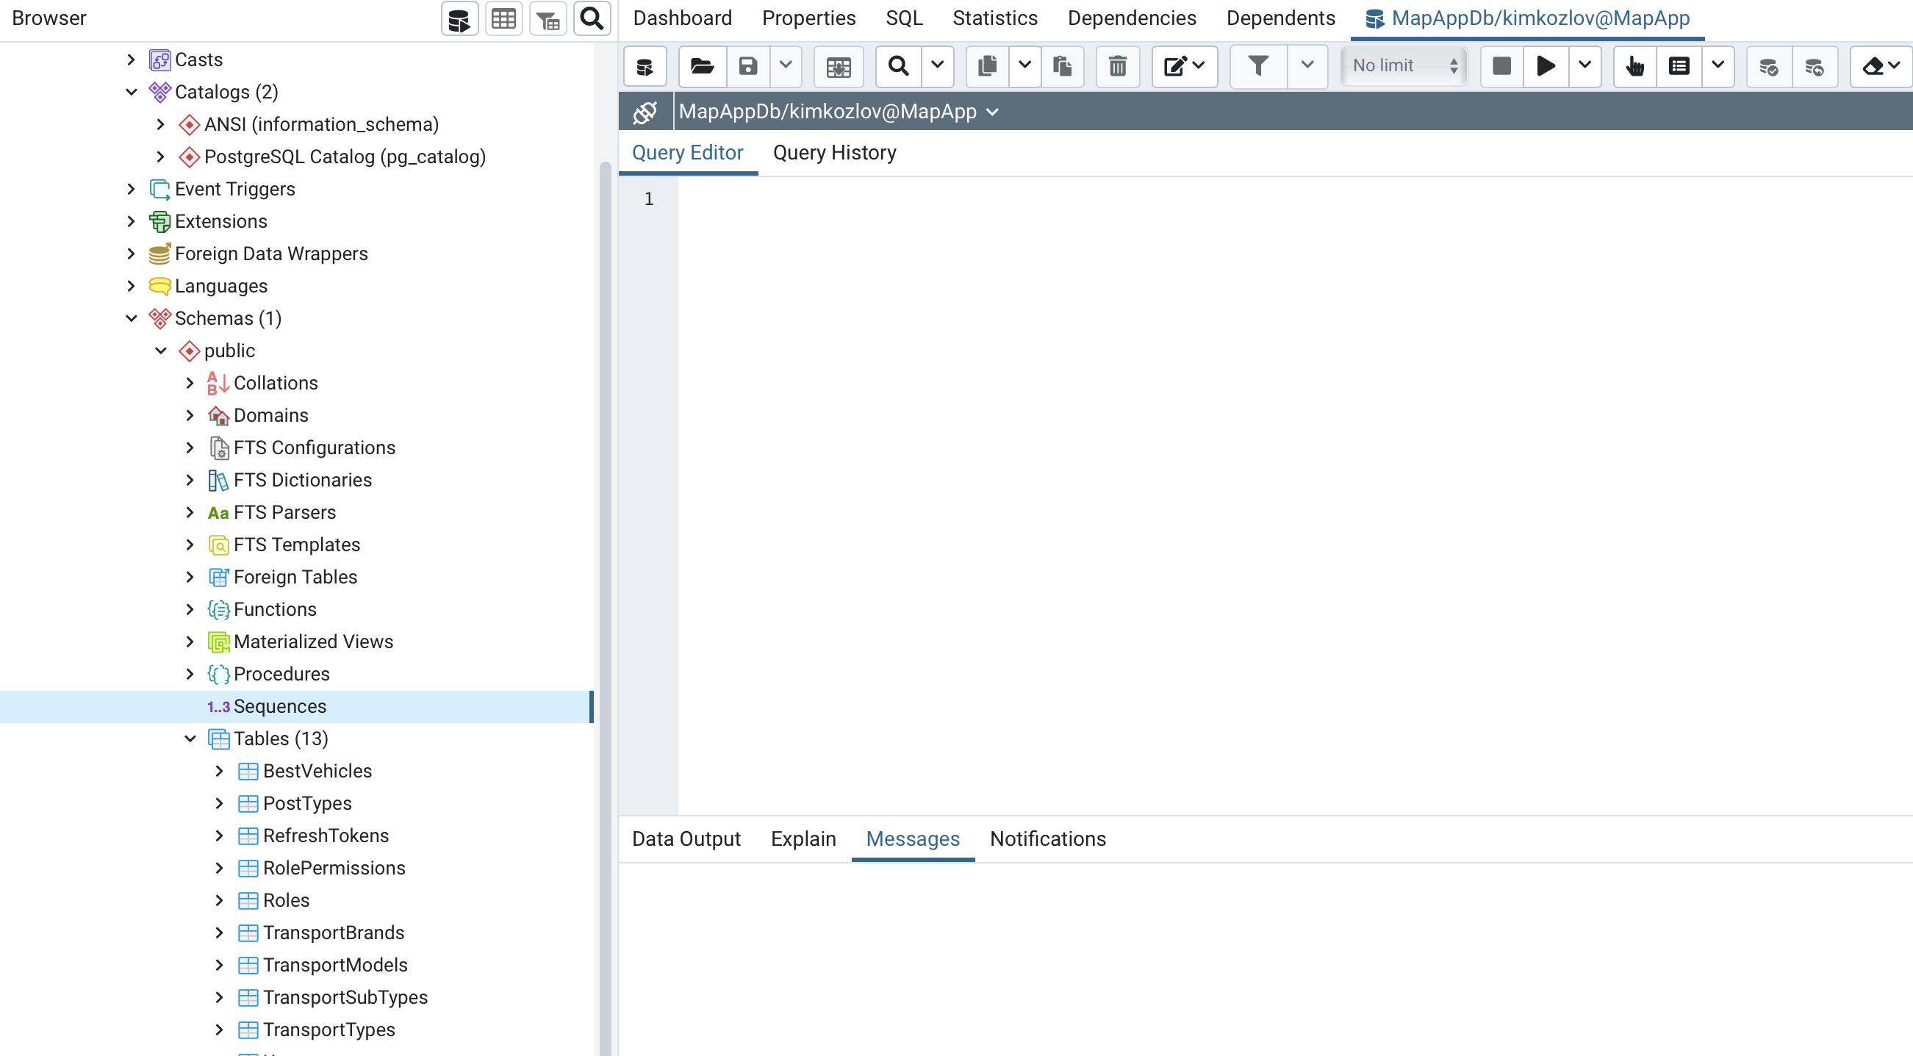
The most strange bug
PostgresSQL error: More than one owned sequence found!

