Slide 1
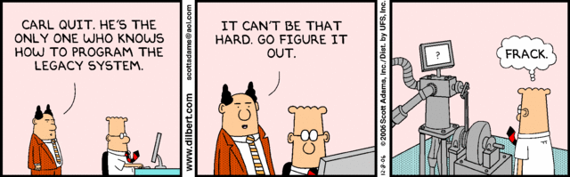
Working with legacy Code
How to maintain legacy code bases and mastering them
2023-05-04 Kim Kulling

Slide 2
Agenda
Introduction : What is legacy code?
Methods to deal with legacy code
A real-life example
Some common problems
Dependency breaking techniques
Conclusion
Q&A and discussion

Slide 3
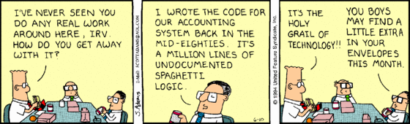
1. Introduction
Notes:
Wer kennt das nicht?

Slide 4
Where is the Problem?
Every line of code you wrote in your life needs to be maintained by someone
A lot of people had written lots of code before you even started reading picture books
A lot of this code is still alive ( at Draeger, too )
There are no automatic tests for this code
You have to work with this code each day
We are still generating code like this
All bad? Ask yourself: How often have you wrote a test suite for a „temporary tool“ like a small script:
  The bad example: The Eeprom-Migrator for the V500 family
We call this Legacy Code

Slide 5
What are typical signs for unmaintable legacy code
No useful documentation is available
There are no automatic tests
You / no one else in the company has any system knowledge
The system is really really big
The system looks like spaghetti
You need too much time to change something
No one wants to change a piece of code anywhere in the system
The number of WTF‘s ( what the fuck‘s ) per class is really really high
You get scared when you have to fix a bug in this mess!

Slide 6
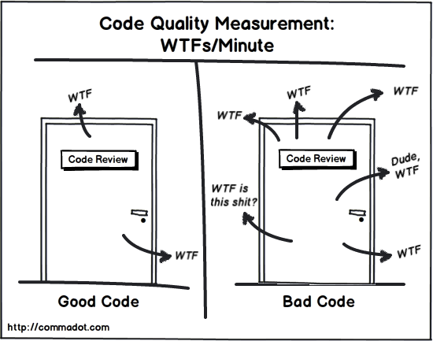
In Short
Bad code? Welcome to hell!

Slide 7
Refactoring: a possible solution?
What do we know?
  We have to work against this trend, sometimes!
Refactoring could be the solution…
… And I will start next week!
…Maybe next month!

Slide 8
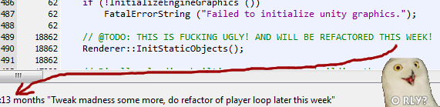
One year later…

Slide 9
Because in reality it is not that simple!
Refactoring should not change existing behaviour!
  But I don‘t even have a clue what the code is doing?
  I don‘t know where to start?
  There are many unknown side effects?
Refactoring should not start without unit tests!
  But there are no unit tests anywhere?
  Even I cannot write a unit test …
    What for ?
    And how?
  If I want to write a unit test I have to redesign first!
    Welcome to hell!

Slide 10
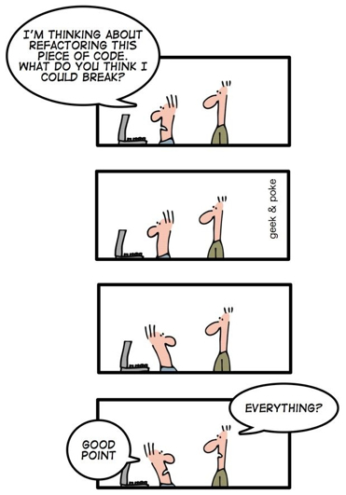
Lets say it in a different way!

Slide 11
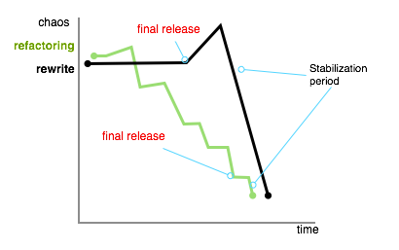
2. Methods to deal with legacy code

Slide 12
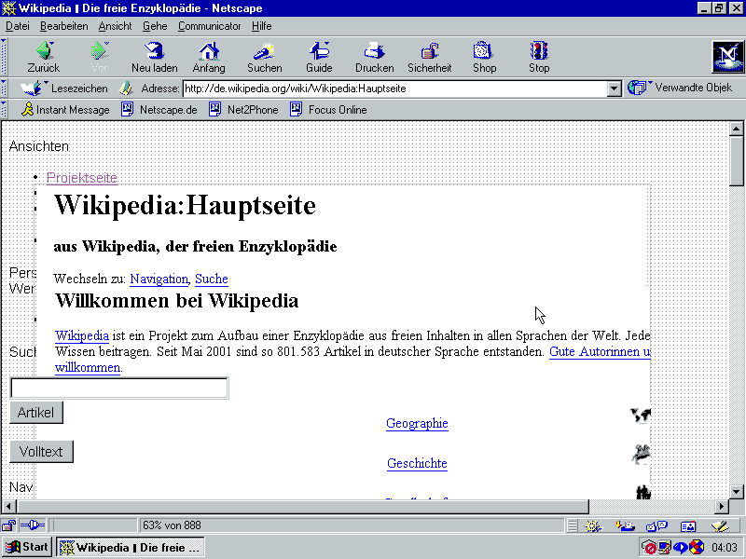
Restart from scratch: a complete rewrite
Often legacy code bases are „stable“
Legacy code contains a lot of bugfixes and workarounds to solve customer issues
If you have to restart from scratch all this will be thrown away
You still have to maintain the old code-base while rewriting a new one
You don‘t even know what kind of features are implemented in the legacy system
Be sure: The customer knows them all!
Welcome to hell … again!
Netscape tried this before, does anyone still knows Netscape?

Slide 13
How to start refactoring in a legacy system?
Do this only if you have to change something!
Use unit tests as a way of learning what the code does
Detect code smells whenever you‘re changing something:
  Look for long methods
  Look for long parameter lists
  Look for large classes
  Look for duplicate code all over the place
  Are there data clumps, complicated constructors?
  Do you have large dependencies per class ( visible / unvisible )
Use code metrics to detect complex methods and classes
Coverity/Lint a bit, whenever there are redundant warnings, it‘s a sign for redundant code

Slide 14
Use test driven design
Before writing code write a unit test against it
  Without any implementation it will fail
  A failed unit test is the best To-Do-list you can possibly have
  Now you can start to implement something
  You will try to write testable code, because you have to test it
Now implement your new behaviour
Use your test to verify the result
Now you will get some reply regarding the changes
Build a test for each defect you have to fix ( Defect driven design )

Slide 15
Which refactoring methods exists?
Some typical refactoring methods are:
Rename variable
Rename method
Extract method
Extract interface
Extract class
You can find a lot more in the book „Refactoring“ from Martin Fowler

Slide 16
But how can this help?
Writing the first test for a bugfix is a good start for new tests
If you do this all the time you will get tests for subsystems all over your legacy system
After a while you will get more and more tests
The refactoring will effect the code quality
Be aware: this will take time

Slide 17
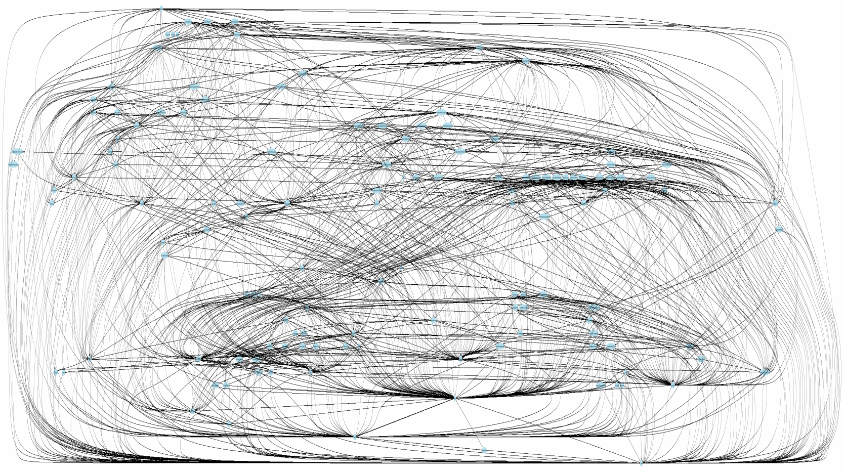
3. A real life example

Slide 18
So lets start: I have to change something here!
Start with a „small“ real-life example
This will show us some issues you have to deal with
Identify methods how to solve this issues

Slide 19
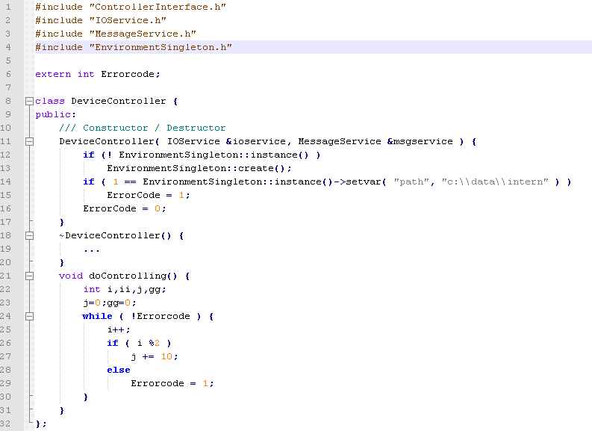
Let‘s start: I have to change something here!

Slide 20
And now???
  What can we do?
  Add the new functionality into a new method and call it ( spround method )
  Add the new functionality into a new class ( sproud class )
  Wrap the functions in a wrapper method ( wrapper method )
  Wrap the methods in a wrapper class ( wrapper class )

Slide 21
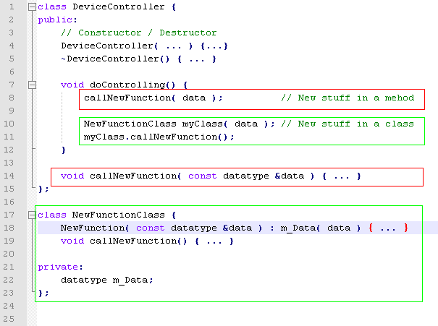
Let‘s see it in real

Slide 22
But wait!
Ok, but there are still no tests
  but now you only have one method / one class / one wrapper to test
  This is a good point to start with
Start with writing a test for the class:
  At first build a test suite and just try to create the class in the test
  Learn something about the required dependencies
  Try to fix the build until it works:
    What do we have do change?
    Where are dependencies I cannot cut?

Slide 23
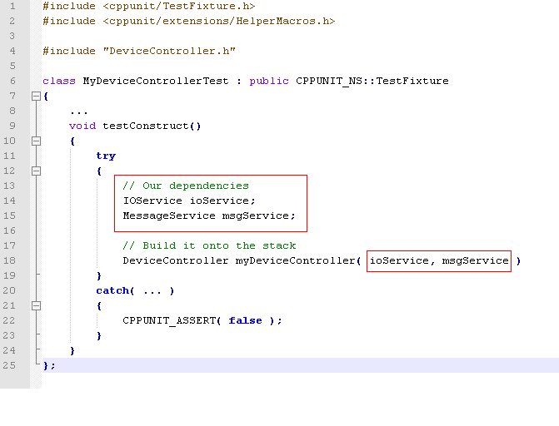
Lets look into it

Slide 24
But, wait! How should I start writing a test
There are 2 visible dependencies in the constructor of the class
Check if we do need a big environment to create instances of it
  IOService: A driver to access the IO-Layer, could be for some HW?
  MessageService: A working network stack, could be a server far far away?
Try to kill these dependencies:
  At first : Extract interfaces on IOService and MessageService

Slide 25
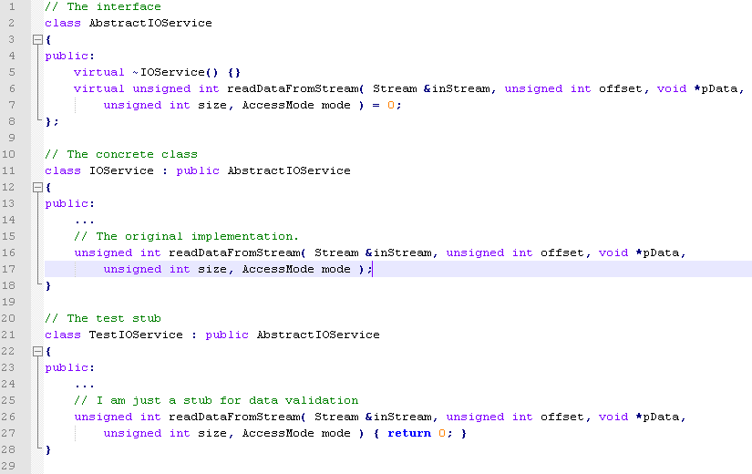
For instance: IOService

Slide 26
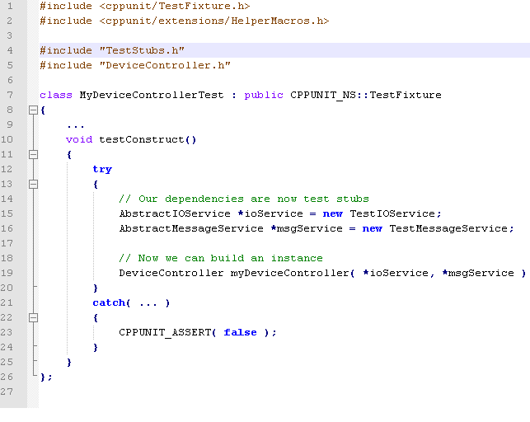
We can build the instance

Slide 27
What next? Use your debugger
We have eleminated the visible dependencies
But there are invisible dependencies and side effects
  A singleton will be created in testConstruct
  The environment will be modified
  A global error state will be modified
We do not know what they are doing
  But now we have a small application to learn it
  Attach a debugger and step into it
As there are caused by side effects, eleminate them!

Slide 28
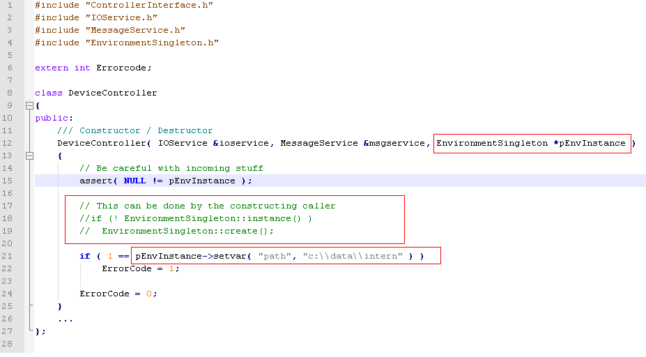
Singleton to parameters, an invisible dependency killer

Slide 29
But wait, their are side effects
We have side effects caused by the setvar call
  Proceed Extract Interface in the EnvironmentSingleton class
  Build a test stub
We have a global error code
  You can hide it behind an error handler for instance
  This error handler can encapsulate the global variable
  The error handler should offer a way to install your test stub

Slide 30
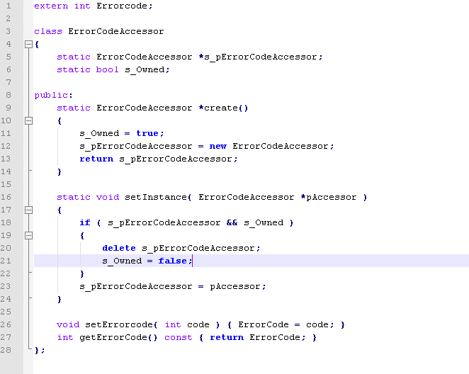
Speaking in code

Slide 31
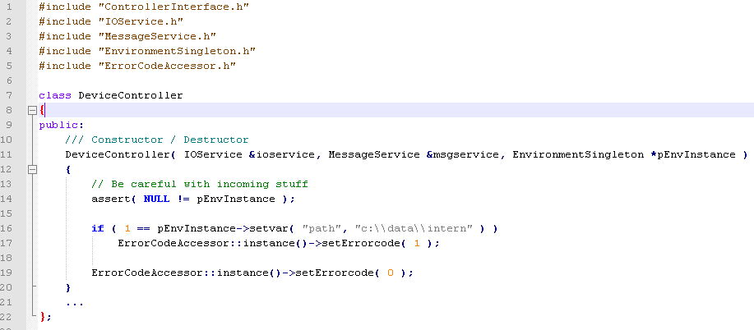
And now lets bring it all together

Slide 32
Possible improvements
You can install a test stub for the error code accessor
You can make the ErrorCodeAccessor to a parameter
Any other suggestions?

Slide 33
Lets finish our test
Now we know all dependencies of the DeviceController
  We can install our own test-stubs
  We can use them to learn how the stubs are working
  We have some test-stubs for other classes
We can write a test for our new method / class
We have a working test suite for this class
  The next developer, who has to change something, can use your test suite
  Your new feature will now be tested automatically
You will be able to repeat this for each change in the future

Slide 34
What else can we do
Rename variables to get a better understanding what the code does
Rename methods to make the interface of the class more readable
Rename the class itself
Separate the class responsibilities into some other classes
…

Slide 35
5. Some common problems
Let‘s have a look onto other typical issues with legacy code
Let‘s learn how you can deal with them

Slide 36
Handle code which you do not understand
One of the biggest problems with legacy code is not understanding the ideas behind it:
  You have to read the code over and over again
  Rename variable to make things clearer
  Add logging code to learn more about the several code paths
  Use unit tests to analyze the behaviour
  Read comments, but do not believe them
You can use effect sketching to get a model of the code
  Effect sketching is a technique to create a diagram which shows the interactions between an object and the the system
  The diagram shows the objects and attributes which are effected by your class / object / event / whatever

Slide 37
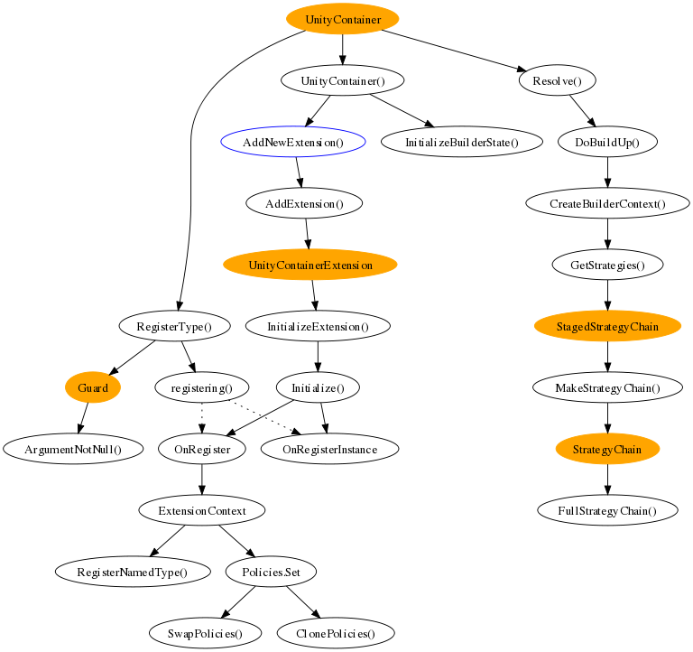
Effect scetching in action: Unity events

Slide 38
I have to work with really big classes
You have a really large clump of code in a class or a single method
You can refactor it
  Learn something about the single response principle
  What is the main responsibility of your class?
  Now group the methods of the class for similar method names
  Look for hidden methods, are there candidates for a separate class?
  What are the data relationships
  What are decision relationships
  All of this can give you a clue about hidden resposibilities of your class
  You can extract an interface for each repsonsibility
  Only do this until it still makes sense!

Slide 39
My Project is not object oriented
Your project is a procedual c-project
The problem:
  you cannot use any OOP-technoligies to cut dependencies
  So you cannot use mockup-classes for tests
Possible solutions
  If you have the chance hide you procedures behind an object-oriented interface
  If you cannot use any interfaces, you can write a wrapper, which will switch to a mockup by a global flag or a define
  Use function pointers instead

Slide 40
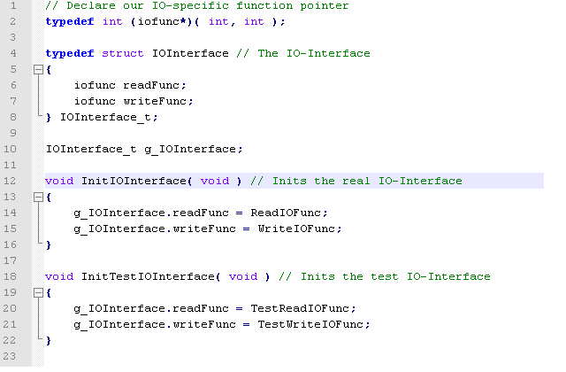
A simple c-interface using function pointers

Slide 41
My Project has a lot of API calls all over the place
The problem:
  You have API-calls like the Win32-API everywhere in your code
  If you have to change the technology, this will affect all of it
The solution
  Identify the usage / protocoll of the API-calls
  Define an interface for this usage / protocoll
  Implement the interface for you special API
  Refactor your project step by step
Now you can offer a different technology just by implementing the interface for your new technology

Slide 42
Dependency breaking techniques
Now let‘s have a look into some very useful techniques to break dependencies:
This can affect your code in various ways:
For optimizing the build time
To make classes more orthogonal
To have common concept-tools, not a very expensive tool like the Apple Imbus
To be able to reuse code, because every dependecy is a specialization
For being able to bring our classes into test

Slide 43
Adapt parameter
The problem:
  A constructor takes a concrete class as a parameter
  This will link the class with a concrete implementation, which cannot be changed ( for a test, for a different behaviour etc. )
The solution:
  Extract the interface from the parameter
  Give the constructor the interface instead
  Now you can use a mock-class for a test

Slide 44
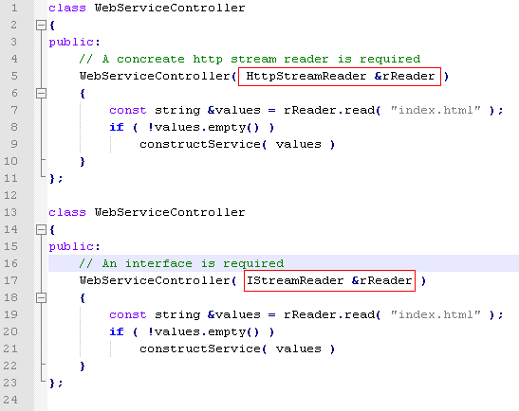
An example

Slide 45
Break out method object
The problem:
  You have identified a long method, which is hard to test
  The method is using a lot of parameters, which are hard to create
The solution:
  Break the method into a single class or an interface
  Move the temporary parameters to attributes of the class
  Give the attributes the constructor of a new class
  Now you have a much easier class to test
  You can easily create test classes without complicated parameters

Slide 46
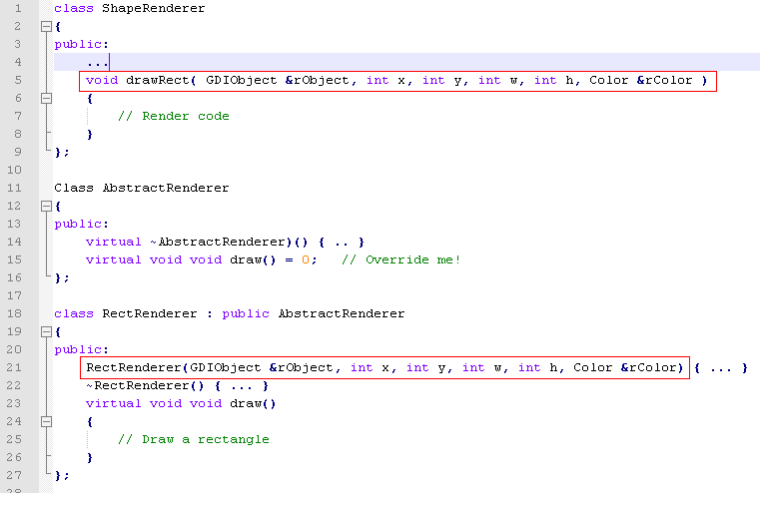
An example

Slide 47
Encapsulate Global References
The problem:
  Globals make code hard to maintenance
  Globals make it hard to create orthogonal code, because you cannot control the access to it
The solution
  Build a class to encapsulate the globals
  Declare a global instance
  Comment the globals
  Use the compiler to find all references of the global variable

Slide 48
Expose static method
The problem
  You have problems to bring a class into a test harmness
The solution
  You can identify a method, which is not using the attributes of the class
  Make this method static
  Change the access all over the code
  Use the compiler to find all references and fix them

Slide 49
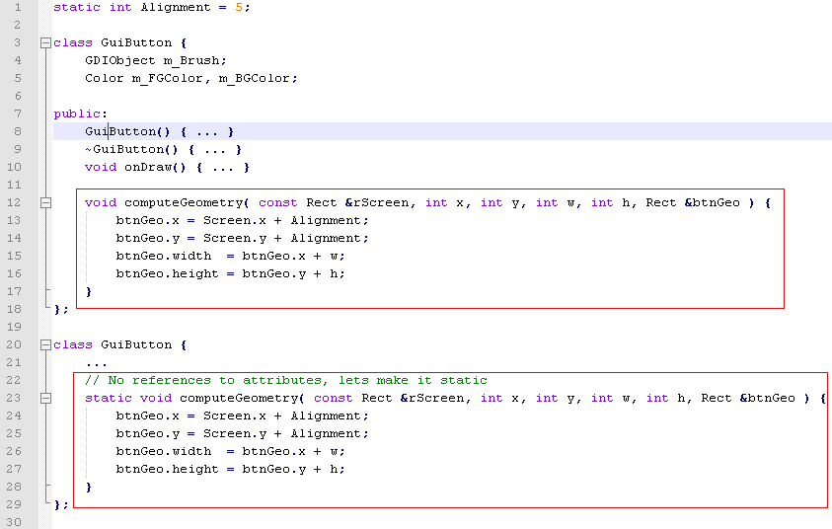
An example

Slide 50
Extract and override factory method
The problem:
  You have a really complicated creation of an object in a constructor
  This is hard to test, especially in a test harmness
The solution:
  Identify the object creation in you code
  Extract it into a factory method / factory class
  Create a test stub-class and overwrite the creation method

Slide 51
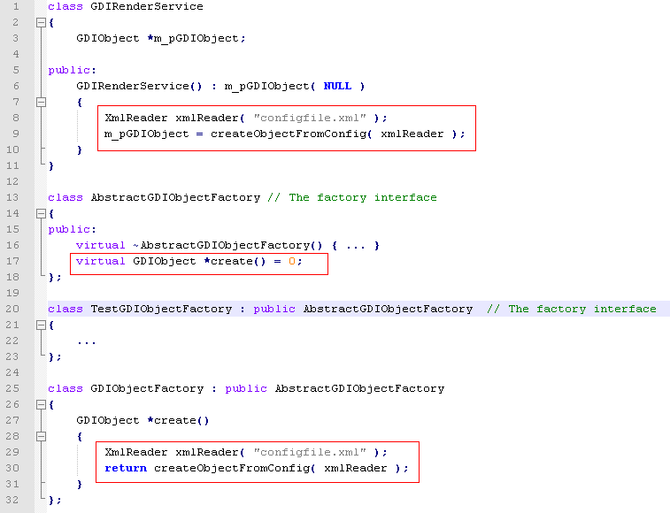
An example

Slide 52
Conclusion – What have we learned?
In your life as a developer you‘ll have to deal with legacy code
Your code will be legacy in the future as well
A rewrite is another issue, not the solution to the problem
You can refactor, redesign and test your code step by step
This is a process you‘ll have to do everytime you are changing something
There a techniques to understand code more easily
There are methods to break dependencies and they will help you

Slide 53
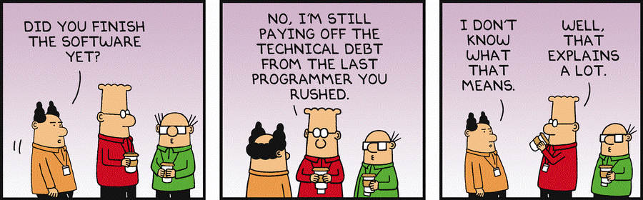
Conclusion - Next steps?
Track your Technical Debt‘s
Cleaning the dishes is part of a Waitress job
Cleaning up the code base is part of your job
Add this effort to your estimations!

Slide 54
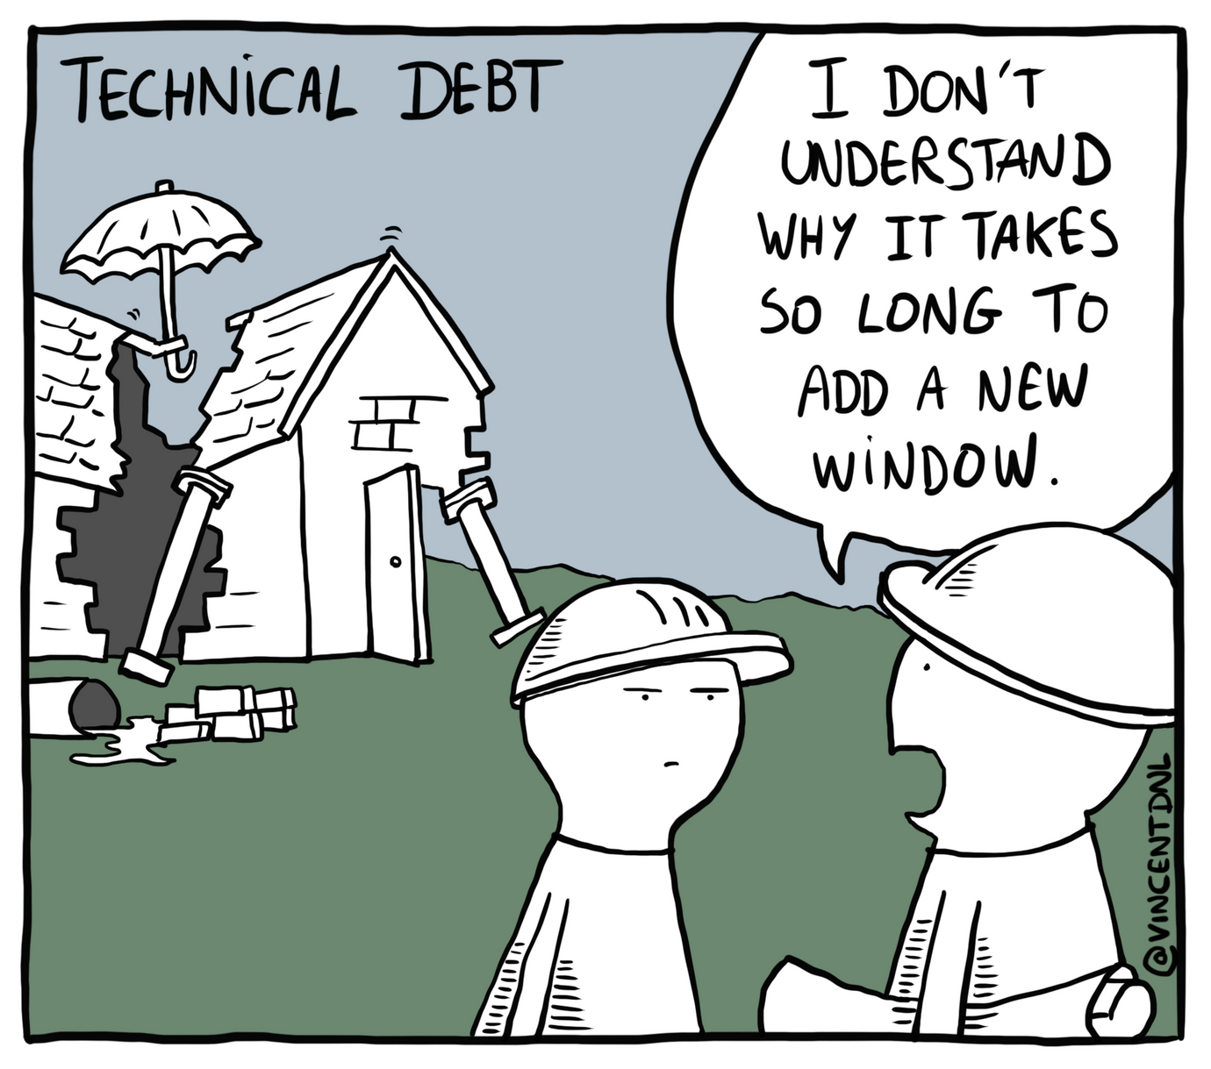
Q&A?

