Slide 1

Predicting likelihood of getting crowd funded
Kim Le
Predicting Crowd Funding, March 2018
General Assembly Data Science Part Time Course

Slide 2
Agenda
Intro
Exploratory Data Analysis
Modeling Process
Modeling Results
Conclusions/Further Work

Slide 3
Objective
Predict the likelihood of indiegogo project submissions getting crowd funded

Slide 4
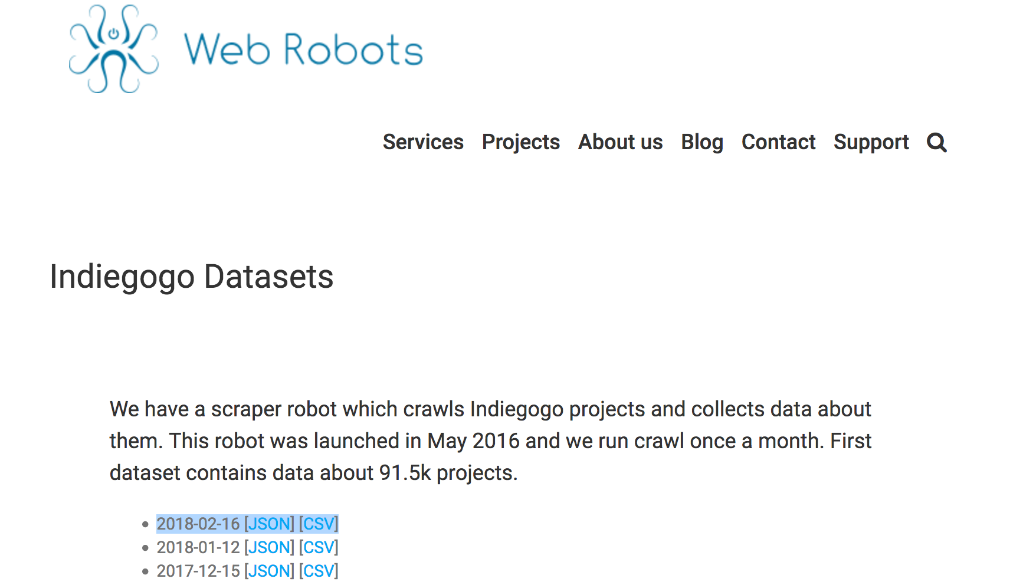
Scraper robot collects Indiegogo project data
“A scraper robot which crawls Indiegogo projects and collects data about them. This robot was launched in May 2016 and we run crawl once a month.”
2018-02-16 [JSON] [CSV]
https://webrobots.io/indiegogo-dataset/

