Slide 1

Predicting likelihood of getting crowd funded
Kim Le
Predicting Crowd Funding, March 2018
General Assembly Data Science Part Time Course

Slide 2
Agenda
Intro
Exploratory Data Analysis
Modeling Process
Modeling Results
Conclusions/Further Work

Slide 3
Objective
Predict the likelihood of indiegogo project submissions getting crowd funded

Slide 4
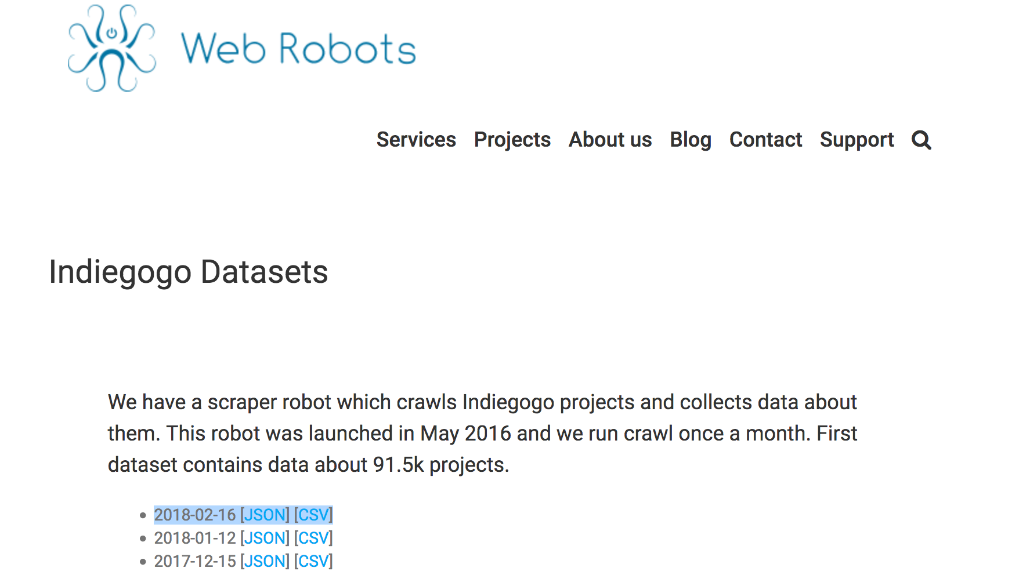
Scraper robot collects Indiegogo project data
“A scraper robot which crawls Indiegogo projects and collects data about them. This robot was launched in May 2016 and we run crawl once a month.”
2018-02-16 [JSON] [CSV]
https://webrobots.io/indiegogo-dataset/

Slide 5
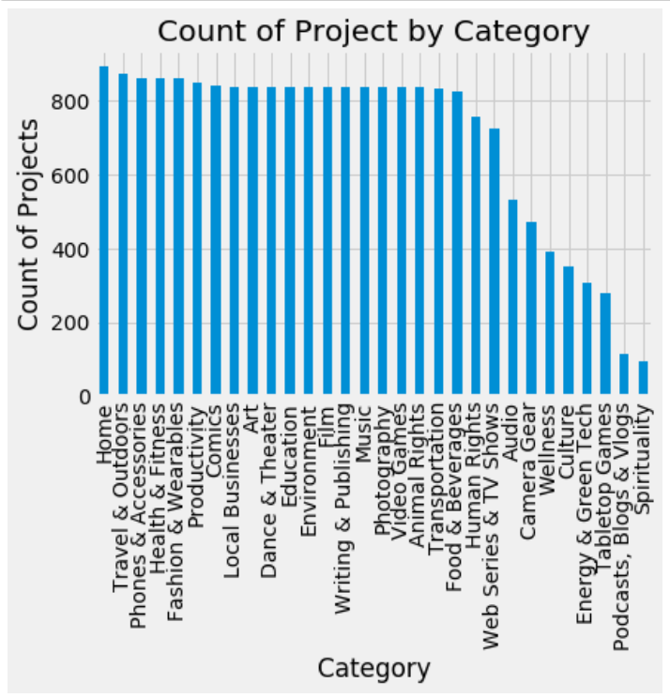
Distribution of Project Ideas Submitted by Categories

Slide 6
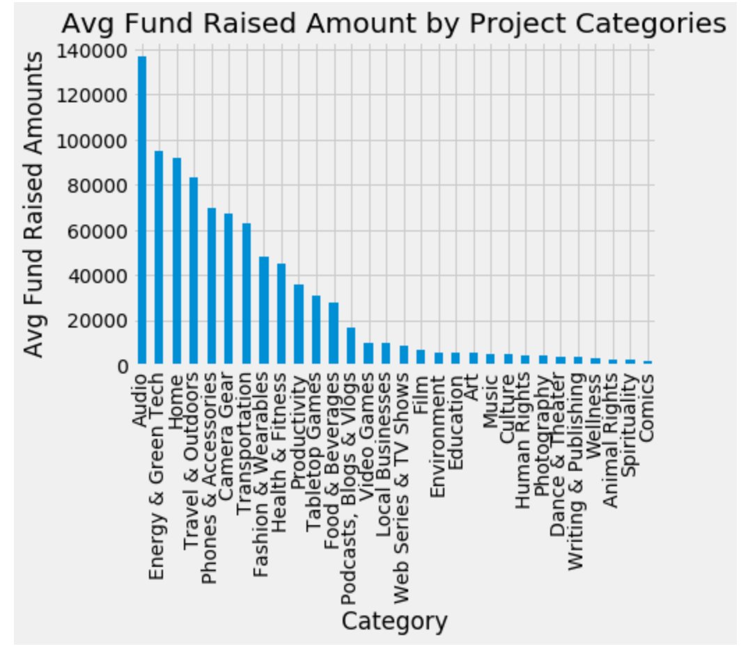
Avg Fund Raised by Category

Slide 7
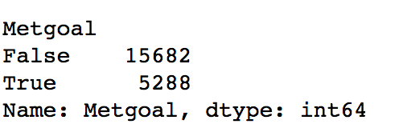
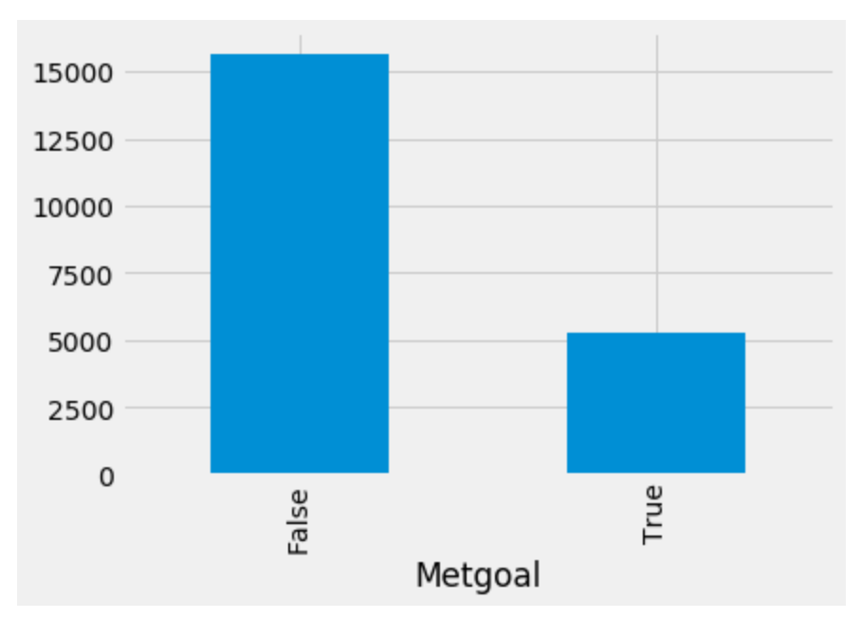
25% met funded project goals by more than 100% >
Of 20,970 projects, 5,288 met it’s funded % amounts greater than > 100%

Slide 8
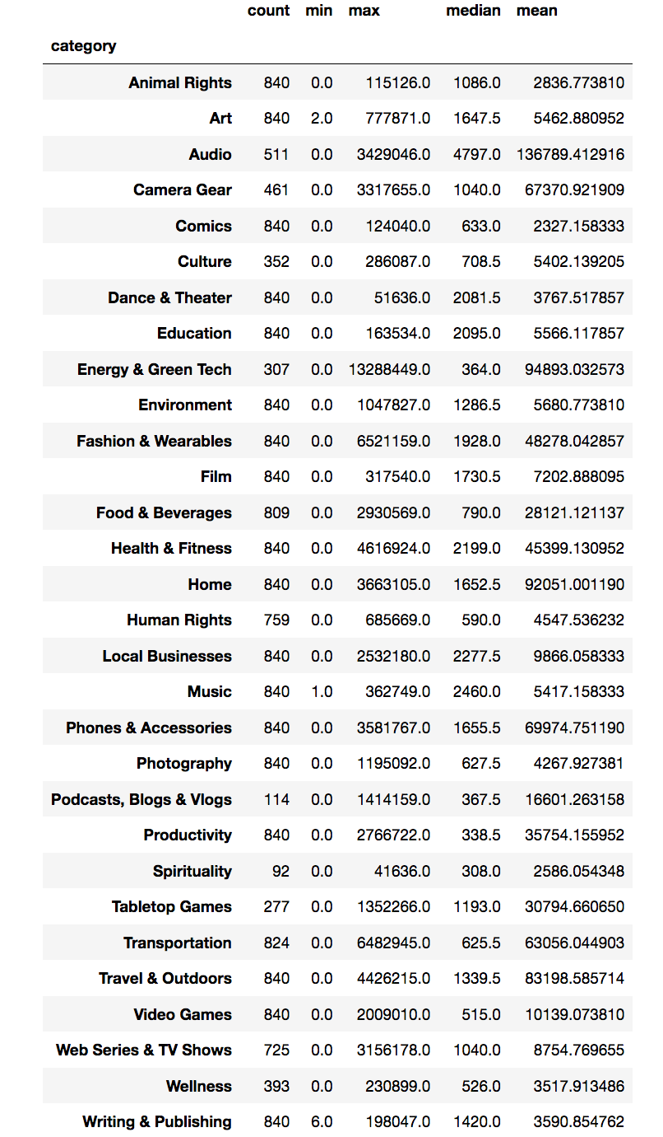
EDA Count / Min/Max/Median/Mean by Category

Slide 9
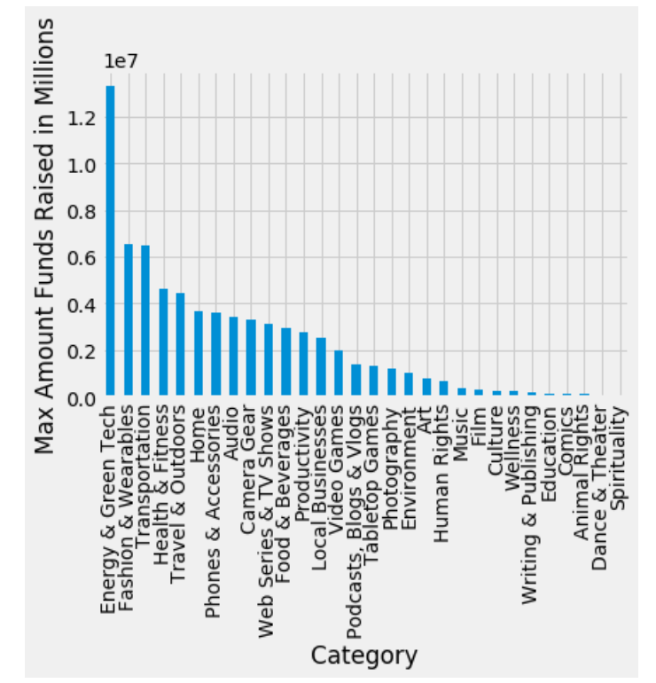
Max funded project 13.29M

Slide 10
Max funded project 13.29M

Slide 11
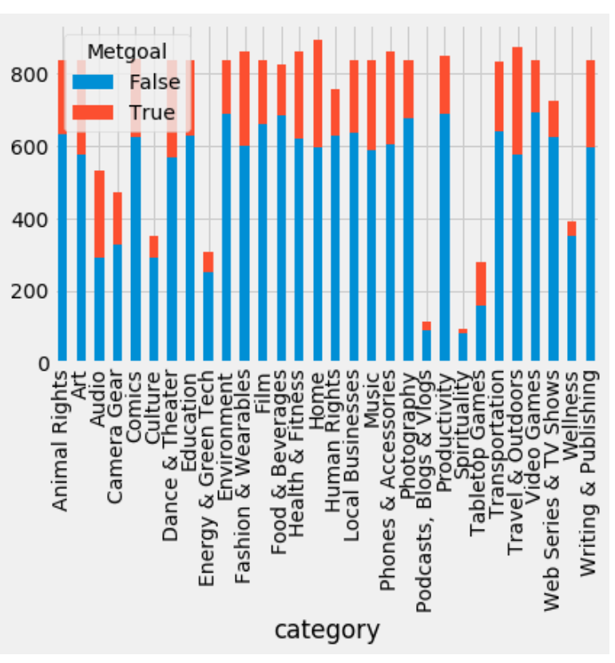
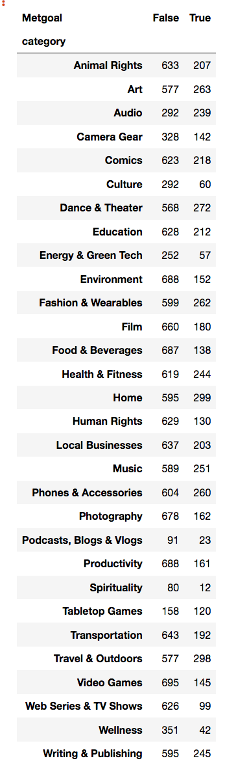
Met funded percent > 100% or Not

Slide 12
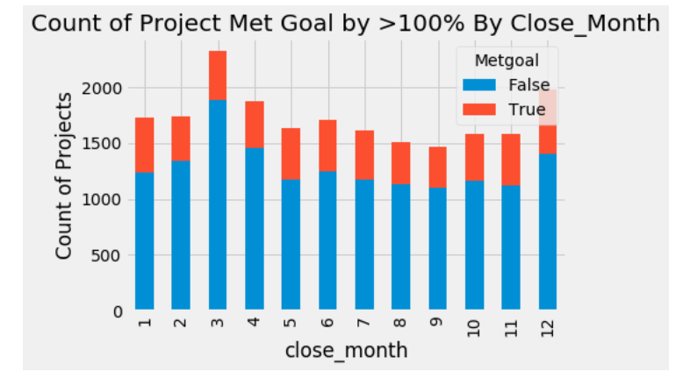
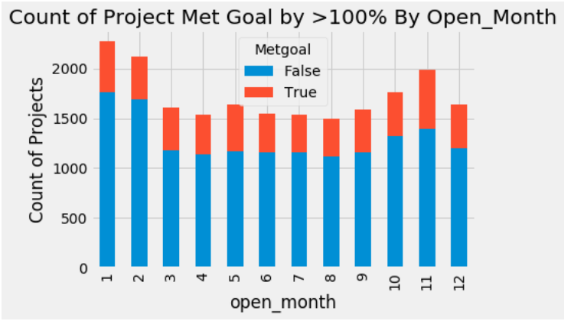

Slide 13
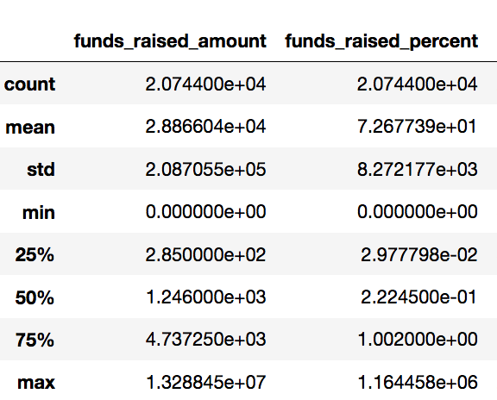
Describe

Slide 14
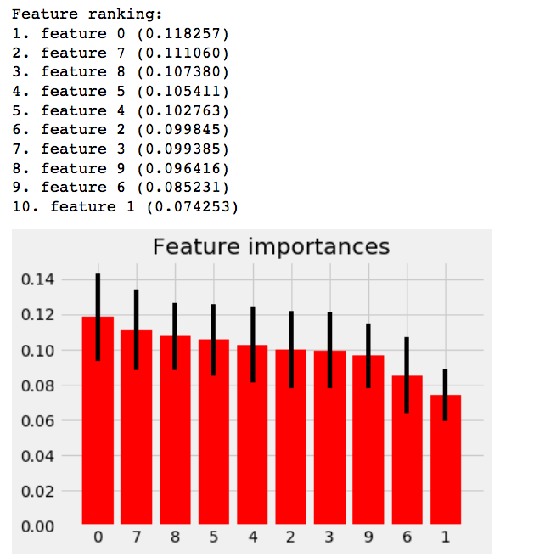
Feature importance

Slide 15
Classification funds met vs not met
Train test split cross validation – “metgoal” true/false.
*Knearsneighbors – what’s the optimal neighbors
Grid search – a way of searching parameters in change the parameters / models around
* regression – try predicting on the percentage funded because it’s continuous
*random forests
Convert date time function pd.datetime('close_date')& “open_date” to see what time of day does it affect predictions.
Parameters – dates, category, amounts & %
Running the models through a grid search.

Slide 16
Assumptions
Assumptions - Amounts funded currency (US & CAN) are similar in value

