Slide 1

Predicting likelihood of getting crowd funded
Kim Le
Predicting Crowd Funding, March 2018
General Assembly Data Science Part Time Course

Slide 2
Objective
Predict the likelihood of indiegogo project submissions getting crowd funded & to capture the important feature sets

Slide 3
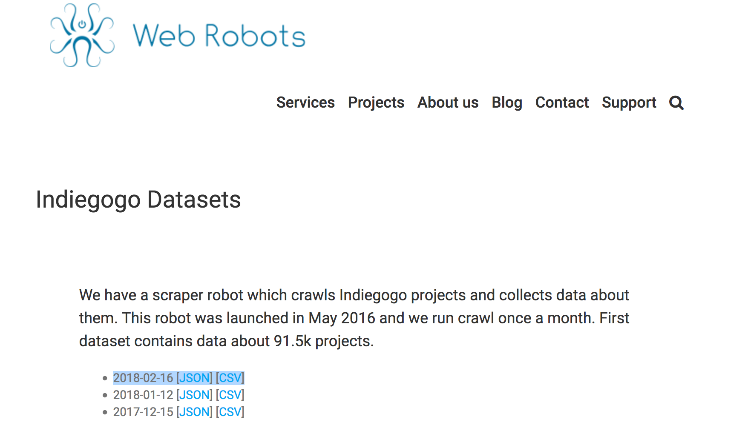
Scraper robot collects Indiegogo project data
“A scraper robot which crawls Indiegogo projects and collects data about them. This robot was launched in May 2016 and we run crawl once a month.”
Facts:
Original dataset size (20970, 22)
Total : 20,970 project/product submissions
Time Period: data since 2010 – current year
2018-02-16 [JSON] [CSV]
https://webrobots.io/indiegogo-dataset/

Slide 4
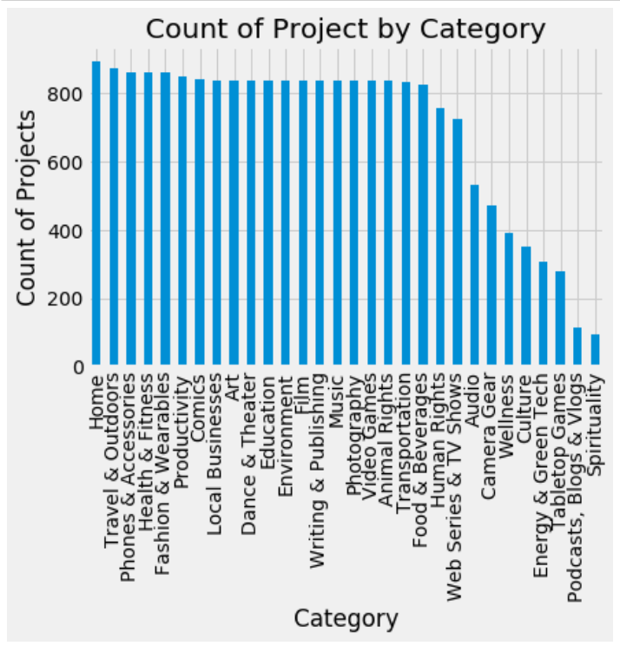
Home Category ranked highest in project / product submissions

Slide 5
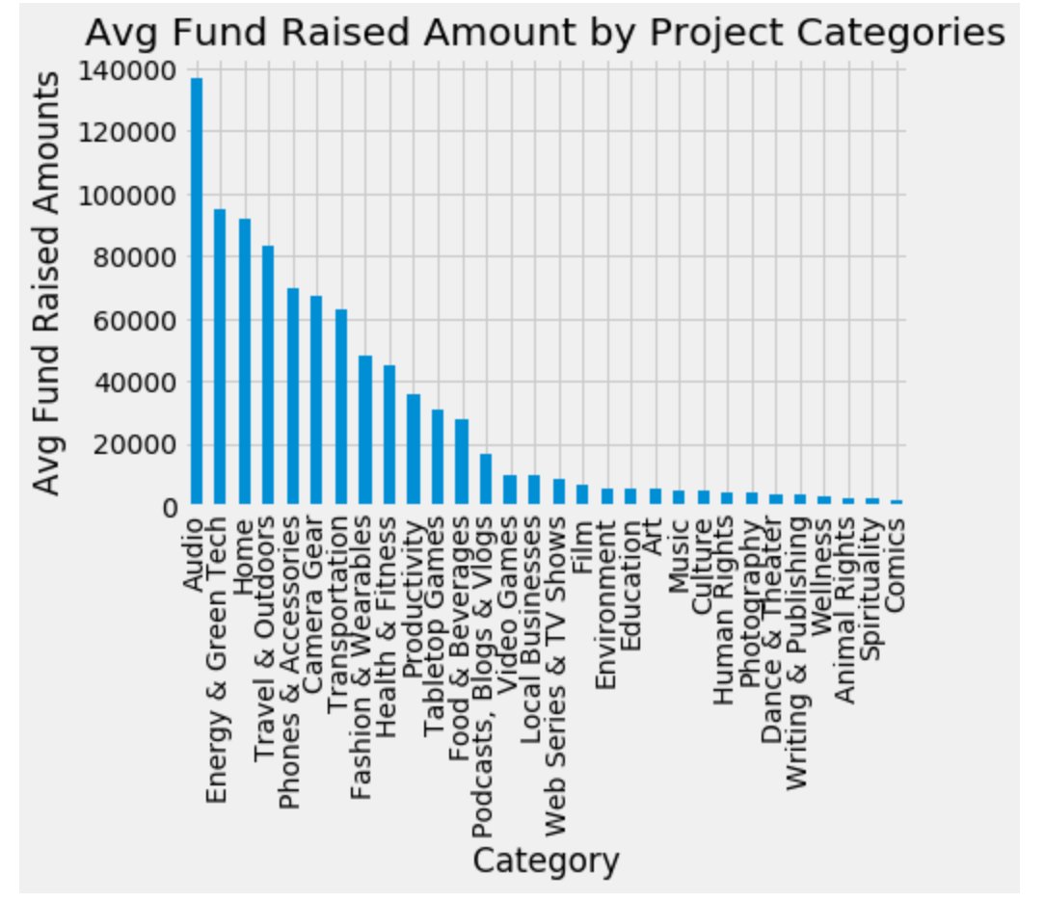
On avg, Audio Category ranked highest avg 140K

Slide 6
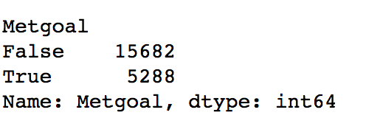
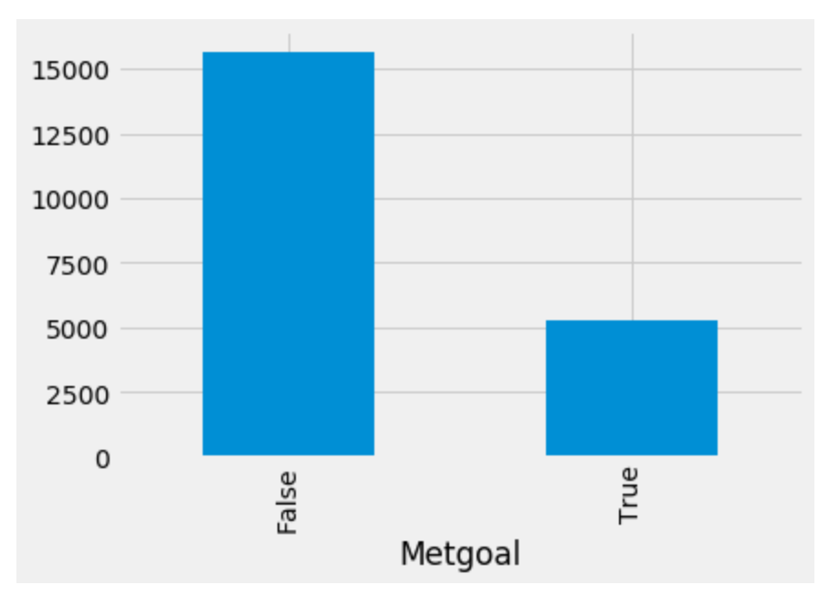
25% met funded project goals by more than 100%
Of 20,970 projects, 5,288 met it’s funded % amounts greater than > 100%

Slide 7
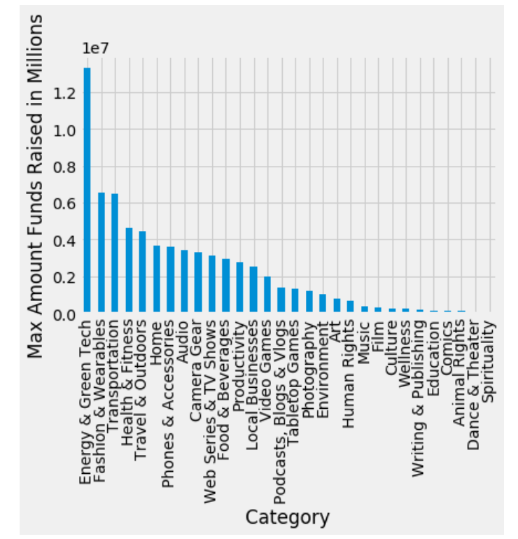
Max funded project 13.29M in Energy / Green Tech

Slide 8
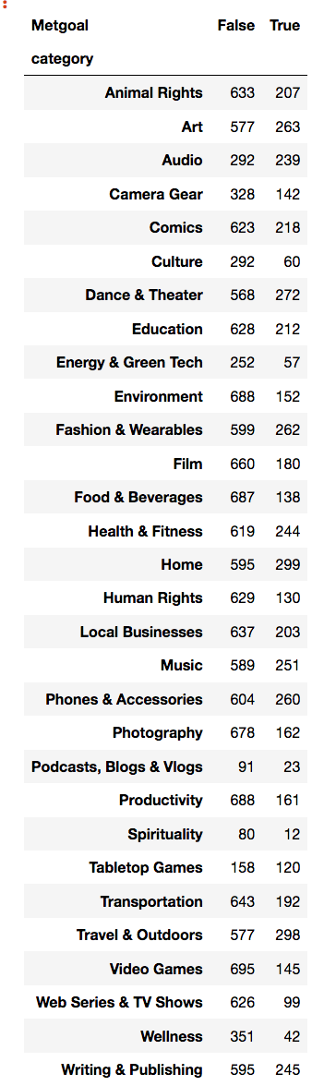
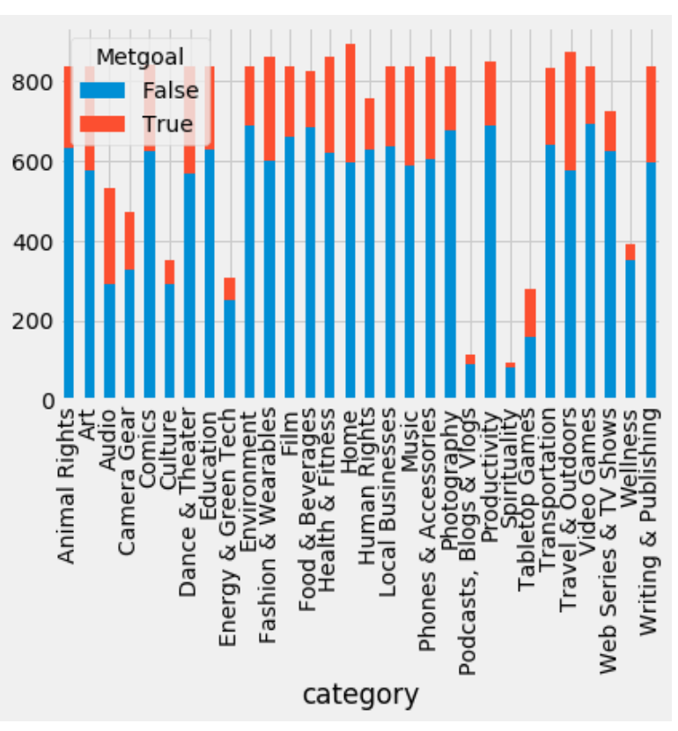
Top 2 categories met it’s goal: 1st place: Home & 2nd place: Travel Outdoors

Slide 9
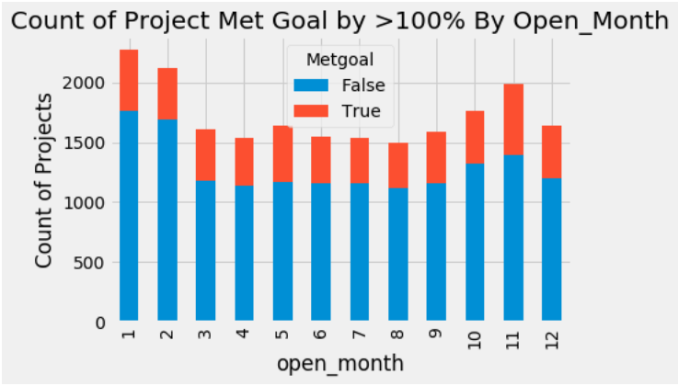
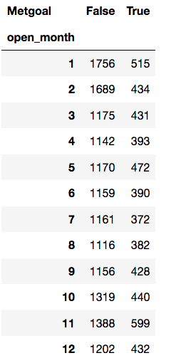
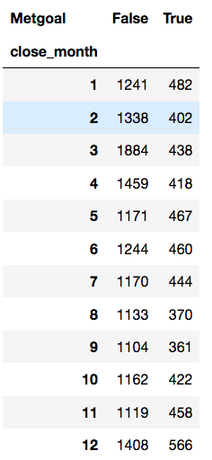
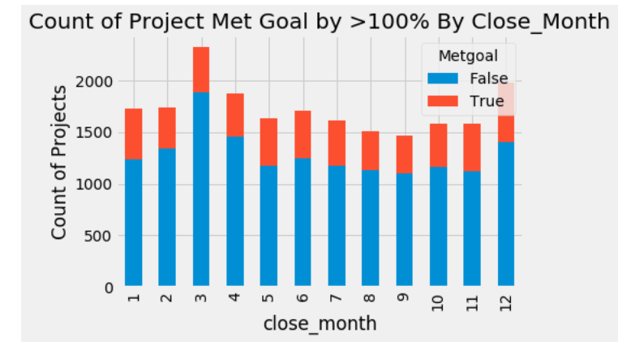
Open Best: Nov/Jan & Worst: Jun/Jul/ Aug Close Best: Dec/Jan & Worst: Sept/Aug

Slide 10
Process
drop 6 columns 'bullet_point','category_url', 'clickthrough_url','image_url', 'project_id', 'source_url’
Drop DateTime Nulls & convert datatype into Date & into Year & Months
Create Y Output Variable for Metgoal = Fund_Amount_Percent > 100% (True/False)
Create Dummy Variables (Category, Open_Month, Close_Month)
Used LabelEncoder to convert objects into Int/Floats
Tested 3 models (KNN, Logistic Regression, Decision Tree Classifer Model.feature_importances_ )

Slide 11
# of projects & variables included in dataset
Original dataset (20970, 22)
Drop columns/rows with Null (20927, 17)
After additional transformation (20721, 89)

Slide 12
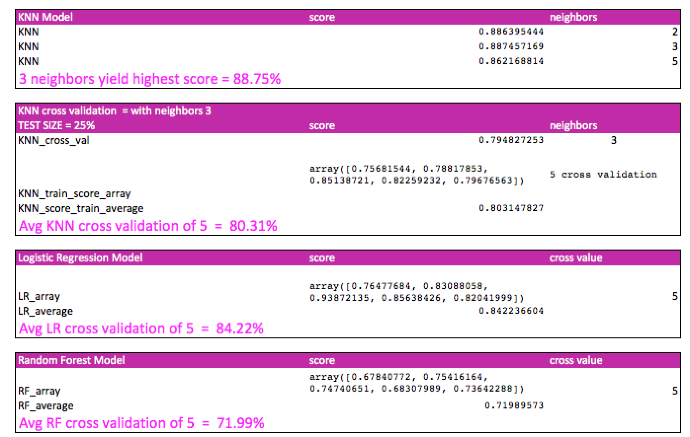
Logistic Regression Best Model > 84%

Slide 13
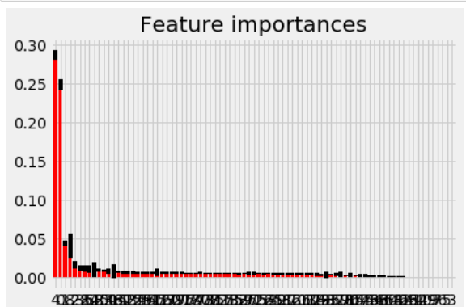
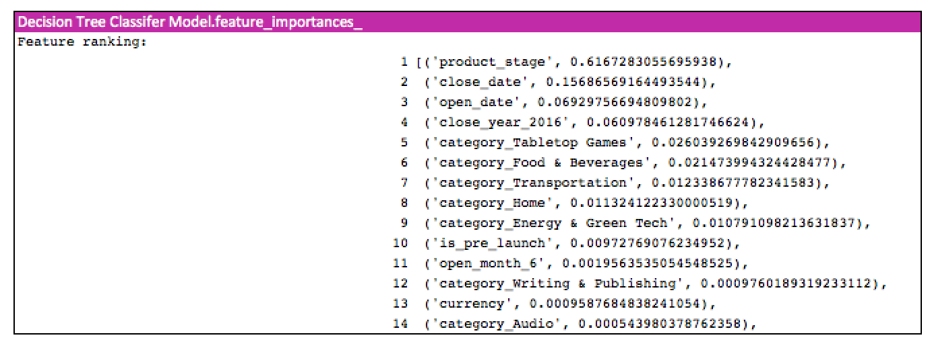
Factors that impacts the output variable – metgoal or not. .
Note:
Obvious factors: Funds Amount & Funds % were dropped as they are 100% correlated to Y output
Home/ Energy & Green Tech were similar to the top avg and top max amounts funded.

Slide 14
Conclusion
Assumptions
Amounts funded currency (US & CAN) are similar in value, additional work required to factor this into model
Important variable:
Strangely year 2016 and month 6 (June) were important features
One would assume product stage & pre-launch is important
Next steps:
More data analysis on top features
More data analysis on top model results

