Slide 1
Introduction to Git
Kim Laine | kim.laine@microsoft.com

Slide 2
What is Git
Git is a version|source|revision control system
Such systems keep track of changes in text/data (often code)
Other systems exist too but Git is the most popular
Official website: https://git-scm.com/
Reference manual: https://git-scm.com/docs
Book: https://git-scm.com/book/en/v2 (a short book)

Slide 3
DEFINITION OF REPOSITORY
BARE REPOSITORY
GIT IS NOT AN IDE!!!

Slide 4
What is GitHub
GitHub.com is a website owned by Microsoft
Hosts git “repositories”
  Helps users connect with projects
  Helps you manage permissions to your projects (who can see the code, modify|contribute to it, etc.)
  Users can post issues and do pull requests (PRs)
  Renders README.md on project page (e.g. http://github.com/Microsoft/SEAL)
Other similar services exist too, like GitLab

Slide 5
Learning Git
Git is a bit hard to learn
Reasons:
  Lots of bad|misguided information is available
  Most users don’t spend any time reading the manual and have a poor understanding of how Git works beyond basics, so if something breaks they have no idea how to fix it
  Git is a very flexible and can do a lot but this brings some complexity
  Git manual and StackOverflow posts etc. use technical git terminology which many on SO can’t explain properly and even the official manual might not explain well
Git is by far best used from a terminal so people with no experience with e.g. Linux or OS X terminal might find it difficult

Slide 6
What is Git good for
Good for collaboration on text documents (code)
  Reason: changes are very easy to track|merge with Git when data is text data (e.g. you can see clearly how various lines have been changed)
Less good when collaborating binary data (like images, MS Word documents, Excel documents, video, sound, …)
  Reason: it’s not possible to “merge” changes to such files because they use a specialized way of saving the data; not possible to say that specific lines have changed in some way
  Still, Git can show that the file has changed and can help you revert back to a previous version

Slide 7
Getting started
For Windows: download Git for Windows from https://git-scm.com/
  When installing, default options are mostly good
  I recommend using git on Bash when that question comes up
For Linux/OS X installing Git with a package manager may be best
To check that Git works, type in terminal: git --version
To get started, go to https://GitHub.com and create an account
  Previously only users with paid subscription can create private projects (visible only to designated GitHub users) but I believe this has now changed
  Paid subscription is inexpensive

Slide 8
Creating a GitHub project
Log in to your GitHub account
From the left-hand side of the website, create a new repository
  In git projects are organized into repositories (one repository holds one project typically)
  In repositories you can have multiple branches of the same project
  Often people develop features in separate branches and when they are ready the branches are merged back to a master branch; sometimes branches are just for testing new ideas and are deleted without merging
Give the repository the name: testrepo
Make the repository private if you want to and click “Create Repository”

Slide 9
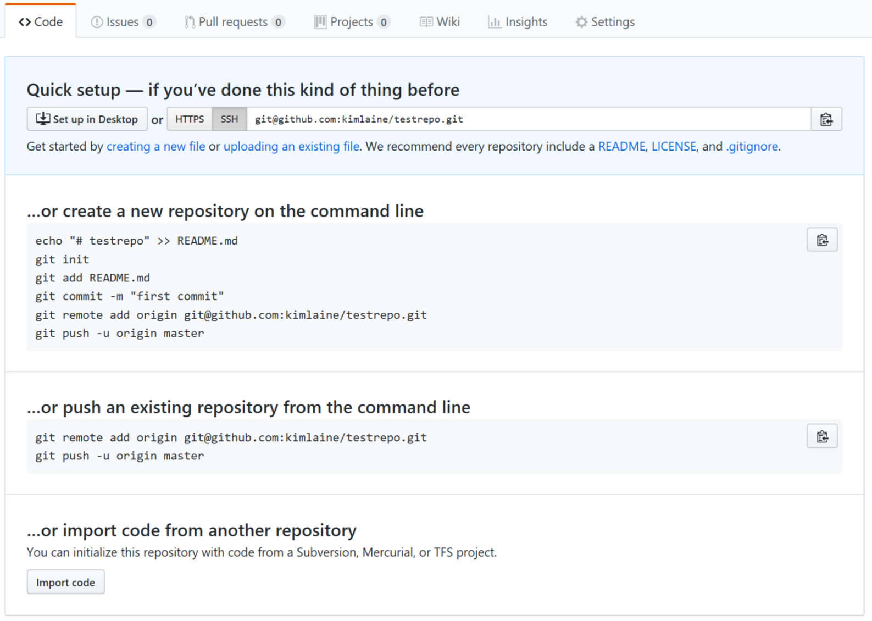
Creating a GitHub project
The website now gives some instructions but these may not make much sense to you
Click the “HTTPS” button unless you want to set up an SSH public key; we’ll see this later
We’ll use this approach to set up our example repository
Make sure you see an https URL for your repository, such as:
https://github.com/kimlaine/testrepo.git

Slide 10
Creating a GitHub project
With git all editing happens in local copies of repositories
You never edit directly the data in GitHub
  You edit a local copy of the repository and push your changes to GitHub
  If someone else made changes to the GitHub repository, you’ll need to merge the changes from the remote to your local copy, then push
What we need to do now is create a new git repository locally and then push it to the remote (our repository on GitHub)
  If the repository would already exist on GitHub, we would have to clone it to get a local copy
  Updating an existing local copy with new changes can be done by pulling or fetching the new changes

Slide 11
Creating a Git repository
All Git commands looks like git <command> <parameters> e.g.
  git clone,
  git add,
  git commit,
  git pull,
  git reset,
  git merge,
  git push,
  git cherry-pick,
  git rebase, …
  Full list: git --help

Slide 12
Creating a Git repository
Create a new directory called testrepo
Change to the new directory in terminal (cd testrepo)
Initiate a new repository by typing: git init
All GitHub projects usually have a README.md file so create a new .md or markdown file called README.md with some content (like “Hello World”)
Now we need to tell Git to “follow” that file: git add README.md
git status shows:
  that your current branch is called master
  that there is a new file (not yet committed)

Slide 13
Creating a Git repository
Tell git that you are done with your changes and are ready to add them as a commit to the repository: git commit
All commits need to include a message describing the commit
If you don’t write a message then the commit will be canceled
By default Git uses the very primitive text editor Nano (save and close with Ctrl+x); you can change this to a different editor like vim by typing:
git config --global core.editor "vim"
git log shows you all commits in the current branch (master)
Note that all of this is still only in your local copy of the repository

Slide 14
Adding a remote
git push updates remotes to match the local copy
  If you try this now, it will give you an error but nothing bad happens
Remotes are copies of the repository that are hosted on other computers (such as GitHub server)
Since this is a new repository that we created locally, we need to tell Git the URL of the remote we want to use before pushing to that:
git remote add origin https://github.com/<something>/testrepo.git

Slide 15
Adding a remote
Actually, testrepo.git is a so-called bare Git repository that doesn’t allow any local changes and is usually used to simply host projects (like GitHub does); you can take local copies (clone) of bare repositories and push changes to them. All bare Git repositories have names that end in .git (like testrepo.git).
What we did in the git remote command was:
  Add a new push “endpoint” (remote) to our local copy of the repository
  All remotes have names and the default remote is called origin
  In many cases you’ll only have one remote in your project (origin)
git remote shows all remotes you have configured (only one now)
git remote show origin shows information about the remote origin
  It should ask your GitHub username and password
  The remote is a flexible concept: it can use a different location to get updates from (fetch|pull) and send updates to (push)

Slide 16
Adding an upstream branch for master
git push still won’t work (try it!)
The problem is that the remote is also a Git repository with branches and all (remember, you are currently on the master branch in your local copy of the repository)
You haven’t told Git to which branch on the remote repository (upstream) you want to push the changes (commits) you made to your local master branch
See how the flexibility of Git creates some complexity

Slide 17
Pushing to GitHub
Type: git push --set-upstream origin master
This sets branch master on the remote called origin to be the target of the push from your current local branch (master) AND does the actual push (you’ll see some output information which may not make sense)
It is possible to separately set the upstream branch and then use simply git push but this way is more common and convenient
From now on you don’t need to separately tell where to push your local master branch; it will automatically go to origin/master
Type git remote show origin to now see more information about how the local branches match to the remote branches

Slide 18
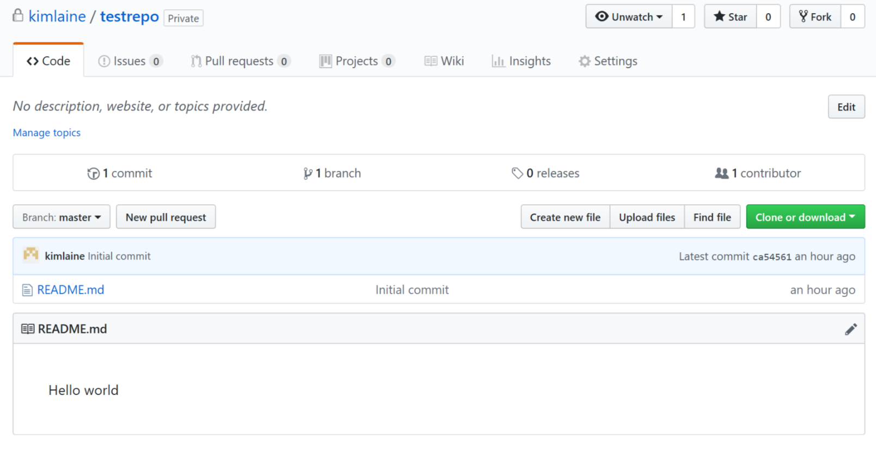
Revisiting GitHub.com
If you now look at your project page in GitHub.com, you’ll see something like:
The only branch is master
Only one commit has been made so far
Directory view of files
Rendering of README.me

Slide 19
Making changes
Now let’s add some other content to our repository
Create a file HelloWorld.java in the testrepo directory with content:
git status shows that there is a new untracked file
Type git add HelloWorld.java to tell Git to track HelloWorld.java
  public class HelloWorld
  {
  public static void main(String[] args) {
  System.out.println("Hello world");
  }
  }
File: testrepo/HelloWorld.java

Slide 20
Making changes
Now add the changes to the current branch (master) by typing
git commit
Again you’ll have to give a message before the commit can be accepted
git log will now show two commits in the history of the branch along with the commit messages
git status shows that your local branch (master) is ahead of the remote branch (origin/master/trunk) by one commit
Push the changes by typing git push
Check that the changes appeared on the GitHub page

Slide 21
Still more changes
Now suppose you want to change the code a bit
Open your local copy of HelloWorld.java and change the message that is printed:
git status will now show that HelloWorld.java has been modified
Type git diff to see the details of the changes
  public class HelloWorld
  {
  public static void main(String[] args) {
  System.out.println("Hello USA");
  }
  }
File: testrepo/HelloWorld.java

Slide 22
HEAD
Some terminology: HEAD refers to the last commit on the current branch
Right now, HEAD means the commit that added HelloWorld.java, as your newest changes are not yet committed
git status shows which commit HEAD refers to, and that origin/master (our remote branch tracking local master) is in sync with that commit

Slide 23
Working directory, index, and HEAD
In Git terminology your changes can be in three different “stages”:
  The working tree (or working directory) refers to changes that you have made but not added or committed to the repository in any way, for example you are working on some code and have made changes to some files; our hw.java shows some changes made to our working directory
  The index is like a “staging arena” of changes that are prepared to be committed to the next commit. Git uses a two-step process where changes are first added to the index to form the next commit, which is then added to the current (or some other) branch as a new commit
  Once the index has been committed, it becomes a commit; at this point HEAD is updated to point to this new commit
Understanding these concepts will make it HUGELY easier for you to read SO posts and other documentation about Git

Slide 24
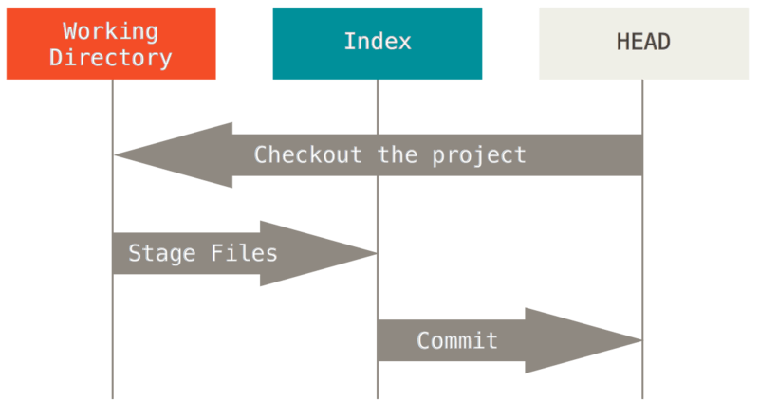
Working directory, index, and HEAD
Source: https://git-scm.com/book/en/v2/Git-Tools-Reset-Demystified

Slide 25
Working directory, index, and HEAD
To add our change to the index type git add HelloWorld.java
Now git status will show that HelloWorld.java is ready to be committed
Make also some change to README.md and add the change to the index with git add README.md
Now git status should show that both files have been modified; we are now happy with our changes and are ready to commit them to the local master branch: git commit
Don’t push these changes to the remote yet; we’ll do something else instead to learn about merging

Slide 26
Checking out commits
Git makes it very easy to go back to previous versions of the repository/branches
Type git status to see all three commits you have made
Note that the name of each commit is actually a hexadecimal string like 217a62ec686c9… that uniquely identifies it and its position in the chain of commits (the latest commit only has a convenient name: HEAD; it is possible to add other such aliases too)
To go back to a previous commit, simply type
git checkout <ID of commit>
You probably don’t want to type the entire long hexadecimal string and you don’t need to: just type a few of the first characters and Git will figure out which commit you mean

Slide 27
Checking out commits
Git makes it very easy to go back to previous versions of the repository/branches
Type git status to see all three commits you have made
Note that the name of each commit is actually a hexadecimal string like 217a62ec686c9… that uniquely identifies it and its position in the chain of commits (the latest commit only has a convenient name: HEAD; it is possible to add other such aliases too)
To go back to a previous commit, simply type
git checkout <ID of commit>
You probably don’t want to type the entire long hexadecimal string and you don’t need to: just type a few of the first characters and Git will figure out which commit you mean
This is a SHA1 hash (cryptographic hash). Actually, Git works exactly like a blockchain!
In practice you don’t need to know really anything about this, but just be aware of it and the terminology.

Slide 28
Checking out commits
Use git checkout <ID of commit> to switch to the previous commit where HelloWorld.java was added
Git also allows you to easily refer to previous commits, e.g., HEAD~0 refers to HEAD, HEAD~1 to one commit before HEAD, HEAD~2 to two commits before HEAD, and so on; the previous action you could therefore also accomplish by git checkout HEAD~1
What actually happened was that HEAD was changed temporarily to point to the commit you specified (detached HEAD state)
If you now look at HelloWorld.java and README.md you’ll see that your most recent changes are no longer there
Type git checkout master to switch to the most recent commit in master branch, i.e. to reset HEAD to point to your newest commit
If you look at HelloWorld.java and README.md you’ll see that your newest changes are back

Slide 29
Reset
One of the most confusing commands in Git is git reset due to people not reading the manual or understanding core terminology
https://git-scm.com/book/en/v2/Git-Tools-Reset-Demystified
It allows you to cancel the effects of git commit, git add (moving files to index aka staging files), and even reset the local branch to that of a remote branch if you want to cancel all of the changes you have made locally

Slide 30
Reset
Type git reset --soft HEAD~1 to change the master branch so that the most recent commit becomes whatever was preceding HEAD (or use the full commit hexadecimal identifier in place of HEAD~1)
This means that your most recent changes are put back in index
Note that no information has been lost: your most recent changes are still there but the most recent commit is gone (git log)
You could type git commit to re-create the commit, or use git add add new files to the index before committing (don’t do either now)

Slide 31
Reset
You can further demote changes from index back to working directory by using git reset <file>; try typing
git reset HelloWorld.java and type git status to see the effects of this
Make some changes to HelloWorld.java:
git add HelloWorld.java and git commit these changes
(don’t push)
  public class HelloWorld
  {
  public static void main(String[] args) {
  System.out.println("Hello Mexico");
  }
  }
File: testrepo/HelloWorld.java

Slide 32
Reset
You can also reset changes in your working directory using
git reset --hard <commit>
This means that all changes made after the given commit are discarded entirely and will not be recoverable from the local copy of the repository
For example, git reset --hard origin/master will reset the state of your local branch to be exactly that of origin/master, i.e. you completely delete all changes you’ve made locally (don’t do this now)
Hard reset can make sense when you try something and decide that it was a bad idea and just want to go back to whatever worked, although a better approach is to create a separate branch that you use for experiments and then delete if it didn’t work out

Slide 33
Branches are commits
On the previous slide you may have noticed how git reset --hard was supposed to take a commit as an argument, but instead the example showed something like origin/master which is a branch
Actually, branches (like master) are just commits, or more correctly a branch is a “pointer” to a commit that is the latest one in the branch
If you look at the file testrepo/.git/refs/heads/master you’ll see this: master consists of nothing more than the identifier of a commit
git reset --soft <commit> changes what the current branch (master in this case) points to but doesn’t change the working directory, thereby “rolling back” the branch
This explains the use of origin/master on the previous slide
https://git-scm.com/book/en/v2/Git-Branching-Branches-in-a-Nutshell

Slide 34
Branches vs HEAD
Branches are pointers to commits (latest commit in the branch)
HEAD is a so-called “symbolic reference” (like an alias) to a commit
HEAD always points to the commit that is checked out at the time
git checkout is used to change the current HEAD, for example you can checkout a branch called mybranch by typing
git checkout mybranch (again, mybranch is really the latest commit in the branch)
Our example before of checking out an earlier commit showed how git checkout changed HEAD to point to other than the latest commit in a branch (detached HEAD state)
https://stackoverflow.com/questions/4386959/difference-between-head-and-master

Slide 35
Clone
Since Git is all about collaboration, let’s imagine that another user wants to contribute to the code
They would look at the GitHub project page https://github.com/<something>/testrepo and see the green “Clone or download” button on the side
Clicking this opens a little dialog that give the appropriate URLs to the repository
Click “Use HTTPS” to get the HTTPS URL instead of the SSH URL (we’ll set up an SSH public key later)
Copy the URL to testrepo.git

Slide 36
Clone
Cloning a repository means making a local copy of a remote repository
A user would get started on working on the project by typing
git clone https://github.com/<something>/testrepo.git
Go to the parent directory above testrepo (cd ..) and type
git clone https://github.com/<something>/testrepo.git testrepo2
to use testrepo2 as the local directory for a fresh local copy
We had to explicitly use testrepo2 as the directory name to avoid directory name conflict since we already have a testrepo directory
You should now have two directories: testrepo/ and testrepo2/
git clone will: create a directory for local copy, download the files and data for all prior edits, create a remote called origin that points to the bare repository hosted at GitHub (testrepo.git)

Slide 37
Non-conflicting changes
Change the directory to testrepo2 (cd testrepo2)
git log will show that this copy of the repository does not yet have the newest edits we made in our other copy of the repository (in testrepo directory)
Let’s make some changes:
  public class HelloWorld
  {
  static int myNumber = 123;
  public static void main(String[] args) {
  System.out.println("Hello world");
  }
  }
File: testrepo2/HelloWorld.java

Slide 38
Non-conflicting changes
Type git commit -a; this is same as git add * followed by
git commit and is very often used to shorten the two-step process)
Push the changes to GitHub: git push
Now let’s go back to our earlier copy of the repository in the testrepo/ directory and try to push our changes: git push
It will not work: the problem is that the remote is ahead of the local branch due to the commit that was made (and pushed) in testrepo2/
This is a very common situation: one user is working on changes while another user already deploys other changes; a merge must happen to fix this problem

Slide 39
Non-conflicting changes
Note that these are non-conflicting changes: the first user changed the print statement, while the second user changed a completely different part of the file (added a static variable)
If both users would have changed the print statement then that would have created a conflict
Non-conflicting changes like these are easy to resolve and Git will do it pretty much automatically
In testrepo/ all we need to do is pull the newest changes from the remote: git pull
This will automatically merge the commits made in testrepo/ with the new commit pulled from the remote

Slide 40
Non-conflicting changes
The merge itself will appear as a commit and therefore will ask for a commit message (look at git log now)
At this point it makes sense to push the merge commit back to the remote so that other users (testrepo2/) can continue working on top of changes made by the first user (testrepo/)
git push should now work (do it)
Now go back to testrepo2/ and pull the changes (git pull); git log shows that the two local copies of the master branch are now identical
Look at HelloWorld.java to see that it indeed contains changes from both users

Slide 41
Non-conflicting changes
The merge itself will appear as a commit and therefore will ask for a commit message (look at git log now)
At this point it makes sense to push the merge commit back to the remote so that other users (testrepo2/) can continue working on top of changes made by the first user (testrepo/)
git push should now work (do it)
Now go back to testrepo2/ and pull the changes (git pull); git log shows that the two local copies of the master branch are now identical
Look at HelloWorld.java to see that it indeed contains changes from both users

Slide 42
Conflicting changes
Now make the following changes:
In testrepo/ do: git commit -a followed by git push
In testrepo2/ do: git commit -a
  public class HelloWorld
  {
  static int myNumber = 123;
  public static void main(String[] args) {
  System.out.println("Hello User 1");
  }
  }
  public class HelloWorld
  {
  static int myNumber = 123;
  public static void main(String[] args) {
  System.out.println("Hello User 2");
  }
  }
File: testrepo/HelloWorld.java
File: testrepo2/HelloWorld.java

Slide 43
Conflicting changes
Trying to push the changes from testrepo2/ won’t work now for the same reason as before: the remote is ahead of the local branch in testrepo2/
Again, the solution is to pull the new changed and merge with the local branch in testrepo2/
However, now there is a problem: how should merge work since the changes are conflicting?
Do git pull and observe the warning about merge conflicts in HelloWorld.java
git status shows what is going on
  the merge process could not be finished
  there is one file that is unmerged (both modified HelloWorld.java); git merge --abort would revert the merge attempt

Slide 44
Conflicting changes
The conflict needs to be resolved by hand
  This can be done entirely manually and is not too hard
  There are multiple graphical tools to help with merging
  There are also some text-based tools such as vimdiff
We will do this by hand so open up HelloWorld.java in any text editor

Slide 45
Merging
You should see something like:
Indicates start of conflicting section
  public class HelloWorld
  {
  static int myNumber = 123;
  public static void main(String[] args) {
  <<<<<<< HEAD
  System.out.println("Hello User 2");
  =======
  System.out.println("Hello User 2");
  >>>>>>> d58edf6afc23bfbdda1dfa6fa67a7cb438bbd160
  }
  }
This is what current HEAD (local copy) looks like
This is what remote branch looks like
File: testrepo2/HelloWorld.java
Name of the conflicting commit/branch; end of conflicting section

Slide 46
Merging
To merge manually, you need to get rid of all of the sections marked as conflicts
Change the file to:
  public class HelloWorld
  {
  static int myNumber = 123;
  public static void main(String[] args) {
  System.out.println("Hello everyone");
  }
  }
File: testrepo2/HelloWorld.java

Slide 47
Completing the merge
To complete the merge, type git commit –a
The changes should also be pushed to the remote so do git push
Change to testrepo/ and pull the changes; there should be no conflicts
In testrepo/ do git log to see the merge commit

Slide 48
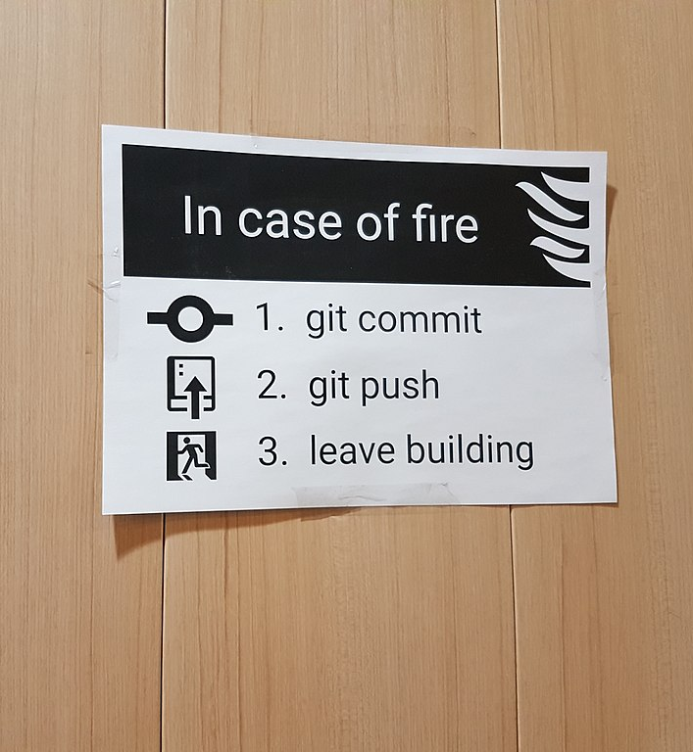
Branches
In practice, developing software involves:
  Each developer cloning the code-base
  Creating one or more local branches where features can be developed and tested
  Pushing the newly created branches to remote (GitHub) at latest at the end of work day
  Regularly merging commits from other developers from other branches while own branch is being developed
  When ready, merging the branch with master or with some other main development branch

Slide 49
Branches
Go to the testrepo/ directory
Make sure you are on (HEAD points to) master branch: git status
Create a new branch called myfeature: git branch myfeature
Try:
  git branch to see local branches
  git branch -r to see remote branches (myfeature is only local for now)
You are still on branch master and not on branch myfeature; in other words, the symbolic reference HEAD (currently active commit) still points to master
git checkout changes HEAD; type git checkout myfeature to change to the branch myfeature

Slide 50
Branches
git status will now show that HEAD points to myfeature
Now change HelloWorld.java as follows:
  import java.util.Calendar;
  public class HelloWorld
  {
  static int myNumber = 123;
  public static void main(String[] args) {
  System.out.println("Hello everyone“);
  System.out.println(Calendar.getInstance().getTime());
  }
  }
File: testrepo/HelloWorld.java / branch myfeature

Slide 51
Branches
You can now test your feature and create multiple commits to myfeature while developing it
Do git add HelloWorld.java
Change README.md to say that the program prints the current time
Add the changes to the index: git add README.md
Once you are happy with your new edits, do git commit

Slide 52
Branches
To push the changes to the remote, we need to designate which branch in remote origin we want to push the local branch myfeature to
If you try git push, Git will give you a very helpful error message
Instead type: git push --set-upstream origin myfeature
  This sets the upstream branch (remote branch) to be origin/myfeature
  It also pushes the local branch myfeature to the remote
If you now look at GitHub project page you’ll see that there are two branches listed: master and myfeature

Slide 53
Branches
Now after some work suppose you are happy with what your (local) myfeature branch contains
We want to bring in the new features to master
Simply checkout the master branch (target of merge):
git checkout master
Type git merge myfeature to merge myfeature into master
In this case there are no merge conflicts, but if there were you would have to deal with them as discussed earlier
git push the merged master back to the remote; the new feature is now rolled out
Btw: git pull is shorthand for git fetch followed by git merge
download changes
merge changes

Slide 54
Appendix 1: Cherry-pick and Rebase
It is also possible to bring specific commits from one branch to another
This can be done with git cherry-pick or git rebase
These two are quite similar commands:
  cherry-pick is intended for bringing in individually selected commits
  rebase is intended more for bringing in an entire line of commits

Slide 55
Appendix 2: .gitignore
Sometimes your local copy of a repository ends up containing files that you have no intention of including in the repository itself
For example, compiling code might result in log files that are not supposed to be a part of the repository
Create a file testrepo/output.log (don’t worry about any content)
git status will now show that file as a new file and suggests git adding it; this is definitely not what we want to do
To completely ignore output.log, you can create a new file testrepo/.gitignore containing just one line: output.log
  You should add, commit, and push the .gitignore file to remote
  Now output.log should not show up anymore at all in git status
  You can also use wildcards in .gitignore: *.log would ignore all .log files (try)

Slide 56
Appendix 3: Setting up SSH public key
In terminal, type ssh-keygen and hit <enter> until all the prompts are done (defaults are good)
You should now have a file ~/.ssh/id_rsa.pub (here ~/ denotes your home directory)
Open this file (there should be one long line there)
Go to GitHub and your account settings; find the tab “SSH and GPG keys”
Click “New SSH key”
Choose any title and copypaste the entire contents of id_rsa.pub there
Now you should be able to use the SSH URLs with GitHub, so it shouldn’t prompt for a GitHub password anymore

