Slide 1

SustainaFund
A $100 million ESG-constrained equity portfolio — efficient frontier, three mandates, and what survived out-of-sample testing
HTW Berlin Summer School 2026 · FICO Xpress case study · September 2026
Notes:
[0:15] Good morning. Over the next twenty minutes I will show you a hundred-million-dollar equity portfolio built as a mixed-integer quadratic programme, and I will spend most of the time on why each choice was made rather than on what the model produced. Every methodology decision in this deck arrives with the measurement that decided it. Two of the slides say outright that our recommended book has no statistically significant edge — I would rather volunteer that than have it extracted.

Slide 2
MANDATE
DATA
RISK MODEL
OPTIMISATION
RESULTS
VALIDATION
The deliverable is a frontier, not a single portfolio
$100M
1,077
15
budget
investable stocks
frontier points
Given by the brief | Added by us
1% ≤ weight ≤ 20% per stock | Sector cap 30%
Each region ≤ 60% | Per-stock ESG floor ≥ 30
At least 30 holdings | Tier 1 weapons exclusion (always on)
Weighted-average ESG ≥ 70 | Tier 2 weapons exclusion (toggle, off)
 | Country cap 25% (built, measured, ships off)
· Risk appetite was never specified in the brief
· So we solve the whole frontier and report three points
· Every addition of ours is priced later in this deck
Risk appetite was never given to us, so we report the frontier and three mandates on it.
2
Notes:
[1:15] The brief fixes four conditions and leaves the most important input unspecified: how much risk the fund wants. So the deliverable cannot be one portfolio. We solve fifteen points along the frontier and report three of them. The left column is the brief's own conditions; the right is what we added, and I will show you the measured cost of each. Worth noting now: the ESG requirement that carries almost the entire cost is the one the brief itself imposed — the per-stock floor we added is free.

Slide 3
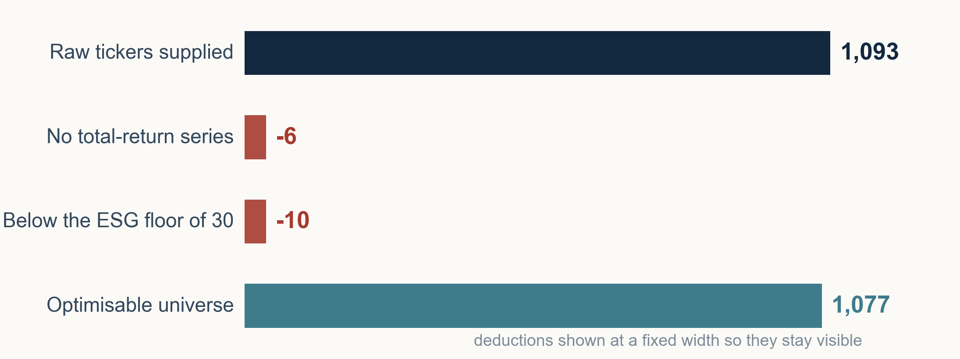
MANDATE
DATA
RISK MODEL
OPTIMISATION
RESULTS
VALIDATION
1,093 tickers in, 1,077 investable out
· Ten years of daily LSEG data, 2015 to 2025
· Converted to USD at daily ECB reference rates
· Total-return prices, not closing prices
Every exclusion is a written rule applied to all names, not a judgement about a company.
3
Notes:
[0:40] Sixteen names leave the universe and both reasons are mechanical. Six lost their total-return series entirely — 2,870 of 2,870 values absent — and three of those six are REITs, whose dividend adjustment factors are the largest, so the extraction most likely failed on them. We dropped them rather than substituting the unadjusted series, because an unadjusted series carries about three percentage points less return and the optimiser would then punish those stocks for a data defect. Ten more fall below our per-stock ESG floor. No name is excluded by opinion.

Slide 4
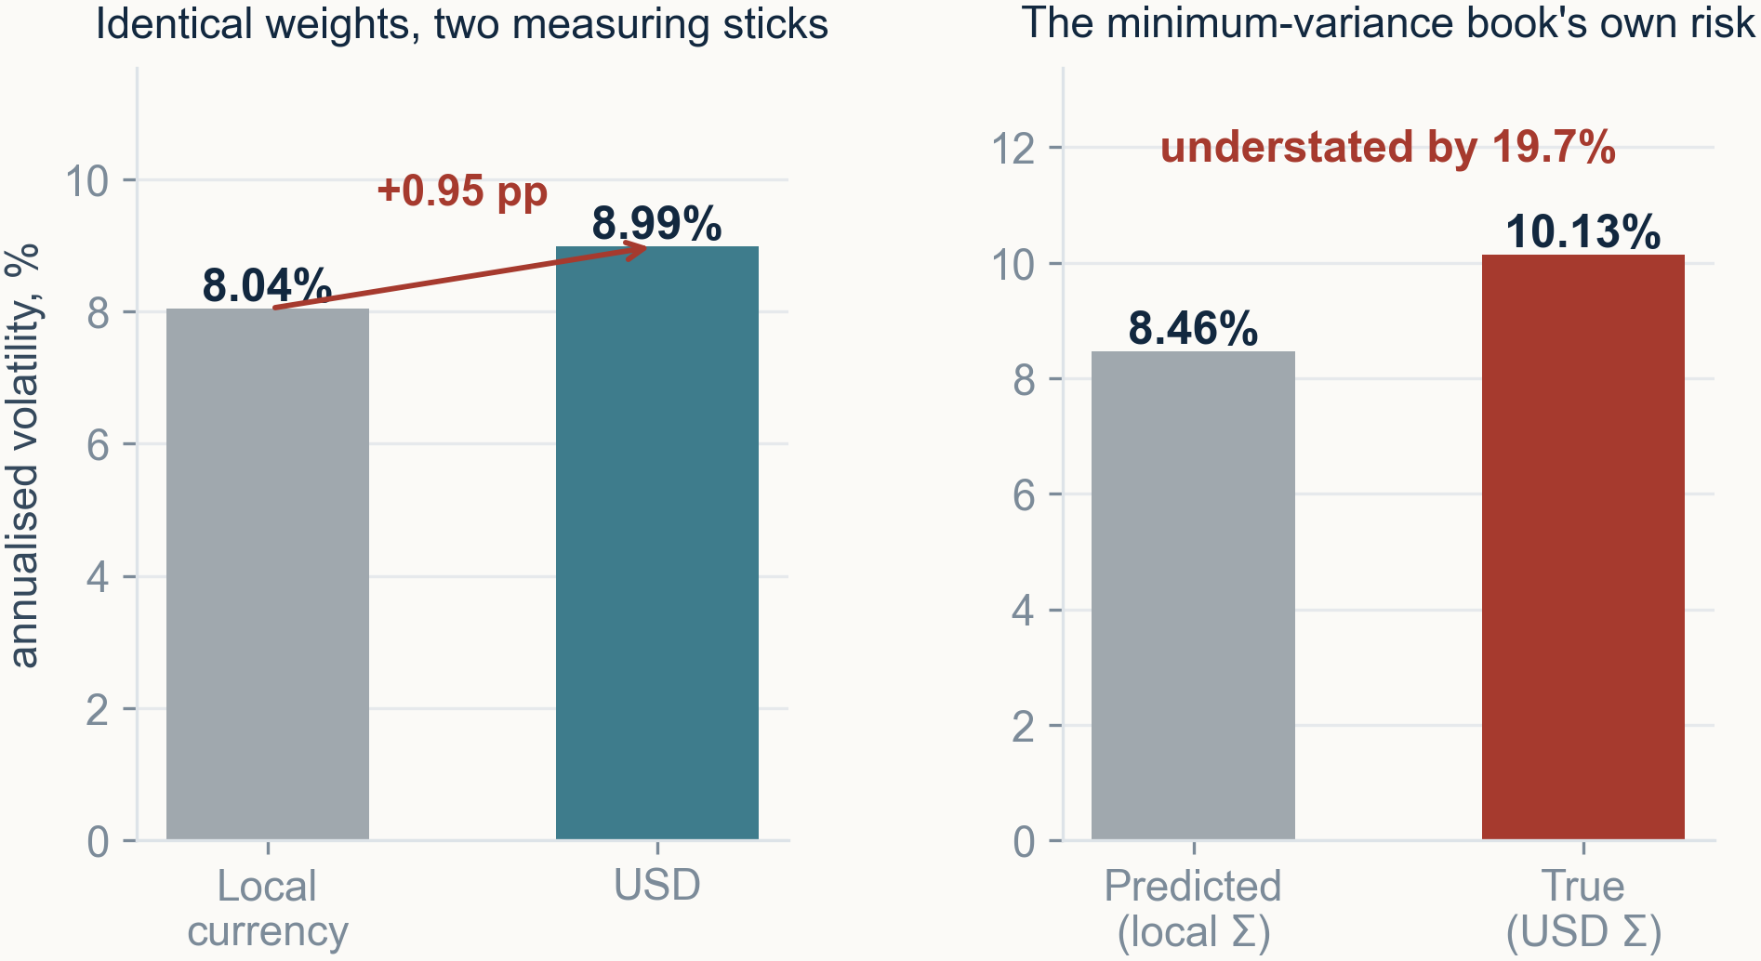
MANDATE
DATA
RISK MODEL
OPTIMISATION
RESULTS
VALIDATION
Currency is a risk factor, not a unit conversion
· ln(P_usd) = ln(P_local) + ln(fx) — the FX term does not cancel
· FX is 17.6% of total portfolio variance
· A fund reports in one currency, not eight
Optimising on local-currency returns optimises a return no investor ever receives.
4
Notes:
[0:45] The natural objection is that currency cannot matter because returns are ratios. That holds for a constant, and an exchange rate is not constant. Take logs and the FX term is additive, so it survives into the return series — and because every stock in a currency shares it, it is a common factor, exactly what a covariance matrix exists to capture. The left panel is the same weight vector priced two ways. The right panel is the consequence: a local-currency covariance tells the minimum-variance book it carries 8.46% risk when it actually carries 10.13%. Understating risk is the one failure a risk-averse mandate cannot tolerate.

Slide 5
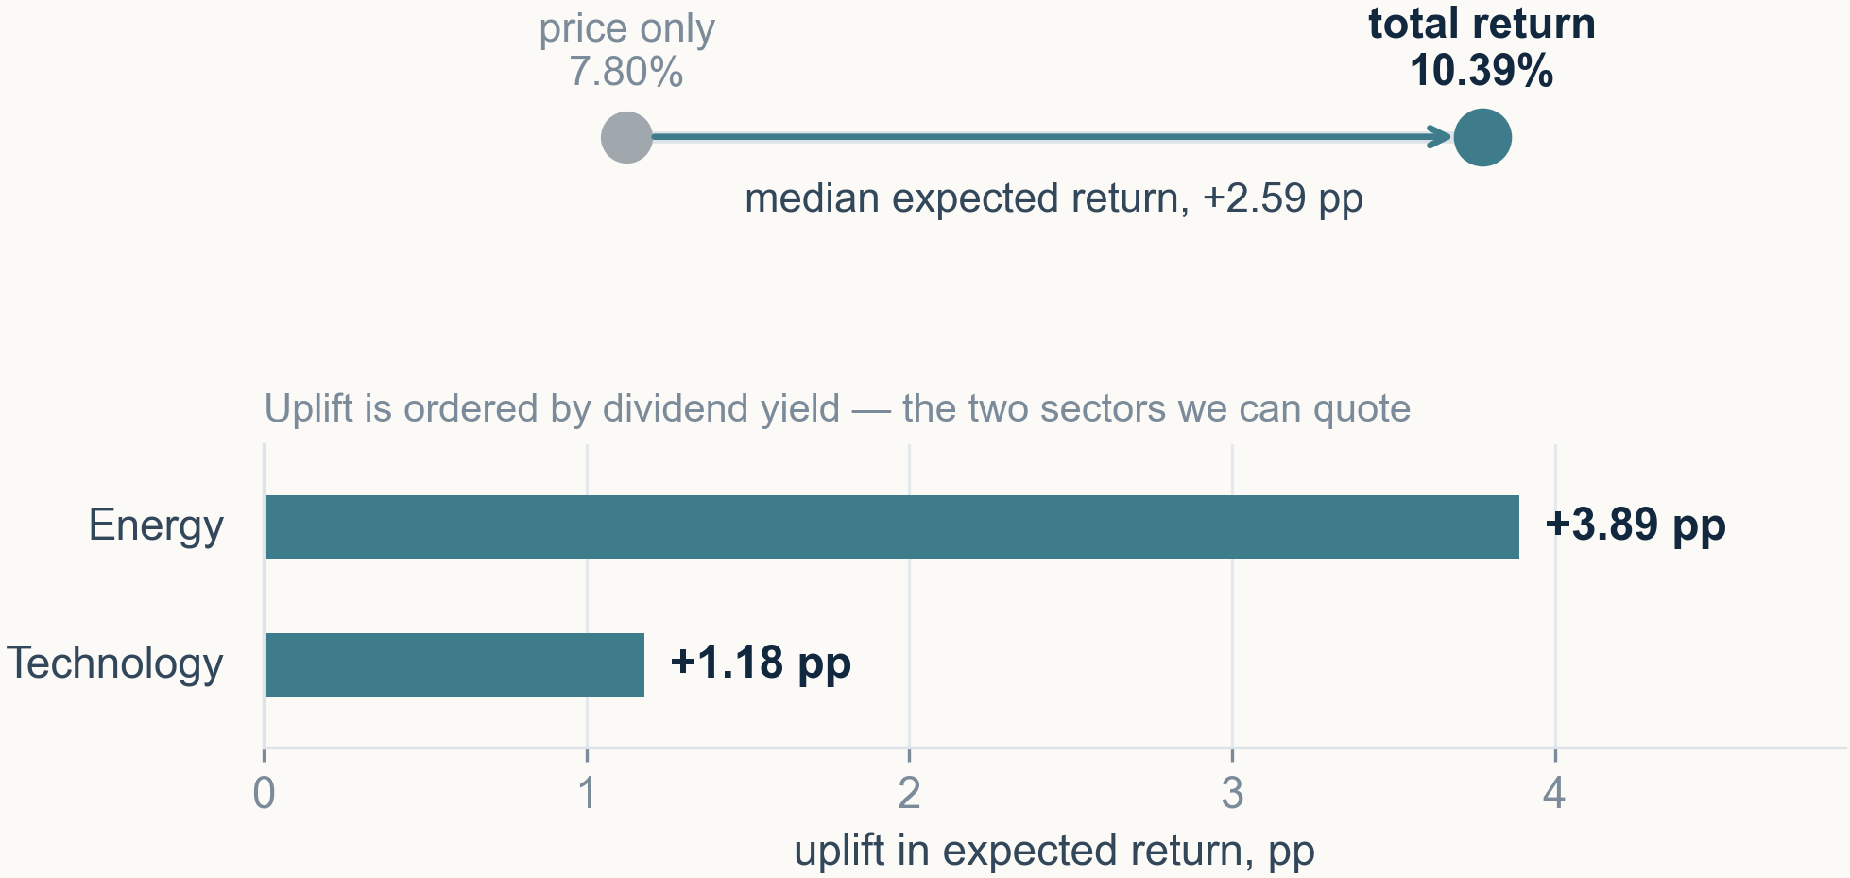
MANDATE
DATA
RISK MODEL
OPTIMISATION
RESULTS
VALIDATION
Price returns penalise the stocks min-variance wants
· Stocks with negative expected return: 3 → 0
· Rank correlation 0.972 — levels move, order mostly holds
· We validated the vendor series with three checks
We tested the adjusted series rather than trusting it: ratio anchored at 1.00, volatility unchanged, uplift ordered by dividend yield.
5
Notes:
[0:35] A closing price omits dividends, and the bias is not neutral — it falls hardest on the high-yield, low-volatility names a minimum-variance book is made of. Median expected return moves from 7.80% to 10.39%. We did not simply trust the vendor's adjusted file: the adjustment ratio is anchored at 1.00 at the most recent date, volatility is unchanged at 31.05% against 31.08% because dividends add drift and not noise, and the uplift is ordered by dividend yield across sectors. Any one of those failing would have meant a broken series.

Slide 6
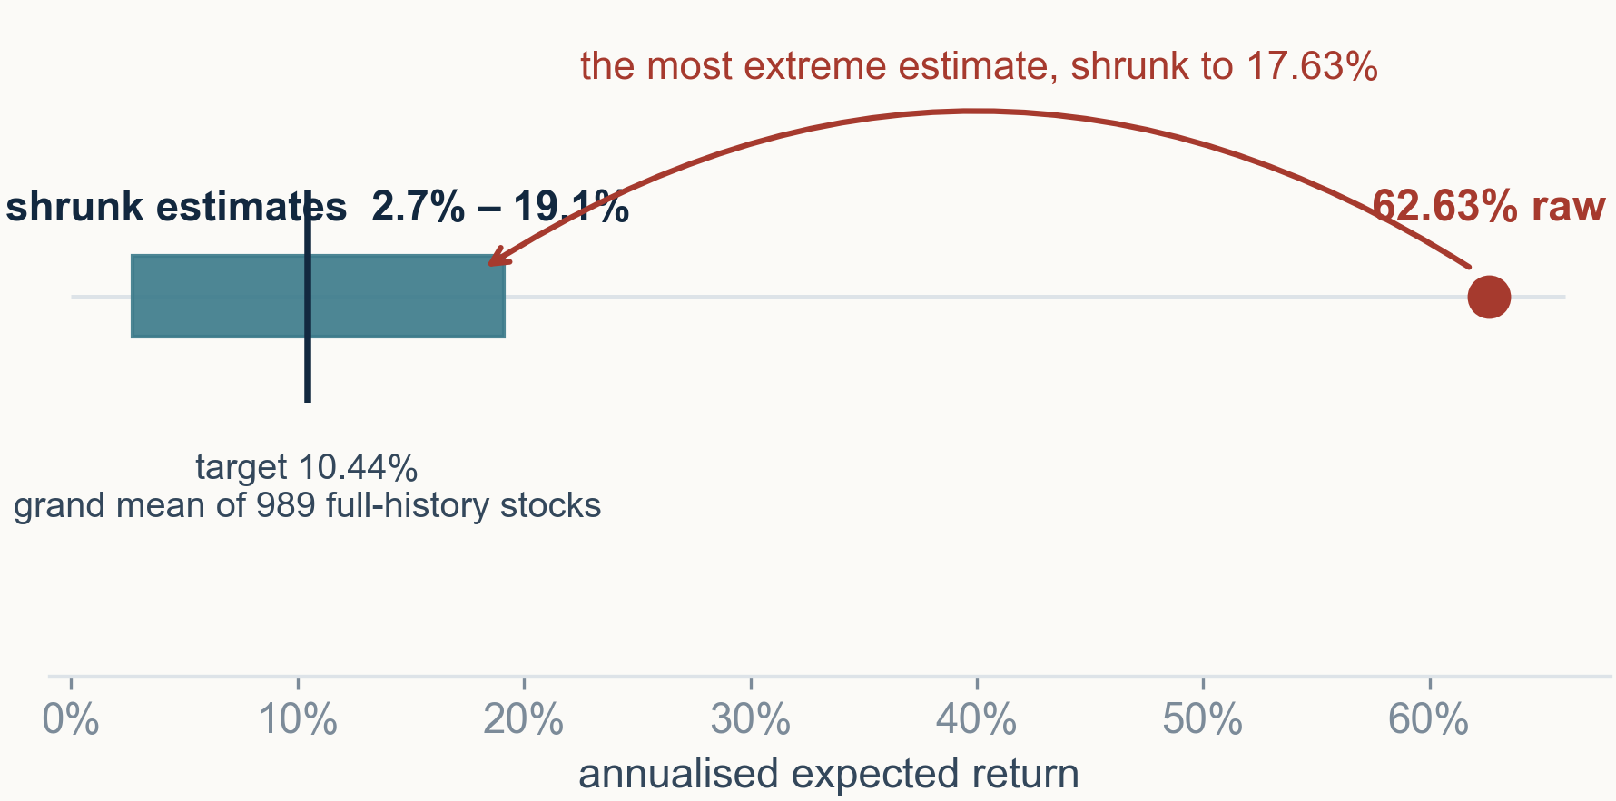
MANDATE
DATA
RISK MODEL
OPTIMISATION
RESULTS
VALIDATION
A 62.6% historical mean is not a forecast
· w_i = τ² / (τ² + se_i²), shrinking toward the grand mean
· Both τ² and se² are estimated from the data
· No tuning parameter anywhere in the estimator
The amount of shrinkage is measured, not chosen — there is no knob for a referee to attack.
6
Notes:
[0:50] A ten-year sample mean is a noisy estimate, and a mean-variance optimiser is not a passive reader of its inputs: it actively hunts for the highest-return assets, so it preferentially buys whatever the estimation error flattered. It is an error maximiser. James-Stein shrinkage pulls each estimate toward the grand mean of the 989 full-history stocks by an amount proportional to that stock's own standard error. The weight a stock keeps on its own estimate ranges from 0.03 to 0.70. If asked what we tuned: nothing — both quantities in that weight are estimated.

Slide 7
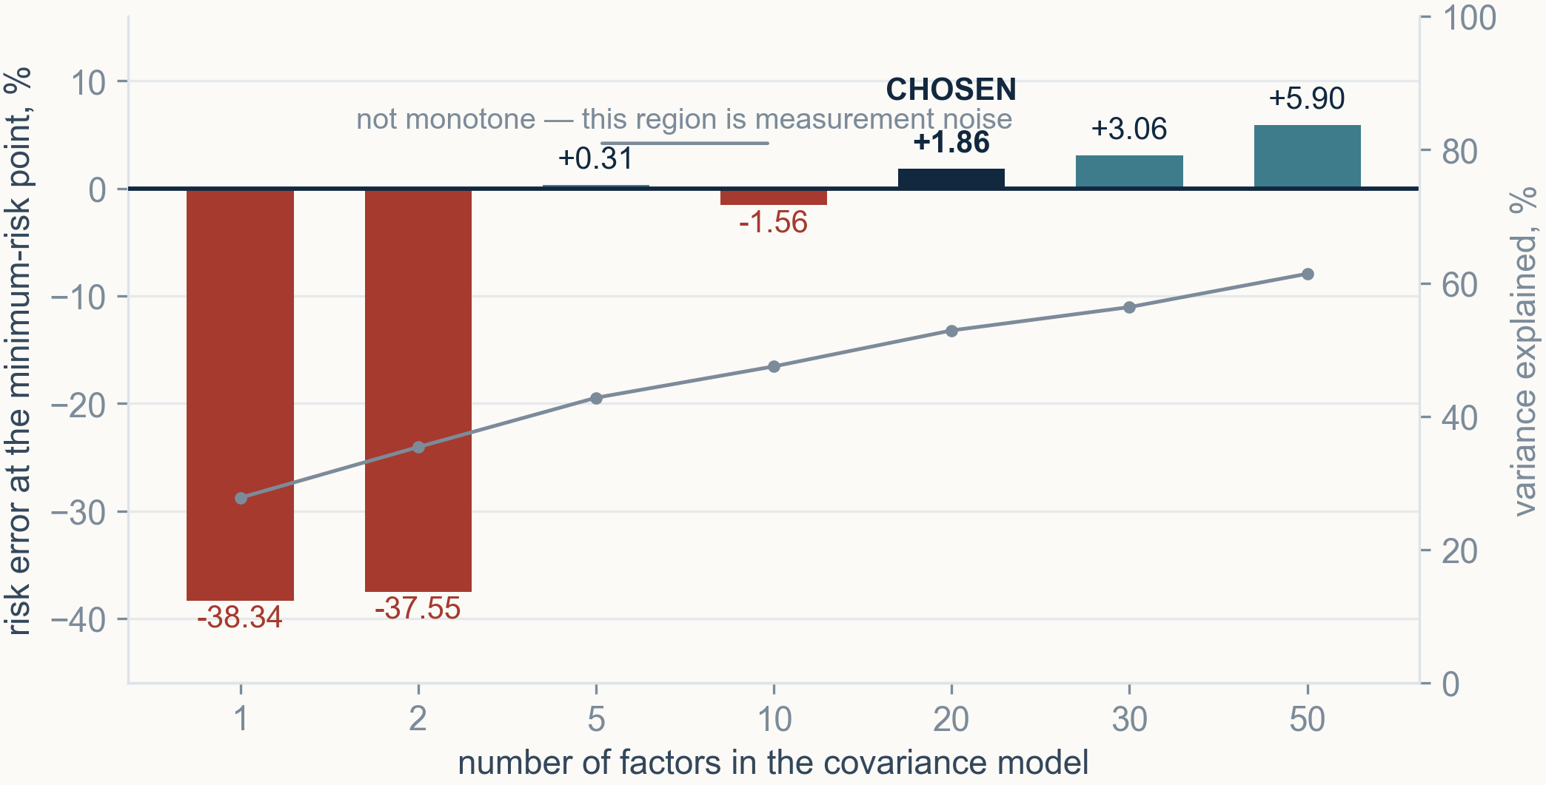
MANDATE
DATA
RISK MODEL
OPTIMISATION
RESULTS
VALIDATION
Twenty factors, chosen by measurement, not convention
· 20 is not the smallest k that reaches zero — five is
· It is the smallest k whose margin holds either way
· At k = 50 the condition number worsens 2,957 → 4,389
We chose the smallest factor count whose margin does not depend on which portfolio you pick.
7
Notes:
[1:10] We had to choose a factor count, and it is the most arbitrary-looking parameter in the model, so we measured it. For each k we compared the predicted risk of every frontier portfolio against the risk those weights actually realised. One or two factors understate risk by thirty-eight percent at the minimum-risk point — that is a cliff, and it is the argument against a single-index model. Five factors already crosses zero, but by a third of a point, and ten falls back below zero, which tells us that region is measurement noise rather than signal. Twenty is the smallest count whose margin is wide enough that the answer does not depend on which portfolio the optimiser picks.

Slide 8
MANDATE
DATA
RISK MODEL
OPTIMISATION
RESULTS
VALIDATION
A MIQP, because the cheaper formulations failed
minimise w' Σ w
subject to w' μ ≥ β
Σ w = 1
0.01 y_i ≤ w_i ≤ 0.20 y_i
y_i ∈ {0,1}, Σ y_i ≥ 30
Rejected | The measurement that killed it
Linear risk proxy Σ wᵢσᵢ | 19.2% more true risk; misreports its own risk by 1.64×
Semi-continuous variables | returned 26 real positions while reporting 30
Weighted-sum λ scalarisation | binaries make the set non-convex — reaches only the convex hull; native multi-objective turned 0.8 s into >2 min
1,077 continuous + 1,077 binary variables · ~1.16 M quadratic elements · 0.3–1.1 s per solve · FICO Xpress 9.9.1 at a 0.1% MIP gap
Each rejection is an experiment we ran, not an argument we made.
8
Notes:
[1:15] The objective is quadratic and the variables include one binary per stock, and both of those were tested rather than assumed. A linear risk proxy is tempting because it turns this into a MILP, but it cannot see correlation — it treats two perfectly correlated stocks as diversification — and the book it picks carries nineteen percent more true risk while misreporting itself by a factor of 1.64. Semi-continuous variables would remove a thousand binaries, but then nothing counts holdings, and the model reported thirty positions while holding twenty-six. This slide also answers why there is no risk-aversion parameter: we sweep the return target instead, because a weighted sum only reaches the convex hull of a non-convex frontier.

Slide 9
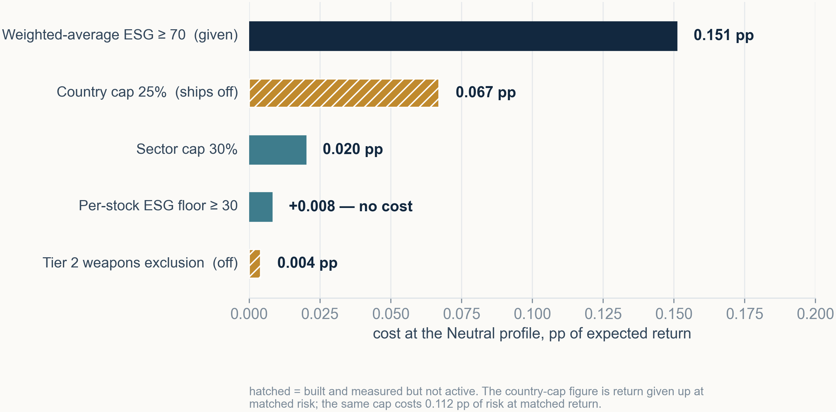
MANDATE
DATA
RISK MODEL
OPTIMISATION
RESULTS
VALIDATION
Every constraint carries a price we can quote
· The brief's own averaging rule carries nearly all the cost
· The per-stock floor we added is effectively free
· The sector cap does not bind at Neutral — 27.10% uncapped
Rheinmetall carries an ESG score of 87.3 and would take 10.2% of the book with no explicit weapons screen.
We can price any constraint the investment committee wants to change, in advance.
9
Notes:
[1:05] Every constraint here has a measured price in percentage points of expected return at the recommended profile, so if the investment committee wants to change one we can quote the cost immediately. Two things to notice. The expensive constraint is the brief's own weighted-average ESG rule at 0.151 points; our per-stock floor measures plus 0.008, which is inside the noise — it does not cost return. And the Rheinmetall figure is the strongest single illustration that an ESG score measures governance and disclosure quality, not what a company makes. A well-run munitions manufacturer scores 87.3. No ESG threshold fixes that, which is why the weapons screen is explicit and separate.

Slide 10
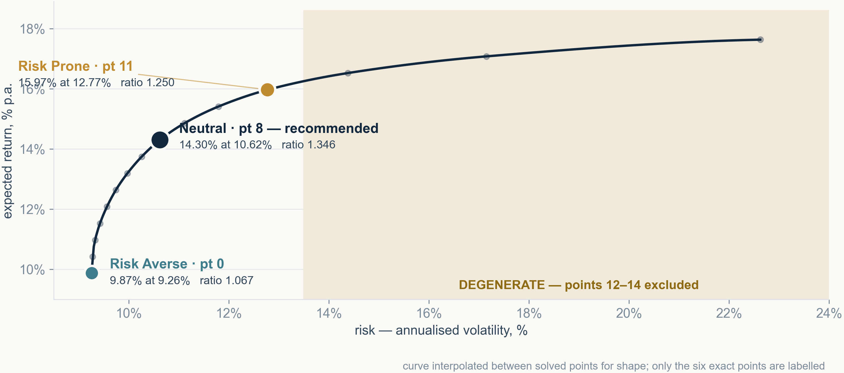
MANDATE
DATA
RISK MODEL
OPTIMISATION
RESULTS
VALIDATION
Fifteen solved portfolios — three are mandates
· Steep on the left, flat on the right
· Past roughly 14% risk, extra risk buys very little return
That shape is the entire argument for not choosing the right-hand corner.
10
Notes:
[1:25] I will pause for a moment and let the shape land. Fifteen separate MIQP solves, the return target swept between the two corners. The shape is the argument: steep on the left, flat on the right, and past roughly fourteen percent volatility extra risk buys very little extra return. The shaded region on the right is excluded by a degeneracy test I will explain in two slides. The three marked points are the mandates we report, and the largest marker is the one we recommend.

Slide 11
MANDATE
DATA
RISK MODEL
OPTIMISATION
RESULTS
VALIDATION
Neutral is the best risk-adjusted point on the frontier
14.30%
10.62%
1.346
expected return
risk
return / risk
Profile | Return | Risk | Return/Risk | Holdings | Weighted ESG
Risk Averse (pt 0) | 9.87% | 9.26% | 1.067 | 42 | 70.00
Neutral — recommended (pt 8) | 14.30% | 10.62% | 1.346 | 30 | 70.00
Risk Prone (pt 11) | 15.97% | 12.77% | 1.250 | 30 | 70.00
· Risk Averse = minimum variance
· Neutral = highest return/risk on the frontier
· Risk Prone = highest return among non-degenerate points
Neutral needs no risk-aversion parameter — it is the best point on a frontier we did not tune.
11
Notes:
[1:05] Three points, three rules, and none of them has a free parameter. Risk Averse is the global minimum-variance portfolio. Neutral is the highest return-to-risk ratio on the frontier, which is why we can recommend it without asking anyone to nominate a risk aversion coefficient. Risk Prone is the highest return among the points that pass a degeneracy test. Weighted ESG is exactly seventy in all three, because that constraint binds everywhere. The recommendation holds thirty stocks with no position at either the twenty percent cap or the one percent floor.

Slide 12
MANDATE
DATA
RISK MODEL
OPTIMISATION
RESULTS
VALIDATION
The maximum-return corner is a dominated portfolio
Point | Return | Risk | Return/Risk | Top-3 weight | At the 1% floor | Status
11 | 15.97% | 12.77% | 1.250 | 33.8% | 10 | Risk Prone
12 | 16.52% | 14.38% | 1.146 | 34.0% | 16 | degenerate — floor count
13 | 17.08% | 17.15% | 1.000 | 40.5% | 21 | degenerate — both tests
14 | 17.63% | 22.62% | 0.779 | 60.0% | 23 | degenerate — the corner
· Degenerate: top-3 above 40%, or over 15 positions at the floor
· Thresholds swept 9×9: point 11 wins for floors 10–15
· More than 15 of 30 is simply more than half the book
0.779 is worse than the risk-averse book's 1.067 — more risk for less reward per unit.
Maximum return without a degeneracy filter returns a corner of the feasible set, not a portfolio anyone would sign.
12
Notes:
[0:50] This slide exists to pre-empt the most likely challenge: why not report the maximum-return portfolio. Because at point fourteen sixty percent of the budget sits in three stocks and twenty-three of thirty positions are pinned at the one percent floor, and its return-to-risk ratio of 0.779 is worse than the risk-averse book's 1.067. It is a corner of the feasible set. If asked where the thresholds come from: they were a judgement call originally, so we swept them on a nine-by-nine grid — point eleven is selected for any floor threshold between ten and fifteen, and at thirty holdings fifteen simply means more than half the book at minimum weight.

Slide 13
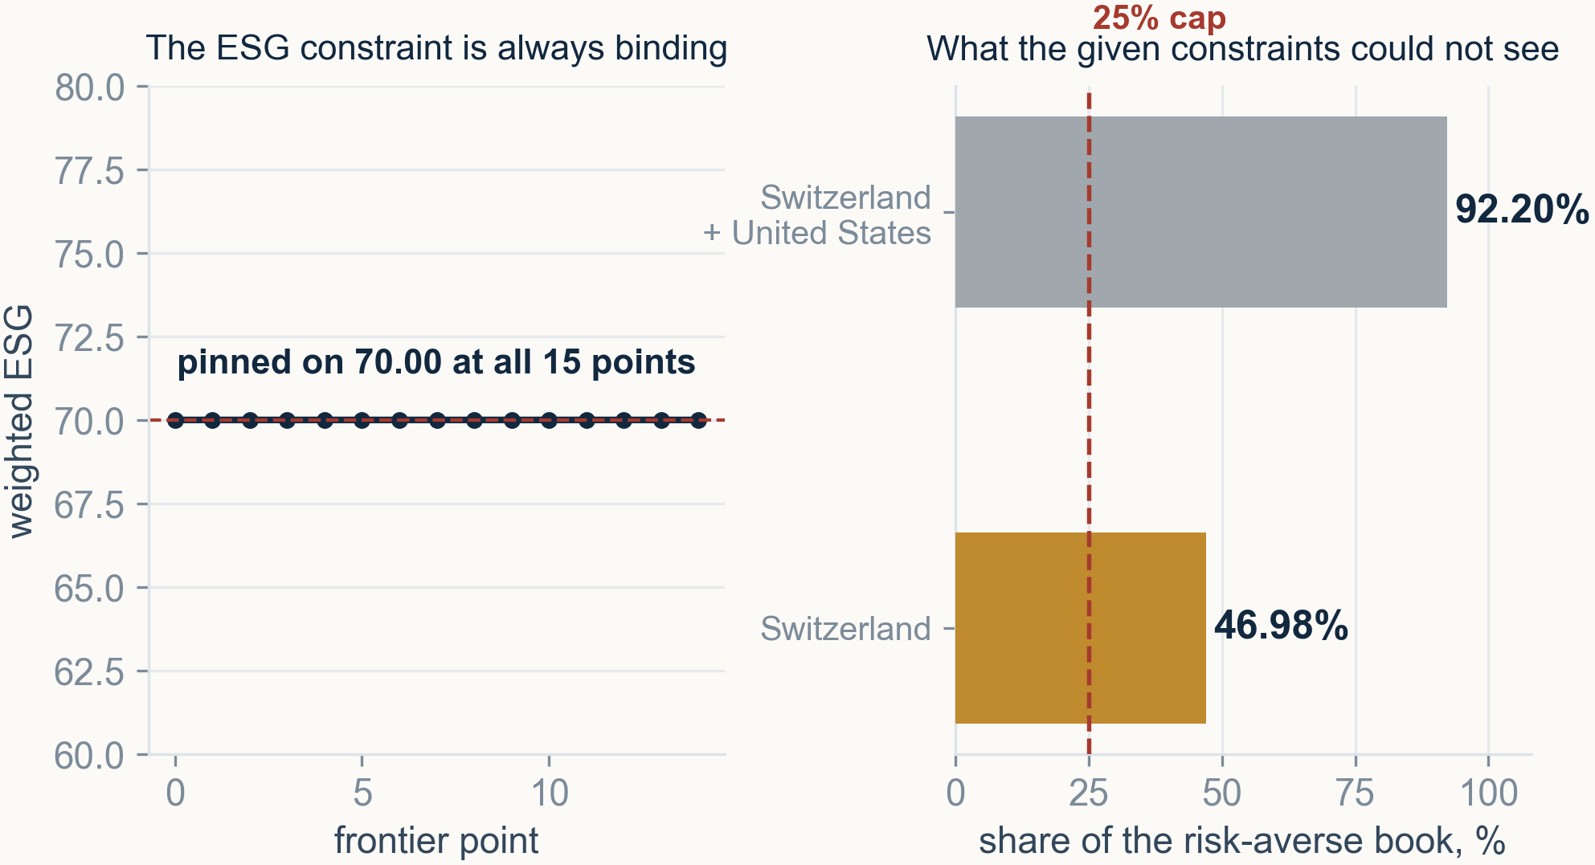
MANDATE
DATA
RISK MODEL
OPTIMISATION
RESULTS
VALIDATION
ESG binds everywhere, and the constraints missed Switzerland
· A region cap cannot see one country
· A sector cap cannot see a country spanning two sectors
· A 25% cap costs 0.067 pp and removes 11.7 pp of concentration
The US exemption is forced, not chosen — with a 25% cap the infeasibility is exactly 1 − 0.60 − 0.25 = 0.15.
13
Notes:
[0:45] Two findings on one slide. Weighted ESG sits at exactly seventy at all fifteen points, so that constraint is always active — and, as we saw, it is also the expensive one. Then the gap: the brief caps regions and we capped sectors, and Switzerland slipped between the two, because it is not a region and it spans two sectors — cantonal banks and real estate. It reaches forty-seven percent of the risk-averse book, and Switzerland plus the United States is ninety-two percent of it. We built a country cap, measured it at 0.067 points of return, and it ships switched off pending your decision. The US exemption is not a preference: the solver proves it with an infeasibility of exactly 0.15.

Slide 14
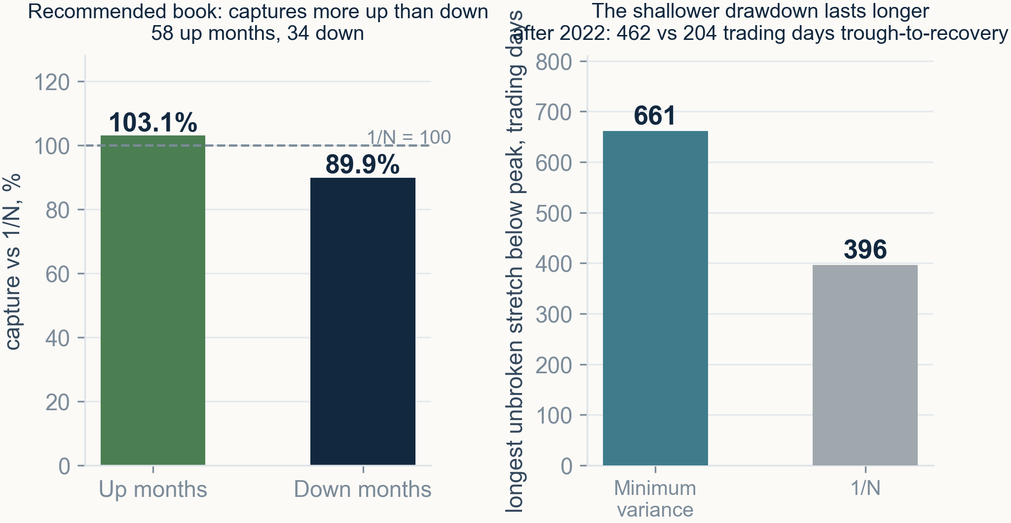
MANDATE
DATA
RISK MODEL
OPTIMISATION
RESULTS
VALIDATION
Averages hide what the portfolio actually does
· Captures 103% of up months, 90% of down months
· Minimum variance stays underwater 661 days vs 396 for 1/N
· The shallower drawdown is also the longer one
The capture asymmetry is the strongest argument for the recommendation, and a Sharpe ratio cannot show it.
14
Notes:
[0:55] Two things a Sharpe ratio cannot show you. First, capture asymmetry: the recommended book takes 103% of the benchmark's up months and only 90% of its down months, over 58 up and 34 down months. That asymmetry is the real argument for the recommendation. Second, the cost of the min-variance book's shallower drawdown is duration — its longest unbroken stretch below peak is 661 trading days against the benchmark's 396, and after 2022 it took 462 trading days from trough to recovery against the benchmark's 204. A note for the record: the recovery figures circulated in an earlier draft could not be reproduced, so these are the trough-to-recovery numbers that do trace.

Slide 15
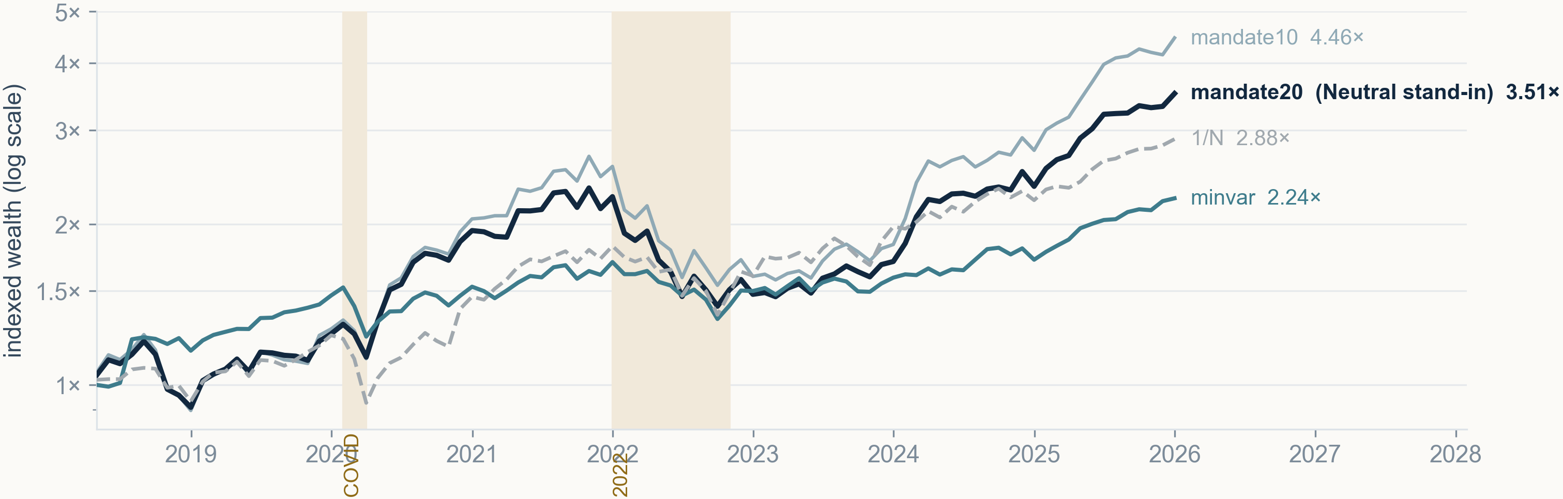
MANDATE
DATA
RISK MODEL
OPTIMISATION
RESULTS
VALIDATION
Out of sample: risk edge real, return edge not
Book | CAGR | Volatility | Sharpe | Max DD
minvar | 10.94% | 13.20% | 0.829 | −33.81%
mandate20 (Neutral stand-in) | 17.60% | 20.08% | 0.876 | −42.31%
mandate10 | 21.29% | 23.30% | 0.914 | −46.00%
1/N benchmark | 14.65% | 16.91% | 0.866 | −37.68%
· 31 rebalances, 3-year rolling window, 7.7 years
· Only data available before each date is used
· The profile is a relative mandate, comparable across regimes
Higher CAGR came with proportionally higher risk — the ranking on Sharpe barely moves.
15
Notes:
[1:05] The protocol: a three-year rolling estimation window, quarterly rebalancing, thirty-one rebalances over 7.7 years, and at each date only data strictly before it. We express the return-seeking profile as a relative mandate — give up at most twenty percent of the achievable maximum — because an absolute return target is not comparable across regimes; the same target is easy in 2021 and infeasible in 2018. Read the table across rather than down: the higher CAGR comes with proportionally higher volatility and a deeper drawdown, and the Sharpe column barely separates.

Slide 16
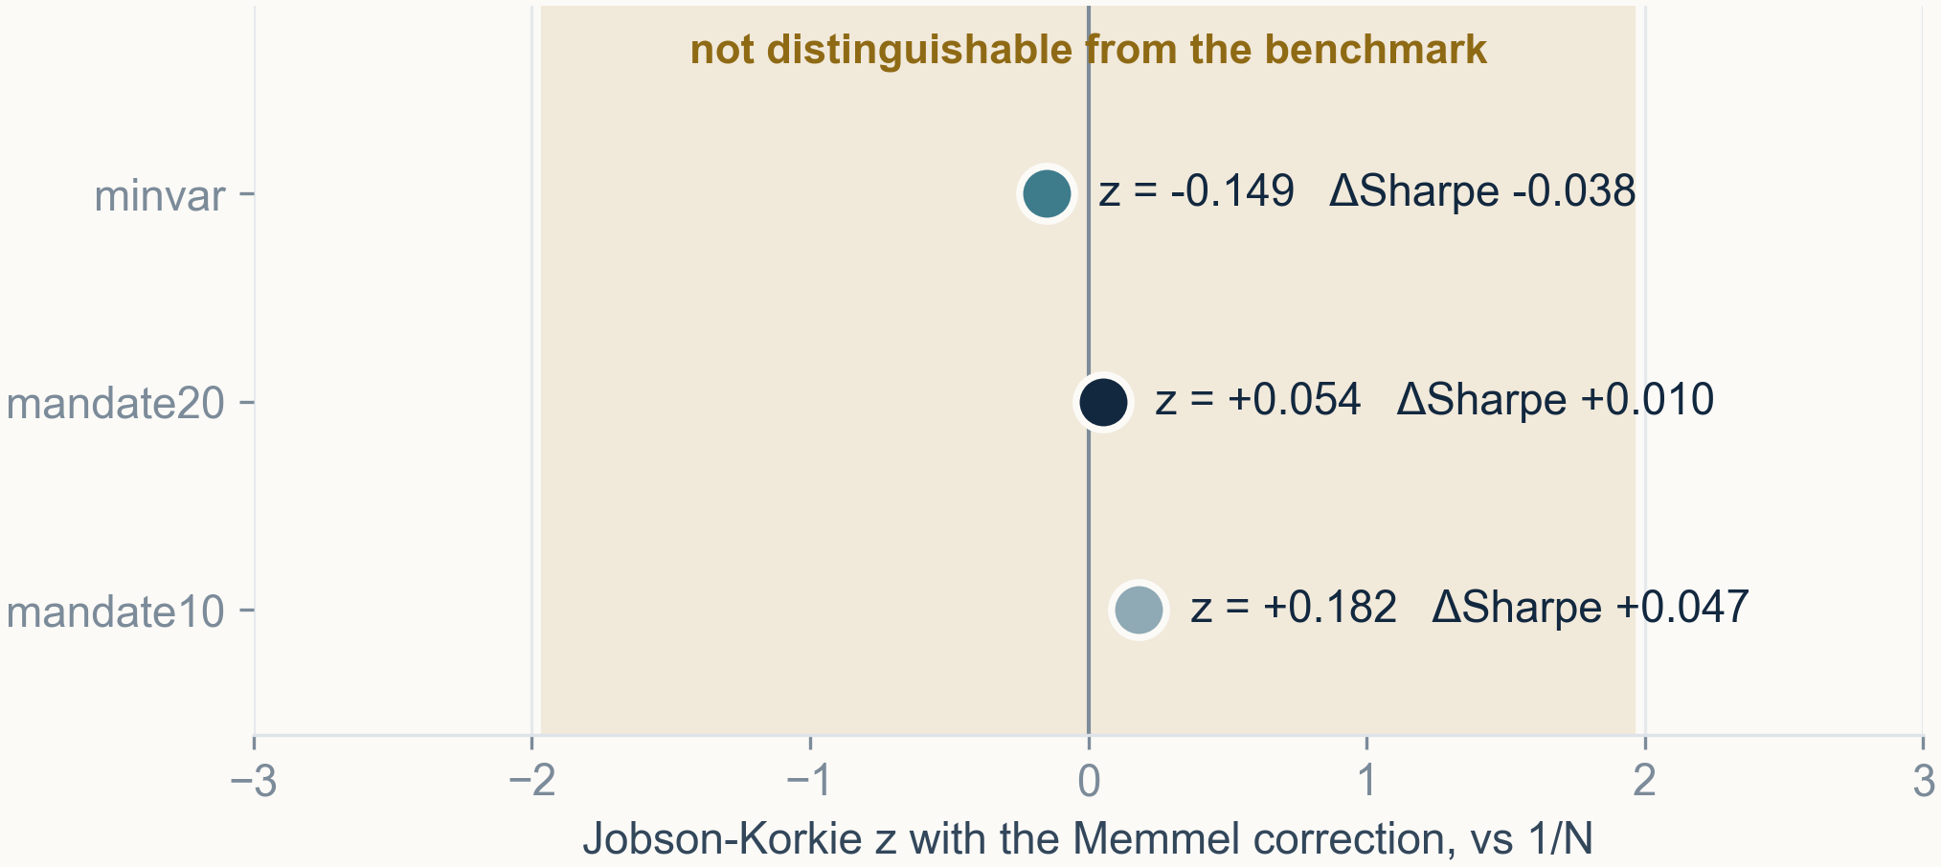
MANDATE
DATA
RISK MODEL
OPTIMISATION
RESULTS
VALIDATION
Every Sharpe difference sits inside the noise band
· After 10 bp of costs the return-seeking book falls below 1/N
· 0.857 against 0.866, at 170% annual turnover
· Jobson-Korkie with Memmel, not a t-test on returns
Over 7.7 years the honest answer is that no book is statistically distinguishable from the benchmark — in either direction.
16
Notes:
[1:00] This is the slide I would most want you to take away. The correct test for a difference of Sharpe ratios is Jobson-Korkie with the Memmel correction, not a t-test on daily return differences, because Sharpe differences are not normally distributed. It gives z of -0.15, +0.05 and +0.18. Every one is inside the band, and the conclusion is unchanged from the simpler test but no longer attackable on distributional grounds. Note the direction: this cuts against our own return-seeking book as much as it cuts against the claim that the optimiser destroys value. And after ten basis points of costs that book falls below the benchmark outright.

Slide 17
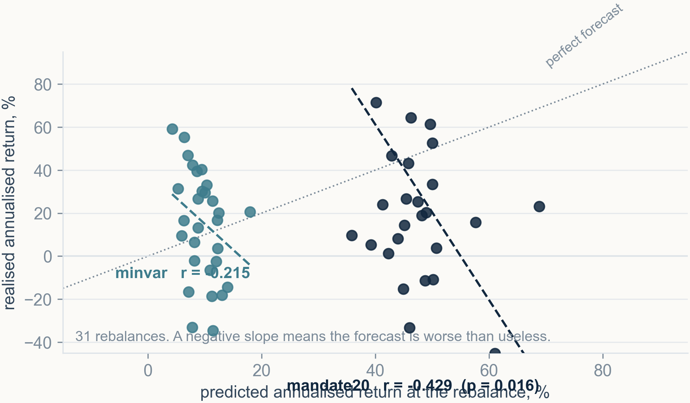
MANDATE
DATA
RISK MODEL
OPTIMISATION
RESULTS
VALIDATION
The expected-return model forecasts backwards
· Correlation -0.43 over 31 rebalances, p = 0.016
· Predicted 47.3%, realised 31.5%
· Minimum variance predicted 9.7%, realised 15.6%
That is error maximisation made visible, and it is why the edge is in risk and not in return.
17
Notes:
[0:55] This is the quantitative evidence behind everything I have said about the return estimate. At each of thirty-one rebalances the model states an expected return; here it is against what those exact weights then earned. The correlation is minus 0.43 with a p-value of 0.016 — not merely uninformative, actively inverted. It predicted an average of 47.3% and realised 31.5%. The minimum-variance book, which barely uses the return estimate, predicted 9.7% and realised 15.6% — it under-promises. The optimiser is an error maximiser and this is the picture of it.

Slide 18
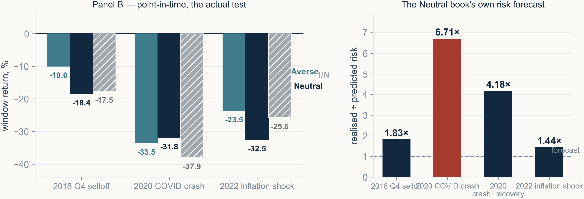
MANDATE
DATA
RISK MODEL
OPTIMISATION
RESULTS
VALIDATION
The crash realised 6.7× the risk we forecast
· Panel A is in-sample, wins 7 of 7 — not evidence
· Panel B re-estimates on the three years before each window
· Risk Averse wins 3 of 3 crises, Neutral 1 of 3
Any risk number this model produces has to be presented as a lower bound.
18
Notes:
[0:50] Two panels kept deliberately apart. Panel A holds the delivered books through the same windows their inputs were estimated over — it wins seven of seven and we do not present it as evidence, because the optimiser had already seen those crises. Panel B re-estimates on the three years strictly before each window and re-solves. There, minimum variance beats the benchmark in all three crisis windows and the recommended book in one of three. And the right-hand panel is the number I would not want extracted from me: in the COVID crash the recommended construction realised 6.71 times the risk it had forecast.

Slide 19
MANDATE
DATA
RISK MODEL
OPTIMISATION
RESULTS
VALIDATION
Recommend on the estimate, recommend risk on the evidence
What we recommend
What we can demonstrate
What we cannot claim
· Neutral, point 8
· 14.30% return at 10.62% risk
· ratio 1.346, 30 holdings, ESG exactly 70.00
· 103% up capture against 90% down
· Volatility 13.20% vs 16.91% — a 21.9% cut
· Lower in 5 of 6 sub-periods
· Drawdown −33.81% vs −37.68%
· Beats 1/N in all three crisis windows
· — all at the minimum-variance end
· A statistically significant risk-adjusted edge
· Every Jobson-Korkie z inside ±1.96
· Over 7.7 years and 31 rebalances
· In either direction
· ESG scores and sectors are a single present-day snapshot — a 2018 rebalance uses 2025 information
· The universe is today's index constituents, so every strategy including the benchmark looks optimistic
· Transaction costs are measured but not priced inside the optimiser
The defensible claim is about risk, not return — and stating that is stronger than a Sharpe ratio that fails a t-test.
19
Notes:
[1:10] I will state the recommendation conditionally, because the estimate and the evidence point to different ends of the frontier and pretending otherwise invites the obvious attack. If you accept mu as the best available estimate, take Neutral: it is the highest return-to-risk point on the frontier, it captures more upside than downside, and the mandate asks for growth. If you weight out-of-sample evidence above the estimate, take Risk Averse: it beats the benchmark in every crisis window and cuts volatility by twenty-two percent. Neither claim extends to a statistically demonstrable risk-adjusted edge, and there are three limitations this dataset cannot fix.

Slide 20
Backup
Detail held back for questions
20
Notes:
[—] Backup slides from here. I will go to these only if asked.

Slide 21
Factor selection, the full table
k | Variance explained | Median R² | Risk error at min-risk
1 | 27.8% | 0.273 | -38.34%
2 | 35.4% | 0.355 | -37.55%
5 | 42.8% | 0.436 | +0.31%
10 | 47.5% | 0.469 | -1.56%
20 | 52.9% | 0.518 | +1.86%
30 | 56.4% | 0.547 | +3.06%
50 | 61.4% | 0.586 | +5.90%
· Negative means the model understates portfolio risk
· k = 20 is the chosen row
· In-sample consistency check, not a forecast test
21
Notes:
[—] The full sweep. The error is predicted risk over realised risk minus one, at the minimum-risk point, and negative means the model understates. Note that this is an in-sample consistency check: it asks whether the optimiser can game a covariance that assumes diagonal residuals, not whether that covariance predicts the future.

Slide 22
The first four factors are economically readable
Factor | Variance | Reading | Evidence
F1 | 27.8% | broad market | correlation 0.996 with the equally weighted index
F2 | 7.5% | Europe vs United States | beta +1.43 Europe / -1.73 US
F3 | 3.4% | Energy vs Technology | beta -2.76 Energy / +1.75 Technology
F4 | 2.4% | Technology vs Utilities | beta -1.47 Technology / +2.94 Utilities
· Nothing about these was specified in advance
· They are eigenvectors of the return covariance
· An explicit region factor moved the error 13.6% → 13.1% only
22
Notes:
[—] These are principal components, not factors we named in advance. Factor two is worth the detail: we added an explicit Europe-versus-US factor as a test and it barely moved the residual correlation, because PCA had already found that split by itself. The failure was never which factor is named — it is how much variance is left in the residual block the model treats as independent.

Slide 23
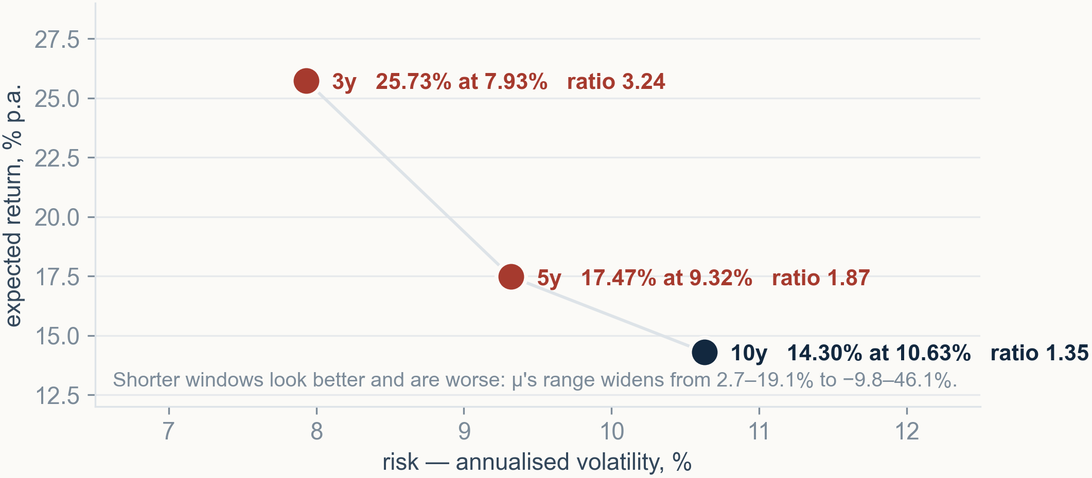
Shorter estimation windows look better and are worse
· 10y Jaccard 1.00 by construction; 5y 0.283; 3y 0.193
· 3y weight correlation with the 10y book: −0.019
· μ's range widens from 2.7–19.1% to −9.8–46.1%
23
Notes:
[—] The window length is the input this model is least robust to, and we choose it. Re-estimating mu and sigma on five and three years makes the book look dramatically better — a ratio of 3.24 on three years against 1.35 on ten — while sharing only eleven of thirty-eight names with the ten-year book and a weight correlation of minus 0.019. That is not an alternative recommendation, it is estimation error.

Slide 24
Why 31 rebalances and not two
Split | Book | Δ Sharpe vs 1/N | Verdict
2019-12 / 2022-12 | mandate20 | +0.087 | beats 1/N
2020-06 / 2023-06 | mandate20 | −0.244 | loses to 1/N
three-point variant | mandate20 | −0.130 | loses to 1/N
31 rebalances | mandate20 | +0.010 | not distinguishable
· A spread of 0.331, decided by where the boundary falls
· Two observations cannot separate skill from luck
· We tested the objection rather than asserting it
24
Notes:
[—] A simpler protocol was proposed: three chunks, two rebalance points. We declined it on the argument that two out-of-sample observations cannot separate skill from luck, and then we tested that argument rather than leaving it as an assertion. The same protocol with two equally defensible split dates says the book beats the benchmark on one and loses on the other — a spread of 0.331 from nothing but the boundary.

Slide 25
Six reproducibility gates, and three defects they caught
Gate | Result
rewriting the group caps in a different idiom | byte-identical LP file; all 15 frontier points re-solved with max |delta weight| = 0.000
rebuilding the covariance at k=20 | reproduces the shipped matrix to 1.8e-15
re-estimating on the ten-year window | reproduces mu to 1.7e-16 and Sigma to 1.8e-15
new backtest harness vs the original | Sharpe 0.829 vs 0.835, volatility 13.197% vs 13.210%
new 1/N vs an independently built one | Sharpe 0.867 vs 0.866
regenerated presentation inputs | every field matches the original; the rebuilt PDF is text-identical
· A number that cannot be reproduced is not evidence
· The deck itself was unbuildable by anyone else at one point
· A 1e-6 tolerance counted zero positions where there was one
25
Notes:
[—] Every rebuild in this project is gated against something it must reproduce, and the gates caught three real defects. The deck-building script read a file from a temporary directory that nothing in the repository wrote, so it worked on one machine and crashed everywhere else. Two backtest inputs were read but never written. And counting positions at the one percent floor with a tolerance of ten to the minus six reported zero where there was plainly one, because the MIP gap leaves the smallest holding five parts per million above the bound.

Slide 26
Weapons screening, and a ticker that would have hidden it
· Tier 1: weapons are the core business — always excluded
· Tier 2: diversified defence — a toggle, currently off, costs 0.004 pp
· Four of ten Tier 2 tickers were absent from the dataset
BA.L was the dangerous one. BA.N exists in this dataset and is Boeing, so a plausible-looking correction would have excluded the wrong company.
26
Notes:
[—] Two tiers, deliberately separated. Tier one is the narrow, near-consensus case following Norwegian sovereign-fund precedent, and is always excluded. Tier two is diversified defence, where defence is a major but not the sole segment — that category is genuinely contested after 2022, so it is a toggle and we can quote its cost rather than baking in a judgement. The data defect is worth telling: four of ten tier-two tickers did not exist in this dataset, so the screen was silently excluding six of ten.

Slide 27
What the 1/N benchmark is, and is not
· 0.093% per name against the brief's 1% floor
· Rebalancing frequency moves it 0.9 pp of CAGR
· The ESG-screened variant breaks the 60% region cap
No 1/N variant is admissible under the brief. It is a reference for what no skill would have earned, not a portfolio we could have proposed.
27
Notes:
[—] Worth saying before anyone offers it as an alternative. Equal weight over 1,077 names puts 0.093 percent in each, against a one percent floor, and no equal-weight portfolio over more than a hundred names can satisfy that floor at all. The unscreened variants also miss weighted ESG of seventy. And the ESG-screened variant clears ESG and then breaks the region cap, because the high-ESG half of this universe is sixty-three percent European. Also: the choice of rebalancing frequency moves the benchmark by nine tenths of a point of CAGR, which is larger than most differences we report against it.

Slide 28
The sub-period record across six regimes
Period | Regime | minvar CAGR | 1/N CAGR | minvar vol | 1/N vol
2018-04..2019-12 | calm market | +24.72% | +13.04% | 14.15% | 11.87%
2020 full year | crash and rebound | +3.82% | +18.09% | 23.44% | 30.78%
2020-02..2020-03 | the crash itself | -87.48% | -94.20% | 63.09% | 66.91%
2021 | boom | +11.25% | +24.50% | 8.02% | 11.47%
2022 | inflation shock | -12.06% | -12.60% | 13.61% | 21.25%
2023-2025 | AI rally | +14.30% | +21.48% | 8.22% | 12.19%
FULL | whole test period | +10.94% | +14.65% | 13.20% | 16.91%
· Volatility lower in 5 of 6 sub-periods
· It wins the 2020 crash and the 2022 inflation shock
· It gives up the 2021 boom and the AI rally
28
Notes:
[—] The volatility edge is not an artefact of one period. Minimum variance realises lower volatility in five of the six regimes, and the two it wins outright on return are the two drawdowns. What it gives up is the boom and the AI rally, which is exactly what a low-volatility book should do.

Slide 29
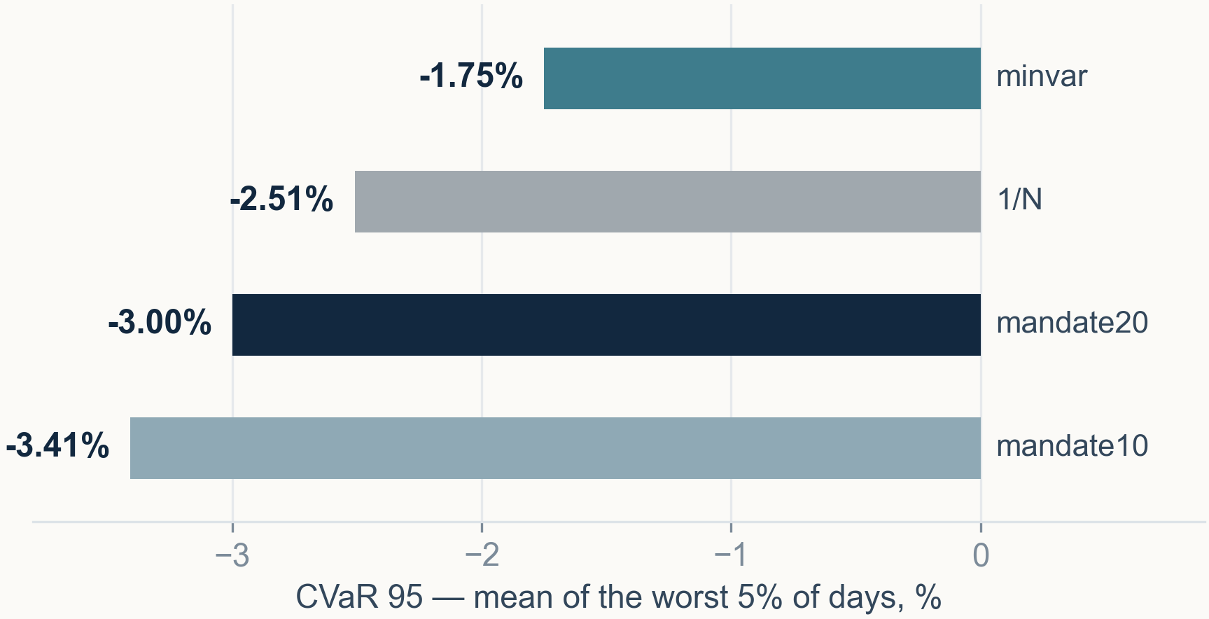
Tail risk, where the minimum-variance book earns its keep
· CVaR 95 of -1.75% against -2.51% for 1/N
· The mean of the worst 5% of days
· The return-seeking books are worse than the benchmark
29
Notes:
[—] Conditional value at risk is the mean of the worst five percent of days, and it is the statistic a mandate holder actually feels. Minimum variance loses 1.75 percent on such a day against the benchmark's 2.51. Both return-seeking books are worse than the benchmark on this measure, which is the same story as the drawdown column but in the tail rather than the peak-to-trough.

