Slide 1
Poker in F#

Slide 2
My approach
Create a rank for a player’s hand in such a way that they easily were comparable
Focused on the bare essentials, not looking at this as something to extend to a full poker game
Only care about the suit for flush hands
Did not ensure only using one deck of cards
Tried to follow typical f# approaches

Slide 3
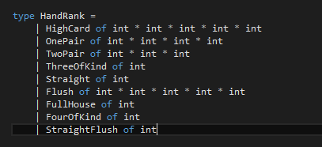

Created hand rank type
Created a rank of cards with the lowest valued hand at the top
Each rank has the all of the required additional details as tuples for determining the tie breaker

Slide 4
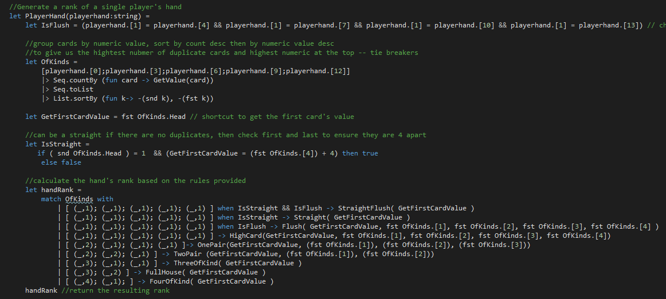
Evaluate playerhand
Have a method to translate 2-A to numeric
Group the values of cards with a count
Sort desc by Negating the values
Wildcard tuple matching of list

Slide 5
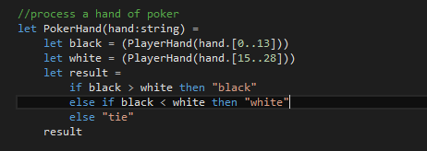
Compare two hands
Split into two hands
Evaluate the rank of those hands
Compare the resulting values
The type took care of all of the tie breaking logic
Provide the result

Slide 6
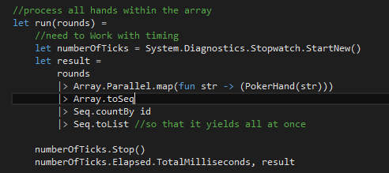
Process the contents of file
I am sure there are other ways to do this parallel processing…was going to try calling my functions in C# to leverage the other built in parallel processing concepts
Produces an list of results, groups by the result, with the count for each Id

Slide 7
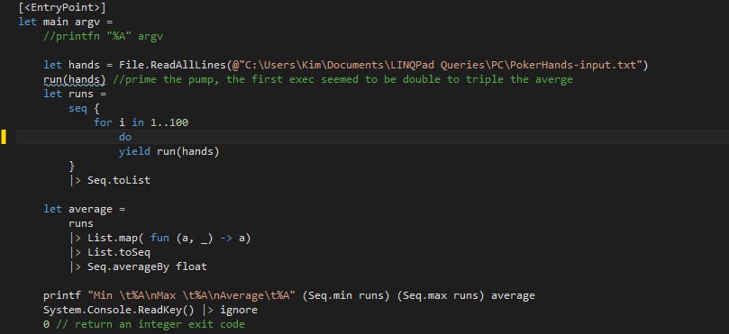
Results
Built in methods to provide the minimum and maximum values, as well as average of the sequence

