Slide 1
Perl - laziness, impatience, hubris, and one liners
by Kirk Kimmel

Slide 2
WARNING:
The slides for this presentation are available online < kimmel.github.com > licensed under a Creative Commons Attribution-ShareAlike 3.0 Unported License.
All images and comics are copyright their respective owners. xkcd rocks

Slide 3
Further Reading (all free)
Andy Lester's “A Field Guide To The Perl Command Line” http://speakerdeck.com/u/petdance/p/a-field-guide-to-the-perl-command-line
The “Modern Perl” book https://github.com/chromatic/modern_perl_book
Higher Order Perl http://hop.perl.plover.com/#free

Slide 4


Slide 5
Basic Perl tools
Syntax Check - perl -c program.pl
perldoc - Think man pages
cpan shell
https://metacpan.org/
Perl::Tidy - for code beautification
Perl::Critic - Static code analysis. Fully configurable for new rulesets.
Devel::NYTProf - Powerful feature-rich perl source code profiler

Slide 6
perldoc in the browser
Yes you can use perldoc in the browser for a more familiar browsing environment
cpan Pod::Webserver
Start the server with: podwebserver
http://localhost:8020/

Slide 7
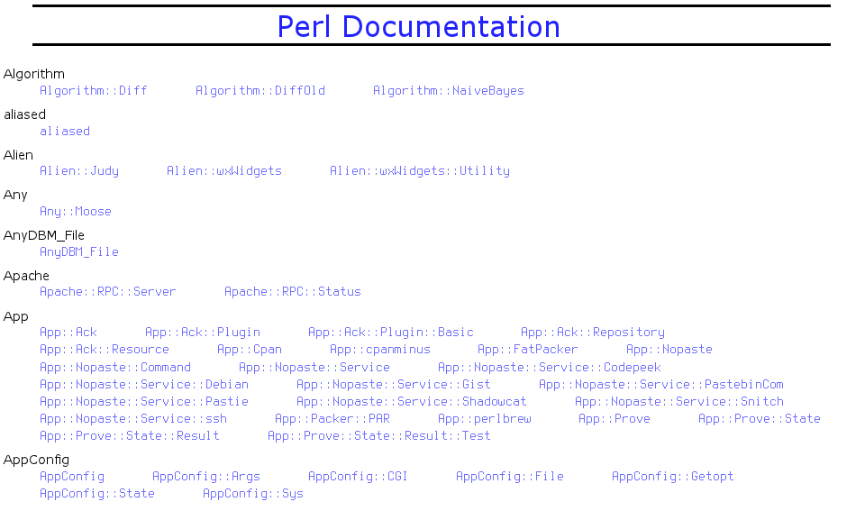

Slide 8
A preface to One-liners
perldoc perlrun
perl -e 'one line program' for Perl prior to 5.10
perl -E 'one line program' to use all the new features
perl -E 'say “Hello World”'
An alternative with less quoting
perl -E 'say q(Hello, World)'

Slide 9
command flags
perl -n
Tells Perl to add the following loop around your program
    while (<>) {
      ...
    }
perl -p
    while (<>) {
      ...
      print $_;
    }

Slide 10
perl -l
Enables automatic line-ending processing.
If used with -n it will chomp the input record separator $/
Example:
find . -name '*.whatever' -exec rm{} \;
find . -name '*.whatever' | perl -lne unlink

Slide 11
Calculator
perl -ple '$_=eval'
10+26
36
7e2
100
sqrt 9
3
exit

Slide 12
What is ack?
Ack is designed as a replacement for 99% of the uses of grep.
By default, ack prints the matching lines and can do colorized output.
Ack can list files that would be searched, without actually searching them, to let you take advantage of ack's file-type filtering capabilities.
ack has very smart defaults which make common search tasks faster.

Slide 13
Helping with the transition
Shell::Command is a library that emulates common shell commands and is cross platform.
cat
eqtime
rm_rf
rm_f
touch
mv
cp
chmod
mkpath
test_f
test_d
dos2unix

Slide 14
a quick example
#!/usr/bin/perl
use warnings;
use strict;
use Shell::Command;
my $name = 'newfile.pl';
rm_rf '*.tar.gz';
touch $name;
mkpath 'cars';
# https://gist.github.com/1306010

Slide 15
ExtUtils::Command
Shell::Command is a wrapper around ExtUtils::Command
The module is used to replace common UNIX commands. In all cases the functions work from @ARGV rather than taking arguments
perl -MExtUtils::Command -e touch files...
perl -MExtUtils::Command -e rm_f files...
perl -MExtUtils::Command -e rm_rf directories...
perl -MExtUtils::Command -e mkpath directories...
perl -MExtUtils::Command -e eqtime source destination
perl -MExtUtils::Command -e test_f file
perl -MExtUtils::Command -e test_d directory

Slide 16
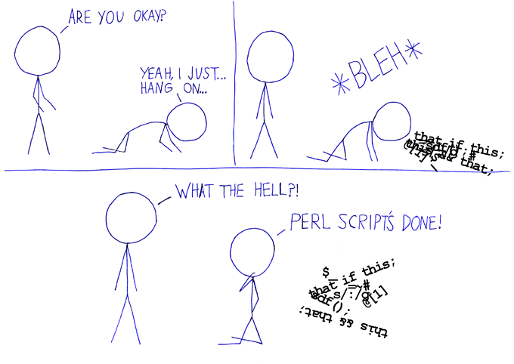
what most people think:

Slide 17
Making Perl look pretty
cpan Perl::Tidy
perltidy -pbp script.pl > new.pl
.perltidyrc if you want to make a certain style the default for all Perl scripts.
perltidy -b filename.pl
https://gist.github.com/1305940

Slide 18
before: Regex::Common t/test_balanced.t
# VOODOO LINE-NOISE
my($C,$M,$P,$N,$S);END{print"1..$C\n$M";print"\nfailed: $N\n"if$N}
sub ok{$C++; $M.= ($_[0]||!@_)?"ok $C\n":($N++,"not ok $C (".
((caller 1)[1]||(caller 0)[1]).":".((caller 1)[2]||(caller 0)[2]).")\n")}
sub try{$P=qr/^$_[0]$/}sub fail{ok($S=$_[0]!~$P)}sub pass{ok($S=$_[0]=~$P)}

Slide 19
after:
# VOODOO LINE-NOISE
my ( $C, $M, $P, $N, $S );
END { print "1..$C\n$M"; print "\nfailed: $N\n" if $N }
sub ok {
$C++;
$M .= ( $_[0] || !@_ )
? "ok $C\n"
: (
$N++,
"not ok $C ("
. ( ( caller 1 )[1] || ( caller 0 )[1] ) . ":"
. ( ( caller 1 )[2] || ( caller 0 )[2] ) . ")\n"
);
}
sub try { $P = qr/^$_[0]$/ }
sub fail { ok( $S = $_[0] !~ $P ) }
sub pass { ok( $S = $_[0] =~ $P ) }

Slide 20
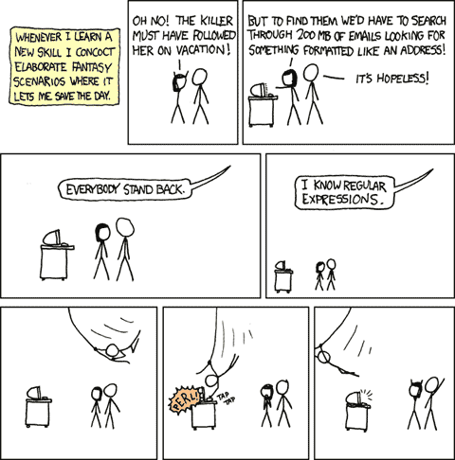

Slide 21
Fair warning. It is going to be like this:

Slide 22
