Slide 1
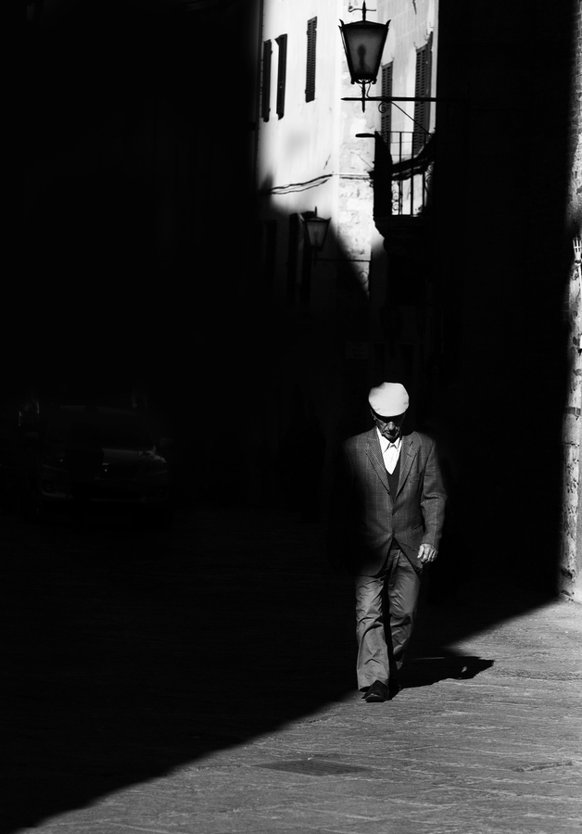
Make your website more user friendly (UX)
Slides: kimmel.github.com
Twitter: @KirkKimmel

Slide 2
This presentation is cat pics FREE.

Slide 3
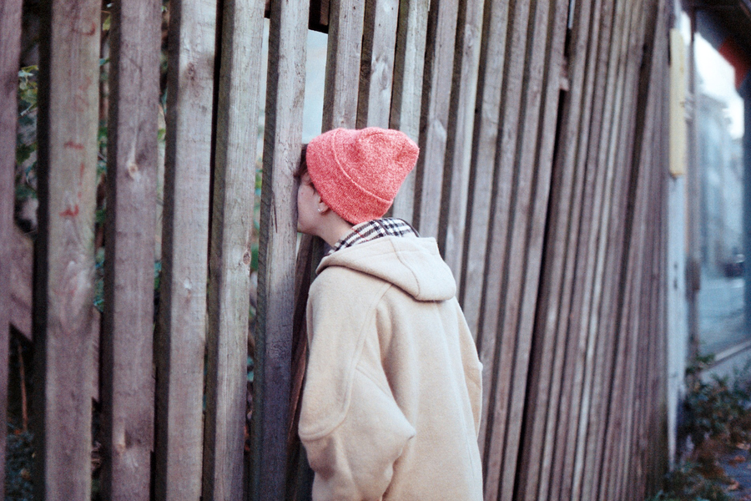

Slide 4
“Usability people are in the business of telling people their baby’s ugly,”

Slide 5
“We don’t just say, ‘Your baby’s ugly,’ we say, ‘here’s how we make this baby pretty.’ And it’s not just about pretty; it’s about useful and usable.”
- Professor Randolph Bias
University of Texas

Slide 6
Overview
A little background history and theory
How UX fits into the overall design plan
Understand your audience
The web is not print
Content and typography

Slide 7
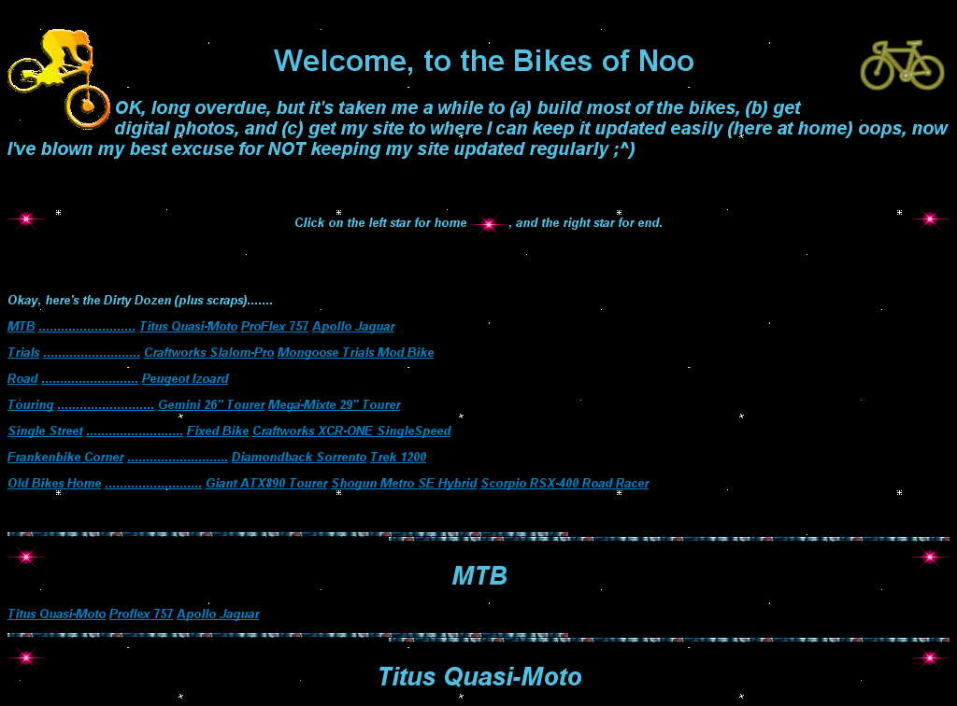

Slide 8
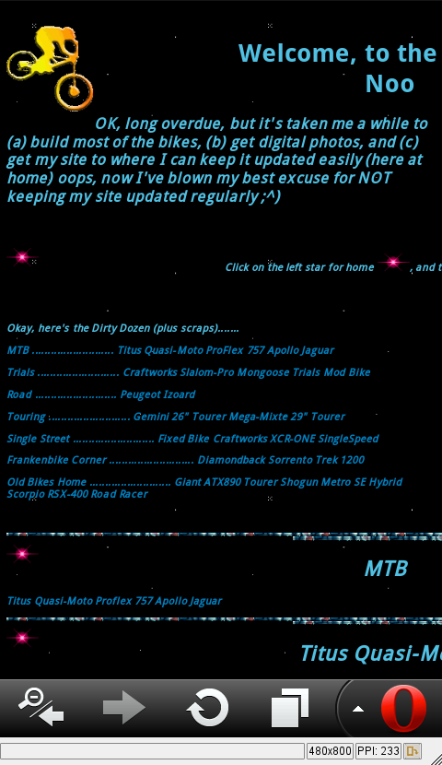

Slide 9


Slide 10
“If we want users to like our software, we should design it to behave like a likeable person.”
– Alan Cooper

Slide 11
Usability is:
Learnability
Efficiency
Memorability
Errors
Satisfaction

Slide 12
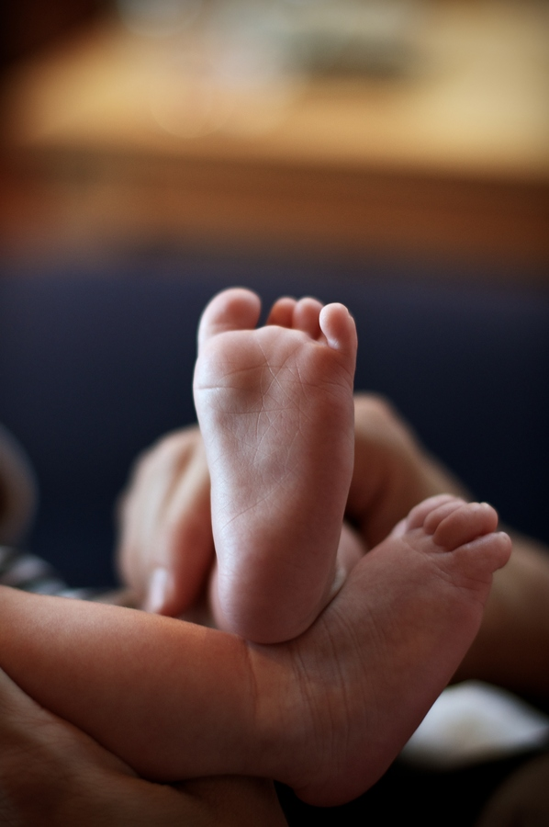

Slide 13
How UX fits into the overall design plan

Slide 14
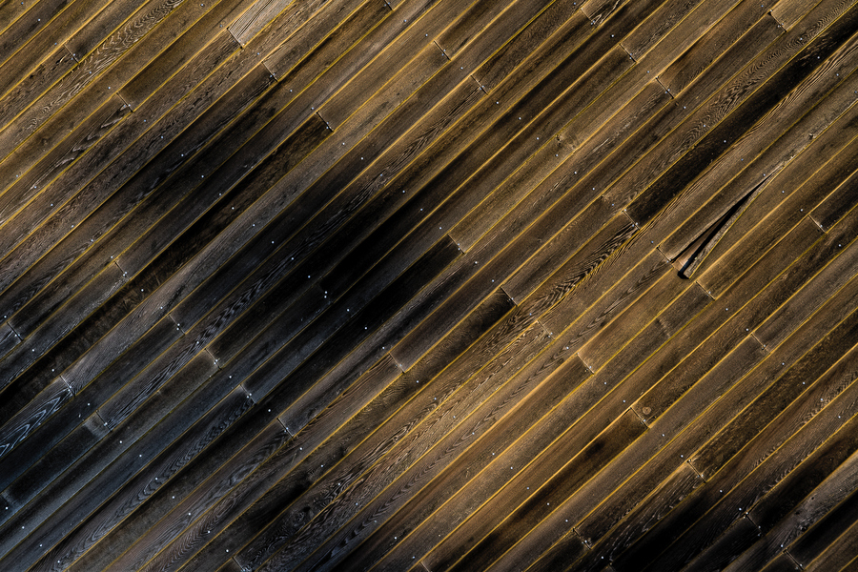
The Surface

Slide 15
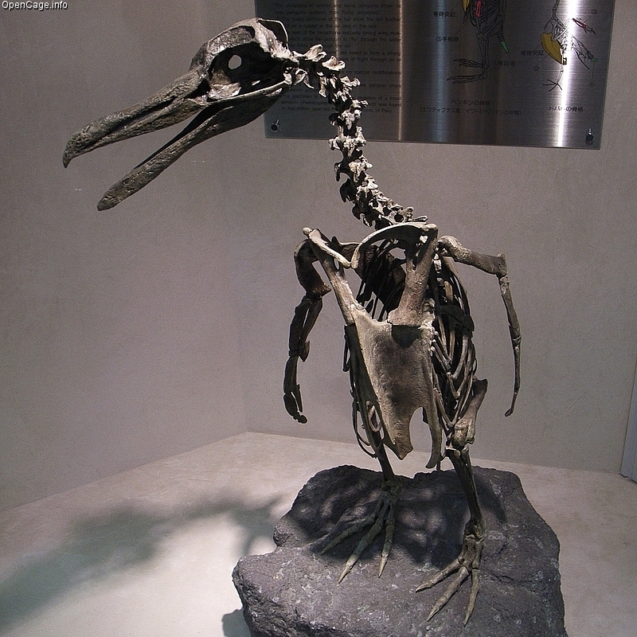
The Skeleton

Slide 16
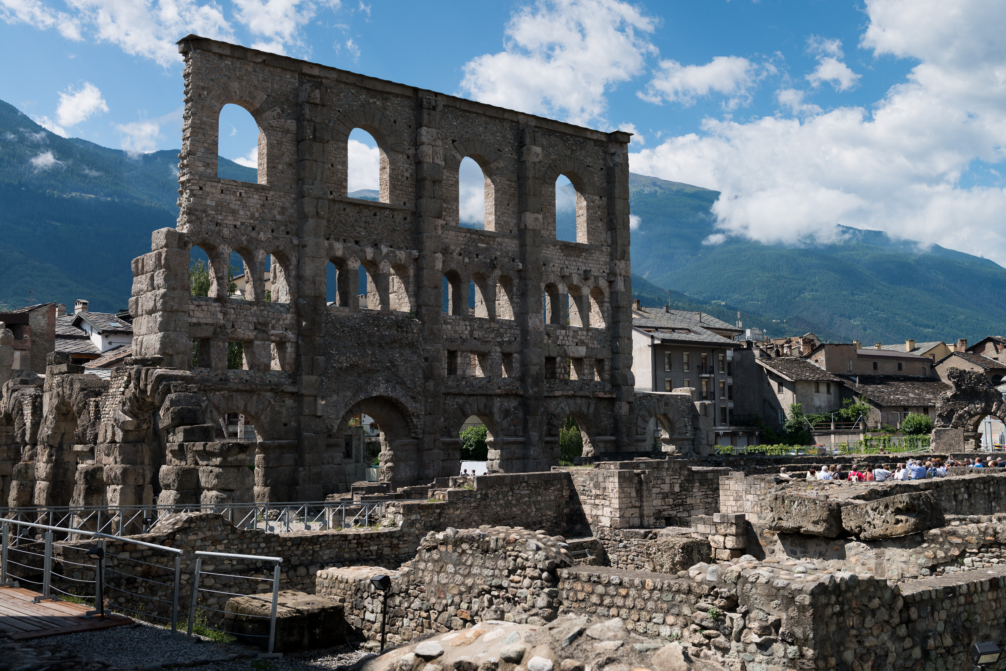
The Structure

Slide 17
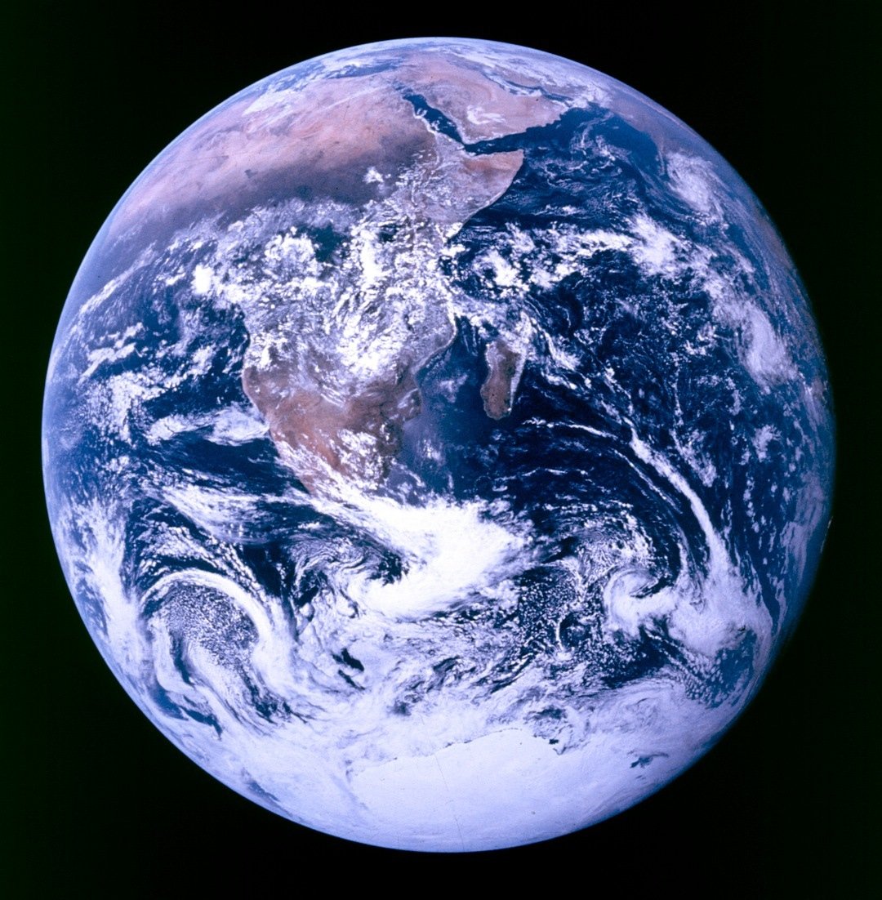
The
Scope

Slide 18
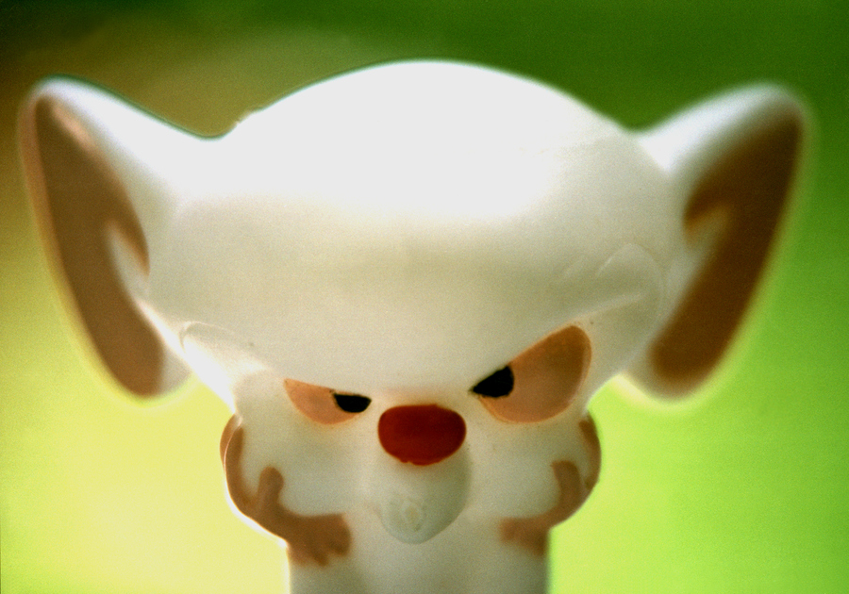
The Strategy

Slide 19
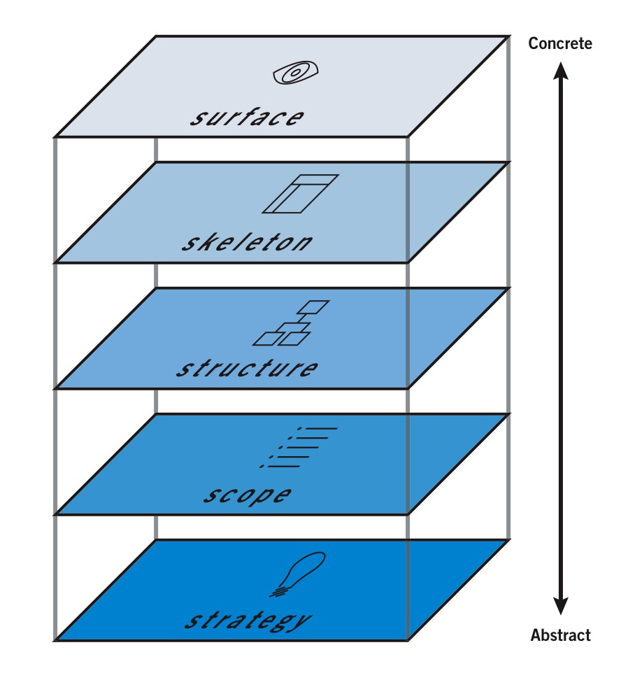

Slide 20
If it were only that simple.

Slide 21
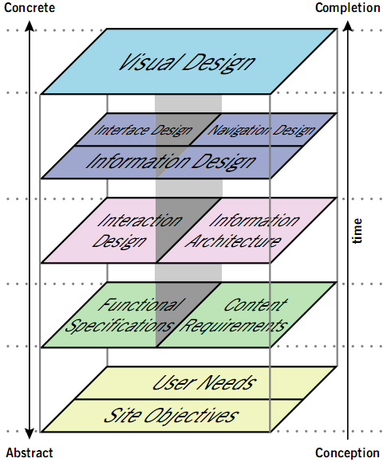

Slide 22
Alright take a deep breath.
Just know this structure exists and keep the chart handy for reference.

Slide 23
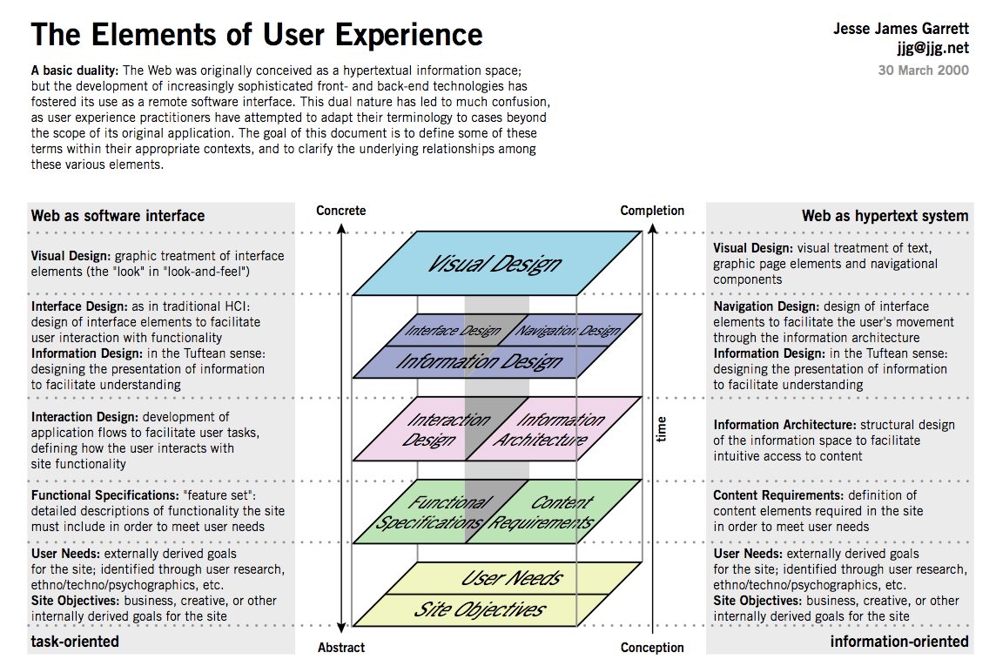

Slide 24
Understand your audience

Slide 25
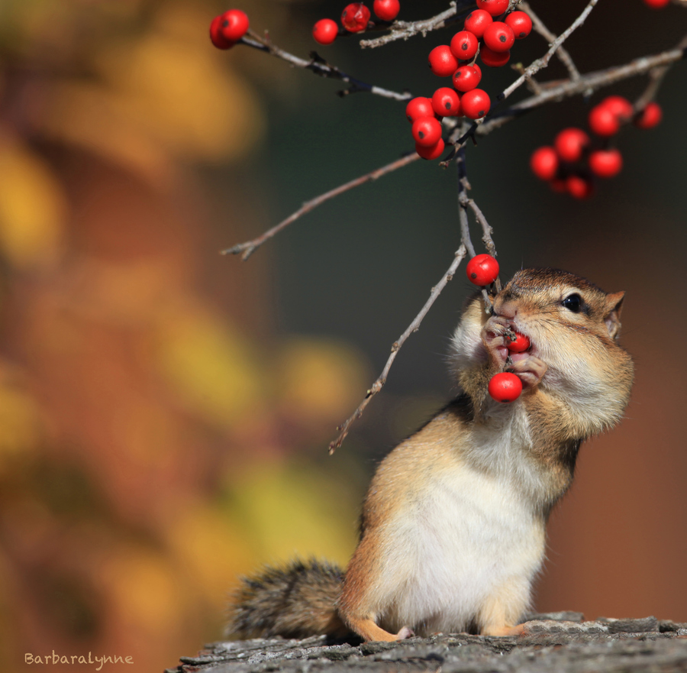

Slide 26
Prototype
Benchmark
Refine

Slide 27
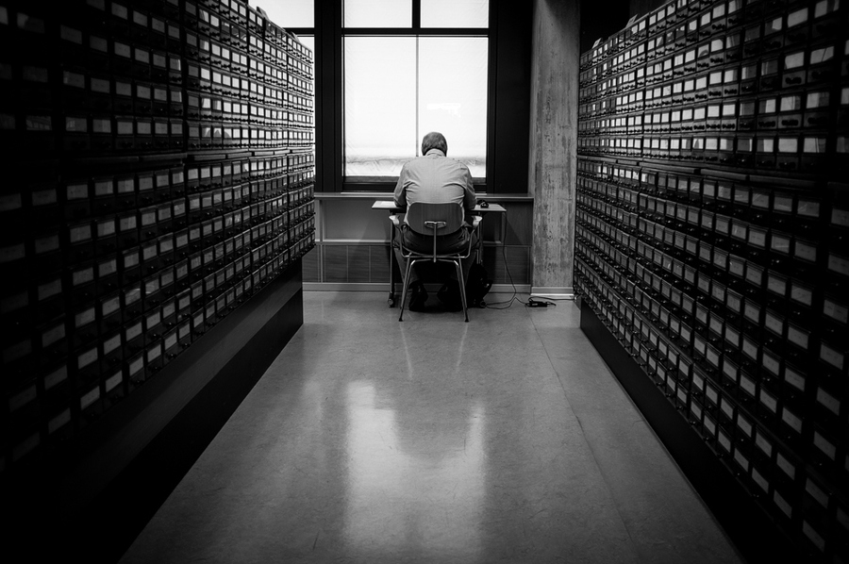

Slide 28
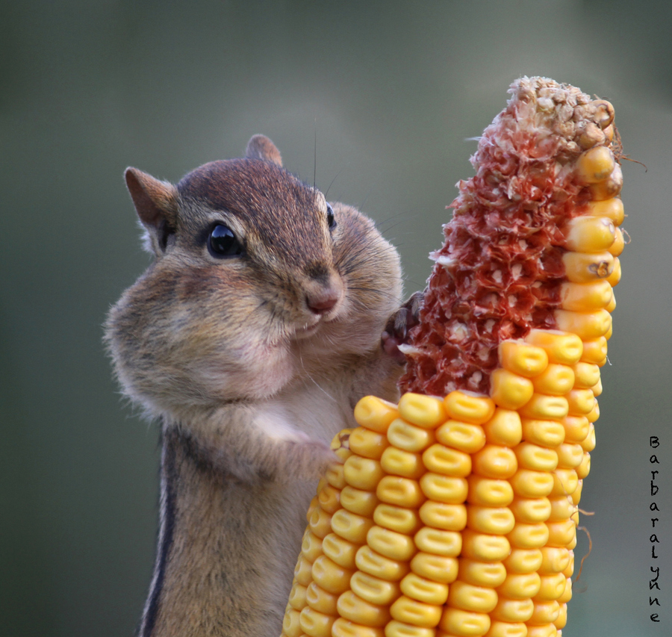

Slide 29
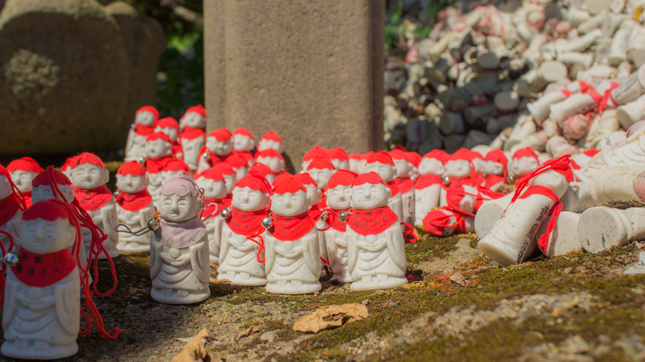

Slide 30
“The control which designers know in the print medium, and often desire in the web medium, is simply a function of the limitation of the printed page. We should embrace the fact that the web doesn’t have the same constraints, and design for this flexibility. But first, we must “accept the ebb and flow of things.”
- John Allsopp

Slide 31
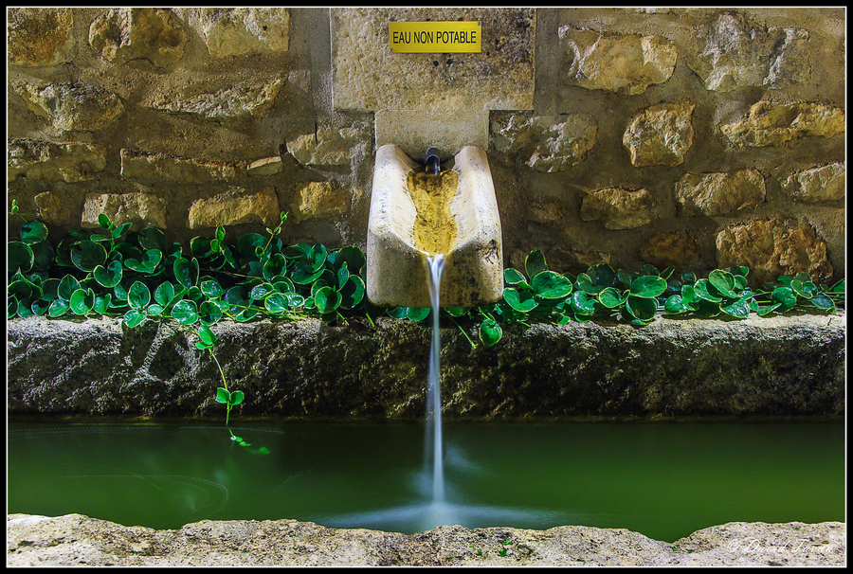

Slide 32
Content and typography

Slide 33
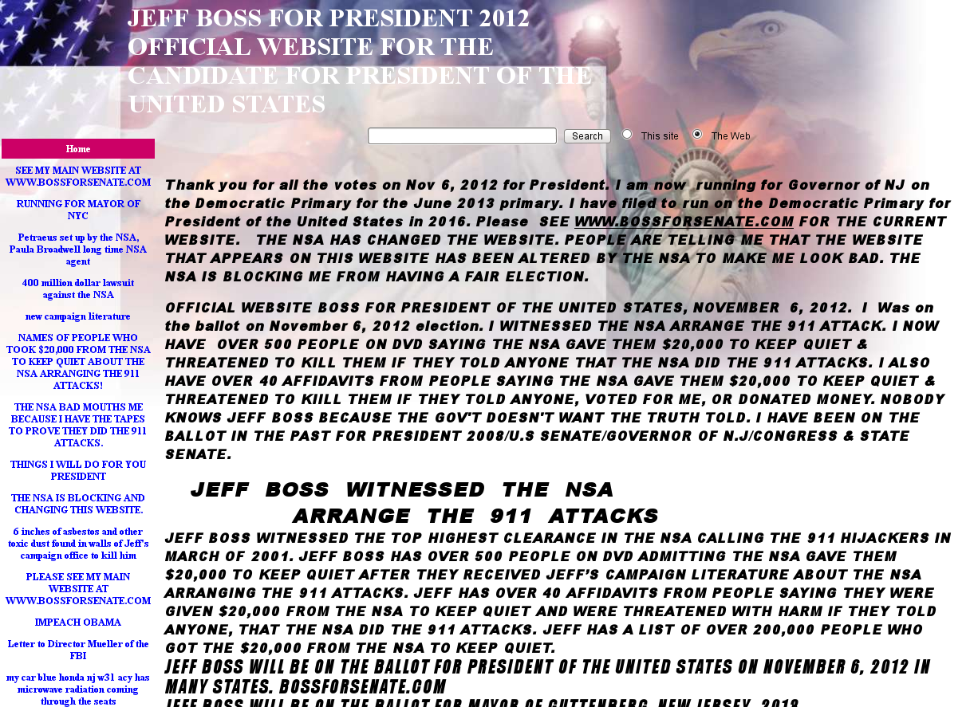

Slide 34
Got any tips?

Slide 35
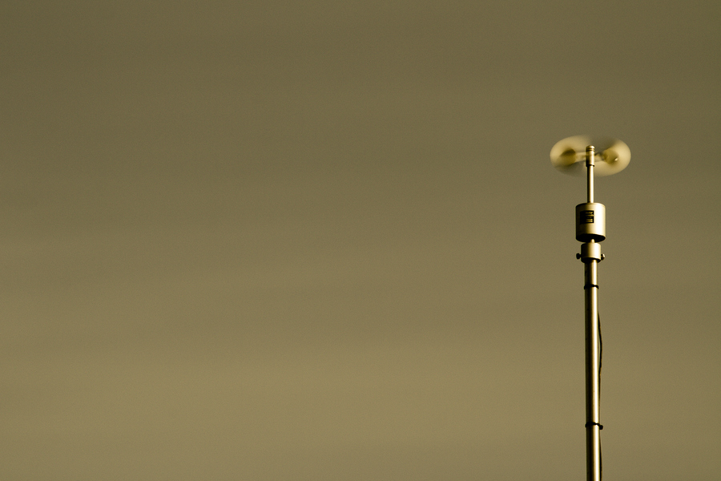

Slide 36
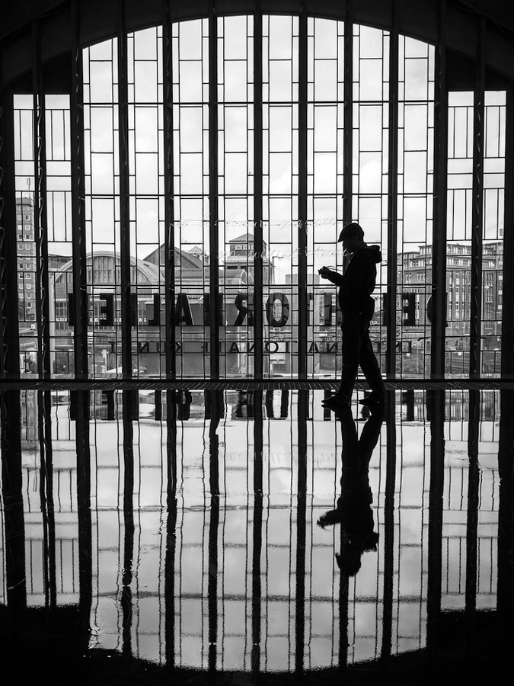

Slide 37
Examples

Slide 38
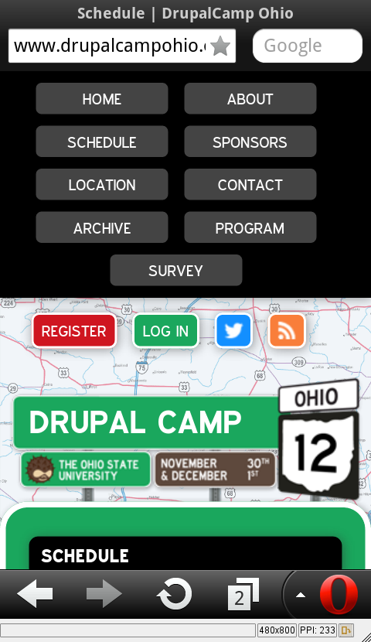

Slide 39
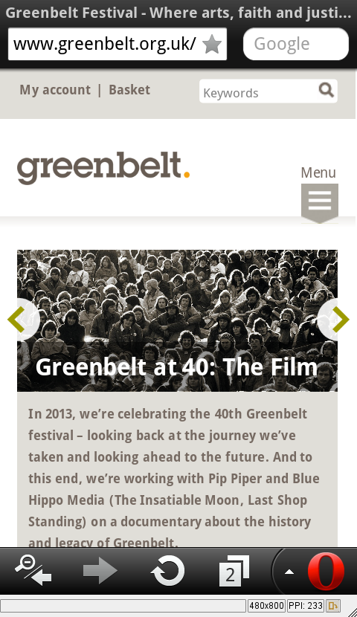

Slide 40
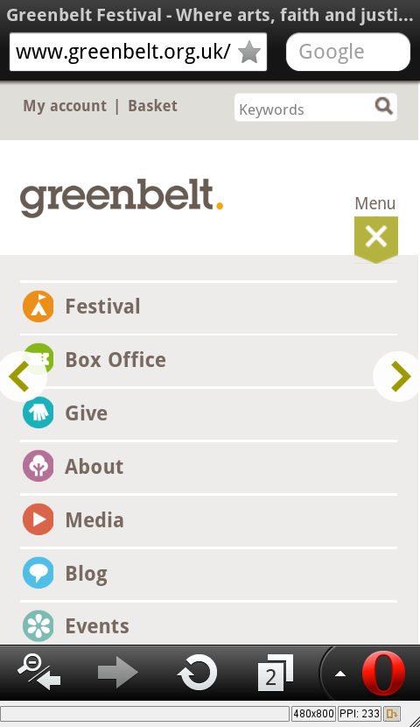

Slide 41
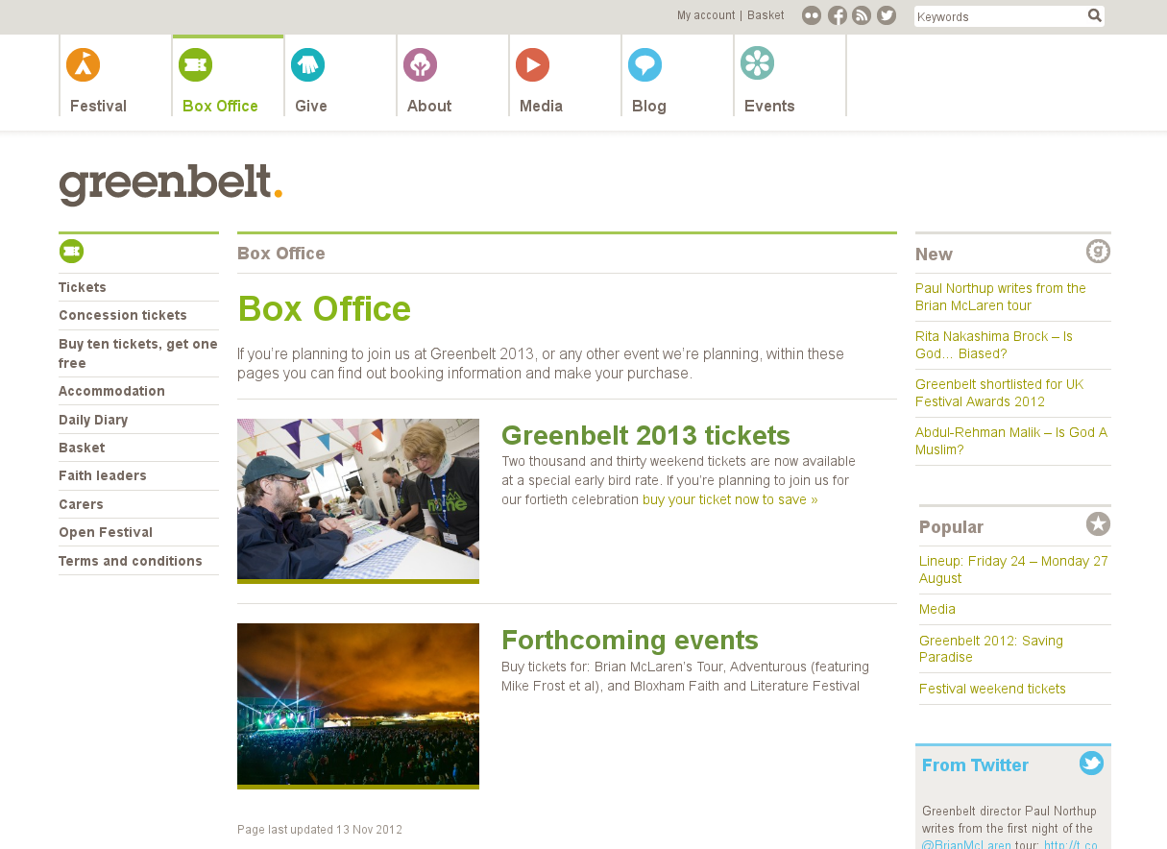

Slide 42
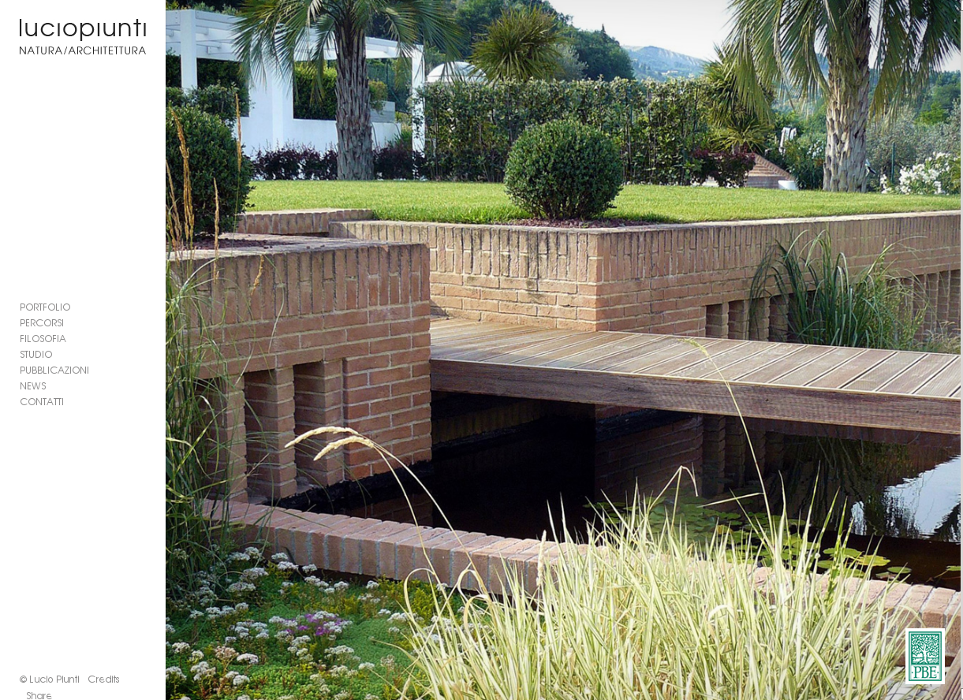

Slide 43
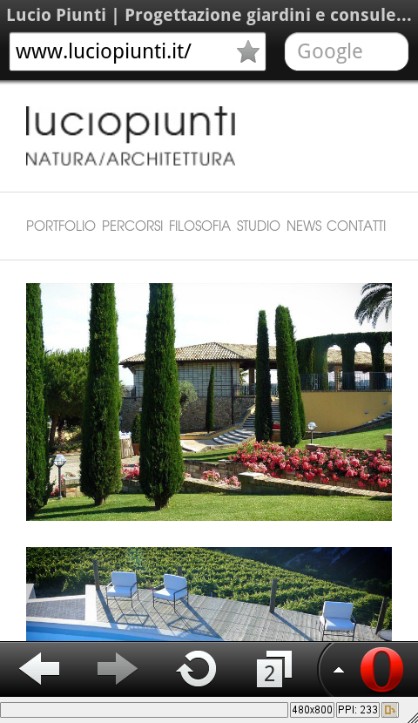

Slide 44
References:
http://500px.com/photo/18564175 - looking through fence
http://500px.com/photo/18513943 - falling water
http://500px.com/photo/17081637 - library
http://500px.com/photo/18563883 - contrast
http://500px.com/photo/1293346 - baby foot
http://500px.com/photo/9783481 - signs
http://500px.com/photo/8728971 - minimal movement
http://500px.com/photo/18352931 - at the top
http://500px.com/photo/7994458 - trash bin man
http://500px.com/photo/4609949 - time leaves
http://500px.com/photo/16100007 - purple berries

Slide 45
http://500px.com/photo/18548635 - stairs
http://500px.com/photo/18429045 - barrels
http://500px.com/photo/4766384 - chain
http://500px.com/photo/5623833 - little nibble
http://500px.com/photo/15267855 - eat everything
http://500px.com/photo/8576203 - the brain
http://500px.com/photo/6007671 - into the light
http://500px.com/photo/14020155 - red hats
http://opencage.info/pics.e/large_9185.asp - penguin skeleton
http://500px.com/photo/10121187 - window grid
http://500px.com/photo/9103367 - deck surface
http://www.fotopedia.com/items/flickr-7586194578 - structure
http://www.fotopedia.com/items/flickr-2222548359 - earth
http://www.jjg.net/elements/pdf/elements_ch02.pdf - Usability planes
Books:
The Elements of User Experience by Jesse James Garrett
Designing Web Usability by Nielsen
The Design of Everyday Things by Norman
About Face 3.0: The Essentials of Interaction Design by Cooper

