Slide 1
Advanced Video Production with FOSS
by Kirk Kimmel

Slide 2
WARNING:
The slides for this presentation are available online < kimmel.github.com > licensed under a Creative Commons Attribution-NonCommercial-ShareAlike 3.0 Unported License.
This presentation is not the end all be all in this area. It is a “short” overview.
All comics and images are copyright their respective owners and are used solely for educational purposes.

Slide 3
How many people select a product:

Slide 4


Slide 5
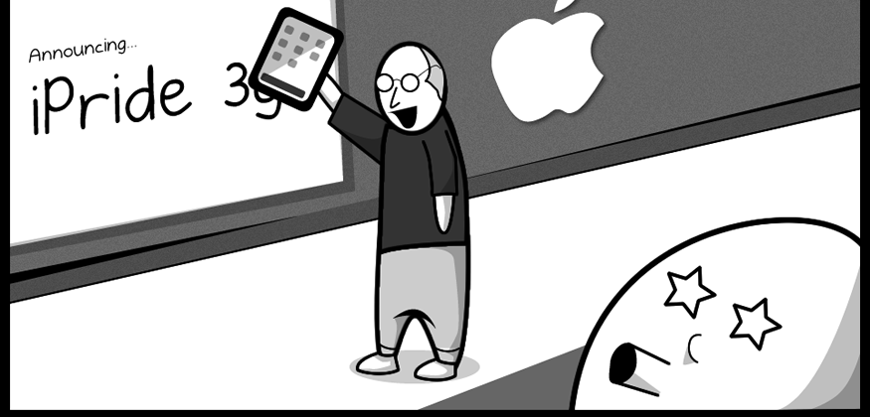
Hear about the new product

Slide 6
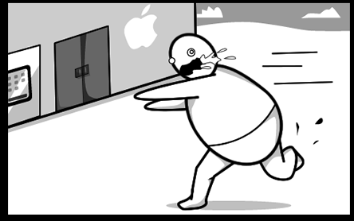
Undignified race to the store

Slide 7
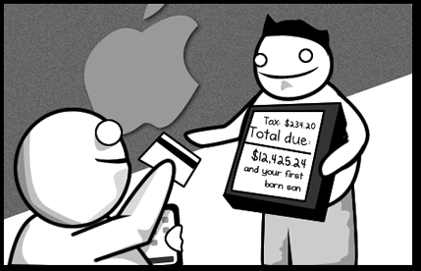
Spend money you do not have

Slide 8

Technology Nirvana

Slide 9

butterflys on the wind

Slide 10
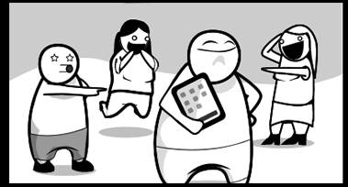
New Product Envy
[Commonly mistaken for coolness.]

Slide 11
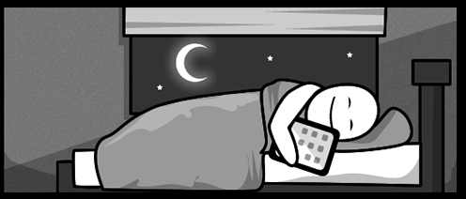
All is right in the world

Slide 12
suddenly

Slide 13
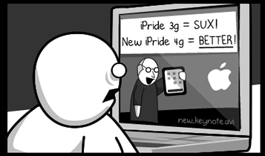
A new product is released
[The marketing machine at work]

Slide 14
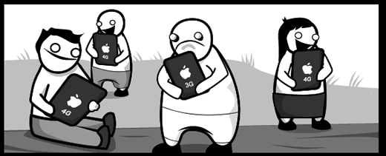
Sudden on set Dissatisfaction

Slide 15
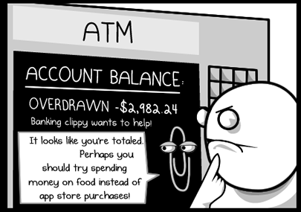
Still ain't got no money!

Slide 16
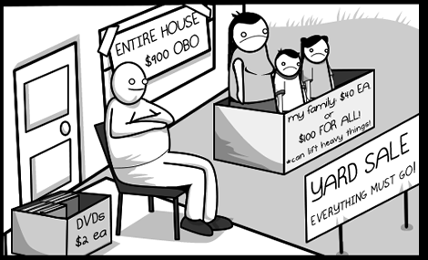
craigslist

Slide 17
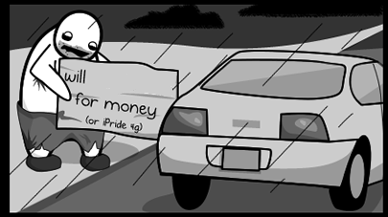
Got a second job

Slide 18

Buy the new version

Slide 19
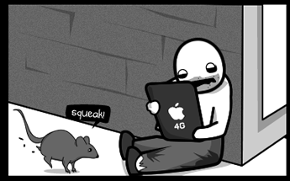
Addiction fed

Slide 20


Slide 21
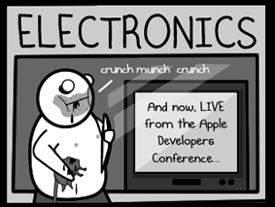
a little while later
[Marketing Machine 2: The Return]

Slide 22
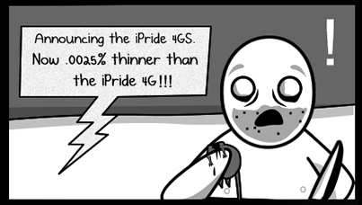
A new version is RELEASED!!1!

Slide 23


Slide 24

desolation

Slide 25
The Big, Big picture
Why video edit and produce the way being presented?
Some reasons are historical
Some reasons are practical
None are optimal.

Slide 26
Super fast Definitions
SMPTE
SMPTE timecode
EDL
Offline Editing
Online Editing
Rec 709
NLE

Slide 27
File Formats
EXR - OpenEXR
DPX - Digital Picture Exchange
mxf - Material eXchange Format
aaf - Advanced Authoring Format
VC-1, VC-2, DNxHD

Slide 28
The Macro Overview
Pre-Production
Production
Post Production
This work flow has proven collaborative and platform / toolset benefits.

Slide 29
Pre-Production Encapsulates
planning
scouting
discussion, etc about props
costumes
concept art
etc...

Slide 30
Production
Filming the project

Slide 31
Post Production
Logging the daily footage
Offline - Editing, timing, storytelling, and fine-tuning your edits
Online - image quality, color correction, maintaining broadcast video specifications, special effects work, titles, audio levels, etc.
Mastering - Encode a master for the target medium (DVD, Blu-Ray, cell phone, internet)

Slide 32
and now a message from Scotty

Slide 33

How many times do I have to tell you, the right tool for the right job! - Star Trek V

Slide 34
Lets repeat
You need the correct tool for the job.
To select the correct tool you must first define what the job is.

Slide 35
The “Hollywood Tools”
Editing
  Avid Media Composer, Lightworks
Compositing, visual effects, color grading
  Nuke, Shake, Smoke, Houdini, Cinema 4D, Photoshop, Pro Tools, Maya, DaVinci

Slide 36


Slide 37
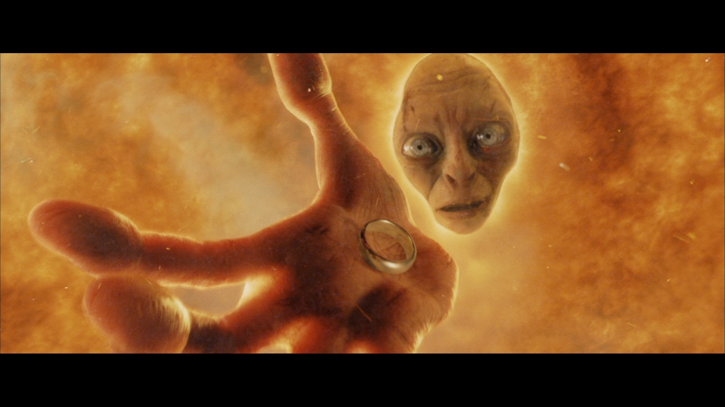

Slide 38


Slide 39
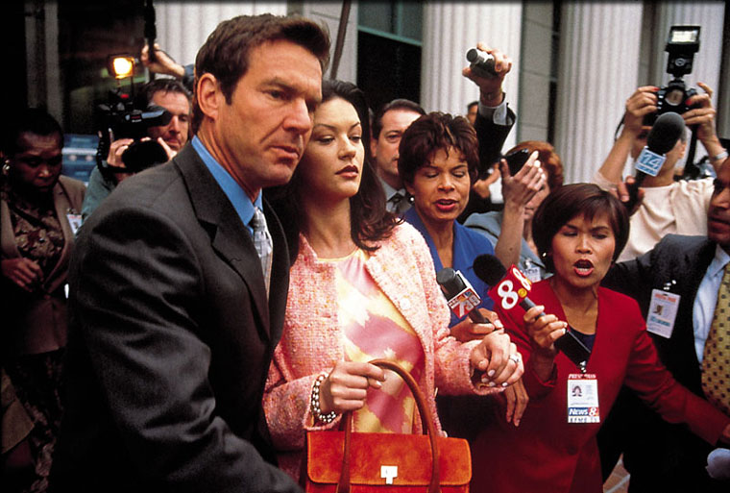

Slide 40
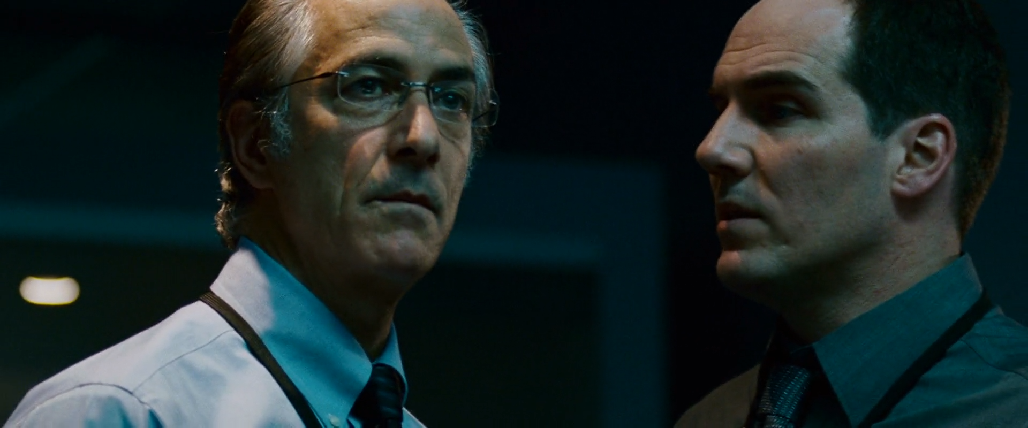

Slide 41
Lets take one of each
NLE - Media Composer by Avid - $2,295
Image Editor - Photoshop CS5 by Adobe - $699
Composite/Grading - Nuke by The Foundry - $4900
Audio Mixing - Pro Tools by Avid - $599
3d - Maya by Autodesk - $3,495
Grand Total: $11,988

Slide 42
missing features
EDL / AAF support in the NLE and audio editors.
EDL and AAF are both formal standards implemented by the hollywood tools for exchanging project information. Without this capability there is no way to plug into the existing tool chains.
Blender has EDL support through a python addon script that is not production ready.

Slide 43
missing features
time code support in the toolchain starting with ffmpeg
Time code support is vital for EDL/AAF processing and is the existing standard for syncing audio and video.
deep painting. Painting on a large image (20k by 20k for example) in real time with no lag.
Support for the Red Camera files. This is blocked by the North American EULA and the camera's proprietary format.

Slide 44
missing features
Asset management tasks
Having proxied copies locally and full resolution copies on a SAN, or a custom file server.
Revision control
EDL support
Metadata
Preview

Slide 45
How bad is it?

Slide 46
ideas
Art and design is far closer to the nebulous and slippery world of sociology and anthropology than "IT COMPILED! We're good to go."
YES it worked, NO it didn't versus an infinite complexity of grey tones. As art is open to interpretation and there is no correct answer or definitive take.

Slide 47
I am going to spell the word culture for the audience.
c-U-l-t-U-r-e
Why aren't there any designers working with open source?

Slide 48
There are many factors as to why designers are scarce inside open source development groups. My first hand experience of the open source community includes a hostile environment where users are rude and if you are not happy with a product they claim it is your fault. Whether it be on irc, mailing lists, forums or in person open source developers have a tendency to be arrogant, dismissive and mean spirited when it comes to opinions that challenge their own.

Slide 49
Here is an example that people often misinterpret which leads to nerd rage.

Slide 50
Adobe Photoshop's History
Adobe is founded in 1982.
October 1988 - 0.63 released for Macintosh
November 1992 - 2.5 released for Macintosh with 16-bit per channel support.

Slide 51
Gimp
February 1996 - version 0.54 released
June 5 1998 - 1.0 released as stable.
Bug 74224 - Add support for 16 bits per channel was opened on 2002-03-11. Gimp still does not have full 16-bit color support across all operations yet.
https://bugzilla.gnome.org/show_bug.cgi?id=74224

Slide 52
Gimp
Looking back through the mailing list archive 16-bit support had been talked about numerous times before 2002. An email from 2000 mentions the “Film Gimp” fork which already has deep image support.
http://lists.xcf.berkeley.edu/lists/gimp-developer/2000-September/013258.html

Slide 53
Stop the presses
Gimp is not a panacea or a golden hammer.
Gimp has a development road map, a target audience for their application and people use it.
Gimp is not photoshop
Once again this is a right tool for the job solution.
There are other raster image editors out there in the open source world.

Slide 54
Cinepaint
Formerly known as “Film Gimp”, “Hollywood Gimp”
Development started in 1998 on Gimp 1.0.4
This fork was specifically created to add 16-bit per channel support.
Jon Cohen said it best in a 2002 email “filmgimp and gimp fulfill fundamentally different needs. The needs of high-end film production are quite different from the needs of web publishers...”

Slide 55
Krita
Formerly known as “KImageShop” and “Krayon”
Initially released on June 21, 2005.
Has 16-bit color support.
Has EXR support but not built in by default in most distributions and custom builds seem to have significant problems when attempting it by hand.
DPX support, I could not get it compiled in.

Slide 56
Making Post-Production on Linux Easier
^_^

Slide 57
Compiling Krita is easy
On this forum thread there are 2 very active scripts for fetching and building krita from git.
http://forum.kde.org/viewtopic.php?f=139&t=92880&start=120
Script to Compile Krita & Karbon for You (page 1)
krita from source (page 9)

Slide 58
Metadata
Lets see it now
mediainfo - http://mediainfo.sourceforge.net/en
What can I see now?

Slide 59
Blender from source
Works on Ubuntu 10.04 and OpenSUSE 11.3/11.4
Handles blender, ffmpeg, x264 building and dependency installation.
https://github.com/kimmel/Blender-from-source

Slide 60
Proxying and syncing
ffmpeg (ffmpeg.org)
libav (libav.org)
FFMedia Broadcase ( code.google.com/p/ffmbc/ )
Get the frames as PNG files
Encoding speed ups

Slide 61
Disk I/O bottlenecks
Do not place the source material and the destination on the same physical drive
tmpfs for source or destination
Raid
SSD
Use work prints when possible

Slide 62
To Avid, etc...
ffmpeg or ffmbc
mxf file format
DNxHD bitrates are determined by video resolution and frame rate.
Blender EDL support (consider alpha) via Python script.

Slide 63
Lightworks
Beta release for Linux on December 19th 2011
Open Source code release Quarter 3, 2012
Based on the released technical specs Lightworks when released as open source will be more feature complete than any open source NLE currently in development.

Slide 64
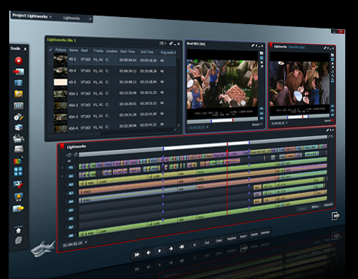

Slide 65
Adjusting video speed
Speeding up a video is no problem.
Slowing video down is a far more complex process.
GREYC's Magic Image Converter (G'MIC)
http://gmic.sourceforge.net/
Calculates frame to frame motion allowing new frames to be generated.

Slide 66
Special Effects
G'MIC
ImageMagick
GraphicsMagick
Can be used in batch mode to create special effects, and do color correction.

Slide 67
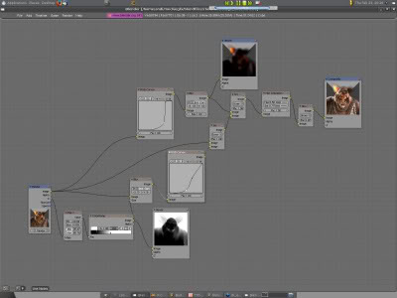

Slide 68
The Linux Kernel
2.6.31 - PROT_EXEC page management now keeps running programs on top of the active memory pages instead of getting swapped to disk.
Translation: up to 50% faster on computers with limited system memory available.

Slide 69
The Linux Kernel
2.6.38
Transparent huge page (THP) - Huge pages are used automatically where possible.
Translation: Your system now runs up to 10% faster on almost all workloads with no configuration changes.
Automatic process grouping
Translation: The kernel performs better under heavy load.
VFS scalability
Translation: A speed up when accessing directories and files.

Slide 70
Questions?

Slide 71
References
A Short Guide to Writing about Film 6th edition by Timothy J, Corrigan
Dictionary of Narratology by Gerald Prince
Final Cut Pro 6 User Manual
Avid Media Composer User Manual
Avid DNxHD Technology White Paper
https://lists.xcf.berkeley.edu/lists/gimp-developer/2002-December/007794.html
http://kernelnewbies.org/
https://lwn.net/Articles/423584/
The Linux Kernel Mailing List

