Slide 1
MSC 572 Dr. Chad Kimmel
Continuation of Probability Distributions

Slide 2
Overview
Properties of Theoretical Distributions
Will use R as a probability distribution calculator
How to Look-Up Theoretical Distributions
Random-variate Distribution

Slide 3
Properties of Theoretical Distributions
Support
Mean, Median, Mode and Variance
Probability Density Function
Distribution Parameters
Cumulative Distribution Function
Inverse Cumulative Distribution Function
For all functions, will show how to manually calculate and then how to calculate using R

Slide 4
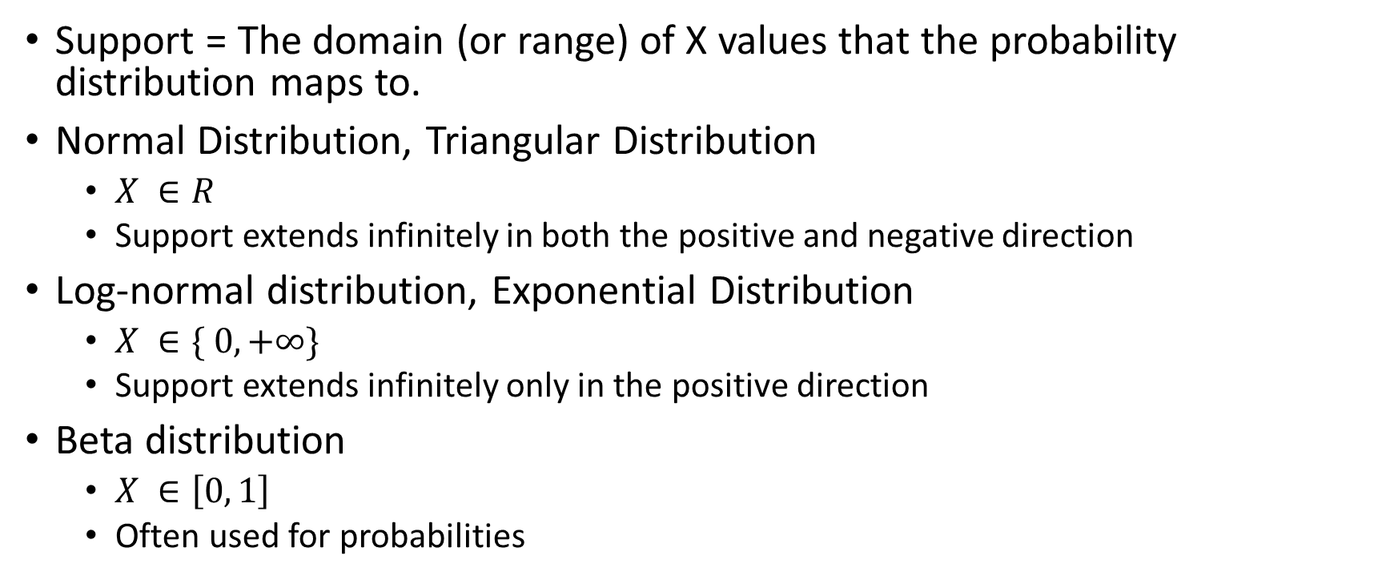
Support
Support = The domain (or range) of X values that the probability distribution maps to.
Normal Distribution, Triangular Distribution
$X ∈R$
Support extends infinitely in both the positive and negative direction
Log-normal distribution, Exponential Distribution
$X ∈\{ 0, +∞\}$
Support extends infinitely only in the positive direction
Beta distribution
$X ∈\left[0, 1\right]$
Often used for probabilities

Slide 5
Mean, Median, Mode, Variance
For every theoretical distribution, you can calculate the theoretical mean (the Expected Value), median, mode and variance.
Equations are often provided to you
Always a function of the distribution parameters.
The mean (or the expected value) E(X) is simply the X_{i} outcomes multiplied by the probabilities of each outcome p_{i}, all summed together.
Roll of a dice: E(X) = 1 * (1/6) + 2 * (1/6) + 3*(1/6) + 4*(1/6) + 5*(1/6) + 6*(1/6) = 3.5
Uniform Distribution
Distribution parameters are a (MIN), b (MODE) and c (MAX)
Mean = ½ * (a + b)
Median = ½ * (a + b)
Mode = any value in (a, b)
Variance = (1/12) * (b-a)²

Slide 6
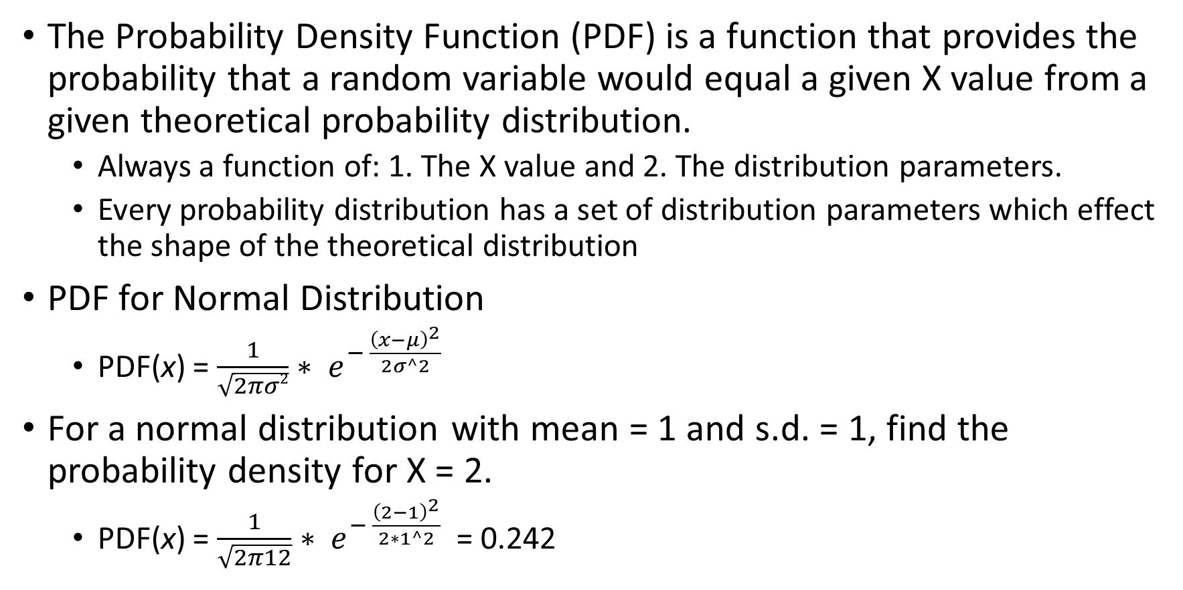
Probability Density Function
The Probability Density Function (PDF) is a function that provides the probability that a random variable would equal a given X value from a given theoretical probability distribution.
Always a function of: 1. The X value and 2. The distribution parameters.
Every probability distribution has a set of distribution parameters which effect the shape of the theoretical distribution
PDF for Normal Distribution
PDF(x) = $\frac{1}{\sqrt{2πσ2}}∗ e^{− \frac{{\left(x−μ\right)}^{2}}{2σ^2}}$
For a normal distribution with mean = 1 and s.d. = 1, find the probability density for X = 2.
PDF(x) = $\frac{1}{\sqrt{2π12}}∗ e^{− \frac{{\left(2−1\right)}^{2}}{2∗1^2}}$ = 0.242

Slide 7
Probability Density Function in R
What is the probability density at point X = 2 using parameters mean = 1 and sd = 1 for a normal distribution?
dnorm(x = 2, mean = 1, sd = 1)
What is the probability density at point X = 0.4 using parameters alpha = 0.5 and beta = 0.5 for a beta distribution?
dbeta(x = 0.4, shape1 = 0.5, shape2 = 0.5)
What is the probability density at point X = 3 using parameters mean = 1, sd = 0 for a log-normal distribution?
dlnorm(x = 3, mean = 0, sd = 1)
What is the probability density at points X = [1, 2, 3] using parameters mean = 1, sd = 0 for a log-normal distribution?
dlnorm(x = c(1, 2, 3), mean = 0, sd = 1)
The “d” part of the above functions means density

Slide 8
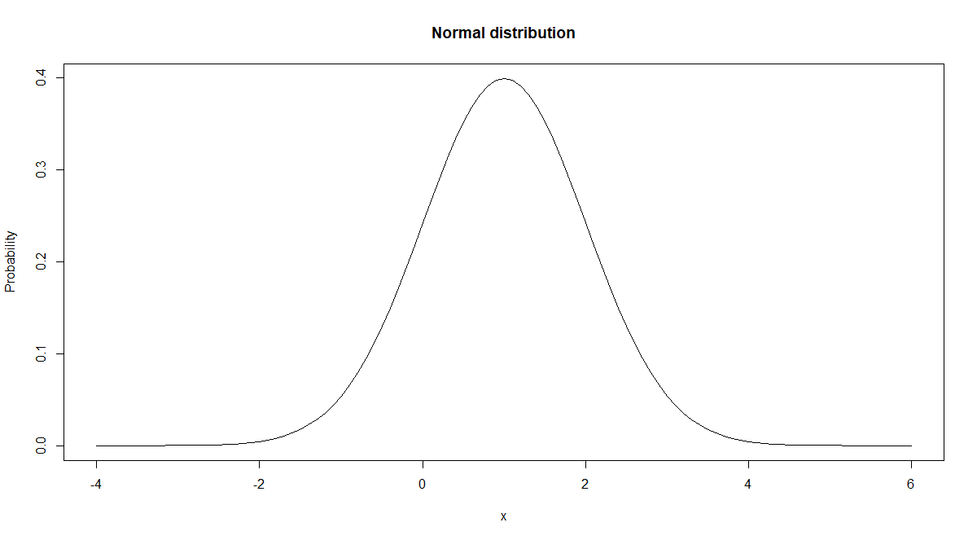
Visual Example of PDF Function
Probability Density Function for Normal Distribution with Mean = 1 and SD = 1 at X=2
0.242
X = 2

Slide 9
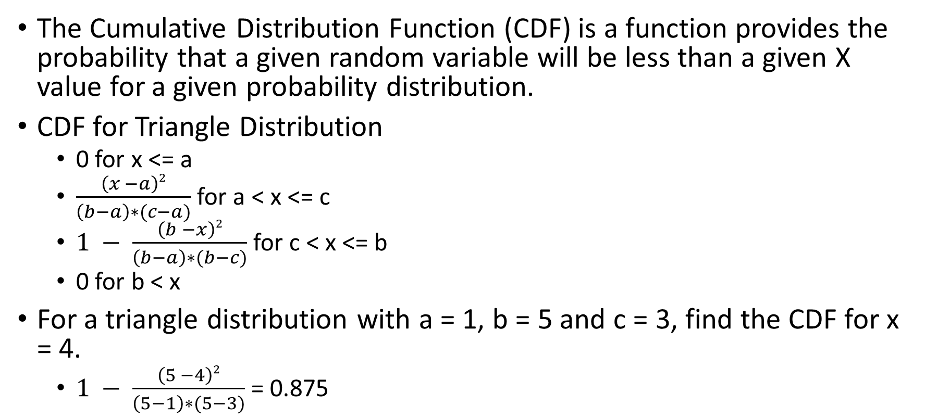
Cumulative Distribution Function
The Cumulative Distribution Function (CDF) is a function provides the probability that a given random variable will be less than a given X value for a given probability distribution.
CDF for Triangle Distribution
0 for x <= a
$\frac{\left(x −a\right)2}{\left(b−a\right)∗(c−a)}$ for a < x <= c
$1 − \frac{\left(b −x\right)2}{\left(b−a\right)∗(b−c)}$ for c < x <= b
0 for b < x
For a triangle distribution with a = 1, b = 5 and c = 3, find the CDF for x = 4.
$1 − \frac{\left(5 −4\right)2}{\left(5−1\right)∗(5−3)}$ = 0.875

Slide 10
Cumulative Distribution Function in R
What is the cumulative density at X = 4 using parameters a = 1, b = 5, c = 3 for the triangle distribution?
require(triangle) #May need to download triangle package. See previous.
ptriangle(q = 4, a = 1, b = 5, c = 3)
What is the cumulative density at point X = 0.7 using parameters alpha = 0.5, beta = 0.5 for the beta distribution?
pbeta(q = 0.7, shape1 = 0.5, shape2 = 0.5)
What is the cumulative density at point X = 0.5 using parameters min = 0, max = 1 for the uniform distribution?
punif(q = 0.5, min = 0, max = 1)
What is the cumulative density at points X = [0.1, 0.3, 0.7] using the same parameters as above for the uniform distribution?
punif(q = c(0.1, 0.3, 0.7), min = 0, max = 1)
The “p” means probability.

Slide 11
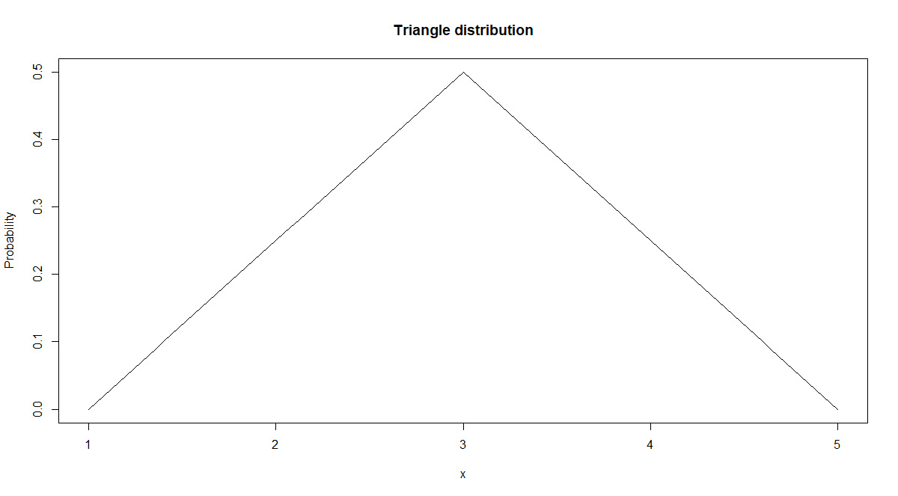
Visual Example of CDF Function
Triangle Distribution with a = 1, b = 5 and c = 3
CDF (X = 4) is the percent of the area under the probability density curve that is less than X= 4
AUC = ?
X = 4

Slide 12
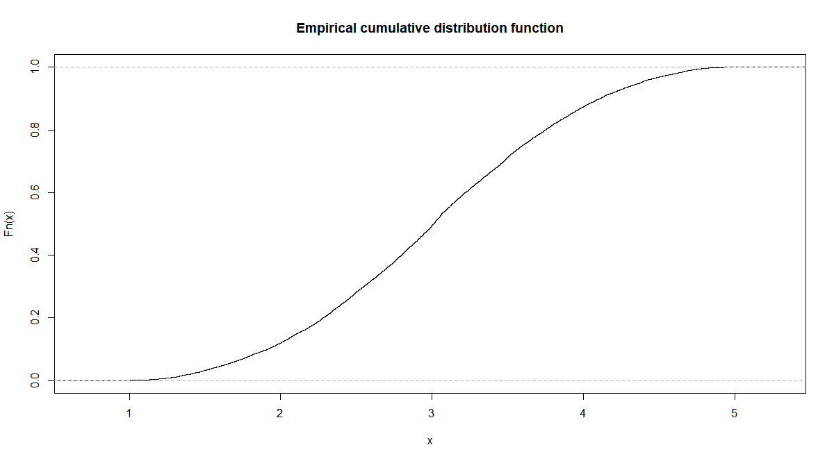
Graphical Example of CDF for Triangular(1,5,3)
CDF(X) = 0.875
X = 4
x.triangle = rtriangle(100000, 1, 5, 3)
plot(ecdf(x.triangle),main='Empirical cumulative distribution function')

Slide 13
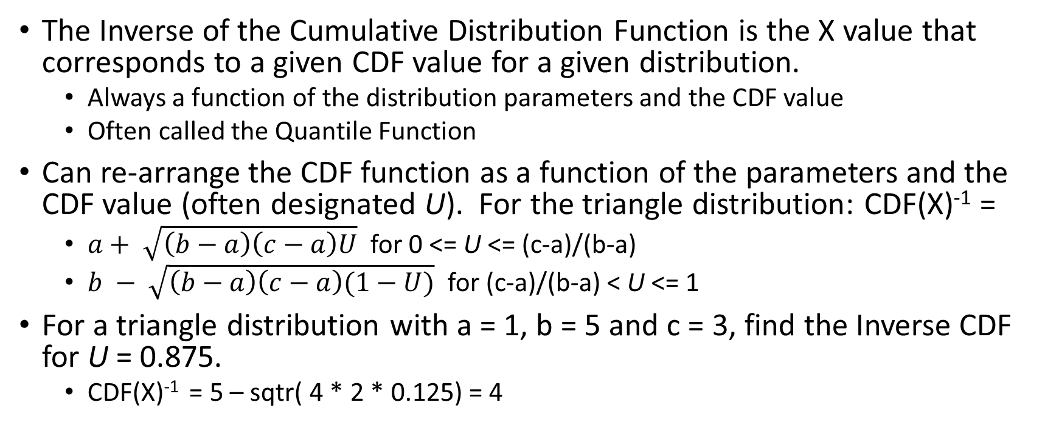
Inverse Cumulative Distribution Function
The Inverse of the Cumulative Distribution Function is the X value that corresponds to a given CDF value for a given distribution.
Always a function of the distribution parameters and the CDF value
Often called the Quantile Function
Can re-arrange the CDF function as a function of the parameters and the CDF value (often designated U). For the triangle distribution: CDF(X)⁻¹ =
$a+ \sqrt{\left(b−a\right)\left(c−a\right)U}$ for 0 <= U <= (c-a)/(b-a)
$b − \sqrt{\left(b−a\right)\left(c−a\right)(1−U)}$ for (c-a)/(b-a) < U <= 1
For a triangle distribution with a = 1, b = 5 and c = 3, find the Inverse CDF for U = 0.875.
CDF(X)⁻¹ = 5 – sqtr( 4 * 2 * 0.125) = 4

Slide 14
Inverse Cumulative Distribution Function in R
What is the Inverse CDF for U = 0.875 using parameters a = 1, b = 5 and c = 3 for the triangle distribution?
qtriangle(p = 0.875, a = 1, b = 5, c = 3)
What is the inverse CDF for U = 0.5 using parameters mean = 0, sd = 1 for the normal distribution?
qnorm(p = 0.5, mean = 1, sd = 1)
What is the inverse CDF for U = 0.2 using parameters alpha = 0.5, beta = 0.5 for the beta distribution?
qbeta(p = 0.2, shape1 = 0.5, shape2 = 0.5)
What is the inverse CDF for U = [0.1, 0.6, 1.0] using parameters alpha = 0.5, beta = 0.5 for the beta distribution?
qbeta(p = c(0.1, 0.6, 1.0), shape1 = 0.5, shape2 = 0.5)
“q” means quantile

Slide 15
Visual Example of Inverse CDF Function
Triangle Distribution with a = 1, b = 5 and c = 3
CDF(0.875)⁻¹ is the X value that corresponds to an area under the curve value of 0.875.
AUC = 0.875
X = ?

Slide 16
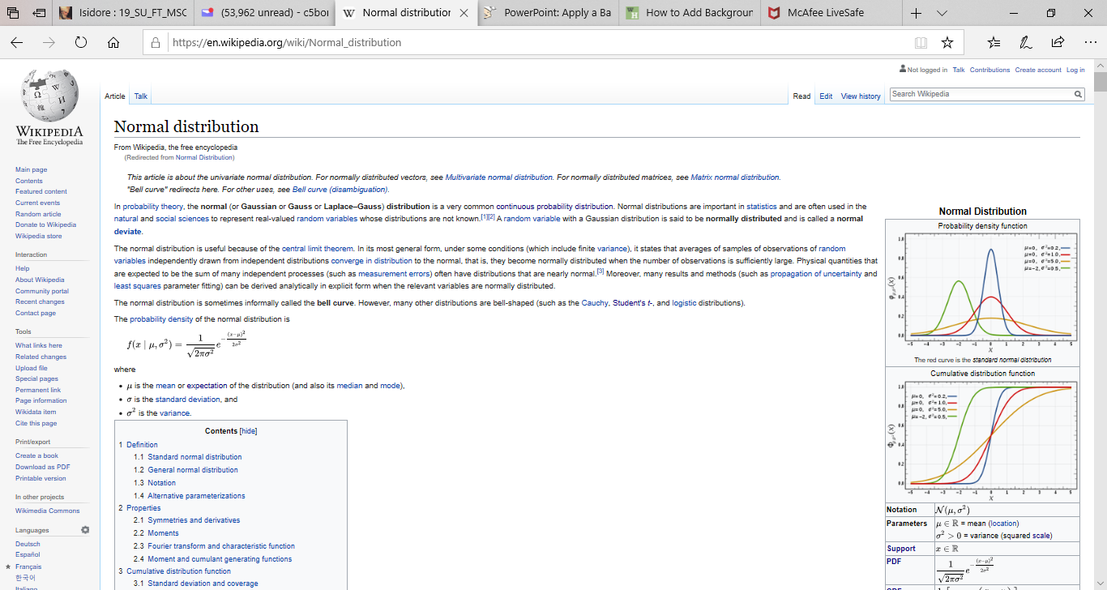
Theoretical Distributions Look-Up
Can use Wikipedia to look-up theoretical distribution properties
Don’t worry about the theoretical jargon (for another course).
Pay attention to the Probability Density/Mass Function and all relevant properties in the right-hand box.
Watch parameterization!! Different software and sources may re-order the exact the same parameters or even have a slightly different parameterization
The triangle distribution can sometimes have parameters in two different orders. In R: (min, max, mode). In Simio: (min, mode, max)
R models the exponential distribution as parameter λ. Simio models the exponential as parameter 1/ λ.
Always verify that distributions match from different sources or software.
Distribution Properties

Slide 17
Theoretical Distributions Look-up
Continuous Distributions To Look-Up
Normal Distribution
Log-Normal Distribution
Gamma distribution
Exponential Distribution
Very commonly used in simulations since it cuts off at 0 on the left side (the Support)
NOT the same as the exponential family of distributions which includes the exponential distribution but also normal, binomial gamma, etc.
Student’s t distribution
May need to first standardize the data: S_{i} = ( X_{i} –u ) / sd
Approximation of normal distribution when sample size is low
Often used in statistical tests

Slide 18
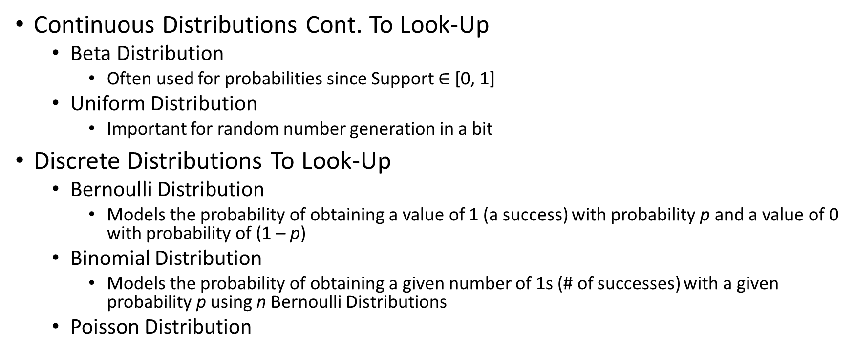
Theoretical Distributions Look-up Cont.
Continuous Distributions Cont. To Look-Up
Beta Distribution
Often used for probabilities since Support $∈$ [0, 1]
Uniform Distribution
Important for random number generation in a bit
Discrete Distributions To Look-Up
Bernoulli Distribution
Models the probability of obtaining a value of 1 (a success) with probability p and a value of 0 with probability of (1 – p)
Binomial Distribution
Models the probability of obtaining a given number of 1s (# of successes) with a given probability p using n Bernoulli Distributions
Poisson Distribution

Slide 19
Random Number Generation
With Random Number Generation, one is trying to obtain a sequence of random numbers between 0 and 1.
Linear Congruential Method
Page 244 in Discrete Event System Simulation (DES) 4th edition; equation 7.2
Produces a sequence of integers Z₁, Z₂, Z₃… between zero and (m – 1) via a recursive relationship
Random number between 0 and 1 obtained: U_{i} = Z_{i} / m
Will not spend a long time on
Today’s computational software (Excel, Simio, R) produce reliable random numbers
May need to change random seed (will show later)

Slide 20
Random Variate Generation
With Random Variate Generation, one is trying to generate random numbers for a given distribution
Inverse-Transform Technique
Pages 273 and 274 in DESS. Simplified below.
Step 1 -> Generate a series of Random Numbers between 0 and 1
Can use the continuous uniform distribution with a = 0 and b = 1
In Excel: “=RAND()”
In R: “runif(n = 1, min = 0, max = 1)”
Step 2 -> For the given distribution, apply the Inverse CDF Function to the random numbers generated in Step 1.
Need to first re-arrange the CDF Function for X in terms of U.

Slide 21
Inverse-Transform Technique for the Triangular Distribution
Step 2: Apply Inverse CDF Function for Triangle with a=1, b=5, c = 3
Step 1: Generate Random Numbers
runif(n = 5, min = 0, max = 1)
[1] 0.7341672 0.7274271 0.2136364 0.6672299 0.8117614
qtriangle( c(0.734, 0.727, 0.214, 0.667, 0.812), a = 1, b = 5, c = 3)
[1] 3.541233 3.522164 2.308434 3.367824 3.773623
Random Number
0.734
0.727
0.214
0.667
0.812
Random Number | Inverse CDF Function, CDF(X)⁻¹
0.734 | 3.54
0.727 | 5.22
0.214 | 2.31
0.667 | 3.37
0.812 | 3.77

Slide 22
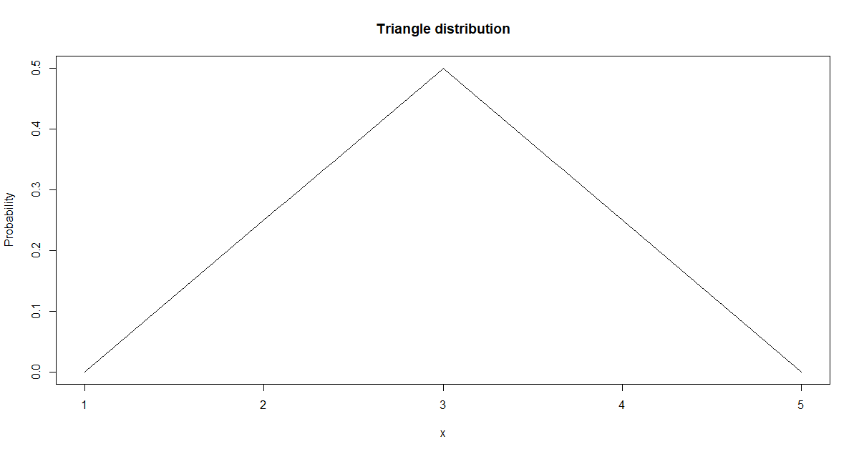
Why does the Inverse-Transform technique work?
Random number between 0 and 1 is being mapped back to an X value via the Inverse CDF Function using the distribution’s probability mass/density function.
This means the X points with higher density are more likely to be generated.
High Density
Points
Low Density
Points

Slide 23
Why is Random Variate Generation Important for Simulation?
Our simulation software will be called upon to generate random numbers from a given distribution.
Important to understand what is happening underneath during this process.

Slide 24
Using R to generate random numbers from a distribution
Generate 10 random numbers from a normal distribution with mean = 0 and sd = 1.
rnorm(n = 10, mean = 0, sd = 1)
Generate 10 random numbers from a triangle distribution with parameters a = 1, b = 5 and c = 3.
rtriangle(n = 10, a = 1, b = 5, c = 3)
Generate 10 random numbers from a uniform distribution with min = 0 and max = 1.
runif(n = 10, min = 0, max = 1)

Slide 25
Overview of R probability distribution functions
“d” for density, the density function (p.d.f.)
dnorm(...), dbeta(..), dunif(..)
“p” for probability, the cumulative distribution function(c.d.f.)
pnorm(…), pbeta(…), punif(…)
“q” for quantile, the inverse c.d.f.
qnorm(…), qbeta(…), qunif(…)
“r” for random, obtaining a random distribution
rnorm(…), rbeta(…), runif(…)
Use ‘?rnorm’ to get the parameter functions in R
List of all distributions in the R stats base package
https://stat.ethz.ch/R-manual/R-devel/library/stats/html/Distributions.html
If distribution is not listed, then there is probably a library package for it (ie: triangular).

Slide 26
In-Class Exercise
For the following distributions, vary the distribution parameters and see how the shape of the distribution changes in R.
Try to match the theoretical distributions on the Wikipedia look-up page
Gamma Distribution
hist( rgamma(100000, shape = 7.5, scale = 1.0), 50 )
Log-Normal Distribution
hist( rlnorm(100000, mean = 0, sd = 0.25), 50 )
Beta Distribution
hist(rbeta(100000, shape1 = 0.5, shape2 = 0.5, 50)

