Slide 1
MSC 572
Dr. Chad Kimmel

Slide 2
Overview
Best Fit Parameter Distribution
Goodness of Fit Tests
Visual goodness of fit tests
Formal Goodness of Fit Tests
All easily done in R!

Slide 3
Best Fit Parameter Fitting
You have a given empirical data set and you want to find the parameters that best match a given theoretical distribution.
First step -> Visualize the data set with a frequency histogram and make sure the data set matches the given distribution
Three methods to parameter estimation.
Analogic
Moments
Maximum Likelihood Estimation (MLE)
We will focus on MLE Estimation

Slide 4
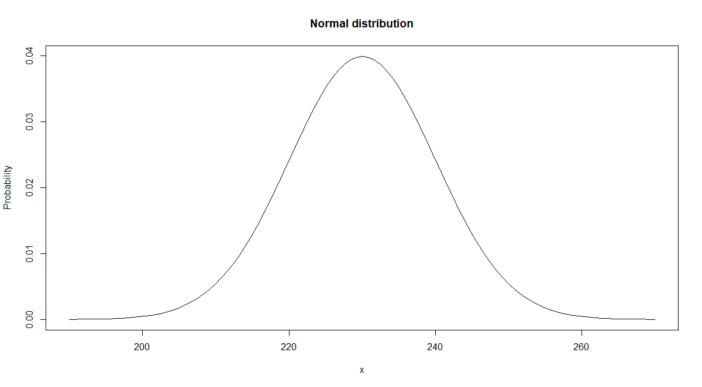
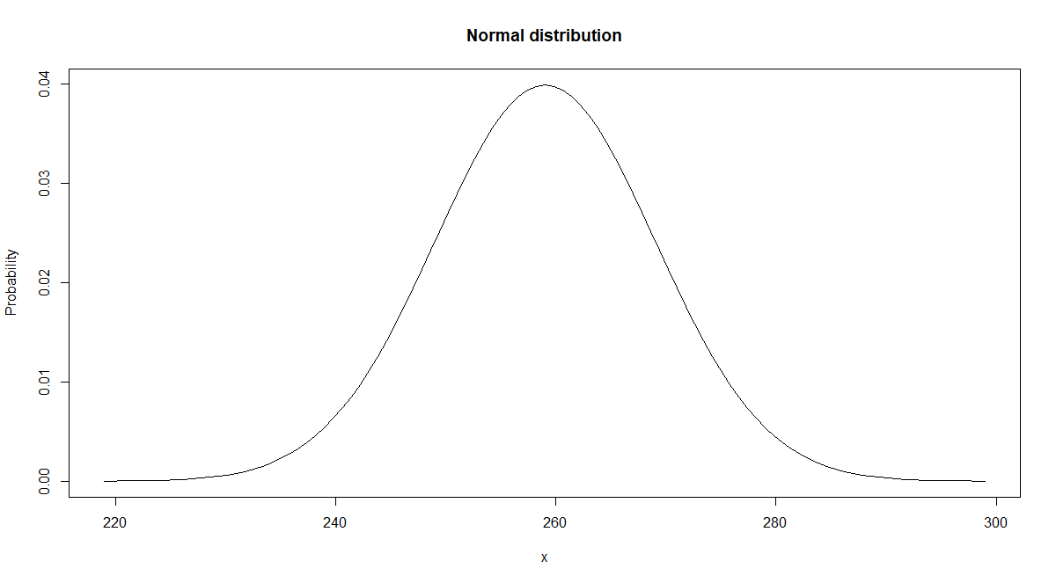
Maximum Likelihood Estimation Visual Example
Consider a Normal Distribution with s.d. = 10. A random sample of 3 data points, Y₁ = 250, Y₂ = 265 and Y₃ = 259, is obtained. We wish to ascertain which mean: u₁ = 230 or u₂ = 259 is more likely.
u₁ = 230
u₂ = 259
Y₁
Y₃
Y₂
Y₁
Y₃
Y₂
More likely

Slide 5
Maximum Likelihood Cont.
The likelihood of a data point is the probability density (p.d.f.) for a given data point from a given distribution
For a normal distribution with mean = 230: PDF(Y₁) = .005399; PDF(Y₂) = .000087; PDF(Y₃) = .000595
R code: dnorm(x = c(250, 265, 259) , mean = 230, sd = 10)
For a normal distribution with mean = 259: PDF(Y₁) = .026609; PDF(Y₂) = .033322; PDF(Y₃) = .039894
R code: dnorm(x = c(250, 265, 259) , mean = 259, sd = 10)
The likelihood value is the product of the individual likelihood values:
L(u = 230) = (.005399)*(.000087)*(.000595) = .279 * 10⁻⁹
L(u = 259) = (.026609)*(.033322)*(.039849) = .0000354

Slide 6
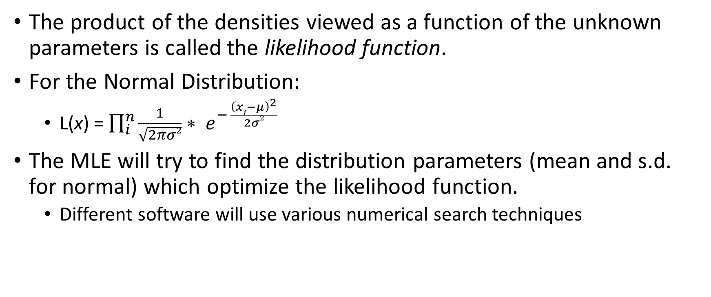
Maximum Likelihood Cont.
The product of the densities viewed as a function of the unknown parameters is called the likelihood function.
For the Normal Distribution:
L(x) = $\prod_{i}^{n}{\frac{1}{\sqrt{2πσ2}}∗ e^{− \frac{{\left(xi−μ\right)}^{2}}{2σ2}}}$
The MLE will try to find the distribution parameters (mean and s.d. for normal) which optimize the likelihood function.
Different software will use various numerical search techniques

Slide 7
Maximum Likelihood Estimation in R
MLE in R uses the “MASS” library
Execute statements below in R
How to obtain the MLE parameters for the Normal Distribution for a given empirical data set:
## The MLE function for a normal distribution
require(MASS) # May need to install library. See previous slide.
theFile = read.csv("C:\\Classes\\UD\\MSC_572_Summer2019\\ClassDocs\\Class1\\InstructorEx1.csv")
hist(theFile$EmpiricalData1, breaks = 50) #Look at frequency histogram
x = theFile$EmpiricalData1 #Assign data to X
fitdistr(x,"normal")$estimate #Obtain MLE Parameters

Slide 8
Maximum Likelihood Estimation in R cont.
How to obtain the MLE parameters for the beta distribution for a given empirical data set:
Need to provide starting parameters in search (just use 1.0 for both)
## The MLE function for a beta distribution
require(MASS)
theFile = read.csv("C:\\Classes\\UD\\MSC_572_Summer2019\\ClassDocs\\Class1\\InstructorEx2.csv")
hist(theFile$EmpiricalData1, breaks = 50) #Look at frequency histogram
x = theFile$EmpiricalData1 #Assign data to X
fitdistr(x,"beta", list(shape1 = 1, shape2 = 1))$estimate #Obtain MLE Parameters

Slide 9
Why is Best Fit parameter fitting important in simulation?
In simulation, we are often provided empirical data, and we need to first estimate the best fit parameters.
Used for random variate number generation.
Various software packages can be used for best fit parameter estimation
SAS JMP; SBSS; etc.
Do not need to use R

Slide 10
Goodness of Fit Tests
Want to see if the estimated parameters for a given empirical distribution are a good fit for the underlying theoretical distribution.
Ex: You think a given empirical distribution comes from a normal distribution with mean = 0 and sd = 1, and you want to see if your intuition is correct.
Two types of goodness of fit tests.
Visual
PDF curve and histogram plots, qqplots
Formal
Chi-square test
Kolmogorov-Smirnov Test

Slide 11
Visual Goodness of Fit Tests
PDF Curve and histogram plot for a normal distribution
Again, execute each line separately. Just point to correct file in first line.
theFile = read.csv("C:\\Classes\\UD\\MSC_572_Summer2019\\ClassDocs\\Class1\\InstructorEx3.csv")
x.Points = theFile$EmpiricalData1
h<-hist(x.Points,breaks=15)
xhist<-c(min(h$breaks),h$breaks)
yhist<-c(0,h$density,0)
xfit<-seq(min(x.Points),max(x.Points),length=40)
yfit<-dnorm(xfit,mean=mean(x.Points),sd=sd(x.Points))
plot(xhist,yhist,type="s",ylim=c(0,max(yhist,yfit)), main='Normal pdf and histogram')
lines(xfit,yfit, col='red')

Slide 12
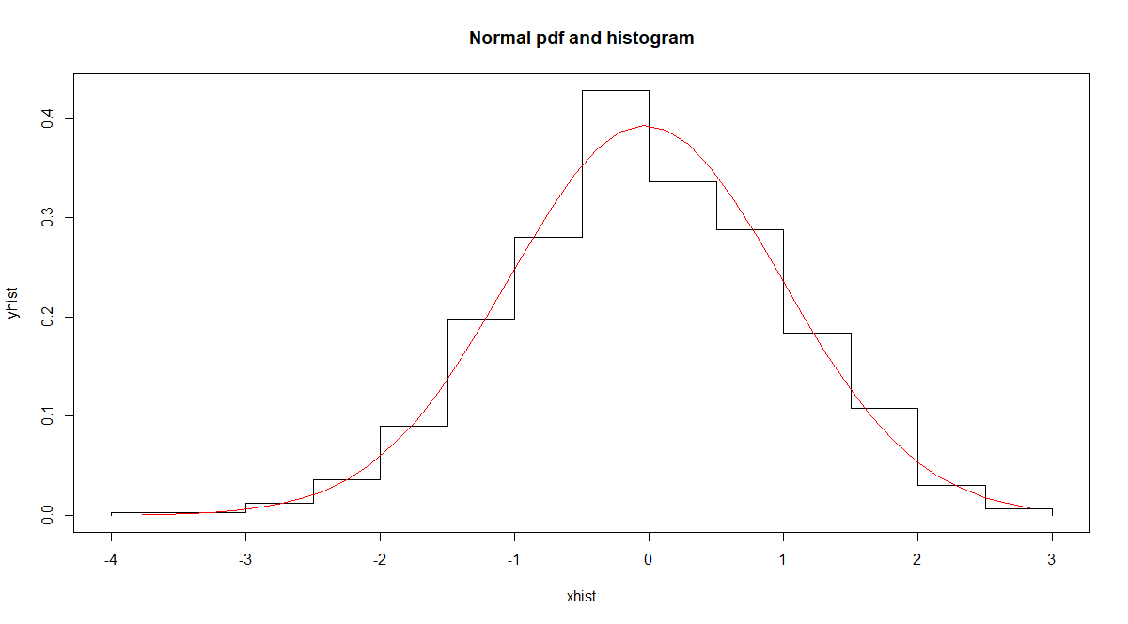
PDF Curve and Histogram Plot
Empirical Distribution
Histogram
Theoretical Distribution
PDF Curve

Slide 13
Visual Goodness of Fit Tests cont.
PDF Curve and histogram plot for the Triangle Distribution
Again, execute each line separately
# Visual goodness of fit test for triangle distribution
theFile = read.csv("C:\\Classes\\UD\\MSC_572_Summer2019\\ClassDocs\\Class1\\InstructorEx4.csv")
x.Points = theFile$EmpiricalData1
h<-hist(x.Points,breaks=15)
xhist<-c(min(h$breaks),h$breaks)
yhist<-c(0,h$density,0)
xfit<-seq(min(x.Points),max(x.Points),length=40)
yfit<-dtriangle(xfit,a = 1, b = 5, c = 3)
plot(xhist,yhist,type="s",ylim=c(0,max(yhist,yfit)), main='Triangle pdf and histogram')
lines(xfit,yfit, col='red')

Slide 14
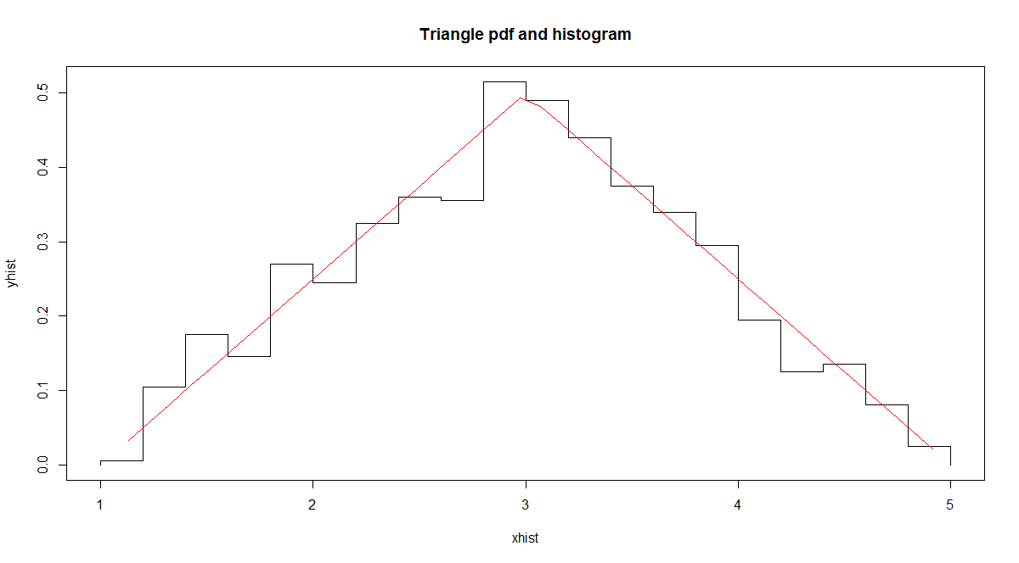
PDF Curve and Histogram Plot
Empirical Distribution
Histogram
Theoretical Distribution
PDF Curve

Slide 15
QQ-Plot
A qqplot plots the actual empirical value vs. what the theoretical value should be for the given distribution parameters.
Step 1 – Sort the empirical data set by value smallest to largest
Step 2 – Obtain the quantile of each data point from Step 1
Step 3 – Apply the Inverse CDF function to each quintile value in Step 2 using the estimated parameters
Step 4 – Plot the data points from Step 1 against the data points in Step 3
If data comes from distribution, points will lie on vertical line through (0,0) and (1,1)
theFile = read.csv("C:\\Classes\\UD\\MSC_572_Summer2019\\ClassDocs\\Class1\\InstructorEx5.csv")
x.Points = theFile$EmpiricalData1
hist(x.Points) #Visualize data first with frequency histogram
sorted_x.normal = sort(x.Points) #Step 1
x.quantile = (0:(length(sorted_x.normal) - 1)) #Step 2
x.quantile = x.quantile/(length(x.quantile)-1) #Step 2
x.norm.the = qnorm(x.quantile, mean = mean(x.Points), sd = sd(x.Points)) #Step 3
plot(sorted_x.normal, x.norm.the, type="p", main = "QQPlot", xlab = "empirical", ylab = "theoretical") #Step 4
abline(0,1) #Step 4

Slide 16
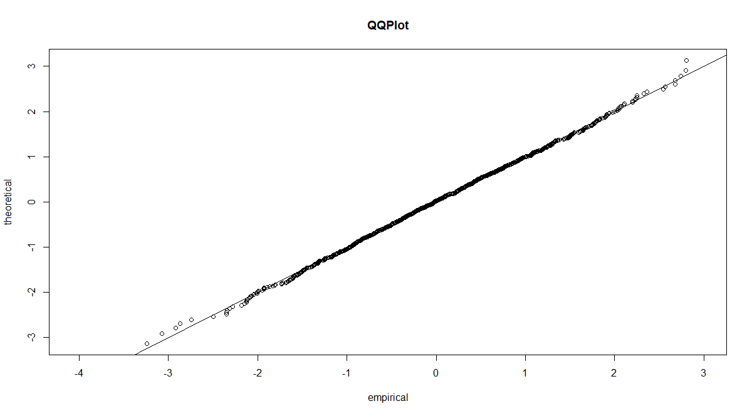
Visual QQ-Plot – Good Fit with normal

Slide 17
QQ-Plot cont. – bad fit example
Take same empirical data points from normal distribution
Now see if the points come from a log-normal distribution with mean = 0, sd = 1
Use “qlnorm” function instead of “qnorm” in Step 3
theFile = read.csv("C:\\Classes\\UD\\MSC_572_Summer2019\\ClassDocs\\Class1\\InstructorEx5.csv")
sorted_x.normal = sort(x.Points) #Step 1
x.quantile = (0:(length(sorted_x.normal) - 1)) #Step 2
x.quantile = x.quantile/(length(x.quantile)-1) #Step 2
x.norm.the = qlnorm(x.quantile, mean = 0, sd = 1) #Step 3
plot(sorted_x.normal, x.norm.the, type="p", main = "QQPlot", xlab = "empirical", ylab = "theoretical") #Step 4
abline(0,1) #Step 4

Slide 18
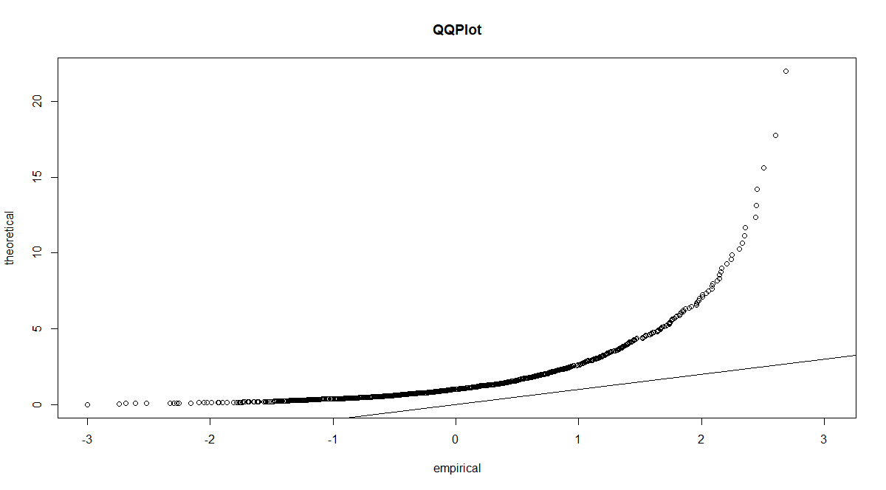
Visual QQ-Plot – Bad Fit with normal

Slide 19
Formal goodness of fit test
Several Formal goodness of fit tests
Kolmogorov-Smirnov Test
Chi-square Test
For all formal goodness of fit tests:
Null Hypothesis H₀: Data comes from sample distribution
Alternative Hypothesis H_{a}: Data does not come from sample distribution
If high p-value, this indicates the data comes from the given distribution
Visual goodness of fit tests in general have higher reliability than the formal ones
Formal ones should only be used to re-inforce the visual ones.

Slide 20
Kolmogorov-Smirnov Test in R
## KS Goodness of fit test
x.normal <- rnorm(1000, 0, 1) # Generate random values from normal distribution with mean = 0, sd = 1
ks.test(x.normal, "pnorm", 10, 1) #p-value < .0001. Reject the null hypothesis that sample comes from dist.
ks.test(x.normal, "pnorm", 0, 1) #p-value very large. Fail to reject the null hypothesis that sample comes from dist.

Slide 21
Overview of Probability Distributions in R
R is great at probability distributions
Helps to be proficient at coding in R
Not needed for basic statistics
Good resource for probability distributions in R
https://cran.r-project.org/doc/contrib/Ricci-distributions-en.pdf
Includes probability distribution graphs produced along with goodness of fit tests.

