Slide 1
MSC 572 Dr. Chad Kimmel
Intro to Probability Distributions

Slide 2
Overview
Intro/Review to Probability Distributions
Define a continuous and discrete probability distribution
Look at visual examples of some probability density and mass functions.
Empirical and Theoretical distributions
In-class exercise
Will use Microsoft Excel and R to visualize distributions

Slide 3
Intro Probability Distribution
What is a Probability Distribution?
A mathematical function that provides the probabilities of occurrence of different possible outcomes in an experiment.
Example would be a coin toss
P (Heads) = 0.5; P (Tails) = 0.5
Another example would be the roll of a dice.
P(Rolling a 1) = 1/6, P(Rolling a 2) = 1/6, P(Rolling a 3) = 1/6 ….. cont.
Another example would be the temperature on a given day
P (60º) = 0.09; P (61º) = 0.1; P (62º) = 0.11; P (63º) = 0.1; P (64º) = 0.09
Relative sum of the probability of all outcomes must equal 1.0

Slide 4
Two classes of Probability Distributions
Discrete Distributions
Outcome values have a discrete (or fixed) range.
Example would be the coin toss or dice roll experiment.
Outcome probabilities specified by a probability mass function.
Continuous Distributions
Outcome values have a continuous range.
Example would be the temperature on any given day.
Outcome probabilities specified via a probability density function.

Slide 5

Visual Example of Probability Mass Function
Roll of a dice
Discrete Distribution
P(X = Any Number) = 0.167
1.0
0.167
0.0
Dice Outcome

Slide 6
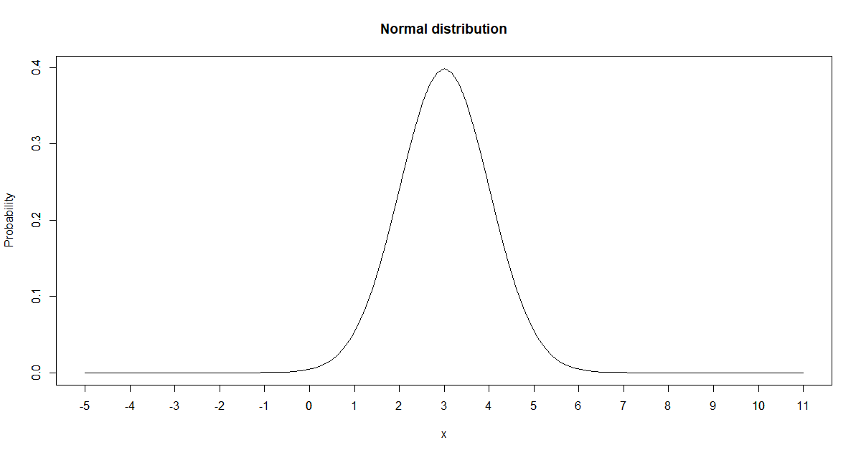
Visual Example of Probability Density Function for Normal Distribution
Continuous Normal Distribution with parameters of Mean = 3, St Dev = 1
Mean and St. Dev are called parameters of the distribution (will discuss more later)
P(X = 1) ~ 0.05; P(X = 2) ~ 0.25; P(X = 3) ~ 0.39; P(X = 4) ~ 0.25
RCode
curve(dnorm(x,mean=3,sd=1),from=-5,to=11,main="Normal distribution", ylab = "Probability")

Slide 7
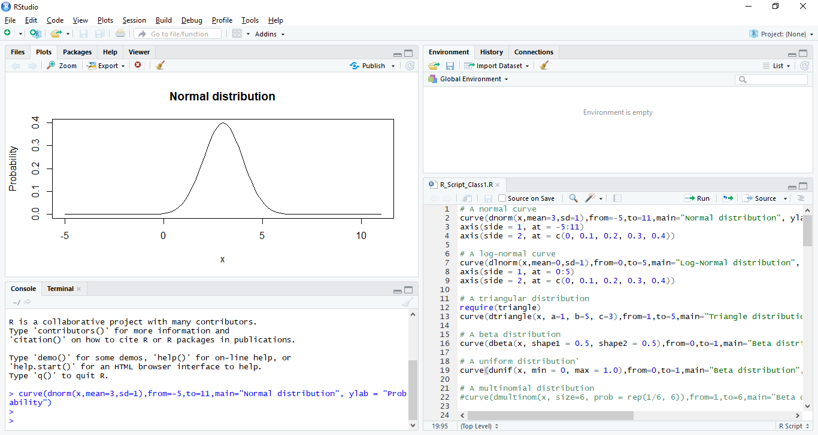
How to execute code in R Studio
Simply enter the code into the console window and hit enter

Slide 8
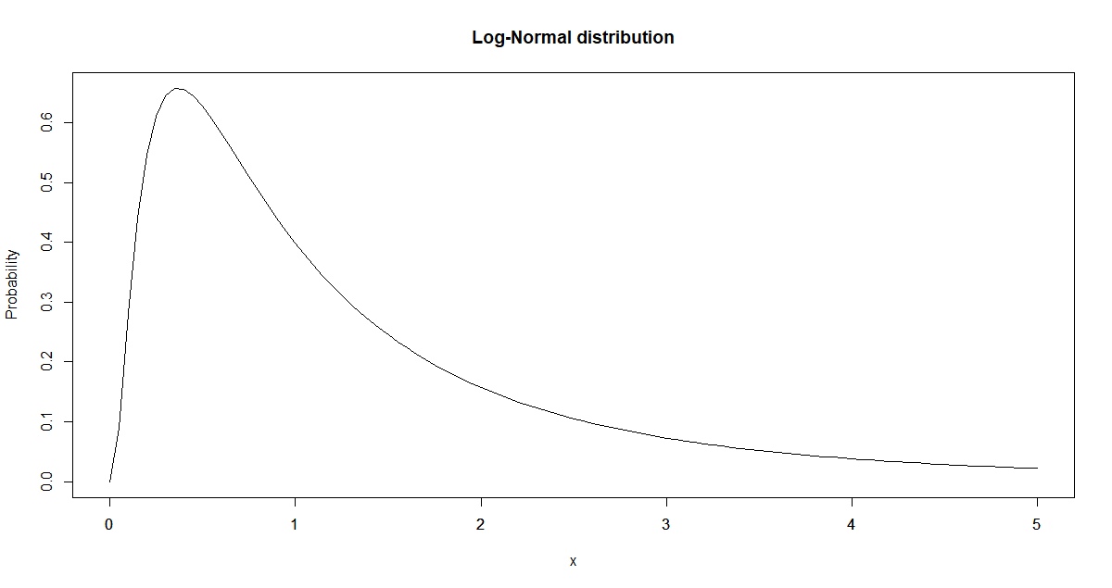
Visual Example of Probability Density Function for Log-Normal Distribution
Log-Normal Distribution with parameters of Mean = 1, St Dev = 0
P(X = 0.5) = ~0.61 ; P(X = 1) = ~0.39; P(X = 2) ~ 0.2; P(X = 3) ~ 0.1
curve(dlnorm(x,mean=0,sd=1),from=0,to=5,main="Log-Normal distribution", ylab = "Probability")

Slide 9
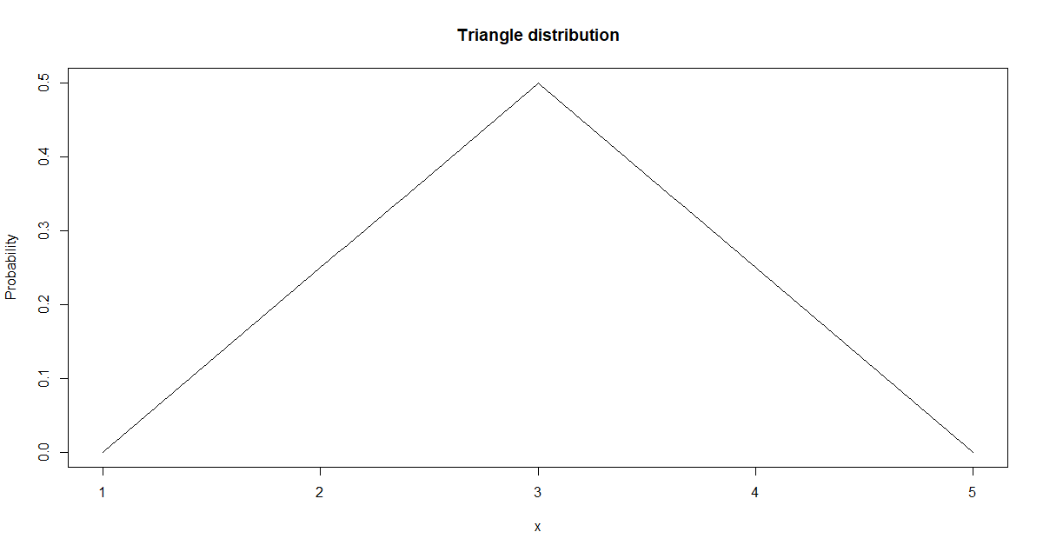
Visual Example of Probability Density Function for Triangular Distribution
Triangular Distribution with parameters of Min = 1, Max = 5, Mode = 3
P(X = 2) ~ 0.2; P(X = 3) ~ 0.5; P(X = 4) ~0.2
require(triangle) #You may first need to install the package. Execute: install.packages("triangle")
curve(dtriangle(x, a=1, b=5, c=3), from=1,to=5,main="Triangle distribution", ylab = "Probability")

Slide 10
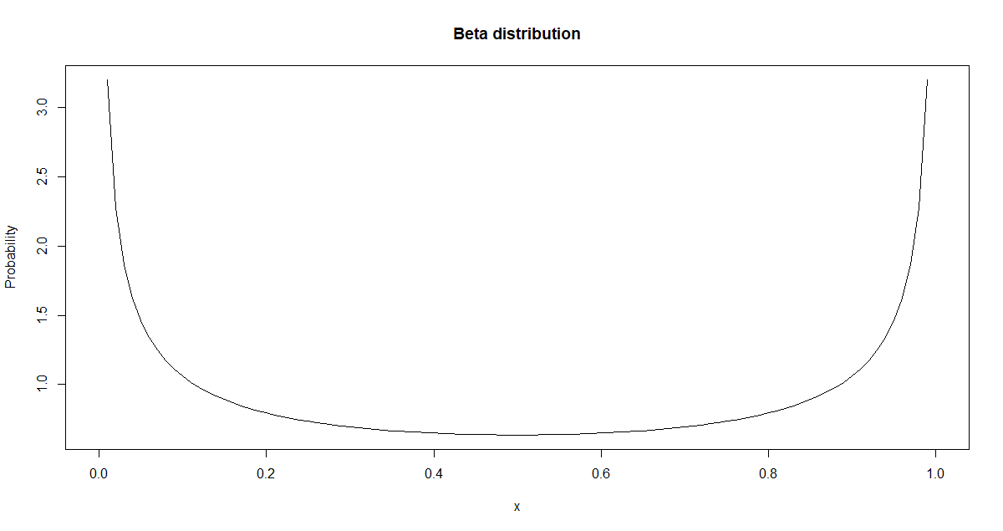
Visual Example of Probability Density Function for Beta Distribution
Beta Distribution with alpha = 0.5, beta = 0.5
P(X = 0.1) ~ 1.5; P(X = 0.2) ~ 0.8; P(X = 0.6) ~ 0.2; P(X = 0.9) ~ 1.5
curve(dbeta(x, shape1 = 0.5, shape2 = 0.5),from=0,to=1,main="Beta distribution", ylab = "Probability")

Slide 11
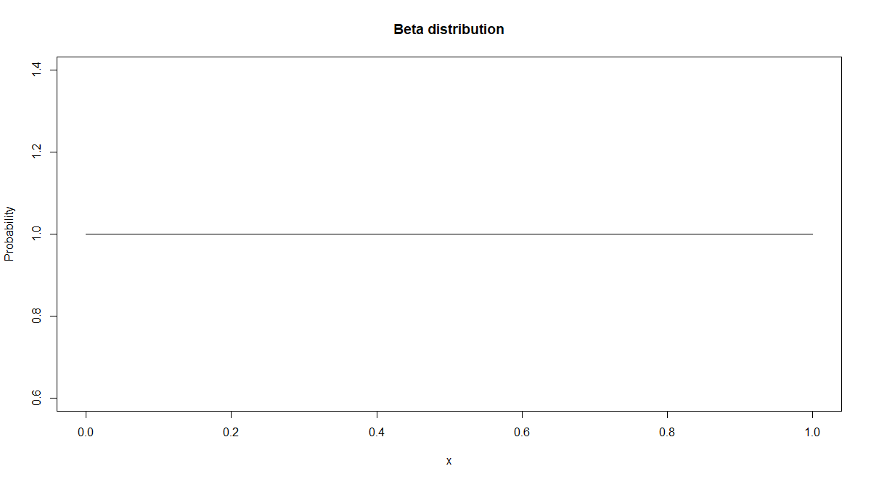
Visual Example of Probability Density Function for the Uniform Distribution
Uniform Distribution with min = 0.0, max = 1.0
P(X = 0.0 to 1.0) = 1.0
curve(dunif(x, min = 0, max = 1.0),from=0,to=1,main="Beta distribution", ylab = "Probability")

Slide 12
Why are Probability Mass and Density Functions Important in Simulation?
Used to generate random numbers for a given distribution
Very common in simulation and many analytical disciplines
Next class will discuss how to randomly generate values from a given type of distribution (ex: normal). This is called random variate generation.

Slide 13
Empirical and Theoretical Probability Distributions
Empirical Probability Distribution
A probability distribution associated with the data collected from an experiment, direct observation, experience or practice.
Underlying distribution and parameters are not known.
Theoretical Probability Distribution
The underlying probability distribution that the empirical probability distribution would approximate very close to after a large sample size.
Look at frequency histogram of empirical distribution and try to match with a known probability density/mass function.
Underlying true distribution and distribution parameters are known
Distributions previously shown are all theoretical probability distributions.

Slide 14
In-Class Exercise
Step 1: Look at 4 Empirical Distributions in Excel.
Sample Size: 100,000
Step 2: Read empirical data into R and create frequency histogram
Step 3: For each histogram, provide the theoretical distribution that the empirical data set comes from (look at probability density graphs).
R Code to read in data and create Frequency Histogram
# Don’t forge the double back-slashes
theFile = read.csv("C:\\Classes\\UD\\MSC_572_Summer2019\\ClassDocs\\Class1\\StudentInClassEx.csv")
head(theFile) #Look at the first few rows.
hist(theFile$Sample1, breaks = 50) # Plot Column 1
hist(theFile$Sample2, breaks = 50) # Plot Column 2
hist(theFile$Sample3, breaks = 50) # Plot Column 3
hist(theFile$Sample4, breaks = 50) # Plot Column 4

