Slide 1
MotoChain & RideTrue
$120 B+
Global Motorcycle Market
A Verifiable Identity & Behavior-Based Insurance Protocol for Motorcycles
$70 B+
Mireu Kim · Enxhi Topalli
Motorcycle Insurance Market
CS495 DeFi · May 2025
Base L2
Ethereum Layer 2 Network

Slide 2
MotoChain & RideTrue
Mireu Kim · Enxhi Topalli
I. THE ELEVATOR PITCH
I. THE ELEVATOR PITCH
A Dual-Protocol DeFi System for Trust
On-chain identity + economic incentives + ZK proofs = verifiable, self-enforcing markets
MotoChain
RideTrue
• Tamper-proof identity layer for motorcycles
• VIN-linked ERC-721 NFT for every bike
• Immutable, staked service records
• Solves information asymmetry in resale
• Portable history owned by the user
• Behavior-based insurance market for riders
• ZK proofs for privacy-preserving scoring
• Pooled USDC insurance — claims on-chain
• Replaces demographic proxies with real data
• Safe-rider rebates from verified behavior
Core innovation: combining on-chain identity, economic enforcement through staking, and privacy-preserving ZK proofs — transforming trust-dependent markets into verifiable, self-enforcing systems.
2 / 20

Slide 3
MotoChain & RideTrue
Mireu Kim · Enxhi Topalli
MISSION STATEMENT
MISSION STATEMENT
Verifiable Truth, User-Owned Identity, Economically Enforced
"MotoChain and RideTrue aim to eliminate trust-based inefficiencies in real-world markets by replacing them with verifiable, user-owned data and economically enforced truth systems."
Starting point
Medium term
Long-term vision
Motorcycles & rider insurance in Seoul
Broader mobility markets — Vietnam, Indonesia, Thailand
Global trustless layer for real-world asset verification and behavior-based financial services
→
→
Individuals — not institutions — control their history, reputation, and financial outcomes.
3 / 20

Slide 4
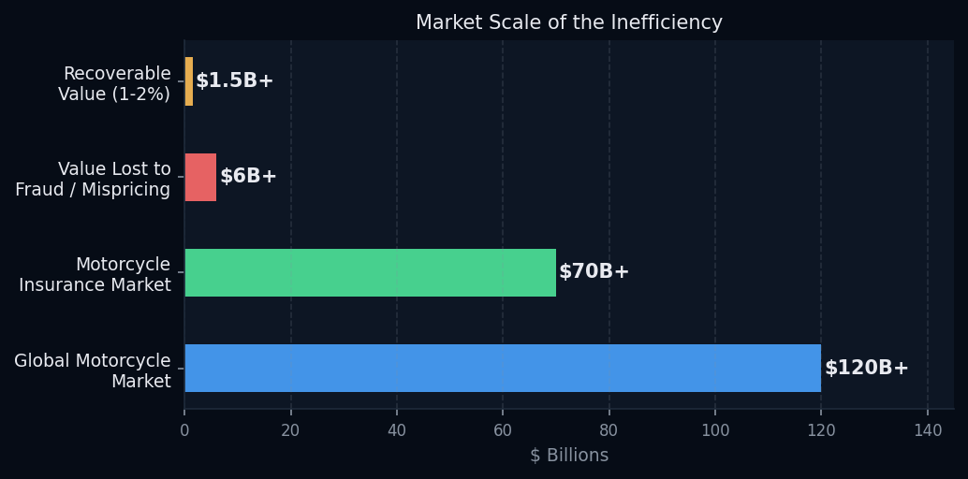
MotoChain & RideTrue
Mireu Kim · Enxhi Topalli
II.1 — COMPREHENSIVE PROBLEM & ROOT CAUSE ANALYSIS
II.1 — PROBLEM & ROOT CAUSE ANALYSIS
Two Broken Markets — One Structural Failure: Trust
$120 B+
$70 B+
Root cause: No shared, tamper-proof, portable record of real-world events — data is siloed, mutable, and inaccessible across platforms.
Global Motorcycle Market
Insurance Market
Sellers possess full knowledge of vehicle history. Buyers depend on unverifiable claims. → Classic "market for lemons" (Akerlof 1970)
Risk priced using age, demographics, not behavior. Safe riders subsidize risky ones. → Systematic mispricing, reduced trust
4 / 20

Slide 5
MotoChain & RideTrue
Mireu Kim · Enxhi Topalli
II.1 — WHY BLOCKCHAIN IS A STRUCTURAL REQUIREMENT
II.1 — WHY BLOCKCHAIN IS A STRUCTURAL REQUIREMENT
Centralized Systems Cannot Provide All Four Properties Simultaneously
Why Centralized Alternatives Fail
Immutability
Decentralized Validation
✗ Data-holders have conflicts of interest in monetizing access
✗ Competing institutions have no incentive to share data openly
✗ Centralized records remain mutable and selectively disclosable
✗ No economic enforcement — data providers have no "skin in the game"
✗ Users cannot carry their history across platforms
Once written, history cannot be altered by any single actor
Multiple independent participants validate every entry
Economic Enforcement
Portable User-Owned Identity
Staking and slashing create real financial consequences for fraud
Reputation and history follow the user across platforms
In this context, blockchain is not an implementation choice — it is a structural requirement.
5 / 20

Slide 6
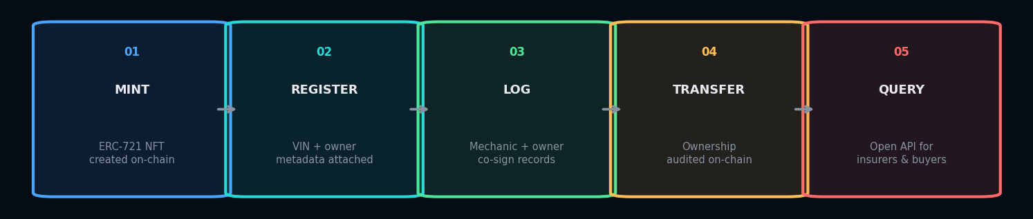
MotoChain & RideTrue
Mireu Kim · Enxhi Topalli
II.2 — TECHNICAL ARCHITECTURE & SYSTEM LOGIC
II.2 — TECHNICAL ARCHITECTURE & SYSTEM LOGIC
MotoChain: VIN Token Lifecycle on Base L2
Each motorcycle is anchored by an ERC-721 NFT. Every event is co-signed and permanently locked on-chain.
Tamper-Resistant
Multi-Party Signed
Auto-Validation
Composable
Once written, no single actor can alter the record. Immutability is enforced at the protocol level.
Every service entry requires cryptographic signatures from BOTH the mechanic and the bike owner.
Smart contracts flag inconsistencies — non-sequential mileage, conflicting records — automatically.
Open API for insurers, lenders, and marketplaces. History is a public good, not a silo.
6 / 20

Slide 7
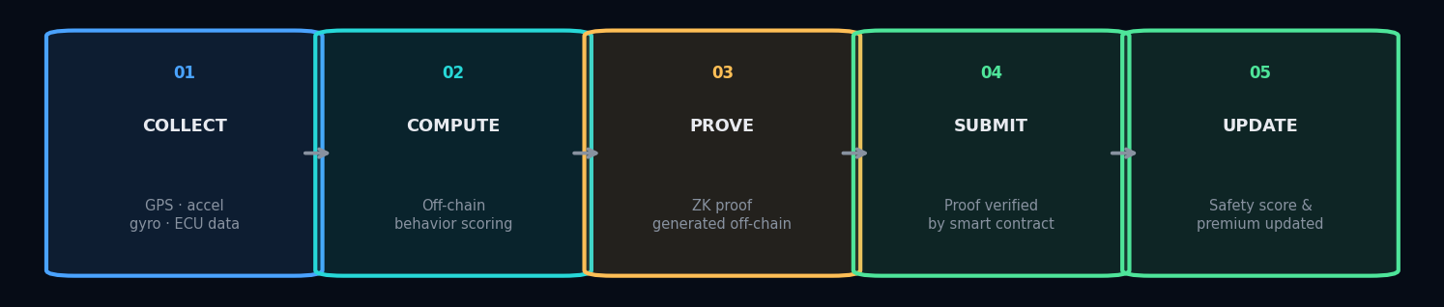
MotoChain & RideTrue
Mireu Kim · Enxhi Topalli
II.2.1 — TELEMATICS INTEGRITY & ANTI-SPOOFING
II.2.1 — TELEMATICS INTEGRITY & ANTI-SPOOFING
RideTrue: Scoring Behavior Without Exposing Your Location
ZK proofs validate computation — not input authenticity. Four defenses close the remaining gap.
Hardware Attestation
Sensor Fusion
Statistical Anomaly Detection
Sampling & Challenge Mechanics
Android Play Integrity API + iOS DeviceCheck confirm data originates from a genuine, uncompromised device.
GPS + accelerometer + gyroscope + ECU data must be internally consistent across all sensors — much harder to spoof than a single feed.
Per-rider behavioral baseline detects physically implausible trajectories, instantaneous position changes, and accelerometer inconsistencies.
Random rides re-verified against cell tower triangulation, traffic data, and (optionally) paired hardware tokens installed on the bike.
7 / 20

Slide 8
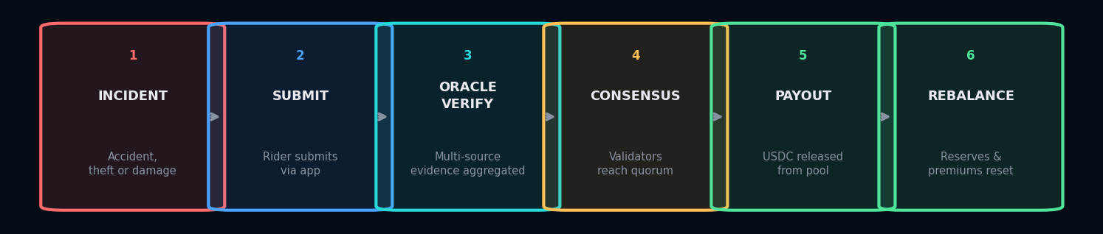
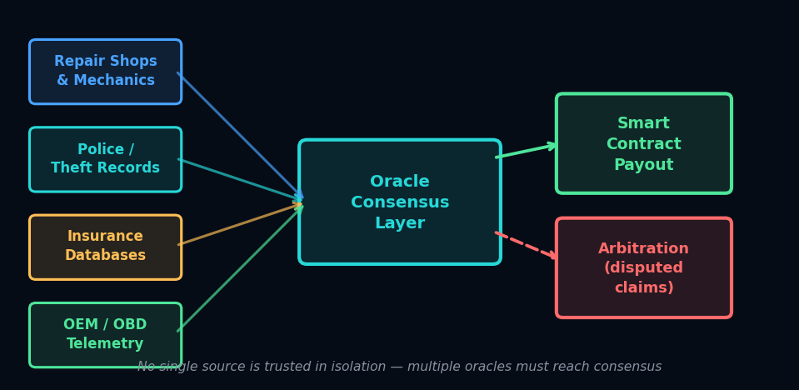
MotoChain & RideTrue
Mireu Kim · Enxhi Topalli
II.2.2 — INSURANCE POOL, CLAIMS & ORACLES
II.2.2 — INSURANCE POOL, CLAIMS & ORACLES
From Premium Deposit to Automated Payout
Oracle Design Principles
• Multi-source aggregation — no single provider trusted in isolation
• Economic staking by oracle operators — bad data = slashed stake
• Stale or conflicting data → verification-pending state, not auto-execution
• High-value claims require higher consensus thresholds and longer review
• DeFi integration: idle capital deployed to Aave for yield on excess reserves
8 / 20

Slide 9
MotoChain & RideTrue
Mireu Kim · Enxhi Topalli
II.3 — USER EXPERIENCE & ONBOARDING FRAMEWORK
II.3 — USER EXPERIENCE & ONBOARDING FRAMEWORK
DeFi That Feels Like a Normal App
Account abstraction + gasless transactions + mobile-first — no seed phrases, no gas fees, no crypto knowledge needed.
Rider Dashboard
Mechanic Interface
Buyer Interface
• Safety score, premium level, projected savings — one screen
• Behavioral tracking runs passively in the background
• Rebate eligibility and score history always visible
• Dynamic premium adjustments and periodic rebates
• Retention: financial incentives compound with safe behavior
• QR code scans identify the vehicle instantly
• Structured form captures service type, mileage, parts
• Owner co-signs via rider app — QR handoff at the shop
• End-to-end record entry: under 30 seconds
• Reputation capital builds with each verified entry
• Scan a code or enter a VIN — no account required
• Complete, cryptographically verified history displayed
• Ownership transfers, service records, claims visible
• MotoChain Verified badge at point of sale
• No wallet, no crypto — just verifiable truth
9 / 20

Slide 10
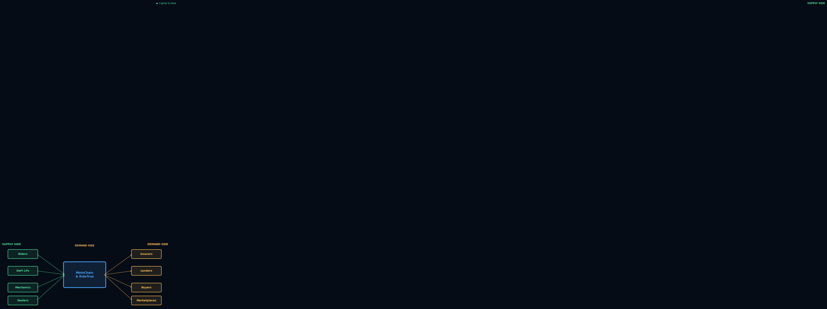
MotoChain & RideTrue
Mireu Kim · Enxhi Topalli
II.4 — TARGET AUDIENCE & CUSTOMER ACQUISITION
II.4 — TARGET AUDIENCE & CUSTOMER ACQUISITION
Two-Sided Marketplace — Both Sides Must Join Simultaneously
Seoul First
Launch in dense urban motorcycle market with high-volume dealers & repair shops.
Dealer Pull
Verified history → faster sales, higher prices, fewer disputes → dealers adopt first.
Mechanic Push
Dealer adoption forces mechanic-side onboarding through commercial pressure.
Sybil Resistance
Rewards require verified actions: real vehicle, real rides, real service logs.
B2B Scale
Marketplace + insurer + lender integrations convert data into immediate value.
Expansion: Seoul → Vietnam, Indonesia, Thailand — Asia's largest two-wheeler markets.
10 / 20

Slide 11
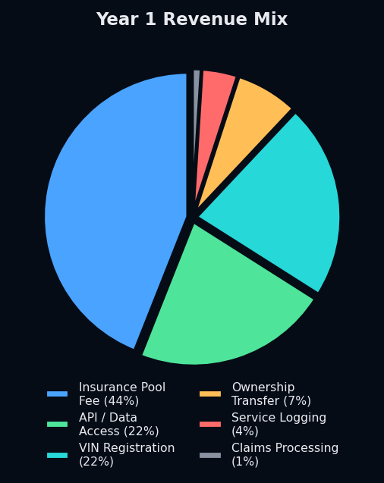
MotoChain & RideTrue
Mireu Kim · Enxhi Topalli
II.5 — ECONOMIC ENGINEERING & TOKENOMICS · II.5.1–5.2 REVENUE STREAMS
II.5.1-5.2 — ECONOMIC DESIGN & REVENUE STREAMS
Revenue Built on Real Usage — Not Speculative Token Emissions
The token is not the product. The token is an enforcement and coordination tool.
VIN Registration
₩10,000 / bike · 5,000 bikes Y1 → ₩50 M
Ownership Transfer
₩15,000 / transfer · 1,000 Y1 → ₩15 M
Service Logging
₩5,000 / record · 10,000 Y1 → ₩50 M
Insurance Pool Fee
5% of premium pool · ₩2B pool → ₩100 M
Claims Processing
1.5% of claim value · 1% net margin → ₩2.25 M
API / Data Access
Subscription · Highest long-term margin → ₩50 M
TOTAL YEAR 1 → ₩ 227 M
11 / 20

Slide 12
MotoChain & RideTrue
Mireu Kim · Enxhi Topalli
II.5.3–5.4 — CORE FINANCIAL ASSUMPTIONS · SEOUL LAUNCH
II.5.3-5.4 — FINANCIAL ASSUMPTIONS & REVENUE DETAIL
Year 1 Revenue Model: Seoul Launch · Conservative Loss Ratio (~8.9%)
Core Assumptions (Seoul Y1)
Revenue Stream Detail
Registered motorcycles
5,000
VIN Registration
₩50 M
5,000 × ₩10,000
Monthly insurance riders
2,000
Ownership Transfer
₩15 M
Avg annual premium
₩1,080,000
1,000 × ₩15,000
Monthly premium pool
₩180M
Service Logging (protocol share)
₩10 M
10,000 × ₩5,000 × 20%
Annual premium pool
₩2,160M
Insurance Pool Fee
₩108 M
Modeled loss ratio
~8.9% (intentionally conservative)
₩2,160M × 5%
Avg monthly premium
₩90,000
Claims Processing Fee
₩2.25 M
₩150M × 1.5%
Claim frequency
8%
API / Data Access
₩50 M
Avg claim severity
₩1,200,000
Pilot subscriptions
Protocol fee
5% of premiums
TOTAL
₩235 M
Note: Loss ratio of ~8.9% is intentionally conservative. Industry-standard motorcycle insurance loss ratios are 55–70%. Protocol prioritizes pool solvency over premium competitiveness during first 12–24 months.
12 / 20

Slide 13
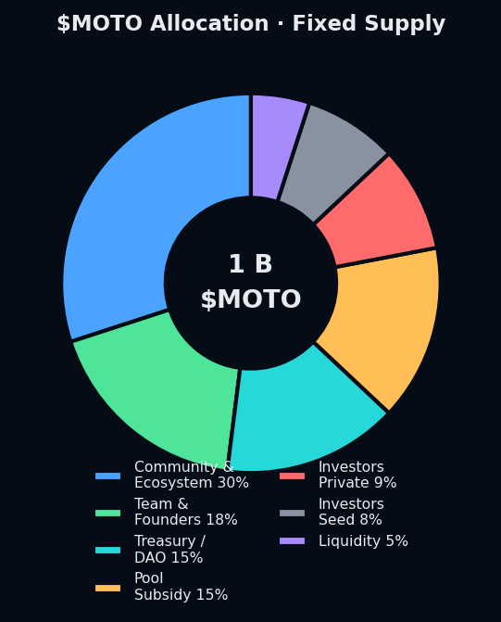
MotoChain & RideTrue
Mireu Kim · Enxhi Topalli
II.5.5 — TOKEN DESIGN ($MOTO) — DRAFT ASSUMPTIONS
II.5.5 — $MOTO TOKEN DESIGN · DRAFT ASSUMPTIONS
$MOTO: Utility & Governance Only — Not a Speculative Yield Engine
Token Utility
Staking & Slashing
Mechanics, validators, oracle operators stake $MOTO for write access. Misbehavior is penalized via slashing.
Governance
Token holders vote on fees, reserve ratios, rebate formulas, treasury deployment, and integrations.
Reputation Gating
Tiered staking unlocks higher write limits and reward shares for established mechanics and dealers.
Fee Discounts
Select API and registration fees payable in $MOTO at a discount. Received tokens burned or accrued by treasury.
⚠ Critical: Insurance pool returns, rider rebates, and all protocol revenue are paid in USDC — NOT in $MOTO. This is intentional: preserves economic discipline and reduces risk of securities classification.
13 / 20
Network: Base L2 · Supply: 1,000,000,000 fixed · Standard: ERC-20 with governance + staking modules

Slide 14
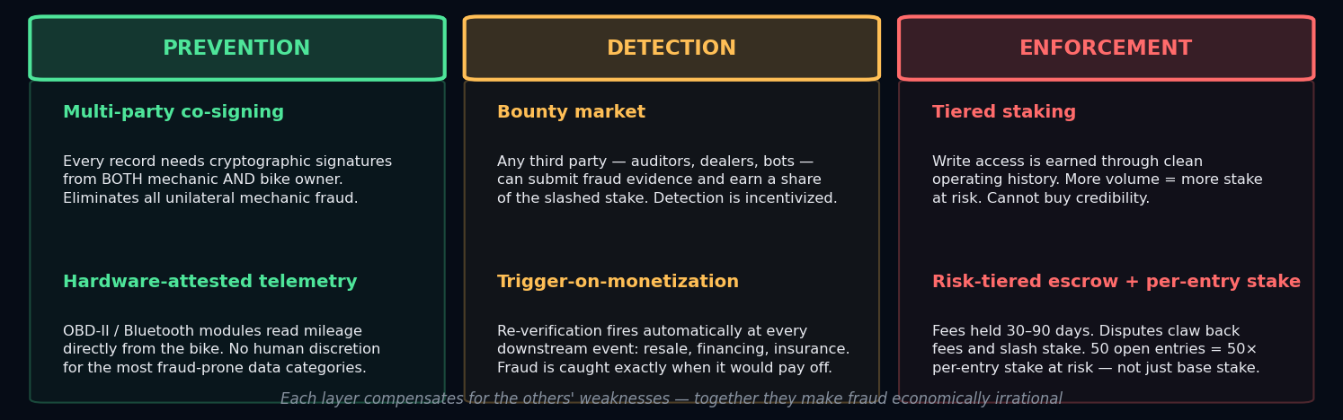
MotoChain & RideTrue
Mireu Kim · Enxhi Topalli
II.5.6 — MECHANIC TRUST: A LAYERED DEFENSE
II.5.6 — MECHANIC TRUST: A LAYERED DEFENSE
Prevention → Detection → Enforcement
Without trustworthy service records, the vehicle history layer is no better than a centralized database.
Tier
Type
Stake Required
Writes / Month
Fee Share
Unlock Requirement
1
New Verified
₩200,000
50 / month
50%
Business verified
2
Trusted
₩750,000
200 / month
60%
90+ day clean record
3
Premium / Dealer
₩2,000,000
1,000 / month
70%
High rating, no disputes
14 / 20
4
Institutional
₩5,000,000+
Custom
70–75%
Audited partner status

Slide 15
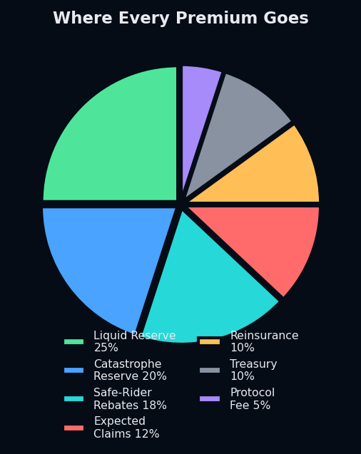
MotoChain & RideTrue
Mireu Kim · Enxhi Topalli
II.5.7 — PREMIUM POOL ALLOCATION
II.5.7 — PREMIUM POOL ALLOCATION
Conservative Capital Management — Insurance ≠ Speculative Capital
Premiums are not free revenue. Every dollar is allocated with solvency as the first priority.
●
Liquid Reserve 25%
Always liquid. Ineligible for DeFi yield. Pays claims immediately.
●
Catastrophe Reserve 20%
Used only during extreme events. Calibrated to Korean typhoon patterns.
●
Safe-Rider Rebates 18%
Returned quarterly to claim-free riders — the "fairness dividend."
●
Expected Claims 12%
Pays approved claims. Buffer above modeled ~9% loss ratio.
●
Reinsurance 10%
External backstop. Required before launch. Covers tail risk above pool capacity.
●
Treasury 10%
Protocol operational reserve and governance discretion.
●
Protocol Fee 5%
Operating revenue captured for protocol development and team.
The DeFi yield cap (up to 10% of excess reserves) is a ceiling — not a target. Only excess reserves above both the 25% liquidity floor and 20% catastrophe floor are eligible for deployment.
15 / 20

Slide 16
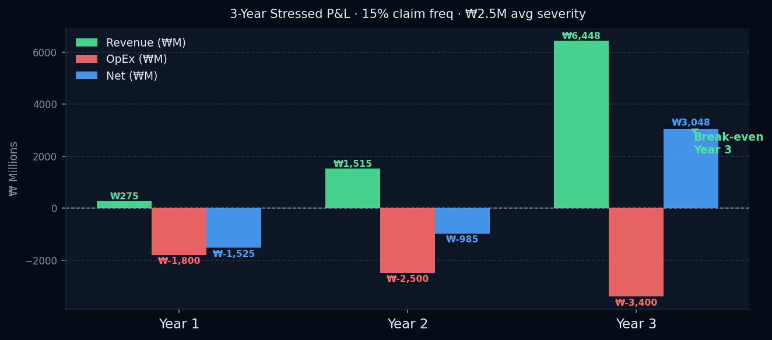
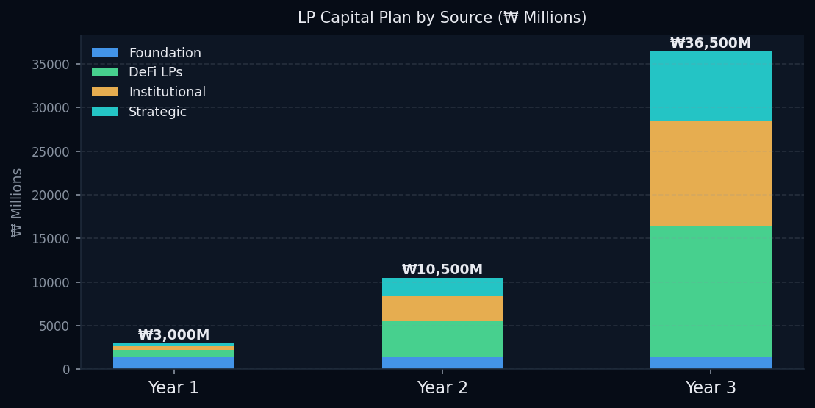
MotoChain & RideTrue
Mireu Kim · Enxhi Topalli
II.5.8–5.9 — FX RISK & STRESS-TESTED FINANCIAL MODEL
II.5.8-5.9 — FX RISK & STRESS-TESTED FINANCIAL MODEL
Commercially Viable Under Realistic Assumptions · Break-Even Year 3
II.5.8 — Currency & FX Risk
II.5.9 — Stress Parameters
Premiums priced in ₩ (KRW) for riders but pool contributions held in USDC on-chain. Structural FX exposure managed via: (i) KRW-pegged stablecoins for a portion of reserves, (ii) USD-equivalent + KRW reserve ratios tracked in parallel, (iii) yield deployment paused when FX volatility exceeds governance thresholds.
Claim frequency:
8% → 15%
Avg claim severity:
₩1.2M → ₩2.5M
Modeled loss ratio:
~8.9% → ~34.7%
Safe-rider rebates:
18% → ~10% (reduced under stress)
Total funding requirement: ~₩4.5B (~$3.3M USD) seed + Series A, separately from LP capital for pool underwriting.
16 / 20

Slide 17
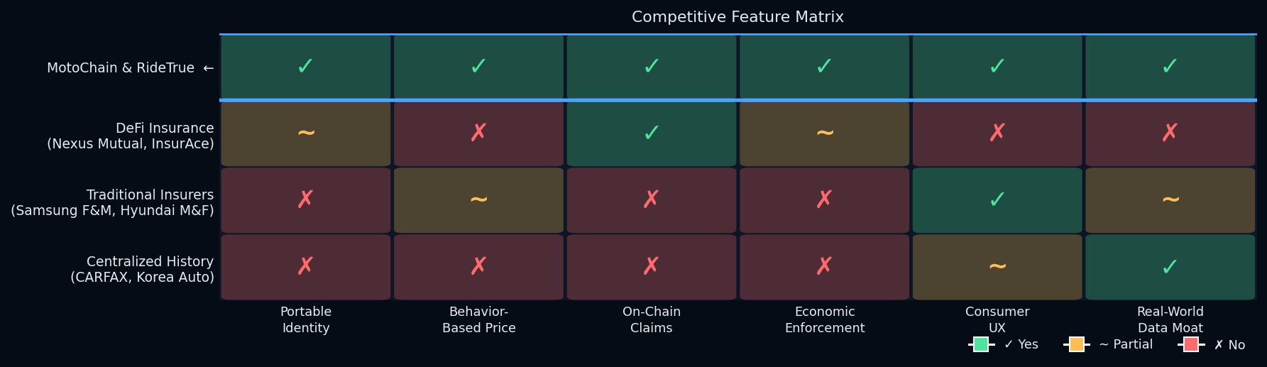
MotoChain & RideTrue
Mireu Kim · Enxhi Topalli
II.6.1 — COMPETITIVE ANALYSIS & MOAT
II.6.1 — COMPETITIVE ANALYSIS & MOAT
Three Competitor Groups — One Intersection They Cannot Occupy
Vertical Data Network Effect
Dual-Protocol Composability
Korea-First Wedge
Consumer-Grade UX
More bikes, riders, mechanics, dealers, partners → dataset value compounds for every participant. Structurally hard to replicate from a standing start.
MotoChain identity data enriches RideTrue behavior scoring. Each protocol makes the other more valuable. No single competitor can replicate both.
Dense urban motorcycle market with realistic expansion to Vietnam, Indonesia, Thailand — Asia's largest two-wheeler markets.
Account abstraction + gasless transactions target non-crypto users. Competitors in all three categories require crypto sophistication.
17 / 20

Slide 18
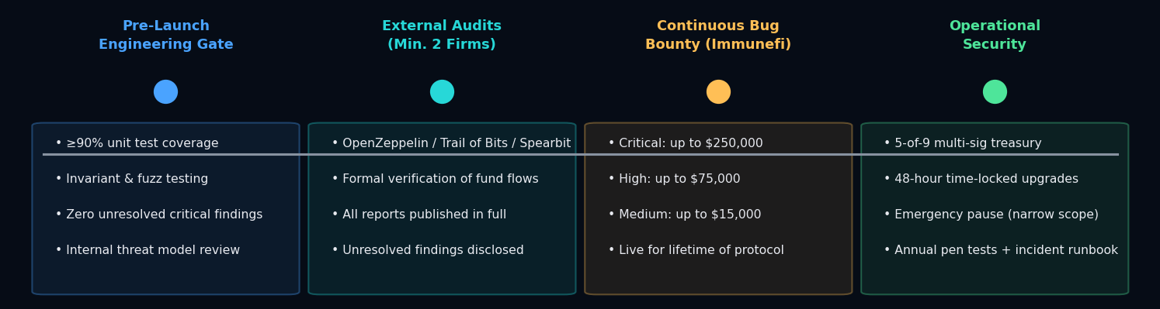
MotoChain & RideTrue
Mireu Kim · Enxhi Topalli
II.6.2 — SECURITY ROADMAP
II.6.2 — SECURITY ROADMAP
Security Is a Launch Gate — Not a Post-Launch Concern
The protocol will not accept user funds until both independent audits complete and all critical findings are resolved.
Operational Security Commitments
• 5-of-9 multi-sig wallet with geographically distributed signers
• 48-hour minimum time-lock on any non-emergency parameter change
• Emergency pause restricted to narrow scope with documented invocation criteria
• Public incident response runbook with quarterly drills
• Annual third-party penetration testing for mobile and telematics back-end systems
• Each material protocol upgrade preceded by an incremental audit
18 / 20

Slide 19
MotoChain & RideTrue
Mireu Kim · Enxhi Topalli
II.6.3–6.4 — ECONOMIC STRESS TESTING & LIQUIDITY SAFEGUARDS
II.6.3-6.4 — BLACK SWAN PLAN & LIQUIDITY SAFEGUARDS
9 Safeguards Against Pool Collapse — Korea Typhoons Are Base-Case, Not Tail Risk
01
Mandatory Liquid Reserve
02
Catastrophe Reserve Fund
03
Reinsurance Backstop
≥25% of pool always liquid — ineligible for DeFi yield.
20% of every premium routed to dedicated catastrophe fund.
External partner covers tail risk above pool capacity. Required pre-launch.
04
Emergency Payout Limits
05
Pro-Rata Distribution
06
Catastrophe Circuit Breaker
Circuit breaker → 50% immediate, 50% over 3–6 months.
If undercollateralized, all claimants receive proportional share.
Triggers on: >20% pool claims in 7 days, reserve ratio <15%.
07
Conservative DeFi Yield
08
Dynamic Premium Adj.
09
Coverage Exclusions & Caps
Only excess reserves deployed. Cap 10–15%. Blue-chip only.
Post-shock: +10–20% temporary increase to rebuild reserves.
Max normal payout: ₩5M. Max catastrophe: ₩3M immediate.
Liquidity safeguards: 25% liquid floor · capped DeFi deployment · 30-day LP withdrawal notice · pro-rata exit queue in emergency mode · stablecoin diversification (USDC + KRW-pegged) · real-time public liquidity dashboard.
19 / 20

Slide 20
MotoChain & RideTrue
Mireu Kim · Enxhi Topalli
II.6.5–6.6 — ORACLE RISK & MECHANIC/VALIDATOR FRAUD
II.6.5-6.6 — ORACLE RISK & MECHANIC FRAUD
The Last Line of Defense: Data Integrity End to End
Oracle Risk Mitigation
• Multi-source aggregation — theft claim needs police record + vehicle registry + insurer confirmation
• No single oracle trusted in isolation — consensus threshold required
• Stale / conflicting data → verification-pending state, not auto-execution
• High-value claims require higher consensus thresholds + longer review windows
Mechanic Fraud Summary
Prevention
Co-signing + hardware telemetry eliminate categories of unilateral fraud at the source.
Detection
Design Goal: The architecture does not assume mechanics are honest or dishonest by default. It assumes they are rational actors — and keeps the expected value of fraud negative across all attack vectors.
Bounty market + monetization-triggered re-verification surface fraud beyond the escrow window.
Enforcement
Tiered staking + risk-tiered escrow + per-entry stake-at-risk make detected fraud economically irrational.
20 / 20

