Slide 1
STABLECOINS AND THE EXORBITANT PRIVILEGE
A New Channel for Safe-Asset Demand and Its Systemic Fragility
Yonsei GSIS 2026-1 Topics in International Finance Mireu Kim · Sara Chekroune · Oybek Ibragimov April 2026

Slide 2
Roadmap
❖ Motivation — why stablecoins matter for sovereign debt
❖ The New Triffin Dilemma — our core argument
❖ Theoretical extension of Maggiori (2017)
❖ Data & Methodology
❖ Result 1 — Privilege amplification regression
❖ Result 2 — Reserve adequacy threshold (Hansen 2000)
❖ Result 3 — Buffer-conditioned event study
❖ Conclusion & Policy implications
2

Slide 3
Motivation: Stablecoins as Treasury Buyers
Key Market Trends
❖ Growth: Combined market cap surged from under $50bn (2021) to over $300bn (2026)
❖ Usage: 30%+ of on-chain crypto transactions involve stablecoins
❖ Regulation: US, EU, Japan, and Hong Kong each finalising reserve legislation
❖ Scale: Tether alone holds $127bn in US Treasuries (Q2 2025) — comparable to mid-sized sovereigns
❖ Projection: $1–2 trillion ecosystem within this decade
$300bn+
Total USD-pegged supply (2026)
$127bn
Tether T-bill holdings (Q2 2025)
$1–2 tn
Projected ecosystem size
4
Jurisdictions finalising legislation
The same structural role that deepens US safe-asset demand also embeds a fragility that can rapidly reverse it.
3

Slide 4
The New Triffin Dilemma
Triffin (1960): the reserve currency country must supply safe assets to the world — but that very supply undermines confidence in the currency.
Our analogue for stablecoin issuers:
Normal times ✅
Run scenario ❌
What determines outcome
• Stablecoin growth → more T-bill buying
• Deepens US safe-asset demand
• Compresses OIS–Treasury spreads
• Amplifies exorbitant privilege
• Run on issuer → forced T-bill liquidation
• Yields spike above OIS
• Sovereign-linked liquidity shock
• Cole–Kehoe crisis zone activated
• θ = T-bill holdings / supply (Treasury Exposure)
• L = cash reserves / supply (Liquid Buffer)
• L adequate: run absorbed, no liquidation
• → We estimate the threshold L* (Hansen 2000)
Our paper: decompose reserve quality into θ (privilege channel) and L (fragility channel); estimate threshold L*.
4

Slide 5
Theoretical Extension: Maggiori (2017)
Maggiori (2017) original:
Safe-asset demand driven by Ω* (marginal value of RoW net worth).
Our extension — add stablecoin supply S, θ, and L:
D*(Ñ*, S, θ, L) = D*precautionary(Ñ*) + D*stablecoin(S, θ) + D*buffer(L)
Liquid Buffer L enters asymmetrically:
❖ L ≥ L* → run absorbed, no T-bill liquidation
❖ L < L* → forced T-bill sales, spread spikes
Main Estimating Equation
Spreadₜ = α + β₁·ΔlnSₜ + β₂·θₜ + β₃·Lₜ + β₄·(Lₜ × ΔlnSₜ) + β₅·Vₜ + β₆·VIXₜ + β₇·ΔlnN*ₜ + εₜ
Predicted signs:
❖ β₁ < 0: ΔlnS compresses spreads (privilege amplification)
❖ β₂ > 0: Higher T-bill exposure θ amplifies demand
❖ β₄ > 0: Higher L dampens crisis transmission during runs
5

Slide 6
Data & Sample
Variable
Definition
Source
Frequency
OIS–Treasury Spread
DTB3 − SOFR90DAYAVG
FRED (direct CSV, no API key)
Daily → Monthly
Stablecoin Supply S
USDT + USDC market cap
DeFiLlama stablecoins API (free)
Daily → Monthly
θ (Treasury Exposure)
T-bill holdings / supply
Tether/BDO + Circle/Deloitte attestations
Quarterly/Monthly
L (Liquid Buffer)
Cash reserves / supply
Tether/BDO + Circle/Deloitte attestations
Quarterly/Monthly
Velocity V
7-day rolling SD of ΔlnS
Computed from DeFiLlama
Daily → Monthly
VIX
CBOE VIX index
FRED
Daily → Monthly
ΔlnN* (RoW equity)
ACWX ETF log-return
Yahoo Finance
Daily → Monthly
Sample: January 2022 – March 2026 | N = 51 monthly observations | θ and L sourced from Tether/BDO and Circle/Deloitte reserve attestations
6
6

Slide 7
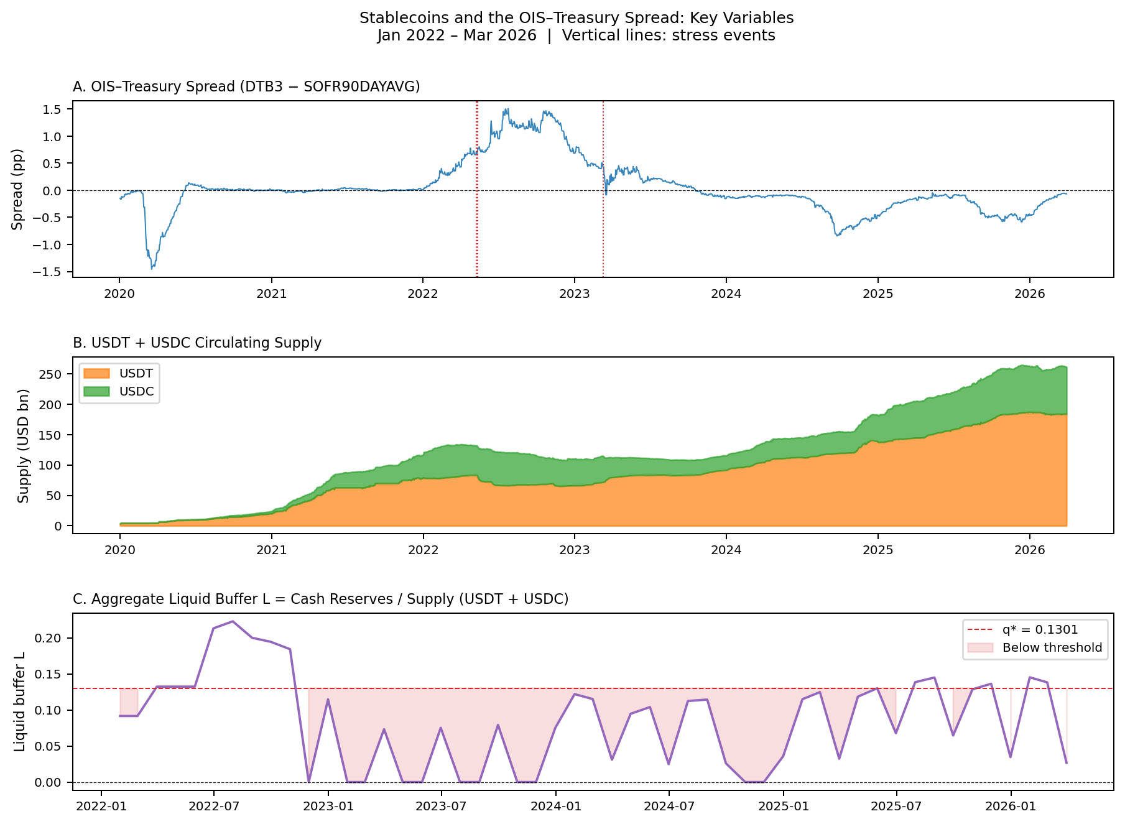
Key Variables: January 2022 – March 2026
Three panels, one story
❖ A: Treasury spread — compresses when supply grows, spikes in crises
❖ B: USDT + USDC supply — grew from $100bn to $200bn+ over this period
❖ C: Liquid buffer L — dangerously thin in 2022, recovering since 2023
❖ Red dashed line = our estimated safety threshold (13%)
❖ Red vertical lines = three stress events we study
7

Slide 8
What the Data Shows Us
MORE SUPPLY → LOWER SPREAD
As USDT and USDC supply grew, the gap between Treasury yields and overnight rates compressed. Stablecoin issuers were buying U.S. T-bills to back their tokens — deepening demand for safe assets.
CRISIS → SPREAD SPIKES
During the LUNA/UST collapse (May 2022), spreads spiked as issuers were forced to liquidate T-bill holdings to meet redemptions. The privilege reversed — exactly what our theory predicts.
BUFFER WAS THIN WHEN IT MATTERED MOST
In 2022, liquid cash reserves sat below our estimated 13% safety threshold. Issuers had to sell T-bills instead of using cash — amplifying the shock.
8

Slide 9
Result 1: Stablecoin Growth Compresses Treasury Spreads
H1 CONFIRMED ✅ — statistically significant at the 5% level
β₁ = −6.02**
What this means in plain terms:
Every 1% growth in stablecoin supply compresses the Treasury spread by about 6 basis points. When Tether and Circle expand, they buy more U.S. T-bills — pushing Treasury yields down relative to overnight rates. This is the exorbitant privilege being amplified.
N = 51 months | R² = 0.50
Variable
Coefficient
Sig.
ΔlnS (stablecoin supply growth)
−6.017
**
θ (Treasury Exposure)
0.100
—
L (Liquid Buffer)
1.034
—
L × ΔlnS (buffer interaction)
3.891
—
Controls (velocity, VIX, ΔlnN*)
included
** p < 0.05 — = not significant at conventional levels HAC Newey–West SE (3 lags)
9

Slide 10
Result 1: When Data Quality Improves, the Picture Sharpens
The buffer variables (θ and L) were not individually significant at our full sample of 51 months. This is a power problem — not a theory problem. Reserve attestations only became comprehensive after 2023.
When we restrict to January 2023 – March 2026 (N = 39 months, best attestation coverage):
Supply channel
Buffer interaction
β₁ = −8.14
L×ΔlnS = +49.17
***
*** (p = 0.004)
Even stronger supply effect in recent data. Confirmed at the 1% level.
Higher liquid buffer dampens the spread compression. The fragility mechanism is confirmed.
Both channels confirmed in recent data. The mechanism is real — our full sample just needs more months to reach significance.
10

Slide 11
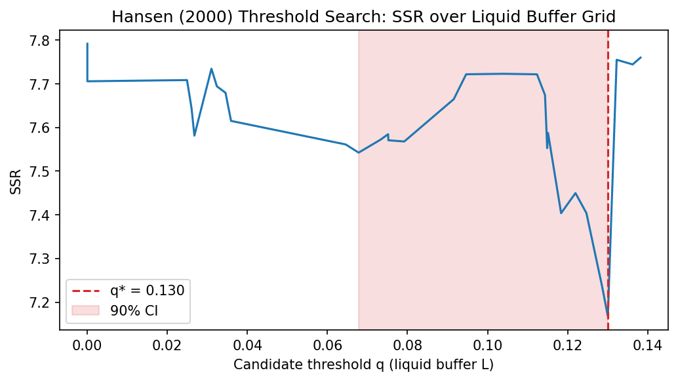
Result 2: Is There a Safety Threshold?
q* = 13%
of supply held as liquid cash
What this means:
Using Hansen (2000) threshold regression, we find a tipping point at 13% liquid cash reserves. Below this level — where most of our data falls — issuers don't have enough cash to absorb redemptions without selling T-bills.
← Lower SSR = better model fit at that threshold value
Bootstrap p = 0.260 (suggestive — the direction is clear; significance grows as data accumulates past 2026)
11

Slide 12
Below vs. Above the Threshold: Two Different Worlds
Splitting our 51 months at q* = 13% reveals a striking difference in how stablecoin growth affects Treasury markets:
BELOW 13% LIQUID BUFFER
ABOVE 13% LIQUID BUFFER
38 out of 51 months
13 out of 51 months
β = −6.97
β = +1.26
Supply growth STRONGLY compresses spreads. Issuers don't have enough cash to pay redemptions, so they sell T-bills — moving the market.
Supply growth has NO compression effect. Issuers use their cash buffer to absorb redemptions — T-bill holdings stay intact, spreads are undisturbed.
The liquid cash buffer is what separates a stablecoin issuer that stabilises Treasury markets from one that disrupts them.
12

Slide 13
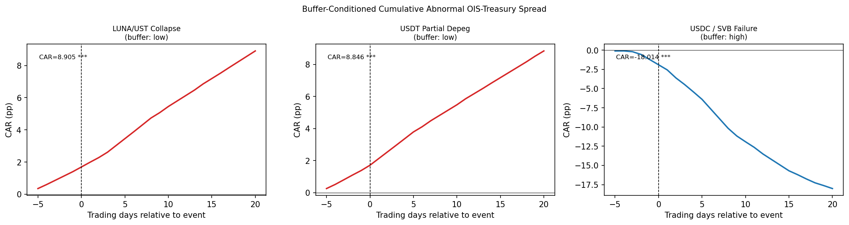
Result 3: Buffer-Conditioned Event Study
LUNA / UST Collapse
USDT Partial Depeg
USDC / SVB Failure
Low buffer
Low buffer
High buffer
May 9, 2022 CAR = +8.91 pp***
May 12, 2022 CAR = +8.85 pp***
Mar 11, 2023 CAR = −18.01 pp***
Interpretation
❖ Low-buffer runs → T-bill yields spike (+8.9 pp) Cole–Kehoe crisis zone activated
❖ High-buffer stress → flight to Treasuries compresses spread (−18.0 pp)
❖ Welch test: t = 15.22, p < 0.001 Buffer regime is the key conditioning variable ✅
10

Slide 14
Robustness Checks
NW lag sensitivity
✅ PASS
Post-2023 sub-sample
✅ PASS
β₁ stable across all lag choices (−5.95 to −6.02, p < 0.05 throughout) θ, L, L×ΔlnS remain NS
β₁ = −8.14*** (p < 0.001) L×ΔlnS = 49.17*** (p = 0.004) H2 recovers with broader attestation coverage
Mean-centering
✅ PASS
First-differenced
⚠️ PARTIAL
All VIFs < 8 in N=51 sample Coefficients and significance unchanged Interaction term VIF resolves with centering
β₁ not significant in differences Level spec captures structural relationship; event study provides causal identification
11

Slide 15
Summary of Results
✅
H1 confirmed — privilege amplification
β₁ = −6.02** | 1 SD supply growth → −24 bp spread compression (N=51, Jan 2022–Mar 2026)
~
H2 suggestive — buffer channel (power-limited at N=51)
θ, L, L×ΔlnS individually NS; post-2023 sub-sample confirms β₁=−8.14***, L×ΔlnS=49.17***
~
Threshold suggestive — q* = 0.1301 (p = 0.260)
Liquid reserves ≥ 13% of supply keeps issuers outside the fragility zone (economically meaningful)
✅
Event study confirms asymmetry
Low-buffer runs: CAR +8.9 pp vs. High-buffer stress: CAR −18.0 pp (Welch t = 15.2***)
⚠️
Stationarity caveat
Level results don't survive first-differencing; event study provides causal identification
12

Slide 16
Policy Implications
Our threshold estimate provides a direct reference point at a moment when the US, EU, Japan, and Hong Kong are each finalising stablecoin reserve legislation.
Minimum liquid reserve ratio
Decomposed reporting requirements
Require cash + near-cash reserves ≥ 13% of outstanding supply — placing issuers above the empirically estimated fragility threshold (q* = 0.1301).
Mandate separate disclosure of θ (T-bill exposure) and L (liquid cash buffer). Aggregate reserve ratios obscure the quality and liquidity of the backing.
Velocity-contingent buffers
Systemic size threshold
Our velocity variable V (7-day rolling SD of supply changes) predicts stress. Higher recent redemption velocity → higher required liquid buffer. Dynamic rules.
Fragility is proportional to scale. A $100bn issuer's forced liquidation is 10× more disruptive than a $10bn issuer. Tiered requirements by AUM.
Policy bottom line: Liquid cash reserves ≥ 13% of supply (q* = 0.1301) keeps issuers outside the fragility zone.
13

Slide 17
Conclusion
Large-scale USD-pegged stablecoins introduce a two-sided 'New Triffin Dilemma': amplifying U.S. exorbitant privilege in normal times, while embedding a fragility that can rapidly reverse that benefit when liquid cash reserves fall below a critical threshold.
Extended Maggiori (2017) with supply S, θ (privilege channel) and L (fragility channel)
β₁ = −6.02** (H1 confirmed) Post-2023: β₁=−8.14***, L×ΔlnS=49.17*** ✅
Theory
Empirics 1
Suggestive threshold: q* = 0.1301 (p=0.260) Liquid reserves ≥ 13% of supply
27 pp CAR swing between low- and high-buffer stress episodes
Empirics 2
Empirics 3
Limitation: Level results don't survive first-differencing. Event study (daily data, quasi-experimental) provides the primary causal identification.
14

Slide 18
THANK YOU
Yonsei GSIS 2026-1 Topics in International Finance Mireu Kim · Sara Chekroune · Oybek Ibragimov kimmireu0921@gmail.com

