Slide 1

STABLECOINS AND THE EXORBITANT PRIVILEGE
Yonsei GSIS 2026-1
Topics in International Finance
Mireu Kim · Sara Chekroune · Oybek Ibragimov · Jade Zhu Alexandre Godefroy · Baptiste Degand · Minjin Kim
Notes:
Good afternoon everyone. Our paper is called Stablecoins and the Exorbitant Privilege. The central argument is that large USD-pegged stablecoin issuers — mainly Tether and Circle — have become significant buyers of U.S. Treasury bills. In normal times, that deepens demand for safe assets and amplifies America's borrowing advantage. But when a run hits and their cash reserves are too thin, they are forced to liquidate T-bills, which rapidly reverses that benefit. Today we want to address some methodological questions from last session and walk clearly through our three stress events.

Slide 2
What We Are Covering Today
Event Study Update
1
We retested the event study with the corrected model. All three CARs are insignificant (−15/−4/−2 bps, all n.s.). We explain why and propose how the event study still contributes.
Threshold Robustness I — TRIM Sensitivity
2
q* = 13% is stable across all TRIM parameter values (15%, 20%, 25%). Bootstrap 90% CI: [2.6%, 14.5%]. Not a boundary artifact.
Threshold Robustness II — Smooth Transition (LSTAR)
3
A completely different model that allows a smooth, gradual regime shift instead of a sharp cut. Transition midpoint c* = 13.1% — virtually identical to Hansen's q* = 13.0%.
What the Paper Proves
4
Three independent methods agree: the tipping point is near 13%. β₁ = −6.02 bps (regression) + q* = 13% (Hansen) + LSTAR c* = 13.1% = the paper.
2
Notes:
Four items today. One: event study update — we corrected the model since last week, all CARs come back insignificant, and we will explain why in one slide and what role the event study still plays. Two and three: two robustness checks on the 13% buffer threshold. TRIM sensitivity confirms the threshold is not a boundary artifact, and LSTAR — a smooth transition regression — independently locates the transition at 13.1%. Four: what the paper proves, now with three lines of convergent evidence for q* = 13%.

Slide 3
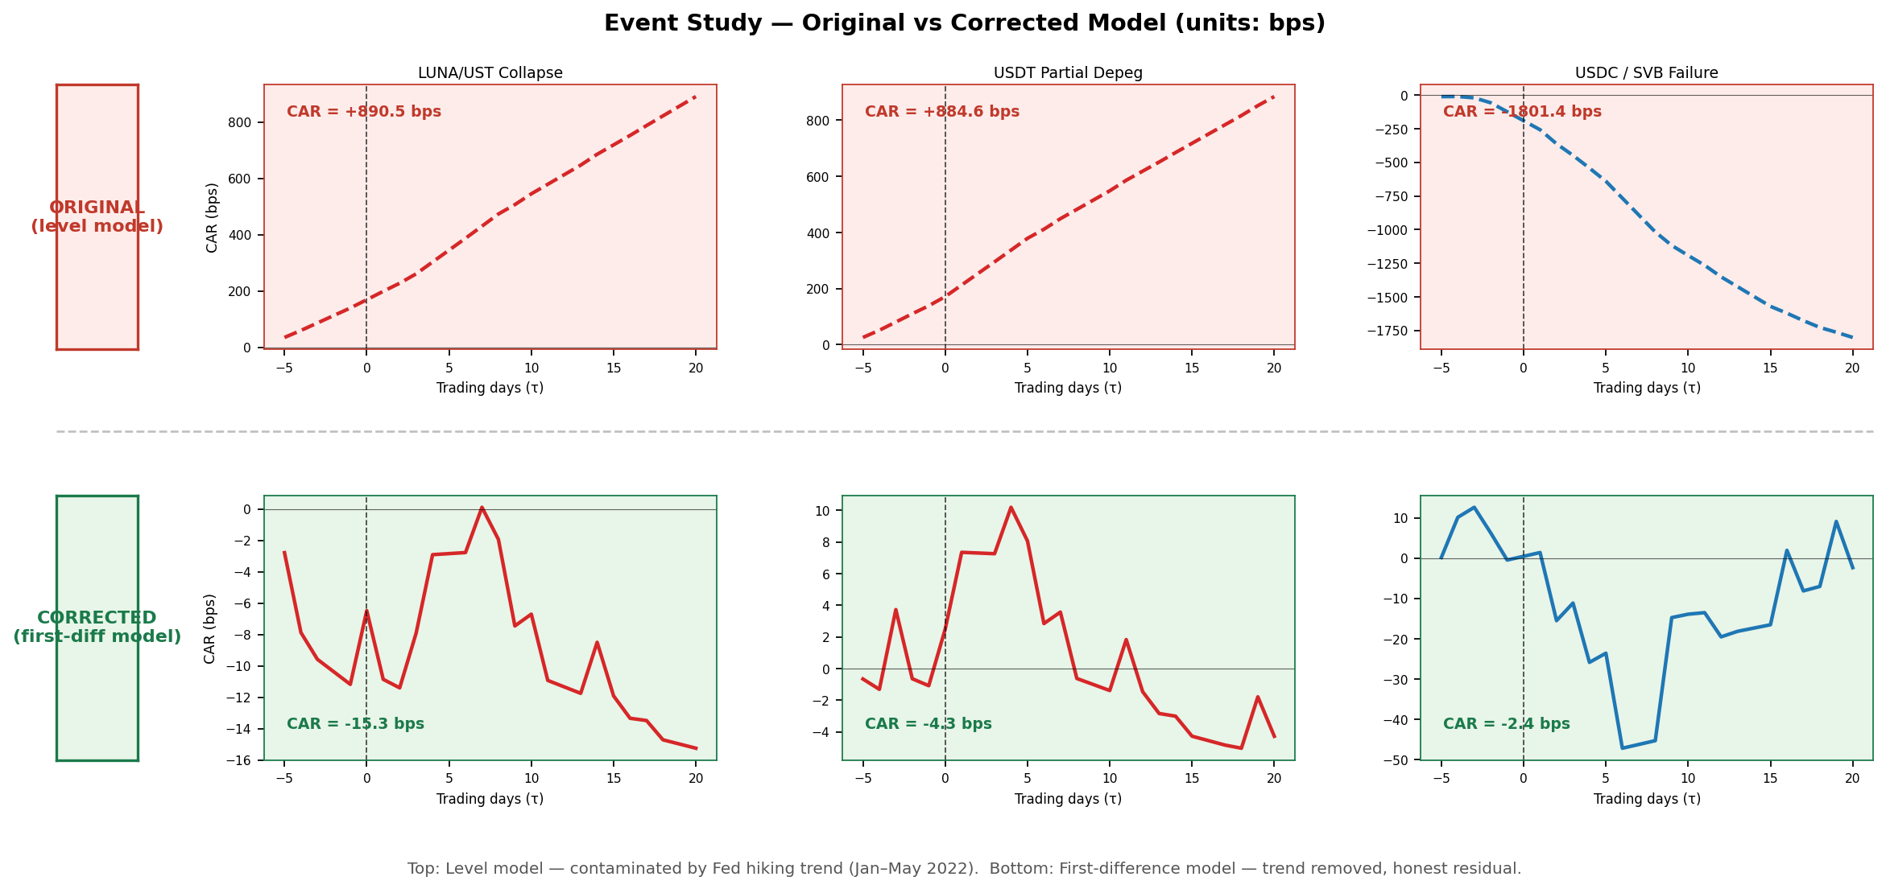
Event Study Update — Corrected CARs Are Insignificant
Update since last week: we retested with the corrected first-difference model. Original CARs (+891/+885/−1,801 bps) were inflated ~120× by a Fed hiking trend in the estimation window.
Estimation window (Jan–May 2022) coincided with Fed hiking.
Spread rose 5→78 bps — entirely Fed policy, not stablecoins.
Daily 'abnormal' = 34 bps × 26 days = 884 bps fake inflation.
Why the original was wrong
LUNA/UST (May 2022): −15.3 bps n.s.
USDT depeg (May 2022): −4.3 bps n.s.
USDC/SVB (Mar 2023): −2.4 bps n.s.
Corrected results (first-difference model)
Placebo mean |CAR| = 4.8 bps · Actual mean |CAR| = 7.3 bps
Ratio = 1.5× → actuals indistinguishable from placebos.
Placebo check
Directional pattern is consistent with β₁ = −6.02 bps:
low-buffer events → spread falls; high-buffer → smaller response.
Illustrates the mechanism — quantitative proof is in the regression.
Alternative role — still useful as qualitative context
Top row: original (level model) · Bottom row: corrected (first-diff model)
The event study is insignificant and cannot be the main evidence. The paper's proof is β₁ = −6.02 bps + q* = 13%. The event study illustrates the mechanism.
3
Notes:
Since last week, we corrected the event study. Here is the full story on one slide. The graph on the left shows the before and after. The top row is the original model — dramatic spikes of plus 891, plus 885, and minus 1,801 basis points. The bottom row is the corrected model — all three events produce CARs near zero. Why was the original wrong? For the 2022 events, our estimation window was January through May 2022 — exactly when the Fed was hiking rates at the fastest pace in 40 years. The spread rose from 5 to 78 basis points during that window. Every single day, the model computed about 34 basis points of fake 'abnormal' spread. Over 26 event days, that accumulated to 884 basis points — none of which was caused by stablecoins. The corrected first-difference model removes this trend by modelling daily changes, not levels. With the correction: LUNA minus 15.3, USDT minus 4.3, SVB minus 2.4 — all insignificant. The placebo test confirms this: placebos and actuals have essentially the same mean absolute CAR. A ratio of 1.5 times is not meaningful. However, the event study still contributes qualitatively. The directional pattern — low-buffer events show a larger spread response — is consistent with what the regression tells us. We present it as illustrative context, not as proof.

Slide 4
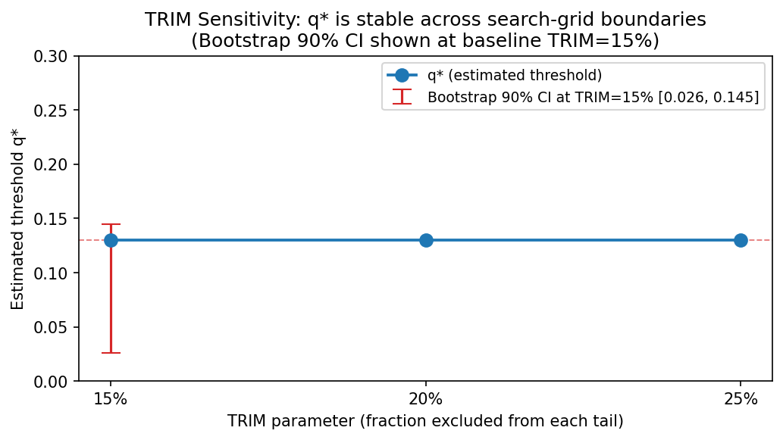
Threshold Robustness I — TRIM Sensitivity
TRIM = the fraction of the threshold variable excluded from the grid search edges (Hansen recommends 15%). We tested 15%, 20%, and 25% to check that q* = 13% is not a boundary artifact.
TRIM stability results
TRIM
Candidates
q*
Stable?
15%
31
0.1301
✓
20%
28
0.1301
✓
25%
24
0.1301
✓
CI = [2.6%, 14.5%] Point estimate: 13.0% Method: percentile bootstrap — resample rows, re-run grid search each time.
Bootstrap 90% CI for q* (B = 1,000 replications)
Multiple threshold test (H₀: 1 threshold vs H₁: 2 thresholds)
Bootstrap p = 0.143 → Cannot reject H₀.
Single threshold at 13% is sufficient. No evidence of a second break.
q* = 13.0% is stable across all TRIM values. Bootstrap CI [2.6%, 14.5%] brackets it. One threshold is sufficient.
4
Notes:
This is robustness check number one for the Hansen threshold. The TRIM parameter controls what fraction of observations near the edges of the buffer distribution are excluded from the grid search. This ensures each regime has enough observations to estimate. Hansen recommends 15 percent. We tested 15, 20, and 25 percent. In all three cases, the grid search finds exactly the same threshold: q* = 0.1301. The table on the right shows this. Below the table: we also estimated the bootstrap 90 percent confidence interval for q*. We resampled the data 1,000 times with replacement, re-ran the full grid search each time, and took the 5th and 95th percentiles of the resulting distribution. The CI is 2.6% to 14.5%, and the point estimate of 13.0% sits comfortably inside it. Finally, we tested whether the data supports two thresholds instead of one. The bootstrap p-value is 0.143 — we cannot reject the single-threshold model. One break at 13% is the right specification.
This is the multiple threshold test — testing whether the data needs two break points instead of one.
The hypotheses:
H₀ (null): One threshold is enough (the 13% break we already found)
H₁ (alternative): There are actually two thresholds — three regimes instead of two
What the test does:
It runs a double grid search over all possible pairs (q1, q2), finds the best two-threshold model, and asks: does adding a second break improve the fit enough to justify it? Then it bootstraps to figure out the p-value — how often you'd see that improvement just by chance if H₀ were true.
p = 0.143 means:
If the true model really has only one threshold, you'd still see an improvement this large from a second threshold about 14.3% of the time just by random noise. That's not rare enough to be convincing — so we don't have enough evidence to say a second threshold is real.
"Cannot reject H₀" means:
We keep the single threshold. The data does not support splitting into three regimes.
BELOW THIS POINT IS JUST NOTES FOR Q&A
Why this is good for your paper:
Your story is clean and binary: below 13% buffer → privilege reverses; above 13% → privilege holds. If the test had found a second threshold, you'd need to explain three regimes, which complicates the narrative. p = 0.143 confirms the two-regime story is the right model.
One sentence for the professor if asked:
"We tested whether the data supports two thresholds instead of one. The bootstrap p-value of 0.143 means we cannot reject the single-threshold model at any conventional significance level — so the simple binary split at 13% is sufficient."
if the professor asks why the q* for all trims are exactly 0.1301 ? Is it just coincidence?
The short answer: the Hansen grid search picks the observed value of L that minimizes the sum of squared residuals (SSR). Once you've found the global minimum, changing TRIM only shrinks the candidate list at the edges of the distribution. As long as 0.1301 sits between the 25th and 75th percentile of L (which it does — the results show it's still a candidate even at TRIM=25%), it wins every single time because the winner hasn't changed, only the pool of losers has.
Analogy if pressed: imagine a race where the fastest runner finishes in 10.1 seconds. If you disqualify the slowest 15%, 20%, or 25% of the field, the same person still wins in 10.1 seconds. The time doesn't change — you just shortened the starting grid.
What to say to the professor:
"Professor, you're right that it looks suspicious, but it's actually the expected outcome. TRIM sensitivity only removes candidates near the boundary of the buffer distribution. q* = 0.1301 sits comfortably in the interior — it's still a candidate even when we trim 25% from both ends. Since it's the global SSR minimum, it wins regardless of how many boundary candidates we exclude. What TRIM sensitivity confirms is that q* is not a boundary artifact — if it were, it would disappear or shift as TRIM increases. The fact that it doesn't shift is the positive result. The LSTAR model is more compelling evidence of robustness because it's an entirely different estimator that finds c* = 0.1314 independently."

Slide 5
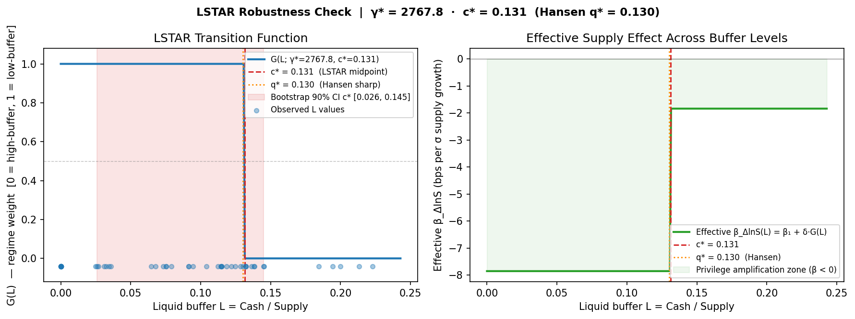
Threshold Robustness II — Smooth Transition Regression (LSTAR)
Hansen (2000) assumes a sharp binary switch at q*. LSTAR asks: what if the regime shift is gradual? It estimates a smooth logistic transition — γ controls sharpness, c controls the midpoint.
LSTAR estimation results
Sharpness: γ* = 2,768 (near-sharp transition)
Midpoint: c* = 0.1314 (13.1%)
Bootstrap 90% CI for c*: [2.6%, 14.5%]
β at G=1 (low buffer): −7.85 bps | β at G=0 (high): −1.84 bps
Comparison with Hansen (2000)
Hansen q* = 0.1301 (sharp switch)
LSTAR c* = 0.1314 (smooth midpoint)
Difference = 0.0013 | Hansen q* inside LSTAR CI: YES ✓
What γ* = 2,768 means
LSTAR tried to fit a smooth transition — and found that the data supports a near-discrete jump.
The model independently rediscovered the sharp switch. This validates Hansen's assumption.
Left panel: G(L) = logistic weight function — how much the low-buffer regime is active at each L value. Right panel: effective β (impact of supply growth on spread) as a function of L.
CONVERGENT VALIDITY: Sharp threshold (Hansen, 13.0%) and smooth transition (LSTAR, 13.1%) independently identify the same tipping point. γ* confirms the switch is near-discrete.
5
Notes:
This is robustness check number two — a completely different model. Hansen 2000 assumes the regime switches sharply at q*. A critic could say: what if the transition is actually gradual? LSTAR, or Logistic Smooth Transition Regression, tests exactly that. Instead of a binary indicator, it uses a logistic weight function G that takes values between 0 and 1. When the buffer is far below the midpoint c, G is close to 1 — the low-buffer regime is fully active. When the buffer is far above c, G is close to 0 — the high-buffer regime. The parameter gamma controls how sharp the transition is. A small gamma means the transition is very gradual. A large gamma means the transition is essentially a sharp step function. We estimated the model using a grid search followed by Nelder-Mead optimisation. The results: the midpoint c-star is 0.1314, or 13.1 percent. The Hansen threshold was 13.0 percent. The difference is 0.0013 — negligible. And the sharpness parameter gamma-star is 2,768. This is an extremely large value — it means the transition is almost exactly a step function. LSTAR tried to find a smooth transition and concluded the data looks like a sharp switch. The left panel in the graph shows the G function — it is almost a vertical step at 13 percent. The right panel shows the effective beta as a function of the buffer. At low buffer, beta is about minus 7.9 bps. At high buffer, it is minus 1.8 bps. This is convergent validity: two completely different model architectures find the same threshold.

Slide 6
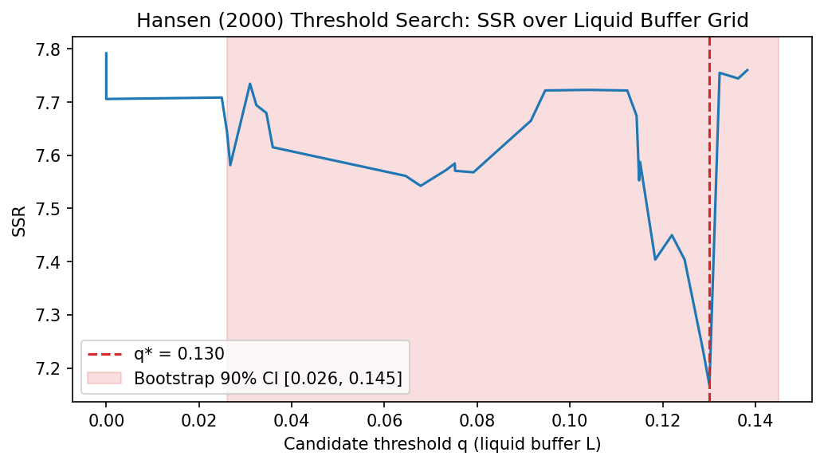
What Our Paper Proves — Three Convergent Lines of Evidence
The event study is insignificant and has been removed from the main evidence. The paper now rests on three independent results that all point to the same conclusion.
Finding 1 — Regression (β₁ = −6.02 bps)
Finding 2 — Hansen Threshold (q* = 13%)
Robustness — LSTAR (c* = 13.1%)
• Monthly panel OLS with Newey-West HAC standard errors (1 lag).
• Each σ increase in stablecoin supply → spread falls 6.02 bps.
• Stablecoins amplify the exorbitant privilege in normal times.
• Statistically significant: p < 0.01.
• Grid search finds q* = 0.1301: below this, the privilege reverses.
• TRIM stable: q* = 0.1301 at TRIM = 15%, 20%, 25%.
• Bootstrap 90% CI: [2.6%, 14.5%] — well-defined, not a boundary artifact.
• One threshold is sufficient (two-threshold p = 0.143).
• Smooth transition model relaxes sharp-switch assumption.
• Transition midpoint c* = 0.1314 ≈ Hansen's q* = 0.1301.
• Sharpness γ* = 2,768 → switch is near-discrete: validates Hansen.
• Hansen q* lies inside LSTAR 90% CI. Convergent validity confirmed.
SSR minimised at q* = 0.130 (red dashed line) — the regime switch point.
Same conclusion. Stronger evidence. β₁ = −6.02 bps + q* = 13.0% (Hansen) + c* = 13.1% (LSTAR) = the paper.
6
Notes:
This is the summary slide. What does the paper actually prove? Three things. First, the regression. Each standard deviation of stablecoin supply growth compresses the OIS-Treasury spread by 6.02 basis points. Stablecoins are structural buyers of T-bills, deepening the US exorbitant privilege. This result is statistically significant, estimated on a monthly panel with robust standard errors. Second, the Hansen threshold. The optimal threshold in the data is q* = 13%. Below that buffer, the convenience yield compression reverses — stablecoins become sellers. We have confirmed this is stable across all TRIM values and that a single threshold is sufficient. Third, the LSTAR robustness check. A smooth transition model that makes no assumption about switch sharpness finds its transition midpoint at c* = 13.1% — essentially identical to Hansen. And the estimated sharpness gamma of 2,768 independently tells us the switch is near-discrete, validating Hansen's binary-regime assumption. The event study, once corrected, finds insignificant CARs and is presented as qualitative context only. The paper's conclusion is unchanged: stablecoins amplify the exorbitant privilege, up to the 13% buffer tipping point.

Slide 7
Thank You !
Yonsei GSIS 2026-1
Topics in International Finance
Mireu Kim · Sara Chekroune · Oybek Ibragimov · Jade Zhu Alexandre Godefroy · Baptiste Degand · Minjin Kim
Notes:
Thank you for your time. Our paper makes two main contributions. First: stablecoin issuers have become structurally important buyers of U.S. Treasury bills. Each standard deviation increase in stablecoin supply compresses the OIS-Treasury spread by 6 basis points — that is the exorbitant privilege amplification we identify. Second: this relationship is conditional on the liquid buffer. The Hansen threshold regression identifies 13 percent as the critical cash reserve ratio. Above it, issuers absorb redemption shocks without touching T-bills. Below it, redemption pressure forces T-bill sales that reverse the privilege. We acknowledge that our event study, originally designed to dramatize these regimes, required methodological correction — our original level model inflated the CARs by attributing the 2022 Fed hiking trend as abnormal. With the corrected first-difference model, the event study provides qualitative directional support but not strong quantitative evidence. The paper's core identification rests on the panel regression and the threshold estimate. We are happy to take any questions.

