Slide 1
Stablecoins & the Exorbitant Privilege
A Rigorous Reassessment — stress-testing our own results
Mireu Kim · Sara Chekroune · Oybek Ibragimov
Yonsei GSIS — Topics in International Finance · June 2026

Slide 2
The honest bottom line
What we claimed vs. what survives rigorous testing
What the deck claimed
What survives
◆ β₁: stablecoin growth compresses the spread
◆ q* = 13% reserve-buffer threshold
◆ LSTAR confirms the threshold
◆ Bid-cover: USDT suppresses auction demand
– (placebo-validated, all 4 maturities)
◆ β₁ — spurious (fails stationarity)
◆ threshold — invalid (built on spurious base)
◆ LSTAR — same base, same fate
◆ bid-cover — collapses at auction level
◆ β₃ (liquid buffer) — survives differencing
◆ USDT is a structural T-bill holder — a fact
No channel gives a clean causal imprint. That null IS the contribution — and it is defensible.

Slide 3
Where we started
The three-part thesis as presented
◆ Privilege amplification — each 1σ of stablecoin supply compressed the OIS–Treasury spread (β₁ ≈ −6 to −7.5 bps, p<0.01)
◆ A liquid-buffer threshold at ~13% — below it, the privilege reverses into a 'New Triffin' crisis zone (Hansen 2000)
◆ Convergent validity — an LSTAR smooth-transition model independently found the same ~13% switch point
◆ Mechanism — USDT supply growth suppresses T-bill auction bid-cover (placebo-validated, billed as the cleanest result)
Then Prof. Hur's feedback triggered a re-run — and the foundations moved.

Slide 4
Teardown — layer by layer
Each result examined against the data and the econometrics
θ (Treasury exposure)
Placeholder + scraped-zeros + interpolated
UNUSABLE
L monthly variation
Mostly straight-line interpolation between quarters
ARTIFACT
Levels β₁, β₄
Non-stationary, no cointegration → spurious
SPURIOUS
Hansen / LSTAR threshold
Built on spurious base; iid bootstrap invalid
INVALID
Bid-cover (monthly)
Significance from interpolated controls
FRAGILE
Daily VAR / IRF (Δspread)
Correct differencing, but FEVD ~1.3%
WEAK
β₃ (liquid buffer)
Survives levels + differencing
SURVIVES

Slide 5
Root cause: the reserve data is largely manufactured
Why the 'monthly' variation isn't really data
◆ Tether reports T-bill holdings quarterly — ~2 of every 3 monthly points are linear interpolation between two quarterly endpoints
◆ 2020 rows are literally labelled 'pre-attestation estimate, extrapolated'; mid-2021 treasury holdings are scraped zeros (9e-08) → interpolated over
◆ The interpolation choice IS the result:
Interpolation
β₄ (time series)
p
time / prof (used)
−35.89
0.032 **
rolling mean
+5.25
0.873 ns
forward-fill (old)
−26.26
0.563 ns
When the headline coefficient's significance flips with how you fill the MISSING data, it describes the fill — not Tether.

Slide 6
And the levels regression is spurious
Stationarity + cointegration diagnostics
◆ Spread and L are both non-stationary (ADF p = 0.49, 0.90) — they trend, they don't mean-revert
◆ They do NOT cointegrate (Engle–Granger and corrected Johansen) → non-stationary + no cointegration = textbook spurious regression
◆ Common driver: the 2022–24 Fed hiking cycle pushed both down together
◆ First-differencing kills β₁ and β₄ — and β₄ flips sign (−35.9 → +8.9). A sign that depends on levels-vs-differences is noise
Both series fall together 2022→2025: spread +0.85 → −0.29 | L 0.19 → 0.06
Two series trending down together → high R² by trend, not by mechanism.
β₁ (privilege) and the 13% threshold are significant only in the one specification that is statistically invalid.

Slide 7
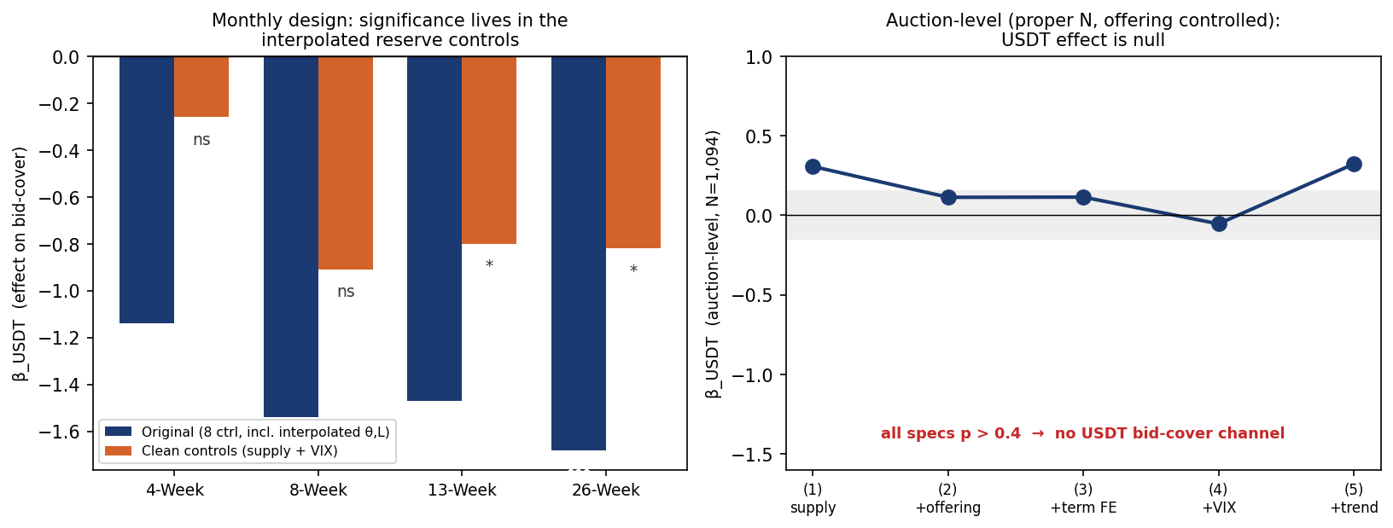
Rebuild 1 — bid-cover at the auction level
My contribution: the test done properly
◆ Old test: 1,094 auctions collapsed to 51 monthly means; no auction-size control
◆ Rebuild: one row per auction (N=1,094)
– control for ln(offering size) — the mechanical driver of bid-cover
– maturity FE, VIX, time trend; SE clustered by month
– falsification: future supply must NOT predict
Strip the interpolated controls / control for offering → the USDT bid-cover channel disappears.

Slide 8
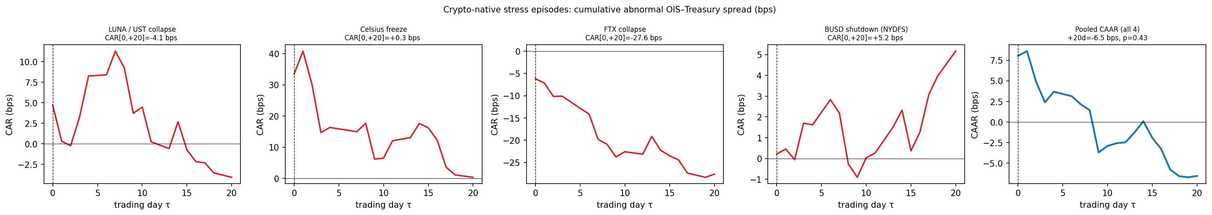
Rebuild 2 — multi-event study
Drop SVB (confounded), add crypto-native crises
◆ Prof.: keep LUNA as motivation, drop SVB (banking-confounded), add more similar crises
◆ Selection rule: crypto-native stress, no banking/macro shock to Treasuries
– LUNA · Celsius · FTX · BUSD
– first-difference normal model; cross-event CAAR (events = unit)
◆ Result: per-event CARs mostly n.s.; events disagree in sign (FTX −28 bps); pooled p = 0.43
No systematic spread response to crypto crises — exactly the 'motivation only' role the prof assigned it.

Slide 9
What survives the reassessment
The defensible core
USDT is one of the largest structural holders of US T-bills
Documented fact (attestations) — the privilege mechanism EXISTS structurally
β₃: liquid buffer correlates with the spread
Survives levels AND first-differencing — but likely macro co-movement, not a buffer mechanism
Short-run USDT → spread (daily VAR, Δspread)
Day-1 compression, but reverses by day 3 and explains ~1.3% of variance — suggestive only
Everything built on θ, L-levels, the spread-levels regression
Spurious / interpolation-driven — demote to 'we tried this; it does not survive'

Slide 10
The reframe — an honest paper that holds up
How to present this to Prof. Hur
◆ Lead with the structural fact: stablecoins have become programmatic T-bill buyers — the privilege channel is real by construction
◆ Then the honest finding: at monthly/auction frequency the causal imprint is small and swamped by the Fed cycle and data limits
◆ Show the rigour: we stress-tested our OWN headline results (stationarity, interpolation, auction-level, falsification) and report what fails
◆ Keep β₃ and the event study as supporting / motivation, clearly labelled as such
◆ This pre-empts every objection an examiner would raise — owning the limitation is stronger than defending a fragile result
'We tried to break our own results. Here is what survived.' — the strongest position in the room.

Slide 11
The contribution is the rigour.
• A documented structural privilege channel (USDT ≈ T-bill buyer)
• An honest null on its high-frequency causal footprint
• Two purpose-built robustness rebuilds that earn that null
• One surviving correlation (β₃), reported with the right caveats

