Slide 1
YONSEI GSIS | TOPICS IN INTERNATIONAL FINANCE | JUNE 2026
Stablecoins and the Exorbitant Privilege
Safe-Asset Demand and Its Systemic Fragility
Mireu Kim · Sara Chekroune · Oybek Ibragimov · Jade Zhu · Alexandre Godefroy · Baptiste Degand · Minjin Kim
β₁ < 0
q* ≈ 13%
USDT ≠ USDC
Privilege amplification
(direction robust)
Liquid-buffer fragility
region (low teens)
Reserve-composition
channel confirmed

Slide 2
BACKGROUND
What Is a Stablecoin?
A programmatic, rule-bound channel for US-dollar safe-asset demand.
What it is
How it is backed
Why it matters
A privately issued token pegged 1:1 to the US dollar (USDT, USDC). Combined supply has grown to roughly $300 billion.
Each token is backed by reserves — cash plus short-dated US Treasury bills. About $300B supply maps to ~$150B in T-bills.
Not a central bank, not a fund manager — an algorithm that must buy T-bills as supply grows. Programmatic, always-on, and fast.
Key insight: stablecoins create a NEW demand channel for T-bills — larger, faster, and more rule-bound than sovereign reserve managers.
Stablecoins & the Exorbitant Privilege
2

Slide 3
MOTIVATION
The Exorbitant Privilege — What Finance Already Knows
The structural role that deepens US safe-asset demand also embeds a fragility that can rapidly reverse it.
The Original Triffin Dilemma (1960)
The Exorbitant Privilege (Gourinchas & Rey, 2007)
A reserve-currency country must supply enough safe assets to meet global demand — but doing so requires running structural deficits that progressively undermine confidence in the currency. The system depends on the very condition that makes it unsustainable.
The US earns more on foreign assets than it pays on its liabilities — a structural borrowing advantage.
Global demand for dollar safe assets keeps T-bill yields low, so the US borrows cheap.
We measure it through the OIS–Treasury (convenience-yield) spread: when T-bill demand rises, US borrowing costs fall below the risk-free baseline.
Stablecoins & the Exorbitant Privilege
3

Slide 4
OUR CORE INSIGHT
The New Triffin Dilemma — Same Mechanism, Two Faces
Supply growth amplifies the privilege in calm times — and undermines it in stress. The liquid buffer L decides which.
NORMAL TIMES ✓
RUN SCENARIO ✗
Issuance → mechanical T-bill acquisition by issuers
Structural rise in safe-asset demand for Treasuries
Spread compresses → yields fall below baseline
Exorbitant privilege amplified via private channel
Redemption shock → programmatic T-bill liquidation
Treasury yields spike above baseline — spread reverses
Sovereign-linked liquidity shock hits debt markets
Self-fulfilling: fear validates liquidation, crisis spreads
What determines the outcome
θ = Treasury holdings / supply
the structural demand channel
L = liquid reserves / supply
crisis-absorption capacity: L ≥ L* absorbed internally; L < L* forced liquidation
Stablecoins & the Exorbitant Privilege
4

Slide 5
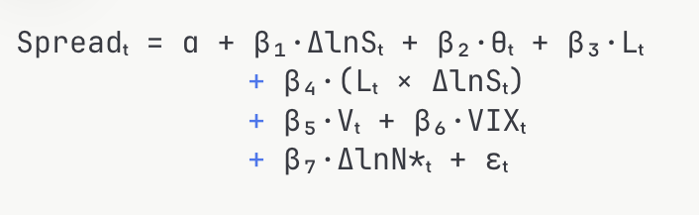
THEORETICAL FRAMEWORK
Extending Maggiori (2017): Adding S, θ and L
Maggiori (2017): safe-asset demand is driven by Ω* — the countercyclical marginal value of rest-of-world net worth. We add three components.
D*(Ñ*, S, θ, L) = D*precautionary(Ñ*) + D*stablecoin(S, θ) + D*buffer(L)
precautionary (Maggiori) + new structural demand via mechanical T-bill purchases + demand from excess reserves above the minimum
Main estimating equation
Predicted signs
Spreadₜ = α + β₁·ΔlnSₜ + β₂·θₜ + β₃·Lₜ
+ β₄·(Lₜ × ΔlnSₜ)
+ β₅·Vₜ + β₆·VIXₜ + β₇·ΔlnN*ₜ + εₜ
β₁ < 0 ΔlnS compresses the spread (privilege amplification)
β₂ > 0 higher T-bill exposure θ amplifies demand
β₄ > 0 higher buffer L dampens crisis transmission
The buffer L introduces a non-linear threshold — the key theoretical departure from Maggiori. Spread = corrected convenience yield (see slide 7).
Stablecoins & the Exorbitant Privilege
5

Slide 6
LITERATURE & CONTRIBUTION
What the Literature Establishes — and Where It Stops
Aldasoro & Ahmed (BIS WP 1270, 2025)
✓ Stablecoin inflows lower 3-mo T-bill yields 2–2.5 bps; outflows raise them 2–3× more.
✗ Moderator is market T-bill supply, not issuer reserves. Uses yield levels, not the spread. No threshold.
Gorton & Zhang (2023)
✓ Issuers are unregulated banks; runs are structurally inevitable without deposit insurance.
✗ Identifies run risk but does not model transmission to sovereign debt markets.
Lyons & Viswanath-Natraj (2023)
✓ Arbitrage keeps dollar-backed coins pegged; weak issuers face speculative attacks.
✗ Internal peg mechanics only — no link to Treasury-market outcomes.
OUR CONTRIBUTION
First to jointly estimate how issuer reserve adequacy moderates the transmission from stablecoin supply growth to the OIS–Treasury spread — and to locate the buffer region below which amplification turns into forced liquidation. β₄ and L* ≈ 13% have no direct antecedent in the published literature.
Stablecoins & the Exorbitant Privilege
6

Slide 7
MEASUREMENT
Why the OIS–Treasury Spread, Not Raw Yields?
A T-bill yield moves for several reasons at once. The spread strips out everything except safe-asset demand.
Raw T-bill yield
OIS benchmark
The spread
NOT used
subtracted
our variable
Driven by Fed-rate expectations
+ inflation expectations
+ safe-asset demand
Cannot separate the three
Expected policy-rate path
Pure monetary expectations
No T-bill-specific demand
Moves with macro, not flows
= T-bill yield − OIS
Cancels monetary policy
Isolates the convenience yield
Moves only on T-bill demand
Literature precedent: Krishnamurthy & Vissing-Jorgensen (2012), Nagel (2016), Greenwood-Hanson-Stein (2015) — the OIS–T-bill spread as the convenience yield of near-money assets.
Correction note: the benchmark must be forward-looking. We replaced a backward-looking 90-day SOFR average (which lagged during 2022 hiking and inflated the mean to 84.8 bps) with DGS3MO − SOFR → mean 16.6 bps. To-do: finish with 3-mo Term SOFR to fully match the OIS definition above.
Stablecoins & the Exorbitant Privilege
7

Slide 8
DATA & SAMPLE
Variables, Sources, and the Corrected Spread
Variable | Definition | Freq.
OIS–Treasury spread | DGS3MO − SOFR (FRED) | D→M
Stablecoin supply S | USDT + USDC (DeFiLlama) | D→M
θ Treasury exposure | T-bill holdings / supply | Q/M
L Liquid buffer | Cash reserves / supply | Q/M
Velocity V | 7-day SD of ΔlnS | D→M
VIX | CBOE VIX (FRED) | D→M
ΔlnN* RoW equity | ACWX ETF return | D→M
The spread correction
OLD (wrong): DTB3 − SOFR90DAYAVG — a backward-looking trailing average that lagged overnight SOFR by up to 119 bps during 2022 hiking. A pure Fed-policy artifact.
Sample: Jan 2022 – Mar 2026 | N = 51 monthly observations | θ, L from Tether/BDO & Circle/Deloitte attestations
Corrected mean = 16.6 bps — consistent with ≈0 in normal times, 10 bps being economically large.
Stablecoins & the Exorbitant Privilege
8

Slide 9
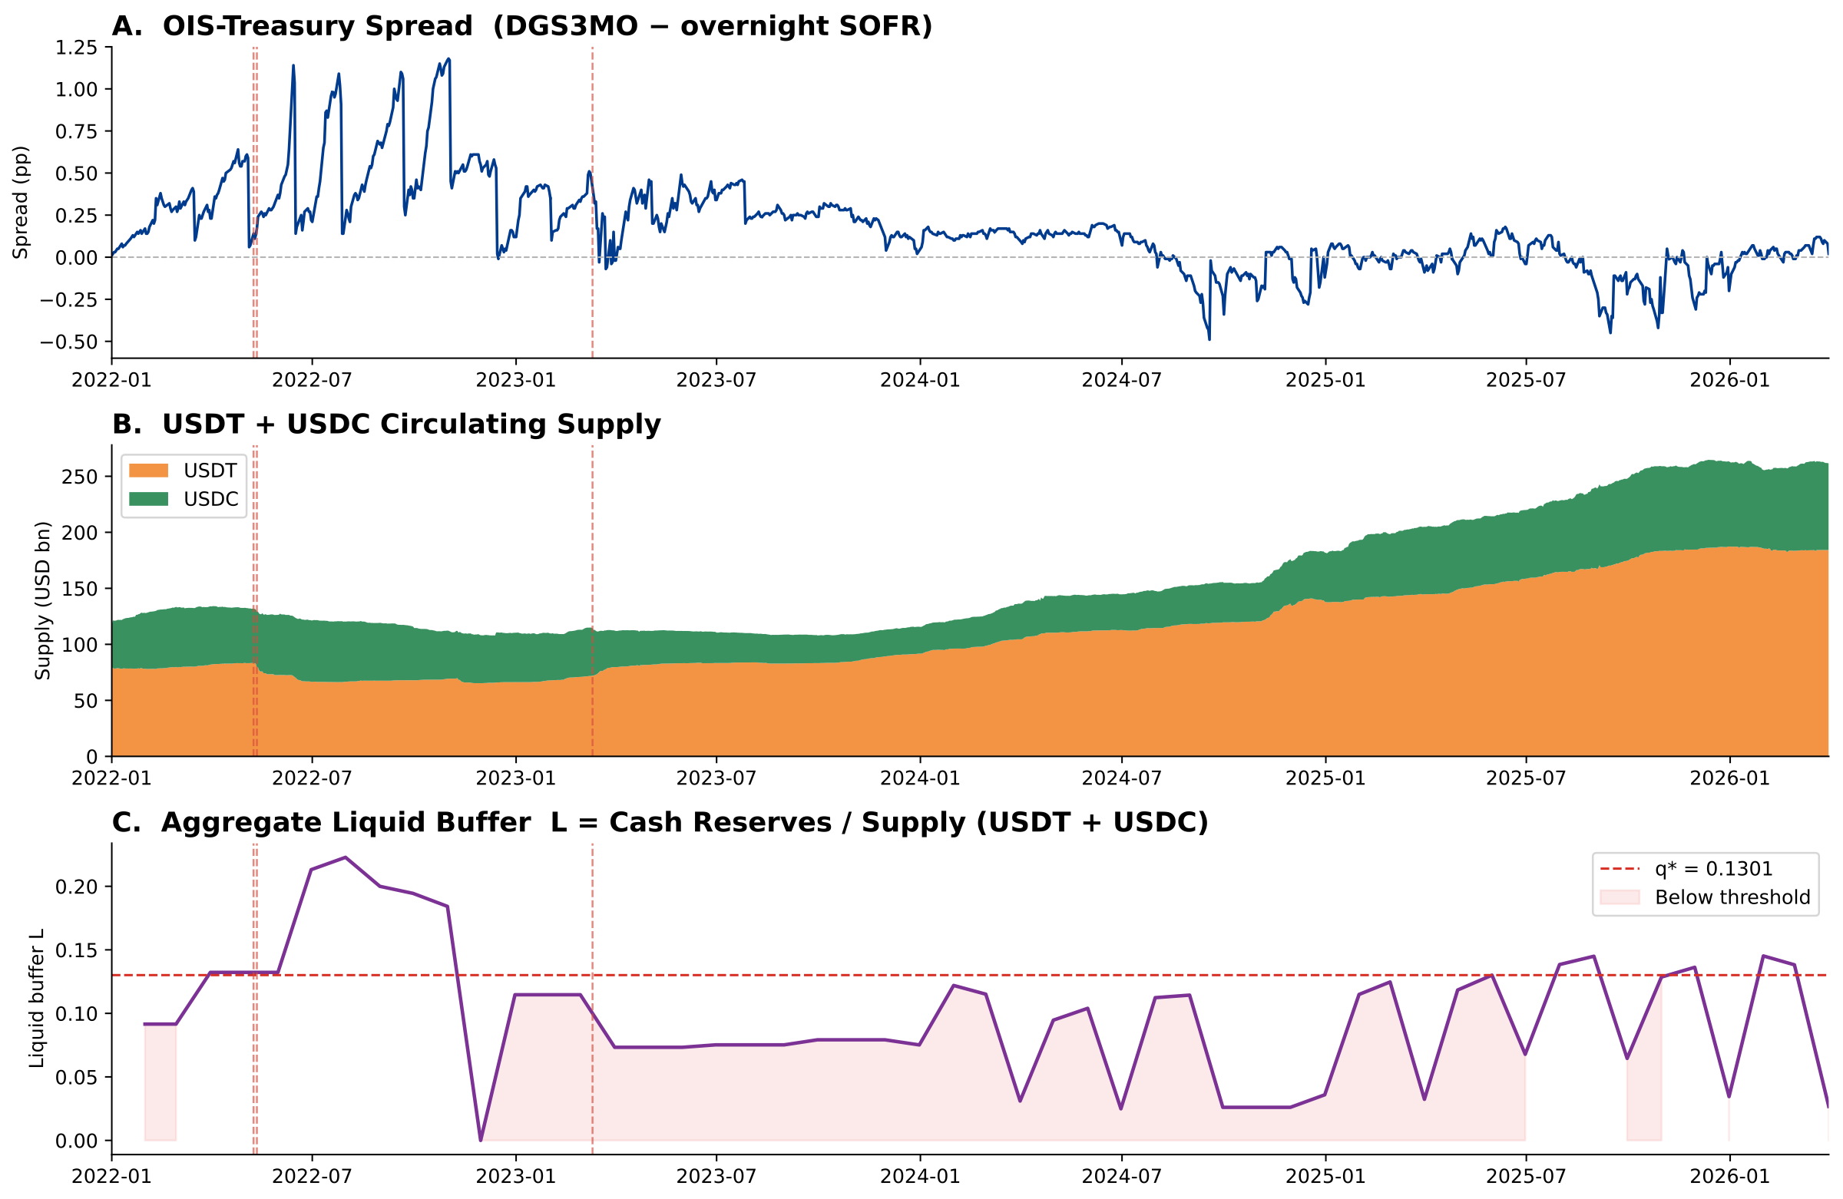
DATA — KEY VARIABLES OVER TIME
Spread, Supply, and the Liquid Buffer (2022–2026)
How to read it
A — corrected convenience-yield spread (DGS3MO − overnight SOFR).
B — USDT+USDC supply, now ~$260B.
C — the buffer L, with the q* = 13% line.
What it shows
The spread sits near zero in calm periods, with a residual term-premium bump during the 2022 hiking cycle that reverts toward zero by 2024–26. Meanwhile L spends long stretches below the 13% line — exactly the fragility region.
Stablecoins & the Exorbitant Privilege
9

Slide 10
INTUITION
What the Buffer Condition Means
L = liquid buffer = cash & cash-equivalents ÷ total supply. Estimated regime break: L* ≈ 13%.
LOW BUFFER (L < 13%)
HIGH BUFFER (L ≥ 13%)
e.g. Tether, May 2022: ~low cash
e.g. Circle, Mar 2023: ~high cash
Issuer holds mostly T-bills, very little cash
Investors redeem → issuer MUST sell T-bills to raise cash
Forced selling pushes T-bill yields UP
Spread reverses — a forced seller into a stressed market
Issuer holds substantial cash reserves
Investors redeem → issuer pays out from cash
T-bills untouched — no forced selling, no yield pressure
Spread does not move from issuer behaviour
Issuer behaviour disrupts the Treasury market.
The cash buffer absorbs the shock; the market is insulated.
Stablecoins & the Exorbitant Privilege
10

Slide 11
INTUITION BEFORE RESULT
What Should β₁ Look Like?
If stablecoins truly act as a safe-asset demand channel,
β₁ must be NEGATIVE — supply growth compresses the spread.
We state the prediction first, then test it on N = 51 monthly observations.
This ordering is deliberate: the sign is a theoretical commitment, not a fitted surprise. The magnitude and significance are what the data then has to say.
Stablecoins & the Exorbitant Privilege
11

Slide 12
MAIN RESULT
Stablecoin Growth Compresses the Spread
Variable | Coeff. | Std. Err. | p-value
Δln(Supply) β₁ | −7.57 | 2.59 | 0.004 ***
VIX β₂ | +0.010 | 0.007 | 0.173
Velocity V β₃ | −52.87 | 23.84 | 0.027 **
B×ΔlnS β₄ (fragility) | −7.52 | 3.21 | 0.019 **
Economic magnitude
≈30 bps
compression from a 1-SD (≈4 pp) rise in supply growth — on the order of a sizeable FOMC surprise.
OLS with Newey-West HAC s.e. N = 51 R² = 0.411 Adj-R² = 0.330 (buffer-ratio spec, Column 2)
Intuition check
β₁ < 0 ✓
supply growth compresses the spread
VIX > 0 ✓
risk-off widens the spread
Read this honestly
The direction (β₁ < 0) is robust across every specification and sub-sample. The exact magnitude is spec-dependent: the decomposed spec gives β₁ = −1.12 (n.s.) because θ, L and L×ΔlnS are collinear at N = 51; the buffer-ratio spec combines them. State the sign as the finding, not the precise −7.57.
Stablecoins & the Exorbitant Privilege
12

Slide 13
INTUITION
Why Should There Be a Regime Break?
Low buffer = forced-liquidation risk; high buffer = orderly redemption. We look for a fragility region, not a knife-edge.
When L is LOW
When L is HIGH
A redemption wave forces rapid T-bill sales
Issuer activity moves the market in both directions
The relationship between supply and spread changes character
Issuer absorbs redemptions from cash
T-bill holdings stay untouched
The privilege channel continues undisturbed
What we estimate: a critical buffer region in the low teens (L* ≈ 13%) separating amplification from forced liquidation — located consistently by two methods, though imprecisely estimated.
Stablecoins & the Exorbitant Privilege
13

Slide 14
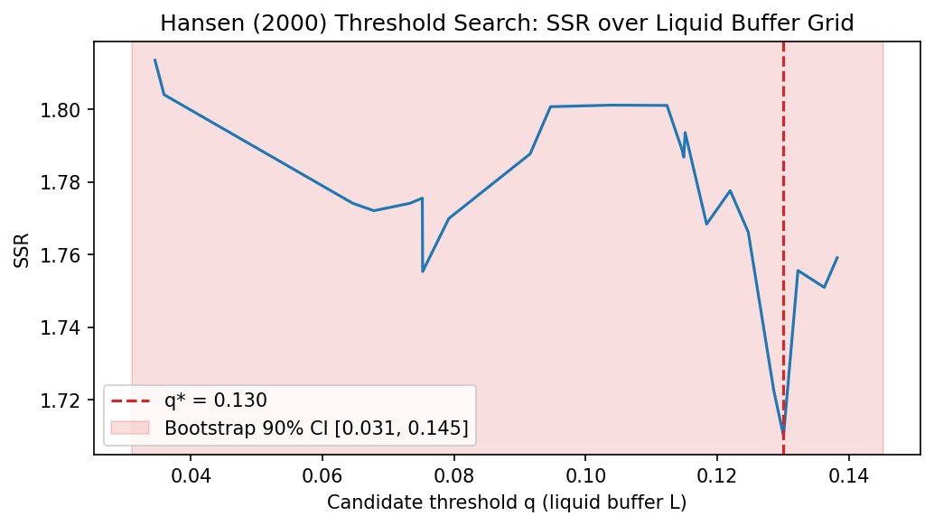
THRESHOLD RESULT
A Fragility Region in the Low Teens (≈ 13%)
Two methods independently locate the break near 13–15%. The location is robust; the precision is limited by N = 51.
q* = 13.0%
Hansen grid search — stable across TRIM 15/20/25%
c* = 14.9%
LSTAR smooth transition — locates the same region
p = 0.406
bootstrap; 90% CI [3.1%, 14.5%] — location robust, not precise
Hansen (2000) SSR over the buffer grid — minimized at q* = 0.130, with the bootstrap 90% CI shaded.
Converges: the threshold LOCATION (≈13%) — stable across both methods, all TRIM values, every model vintage. Does NOT converge: the regime-beta magnitudes — Hansen (hard split) and LSTAR (smooth model) estimate different objects, so do not show them as mutual corroboration. Claim only: “two methods locate the same fragility region near 13%.”
Stablecoins & the Exorbitant Privilege
14

Slide 15
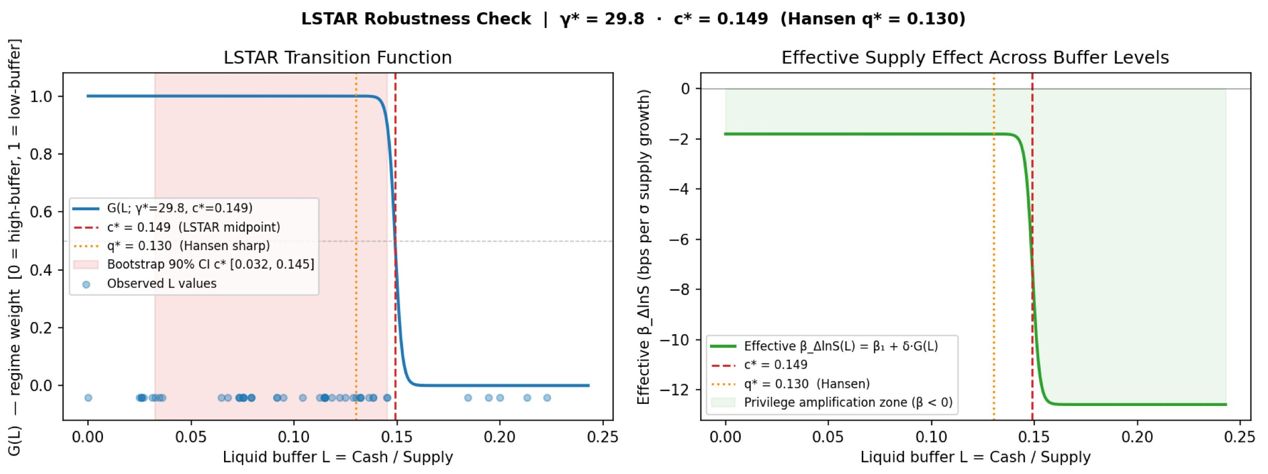
ROBUSTNESS
LSTAR Smooth-Transition Regression
Does Hansen's sharp-switch assumption drive the result? A gradual-transition model locates the same region.
What this adds: the transition midpoint c* = 14.9% lands inside the Hansen bootstrap CI — two methods, same 13–15% region. Read with care: the per-regime betas (−1.81 / −12.59) come from a different functional form than Hansen's — treat them as the LSTAR fit, not as beta-level confirmation. The robust cross-model claim is the threshold LOCATION.
Stablecoins & the Exorbitant Privilege
15

Slide 16
MECHANISM — HEADLINE EVIDENCE
Auction Bid-Cover: Only the T-bill-Heavy Issuer Moves It
Issuer heterogeneity as a natural control: USDT (~80% T-bills) should suppress bid-cover; USDC (~30–40%) should not. Same macro environment — the difference isolates the channel.
Maturity | β USDT | p USDT | β USDC | p USDC | Wald p
4-Week | −1.225 | 0.010 ** | +0.452 | 0.060 | 0.001 ***
8-Week | −1.553 | 0.007 *** | +0.145 | 0.516 | 0.003 ***
13-Week | −1.366 | 0.003 *** | +0.338 | 0.131 | 0.000 ***
26-Week | −1.587 | 0.000 *** | −0.016 | 0.937 | 0.001 ***
USDT: negative and significant at all four maturities. USDC: insignificant everywhere. Wald rejects β_USDT = β_USDC (p < 0.004). This is our cleanest causal evidence — and the one result that does not depend on the spread variable, so the spread correction left it untouched.
Stablecoins & the Exorbitant Privilege
16

Slide 17
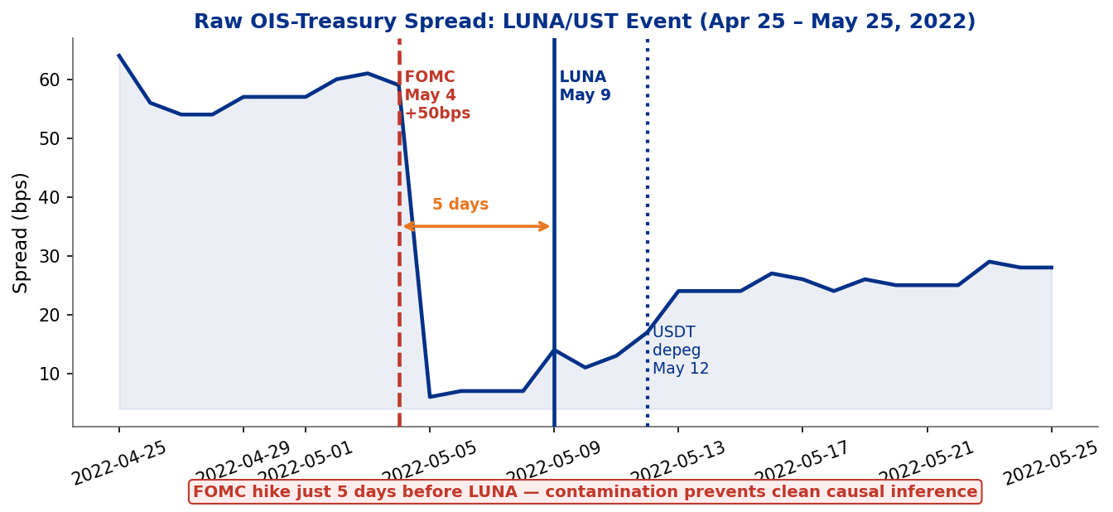
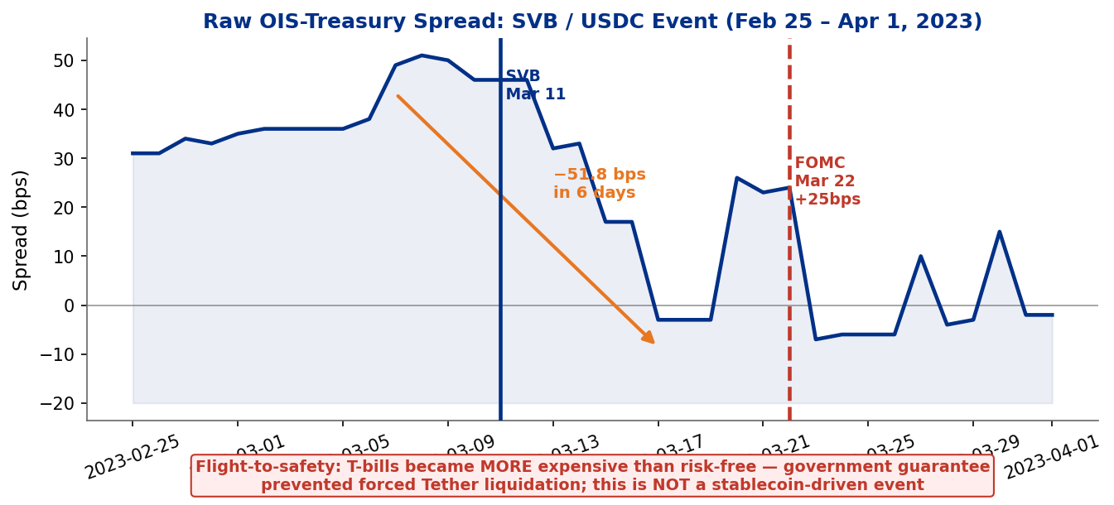
SUPPORTING / ILLUSTRATIVE
Event Study — Honest About Its Limits
Raw daily spread around stress events (not CARs). Included to illustrate plausibility — not as proof.
The honest read
Only 3 events; FOMC contamination in 2 of 3. All CARs individually insignificant (−41 / +23 / −27 bps).
Placebo ratio 7.0× — suggestive, not individually significant. Story has shifted across re-runs — too unstable to be evidence.
Role: illustrate the mechanism. The proof lives in the regression and the bid-cover test.
Stablecoins & the Exorbitant Privilege
17

Slide 18
POLICY IMPLICATIONS
From an Empirical Region to a Regulatory Reference
MiCA (EU, 2024)
GENIUS Act (US, 2025)
Market trajectory
Mandates liquid-reserve requirements for ‘significant’ e-money tokens. Our region gives an empirically grounded floor.
Requires issuers to hold cash or near-cash reserves. Our CI [3.1%, 14.5%] maps to a regulatory range.
Supply heading toward $1–2T. At that scale, forced-liquidation risk becomes systemic — a break-the-buck analogue.
Our reference — stated as a range, not a precise mandate
Target a low-teens liquid-buffer floor (cash / near-cash), with estimates centered near 13% of outstanding supply — as a behavioural break, not a welfare optimum. Below ~3% is clearly under-reserved; above ~14.5% is clearly adequate. As attestation data accumulates, the estimate will sharpen.
Stablecoins & the Exorbitant Privilege
18

Slide 19
SUMMARY
Three Lines of Evidence — Each Limited, Together Coherent
1
Regression
2
Bid-cover mechanism
3
Threshold region
β₁ < 0 — direction robust across every spec & sample.
Stablecoins amplify the privilege in normal times.
~30 bps compression per 1-SD supply growth.
Only the T-bill-heavy issuer (USDT) moves auction bid-cover.
Wald rejects equality with USDC (p < 0.004).
Cleanest causal evidence; spread-independent.
Two methods locate a break near 13% (Hansen, LSTAR).
Location robust; precision limited (p = 0.406, N = 51).
Reported as a region, not a knife-edge.
All three point the same way: stablecoins amplify the exorbitant privilege, with a fragility threshold near a 13% liquid buffer.
Stablecoins & the Exorbitant Privilege
19

Slide 20
LIMITATIONS & NEXT STEPS
Honest Constraints and the Agenda Ahead
Limitations
Next steps
N = 51 months limits power for threshold confirmation.
L forward-filled for ~13 months (Tether quarterly attestations).
Spread benchmark still overnight SOFR — finish with 3-mo Term SOFR.
Endogeneity not fully resolved (Granger addresses, doesn’t solve).
Only 3 stress events; FOMC contamination in 2 of 3.
Sample Jan 2022 – Mar 2026; may not generalize past 2026.
Longer sample as attestations accumulate → power improves.
Better identification: instrument supply with regulatory announcements.
High-frequency: daily spread + daily supply for cleaner events.
Non-USD ecosystems: euro stablecoins, CBDC interactions.
Cross-country: does the same mechanism hold for EUR safe assets?
Stablecoins & the Exorbitant Privilege
20

Slide 21
Thank You — Questions Welcome
Stablecoins and the Exorbitant Privilege · Safe-Asset Demand and Its Systemic Fragility
Mireu Kim · Sara Chekroune · Oybek Ibragimov · Jade Zhu · Alexandre Godefroy · Baptiste Degand · Minjin Kim
Yonsei GSIS | Topics in International Finance | June 2026
github.com/stablecoin-privilege-research

