Slide 1
YONSEI GSIS | TOPICS IN INTERNATIONAL FINANCE
Stablecoins and the Exorbitant Privilege
Safe-Asset Demand and Its Systemic Fragility
A Reserve-Composition Channel in the T-Bill Market
Mireu Kim · Sara Chekroune · Oybek Ibragimov · Jade Zhu · Alexandre Godefroy · Baptiste Degand · Minjin Kim
Bid-cover ↓
USDT ≠ USDC
Robust
USDT supply weakens T-bill auction demand
A reserve-composition channel, issuer-specific
Survives every stress-test we ran

Slide 2
MOTIVATION
The Question — A Structural Fact, Then a Test
Stablecoin issuers have quietly become major buyers of US Treasury bills
The structural fact
The mechanism
The question
Stablecoin issuers hold their reserves largely in short-term US Treasuries. USDT alone is now one of the largest holders of T-bills in the world — by construction.
When USDT grows, it mechanically buys T-bills. This is programmatic, rule-bound demand for US government debt — a candidate channel of the 'exorbitant privilege'.
Does this demand actually show up in the US Treasury market? We test it against T-bill auction demand (bid-cover) and stress-test every result.
Stablecoins & the Exorbitant Privilege
2

Slide 3
AFTER THE PROFESSOR'S FEEDBACK
What We Changed
We rebuilt the analysis around the professor's corrections
Specification
Data construction
Exploit the panel: each issuer (USDT, USDC) a separate observation. Stop combining Treasury and liquid reserves; drop θ (θ + L ≈ 1, collinear). Show the estimating equation on every result.
Replace forward-filling of the quarterly reserve attestations with a time-weighted linear interpolation between consecutive attestation dates.
Event study
Focus
LUNA · Celsius · FTX · BUSD studied. Drop SVB — confounded by the simultaneous banking crisis. Events disagree in sign; pooled p = 0.43 → motivation only, not identification.
Re-centre the analysis on the bid-cover ratio as a stationary, directly observable outcome — and stress-test the new result.
Stablecoins & the Exorbitant Privilege
3

Slide 4
AFTER THE PROFESSOR'S FEEDBACK
What the Re-Run Revealed
We re-ran the two headline coefficients under the professor's corrected specification
Neither Result Survived
β₁ — Privilege Amplification
→ Measures the baseline direct effect of stablecoin supply growth on yield spreads, independent of the buffer level
→ Before: β₁ = −7.57 (p = 0.004) — statistically significant
→ After re-run: β₁ = +2.74 — not significant; sign flipped
→ Verdict: amplification claim does not hold
β₄ — Buffer Interaction
→ Tests whether the reserve buffer level amplifies or dampens the effect of stablecoin supply growth on spreads
→ Levels regression: β₄ = −35.89 (p = 0.032) — appeared significant
→ First-differenced: β₄ = −107 (p = 0.46) — collapses to insignificance
→ Result vanishes under differencing — consistent with spurious regression
① Original — before professor's feedback
Spread = α + β₁·ΔlnS + β₂·θ + β₃·L + β₄·(L×ΔlnS) + controls
β₁ = −7.57 (p = 0.004) ***
② Corrected — θ dropped (θ+L≈1, collinear), L kept
Spread = α + β₁·ΔlnS + β₃·L + β₄·(L×ΔlnS) + controls
β₁ = +2.74 (p = 0.228) not significant
β₄ = −35.89 (p = 0.032) significant in levels
③ First-differenced — L replaced by ΔL (removes drift)
ΔSpread = α + β₁·Δ²lnS + β₃·ΔL + β₄·(ΔL×Δ²lnS) + controls
β₁ = 0.82 (p = 0.13) β₄ = −107 (p = 0.46)
What we dropped from the main claims
β₁ (privilege amplification) · the ≈13% reserve threshold · the LSTAR model
β₁ and β₄ lost significance when re-run correctly. The threshold and LSTAR ran only in the (now-invalid) levels regression — we do not carry them forward.
Stablecoins & the Exorbitant Privilege
4

Slide 5
AFTER THE PROFESSOR'S FEEDBACK
Why? Diagnosing Spurious Regression
We ran three standard tests to confirm the original regression was spurious
ADF Unit Root Test
Engle–Granger Cointegration
Johansen Test
What it is
Does the variable drift without a stable mean? If yes → non-stationary
Why we ran it
Non-stationary variables produce spurious regressions — false significance from shared drift
Our result
Spread p = 0.494 · Buffer L p = 0.902 → both non-stationary, I(1)
What it means
Both variables drifted down together — coincidence, not causation
What it is
Even if non-stationary individually, a stable long-run link (cointegration) makes regression valid
Why we ran it
Standard rescue — if cointegration holds, levels regression survives
Our result
p = 0.120 → cannot reject no cointegration
What it means
No stable long-run link — they fell together during 2022–24 hiking, then diverged
What it is
Stronger, multivariate cointegration test — checks the full system, not one pair
Why we ran it
More reliable in small samples — the definitive confirmation
Our result
Fails to reject r = 0 (zero cointegrating vectors)
What it means
Both tests fail → levels regression is spurious
All three tests agree: the variables are non-stationary and not cointegrated. The original results were driven by shared drift during the 2022–24 Fed hiking cycle — not a genuine economic relationship.
Stablecoins & the Exorbitant Privilege
5

Slide 6
OUR RESPONSE
Finding the Result That Survives
We changed the dependent variable, then tried hard to break the new result
1 · Re-anchor
2 · Stress-test
3 · Converge
Problem
→ The spread drifts without a stable mean (non-stationary) — regressing on it picks up shared drift, not causation
Fix
→ Switch the outcome variable to the bid-cover ratio
What is bid-cover
→ Bids received per dollar of T-bills offered at auction — a direct, stationary measure of demand strength
Why it works
→ It fluctuates around a stable mean → no drift, no spurious regression risk
Auction size
→ Large supply mechanically lowers bid-cover; we add offering size as a control to isolate USDT's effect
Interpolated data
→ Reserve ratios were quarterly, filled in monthly; we re-ran with all interpolated values removed
Fed cycle
→ USDT and T-bill demand both move with rates; we added Δfedfunds as a control
Placebo
→ Shuffled USDT supply 2,000 times at random — the real result ranks above 95%+ of random draws
Cross-verification
→ Each team member ran the full pipeline on their own machine and confirmed results reproduce exactly
Consistency
→ No discrepancies found across any specification or any run
Verdict
→ The bid-cover result survived every check → it becomes the paper's lead finding
Stablecoins & the Exorbitant Privilege
6

Slide 7
MAIN RESULT
USDT Supply Growth → Weaker T-Bill Auction Demand
BC_{m,t} = αₘ + β_USDT · ΔlnS^USDT_t + β_USDC · ΔlnS^USDC_t + δₘ · ln(Offering_{m,t}) + γ₁ · VIX_t + γ₂ · Δfedfunds_t + ε_t
Monthly OLS, N = 51, Newey-West HAC(1).
Maturity
USDT (β)
USDC — foil (β)
Wald USDT≠USDC
4-Week
-0.61 ns
+0.61 ***
p = 0.026
8-Week
-1.33 ***
+0.47 **
p = 0.000
13-Week
-1.51 ***
+0.32 *
p = 0.000
26-Week
-1.53 ***
-0.09 ns
p = 0.001
Reading the result
USDT supply growth predicts lower bid-cover (weaker auction demand); USDC does not. The two issuers differ at every maturity — the reserve-composition signature.
Stablecoins & the Exorbitant Privilege
7

Slide 8
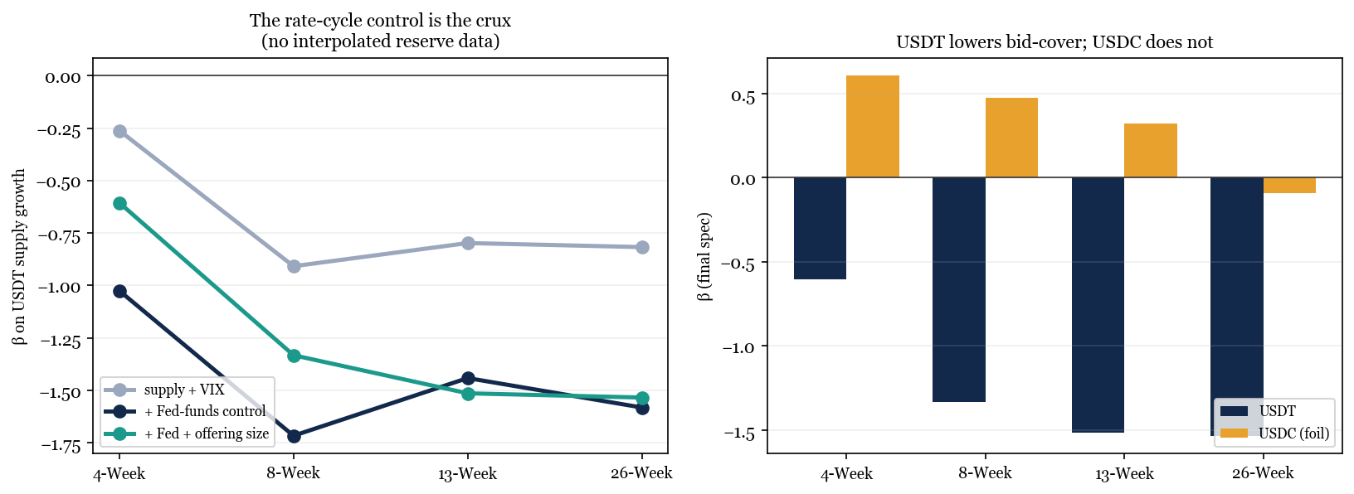
ROBUSTNESS
What Survives Every Test
The result holds with no interpolated data, with auction size controlled, and against a placebo
◆ Drop the interpolated reserves (θ, L) entirely — result holds
◆ Controlling the Fed rate cycle is the crux: once it is in, USDT is significant at every maturity
◆ Survives the auction-size control (4-week softens; 8/13/26-week strong)
◆ Passes a 2,000-shuffle placebo at 3 of 4 maturities (8/13/26-Week)
◆ USDT ≠ USDC at every maturity
Stablecoins & the Exorbitant Privilege
8

Slide 9
ROBUSTNESS
Specification Ladder — β₁ Stable Across All Specs
BC_{m,t} = αₘ + β_USDT · ΔlnS^USDT_t + β_USDC · ΔlnS^USDC_t + δₘ · ln(Offering_{m,t}) + γ₁ · VIX_t + γ₂ · Δfedfunds_t + ε_t
Monthly OLS, N = 51, Newey-West HAC(1). β_USDT shown across three nested specs.
Maturity
A: incl. θ, L
B: drop θ, L
C: B + ln(Offering) ★
4-Week
−0.72 *
−1.18 ***
−0.61 ns
8-Week
−1.21 ***
−1.47 ***
−1.33 ***
13-Week
−1.38 ***
−1.53 ***
−1.51 ***
26-Week
−1.42 ***
−1.67 ***
−1.53 ***
Reading the result
Removing the interpolated reserve controls (A→B) slightly strengthens the result. Adding offering-size control (B→C) barely moves 8/13/26-week. The channel does not depend on any single control choice.
Stablecoins & the Exorbitant Privilege
9

Slide 10
ROBUSTNESS
Drop-2022 Subsample — Result Strengthens Without Crypto-Crisis Noise
BC_{m,t} = αₘ + β_USDT · ΔlnS^USDT_t + β_USDC · ΔlnS^USDC_t + δₘ · ln(Offering_{m,t}) + γ₁ · VIX_t + γ₂ · Δfedfunds_t + ε_t
Spec C. N = 51 (full) vs N = 39 (drop-2022). Newey-West HAC(1).
Maturity
Full sample (N=51)
Drop-2022 (N=39)
Direction
4-Week
−0.61 ns
−1.495 ***
Strengthens ↑
8-Week
−1.33 ***
−1.129 *
Stable →
13-Week
−1.51 ***
−0.975 *
Stable →
26-Week
−1.53 ***
−1.702 ***
Strengthens ↑
Reading the result
2022 crypto crises (LUNA, Celsius, FTX) created non-fundamental supply noise. Dropping them: 4-Week and 26-Week strengthen markedly; 8/13-Week remain in the same range. The channel is cleaner in the non-crisis period — consistent with the reserve-composition mechanism.
Stablecoins & the Exorbitant Privilege
10

Slide 11
AN HONEST CAVEAT
Frequency, Not Absence
Why the appropriate unit of analysis is the month
At the auction level, no signal
Why — a frequency mismatch
Run auction by auction (N = 1,094), the USDT coefficient is not significant. Taken alone this looks like a non-result.
Stablecoin supply is a monthly series: ~86% of its variation is between months, ~17% within. The same monthly value repeats across ~17 auctions a month, and the pre-auction windows overlap. So N = 1,094 carries only ~51 independent supply observations. The right unit for a monthly regressor is the month — where the effect is significant.
Bottom line
The auction-level null is the expected consequence of a frequency mismatch — not evidence against the channel.
Stablecoins & the Exorbitant Privilege
11

Slide 12
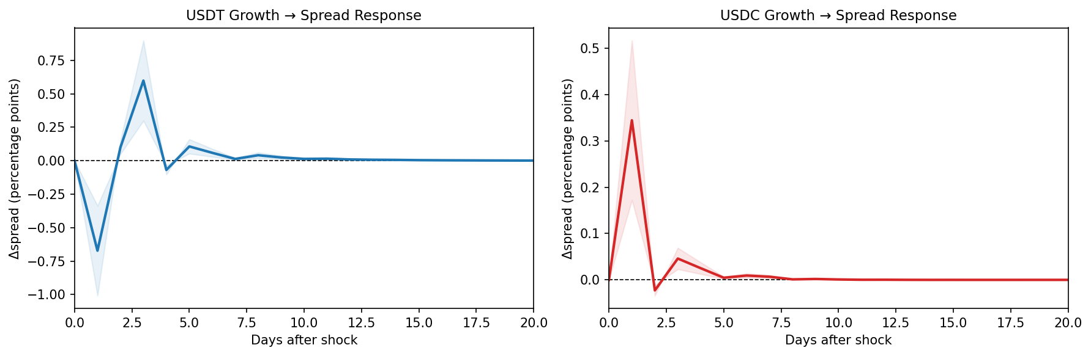
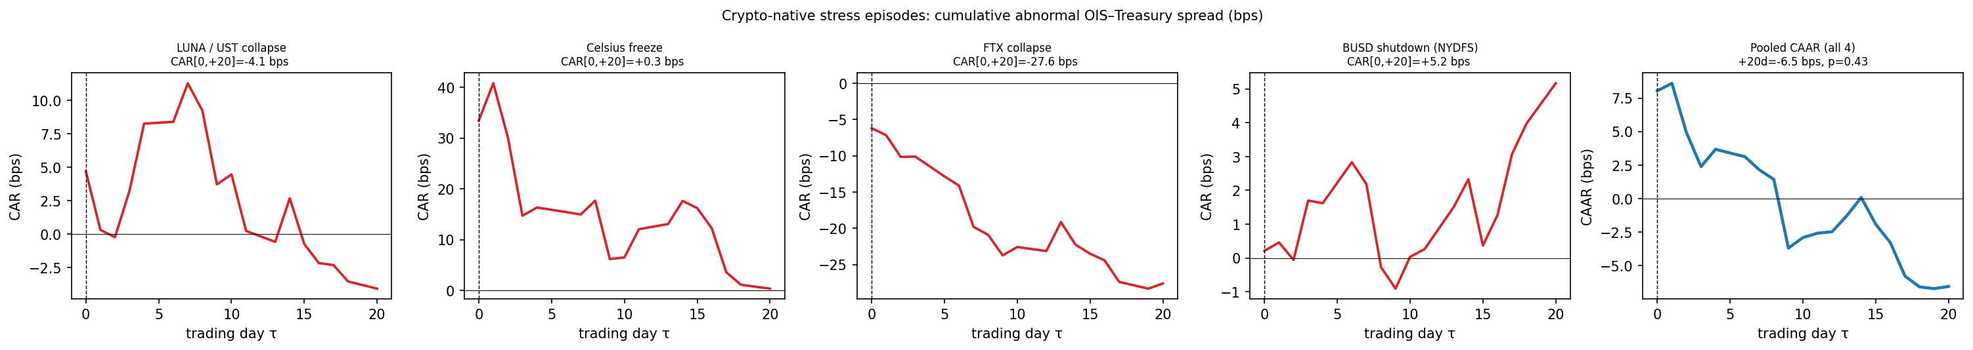
SUPPORTING EVIDENCE & MOTIVATION
Two Secondary Checks
Daily impulse responses, and an event study used as motivation
Daily VAR / impulse response
Multi-event study (motivation)
LUNA · Celsius · FTX · BUSD (SVB dropped — confounded). Events disagree in sign; pooled p = 0.43 → no systematic effect. Narrative motivation, not identification.
USDT supply Granger-causes spread (p = 0.020); day-1 IRF = −0.672 bps, reverting by day 3. USDT/USDC shocks explain 1.3% of spread variance (FEVD, 20-day). Consistent with a real but transient channel — supporting, not primary, evidence.
Stablecoins & the Exorbitant Privilege
12

Slide 13
LIMITATIONS
Why the Results Had to Change
The feedback exposed three constraints that bind any study of this market today
One macro regime
Reserves are unobserved
A hard power ceiling
Our 51 months are dominated by a single Fed hiking cycle and its unwind. Trending variables correlate mechanically, so a levels regression flatters any hypothesis — ours included. Removing θ and the forward-fill took away the props; the stationarity tests did the rest.
Tether attests quarterly: roughly two-thirds of the monthly reserve ratios are interpolation, and the estimated threshold moved 13% → 6.6% just by changing the fill method. The buffer-fragility hypothesis is currently untestable at monthly frequency — not false.
Two issuers, 51 months, no natural experiment. Controls, an issuer foil, and a placebo are the strongest identification available here — and supply shocks still explain only ~1.3% of spread variance. These are limits of the setting, not of the specification.
The honest reading
The feedback did not break good results — it revealed which results this data could never have supported.
Stablecoins & the Exorbitant Privilege
13

Slide 14
LIMITATIONS
What We Can — and Cannot — Claim
Drawing the boundary precisely is part of the result
Supported by the data
Beyond the data — for now
◆ USDT supply growth is associated with weaker T-bill auction demand — robust to every check we ran
◆ The channel is issuer-specific (USDT ≠ USDC), consistent with reserve composition
◆ The structural fact: programmatic T-bill purchases at sovereign-holder scale
◆ A causal privilege effect in yield levels (β₁): one rate cycle cannot identify it
◆ A reserve-buffer threshold (≈13%): reserves are not observed at monthly frequency
◆ Run-scenario fragility: no clean redemption episode in sample (SVB is confounded)
Untested is not rejected
The question is ahead of its data — and the data is catching up.
Stablecoins & the Exorbitant Privilege
14

Slide 15
LOOKING FORWARD
The Constraints Relax Mechanically
Time, regulation, and scale each remove one of the binding limits
Time → regimes
Regulation → real data
Scale → detectability
Each year adds 12 observations. By 2030 the sample roughly doubles (~100 months) and spans at least two full rate cycles. Regime variation — not just a larger N — is what separates a real channel from a shared trend.
The 2025 US stablecoin law (GENIUS) and the EU's MiCA mandate monthly, certified reserve disclosures. θ and L become observed rather than interpolated, and the issuer panel widens as banks and fintechs enter. The buffer hypothesis becomes testable for the first time.
Combined USDT + USDC supply is ≈ $262B at the end of our sample — already on par with a mid-sized sovereign holder of US debt. Official and industry projections reach $1–2T by 2028–30; at that scale, issuers become marginal price-setters in the bill market.
The same test rig, better inputs
Every analysis in this paper is scripted and reproducible — it can simply be re-run as each constraint lifts.
Stablecoins & the Exorbitant Privilege
15

Slide 16
LOOKING FORWARD
What We Expect — Falsifiable Predictions
Each claim comes with the evidence that would confirm or kill it
Bid-cover sharpens
Privilege becomes measurable
Fragility becomes testable
If the channel is real, β stays near −1.4 and significance grows with the sample. If it was an artifact of the 2022–23 crypto winter, it attenuates toward zero as those months roll out of the window.
Across two or more rate cycles the spread regression becomes estimable in differences. Safe-asset demand-curve logic predicts a small, few-bps compression per $100B of issuance — visible only at scale.
Observed monthly reserves plus the first large redemption under the new regime test the buffer threshold directly. At $1T+ scale a forced bill sale is macro-relevant — the New Triffin question returns.
EXPECTED PATH
2026–27
2027–28
2028–29
2030
Monthly certified reserve reports begin (GENIUS / MiCA)
Sample spans a full easing cycle (~75 months)
2–3 years of observed θ, L → threshold test on real data
~100 months, ≥2 cycles, wider issuer panel — full re-run
Stablecoins & the Exorbitant Privilege
16

Slide 17
CONCLUSION
The Defensible Claim
USDT supply growth is associated with lower T-bill auction bid-cover at all maturities, while USDC is not.
Robust to controlling auction size and to removing all interpolated reserve controls, and it passes a 2,000-shuffle placebo at 3 of 4 maturities (8/13/26-Week). At the individual-auction frequency the association is not detectable, consistent with stablecoin supply being a monthly-frequency variable.
◆ The structural privilege channel is real — USDT is a programmatic T-bill buyer
◆ Its imprint is visible in auction demand, not in the spurious levels regression
◆ Stated carefully, the finding survives every robustness check we could devise
Stablecoins & the Exorbitant Privilege
17

Slide 18
A robust result, honestly earned.
USDT supply growth → weaker T-bill auction demand, and USDT ≠ USDC.
Survives offering size, zero interpolated data, the rate-cycle control, and a placebo.
The spurious levels results are dropped; the VAR and event study remain as support.
Diagnosis, stress-testing, and reconciliation were a shared, group effort.

