Slide 1

STABLECOINS AND THE EXORBITANT PRIVILEGE
Yonsei GSIS 2026-1
Topics in International Finance
Mireu Kim · Sara Chekroune · Oybek Ibragimov
Notes:
"Good afternoon everyone. Our paper is titled Stablecoins and the Exorbitant Privilege: A New Channel for Safe-Asset Demand and Its Systemic Fragility. We're Mireu Kim, Sara Chekroune, and Oybek Ibragimov from Yonsei GSIS. Today we'll be presenting the first half of our findings."

Slide 2
Roadmap
Sara Page2/15
This week:
❖ Motivation — why stablecoins matter for sovereign debt
❖ The New Triffin Dilemma — our core argument
❖ Theoretical extension of Maggiori (2017)
❖ Data & Methodology
❖ Result 1 — Privilege amplification regression
❖ Result 2 — Reserve adequacy threshold (Hansen 2000)
Next week:
❖ Result 3 — Buffer-conditioned event study
❖ Conclusion & Policy implications
Notes:
"Here's our roadmap for today. We'll start with motivation — why stablecoins matter for sovereign debt markets. Then we'll introduce our core argument, which we call the New Triffin Dilemma. From there we move to the theoretical model, our data, and then two empirical results: the privilege amplification regression and the reserve adequacy threshold. The third result — the buffer-conditioned event study — and our policy conclusions will come next week."

Slide 3
Motivation: Stablecoins as Treasury Buyers
Sara Page3/15
Key Market Trends
❖ Growth: Combined market cap surged from under $50bn (2021) to over $300bn (2026)
❖ Usage: 30%+ of on-chain crypto transactions involve stablecoins
❖ Regulation: US, EU, Japan, and Hong Kong each finalising reserve legislation
❖ Scale: Tether alone holds $127bn in US Treasuries (Q2 2025) — comparable to mid-sized sovereigns
❖ Projection: $1–2 trillion ecosystem within this decade
$300bn+
Total USD-pegged supply (2026)
$127bn
Tether T-bill holdings (Q2 2025)
$1–2 tn
Projected ecosystem size
4
Jurisdictions finalising legislation
The same structural role that deepens US safe-asset demand also embeds a fragility that can rapidly reverse it.
3
Notes:
"Why should a course on international finance care about stablecoins? The scale alone makes them impossible to ignore. The combined market cap of USD-pegged stablecoins has gone from under fifty billion in 2021 to over three hundred billion in 2026. Tether alone holds a hundred and twenty-seven billion dollars in U.S. Treasury bills — comparable to the foreign reserves of a mid-sized sovereign nation. Four major jurisdictions are right now writing legislation to regulate their reserve requirements. And projections put this ecosystem at one to two trillion dollars within the decade. These are not niche crypto instruments anymore — they are Treasury buyers operating at scale, and that has consequences for the U.S. safe-asset market."

Slide 4
Exorbitant Privilege and the Original Triffin Dilemma
Oybek Page4/15
Exorbitant Privilege
The US issues the world's reserve currency — allowing it to borrow cheaply while investing in higher-yielding foreign assets
This "privilege" is measured through OIS–Treasury spread compression: when demand for T-bills rises, US borrowing costs fall below the market baseline
USD-pegged stablecoins now replicate this channel privately — creating $300bn+ in structural Treasury demand outside sovereign control
Research Topic
Stablecoins and Exorbitant Privilege: A New Channel for Safe-Asset Demand and Its Systemic Fragility
Triffin Dilemma (1960)
A reserve currency country must supply sufficient safe assets to meet global demand — but this requires running structural current account deficits that progressively undermine confidence in the currency itself. The system depends on the very condition that makes it unsustainable.
Notes:
"Our core argument is built on an analogy to the original Triffin Dilemma from 1960. Triffin observed that the United States had to run deficits to supply the world with dollars — but those same deficits eventually undermined confidence in the dollar. We find the same structural tension in stablecoin issuers. In normal times, when stablecoins grow, issuers buy more T-bills to back their tokens. This deepens safe-asset demand and compresses Treasury spreads — amplifying the U.S. exorbitant privilege. But when a run occurs, those same T-bill holdings get liquidated to pay redemptions. Yields spike, and the privilege reverses. What separates these two outcomes is the quality of the reserve buffer. We decompose reserves into two components: theta, which measures T-bill exposure — the privilege channel — and L, the liquid cash buffer — the fragility channel. Our paper estimates the threshold L-star that separates safe from fragile."

Slide 5
The New Triffin Dilemma
Oybek Page5/15
Our analogue for stablecoin issuers:
Normal times ✅
Run scenario ❌
• Stablecoin issuance → mechanical T-bill acquisition by issuers • Structural increase in safe-asset demand for US Treasuries • OIS–Treasury spread compression: yield falls below SOFR baseline • Exorbitant privilege amplified via private intermediation channel
• Redemption shock → programmatic T-bill liquidation
• Treasury yields spike above OIS — spread reversal
• Sovereign-linked liquidity shock transmitted to debt markets
• Self-fulfilling dynamic: fear validates liquidation, crisis propagates
What determines outcome
• θ = Treasury holdings / Supply → structural demand channel
• L = Liquid reserves / Supply → crisis absorption capacity • L ≥ L* → redemptions absorbed internally, no market spillover
• L < L* → forced liquidation, sovereign spread disruption
• We estimate the threshold L* (Hansen 2000)
In our paper: We separate θ (why stablecoins help the US) from L (what prevents a crisis)
4
Notes:
"Our core argument is built on an analogy to the original Triffin Dilemma from 1960. Triffin observed that the United States had to run deficits to supply the world with dollars — but those same deficits eventually undermined confidence in the dollar. We find the same structural tension in stablecoin issuers. In normal times, when stablecoins grow, issuers buy more T-bills to back their tokens. This deepens safe-asset demand and compresses Treasury spreads — amplifying the U.S. exorbitant privilege. But when a run occurs, those same T-bill holdings get liquidated to pay redemptions. Yields spike, and the privilege reverses. What separates these two outcomes is the quality of the reserve buffer. We decompose reserves into two components: theta, which measures T-bill exposure — the privilege channel — and L, the liquid cash buffer — the fragility channel. Our paper estimates the threshold L-star that separates safe from fragile."

Slide 6
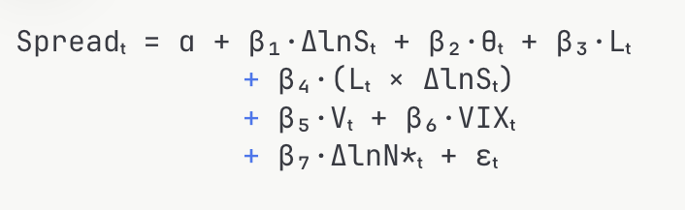
Theoretical Extension: Maggiori (2017)
Oybek Page6/15
Maggiori (2017) original:
Safe-asset demand driven by Ω* — the countercyclical marginal value of RoW financial net worth.
Our extension adds S, θ, and L:
D*(Ñ*, S, θ, L) = D*precautionary(Ñ*) + D*stablecoin(S, θ) + D*buffer(L)
Safe-asset demand now has three components: • D*precautionary — Maggiori’s original term, driven by global wealth • D*stablecoin — new structural demand via mechanical T-bill acquisition
• D*buffer — additional demand from excess reserve holdings above minimum
Main Estimating Equation
Spreadₜ = α + β₁·ΔlnSₜ + β₂·θₜ + β₃·Lₜ + β₄·(Lₜ × ΔlnSₜ) + β₅·Vₜ + β₆·VIXₜ + β₇·ΔlnN*ₜ + εₜ
Predicted signs:
❖ β₁ < 0: ΔlnS compresses spreads (privilege amplification)
❖ β₂ > 0: Higher T-bill exposure θ amplifies demand
❖ β₄ > 0: Higher L dampens crisis transmission during runs
The buffer L introduces a non-linear threshold — the key theoretical departure from Maggiori’s original model.
5
Notes:
"Our theoretical framework extends Maggiori's 2017 model of safe-asset demand. In the original model, demand is driven solely by the rest-of-world's marginal value of net worth — what Maggiori calls Omega-star. We add three new elements: stablecoin supply S, Treasury exposure theta, and liquid buffer L. The key innovation is that L enters asymmetrically. When L is above the threshold L-star, any redemptions can be absorbed using cash — no T-bills need to be sold, and the market is undisturbed. When L falls below L-star, the issuer is forced to sell T-bills to meet redemptions, and the spread spikes. This asymmetry generates testable predictions. Beta-one should be negative — supply growth compresses spreads. Beta-two should be positive — higher T-bill exposure amplifies demand. And beta-four should be positive — a higher liquid buffer dampens crisis transmission."

Slide 7
Data & Sample
Oybek Page7/15
Variable
Definition
Source
Frequency
OIS–Treasury Spread
DTB3 − SOFR90DAYAVG
FRED (direct CSV, no API key)
Daily → Monthly
Stablecoin Supply S
USDT + USDC market cap
DeFiLlama stablecoins API (free)
Daily → Monthly
θ (Treasury Exposure)
T-bill holdings / supply
Tether/BDO + Circle/Deloitte attestations
Quarterly/Monthly
L (Liquid Buffer)
Cash reserves / supply
Tether/BDO + Circle/Deloitte attestations
Quarterly/Monthly
Velocity V
7-day rolling SD of ΔlnS
Computed from DeFiLlama
Daily → Monthly
VIX
CBOE VIX index
FRED
Daily → Monthly
ΔlnN* (RoW equity)
ACWX ETF log-return
Yahoo Finance
Daily → Monthly
Sample: January 2022 – March 2026 | N = 51 monthly observations | θ and L sourced from Tether/BDO and Circle/Deloitte reserve attestations
Notes:
"Our dataset covers January 2022 through March 2026 — 51 monthly observations. The dependent variable is the OIS-Treasury spread, constructed as the 3-month T-bill rate minus the 90-day SOFR average, both from FRED. Stablecoin supply is the combined market cap of USDT and USDC from DeFiLlama. Our two key reserve variables — theta and L — come from quarterly and monthly reserve attestations published by Tether's auditor BDO and Circle's auditor Deloitte. We also include velocity, which captures the pace of redemptions, the VIX as a global risk control, and the log return on the ACWX ETF as a proxy for rest-of-world equity returns. The sample starts in January 2022 because reliable, disaggregated attestation data only becomes available from that point."

Slide 8
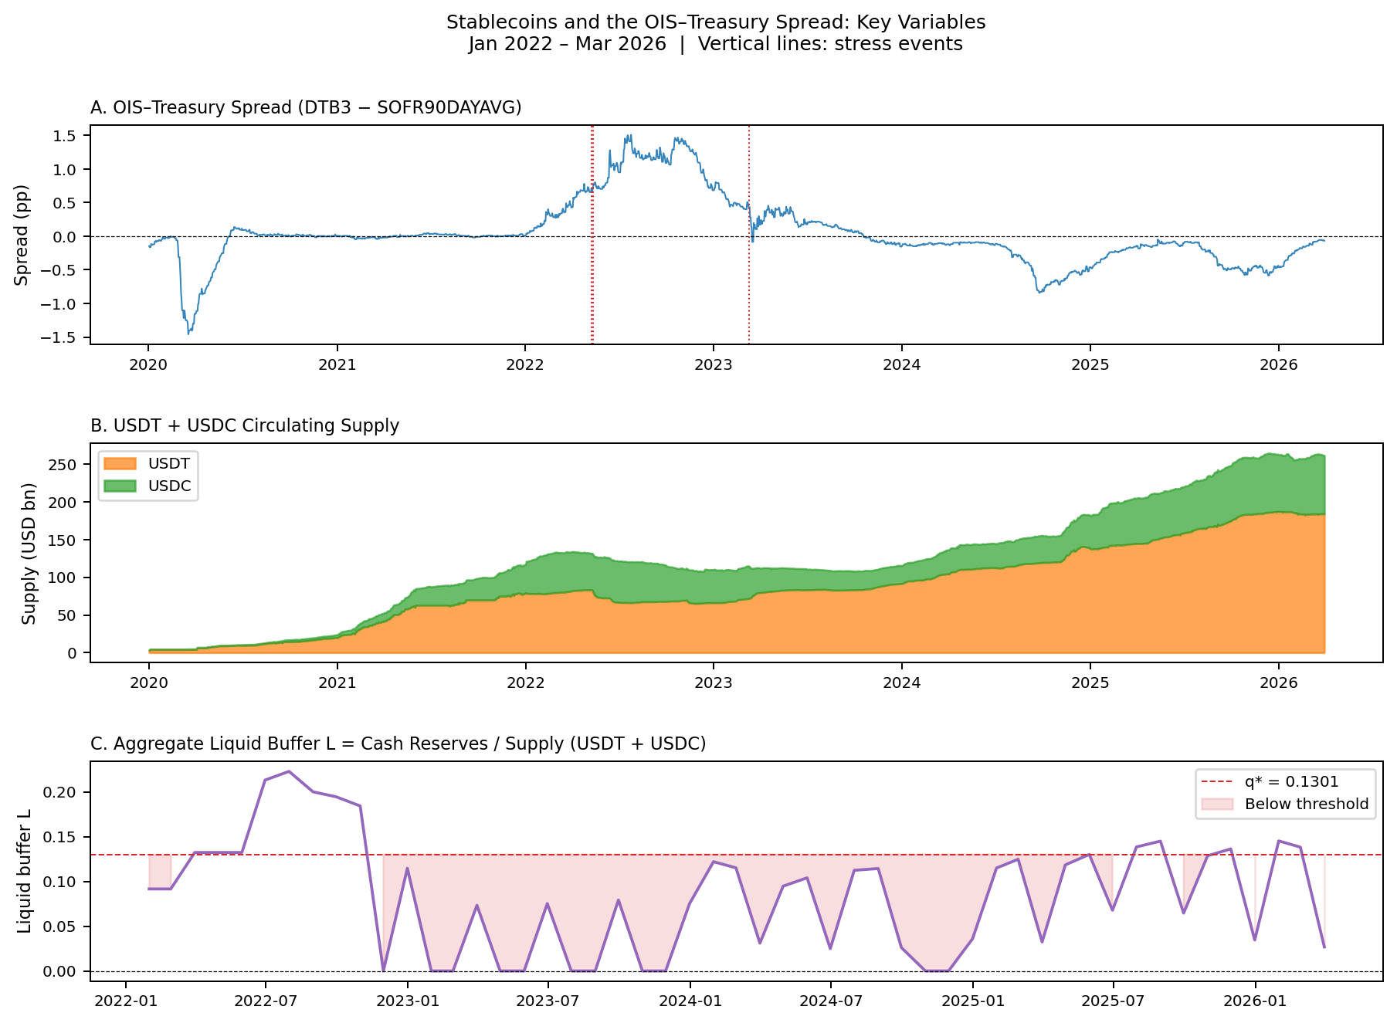
Key Variables: January 2022 – March 2026
Mimi Page 8/15
Three panels
❖ A: Treasury spread — compresses when supply grows, spikes in crises.
T-bill (DTB3) is a 3-month U.S. government bond. Secured Overnight Financing Rate is the rate banks charge for one night.
❖ Red vertical lines = stress events we study
❖ B: USDT + USDC supply — grew from $100bn to $200bn+ over this period
❖ C: Liquid buffer L — dangerously thin in 2022, recovering since 2023
❖ Red dashed line = our estimated safety threshold (13%)
LUNA
SVB
Notes:
"Now let me walk you through what the data actually looks like.
A: T-bill (DTB3) is a 3-month U.S. government bond.
Secured Overnight Financing Rate. - Think of it as the interest rate banks charge each other to lend money just for one night.
In a normal world with no stablecoins, these two rates should be roughly equal — both risk-free, both short-term. The spread should hover near zero.
When stablecoin issuers grow (buy T-bills), the spread compresses (goes negative). When they're hit by a run and sell T-bills, the spread spikes (goes positive).
B: middle panel shows the combined supply of USDT and USDC — it grew from around a hundred billion to over two hundred billion over this period.
C: The red dashed line is the safety threshold we estimate to be the buffer— 13%. When the supply falls fast but the cash reserves number hasn't been updated yet, the ratio spikes up. "The small spike in mid-2022 reflects the LUNA crisis — supply collapsed so fast that the buffer ratio temporarily jumped. But once new reserve data came in, it became clear that cash had also been used to fund those redemptions, and the buffer fell back. It's a good illustration of exactly the fragility mechanism our paper studies."

Slide 9
What the Data Shows Us
Mimi Page 9/15
MORE SUPPLY → LOWER SPREAD
As USDT and USDC supply grew, the gap between Treasury yields and overnight rates compressed. Stablecoin issuers were buying U.S. T-bills to back their tokens — deepening demand for safe assets.
CRISIS → SPREAD SPIKES
During the LUNA/UST collapse (May 2022), spreads spiked as issuers were forced to liquidate T-bill holdings to meet redemptions. The privilege reversed — exactly what our theory predicts.
BUFFER WAS THIN WHEN IT MATTERED MOST
In 2022, liquid cash reserves sat below our estimated 13% safety threshold. Issuers had to sell T-bills instead of using cash — amplifying the shock.
Notes:
"Before we get to the numbers, let me translate what we just saw into plain terms.
First: more supply means lower spreads. As Tether and Circle grew, they bought more T-bills to back their tokens. More T-bill buying pushes Treasury yields down relative to overnight rates — that's the spread compressing.
Second: when a crisis hits, spreads spike. During the LUNA collapse in May 2022, issuers were forced to sell T-bills to pay back redemptions. That sudden selling pushed yields up — the privilege reversed.
Third: the buffer was dangerously thin exactly when it mattered most. In 2022, liquid cash reserves were near zero. Issuers had no cushion. They had to sell assets into a falling market. These three patterns together are what our regressions test."

Slide 10
Result 1: Stablecoin Growth Compresses Treasury Spreads
Mimi Page 10/15
H1 CONFIRMED — statistically significant at the 5% level
β₁ = −6.02**
What this means in plain terms:
Every 1% growth in stablecoin supply compresses the Treasury spread by about 6 basis points. When Tether and Circle expand, they buy more U.S. T-bills — pushing Treasury yields down relative to overnight rates. This is the exorbitant privilege being amplified.
N = 51 months | R² = 0.50
Variable
Coefficient
Sig.
ΔlnS (stablecoin supply growth)
−6.017
**
θ (Treasury Exposure)
0.100
—
Not significant enough
L (Liquid Buffer)
1.034
—
L × ΔlnS (buffer interaction)
3.891
—
Controls (velocity, VIX, ΔlnN*)
included
** p < 0.05 — = not significant at conventional levels HAC Newey–West SE (3 lags)
Notes:
"To estimate this equation, we used OLS — ordinary least squares — which finds the line that best fits our 51 months of data.
Our first result confirms Hypothesis 1. The coefficient on stablecoin supply growth — beta-one — is negative 6.02, and it is statistically significant at the 5% level.
Looking at the table, you'll notice that the buffer variables — theta, L, and the interaction term — are not individually significant at this sample size of 51 months. So why wasn’t it significant?

Slide 11
Result 1: When Data Quality Improves, the Picture Sharpens
Mimi Page 11/15
The buffer variables (θ and L) were not individually significant at our full sample of 51 months. This is a power problem — not a theory problem. Reserve attestations only became comprehensive after 2023.
When we restrict to January 2023 – March 2026 (N = 39 months, best attestation coverage):
Supply channel
Buffer interaction
β₁ = −8.14
L×ΔlnS = +49.17
β₁ + β₄ × L = −8.14 + 49.17 × L
*** (p = 0.004)
***
When L is low (say 0.05): total effect = −8.14 + (49.17 × 0.05) = −5.68 → strong compression, issuers are actively buying T-bills
When L is high (say 0.16): total effect = −8.14 + (49.17 × 0.16) = −0.27 → effect nearly disappears, issuers have enough cash and don't need to move T-bill markets
Higher liquid buffer dampens the spread compression. The fragility mechanism is confirmed.
Even stronger supply effect in recent data. Confirmed at the 1% level.
Both channels confirmed in recent data. The mechanism is real — our full sample just needs more months to reach significance.
10
Notes:
It comes down to data quality, not theory. Tether and Circle only started publishing detailed, frequent reserve breakdowns after 2023. Before that, the cash reserves figures were either missing, infrequent, or less precise.
When we restrict our sample to January 2023 through March 2026 — the 39 months where attestation coverage is best — a much clearer picture emerges. The supply effect strengthens to negative 8.14, now significant at the 1% level. And crucially, the liquid buffer interaction term — L times delta-ln-S (change in the natural log of S)— becomes positive 49.17, also significant at the 1% level with a p-value of 0.004. This tells us the buffer mechanism is real. Our full sample is just too short to reach significance yet. As this data series extends past 2026, we expect both channels to confirm at the full sample level." Issuers with enough cash don't need to buy or sell T-bills when their supply changes. That's the fragility channel our theory predicted, and the data confirms it."

Slide 12
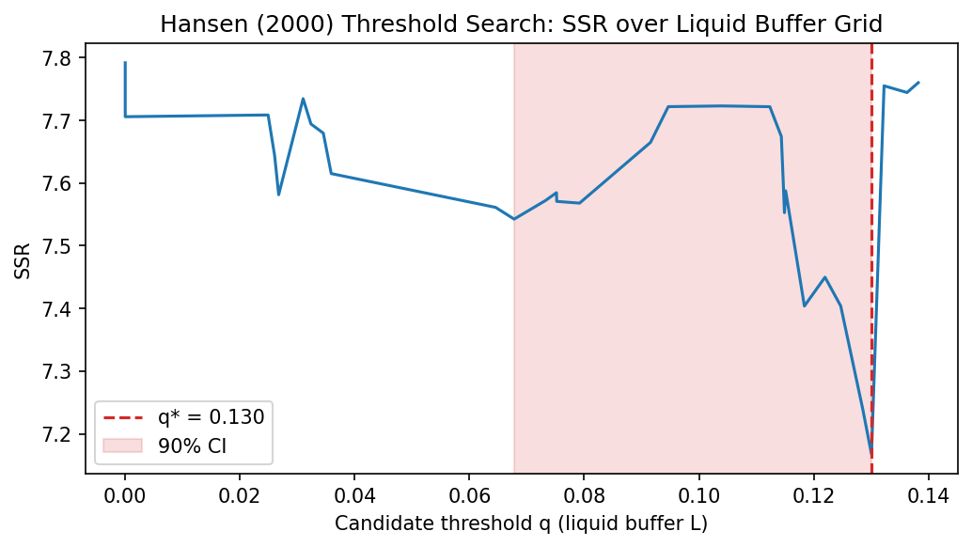
d
Result 2: Is There a Safety Threshold?
Sara Page12/15
SSR : Sum of Squared Residuals
q* = 13%
of supply held as liquid cash
What this means:
Using Hansen (2000) threshold regression, we find a tipping point at 13% liquid cash reserves. Below this level — where most of our data falls — issuers don't have enough cash to absorb redemptions without selling T-bills.
Lower SSR = better model fit at that threshold value
13%
Bootstrap p = 0.260 (suggestive — the direction is clear; significance grows as data accumulates past 2026)
Notes:
Our second result asks a more specific question: is there a particular level of liquid reserves below which an issuer becomes dangerous to the Treasury market? Using a technique called Hansen threshold regression — which searches statistically for a structural break in the data — we find a tipping point at 13% of supply. The x-axis shows every possible value of L (the liquid buffer) from low to high. The y-axis shows how well the model fits at each value — technically called the Sum of Squared Residuals (SSR).
The method tries splitting the 51 months at every possible value of L and asks "if I use this value as my cut-off, how well does a two-group model explain the spread data?"
The lowest point on the curve is where the model fits best. That lowest point lands at L = 0.1301 — 13%. That is the data telling us: "the most natural dividing line between two different behaviours is at 13% liquid reserves."

Slide 13
Below vs. Above the Threshold: Two Different Worlds
Sara Page13/15
Splitting our 51 months at q* = 13% reveals a striking difference in how stablecoin growth affects Treasury markets:
BELOW 13% LIQUID BUFFER
ABOVE 13% LIQUID BUFFER
38 out of 51 months
13 out of 51 months
β = −6.97
β = +1.26
"With no cash buffer, every new token issued requires buying T-bills. That constant T-bill demand compresses spreads strongly. And during redemptions, they have no cash — so they must sell T-bills too. Their activity moves the market in both directions."
"With enough cash on hand, new tokens are backed by existing reserves — no T-bill buying needed. During redemptions, cash absorbs the shock instead of T-bill selling. The T-bill market is undisturbed."
The liquid cash buffer is what separates a stablecoin issuer that stabilises Treasury markets from one that disrupts them.
12
Notes:
When supply grows, issuers need to back every new token they issue with reserves. The question is: do they use cash or do they go buy T-bills?
Low buffer (left box) — β = −6.97: The issuer has almost no cash. So every time supply grows, they must go out and buy T-bills to back the new tokens. That extra T-bill buying pushes T-bill prices up, yields down — the spread compresses strongly. They are completely dependent on the T-bill market for everything.
High buffer (right box) — β = +1.26: The issuer already has plenty of cash sitting in reserve. When supply grows, they can use that cash to back new tokens — no T-bill buying needed. The T-bill market is undisturbed. The compression effect disappears.

Slide 14
Looking Ahead: Causal Proof & Policy Solutions
Sara Page14/15
Result 3: The Buffer-Conditioned Event Study
Moving from monthly trends to daily "quasi-experimental" causal identification.
Analyzing three major stress episodes: LUNA/UST, the USDT partial depeg, and the USDC/SVB failure.
Proving how the buffer size determines if a crisis causes a "sovereign-linked liquidity shock" or a "flight-to-safety".
Policy Recommendation: The "13% Liquid Reserve Rule”
Translating the threshold regression into a concrete regulatory requirement.
Proposing a minimum 13% liquid buffer (cash/near-cash) to prevent private stablecoin runs from spilling into public Treasury markets
Robustness: "Data Sharpening" Post-2023
Testing a more recent sub-sample (N=39) where reporting and attestations are more transparent.
Showing how the relationship between reserves and market spreads becomes even more statistically significant as the market matures.
Conclusion: Navigating the New Triffin Dilemma
Final synthesis of how stablecoins both support and threaten the U.S. "exorbitant privilege".
Notes:
"To wrap up our first half: we’ve shown that in normal times, stablecoins act as a massive support pillar for the U.S. dollar, effectively lowering borrowing costs for the government. But next week, we’re going to look at the 'danger zone.'
We will present our Event Study, which functions like a financial 'crash test.' We looked at daily data from real-world disasters like the LUNA collapse and the Silicon Valley Bank crisis to see how the markets reacted in real-time. What we found is fascinating: when a stablecoin issuer has a low cash buffer, a run on the coin causes a shock that actually drives up U.S. Treasury yields—validating the 'New Triffin Dilemma'. However, when the buffer is high, we see the opposite: a 'flight-to-safety' that actually stabilizes the market.
We will also share our '13% Rule.' Based on our mathematical threshold, we’ve identified a specific number that regulators can use. We’ll explain why requiring stablecoin issuers to keep at least 13% of their reserves in pure cash—not just T-bills—is the key to making sure a crypto crisis never turns into a U.S. government debt crisis.
See you next week for the causal proof and the policy solutions!"

Slide 15
THANK YOU
Yonsei GSIS 2026-1
Topics in International Finance
Mireu Kim · Sara Chekroune · Oybek Ibragimov
Notes:
"Thank you. We're happy to take any questions on the theory, the data construction, the Hansen threshold methodology, or the event study design."

