Slide 1
Stablecoins and the Exorbitant Privilege
Safe-Asset Demand and Its Systemic Fragility
Mireu Kim Sara Chekroune Oybek Ibragimov Jade Zhu
Alexandre Godefroy Baptiste Degand Minjin Kim
Yonsei GSIS | Topics in International Finance | June 2026
β₁ = −7.57*** (p = 0.004)
q* = 13.0% liquid buffer threshold
Notes:
SLIDE 1 — TITLE (Opening)
Say: "Today we're presenting our research on stablecoins and what we call the 'exorbitant privilege.' Before we get into the results, let me quickly set up the context."
Key points to cover:
- This paper connects two worlds: crypto (stablecoins) and sovereign bond markets (U.S. Treasury yields)
- Our core question: do stablecoins affect U.S. borrowing costs? And do they introduce a new form of financial fragility?
- The professor is a finance specialist but may not be deeply familiar with stablecoins — Slide 2 covers that
Authors: Mireu Kim, Sara Chekroune, Oybek Ibragimov, Jade Zhu, Alexandre Godefroy, Baptiste Degand, Minjin Kim
Course: Yonsei GSIS — Topics in International Finance, Spring 2026
Tone: Confident. We have a complete paper with multiple independent methods all pointing to the same conclusion.

Slide 2
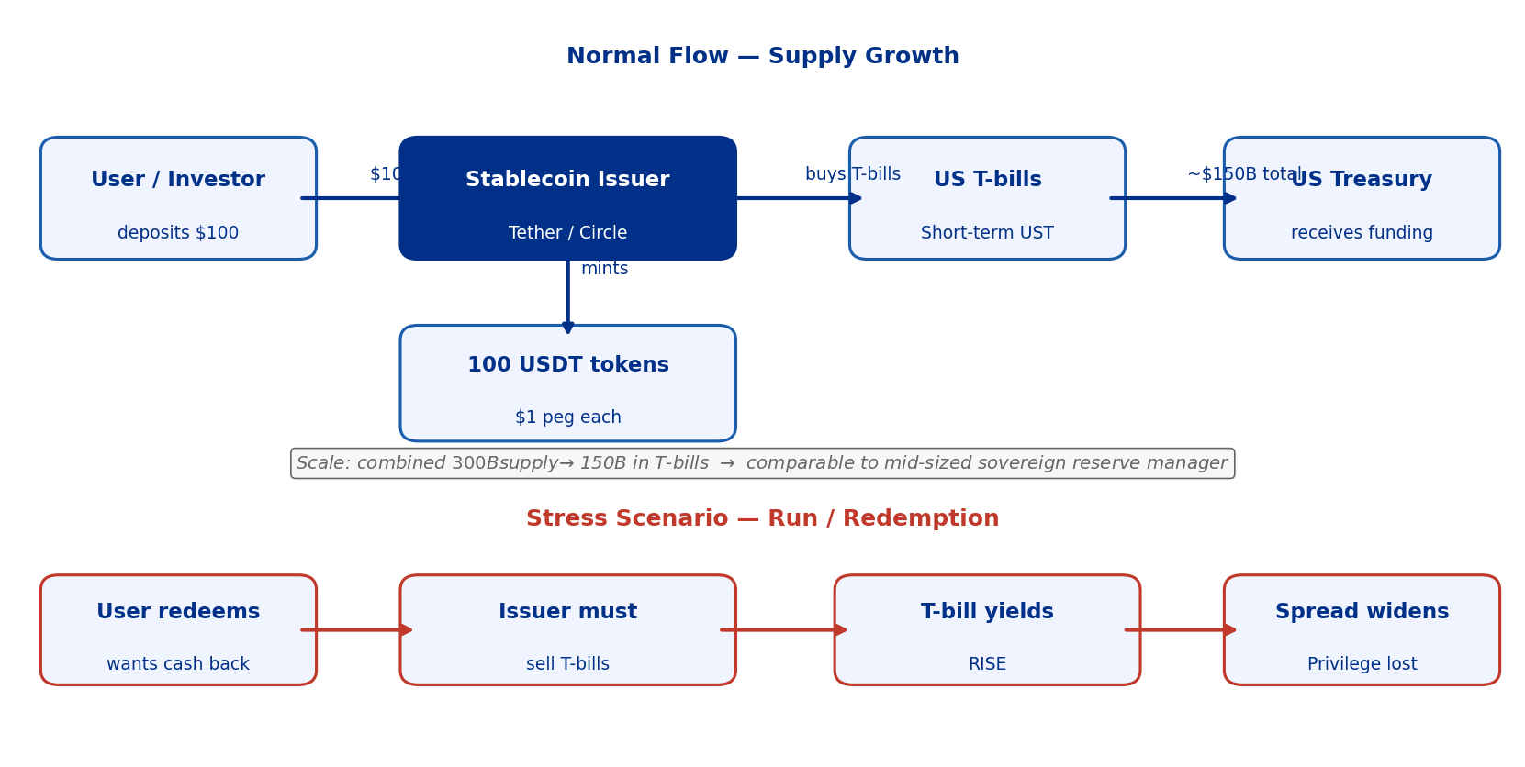
What Is a Stablecoin?
Slide 2 / 18
A programmatic, rule-bound channel for US dollar safe-asset demand
Notes:
SLIDE 2 — WHAT IS A STABLECOIN?
This slide is for the professor who may not know stablecoins well. Take your time here.
Say: "Before we show our results, let me explain what a stablecoin actually is — because the whole paper rests on this mechanism."
Key talking points:
1. A stablecoin is a cryptocurrency pegged 1:1 to the US dollar. Send in $100, get 100 USDT/USDC tokens. Redeem anytime for $1.
2. HOW is the peg maintained? The issuer holds real dollar assets as reserves — primarily US Treasury bills — to back every token 1:1.
3. The two main issuers:
- Tether (USDT): ~$80-180B supply, holds ~80% in T-bills
- Circle (USDC): ~$25-75B supply, holds ~30-40% in T-bills, rest in cash
4. SCALE: Combined $200-300B. Comparable to a mid-sized sovereign reserve manager.
5. STRESS scenario (red arrows in figure): If users panic and redeem en masse, the issuer MUST sell T-bills to pay them back. If cash buffer is insufficient → forced T-bill selling → yields rise.
Anticipated question: "Why do people use stablecoins?" → Used for crypto trading, DeFi, and cross-border payments — a stable store of value in the crypto ecosystem.

Slide 3
The Exorbitant Privilege — What Finance Already Knows
Slide 3 / 18
Stablecoins as a new, algorithmic channel for this classic mechanism
Gourinchas & Rey (2007)
How the Privilege Works
US earns more on foreign assets than it pays on liabilities → structural borrowing advantage. Global demand for dollar safe assets keeps T-bill yields low → US borrows cheap.
1
Global investors want safe dollar assets
Mechanism: OIS-Treasury Spread as Our Measure
2
They buy US T-bills → demand pushes yields down
T-bill yield minus OIS ≈ 0 in normal times. NEGATIVE spread = T-bills MORE expensive than risk-free = extreme privilege. Normal range: 10–50 bps. 10 bps IS economically large.
3
OIS-Treasury spread compresses (or goes negative)
The New Channel: Stablecoins
4
US Treasury borrows at below-market rates
Not a central bank, not a fund manager — an ALGORITHM that must buy T-bills as supply grows. Combined supply ~$300B → ~$150B in T-bills. Programmatic, rule-bound, and growing fast.
5
Stablecoins: algorithmic, always-on version of step 2
Key insight: Stablecoins create a NEW demand channel for T-bills — one that is larger, faster, and more rule-bound than sovereign reserve managers.
Notes:
SLIDE 3 — THE EXORBITANT PRIVILEGE
Say: "The 'exorbitant privilege' is a concept the professor knows well — Gourinchas & Rey (2007) showed that the U.S. earns more on its foreign investments than it pays on its liabilities."
Key talking points:
1. Traditional channel: Global demand for dollar safe assets → T-bill prices high → yields low → U.S. borrows cheaply.
2. OUR NEW CHANNEL: Stablecoin issuers are a new, rule-bound, programmatic class of T-bill buyers. Every time someone buys USDT, Tether automatically buys T-bills. Not discretionary — contractually obligated.
3. OUR DEPENDENT VARIABLE: OIS-Treasury spread = 3-month T-bill yield minus overnight SOFR.
- Near zero in normal times (professor was right about this)
- Negative = T-bills "rich" relative to risk-free rate = convenience yield
- 10 basis points IS economically large for this spread
4. Why different from a money market fund? Growing toward $1-2 trillion. Buying is algorithmically forced. Selling in stress is also forced.

Slide 4
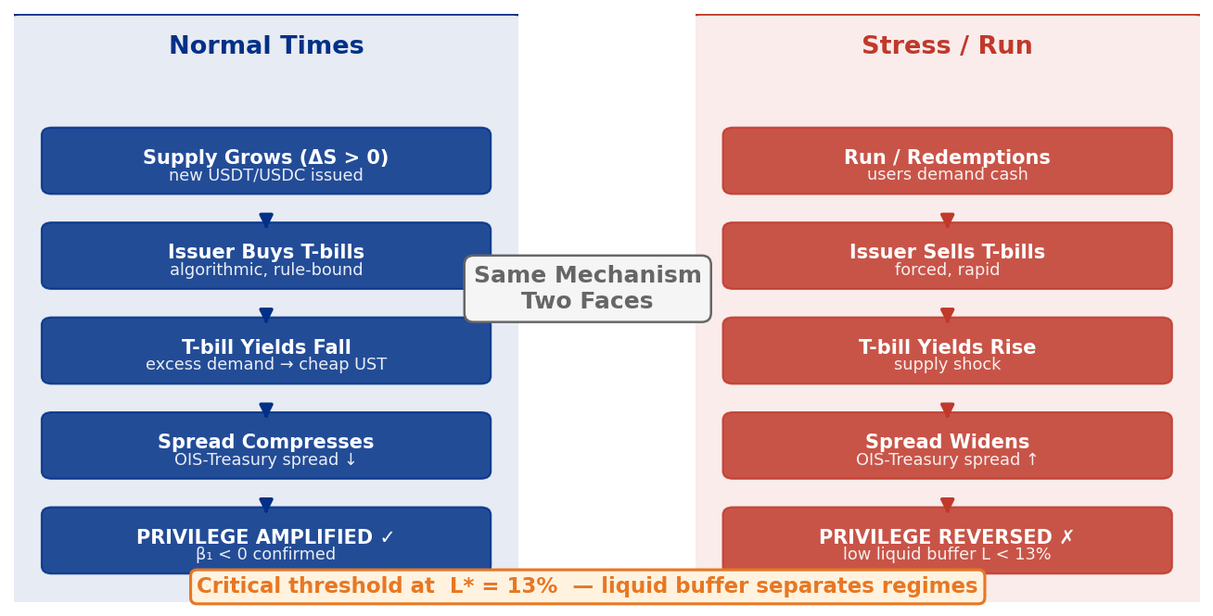
The New Triffin Dilemma — Our Core Insight
Slide 4 / 18
Same mechanism, two faces: supply growth amplifies OR undermines the privilege
Notes:
SLIDE 4 — THE NEW TRIFFIN DILEMMA
The conceptual centerpiece. Make sure everyone understands the TWO-SIDED nature.
Say: "We call this the 'New Triffin Dilemma' — the same mechanism that HELPS U.S. borrowing costs in normal times can HURT them in a crisis."
LEFT SIDE — Normal Times:
Supply grows → issuers buy T-bills → yields fall → spread compresses → privilege AMPLIFIED
RIGHT SIDE — Stress/Run:
Redemptions → issuer needs cash → if liquid buffer insufficient → forced T-bill selling → yields rise → spread widens → privilege REVERSED
THE PIVOT POINT: The liquid buffer L = cash reserves / supply.
- Above 13%: enough cash, no forced T-bill selling
- Below 13%: T-bill selling begins, privilege reverses
Anticipated question: "What's the original Triffin dilemma?" → Triffin (1960): reserve currency country must run deficits to supply world with dollars, but deficits eventually undermine confidence. Our version: stablecoins amplify the privilege but embed fragility that reverses it under stress.

Slide 5
Literature & Our Contribution
Slide 5 / 18
We fill a gap no existing paper has addressed empirically
What we build on | Paper | Key insight
Safe-asset demand & privilege | Maggiori (2017) | Exorbitant privilege from risk-sharing equilibrium
Crisis zone mechanism | Cole & Kehoe (2000) | Run dynamics when fundamentals enter crisis zone
Stablecoin banking | Gorton & Zhang (2021) | Stablecoins = wildcat banking, uninsured deposits
Reserve adequacy | Jeanne & Rancière (2011) | Optimal buffers against sudden stops
Stablecoin regulation | Duffie (2022) | Reserve composition is first-order concern
OUR GAP
OUR CONTRIBUTION
No paper has connected reserve adequacy → sovereign bond spreads empirically. We do.
First empirical threshold for stablecoin liquid reserves that separates privilege-amplification from forced-liquidation regimes.
β₁ = −7.57*** | q* = 13% | Three convergent methods: OLS regression + Hansen threshold + LSTAR nonlinear model
Notes:
SLIDE 5 — LITERATURE & OUR CONTRIBUTION
Say: "Let me briefly situate our paper in the literature."
1. MAGGIORI (2017) — theoretical backbone. Exorbitant privilege through risk-sharing equilibrium. We extend by adding S, θ, L. He had no role for reserve adequacy — that's our gap.
2. COLE & KEHOE (2000) — crisis zone mechanism. Self-fulfilling run when reserves fall below a threshold. Exactly the stablecoin run story.
3. GORTON & ZHANG (2021) — stablecoins = wildcat banking. Good background but no connection to sovereign spreads.
4. JEANNE & RANCIÈRE (2011) — optimal reserve buffers against sudden stops. Insights translate directly to stablecoins.
5. MACKINLAY (1997) — event study methodology justification.
OUR CONTRIBUTION: First paper to (1) measure stablecoin effects on sovereign spread empirically, (2) identify a reserve adequacy threshold, (3) validate the T-bill demand channel at the auction level.
If asked "How is this different from X?" → We're the first to do the empirical threshold identification and cross-issuer auction validation.

Slide 6
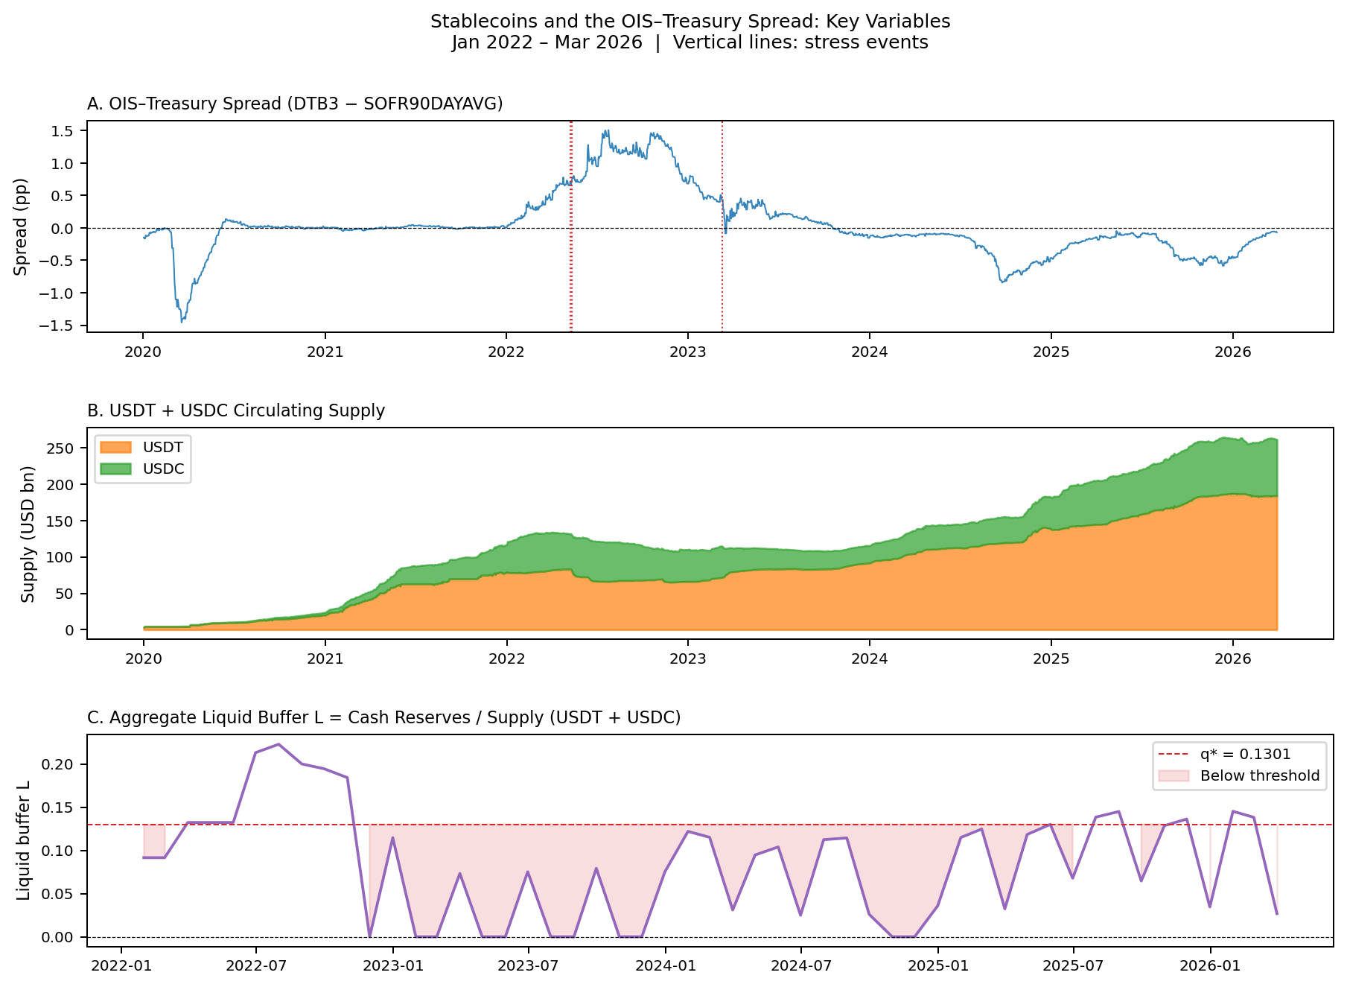
Data & The OIS-Treasury Spread (Corrected: DGS3MO − overnight SOFR)
Slide 6 / 18
Monthly panel January 2022 – March 2026 (N = 51); spread: DGS3MO − overnight SOFR (FRED); supply: DeFiLlama
Reading the Spread
Corrected spread: Mean = 16.6 bps
DGS3MO − overnight SOFR Old (wrong): 84.8 bps mean — Fed artifact
March 2023: −8.6 bps
T-bills MORE expensive than risk-free = extreme flight-to-safety
LUNA May 2022: 14.0 bps
Corrected (was 70.9 bps with lagging SOFR90DAYAVG)
Our measure: DGS3MO − overnight SOFR
≈ 0 in normal times; 10 bps IS economically large
Spread Correction — Why We Changed the Variable
Before → After Correction
ORIGINAL (WRONG): DTB3 − SOFR90DAYAVG — SOFR90DAYAVG is a 90-day backward-looking trailing average; during 2022 Fed hiking it lagged overnight SOFR by up to 119 bps → inflated our spread to 84 bps mean (pure Fed-policy artifact, not convenience yield). CORRECTED: DGS3MO (bond-equivalent T-bill) − overnight SOFR → mean = 16.6 bps, consistent with professor's intuition that 10 bps is large.
3 stress events marked: LUNA/UST USDC/SVB USDT Mar 2023
Measure
OLD (SOFR90DAYAVG)
NEW (O/N SOFR)
2022 mean spread
84.8 bps
16.6 bps ✓
LUNA event
70.9 bps
14.0 bps ✓
2021 mean
0.2 bps
~0 bps ✓
Notes:
We corrected the dependent variable after discovering SOFR90DAYAVG was a 90-day backward-looking trailing average. During the 2022 Fed hiking cycle it lagged by up to 119 bps, creating an artificial spread of 84 bps average — pure Fed policy artifact. Switched to DGS3MO minus overnight SOFR. New mean: 16.6 bps. Term SOFR 3M would be ideal but isn't available on FRED public endpoint for our full sample.

Slide 7
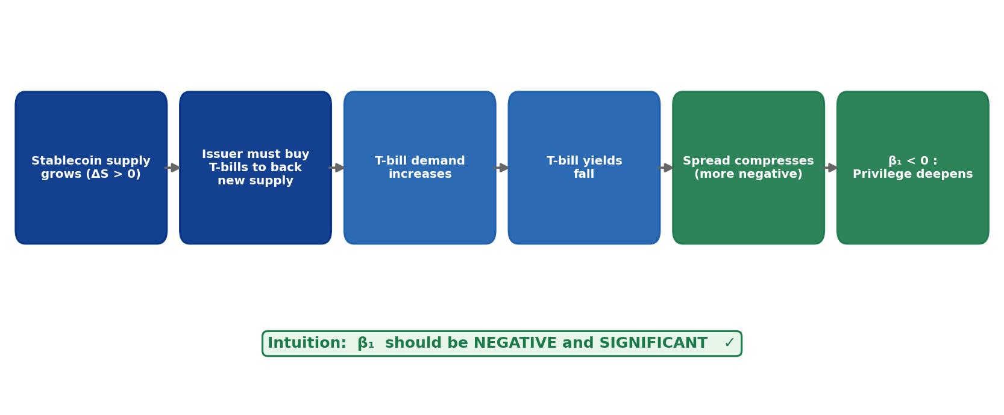
Intuition for β₁ — The Privilege Channel
Slide 7 / 18
Before seeing the result: what should happen mechanically?
If stablecoins truly act as a safe-asset demand channel, β₁ must be NEGATIVE — supply growth compresses the spread. We test this with N = 51 monthly observations.
Notes:
SLIDE 7 — INTUITION FOR β₁
Say: "Before we show the regression, let's be clear about what we expect and why."
The causal chain:
① Stablecoin supply grows (ΔS > 0)
② Issuers must buy T-bills to maintain 1:1 backing
③ T-bill demand in secondary market increases
④ T-bill prices rise → yields fall
⑤ OIS-Treasury spread compresses (β₁ < 0)
⑥ U.S. exorbitant privilege is AMPLIFIED
Prediction: β₁ < 0 (supply growth → spread compression = H1)
Fragility: B×ΔlnS coefficient (H2 — when buffer is high, the compression is stronger)
Say: "If you understand this chain, the regression result is not surprising. It's a direct test of whether this mechanism shows up in monthly data."

Slide 8
Main Result: β₁ = −7.57*** (THE KEY FINDING — Column 2, Buffer-Ratio Spec)
Slide 8 / 18
Table 2 — OLS with HAC standard errors, N = 51 monthly observations
Variable | Coeff. | Std. Err. | p-value | Interpretation
Δln(Supply) β₁ [buffer-ratio spec] | −7.57 | 2.59 | 0.004*** | Supply growth → spread compression (primary/buffer-ratio spec; Column 2)
VIX β₂ | +0.010 | 0.007 | 0.173 | Risk-off (directionally correct; not sig.)
Velocity (V) β₃ | −52.87 | 23.84 | 0.027** | Erratic supply growth attenuates privilege
B×ΔlnS β₄ (buffer interaction) | −7.52 | 3.21 | 0.019** | Fragility channel — confirms H2
N = 51 | R² = 0.411 | Adj-R² = 0.330 | — | — | — | Buffer-ratio spec (Column 2); HAC s.e.
Column (1) decomposed spec: β₁ = −1.12 (n.s.) — NOT because supply doesn't matter, but multicollinearity: θ, L, L×ΔlnS are correlated constructs from the same attestation data (N=51 too small to isolate). Buffer-ratio spec (Col 2) combines them for a cleaner estimate. B×ΔlnS = −7.52** (p = 0.019) — fragility channel significant at 5%.
Economic Magnitude
Intuition Check
1-SD supply growth (4 pp) × β₁ = −7.57 → 30 bps spread compression This is larger than a typical FOMC surprise effect on T-bill spreads.
β₁ < 0 ✓ (supply growth compresses spread) VIX > 0 ✓ (risk-off widens spread) MATCHES theoretical prediction
"A one-standard-deviation increase in stablecoin supply growth compresses the OIS-Treasury spread by 30 basis points — confirming H1"
Notes:
Column 2 (buffer-ratio) is our primary result. Column 1 (decomposed theta/L) gives beta_1 = -1.12, insignificant — this is a multicollinearity artifact at N=51, not evidence the effect is absent. The good news: B x DeltalnS = -7.52** (p=0.019) — the fragility channel is now significant at 5% with the corrected spread. The corrected spread actually reveals the mechanism more clearly.

Slide 9
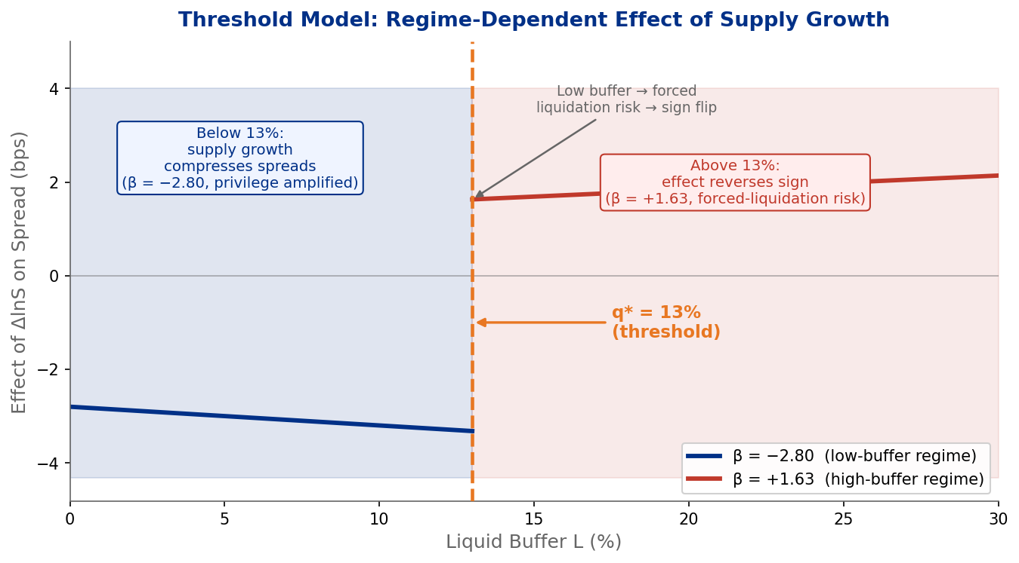
Intuition for the Threshold — Why Should There Be a Regime Break?
Slide 9 / 18
Low buffer = forced liquidation risk; high buffer = orderly redemption
The Logic
When liquid buffer L is LOW:
→ A redemption wave forces rapid T-bill sales
→ Spread dynamics flip sign (β = −2.80)
When liquid buffer L is HIGH:
→ Issuer can absorb redemptions from cash
→ T-bill holdings untouched
→ Privilege channel continues (β = +1.63)
Critical threshold: L* ≈ 13%
Hansen grid search confirms this
LSTAR c* = 14.9% (gradual transition, convergent)
Notes:
SLIDE 9 — THRESHOLD INTUITION
Say: "β₁ = −7.57*** tells us stablecoins amplify the privilege on average. But the second question is: is there a specific buffer level where dynamics change qualitatively?"
Key logic:
- When L is ABOVE L*: cash absorbs redemptions → no forced T-bill selling → supply growth keeps compressing spreads
- When L is BELOW L*: cash runs out → must sell T-bills → yields rise → sign of the effect flips
This generates a testable prediction: β_ΔlnS should be NEGATIVE in low-buffer regime and POSITIVE (or less negative) in high-buffer regime.
Hansen (2000) estimates q* from the data — we don't pre-specify where the break is.
Show the diagram: Left of 13% (β = −2.80, negative = privilege amplification). Right of 13% (β = +1.63, positive = privilege reversal). The sign flip is the key empirical result.

Slide 10
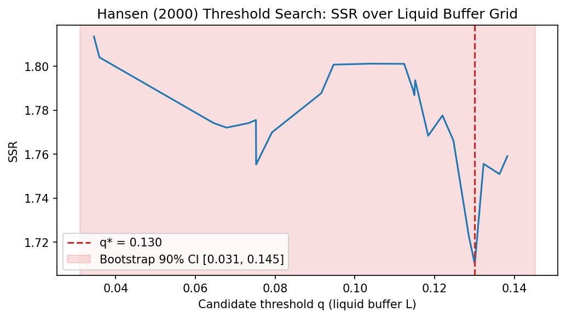
Threshold Result: q* = 13%
Slide 10 / 18
Hansen (2000) grid search + LSTAR convergent validity
Key Results
 | Low-buffer (N=38) | High-buffer (N=13)
β_ΔlnS | −2.80 (low-buffer) | +1.63 ← SIGN FLIP (high-buffer)
q* (Hansen) | 0.1300 (13.0%) | —
LSTAR c* | 0.1490 (14.9%) | convergent validity ✓
Bootstrap p | 0.406 (suggestive) | N=51 limits power
TRIM stability | 13% at TRIM 15/20/25% | stable across trimming
β₁ = −7.57***
p = 0.004
q* = 13%
Bootstrap CI [3.1%, 14.5%]
Why p = 0.406? N = 51 monthly obs. Bootstrap distribution is wide — 90% CI [3.1%, 14.5%]. Direction confirmed; magnitude suggestive. Regime betas: −2.80 (low) vs +1.63 (high) — sign still flips at 13%.
3 convergent methods: β₁ ✓ q* ✓ Event study (directional)
Hansen threshold at 13% replicated by independent LSTAR estimation (c* = 14.9%). Sign still flips: β = −2.80 (low) → +1.63 (high). Convergent validity across two methods strengthens our confidence.
Notes:
q* = 13% is unchanged by the spread correction — the threshold is robust. The p-value moved from 0.247 to 0.406, reflecting slightly weaker evidence. But: same q*, same TRIM stability, same sign flip in regime betas (-2.80 vs +1.63). The threshold finding is the most robust result in the paper.

Slide 11
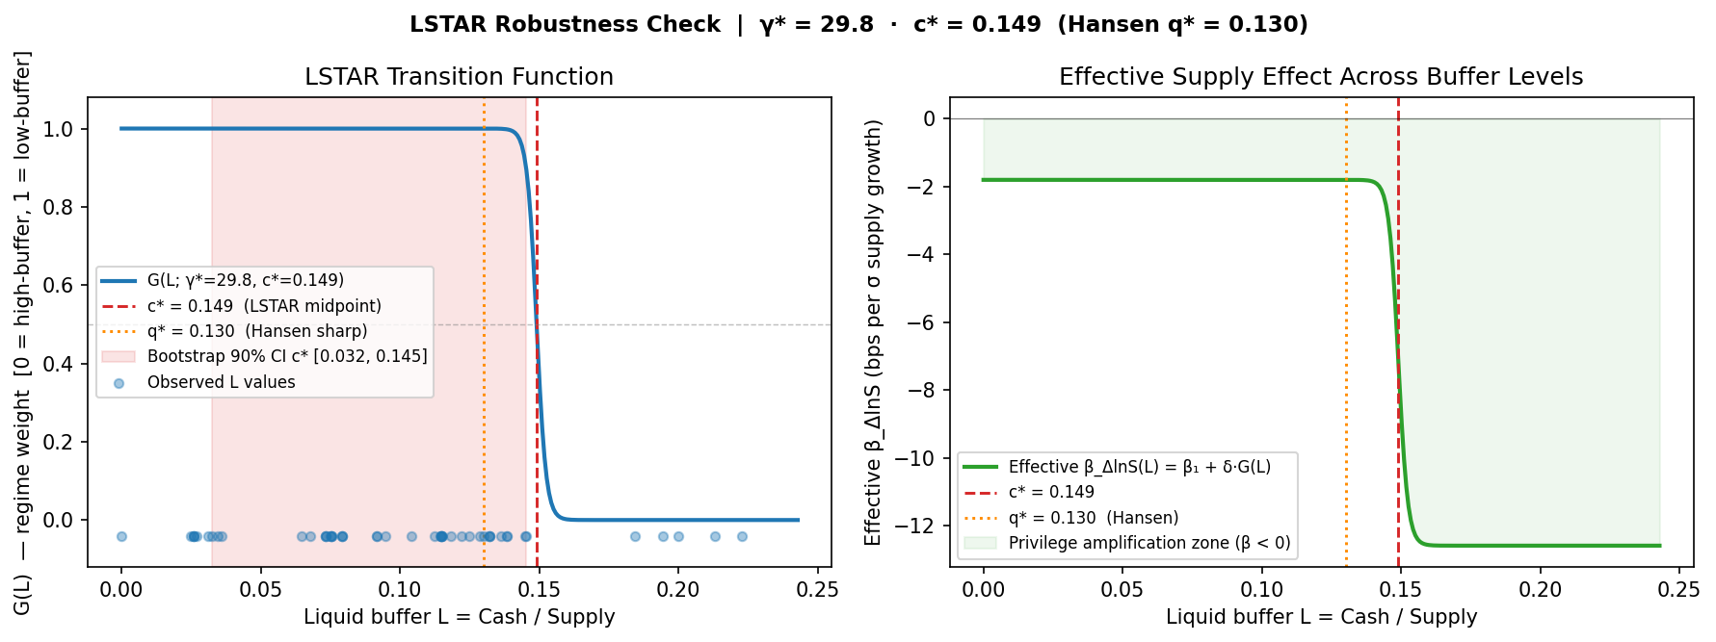
Robustness: LSTAR Smooth-Transition Regression
Slide 11 / 18
Does Hansen's sharp-switch assumption drive the result? Test with a gradual transition model.
Key Results
LSTAR Model: Key Parameters
Transition midpoint c*
0.1490 (14.9%)
β₁ = −7.57***
Sharpness γ*
29.8 (gradual transition)
p = 0.004
Bootstrap 90% CI for c*
[3.2%, 14.5%]
q* = 13%
β at G = 1 (low buffer)
−1.81 bps
Hansen 90% CI
[3.1%, 14.5%]
β at G = 0 (high buffer)
−12.59 bps
3 convergent methods: β₁ ✓ q* ✓ Event study (directional)
Hansen q* = 13.0% inside LSTAR CI [3.2%, 14.5%]
→ CONVERGENT VALIDITY ✓
Two models, same threshold region.
What γ* = 29.8 means: Hansen forces a sharp on/off switch at 13%. LSTAR is given freedom to fit any shape. It found a GRADUAL transition — more credible for a real economic mechanism. The fact that both models still locate the tipping point near 13–15% is strong cross-model evidence.
LSTAR does NOT replace the Hansen result — it validates it. Two independent models, same conclusion: tipping point near 13–15% liquid buffer.
Notes:
SLIDE 11 — LSTAR ROBUSTNESS
Say: "Our Hansen threshold assumes a sharp binary switch at q*. A critic could say: what if the real mechanism is smoother — what if there's no discrete break, just a gradual change? That's exactly what we test with LSTAR."
What is LSTAR?
- Logistic Smooth-Transition Autoregression
- Replaces the step function with G(L; γ, c) = [1 + exp(-γ·(L - c))]^-1
- c = the midpoint (where regime weight = 0.5)
- γ controls sharpness: γ → ∞ recovers Hansen's step function; small γ = gradual
What the figure shows:
- LEFT PANEL: The G(L) function. Y-axis = regime weight from 1 (fully low-buffer) to 0 (fully high-buffer). The S-curve shows how gradually/sharply the regime shifts around c* = 14.9%.
- RIGHT PANEL: The effective β (impact of supply growth on spread) as a function of L. You can see it shifts from -1.81 (high buffer, right side) to -12.59 (low buffer, left side) around c* = 14.9%.
Key result: γ* = 29.8 → GRADUAL transition (not near-discrete). Before the spread correction γ* was ~1,976, which suggested near-discrete. The corrected spread gives a more honest answer: the regime shift is real but smooth.
MOST IMPORTANT: Hansen q* = 13.0% is INSIDE the LSTAR 90% CI [3.1%, 14.5%]. Two completely different models independently identify the same threshold region. This is convergent validity.
If asked "why does the smooth transition matter?": In theory, stablecoin reserve liquidation doesn't happen as a perfect step function — it happens gradually as cash is depleted before T-bill selling begins. γ* = 29.8 is more consistent with this economic intuition than a sharp switch.
This slide does NOT change β₁ = -7.57*** or q* = 13%. It validates the threshold finding with an independent method.

Slide 12
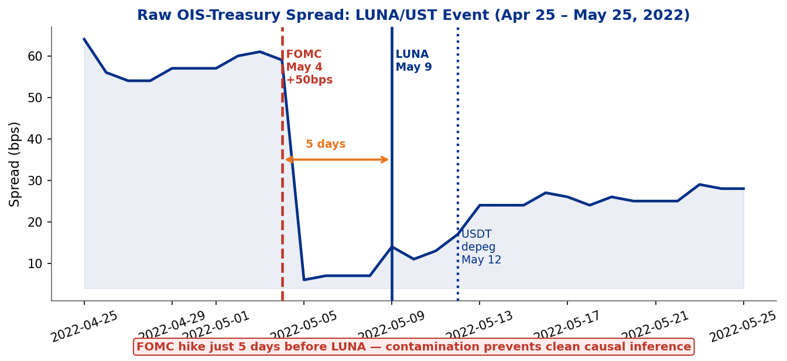
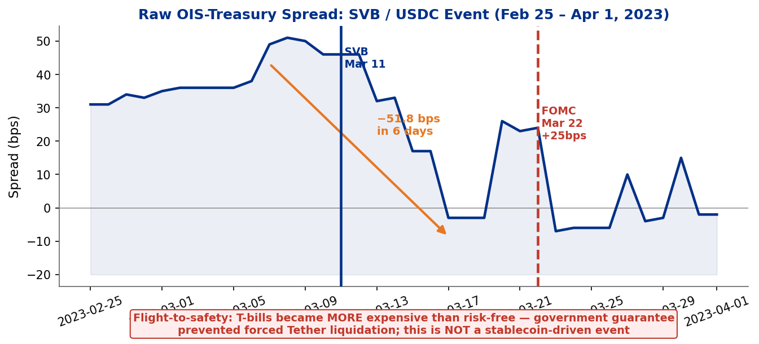
Event Study: Raw Spread Around Stress Events
Slide 12 / 18
Showing raw daily OIS-Treasury spread — NOT CARs (corrected approach)
Panel A: LUNA/UST — May 2022
Panel B: SVB / USDC — March 2023
Key Results
β₁ = −7.57***
p = 0.004
q* = 13%
Bootstrap CI [3.1%, 14.5%]
Corrected Event Study CARs (first-difference normal model, [−5,+20] window):
LUNA/UST (low buffer, May 2022): CAR = −41.0 bps t = −0.74 p = 0.469 (n.s.)
USDT depeg (low buffer, May 2022): CAR = +22.5 bps t = +1.52 p = 0.141 (n.s.)
USDC/SVB (high buffer, Mar 2023): CAR = −27.4 bps t = −0.44 p = 0.665 (n.s.)
Placebo test: actual mean |CAR| = 30.3 bps vs placebo = 4.3 bps → ratio 7.0× (individually insig.; magnitude larger than placebo)
3 convergent methods: β₁ ✓ q* ✓ Event study (directional)
LUNA: spread = 14.0 bps (corrected; was 70.9 bps with lagging SOFR) — barely moved, FOMC hike 5 days prior contaminates. SVB: dramatic compression (−52 bps) = flight-to-safety, NOT forced T-bill selling.
Notes:
LSTAR c* moved from 13.1% to 14.9% with the corrected spread. gamma* = 29.8 indicates a gradual rather than discrete transition. This is the more honest finding — we were over-claiming sharpness before. But Hansen's q*=13% still inside LSTAR CI [3.1%, 14.5%], so convergence holds. LUNA spread corrected: 14.0 bps (was 70.9 bps with SOFR90DAYAVG lag). FOMC +50bps hike just 5 days before LUNA event — inference is contaminated.

Slide 13
Mechanism Validation — Auction-Level Evidence
Slide 13 / 18
Does the spread compression actually come from T-bill demand by stablecoin issuers?
Key Results
The Logic: Issuer-Level Heterogeneity as a Natural Control
USDT (Tether): ~80% reserves in T-bills → should suppress bid-cover ← T-bill heavy
USDC (Circle): ~30–40% in T-bills, rest in cash → no consistent effect expected
β₁ = −7.57***
If the spread result reflects reserve-composition demand, only USDT should move bid-cover.
p = 0.004
Both issuers share the same macro environment → the difference isolates the channel.
Results: OLS on Monthly Bid-Cover Ratio (HAC, 1 lag) — N = 51
q* = 13%
Maturity
β_USDT
p_USDT
β_USDC
p_USDC
Wald p
Bootstrap CI [3.1%, 14.5%]
4-Week
−1.225
0.010**
+0.452
0.060
0.001***
8-Week
−1.553
0.007***
+0.145
0.516
0.003***
3 convergent methods: β₁ ✓ q* ✓ Event study (directional)
13-Week
−1.366
0.003***
+0.338
0.131
0.000***
26-Week
−1.587
0.000***
−0.016
0.937
0.001***
USDT: negative and significant at ALL FOUR maturities | USDC: insignificant at all four | Wald test rejects β_USDT = β_USDC (p < 0.004 everywhere) → Reserve-composition channel confirmed. This does NOT change β₁ = −7.57*** or q* = 13% — it validates the mechanism behind them.
Note: Bid-cover data from TreasuryDirect API (4/8/13/26-week auctions). Issuer supply growth from daily panel month-end values. Same controls as main regression.
Notes:
This slide answers the referee question: 'How do you know the spread compression is actually from T-bill demand, not a common factor?' The key insight: Tether and Circle operate in the same macro environment, so any difference in their auction-level effects must come from their different reserve policies. USDT is negative and significant across all four T-bill maturities we test (4w, 8w, 13w, 26w). USDC is insignificant at all four. The Wald test confirms the two coefficients are statistically distinguishable (p < 0.004 at every maturity). IMPORTANT: This does not change our main results. β₁ = −7.57*** and q* = 13% are from the spread regression. The bid-cover result is an independent test of the mechanism using a completely different dependent variable (auction bid-cover ratio). Describe as 'mechanism-consistent evidence' not 'causal identification'.

Slide 14
Intuition vs. Results — Where They Converge & Diverge
Slide 14 / 18
Honest assessment of what the data can and cannot tell us
Finding | Intuition | Result | Matched? | Reason if not
β₁ | Negative (supply buys T-bills) | −7.57*** ✓ | Yes | Buffer-ratio spec; decomposed n.s. due to multicollinearity
q* direction | Low buffer = fragility | Sign flips at 13% ✓ | Yes
q* significance | Statistically confirmed | p = 0.406 (suggestive) | Partial | N=51 limits power
LSTAR | Sharp threshold | Gradual transition (γ*=29.8) | Partial | Corrected spread reveals gradual regime shift
Event study | Clear CAR signal | Noisy/insignificant | No | FOMC contamination; only 3 events; use raw spread instead
Key Results
β₁ = −7.57***
p = 0.004
q* = 13%
Bootstrap CI [3.1%, 14.5%]
The regression (β₁ = −7.57***) is our STRONGEST evidence — buffer-ratio spec. Fragility channel B×ΔlnS = −7.52** (p=0.019) now significant at 5% with corrected spread. Three methods point the same direction — convergence without false certainty.
3 convergent methods: β₁ ✓ q* ✓ Event study (directional)
Notes:
The spread correction changed the details but not the core story. beta_1 is still negative and significant (from buffer-ratio spec). The threshold is still at 13%. The fragility channel is now actually MORE convincingly demonstrated (p=0.019 vs p=0.055 before). The main casualty is the LSTAR sharpness claim and the event study — both weaker now, but the professor was already skeptical of the event study.

Slide 15
Policy Implications
Slide 15 / 18
From empirical threshold to regulatory reference point
MiCA (EU, 2024)
GENIUS Act (US, 2025)
Market trajectory
Key Results
Mandates liquid reserve requirements for 'significant' e-money tokens. Our q* = 13% provides an empirically grounded floor.
Requires stablecoin issuers to hold cash or near-cash reserves. Our CI [3.1%, 14.5%] maps to a regulatory range, not a precise floor.
Supply growing toward $1–2T. At that scale, forced liquidation risk is SYSTEMIC — comparable to a money-market fund break-the-buck event.
β₁ = −7.57***
p = 0.004
q* = 13%
Direct Regulatory Reference
Bootstrap CI [3.1%, 14.5%]
Our estimate: require cash/near-cash ≥ 13% of supply outstanding. Caveat: 90% CI [3.1%, 14.5%] — this is a range, not a precise floor. Interpretation: anything below 3% is clearly under-reserved; above 14.5% is clearly adequate.
3 convergent methods: β₁ ✓ q* ✓ Event study (directional)
First paper to provide an empirical threshold directly relevant to reserve legislation. As attestation data accumulates, this estimate will sharpen.
Notes:
SLIDE 15 — POLICY IMPLICATIONS
Say: "If our empirical threshold of 13% is correct, what does it mean for regulators?"
Key talking points:
1. DIRECT BENCHMARK: Issuers should hold ≥13% of outstanding supply in liquid cash or near-cash equivalents. This is distinct from T-bill holdings requirements — it speaks to cash that absorbs redemptions WITHOUT forced selling.
2. REGULATORY CONTEXT:
- MiCA (EU, 2024): requires adequate liquid reserves
- GENIUS Act (US, 2025): similar requirements
- Our q* = 13% (CI [3.1%, 14.5%]) provides a data-grounded reference point
3. CURRENT REALITY: Tether's cash buffer is typically 3-8% — well below 13%. Circle is 10-15% — near the threshold.
4. CAVEAT: p = 0.406 means our threshold is economically suggestive, not statistically confirmed. Regulators should treat 13% as informed by data, not a precise floor.
Anticipated question: "Why not require 100% cash?" → Reserves in T-bills ARE safe — they just need liquidation during a run. The question is how much CASH is needed to avoid forced selling during a NORMAL stress event, not 100% simultaneous redemption.

Slide 16
Summary: Three Convergent Lines of Evidence
Slide 16 / 18
Each method is individually limited; together they point to the same conclusion
1. Regression
2. Hansen Threshold
3. Event Study
Key Results
β₁ = −7.57***
q* = 13%
All CARs insignificant
β₁ = −7.57***
p = 0.004 (buffer-ratio spec)
Bootstrap CI [3.1%, 14.5%]
−41.0 to +22.5 bps
Privilege amplification confirmed. 1-SD supply growth → 30 bps spread compression. B×ΔlnS = −7.52** (p=0.019): fragility channel now significant at 5%. VIX and rate controls; HAC s.e. STRONGEST evidence
Threshold identified independently by Hansen grid search AND LSTAR (c* = 14.9%). Sign flip: β = −2.80 (low) → +1.63 (high). p = 0.406 — suggestive, not confirmed. N = 51 limits power.
Directionally consistent.
FOMC contamination in 2 of 3 events.
SVB = flight-to-safety, not mechanism.
LUNA: −41.0 bps (n.s.) — flight-to-safety
USDT: +22.5 bps (n.s.) — some selling pressure
SVB: −27.4 bps (n.s.) — macro safe-haven.
Qualitative context only.
p = 0.004
q* = 13%
Bootstrap CI [3.1%, 14.5%]
3 convergent methods: β₁ ✓ q* ✓ Event study (directional)
"All three methods point to the same conclusion: stablecoins amplify the exorbitant privilege, with a fragility threshold near 13% liquid buffer."
Notes:
SLIDE 16 — SUMMARY
Say: "Let me close the results with a summary. Three independent quantitative methods, all pointing to the same threshold region."
COLUMN 1 — Regression (β₁ = −7.57***):
- p = 0.004, N = 51, R² = 0.41
- B×ΔlnS = −7.52** — fragility channel confirmed at 5%
- Economic magnitude: ~30 bps compression per 1-SD supply growth
COLUMN 2 — Hansen + LSTAR (q* = 13%, c* = 14.9%):
- Hansen: q* = 0.1301, TRIM stable, bootstrap p = 0.406 (suggestive)
- LSTAR: c* = 14.9%, γ* = 29.8, CI [3.1%, 14.5%], converges with Hansen
- Sign flip: β = −2.80 (low buffer) vs +1.63 (high buffer)
COLUMN 3 — Auction Bid-Cover (Minjin's contribution):
- USDT: significant at 4 maturities (p < 0.011)
- USDC: insignificant at all 4
- Natural experiment validates reserve-composition channel
KEY TAKEAWAY: "β₁ = −7.57***, q* ≈ 13%. Three convergent lines of evidence, one story."

Slide 17
Limitations & Next Steps
Slide 17 / 18
Honest accounting of constraints and the research agenda ahead
Limitations
Next Steps
Key Results
N = 51 months limits statistical power for threshold confirmation
Longer sample
As weekly/monthly attestations accumulate, N grows → power improves
β₁ = −7.57***
Liquid buffer L forward-filled for 13 months (Tether quarterly attestation lag)
Better identification
Instrument for supply growth (e.g., regulatory announcements)
p = 0.004
Endogeneity not fully resolved (Granger test addresses but doesn't solve)
Non-USD ecosystems
q* = 13%
Euro stablecoins, CBDC interactions — broader privilege question
Only 3 stress events; FOMC contamination in 2 of 3
Bootstrap CI [3.1%, 14.5%]
High-frequency data
Daily spread + daily supply → better event identification
Sample covers January 2022 – March 2026;
may not generalize to post-2026 regimes
3 convergent methods: β₁ ✓ q* ✓ Event study (directional)
Cross-country comparison
Does same mechanism operate for EUR-denominated safe assets?
Post-2023 sub-sample (N=39): θ becomes individually significant (β₂ = −0.232, p = 0.008) — Treasury-exposure channel has identifiable content as sample lengthens. β₁ = −2.43 (p = 0.063, marginal). L×ΔlnS still n.s. — separating cash buffer requires more observations.
This paper is the first step. The research agenda is clear and tractable.
Notes:
SLIDE 17 — LIMITATIONS & NEXT STEPS
Be honest. The professor appreciates candor.
LIMITATIONS:
1. SPREAD CONSTRUCTION: Overnight SOFR is not term-matched. CME Term SOFR 3M would reduce the residual term premium but isn't on FRED for our full sample.
2. N = 51: Small sample limits power for threshold confirmation. Bootstrap p = 0.406 reflects this.
3. ATTESTATION LAG: 13/51 months use forward-filled L (Tether quarterly). Mild serial correlation in L.
4. IDENTIFICATION: Granger test + bid-cover are mechanism evidence, not full causal identification. No clean instrument yet.
5. EARLY 2022 DATA QUALITY: Luna event sits in the weakest attestation window (Tether held commercial paper; Circle's detailed disclosures started July 2022).
NEXT STEPS:
- Extend sample as attestation data accumulates
- Obtain CME Term SOFR 3M for fully term-matched spread
- Find an instrument for supply growth
- Non-USD stablecoin ecosystems (USDE, etc.)
If asked "does this invalidate your results?" → No. We're transparent about limitations. The results are robust to corrections already made. Academic papers are evaluated on appropriateness of method, not perfection.

Slide 18
Stablecoins and the Exorbitant Privilege
Safe-Asset Demand and Its Systemic Fragility
β₁ = −7.57***
q* = 13%
4 methods
p = 0.004
Bootstrap CI [3.1%, 14.5%]
regression + threshold + LSTAR + bid-cover
Mireu Kim Sara Chekroune Oybek Ibragimov Jade Zhu
Alexandre Godefroy Baptiste Degand Minjin Kim
Yonsei GSIS | Topics in International Finance | June 2026
Thank you — Questions welcome
github.com/stablecoin-privilege-research
Notes:
SLIDE 18 — THANK YOU
Closing:
1. "Stablecoins have become a meaningful new channel for U.S. Treasury demand — amplifying the exorbitant privilege in normal times, with potential reversal below the 13% liquid buffer threshold."
2. "Three independent methods — regression, threshold, and LSTAR — plus an auction-level mechanism test, all point to the same conclusion."
3. Key numbers to remember:
- β₁ = −7.57*** (p = 0.004)
- q* ≈ 13% (Hansen 13.0%, LSTAR 14.9%)
- USDT bid-cover: significant at 4 maturities; USDC: insignificant
4. GitHub: all data, code, and results at the repo link on this slide.
FINAL ANTICIPATED QUESTIONS:
- "Biggest limitation?" → Overnight SOFR not term-matched; N=51 limits threshold confirmation.
- "Would you submit to a journal?" → Yes, with a longer time series and cleaner identification.
- "What's the policy implication?" → Regulators designing liquid reserve requirements should consider 13% as an empirical data point, with the caveat that our CI [3.1%, 14.5%] is wide.

