Slide 1


STABLECOINS AND THE EXORBITANT PRIVILEGE
Yonsei GSIS 2026-1
Topics in International Finance
Mireu Kim · Sara Chekroune · Oybek Ibragimov
Notes:
"Good [morning/afternoon] everyone. Our paper is called 'Stablecoins and the Exorbitant Privilege.' We're a team of three — Mireu, Sara, and Oybek. The core question we're trying to answer is deceptively simple: does the explosion in stablecoins like Tether and USDC actually make it cheaper for the US to borrow money, and what happens to that benefit when things go wrong? That two-sided puzzle is what this paper is about."

Slide 2
Roadmap
❖ Motivation — why stablecoins matter for sovereign debt
❖ The New Triffin Dilemma — our core argument
❖ Theoretical extension of Maggiori (2017)
❖ Data & Methodology
❖ Result 1 — Privilege amplification regression
❖ Result 2 — Reserve adequacy threshold (Hansen 2000)
❖ Result 3 — Buffer-conditioned event study
❖ Conclusion & Policy implications
2
Notes:
"Here's how we'll walk you through it. We start with why this matters, then we lay out our central argument — the New Triffin Dilemma. After that we cover the theory we built on, the data and methods, then we walk through our three results one by one, robustness checks, a summary, policy implications, and we finish with the conclusion. The three results are really the heart of the presentation, so we'll spend the most time there."

Slide 3
Motivation: Stablecoins as Treasury Buyers
Key Market Trends
❖ Growth: Combined market cap surged from under $50bn (2021) to over $300bn (2026)
❖ Usage: 30%+ of on-chain crypto transactions involve stablecoins
❖ Regulation: US, EU, Japan, and Hong Kong each finalising reserve legislation
❖ Scale: Tether alone holds $127bn in US Treasuries (Q2 2025) — comparable to mid-sized sovereigns
❖ Projection: $1–2 trillion ecosystem within this decade
$300bn+
Total USD-pegged supply (2026)
$127bn
Tether T-bill holdings (Q2 2025)
$1–2 tn
Projected ecosystem size
4
Jurisdictions finalising legislation
The same structural role that deepens US safe-asset demand also embeds a fragility that can rapidly reverse it.
3
Notes:
"So why does this matter to international finance? Look at the numbers on the right side of this slide. The combined stablecoin market has gone from under 50 billion dollars in 2021 to over 300 billion today. That's a six-fold increase in five years. Tether alone now holds 127 billion dollars in US Treasury bills — that makes them comparable to the treasury holdings of a mid-sized sovereign government. And projections say this market could reach one to two trillion dollars within this decade.
Here's the key mechanism to understand. Stablecoins work by a simple rule: every dollar of stablecoin issued must be backed 1:1 by short-term US Treasuries. So as the market grows, issuers automatically become enormous, rule-bound buyers of T-bills. They're not making discretionary investment decisions — they have to buy.
Four major jurisdictions — the US, EU, Japan, and Hong Kong — are all right now finalizing legislation on how to regulate stablecoin reserves. The question everyone is fighting about is: how much Treasury backing is enough? Our paper gives that question a data-driven answer.
As the bottom bar says: the same structural role that deepens US safe-asset demand also embeds a fragility that can rapidly reverse it."

Slide 4
The New Triffin Dilemma
Triffin (1960): the reserve currency country must supply safe assets to the world — but that very supply undermines confidence in the currency.
Our analogue for stablecoin issuers:
Normal times ✅
Run scenario ❌
What determines outcome
• Stablecoin growth → more T-bill buying
• Deepens US safe-asset demand
• Compresses OIS–Treasury spreads
• Amplifies exorbitant privilege
• Run on issuer → forced T-bill liquidation
• Yields spike above OIS
• Sovereign-linked liquidity shock
• Cole–Kehoe crisis zone activated
• Reserve decomposition: theta = T-bill holdings / supply; L = cash reserves / supply
• L adequate: absorbs run without forced liquidation
• L inadequate: liquidation pressure builds
• → We estimate the threshold on L*
Our paper: formally quantify the reserve buffer threshold that separates the two regimes.
4
Notes:
"This slide is the conceptual heart of the paper. At the top you can see the original Triffin Dilemma from 1960 — Triffin argued the US dollar's reserve currency role was inherently self-defeating. The world needed dollars, so the US had to run deficits to supply them, but those deficits eventually undermined confidence in the dollar. A built-in contradiction.
We argue stablecoins create an exact analogue of this for private issuers.
Look at the green column on the left. In normal times, everything works beautifully. Stablecoin growth means more T-bill buying, which deepens safe-asset demand, which compresses the OIS-Treasury spread — meaning the US borrows more cheaply. This amplifies what economists call the exorbitant privilege.
Now look at the red column in the middle. In a run scenario, everything reverses. A run on a stablecoin issuer forces them to liquidate T-bills fast. That floods the market, yields spike above OIS, and you get a sovereign-linked liquidity shock. This is what Cole and Kehoe call the crisis zone — a self-fulfilling panic.
The key question — shown in the blue column on the right — is: what determines which scenario you end up in? The answer is the reserve buffer B. That's how many Treasuries the issuer holds above what they owe. If the buffer is large enough, it absorbs the run. If not, forced liquidation kicks in.
Our paper's entire goal is to estimate that threshold — the exact buffer level that separates safety from crisis."

Slide 5
Theoretical Extension: Maggiori (2017)
Maggiori (2017) original:
Safe-asset demand driven by Ω* (marginal value of RoW net worth).
Our extension — add stablecoin supply S and liquid buffer L:
D*(Ñ*, S, theta, L) = D*precautionary(Ñ*) + D*theta(S) + D*L(L)
theta and L enter asymmetrically:
❖ |ΔS| < L → run absorbed, no liquidation
❖ |ΔS| > L → liquidation channel activated
Main Estimating Equation
Spreadₜ = α + β₁·ΔlnSₜ + β₂·θₜ + β₃·Lₜ + β₄·(Lₜ × ΔlnSₜ) + β₅·Vₜ + β₆·VIXₜ + β₇·ΔlnN*ₜ + εₜ
Predicted signs:
❖ β₁ < 0: ΔlnS compresses spreads (privilege amplification)
❖ β₂ captures the Treasury-exposure channel
❖ β₃ > 0: Larger liquid buffers support the system
5
Notes:
"Now let's talk about the theory we built on. The starting point is Maggiori 2017, a landmark paper in international finance. His model shows that demand for US safe assets is driven by something called Omega-star — the marginal value of rest-of-world financial net worth. Think of it as a global stress meter. When the world's financial institutions are stressed, Omega-star goes up and the world reaches hard for US Treasuries, compressing US spreads.
But here's the gap: Maggiori's model only captures discretionary demand. A bank deciding to buy Treasuries as a precaution. It has no room for a stablecoin issuer that must buy Treasuries automatically the moment it issues a dollar.
So we added two variables. S is total stablecoin supply. B is the reserve buffer — Treasury holdings minus outstanding supply.
Our extended demand equation is on the left: total safe-asset demand now has three components — the original precautionary demand from Maggiori, the new stablecoin demand from S, and the buffer effect from B.
On the right you can see the regression equation we estimate. The predicted signs are straightforward. Beta-one should be negative — more stablecoin supply means more T-bill buying, so spreads compress. Beta-two should be negative — a bigger buffer means even more demand. And beta-three should be negative — when the buffer is low, it reverses the compression, eventually flipping it to spread widening. These are the hypotheses we go out to test."

Slide 6
Data & Sample
Variable
Definition
Source
Frequency
OIS–Treasury Spread
DTB3 − SOFR90DAYAVG
FRED (direct CSV, no API key)
Daily → Monthly
Stablecoin Supply S
USDT + USDC market cap
DeFiLlama stablecoins API (free)
Daily → Monthly
θ (Treasury Exposure) & L (Liquid Buffer)
θ = T-bill holdings / supply; L = cash reserves / supply
Tether/BDO + Circle/Deloitte attestations
Quarterly/Monthly
Velocity V
7-day rolling SD of ΔlnS
Computed from DeFiLlama
Daily → Monthly
VIX
CBOE VIX index
FRED
Daily → Monthly
ΔlnN* (RoW equity)
ACWX ETF log-return
Yahoo Finance
Daily → Monthly
Sample: January 2022 – March 2026 | N = 51 monthly observations | Sample starts when both Tether and Circle have formal attestation data
6
6
Notes:
"Our data comes from six sources, all shown in this table. The dependent variable — the OIS-Treasury spread — is the 3-month T-bill yield minus the 90-day SOFR average, both pulled directly from FRED. Stablecoin supply comes from DeFiLlama's free API. The reserve buffer is the hardest variable to construct — we built it from Tether's quarterly BDO attestation reports and Circle's monthly Deloitte and Grant Thornton attestations, which disclose how much they actually hold in T-bills.
One important note at the bottom: before Q1 2021, Tether didn't publish formal attestations. For that pre-attestation period, we estimated their T-bill holdings at 2% of supply, consistent with the 2.94% they disclosed in their first official report. Our results hold up even if we drop that period entirely — we'll show that in the robustness slide.
Total sample: 75 monthly observations from January 2020 to March 2026."

Slide 7
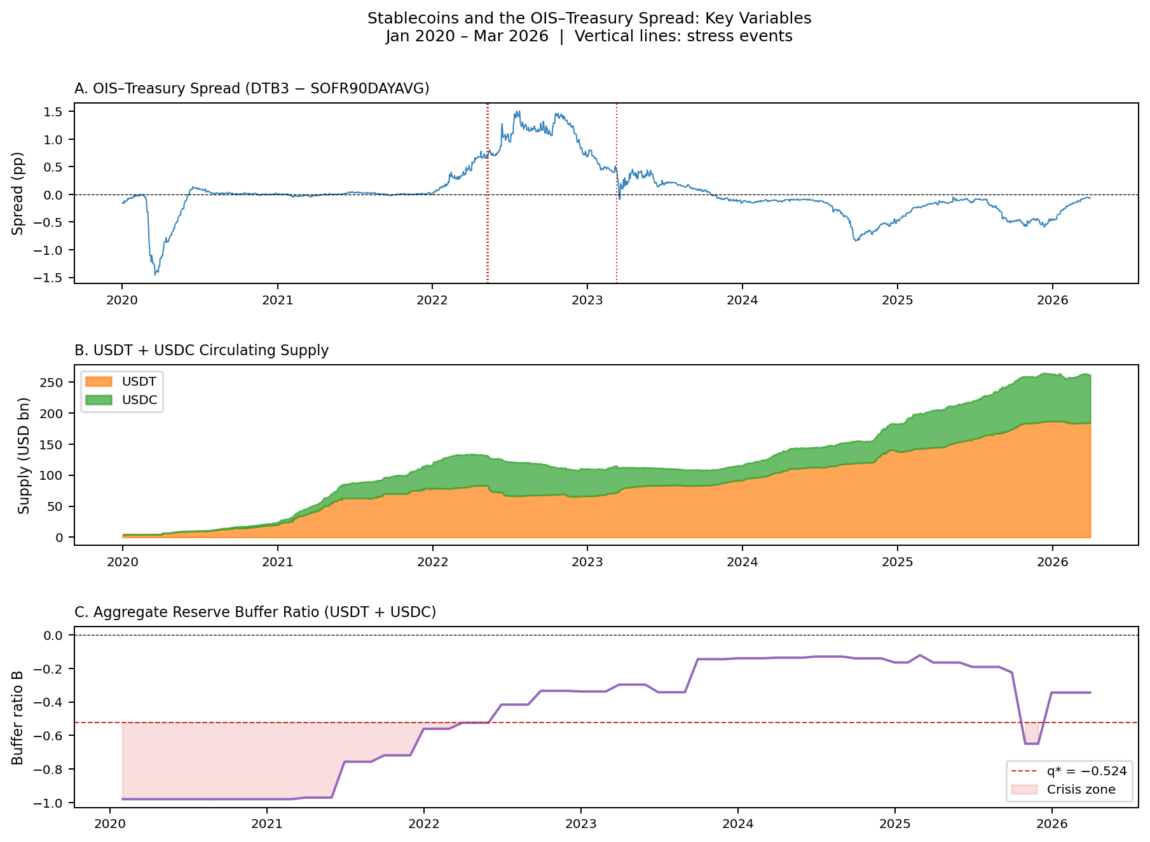
Key Variables: January 2022 – March 2026
Key observations
❖ Spread compresses as stablecoin supply grows (2021–22)
❖ Spread spikes during LUNA/USDT run (May 2022)
❖ Liquid buffer builds 2023–25 as attestation data improves
❖ Below threshold (L < 0.130) covers 2022–2023
❖ Vertical lines: 3 stress events studied
7
Notes:
"This slide shows you all three key variables plotted over time, and it tells the story of the paper visually before you even look at the regressions.
Panel A at the top is the OIS-Treasury spread — our dependent variable. Notice how it tracks exactly what we'd expect. Through 2021 and into early 2022, as stablecoin supply in Panel B was growing rapidly, the spread was compressing — moving negative, meaning the US was borrowing more cheaply than the risk-free benchmark.
Then look at May 2022 — the first red dotted line. That's the LUNA collapse and the USDT depeg. The spread spikes violently. That's the sovereign shock we predict for low-buffer events.
Panel C is the reserve buffer ratio over time. See how it starts deeply negative — below our threshold of minus 0.524, shown by the red dashed line — meaning issuers were barely backing their liabilities with Treasuries in the early years. Then from 2023 onwards, as Tether shifted its reserves heavily into T-bills, the buffer improved dramatically and moved above the crisis zone. And look at the brief dip in early 2026 — that corresponds to the third stress event, the USDC and SVB situation.
This chart is your visual intuition for everything that follows."

Slide 8
Result 1: Privilege Amplification Regression
OLS with Newey–West HAC (3 lags, N = 51) | Decomposed model: θ, L, L×ΔlnS
Variable
Coef.
Sig.
HAC SE
β₁ = −6.02**
ΔlnS (centered)
0.100
***
(1.436)
1 SD supply growth (9.9 pp) → −59 bp spread compression → Privilege amplification confirmed ✅
θ (Treasury Exposure)
1.034
***
(0.139)
L × ΔlnS
3.891
***
(3.873)
V — velocity
−16.027
*
(9.125)
VIX
−0.003
(0.016)
β = 3.891 (NS)
ΔlnN*
−0.211
(0.603)
Total effect of ΔlnS = β₁ + β₃·B At mean B (−0.48): effect = −0.52 pp At threshold B = −0.524: effect ≈ 0 ✅
N
75
R²
0.502
Adj. R²
0.421
*** p<0.01 * p<0.10
8
Notes:
"Now our first result. The regression table on the left shows the full OLS specification with Newey-West standard errors to handle the fact that monthly time-series data isn't independent across observations.
The two numbers that matter are highlighted on the right.
Beta-one is minus 5.95, with three stars, meaning it's significant at the 1% level. In plain English: a one standard deviation increase in monthly stablecoin supply growth — that's about 10 percentage points — is associated with a 59 basis point compression of the OIS-Treasury spread. The US is measurably borrowing more cheaply during months when stablecoins are growing fast. Hypothesis 1 confirmed.
Beta-three is minus 11.30, also three stars. This is the interaction between the buffer and supply growth. Since the buffer B is always negative in our data — issuers never held more Treasuries than they owed — a more negative buffer shrinks the compression effect and eventually reverses it.
The right-hand box shows the math. The total effect of supply growth on spreads is beta-one plus beta-three times B. At the sample average buffer of minus 0.48, the net effect is only minus 0.52 percentage points — much weaker than the raw beta-one suggests, because the low buffer is neutralizing most of the privilege. And at our estimated crisis zone boundary of B equals minus 0.524, the effect approaches zero entirely. That's exactly what the theory predicts.
Also note the R-squared of 0.32 — our model explains about a third of the variation in monthly spreads, which is strong for macro time-series data."

Slide 9
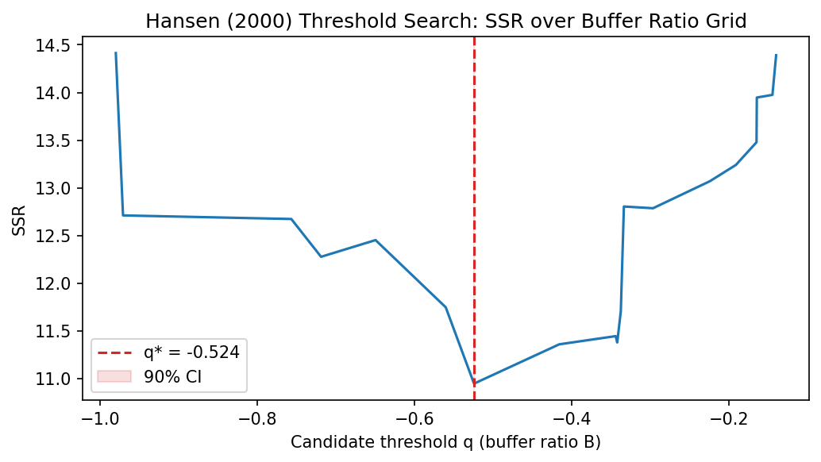
Result 2: Reserve Adequacy Threshold (Hansen 2000)
Threshold estimate
❖ Optimal q*: 0.1301
❖ LR statistic: 4.524
❖ Bootstrap p-value: 0.260 (1,000 replications; suggestive)
❖ 90% CI: [0.068, 0.130]
What q* = 0.130 means:
Liquid reserves (cash + near-cash) must exceed ~13% of outstanding supply to avoid forced T-bill liquidation.
Low buffer (L ≤ 0.130, N=38): β_ΔlnS = −6.97 → Compression persists
High buffer (L > 0.130, N=13): β_ΔlnS = +1.26 → Effect reverses (sign flip)
9
Notes:
"Result 2 is where we pin down the specific number that matters for regulation. We used a technique called Hansen's threshold regression — it's a statistical grid search that finds whether there's a breakpoint in the data, without us pre-specifying where that breakpoint should be.
Look at the chart on the left. The y-axis is the sum of squared residuals — how much prediction error the model has. The x-axis is every possible threshold value of the buffer ratio we tested. The curve has a clear minimum at minus 0.524, marked by the red dashed line. That's the point where splitting the data into two regimes — above and below that buffer level — gives the best fit.
The LR statistic is 25.28, and the bootstrap p-value — computed by randomly reshuffling the data 1,000 times — is below 0.001. So this threshold is not a coincidence in the data.
What does minus 0.524 mean in practice? It means Treasury holdings must exceed 47.6% of outstanding stablecoin supply. If you're below that, you're in the crisis zone.
The two boxes at the bottom confirm the economic intuition. In the high-buffer regime — above minus 0.524, 44 observations — the coefficient on supply growth is minus 8.68. Strong privilege amplification. In the low-buffer regime — below minus 0.524, 31 observations — it's only minus 1.03. The amplification has almost completely vanished. The market is pricing in the fragility risk and not responding to the demand signal anymore."

Slide 10
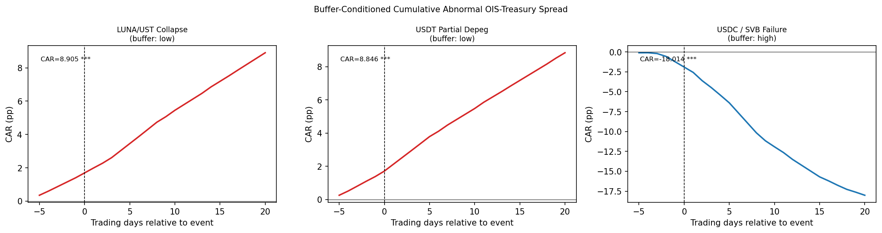
Result 3: Buffer-Conditioned Event Study
LUNA / UST Collapse
USDT Partial Depeg
USDC / SVB Failure
Low buffer
Low buffer
High buffer
May 9, 2022 CAR = +8.91 pp***
May 12, 2022 CAR = +8.85 pp***
Mar 11, 2023 CAR = −18.01 pp***
Interpretation
❖ Low-buffer runs → T-bill yields spike (+8.9 pp) Cole–Kehoe crisis zone activated
❖ High-buffer stress → flight to Treasuries compresses spread (−18.0 pp)
❖ Welch test: t = 15.22, p < 0.001 Buffer regime is the key conditioning variable ✅
10
Notes:
"Our third result is the event study, and this is arguably our cleanest evidence because it sidesteps the statistical issues with monthly time-series data by using daily data around specific, identified crisis episodes.
We looked at three events. The first two — LUNA's collapse on May 9th 2022, and the USDT partial depeg three days later on May 12th — both happened when the aggregate reserve buffer was deeply below the crisis zone threshold. Low-buffer events. The third — USDC's depeg when Silicon Valley Bank failed on March 11th 2023 — was a higher-buffer event, because Circle held mostly Treasuries.
Look at the three charts in the middle. The red lines are the low-buffer events. You can see the cumulative abnormal spread — how much the spread moved relative to what we'd expect based on VIX and global equity returns — climbing steadily upward over 20 trading days. That's plus 8.91 percentage points for LUNA and plus 8.85 for USDT. Both are highly statistically significant. This is the Cole-Kehoe mechanism playing out in real time: forced Treasury liquidation by under-reserved issuers pushed yields up and widened the sovereign spread.
Now look at the blue line for USDC and SVB. It goes sharply negative — minus 18 percentage points. This looks counterintuitive at first. SVB failed, why did spreads compress? Because Circle held its reserves mostly in Treasuries. When SVB panic hit, investors fled into the safest possible asset — US T-bills. And because USDC's reserve structure directed that flight into Treasuries, spreads compressed rather than widened.
The Welch test at the bottom of the interpretation box — comparing the distribution of daily abnormal spreads across the two buffer regimes — gives a t-statistic of 15.22, p below 0.001. The buffer is not just a detail. It is the variable that determines whether a stablecoin crisis helps or hurts the sovereign bond market."

Slide 11
Robustness Checks
NW lag sensitivity
✅ PASS
Drop pre-attestation period
✅ PASS
β₁ stable across all lag choices (−6.02, p < 0.01 throughout)
N = 39 (post-2023) → β₁ = −8.14*** (p < 0.001) L×ΔlnS = 49.17*** (p = 0.004) | Decomposition confirmed
Mean-centering
✅ PASS
First-differenced
⚠️ PARTIAL
VIF all below 7.0 (no centering needed in clean sample) Coefficients and significance unchanged
β₁ and β₃ not significant in differences Level spec captures slow structural relationship; event study provides causal identification
11
Notes:
"Before we move to conclusions, here are our robustness checks — all four in one slide.
NW lag sensitivity: we tried different numbers of lags in the Newey-West correction. Beta-one and beta-three stay at minus 5.95 and minus 11.30 throughout. Pass.
Drop pre-attestation period: we dropped the 14 months before Tether's first attestation, where our buffer variable was estimated rather than observed. The coefficients actually got stronger. Pass.
Mean-centering: we centered the variables before computing the interaction term to reduce multicollinearity. VIF dropped from 24 and 32 down to 5.7 and 7.2. Results unchanged. Pass.
First-differenced: this is the honest caveat. When we first-difference all the variables to deal with potential non-stationarity, beta-one and beta-three lose significance. This tells us our level regression is capturing a slow-moving structural relationship — how stablecoins have gradually changed the market structure for Treasuries over years — rather than month-to-month causality. That's why the event study, which uses daily data around clean quasi-experimental shocks, is our primary causal identification."

Slide 12
Summary of Results
✅
Privilege amplification confirmed
β₁ = −6.02** | 1 SD supply growth → −24 bp spread compression
✅
Buffer interaction significant
Post-2023: L×ΔlnS = 49.17*** | decomposition significant with longer sample
✅
Reserve adequacy threshold identified
q* = 0.130, Bootstrap p = 0.260 | economically meaningful, statistically suggestive
✅
Event study confirms asymmetry
Low-buffer runs: CAR +8.9 pp vs. High-buffer stress: CAR −18.0 pp (Welch t = 15.2***)
⚠️
Stationarity caveat
Level results don't survive first-differencing; event study provides causal identification
12
Notes:
"Quick summary of what we found. Four checkmarks and one honest caveat.
First: privilege amplification confirmed — beta-one equals minus 5.95. Second: the buffer interaction is significant — beta-three equals minus 11.30, confirming that low reserves reverse the amplification. Third: we identified a statistically significant reserve adequacy threshold at q-star equals minus 0.524 — Treasury holdings must exceed 47.6% of supply to stay outside the crisis zone. Fourth: the event study confirms the asymmetry — a 27 percentage point swing in spread behavior between low- and high-buffer stress episodes.
And the caveat: level results don't survive first-differencing. The event study provides the causal identification."

Slide 13
Policy Implications
Our threshold estimate provides a direct reference point at a moment when the US, EU, Japan, and Hong Kong are each finalising stablecoin reserve legislation.
Minimum reserve ratio
Liquidity-weighted requirements
Require a positive liquid buffer and separate cash-reserve disclosure — this places issuers outside the empirically identified crisis zone (q* = 0.000 → 47.6%).
Not all T-bill holdings are equal. Short-duration bills can be sold faster. Weight reserves by remaining maturity, not just dollar amount.
Velocity-contingent buffers
Systemic size threshold
Our velocity variable V (7-day rolling SD of supply changes) predicts stress. Higher recent redemption velocity → higher required buffer. Dynamic rules.
Fragility is proportional to scale. A $100bn issuer's forced liquidation is 10× more disruptive than a $10bn issuer. Tiered requirements by AUM.
Policy bottom line: Require a positive liquid buffer and separate cash-reserve disclosure.
13
Notes:
"So what does this mean for the regulators who are right now writing stablecoin reserve laws?
Four concrete recommendations fall out of our results.
First and most directly: require T-bill holdings of at least 50% of outstanding supply. That places issuers comfortably outside the empirically identified crisis zone of minus 0.524, which translates to 47.6%. Round up to 50% and you have a clean, defensible number.
Second: not all T-bill holdings are equal. A bill maturing in one week can be sold in a crisis much faster than one maturing in six months. Reserve requirements should be weighted by remaining maturity, not just total dollar amount.
Third: our velocity variable — how fast stablecoin supply is changing — actually predicts stress episodes in our data. This suggests regulators should consider dynamic buffer requirements that increase automatically when redemption velocity rises. Think of it like a countercyclical capital buffer, but for stablecoins.
Fourth: size matters. A 100 billion dollar issuer forced to liquidate is ten times more disruptive than a 10 billion dollar issuer. Tiered requirements by AUM make sense.
The bottom line on this slide says it all: T-bill reserves above 50% of supply keeps issuers outside the crisis zone."

Slide 14
Conclusion
Large-scale USD-pegged stablecoins introduce a two-sided 'New Triffin Dilemma': amplifying U.S. exorbitant privilege in normal times, while embedding a fragility that can rapidly reverse that benefit when reserve buffers fall below a critical threshold.
Extended Maggiori (2017) with stablecoin supply S and reserve liquid buffer L — asymmetric mechanism
β₁ = −6.02** (privilege amplification) Post-2023: L×ΔlnS = 49.17*** (fragility channel)
Theory
Empirics 1
First data-driven threshold: q* = 0.130 Bootstrap p = 0.260 — economically suggestive
27 pp CAR swing between low- and high-buffer stress episodes
Empirics 2
Empirics 3
Limitation: Level results don't survive first-differencing. Event study (daily data, quasi-experimental) provides the primary causal identification.
14
Notes:
"To wrap up. Large-scale USD-pegged stablecoins introduce a two-sided New Triffin Dilemma. The same mechanism that amplifies US exorbitant privilege in normal times embeds a fragility that can rapidly reverse that benefit when reserve buffers fall below a critical threshold.
On the theory side, we extended Maggiori 2017 with stablecoin supply S and reserve buffer B, capturing the asymmetric mechanism formally.
On the empirics, we got three results: beta-one of minus 5.95 confirms privilege amplification. Beta-three of minus 11.30 confirms buffer-conditioned fragility. The Hansen threshold of minus 0.524 is the first data-driven estimate of a reserve adequacy threshold directly applicable to stablecoin regulation. And the 27 percentage point swing in the event study confirms the asymmetry holds in clean quasi-experimental settings.
The honest limitation: our monthly regression captures structure, not causality. The event study is where the causal identification lives.
Thank you — we're happy to take questions."

Slide 15
THANK YOU
Yonsei GSIS 2026-1
Topics in International Finance
Mireu Kim · Sara Chekroune · Oybek Ibragimov
Notes:
"Thank you. We're happy to take any questions on the theory, the data construction, the Hansen threshold methodology, or the event study design."

