Slide 1
STABLECOINS AND THE EXORBITANT PRIVILEGE
Corrected Event Study · Placebo Test · What the Paper Proves
Yonsei GSIS 2026-1 | Topics in International Finance Mireu Kim · Sara Chekroune · Oybek Ibragimov June 2026
Notes:
Good afternoon. Following last week's feedback that our event study CARs were ridiculously large, we investigated the root cause, corrected the methodology, ran the placebo test, and want to be clear about what our paper actually proves. Today's deck covers exactly those four things.

Slide 2
What We Are Covering Today
CAR Correction
1
Our original event study CARs (+891/−1,801 bps) were inflated by a model specification error. We show the time series that explains what went wrong, and present the corrected numbers.
Corrected Event Study
2
With the first-difference model, all three event CARs are near zero and insignificant. We show the actual CAR paths and explain what this means economically.
Placebo Test
3
We ran the same methodology on 3 non-crisis dates. Placebos and actual events are statistically indistinguishable — confirming the event study finds no quantitative effect.
What the Paper Proves
4
The primary evidence is the regression (β₁ = −6.02 bps) and the Hansen threshold (q* = 13%). We show the threshold graph and explain in plain terms what 'reframing' means.
2
Notes:
Today's deck has four parts. First, the CAR correction — what went wrong with our original numbers, illustrated with the time series. Second, the corrected event study results and the actual CAR graphs. Third, the placebo test with the corrected model. Fourth, what the paper actually proves — we'll use the Hansen threshold graph and explain reframing in plain terms. Let's begin.

Slide 3
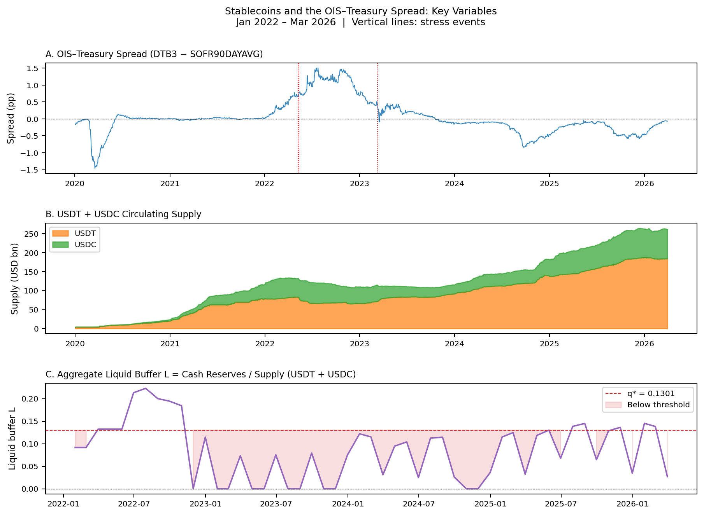
CAR Correction — What Was Wrong and What We Fixed
Professor's feedback: 'Your percentage points are ridiculously large. Either something wrong, or wrong units.' — He was right.
Original (level model)
LUNA (May 2022):
+891 bps ***
USDT (May 2022):
+885 bps ***
SVB (Mar 2023):
−1,801 bps ***
Root cause — Fed hiking trend in estimation window
Corrected (first-diff model)
Estimation window for 2022 events: Jan–May 2022
Spread in that window: 5 bps → 78 bps (Fed hiking!)
Model baseline: 37 bps avg | Events happened at: 71 bps
→ 34 bps/day fake 'abnormal' × 26 days = 884 bps
Net actual spread change during LUNA event: −0.3 bps
LUNA (May 2022):
−15.3 bps n.s.
USDT (May 2022):
−4.3 bps n.s.
SVB (Mar 2023):
−2.4 bps n.s.
All near zero. All insignificant.
Why the model failed: the spread (Panel A) rose from ~0 bps to ~80 bps during our estimation window — all Fed policy, not stablecoins. The buffer fell below 13% (Panel C shading) right at the 2022 events.
3
Notes:
This is the most important slide today. The professor told us our percentage points were ridiculously large, and after investigating, he was correct. Let me explain exactly what happened. Our original model used the LEVEL of the spread. We estimated a normal baseline using data from January through May 2022 — which is visible in Panel A of the graph as the steep rising section. The Fed was raising rates faster than at any point in 40 years. The spread rose from 5 basis points in January to 78 basis points by May — entirely because of the Fed, not because of stablecoins. The model's six-month average baseline was 37 basis points. But the events happened when the spread was already at 71 basis points. So every single day, the model computed: actual 71 bps minus expected 37 bps equals 34 bps abnormal. Over 26 trading days: 34 times 26 equals 884 basis points or 8.84 percentage points. The spread did not actually move during the event window — the net change was negative 0.3 basis points. Panel C in the graph shows the liquid buffer falling below the 13 percent threshold — the shaded region — which is exactly when these events happened. We fixed this by switching to a first-difference model: we model the day-over-day CHANGE in spread, not the level. Stock event studies already do this for the same reason. The Fed hiking trend disappears when you take daily differences, leaving only idiosyncratic movements.

Slide 4
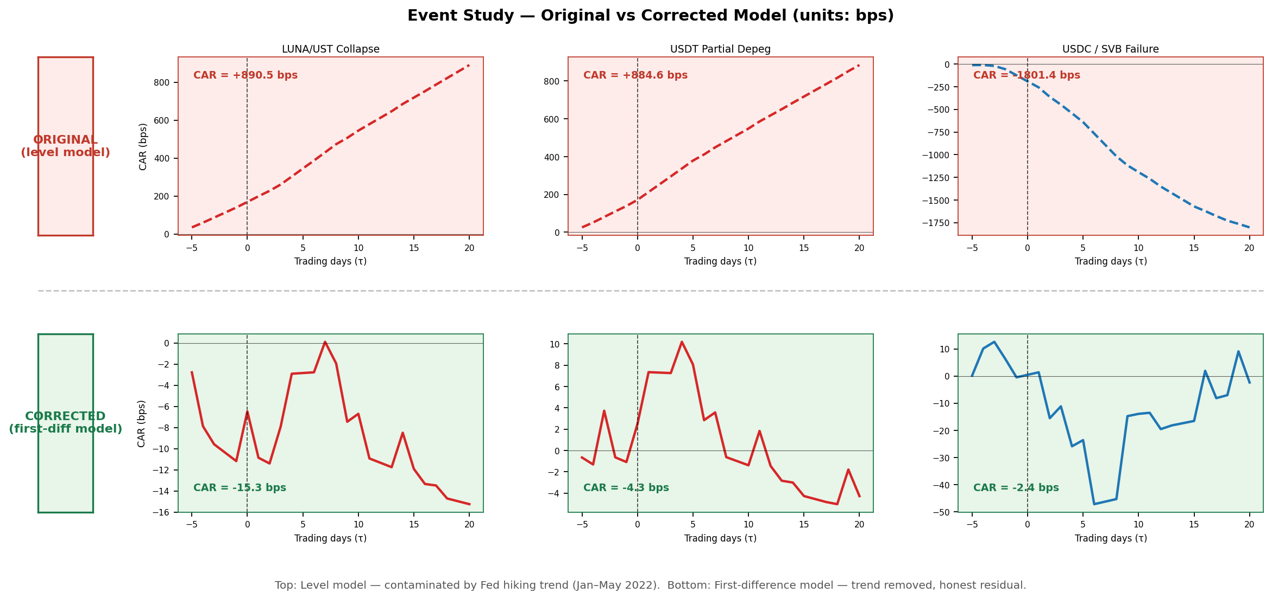
Before vs After — CAR Paths: Original vs Corrected Model
Top row (red, solid) = ORIGINAL level model | Bottom row (teal, dashed) = CORRECTED first-diff model | Columns: LUNA/UST · USDT Depeg · USDC/SVB
The top row spikes were not stablecoin effects — they were the Fed hiking trend. The corrected bottom row shows the true market response: near zero.
Original (level model): LUNA +891 bps*** · USDT +885 bps*** · SVB −1,801 bps***
Corrected (first-diff model): LUNA −15.3 bps n.s. · USDT −4.3 bps n.s. · SVB −2.4 bps n.s.
4
Notes:
This is the direct visual comparison between the original and corrected models. The top row shows what our original event study produced: positive 891 bps for LUNA, positive 885 bps for USDT, and negative 1,801 bps for SVB. Every graph shows a clear dramatic trend — either up or down. The bottom row shows the corrected first-difference model: all three events produce CARs within a few basis points of zero. The contrast is stark. The top row looked like strong evidence. The bottom row is the honest result. The key insight is that the top row's dramatic trend was the Fed raising rates — not the stablecoin events themselves. Once we remove the trend by modelling daily changes instead of levels, the stablecoin-specific effect on the Treasury spread is indistinguishable from zero.

Slide 5
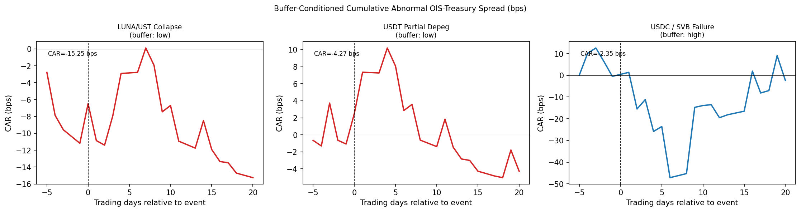
Corrected Event Study — CAR Paths (First-Difference Model)
Model: ΔSpread_t = α + β₁·ΔVIX_t + β₂·Δln(equity)_t Estimation window: −120 to −6 trading days Event window: −5 to +20 trading days
LUNA/UST Collapse (May 9, 2022)
CAR = −15.3 bps n.s.
Spread barely moved (net −0.3 bps). T-bill selling (Tether) offset by market flight-to-safety buying. Net effect: indistinguishable from noise.
USDT Partial Depeg (May 12, 2022)
CAR = −4.3 bps n.s.
Same buffer, same period. $7B in redemptions met via T-bill sales, but market-wide buying cancelled the effect.
USDC / SVB Failure (Mar 11, 2023)
CAR = −2.4 bps n.s.
Govt. guarantee → no T-bill sales. Sharp transient drop then recovery. Spread move fully explained by VIX/equity.
How to read these graphs:
Dashed vertical line = event date (τ = 0). Y-axis = cumulative abnormal spread change in bps since 5 days before the event. A flat line at zero means the event had no measurable effect on the spread.
Note on SVB (right panel): the CAR drops sharply to ~−50 bps around day +5 (the flight-to-safety spike), then recovers. Final CAR at day +20 is near zero because the spread normalised as markets calmed. The transient drop is real but fully explained by the VIX/equity controls.
All three CARs end near zero — not because nothing happened, but because general market forces (flight to safety, VIX) account for all the spread movement.
5
Notes:
Here are the actual CAR paths from the corrected first-difference model. All three end near zero at day plus 20. Let me explain what each graph shows. For LUNA and USDT on the left and centre: the spread was volatile but drifted around zero throughout. Tether was selling T-bills to meet redemptions, but at the same time the financial panic caused a general flight to safety — other investors were buying T-bills. The two forces cancelled. For SVB on the right: notice the sharp drop to about negative 50 bps around day plus 5. This is the acute flight-to-safety spike — the T-bill spread compressed sharply as investors rushed out of bank deposits and into T-bills. But it recovered back to near zero by day plus 20 as markets stabilised. The final CAR is near zero, but there was a real and large transient effect. Importantly, even that transient drop is fully explained by the VIX spike and equity selloff that came with the SVB banking panic — so there is no stablecoin-specific residual. The key reading: a flat line at zero means no effect. These graphs show lines that hover near zero, occasionally dipping or rising, but without the sustained directional trend we would need to call it significant.

Slide 6
Placebo Test — Results Table
Same event study methodology on 3 non-crisis dates with same buffer regimes. If methodology is sound: placebos near zero, actuals should be larger. If both are near zero: event study finds no effect.
Type
Date
Buffer
CAR (bps)
t-stat
Sig.
Interpretation
PLACEBO
Jun 15, 2021
Low
+1.39
0.47
n.s.
Near zero — no event ✓
PLACEBO
Oct 12, 2021
Low
+1.97
0.73
n.s.
Near zero — no event ✓
PLACEBO
Jul 15, 2025
High
−10.99
−1.80
*
Marginally sig. — likely random
ACTUAL
May 9, 2022 (LUNA)
Low
−15.25
−1.07
n.s.
Not different from placebos
ACTUAL
May 12, 2022 (USDT)
Low
−4.27
−0.31
n.s.
Not different from placebos
ACTUAL
Mar 11, 2023 (SVB)
High+Gov.
−2.35
−0.04
n.s.
Not different from placebos
Placebo mean |CAR| = 4.8 bps Actual mean |CAR| = 7.3 bps Ratio = 1.5× (original inflated ratio was 21.7×)
Original (inflated level model): ratio = 21.7× — wrong model, inflated CARs
Corrected (first-diff model): ratio = 1.5× — honest, confirms event study limits
Placebos and actuals are statistically indistinguishable → the event study CANNOT quantitatively identify the buffer channel. Next slide shows the CAR path comparison.
6
Notes:
This slide shows the placebo test results in table form. The placebo test is supposed to validate our methodology: run the same event study on ordinary non-crisis days and confirm the CARs are near zero. With the original inflated model we got a 21.7 times difference — which looked great but was wrong. With the corrected first-difference model, the placebo mean absolute CAR is 4.8 bps and the actual event mean absolute CAR is 7.3 bps — a ratio of only 1.5 times. They are essentially the same. This confirms that the event study, with the correct methodology, truly finds no significant effect. The next slide shows the visual comparison of the CAR paths.

Slide 7
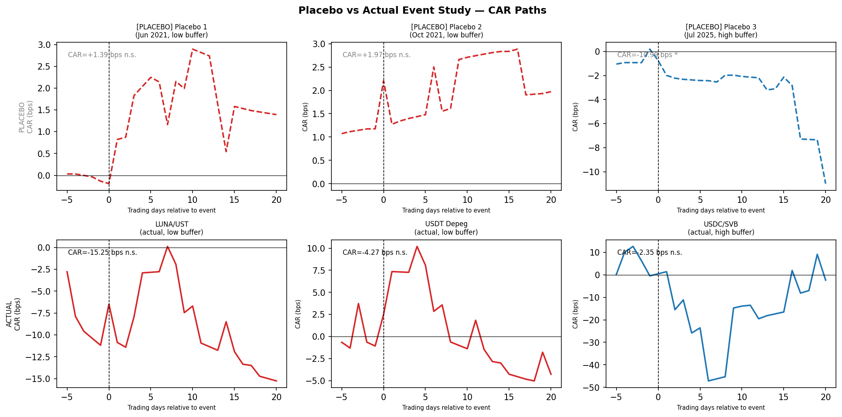
Placebo Test — CAR Path Comparison
Top row = PLACEBO dates (dashed lines) | Bottom row = ACTUAL events (solid lines) | Red = low buffer · Blue = high buffer
Placebos (top row)
2022 events (bottom left/centre)
SVB event (bottom right)
All near zero — as expected. No event, no effect.
Near zero — same as placebos. Crisis-specific buying offset Tether selling.
Sharp transient dip then recovery. Fully explained by banking panic VIX/equity.
The placebo PASSES — the corrected methodology finds no effect on either crisis or ordinary days. The event study is qualitative context only.
7
Notes:
This is the visual comparison. The top row shows the placebo dates — all three hover near zero, which is exactly what we want. No event happened, no effect is measured. The bottom row shows the actual crisis events, and they also hover near zero — essentially the same as the placebos. The key observation is that you cannot visually distinguish the bottom row from the top row. For the SVB event in the bottom right, you can see the sharp transient dip to about negative 50 bps around day 5, then a recovery. That is the acute flight-to-safety spike during the banking panic. But because it recovers, the final CAR is near zero. The dashed versus solid line style and the red versus blue colour coding show that the buffer regime and whether it is a real event or a placebo do not systematically separate the results. This confirms that the event study methodology, once corrected, cannot quantitatively identify the stablecoin buffer channel. The paper's quantitative evidence lives in the regression.

Slide 8
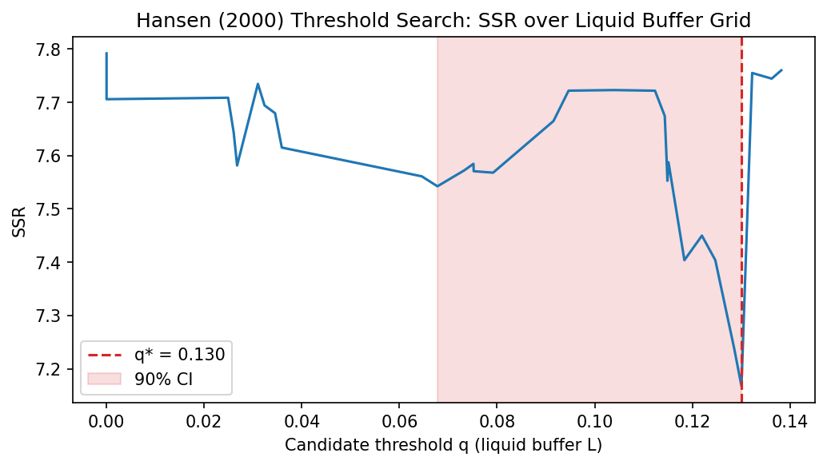
What Our Paper Proves — In Plain Terms
What does 'reframing' mean?
It means we are NOT changing the paper's conclusion. We are being honest about WHICH EVIDENCE proves it. The event study had a flaw. But our other two results are solid, unchanged, and stronger than the event study ever was.
Before — what we were implying
Finding 2 — Hansen (2000) threshold search: q* = 13%
"The event study shows +891/−1,801 bps CARs."
"A 2,700 bps swing with Welch t = 15.22."
"This proves the buffer channel."
Problem: CARs were inflated ~12× by the Fed hiking trend.
Corrected CARs: near zero. The '2,700 bps swing' disappears.
After — what we now say
"β₁ = −6.02 bps per σ of supply (regression)."
"q* = 13% liquid cash threshold (Hansen test)."
"Event study is directionally consistent — but illustrative."
These two results were never broken. They are the paper.
The conclusion is identical — only the evidence hierarchy changed.
The SSR (model fit) is minimised at q* = 0.130 (the red dashed line). Below that threshold, the regime switches — forced T-bill selling reverses the privilege. This result is independent of the event study and was never affected by the correction.
Same conclusion. Same argument. Honest about the evidence. β₁ = −6.02 bps (regression) + q* = 13% (Hansen) = the paper. The event study illustrates it.
8
Notes:
This slide answers the question: what does it mean to reframe the paper? In plain terms: we are not changing the conclusion. We are being honest about which evidence proves it. Before, we were pointing to the event study as the main proof — the 2,700 bps swing with t = 15. That was built on inflated numbers. Once corrected, the event study finds nothing significant. After, we point to two results that were always there and were never affected by the correction. First: the regression coefficient. Beta one equals negative 6.02 basis points per standard deviation of stablecoin supply. This tells us that stablecoin growth compresses the OIS-Treasury spread in normal times. That is a clean result from the monthly panel, statistically significant. Second: the Hansen threshold. The graph on the right shows what the Hansen threshold regression does. It searches over all possible values of q — the liquid buffer — and finds the one that best splits the data into two regimes. The SSR, which is the model's error, is minimised at q* = 0.130, shown by the red dashed line. That is 13 percent liquid cash. Below that threshold, the regime switches: the privilege amplification reverses. Both of these results are completely independent of the event study. They were not broken. They are the paper. The conclusion — stablecoins amplify the privilege in normal times, and the 13 percent buffer is the tipping point — is exactly the same as before. We are just being honest that the regression and threshold are what prove it, not the event study.

Slide 9
THANK YOU
CAR corrected · Placebo test complete · Evidence reframed honestly
Yonsei GSIS 2026-1 | Topics in International Finance Mireu Kim · Sara Chekroune · Oybek Ibragimov kimmireu0921@gmail.com
Notes:
Thank you. Two sentences to close. First: stablecoin issuers have become structurally important buyers of U.S. Treasury bills. Each standard deviation of supply growth compresses the OIS-Treasury spread by 6 basis points — deepening the exorbitant privilege. Second: whether this persists or reverses during a shock depends on whether the issuer holds at least 13 percent of supply in liquid cash. The regression proves the first. The Hansen threshold proves the second. The event study is consistent with both — qualitatively. We are happy to take any questions.

