Slide 1
PHP: An Introduction

Slide 2
objectives
Understand how to install and configure XAMPP
Understand the use of variables, and data types.
Understand best practices in building mathematical expressions in PHP programs
Understand/Demonstrate conditional and looping statements

Slide 3
PHP
It is an open-source, cross-platform, interpreted, and server-side scripting language that is used to create web applications/sites
Written by Rasmus Lerdorf and originally known as Personal Homepage/Forms Interpreter
Now stands for the recursive acronym “PHP: Hypertext Preprocessor “
Notes:
Server side scripting language where involves employing scripts/code snips on a web server and produce a customized response to the user.
Client side scripting where in the user's web browser executes the script
It does not need commercial license and cross-platform

Slide 4
Client Side vs Server Side Scripting
Client-Side | Server-Side
1. Executed on the client side. | 1. Runs on a web server.
2. User has access to all the code received by the client. | 2. Source code is hidden.
3. Do not require additional software on the server | 3. Require that their language's interpreter be installed on the server
Notes:
Environment under which each type is used
Client Side - The source code is transferred from the web server to the users computer over the internet and run directly in the browser.
Server side – executed on a web server

Slide 5
What do I need to run my PHP script?
Linux or Windows or any OS - Linux provides the base operating system (OS) and server environment
Apache or IIS (HTTP Server) The Apache web server intercepts HTTP request and either serves them directly or passes them on to the PHP interpreter for execution
MySQL The MySQL RDBMS serves as the data storage engine, accepting connections from the PHP layer and inserting, modifying, or retrieving data
PHP Package (Authoring tool) The PHP interpreter parses and executes PHP code, and returns the results to the web server

Slide 6
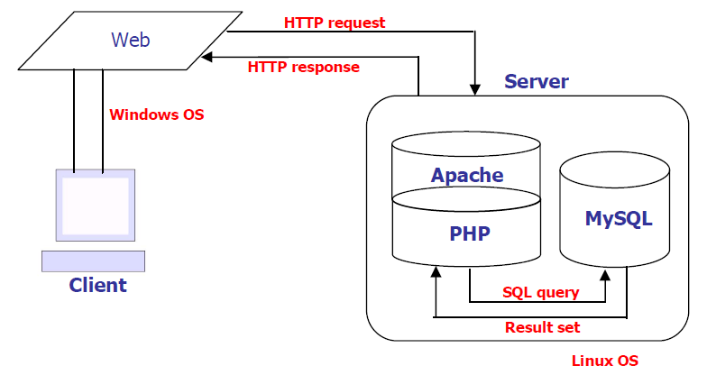
PHP Architecture

Slide 7
PHP Script
<!DOCTYPE html> <html>
<head>
</head> <body> <?php echo "Hello World!"; ?> </body> </html>

Slide 8
Insert PHP in HTML tags
Four Rules in Coding
Every block of PHP starts with <?php and ends with ?>
PHP statements end with a semicolon (;)
Text that is not a command must be put in quotes
Any time you have a curly bracket or parenthesis, you should have a matching end bracket or parenthesis.

Slide 9
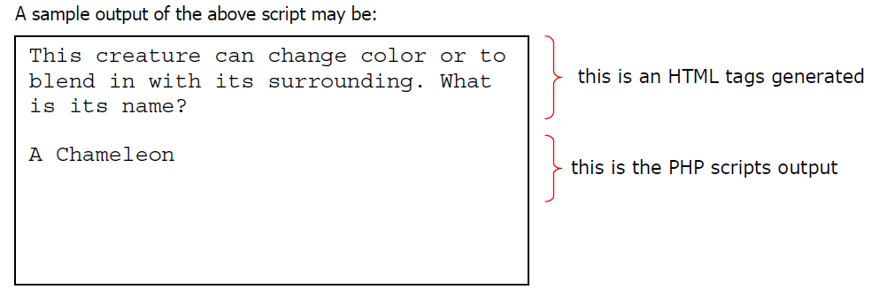
Embedding PHP within HTML
<!DOCTYPE html>
<html>
<head><title>My First PHP Code</title>
</head>
<body>
<h2>This creature can change color or to blend in with its surrounding. What is its name?</h2>
<?php
//display output
echo “<h2>A Chameleon</h2>”;
?>
</body>
</html>
You can insert the PHP scripts in any portions of the HTML tags. Also you can embed HTML
tags in PHP statements however it will be treated as text.

Slide 10
Comments
<!DOCTYPE html> <html> <body> <?php // This is a single-line comment # This is also a single-line comment /* This is a multiple-lines comment block that spans over multiple lines */
</body
</html>

Slide 11
PHP: VaRIaBLE, data types, operators, conditions and iteration

Slide 12
Variable
In PHP, a variable starts with the $ sign and followed by the name of the variable;
It can have a short name or a more descriptive
Rules for PHP variables:
A variable name must start with a letter or the underscore character
A variable name cannot start with a number
A variable name can only contain alpha-numeric characters and underscores (A-z, 0-9, and _ )
Variable names are case-sensitive ($age and $AGE are two different variables)
<?php
$string = "Hello world!"; $x = 5; $y = 10.5;
echo " <h2>$string</h2> "; //Outputs: Hello World!
echo " x + y = ".$x+$y; //Outputs: x+y=15.5
?>

Slide 13
Single vs Double Quotes
' ' (Single Quotes)
Content inside single quotes is evaluated literally.
Example
$string = 'Single Quotes';
echo '$string';
" " (double quotes) – Variables inside double quotes are evaluated for their values.
Example
$string= " Single Quotes ";
echo " $string ";

Slide 14
Data Types
It is a loosely type language.
PHP supports 7 data types:
String
Integer
Float (floating point numbers - also called double)
Boolean
Array []
Object
NULL

Slide 15
PHP Operators
Operators are used to perform operations on variables and values.
PHP divides the operators in the following groups:
Arithmetic
Relational
Logical
String
Unary

Slide 16
Arithmetic Operators
Operator | Name | Example $x=5; $y=3 | Result
+ | Addition | $x + $y | 8
- | Subtraction | $x - $y | 2
* | Multiplication | $x * $y | 15
/ | Division | $x / $y (int) ($x/$y) | 1.67 1
% | Modulo | $x % $y | 2
** | Exponentiation | $x **$y | 125

Slide 17
Relational Operators
Operator | Name | Example $x=5; $y=3 | Result
== | Equality | $x ==$y | false
!=, <> | Inequality | $x !=$y | true
> | Greater Than | $x > $y | true
< | Less Than | $x < $y | false
>= | Greater than or Equal | $x >= $y | true
<= | Less than or equal | $x <=$y | false

Slide 18
Logical Operators
Operator | Name | Example | Result
&&/and | And | $x &&$y | True if both $x and $y are true
||/or | Or | $x ||$y | True if $x or $y are true
! | Not | !$x | True if $x is not true

Slide 19
Assignment Operators
Assignment | Sames as … | Description
$x = $y | x = y | The left operand gets set to the value of the expression on the right
$x += $y | x = x + y | Addition
$x -= $y | x = x - y | Subtraction
$x *= $y | x = x * y | Multiplication
$x /= $y | x = x / y | Division
$x %= $y | x = x % y | Modulus

Slide 20
String Operators
Unary Operators
Operator | Name | Example | Result
. | Concatenation | $x . $y | Concatenation of $x and $y
.= | Concatenation assignment | $x.= $y | Appends $str2 to $str1
Operator | Name | Example | Result
++ | Increment | $x++; ++$x
-- | Decrement | $x--; --$x

Slide 21
Control Structures

Slide 22
Conditional Statements
In PHP we have the following conditional statements:
if statement - executes some code only if a specified condition is true
if...else statement - executes some code if a condition is true and another code if the condition is false
if...elseif....else statement - specifies a new condition to test, if the first condition is false
switch statement - selects one of many blocks of code to be executed

Slide 23
if statement
Syntax
if (expression) {
// code to execute if the expression evaluates to true
}
<?php
$d1 = new DateTime("2013-12-09");
$d2 = new DateTime("2014-03-17");
$difference=$d1->diff($d2)->days;
if ($difference<100){
echo 100-$difference." left before 100 days";}
?>

Slide 24
if..else statement
Syntax
if (expression) {
// code to execute if the expression evaluates to true
} else {
// code to execute in all other cases
}
<?php
$mood = "sad";
if ($mood == "happy") {
echo " Yehey, Masaya ako nasa mood ako";
}
else {
echo "Di Masaya kaya malungkot";
}
?>

Slide 25
if..elseif statement
Syntax
if (expression) {
// code to execute if the expression evaluates to true
} else if (another expression) {
// code to execute if the previous expression failed
// and this one evaluates to true
} else {
// code to execute in all other cases
}
<?php
$mood = "sad";
if ($mood == "happy") {
echo "Yehey, Masaya ako nasa mood ako";
} elseif ($mood == "sad") {
echo "Di Masaya kaya malungkot”;
} else {
echo "Masaya b o malungkot?";
}
?>

Slide 26
switch statement
Syntax
switch (expression) {
case result1:
// execute this if expression results in result1
break;
case result2:
// execute this if expression results in result2
break;
default:
// execute this if no break statement
// has been encountered hitherto
}
<?php
$mood = "sad";
switch ($mood) {
case "happy":
echo "Yehey, Masaya ako nansa mood ako";
break;
case "sad":
echo " Di Masaya kaya malungkot”;
break;
default:
echo "Masaya b o malungkot?";
break;
}
?>

Slide 27
Looping Statement

Slide 28
while statement
Syntax
while (expression) {
// do something
}
<?php
$counter = 1;
$total=0;
while ($counter <= 12) {
echo "$counter times 2 is ".($counter * 2)."<br/>";
$total+=$counter*2;
$counter++;
}
echo “The total of the numbers is ”. $total;
?>

Slide 29
while statement
Syntax
while (expression) {
// do something
}
<?php
$counter = 1;
$total=0;
while ($counter <= 12) {
echo "$counter times 2 is ".($counter * 2)."<br/>";
$total+=$counter*2;
$counter++;
}
echo “The total of the numbers is ”. $total;
?>

Slide 30
do..while statement
Syntax
do {
// do something
}while (expression);
<?php
$num = 1;
do {
echo "The number is: $num<br>";
$num++;
} while (($num > 200) && ($num < 400));?>

Slide 31
for..loop statement
Syntax
for (initialization expression; test expression; modification
expression) {
// code to be executed
}
<?php
for ($counter=1; $counter<=12; $counter++) {
echo "$counter times 2 is ".($counter * 2)."<br/>";
}
?>

Slide 32
references
Gosselin, D. (2011). Php with MySQL.
Pomperada, J. R. (2015). Php with MySQL : A Web programming language. php.net
tutorialrepublic.com/php-tutorial
tutorialspoint.com/php/index.html
w3schools.com/php

Slide 33
Form Handling

Slide 34
$_GET Predefined Variable
The $_GET variable is an array of variable names and values sent by the HTTP GET method.
The $_GET variable is used to collect values from a form with method="get".
Information sent from a form with the GET method is visible to everyone (it will be displayed in the browser's address bar) and it has limits on the amount of information to send (max. 100 characters).
http://localhost/form.php?name=Peter&age=37

Slide 35
$_POST Predefined Variable
The $_POST variable is an array of variable names and values sent by the HTTP POST method.
The $_POST variable is used to collect values from a form with method="post".
Information sent from a form with the POST method is invisible to others and has no limits on the amount of information to send.

Slide 36
$_REQUEST Predefined Variable
The PHP $_REQUEST variable contains the contents of both GET, POST methods.

Slide 37
Dealing with Multivalue Field
Example
<input type= "checkbox" name=“number[]" value= "1" />1
<input type= "checkbox" name=“number[]" value= "2" />2
<input type= "checkbox" name=“number[]" value= "3" />3

Slide 38
Storing PHP Variables in Forms
A hidden field is a special type of input element that can store and send a string value, however, it is not displayed, its value cannot be change by the user;
Example
$name="John Smith";
<input type="hidden" name="name"
value="<?php echo $name?> " >

Slide 39
Redirecting after a Form Submission
Example
header( “Location: thanks.html”);
header('Refresh: 10; URL=home.php');

