Slide 1

Exception Handling
PHP ADVANCED
LEO GABRIEL V. VILLANUEVA, MIT
Leo Gabriel Villanueva

Slide 2
PHP Date and Time
PHP date() function formats a timestamp to a more readable date and time
Syntax
date(format,timestamp)
Parameter Description
format Required. Specifies the format of the timestamp
timestamp Optional. Specifies a timestamp. Default is the current date and time
A timestamp is a sequence of characters, denoting the date and/or time at which a certain event occurred.

Slide 3
PHP Date and Time
Formatting
Specifies the format for the date. The following characters can be used:
d - The day of the month (from 01 to 31)
D - A textual representation of a day (three letters)
j - The day of the month without leading zeros (1 to 31)
l (lowercase 'L') - A full textual representation of a day
N - The ISO-8601 numeric representation of a day (1 for Monday, 7 for Sunday)
S - The English ordinal suffix for the day of the month (2 characters st, nd, rd or th. Works well with j)

Slide 4
PHP Date and Time
Formatting
Specifies the format for the date. The following characters can be used:
w - A numeric representation of the day (0 for Sunday, 6 for Saturday)
z - The day of the year (from 0 through 365)
W - The ISO-8601 week number of year (weeks starting on Monday)
F - A full textual representation of a month (January through December)
m - A numeric representation of a month (from 01 to 12)
M - A short textual representation of a month (three letters)
n - A numeric representation of a month, without leading zeros (1 to 12)
t - The number of days in the given month
L - Whether it's a leap year (1 if it is a leap year, 0 otherwise)

Slide 5
PHP Date and Time
Formatting
Specifies the format for the date. The following characters can be used:
o - The ISO-8601 year number
Y - A four digit representation of a year
y - A two digit representation of a year
a - Lowercase am or pm
A - Uppercase AM or PM
B - Swatch Internet time (000 to 999)
g - 12-hour format of an hour (1 to 12)
G - 24-hour format of an hour (0 to 23)
h - 12-hour format of an hour (01 to 12)

Slide 6
PHP Date and Time
Formatting
Specifies the format for the date. The following characters can be used:
H - 24-hour format of an hour (00 to 23)
i - Minutes with leading zeros (00 to 59)
s - Seconds, with leading zeros (00 to 59)
u - Microseconds (added in PHP 5.2.2)
e - The timezone identifier (Examples: UTC, GMT, Atlantic/Azores)
I (capital i) - Whether the date is in daylights savings time (1 if Daylight Savings Time, 0 otherwise)
O - Difference to Greenwich time (GMT) in hours (Example: +0100)
o - The ISO-8601 year number

Slide 7
PHP Date and Time
Formatting
Specifies the format for the date. The following characters can be used:
P - Difference to Greenwich time (GMT) in hours:minutes (added in PHP 5.1.3)
T - Timezone abbreviations (Examples: EST, MDT)
Z - Timezone offset in seconds. The offset for timezones west of UTC is negative (-43200 to 50400)
c - The ISO-8601 date (e.g. 2013-05-05T16:34:42+00:00)
r - The RFC 2822 formatted date (e.g. Fri, 12 Apr 2013 12:01:05 +0200)
U - The seconds since the Unix Epoch (January 1 1970 00:00:00 GMT)

Slide 8
PHP Date and Time
Get a Date
The required format parameter of the date() function specifies how to format the date (or time).
Here are some characters that are commonly used for dates:
d - Represents the day of the month (01 to 31)
m - Represents a month (01 to 12)
Y - Represents a year (in four digits)
l (lowercase 'L') - Represents the day of the week
Other characters, like"/", ".", or "-" can also be inserted between the characters to add additional formatting.

Slide 9
PHP Date and Time
Example
$today = date("F j, Y, g:i a"); // March 10, 2001, 5:16 pm $today = date("m.d.y"); // 03.10.01 $today = date("j, n, Y"); // 10, 3, 2001 $today = date("Ymd"); // 20010310 $today = date('h-i-s, j-m-y, it is w Day'); // 05-16-18, 10-03-01, 1631 1618 6 Satpm01 $today = date('\i\t \i\s \t\h\e jS \d\a\y.'); // it is the 10th day. $today = date("D M j G:i:s T Y"); // Sat Mar 10 17:16:18 MST 2001 $today = date('H:m:s \m \i\s\ \m\o\n\t\h'); // 17:03:18 m is month $today = date("H:i:s"); // 17:16:18 $today = date("Y-m-d H:i:s"); // 2001-03-10 17:16:18 (the MySQL DATETIME format)

Slide 10
PHP Include Files
include (or require) statement takes all the text/code/markup that exists in the specified file and copies it into the file that uses the include statement.
The include and require statements are identical, except upon failure:
require will produce a fatal error (E_COMPILE_ERROR) and stop the script
include will only produce a warning (E_WARNING) and the script will continue
include 'filename'; or require 'filename';

Slide 11
PHP Include Files
include (or require) statement takes all the text/code/markup that exists in the specified file and copies it into the file that uses the include statement.
The include and require statements are identical, except upon failure:
require will produce a fatal error (E_COMPILE_ERROR) and stop the script
include will only produce a warning (E_WARNING) and the script will continue
include 'filename'; or require 'filename';

Slide 12
PHP readfile() Function
readfile() function reads a file and writes it to the output buffer.
readfile(“filename.txt”);
<?php echo readfile("webdictionary.txt"); ?>

Slide 13
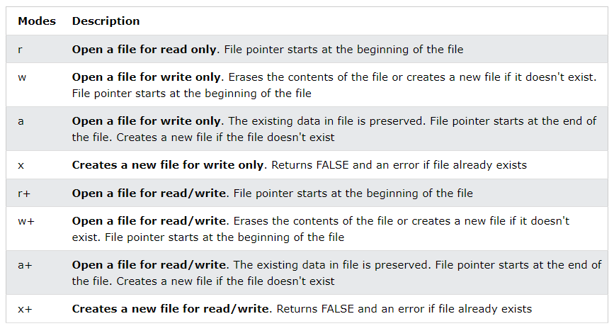
PHP readfile() Function

Slide 14
PHP Open/ Read File
A better method to open files is with the fopen() function. This function gives you more options than the readfile() function.
<?php $myfile = fopen("webdictionary.txt", "r") or die("Unable to open file!"); echo fread($myfile,filesize("webdictionary.txt")); fclose($myfile); ?>
fread() function reads from an open file.
fread($myfile,filesize("webdictionary.txt"));
fclose() function is used to close an open file.
fre<?php $myfile = fopen("webdictionary.txt", "r"); fclose($myfile); ?>

Slide 15
PHP Open/Read File
fgets() function reads from an open file.
<?php $myfile = fopen("webdictionary.txt", "r") or die("Unable to open file!"); echo fgets($myfile); fclose($myfile); ?>
feof() unction checks if the "end-of-file" (EOF) has been reached. Useful for looping through data unknown length
$myfile = fopen("webdictionary.txt", "r") or die("Unable to open file!"); // Output one line until end-of-file while(!feof($myfile)) { echo fgets($myfile) . "<br>"; } fclose($myfile);

Slide 16
PHP Create File - fopen()
fopen() function is also used to create a file.
If you use fopen() on a file that does not exist, it will create it, given that the file is opened for writing (w) or appending (a).
$myfile = fopen("testfile.txt", "w")
fwrite() function is used to write to a file.
first parameter of fwrite() contains the name of the file to write to and the second parameter is the string to be written.

Slide 17
PHP Create File - fopen() alter
<?php $myfile = fopen("newfile.txt", "w") or die("Unable to open file!"); $txt = "John Doe\n"; fwrite($myfile, $txt); $txt = "Jane Doe\n"; fwrite($myfile, $txt); fclose($myfile); ?>

Slide 18
PHP Overwriting
<?php $myfile = fopen("newfile.txt", "w") or die("Unable to open file!"); $txt = "Mickey Mouse\n"; fwrite($myfile, $txt); $txt = "Minnie Mouse\n"; fwrite($myfile, $txt); fclose($myfile); ?>

Slide 19
PHP File Upload
Configure The "php.ini" File
First, ensure that PHP is configured to allow file uploads.
In your "php.ini" file, search for the file_uploads directive, and set it to On:
file_uploads = On

Slide 20
PHP File Upload
<!DOCTYPE html> <html> <body> <form action="upload.php" method="post" enctype="multipart/form-data"> Select image to upload: <input type="file" name="fileToUpload" id="fileToUpload"> <input type="submit" value="Upload Image" name="submit"> </form> </body> </html>

Slide 21
PHP File Upload
Some rules to follow for the HTML form above:
Make sure that the form uses method="post"
The form also needs the following attribute: enctype="multipart/form-data". It specifies which content-type to use when submitting the form
Without the requirements above, the file upload will not work.
Other things to notice:
The type="file" attribute of the <input> tag shows the input field as a file-select control, with a "Browse" button next to the input control
The form above sends data to a file called "upload.php", which we will create next.

Slide 22
PHP File Upload
<?php $target_dir = "uploads/"; $target_file = $target_dir . basename($_FILES["fileToUpload"]["name"]); $uploadOk = 1; $imageFileType = strtolower(pathinfo($target_file,PATHINFO_EXTENSION)); // Check if image file is a actual image or fake image if(isset($_POST["submit"])) { $check = getimagesize($_FILES["fileToUpload"]["tmp_name"]); if($check !== false) { echo "File is an image - " . $check["mime"] . "."; $uploadOk = 1; } else { echo "File is not an image."; $uploadOk = 0; } } ?>

Slide 23
PHP File Upload
PHP script explained:
$target_dir = "uploads/" - specifies the directory where the file is going to be placed
$target_file specifies the path of the file to be uploaded
$uploadOk=1 flagger
$imageFileType holds the file extension of the file (in lower case)
Next, check if the image file is an actual image or a fake image

Slide 24
PHP File Upload
check if the file already exists in the "uploads" folder. If it does, an error message is displayed, and $uploadOk is set to 0:
// Check if file already exists if (file_exists($target_file)) { echo "Sorry, file already exists."; $uploadOk = 0; }

Slide 25
PHP File Upload
Limit File Size
The file input field in our HTML form above is named "fileToUpload".
Now, we want to check the size of the file. If the file is larger than 500KB, an error message is displayed, and $uploadOk is set to 0:
// Check file size if ($_FILES["fileToUpload"]["size"] > 500000) { echo "Sorry, your file is too large."; $uploadOk = 0; }

Slide 26
PHP File Upload
Limit File Type
The code below only allows users to upload JPG, JPEG, PNG, and GIF files. All other file types gives an error message before setting $uploadOk to 0:
// Allow certain file formats if($imageFileType != "jpg" && $imageFileType != "png" && $imageFileType != "jpeg" && $imageFileType != "gif" ) { echo "Sorry, only JPG, JPEG, PNG & GIF files are allowed."; $uploadOk = 0; }

Slide 27
PHP File Upload
Complete code

Slide 28
THANK YOU

