Slide 1

Exception Handling
AJAX
Leo Gabriel Villanueva

Slide 2
WHAT IS AJAX
AJAX = Asynchronous JavaScript And XML.
AJAX is not a programming language.
AJAX applications might use XML to transport data, but it is equally common to transport data as plain text or JSON text.
AJAX just uses a combination of:
A browser built-in XMLHttpRequest object (to request data from a web server)
JavaScript and HTML DOM (to display or use the data)

Slide 3
WHAT IS AJAX
AJAX allows web pages to be updated asynchronously by exchanging data with a web server behind the scenes. AJAX is not a programming language.

Slide 4
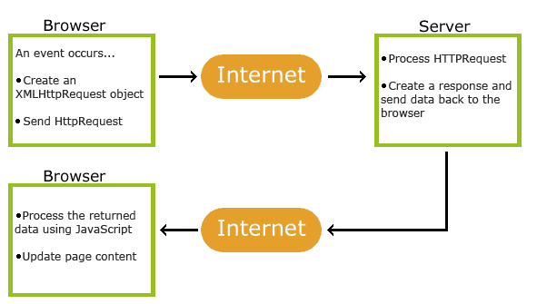
HOW AJAX WORKS

Slide 5
HOW AJAX WORKS
1. An event occurs in a web page (the page is loaded, a button is clicked)
2. An XMLHttpRequest object is created by JavaScript
3. The XMLHttpRequest object sends a request to a web server
4. The server processes the request
5. The server sends a response back to the web page
6. The response is read by JavaScript
7. Proper action (like page update) is performed by JavaScript

Slide 6
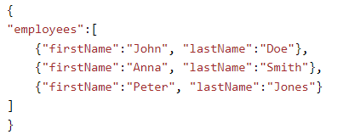
WHAT IS JSON
JSON stands for JavaScript Object Notation
JSON is a lightweight format for storing and transporting data
JSON is often used when data is sent from a server to a web page
JSON is "self-describing" and easy to understand

Slide 7
JSON SYNTAX RULES
Data is in name/value pairs
Data is separated by commas
Curly braces hold objects
Square brackets hold arrays

Slide 8
JSON DATA
written as name/value pairs, just like JavaScript object properties.
A name/value pair consists of a field name (in double quotes), followed by a colon, followed by a value: Curly braces hold objects
JSON names require double quotes. JavaScript names do not.

Slide 9
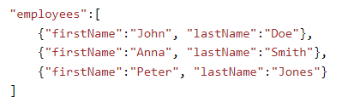
JSON OBJECTS
JSON objects are written inside curly braces.
JSON arrays are written inside square brackets.

Slide 10
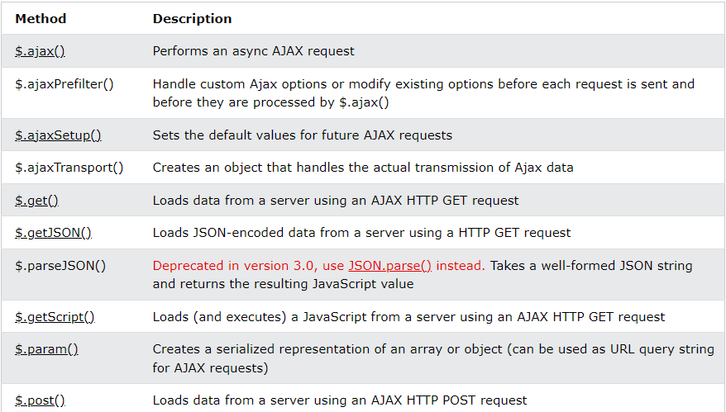
JQUERY – AJAX METHODS

Slide 11
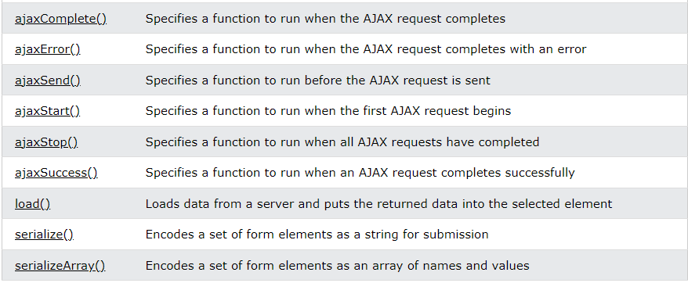
JQUERY – AJAX METHODS

Slide 12
JQUERY – AJAX LOAD() METHOD
The load() method loads data from a server and puts the returned data into the selected element.
Syntax:
$(selector).load(URL,data,callback);
URL = parameter specifies the URL you wish to load.
data = optional parameter specifies a set of query string key/value pairs to send along with the request.
callback = parameter is the name of a function to be executed after the load() method is completed.

Slide 13
JQUERY – AJAX LOAD() METHOD
function emailFormat(){
let email = $('#email').val();
let re = /^\w+([-+.'][^\s]\w+)*@\w+([-.]\w+)*\.\w+([-.]\w+)*$/;
var emailFormat = re.test(email); // This return result in Boolean type
if (!emailFormat) {
$('#email').css("border", "1px solid red");
$('#erroremail').html("Email is invalid");
}else{
$('#email').css("border", "1px solid black");
$('#erroremail').html("");
}
}

Slide 14
JQUERY – AJAX LOAD() METHOD
Here is the content of our example file: "demo_test.txt":
<h2>jQuery and AJAX is FUN!!!</h2> <p id="p1">This is some text in a paragraph.</p>
$("#div1").load("demo_test.txt");
$("#div1").load("demo_test.txt #p1");

Slide 15
JQUERY – AJAX LOAD() METHOD
callback parameter specifies a callback function to run when the load() method is completed. The callback function can have different parameters:
responseTxt - contains the resulting content if the call succeeds
statusTxt - contains the status of the call
xhr - contains the XMLHttpRequest object

Slide 16
JQUERY – AJAX LOAD() METHOD
Example:
$("button").click(function(){ $("#div1").load("demo_test.txt", function(responseTxt, statusTxt, xhr){ if(statusTxt == "success") alert("External content loaded successfully!"); if(statusTxt == "error") alert("Error: " + xhr.status + ": " + xhr.statusText); }); });

Slide 17
JQUERY – AJAX GET() AND POST() METHOD
HTTP Request: GET vs. POST
GET - Requests data from a specified resource
POST - Submits data to be processed to a specified resource
GET is basically used for just getting (retrieving) some data from the server. Note: The GET method may return cached data.
POST can also be used to get some data from the server. However, the POST method NEVER caches data, and is often used to send data along with the request.

Slide 18
JQUERY – AJAX $.GET() METHOD
$.get() method requests data from the server with an HTTP GET request.
Syntax: $.get(URL,callback);
URL : required parameter specifies the URL you wish to request.
Callback : optional parameter is the name of a function to be executed if the request succeeds.

Slide 19
JQUERY – AJAX $.GET() METHOD
Example:
$("button").click(function(){ $.get("demo_test.php", function(data, status){ alert("Data: " + data + "\nStatus: " + status); }); });
The first parameter of $.get() is the URL we wish to request ("demo_test.asp").
The second parameter is a callback function. The first callback parameter holds the content of the page requested, and the second callback parameter holds the status of the request.

Slide 20
JQUERY – AJAX $.POST() METHOD
$.post() method requests data from the server using an HTTP POST request
Syntax:
$.post(URL,data,callback);
URL : parameter specifies the URL you wish to request.
Data : optional parameter specifies some data to send along with the request.
Callback : optional parameter is the name of a function to be executed if the request succeeds.

Slide 21
JQUERY – AJAX $.POST() METHOD
Example:
$("button").click(function(){ $.post("demo_test_post.php", { name: "Donald Duck", city: "Duckburg" }, function(data, status){ alert("Data: " + data + "\nStatus: " + status); }); });

Slide 22
THANK YOU

