Slide 1

Exception Handling
GIT REPOSITORY
A distributed version control system
Leo Gabriel Villanueva

Slide 2

Outline
Introduction to source control
What is version control system
History of source control
Centralized vs Distributed version control
Introduction to Git
What is Git
Git Pros and Cons
Git workflow
Git Architecture
Git at work

Slide 3
WHAT IS VERSION CONTROL SYSTEM?
a way to manage files and directories
track changes over time
recall previous versions
'source control' is a subset of VCS

Slide 4



HISTORY OF SOURCE CONTROL
(1972) Source Code Control System (SCCS)
- closed source, part of UNIX
(1982) Revision Control Systems(RCS)
- open source
(1986) Concurrent Version System(CVS)
- open source

Slide 5



HISTORY OF SOURCE CONTROL
(2000) Apache Subversion (SVN)
- open source
(2005) Git
- open source
- distributed version control system

Slide 6
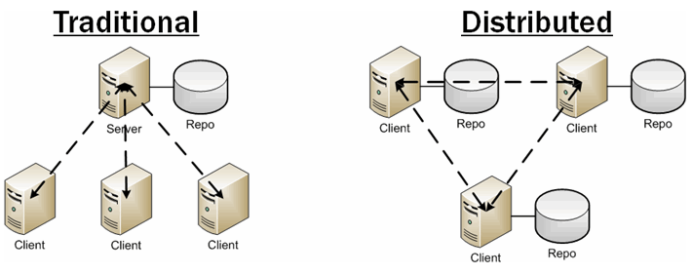
CENTRALIZED VS DISTRIBUTED VERSION CONTROL
- no central server
every developer is a client, the server and repository

Slide 7

WHAT IS GIT?
created by Linus Torvalds, April 2005
replacement for BitKeeper to manage Linux kernel changes
a command line version control program
uses checksums to ensure data integrity
distributed version control
cross-platform(including windows)
open source, free

Slide 8
GIT PROS AND CONS
CONS
Has a higher learning curve
Lacks granular access control
Does not effectively handle storing large binary files.
PROS
Operates locally
Avoids having a single point of failure.
Handles merging from multiple contributors effectively.
Notes:
no need to connect to central server
can work without internet connection
no single failure point
developers can work independently and merge their work later
every copy of a Git repository can serve either as the server or as a client
git track changes, not versions

Slide 9
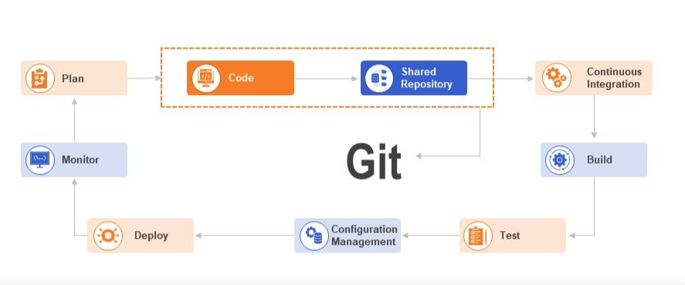
GIT WORKFLOW

Slide 10
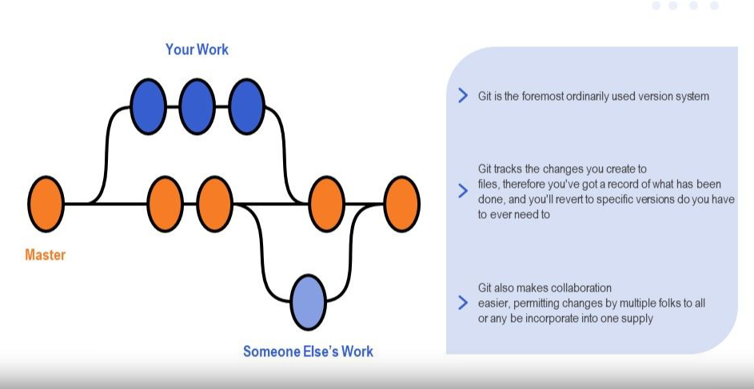
GIT WORKFLOW

Slide 11
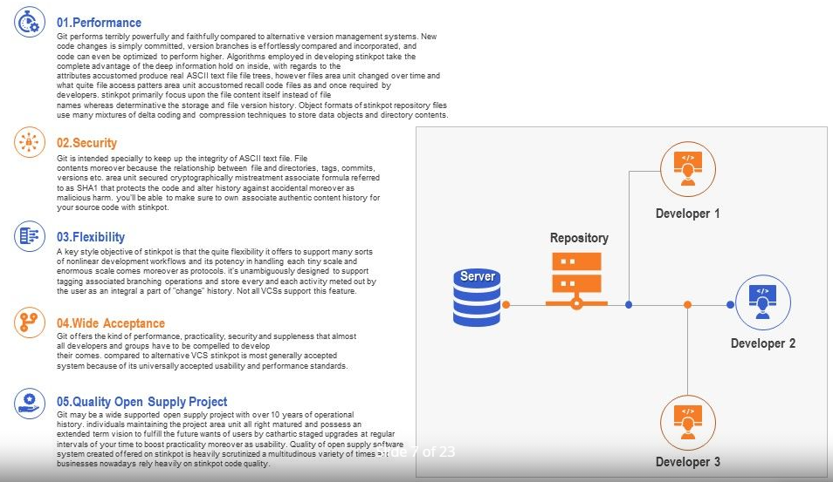
ROLES IN FDD

Slide 12
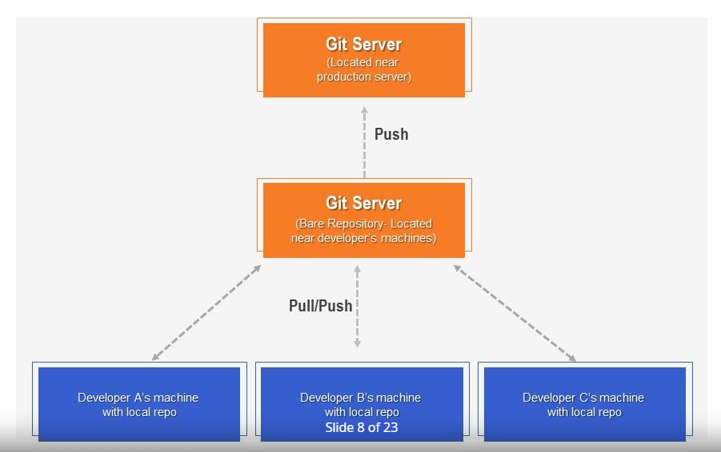
ARCHITECTURE OF GIT

Slide 13
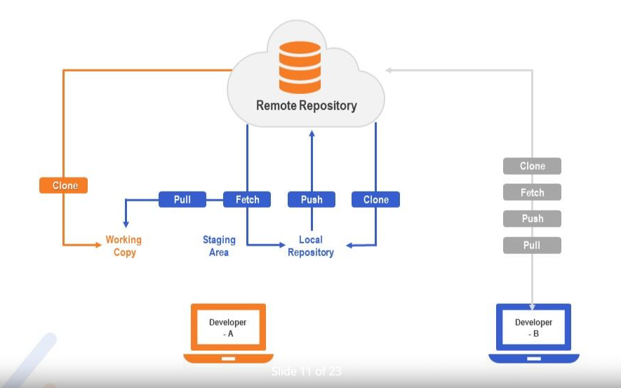
GIT AT WORK

Slide 14
STEPS HOW TO USE GIT
Download and install git bash https://git-scm.com/downloads or you can use powershell, terminal for mac or any alike application
Open any terminal installed
Create folder on your local station folder (e.g xampp/htdocs/foldername)
Git clone <urlofgitrepository>
Locate your newly cloned files then type ls to check files.
Type git status – all files in red means needs to push to repository
Type git status – all in red files must be gone – all files must be in green
Type git commit –m ‘reason of commit’
Type git status
Type git pull
Type git push

Slide 15
THANK YOU

