Slide 1
Options Theory & Collecting/Analyzing Data
Kim Pham

Slide 2
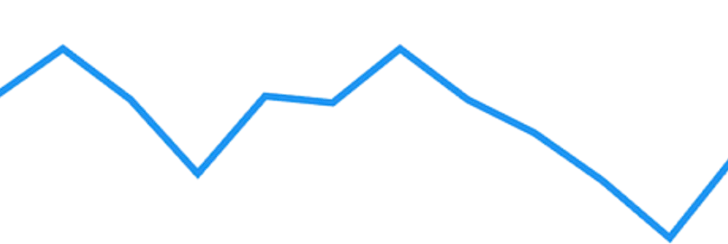
What is an Option?
Let’s first understand how stocks work
$200
Your Purchase Price
$145
$100

Slide 3
What is an Option?
Let’s first understand how stocks work
If the stock goes up: $200 - $145 = $55 profit
$200
Your Purchase Price
$145
$100

Slide 4
What is an Option?
Let’s first understand how stocks work
$200
Your Purchase Price
$145
If the stock goes down: $100 - $145 = $45 loss
$100

Slide 5
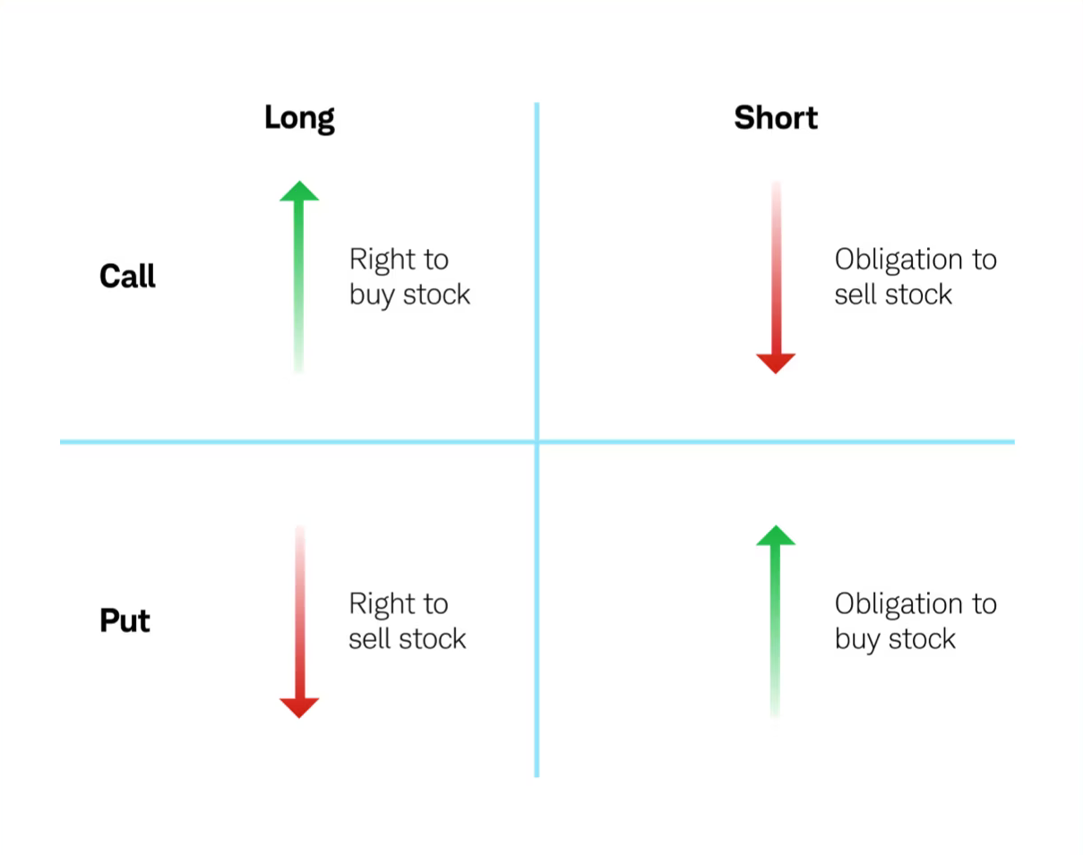
What is an Option? Cont.
Options are similar but different
Put Option: Right to sell stocks at the strike price up to expiry
Call Option: Right to buy stocks at the strike price up to expiry
You can either long (buy) or short (write/sell) a put/call

Slide 6
What is an Option? Cont.
So what if you decide to buy a call option for $5 instead of buying the underlying directly?
$200
Your Purchase Price
$145
$100

Slide 7
What is an Option? Cont.
So what if you decide to buy a call option for $5 instead of buying the underlying directly?
If the stock goes up: $200 - $145 - $5 = $50 profit
$200
Your Purchase Price
$145
$100

Slide 8
What is an Option? Cont.
So what if you decide to buy a call option for $5 instead of buying the underlying directly?
$200
Your Purchase Price
$145
If the stock goes down: $5 loss
$100

Slide 9


Wait...Why do I Even Care?
Total Return ($)
Total Return ($)
$0
Underlying Stock’s Price ($)
$0
Underlying Stock’s Price ($)
CALL OPTION
STOCK

Slide 10
Wait...Why do I Even Care?
Total Return ($)
Total Return ($)
Potentially unlimited profit
$0
Underlying Stock’s Price ($)
$0
Underlying Stock’s Price ($)
CALL OPTION
STOCK

Slide 11
Wait...Why do I Even Care?
Total Return ($)
Total Return ($)
Potentially unlimited profit
$0
Underlying Stock’s Price ($)
$0
Underlying Stock’s Price ($)
CALL OPTION
STOCK
Potentially unlimited loss

Slide 12
Wait...Why do I Even Care?
Total Return ($)
Total Return ($)
Potentially unlimited profit
Still potentially unlimited profit!
$0
Underlying Stock’s Price ($)
$0
Underlying Stock’s Price ($)
CALL OPTION
STOCK
Potentially unlimited loss

Slide 13
Wait...Why do I Even Care?
Total Return ($)
Total Return ($)
Potentially unlimited profit
Still potentially unlimited profit!
$0
Underlying Stock’s Price ($)
$0
Underlying Stock’s Price ($)
CALL OPTION
STOCK
Loss limited to premium
Potentially unlimited loss

Slide 14
Wait...Why do I Even Care?
    Unlimited profit with limited risks! Who doesn’t like that?
Total Return ($)
Total Return ($)
Potentially unlimited profit
Still potentially unlimited profit!
$0
Underlying Stock’s Price ($)
$0
Underlying Stock’s Price ($)
CALL OPTION
STOCK
Loss limited to premium
Potentially unlimited loss

Slide 15
Total Return ($)
$0
Underlying Stock’s Price ($)
Notice how Call Option has a little bit of less profit

Slide 16
Call Options
Call Buyer
Call Seller
Total Return ($)
Total Return ($)
+$50
$145 Strike
Underlying Stock’s Price ($)
$200
Underlying Stock’s Price ($)
$0
$0
$200
$145 Strike
-$50
$200 - $145 - $5 = $50 profit

Slide 17
Call Options
Call Buyer
Call Seller
Total Return ($)
Total Return ($)
+$50
$145 Strike
Underlying Stock’s Price ($)
$200
Underlying Stock’s Price ($)
$0
$0
$200
$145 Strike
-$50
$200 - $145 - $5 = $50 profit
$145 - $200 + $5 = $50 loss

Slide 18
Put Options
Put Buyer
Put Seller
Total Return ($)
Total Return ($)
+$40
$145 Strike
$100
Underlying Stock’s Price ($)
Underlying Stock’s Price ($)
$0
$0
$100
$145 Strike
-$40
$145 - $100 - $5 = $40 profit

Slide 19
Put Options
Put Buyer
Put Seller
Total Return ($)
Total Return ($)
+$40
$145 Strike
$100
Underlying Stock’s Price ($)
Underlying Stock’s Price ($)
$0
$0
$100
$145 Strike
-$40
$145 - $100 - $5 = $40 profit
$100 - $145 + $5 = $40 loss

Slide 20

Options Styles
Put Options

Slide 21
Project Background
Put Options
What is the goal of my project?
Data collection issues
Calculating implied volatility
Graphing volatility surfaces
Plotting volatility smiles

Slide 22
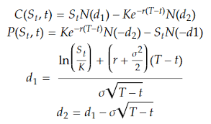
Implied Volatility
What is implied volatility and the Black-Scholes model?
N = CDF of normal distribution
S = Price of underlying
K = strike price
r = risk-free interest rate
T = time to maturity
σ = volatility

Slide 23
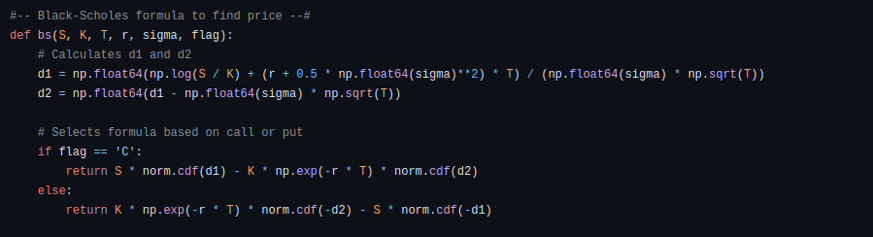

Slide 24


Slide 25
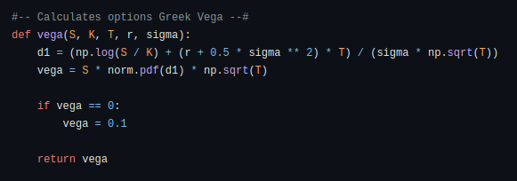

Slide 26
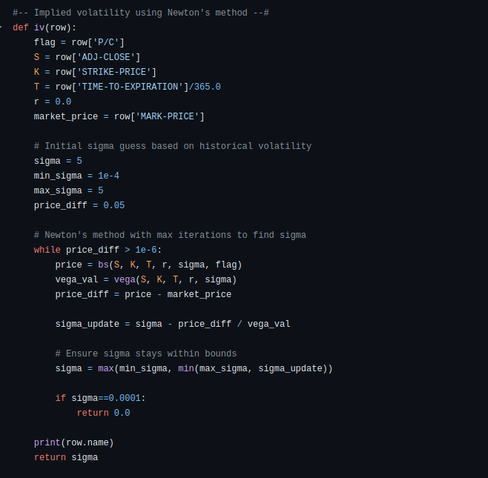

Slide 27
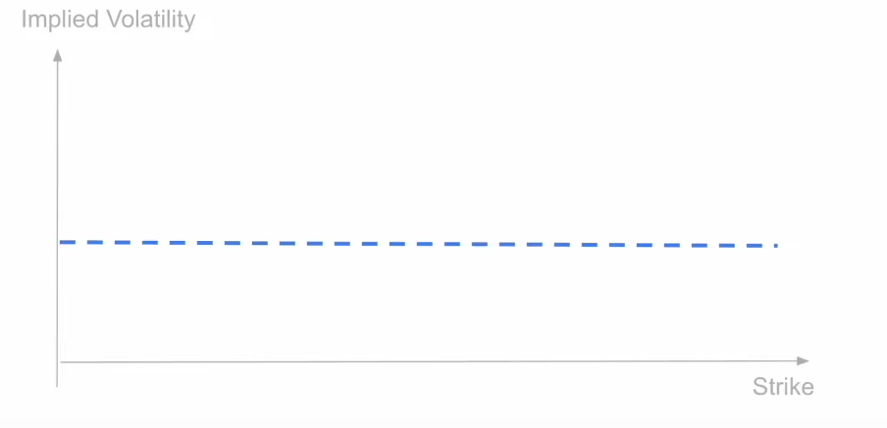

Slide 28
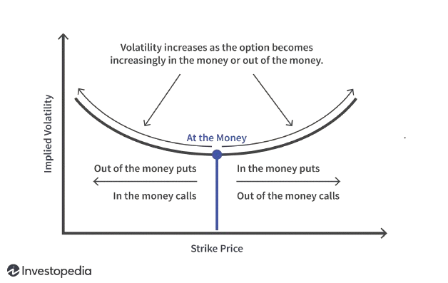
Volatility Smile

Slide 29
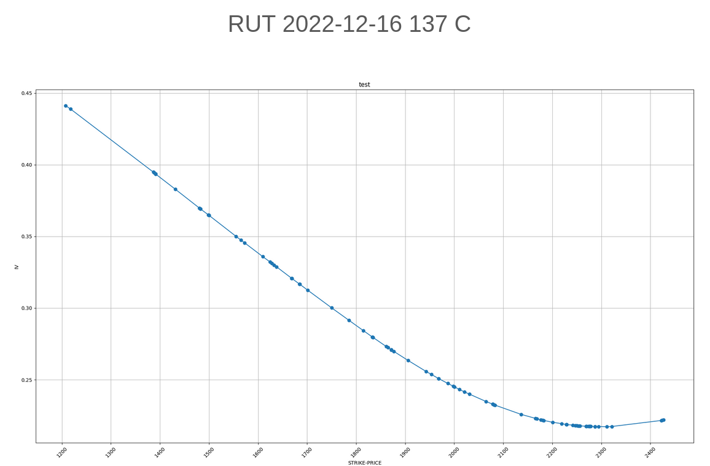

Slide 30
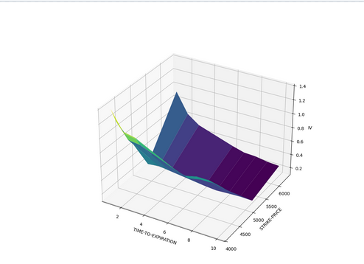

Slide 31
Steps Beyond the Internship
Using Time-Series models to predict future stock prices and implied volatility using the data
Create a more organized structure in the code for future improvements
Fix volatility surfaces
Questions?

