Slide 1
Data Structures in C
Kim Pham

Slide 2
What are Data Structures
Ways to arrange data
Arrays, stacks, queues

Slide 3
Arrays
Linear data structure
Elements accessible through indexes
Datatype varname [size] ;
Datatype varname [] = {ele1, ele2, ele3, ele4};

Slide 4
Arrays
Replacement of multiple variables
Easy sorting/iteration
Fixed size
Hard to delete/insert
If array is too big, then array is wasted

Slide 5
Stacks
Kind of like a stack of plates; only top elements are available to be accessed
Insertion/deletion takes place from the top
push(element)
Pop()
Show()

Slide 6


Slide 7
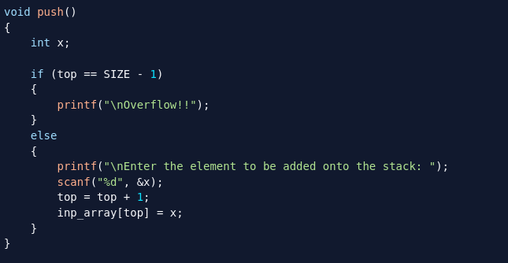

Slide 8
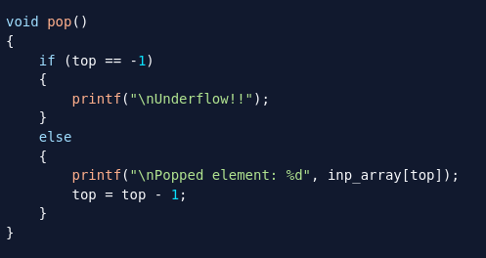

Slide 9
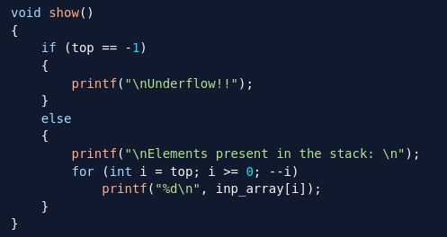

Slide 10
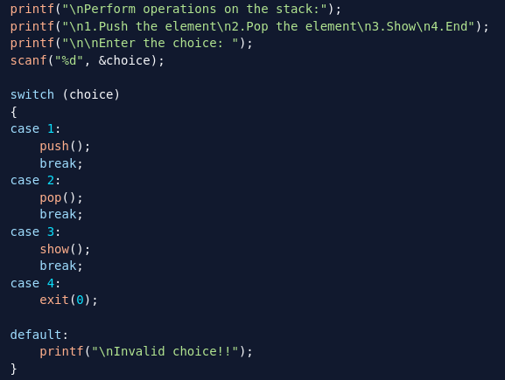

Slide 11
Stacks
Most recent element readily for use
Fast! O(1) complexity
Hard to manipulate
Not really flexible

Slide 12
Queues
Kind of like a line; bottom/top can get removed
enqueue(element)
dequeue()
Show()

Slide 13
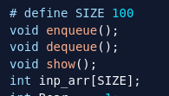

Slide 14
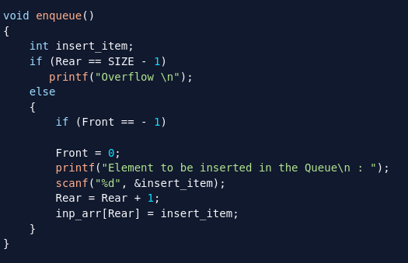

Slide 15
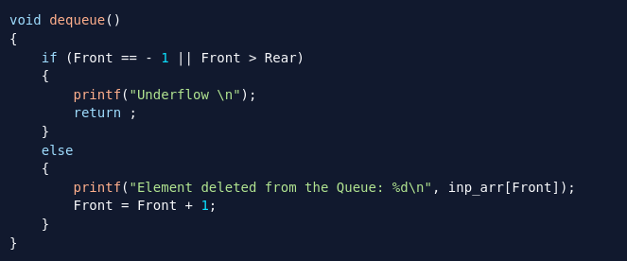

Slide 16
