Slide 1
Component Lifecycles
Tracking the Birth, Life, and Death of UI Components

Slide 2
3 Phases of the lifecycle

Slide 3
Mounting (Birth): The component is created and placed on the screen for the very first time. Think of this as putting a brand-new TV on a table. It didn't exist there before; now it does.
Updating (Life / Redraw): The component is already on the screen, but new data arrives. It clears the old visual and redraws itself to reflect the new data. Think of this as changing the channel—the TV stays on the table, but the picture updates.
Unmounting (Death): The component is completely removed from the screen and erased from the device's memory. Think of this as throwing the TV in the trash. It is completely gone.

Slide 4
Takeaways to keep in mind

Slide 5
Functional Execution: A functional component is just a regular JavaScript function.
  Every time it needs to update, JavaScript runs every single line of code inside that function from top to bottom to figure out what the new UI should look like.
State Updates Drive Re-renders: A component is lazy; it will not redraw its UI on its own.
  Calling a state setter (like setNumber) is the specific trigger that forces the component to run its function again (the Update Phase).

Slide 6
Prop Changes Trigger Updates: If a Parent component updates and passes new data (props) down to a Child component, the Child is forced to run its own function again to display that new data.
Conditional Rendering: You don't "hide" components with CSS in React.
  You use JavaScript logic (like isAlive && <Component/>) to decide if a component is Mounted (exists in memory) or Unmounted (erased from memory).
  Take note “isAlive” is just a naming convention

Slide 7
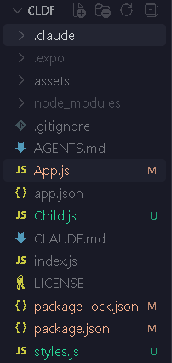
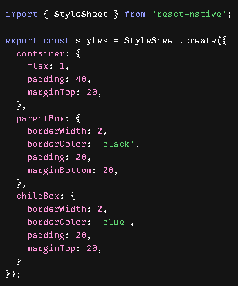
Project Structure
style.js

Slide 8
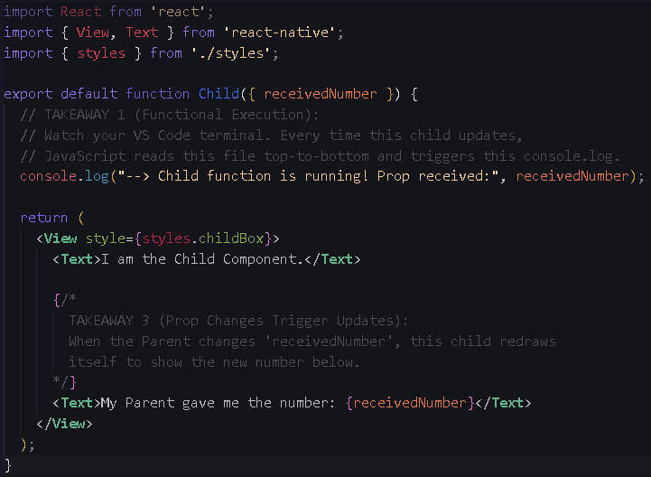
Child.js

Slide 9
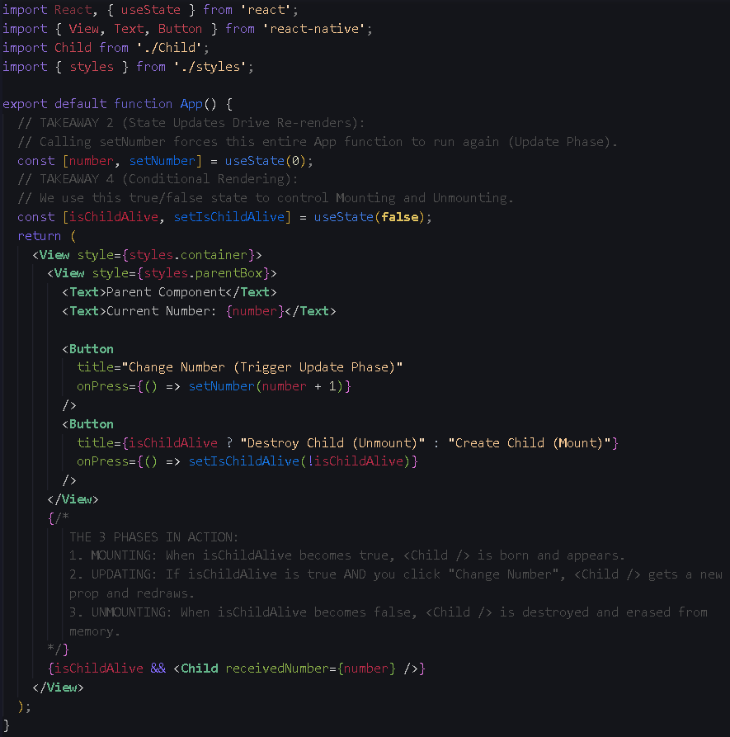
App.js

