Slide 1
Introduction to useeffect and dependency arrays
Managing Side Effects and Controlling Component Execution

Slide 2
What is the useeffect hook?

Slide 3
In React, the main job of a component function is to return UI.
A "side effect" is anything that happens outside of simply returning that UI—like fetching data from the internet, setting up a timer, or manually interacting with the device screen.
useEffect is a hook that tells React: "After you finish rendering the UI to the screen, run this extra piece of code."

Slide 4
What is a Dependency Array?

Slide 5
By default, useEffect runs its code after every single render.
The dependency array is the second argument you pass to useEffect (written as []).
It acts as a strict set of rules that tells React exactly when to execute the effect, preventing your app from running heavy background tasks unnecessarily.
Syntax:
  useEffect( function , dependencyArray );
  useEffect( ( ) => { } , [] );

Slide 6
No Array: The effect runs after every single render (rarely used, can cause infinite loops).
Empty Array []: The effect runs only once when the component first appears (Mounts). Perfect for initial data fetching.
Array with Variables [stateName]: The effect runs on the first render, and then only if the variables inside the array have changed (Update phase).

Slide 7
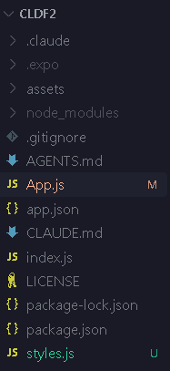
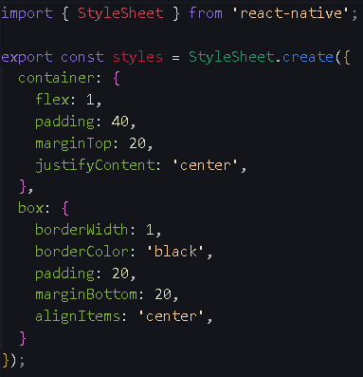
Project Structure
style.js

Slide 8
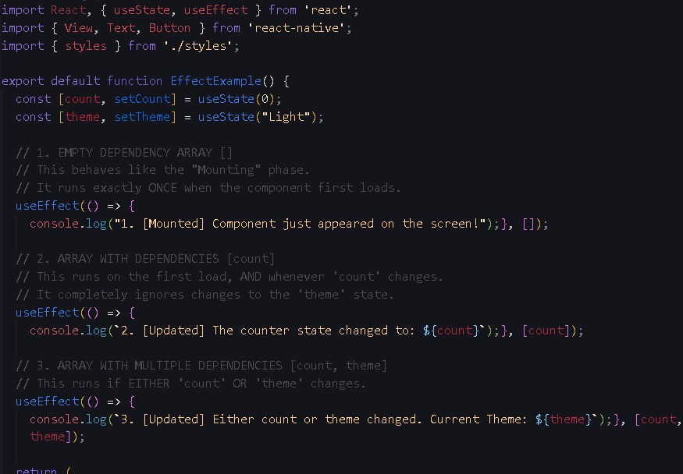
App.js
First half

Slide 9
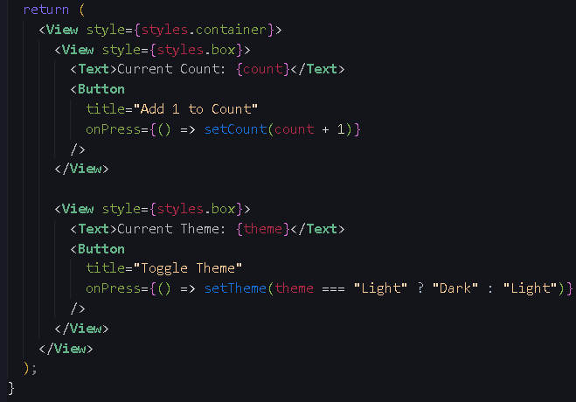
Second half

