Slide 1
Data fetching
Connecting Your App to the Outside World

Slide 2
Asynchronous javascript

Slide 3
JavaScript normally runs code one line at a time (synchronously).
If a task takes a long time (like downloading data), the whole app would freeze.
Asynchronous code allows the app to start a long task, move on to run other code in the background, and then come back to the long task when it's finished.
A “Promise” is a JavaScript object that represents a task that hasn't finished yet. Think of it like a restaurant buzzer.
You place an order, they hand you a buzzer (the Promise). You can go sit down (app keeps running). When the food is ready, the buzzer flashes (the Promise "resolves").

Slide 4
Async/await

Slide 5
Async / Await: This is modern syntax that makes Asynchronous code easier to read.
async goes in front of a function to tell React: "This function contains background tasks.“
await goes in front of a Promise to say: "Pause this specific function right here until the background task finishes."

Slide 6
No Array: The effect runs after every single render (rarely used, can cause infinite loops).
Empty Array []: The effect runs only once when the component first appears (Mounts). Perfect for initial data fetching.
Array with Variables [stateName]: The effect runs on the first render, and then only if the variables inside the array have changed (Update phase).

Slide 7
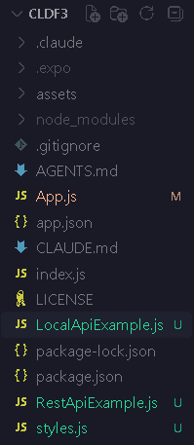
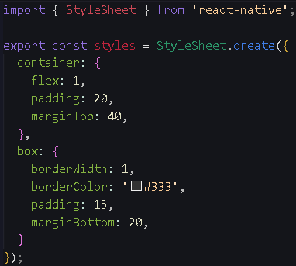
Project Structure
style.js

Slide 8
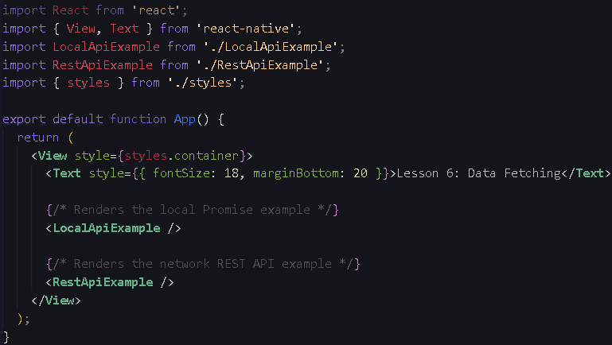
App.js

Slide 9
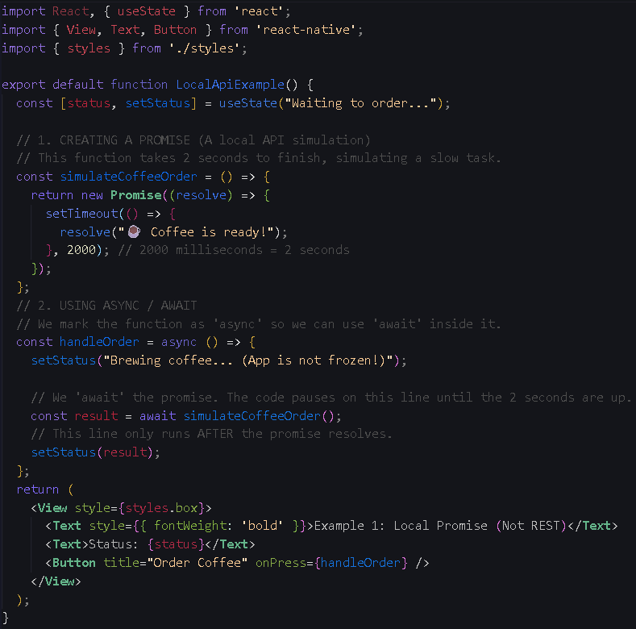
LocalApiExample.js

Slide 10
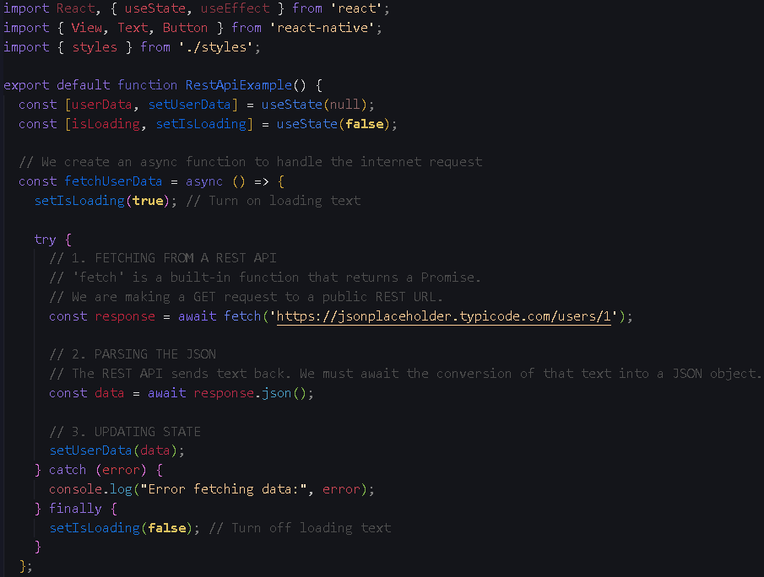
RestApiExample.js
First half

Slide 11
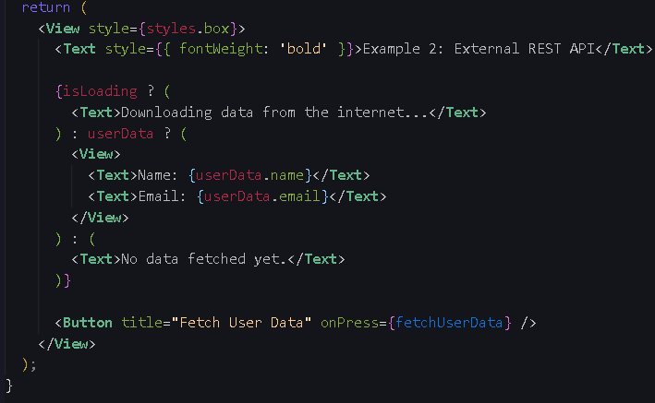
Second half

