Slide 1
Advanced navigation
Implementing Bottom Tab Navigators

Slide 2
What is tab navigation

Slide 3
Tab navigation allows users to switch between different main sections of an app using a persistent menu bar at the bottom of the screen.
Unlike Stack Navigation (which pushes screens on top of each other), Tab Navigation keeps each screen's state alive in the background while you switch between them.

Slide 4
Required setup

Slide 5
  Before writing the code, React Navigation requires specific packages. Run these commands in your VS Code terminal:
  Install the core navigation library:
    npm install @react-navigation/native
  Install Expo-specific dependencies:
    npx expo install react-native-screens react-native-safe-area-context
  Install the bottom tabs package:
    npm install @react-navigation/bottom-tabs

Slide 6
3 core components

Slide 7
NavigationContainer: The wrapper that manages the app's navigation tree and state. It must wrap all navigators at the very root of your app.
createBottomTabNavigator(): A function that returns two components: Tab.Navigator (the menu bar itself) and Tab.Screen (the individual tabs).
Tab.Screen: Defines the name of the tab in the menu and the actual React Component to display when that tab is tapped.

Slide 8
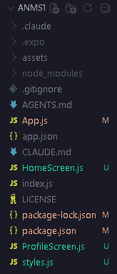
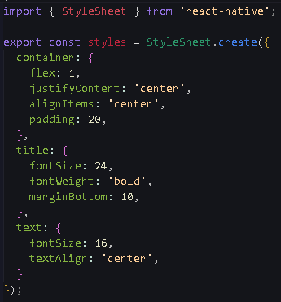
Project Structure
style.js

Slide 9
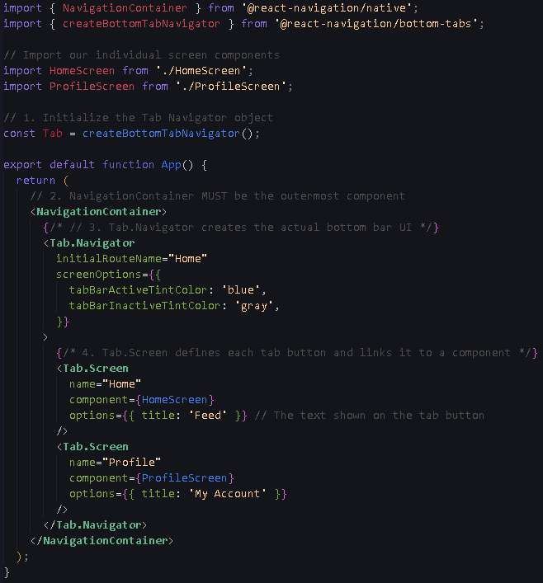
App.js

Slide 10
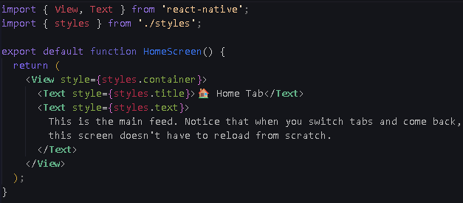
HomeScreen.js

Slide 11
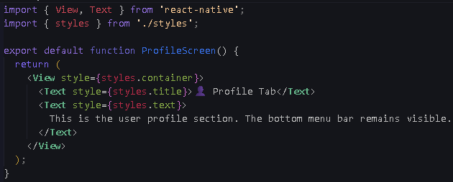
ProfileScreen.js

