Slide 1
Managing state & UI Feedback
Lifting State, Context API, and Loading/Error Handling

Slide 2
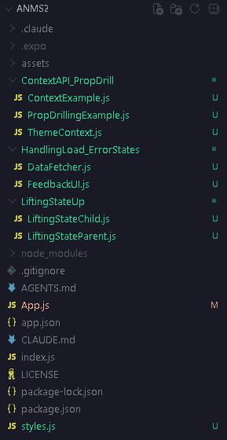
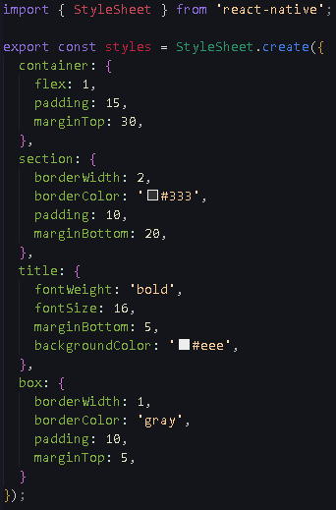
Project Structure
style.js

Slide 3
What is “lifting state up”?

Slide 4
The Problem: In React, data only flows downwards (from Parent to Child).
  Two sibling components cannot directly share state with each other.
The Solution: If Sibling A and Sibling B need the same data, you "lift" the state up to their closest common Parent component.
  The Parent holds the state and passes it down to both children as props.

Slide 5
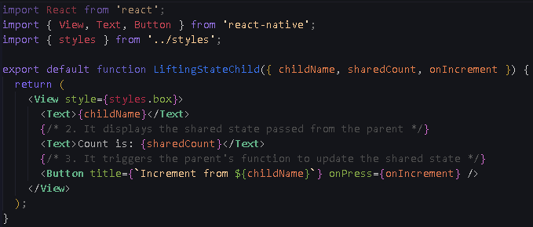
LiftingStateChild.js

Slide 6
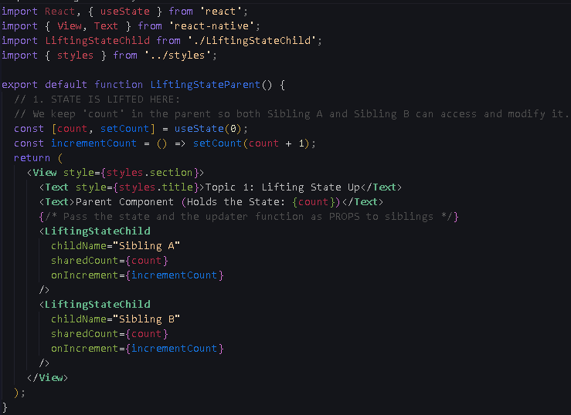
LiftingStateParent.js

Slide 7
The problem of “prop drilling”

Slide 8
  When you lift state too high in a large app, you are forced to pass props through many middle components that don't actually need the data—they just act as a bridge.
  This messy chain is called Prop Drilling.

Slide 9
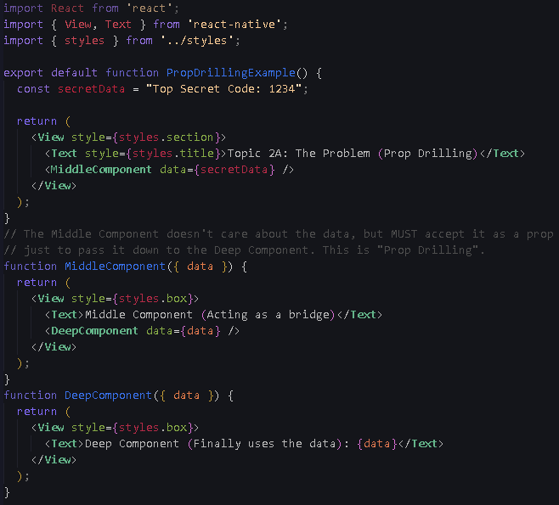
PropDrillingExample.js

Slide 10
Introduction to global state (context API)

Slide 11
The Context API acts like a global "teleportation system" for your data.
Instead of passing props down a chain, you wrap your app in a Provider.
Any component inside, no matter how deep, can instantly grab the data it needs using the useContext hook.

Slide 12
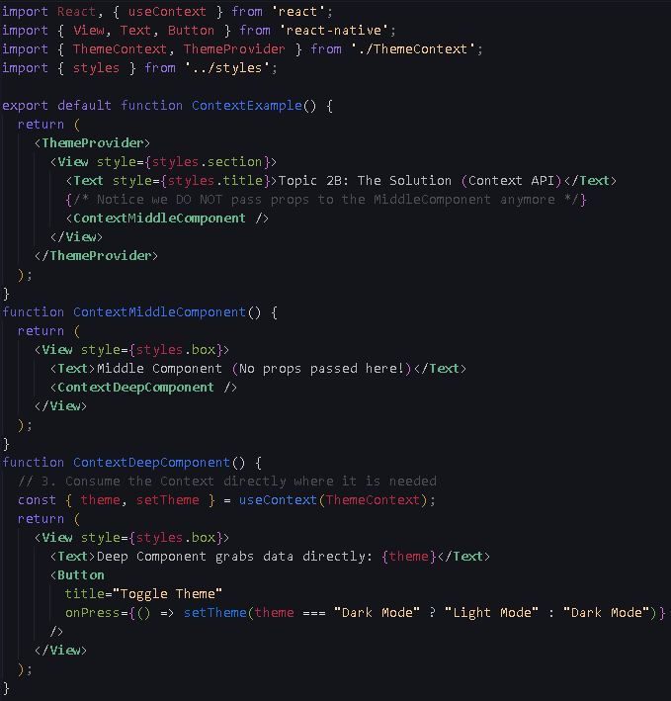
ContextExample.js

Slide 13
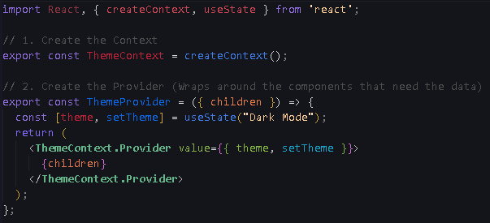
ThemeContext.js

Slide 14
Handling loading & error states

Slide 15
When fetching data asynchronously, the UI shouldn't just stay blank.
We manage this by creating three distinct states:
  isLoading (boolean),
  error (string/null)
  actual data.
We use standard conditional rendering (if/else) to show
  a spinner,
  an error message,
  or the data.

Slide 16
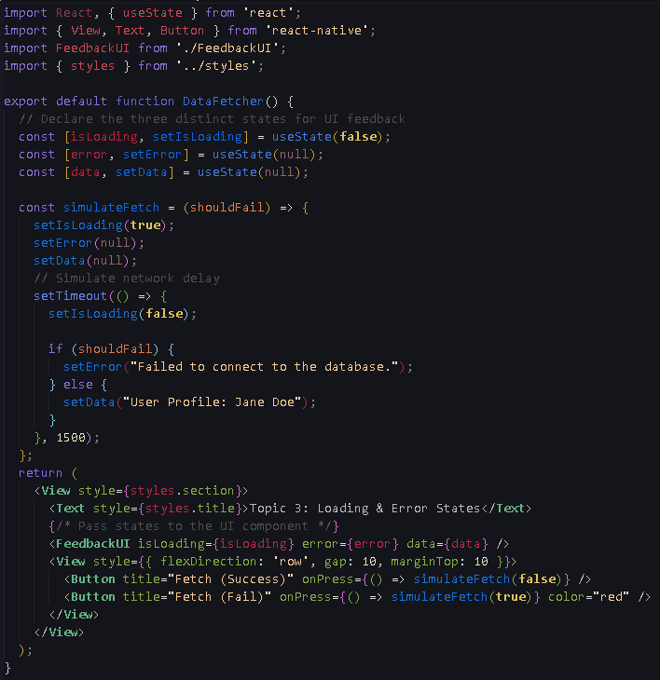
DataFetcher.js

Slide 17
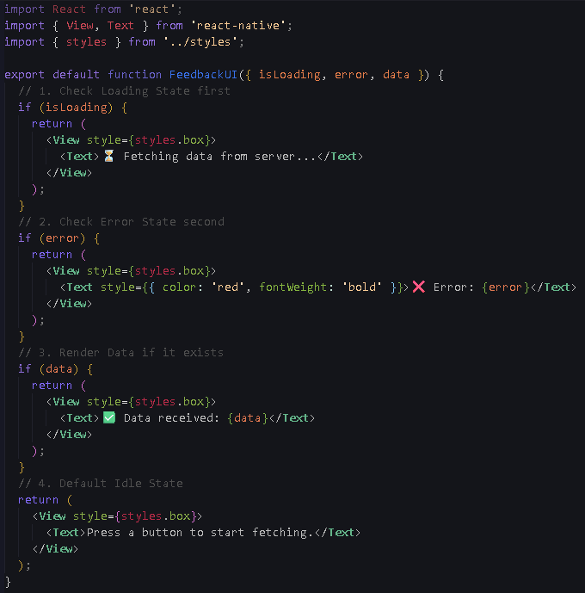
FeedbackUI.js

