Slide 1
Local Data Persistence
Storing JSON Data, CRUD Operations, and AsyncStorage

Slide 2
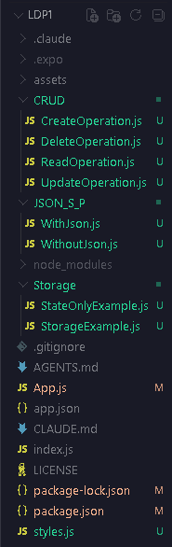
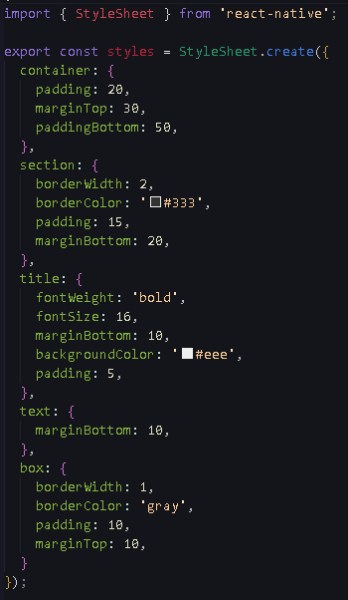
Project Structure
styles.js

Slide 3
Introduction to Device Storage

Slide 4
State (useState) is temporary memory;
  it is completely erased the moment the app is closed.
Device storage saves data permanently to the phone's internal storage, allowing the app to "remember" information between sessions.
In React Native, the industry standard for lightweight device storage is AsyncStorage.

Slide 5
Setting Up AsyncStorage

Slide 6
  Since AsyncStorage is not built into the core of React Native anymore, you must install it via the terminal.
  Run this command in your Expo project:
    npx expo install @react-native-async-storage/async-storage

Slide 7
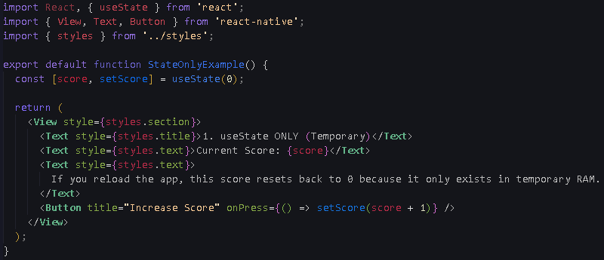
StateOnlyExample.js

Slide 8
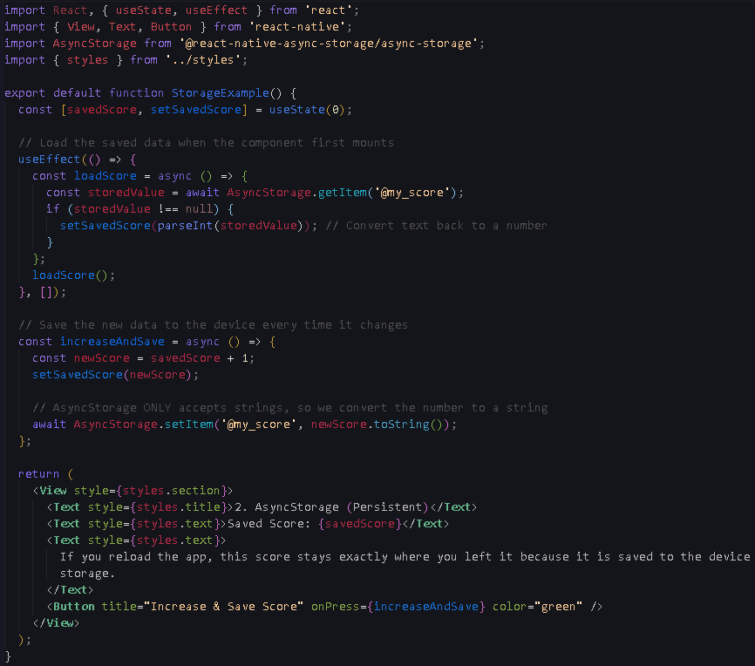
StorageExampler.js

Slide 9
The Golden Rule:
Stringifying & Parsing

Slide 10
AsyncStorage has one major limitation: It can only save strings (text). It cannot save JavaScript Objects or Arrays directly.
Writing Data (Stringify): Before saving an array of data, you must convert it into a text string using JSON.stringify(data).
Reading Data (Parse): When loading the string text back from storage, you must convert it back into a usable JavaScript array using JSON.parse(stringData).

Slide 11
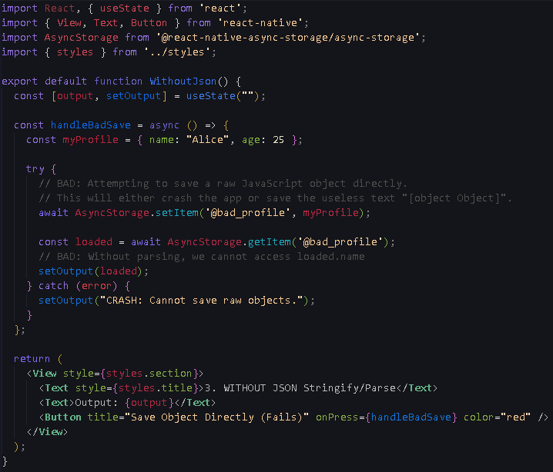
WithoutJson.js

Slide 12
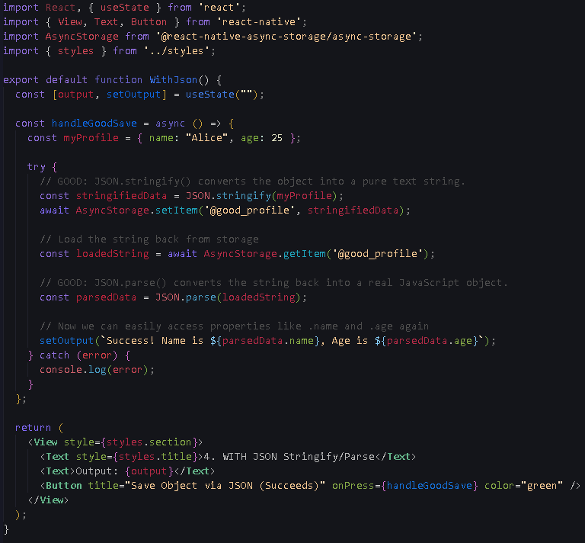
WithJson.js

Slide 13
CRUD Operations

Slide 14
Create: Adding a new item to the array and saving the updated array to storage.
Read: Fetching the saved string from storage on initial load and parsing it into state.
Update: Finding a specific item in the array, modifying it, and saving the updated array.
Delete: Filtering an item out of the array and saving the new, smaller array.

Slide 15
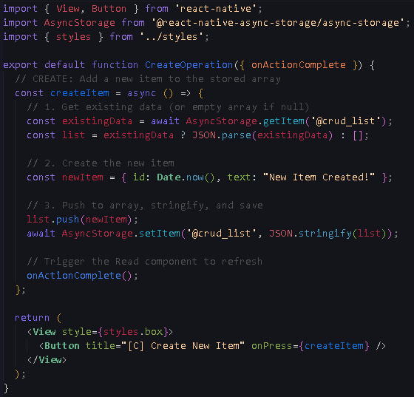
CreateOperation.js

Slide 16
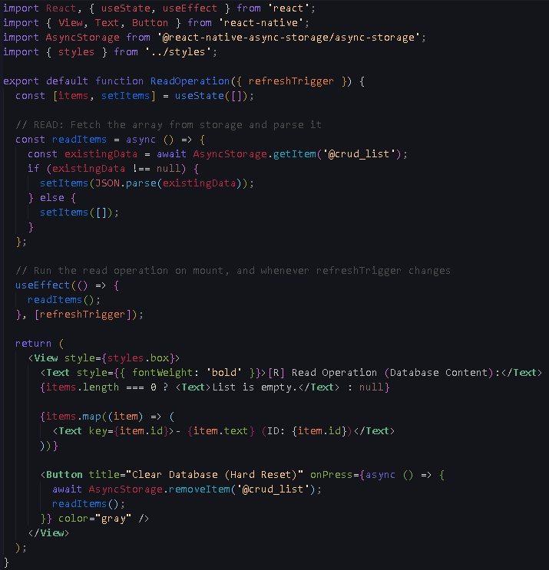
ReadOperation.js

Slide 17
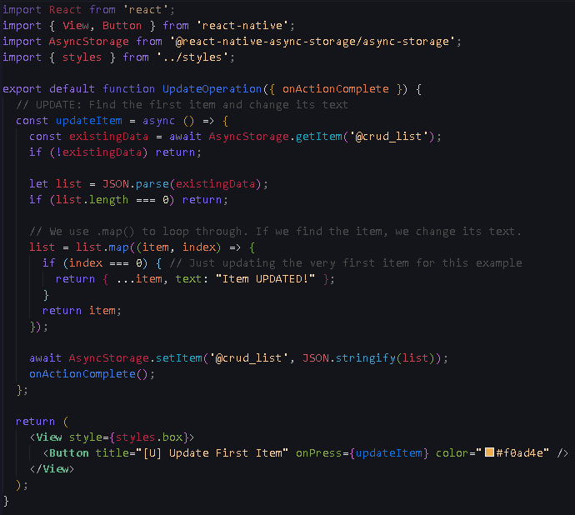
UpdateOperation.js

Slide 18
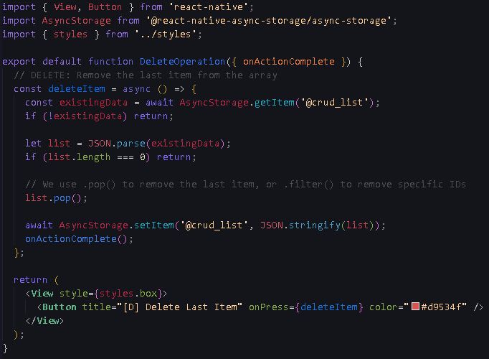
DeleteOperation.js

Slide 19
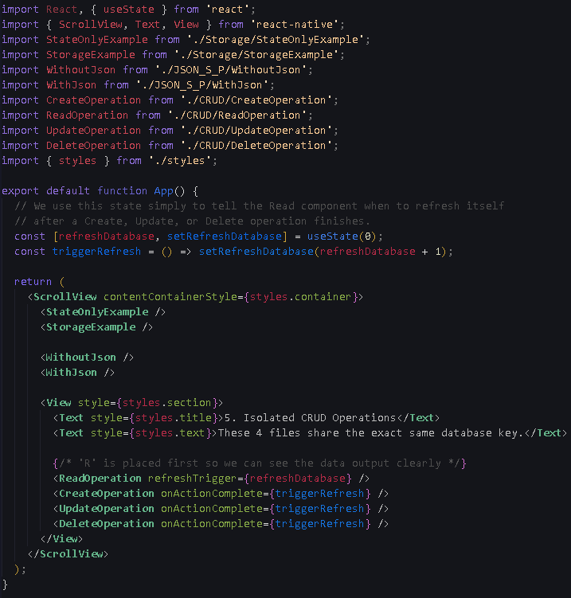
App.js

