Slide 1
User Interactivity & Dynamic Lists
Building dynamic, responsive apps with React Native

Slide 2
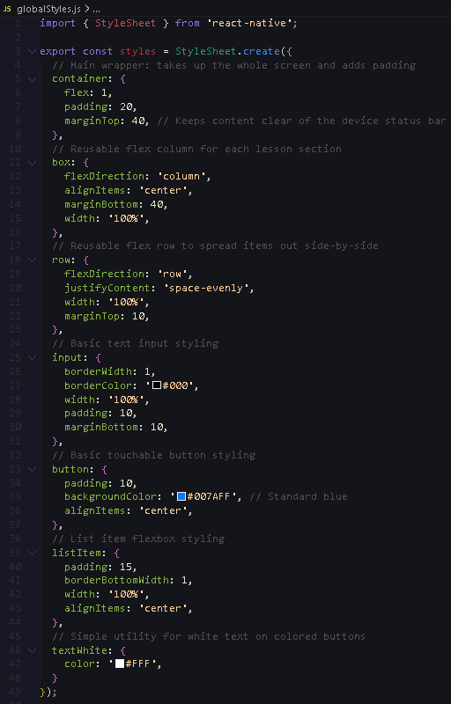
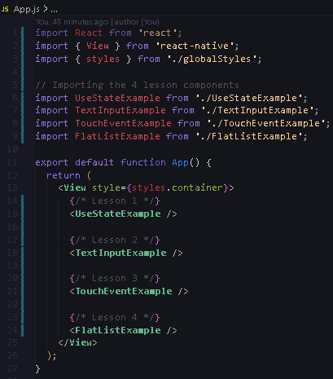
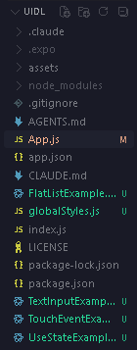
External Style
App.js
Project Structure

Slide 3
Introduction to the useState Hook

Slide 4
What is it?
useState() is a React function that gives your app a "memory.“
It allows variables to change over time (like a score going up).
The Syntax:
const [value, setValue] = useState(initialValue);
value: The current data.
setValue: The specific function used to change that data.
The Magic:
Whenever you call setValue, React Native automatically refreshes (re-renders) the screen to show the new data.

Slide 5
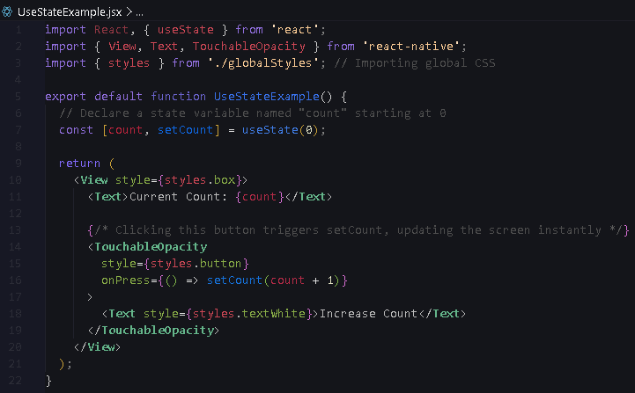

Slide 6
Capturing Text Input

Slide 7
The Component:
React Native uses <TextInput> to capture keyboard typing instead of HTML's <input>.
onChangeText:
This prop fires a function every single time a user types or deletes a character.
Controlled Input:
We tie the <TextInput> directly to a useState variable so the app always knows exactly what is currently typed in the box.

Slide 8
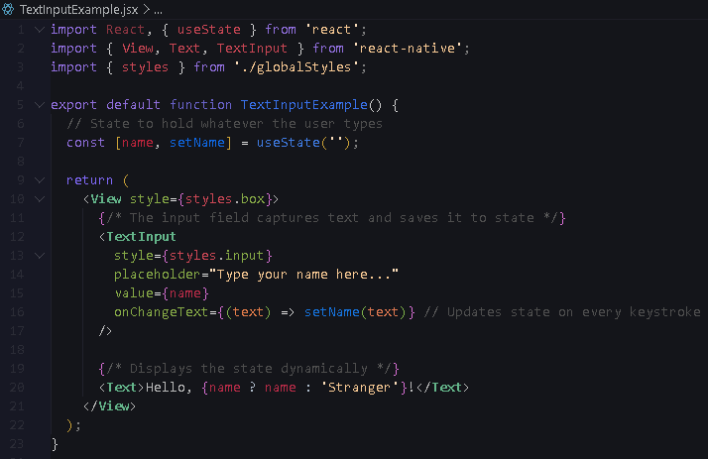

Slide 9
Handling Touch Events

Slide 10
No "Clicks":
Mobile devices use touch events instead of mouse clicks.
Custom Buttons:
While <Button> exists, developers usually use <TouchableOpacity> or <Pressable> because they can be styled freely with Flexbox.
Visual Feedback:
<TouchableOpacity> briefly fades out when tapped, proving to the user that the app registered their physical touch.
onPress :
This prop triggers an action when tapped.

Slide 11
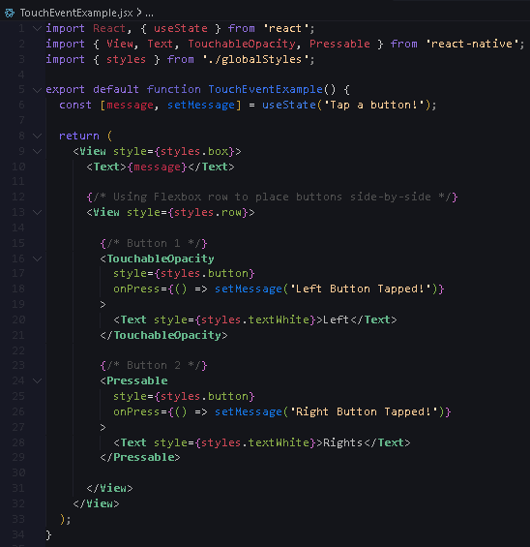

Slide 12
Efficient Lists with FlatList

Slide 13
The Problem:
Rendering a list of 1,000 items all at once will crash a mobile phone.
The Solution:
<FlatList> only renders the items currently visible on the screen. As you scroll, it recycles the off-screen items (Lazy Loading).
Required Props:
data: The array of data you want to display.
renderItem: The UI blueprint for a single row.
keyExtractor: A unique ID for each row so React Native can track them efficiently.

Slide 14
