Slide 1
JavaScript (ES6+) Essentials
Advance OOP Concepts

Slide 2
Let vs const

Slide 3
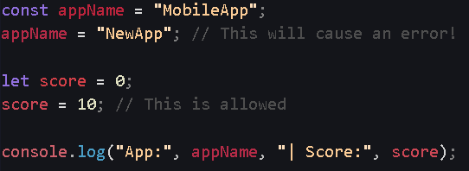
const: Variables that cannot be reassigned. This is the default choice in React.
let: Variables that can be reassigned (like loop counters).Both are block-scoped (only exist within their { } ).

Slide 4
Arrow Functions

Slide 5
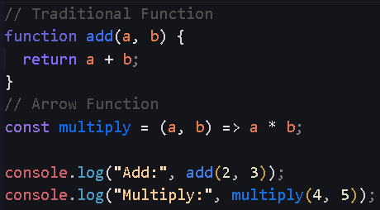
A shorter, cleaner way to write functions.
Omits the function keyword.
Supports "implicit return" (no need for the return keyword or { } for single-line operations).

Slide 6
Template Literals

Slide 7
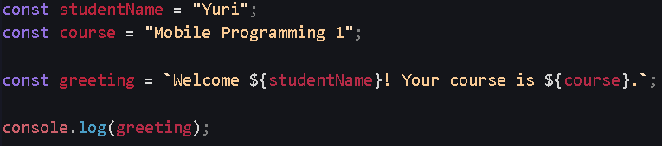
Uses backticks (`) instead of single or double quotes.
Allows multi-line strings easily.
Injects variables directly using ${variableName}.

Slide 8
Destructuring (Objects & Arrays)

Slide 9
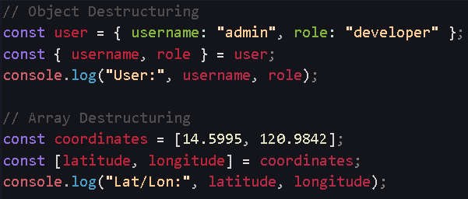
Extracts specific properties from an object or array into distinct, independent variables.
Makes code significantly cleaner by avoiding repetitive dot notation (e.g., user.name, user.age).

Slide 10
Spread Operator (...)

Slide 11
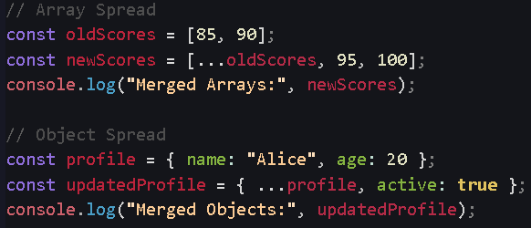
Expands elements of an iterable (like an array or object).
Used to copy data safely without modifying the original source (Immutability).
Combines multiple arrays or objects together easily.

Slide 12
Array Transformations (.map & .filter)

Slide 13
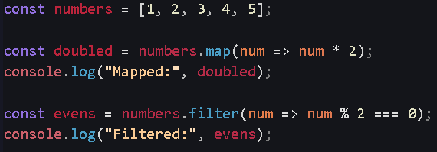
.map(): Transforms every item in an array and returns a new array of the same length.
.filter(): Returns a new array containing only items that match a specific condition.
Neither method modifies the original array.

Slide 14
Optional Chaining (?.)

Slide 15
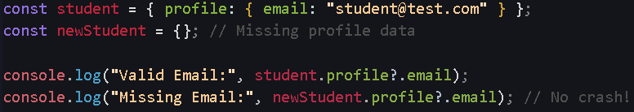
Safely attempts to read deeply nested object properties.
If a property does not exist (null or undefined), it simply returns undefined instead of crashing the entire app.

Slide 16
ES Modules (import / export)

Slide 17
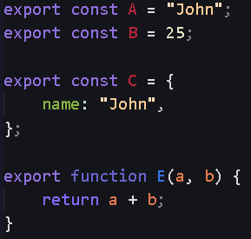
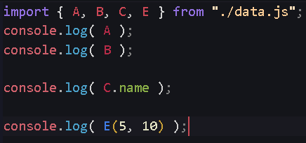
Splits code into multiple manageable files.
export: Makes variables/functions available to other files.
import: Brings variables/functions in from other files.
data.js
app.js

