Slide 1
Anatomy of a React Native functional component
Mobile App Start

Slide 2
Setup guide

Slide 3
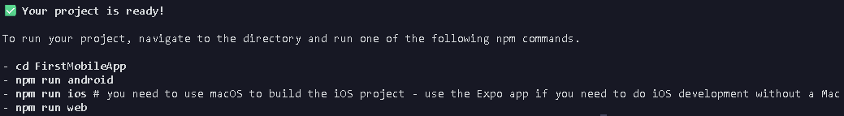
Must have node.js installed, and Expo Go app installed in smartphone.
Create a folder, then open it in VSCode
Run the command “npx create-expo-app FirstMobileApp --template blank”, you can replace “FirstMobileApp” with your preferred name for your project.
You’ll be asked to “Select an Expo SDK version” use your up or down arrow keys to select “Latest (SDK 57)” then press enter and wait for it to finish downloading and extracting every project files needed, if this is your first time doing it, it will take around 5 to 10mins or longer for it also depends on your internet connection.
Once it’s done it will output this on your terminal, and you will see another folder inside your created folder navigate to it by typing “cd <foldername>”, don’t mind the npm commands.

Slide 4
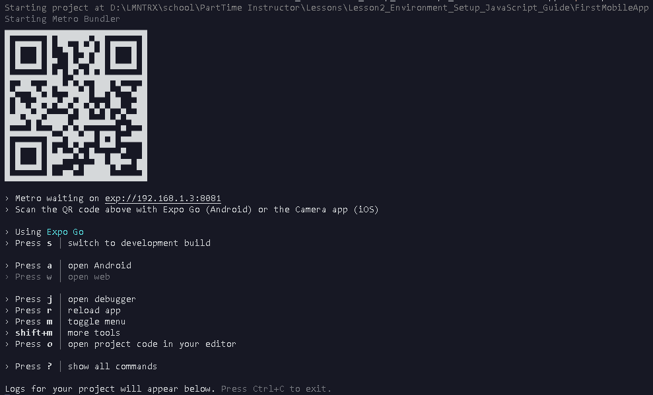
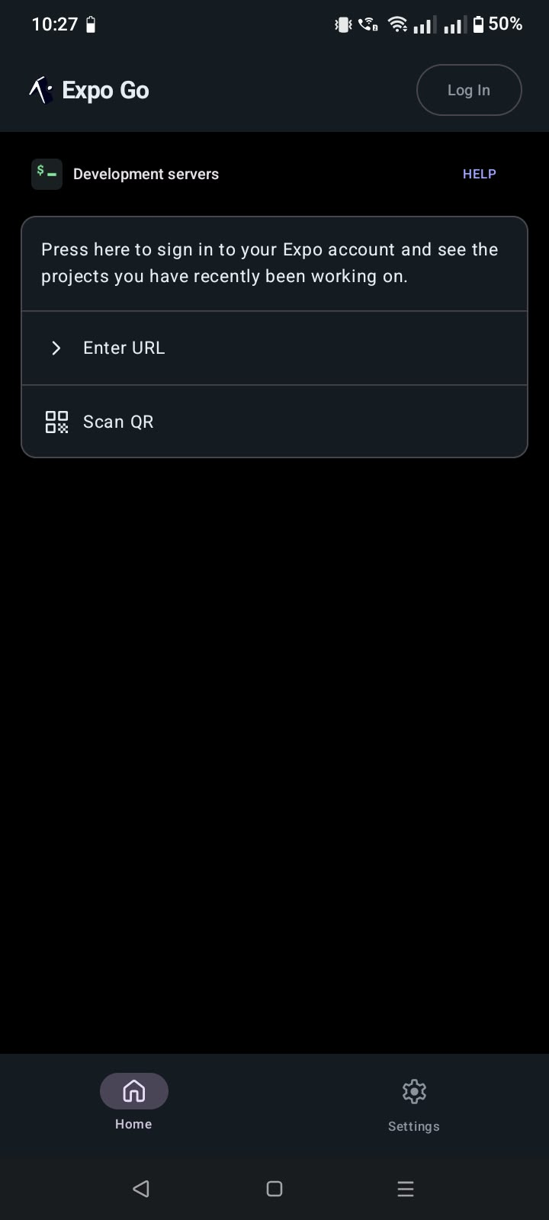
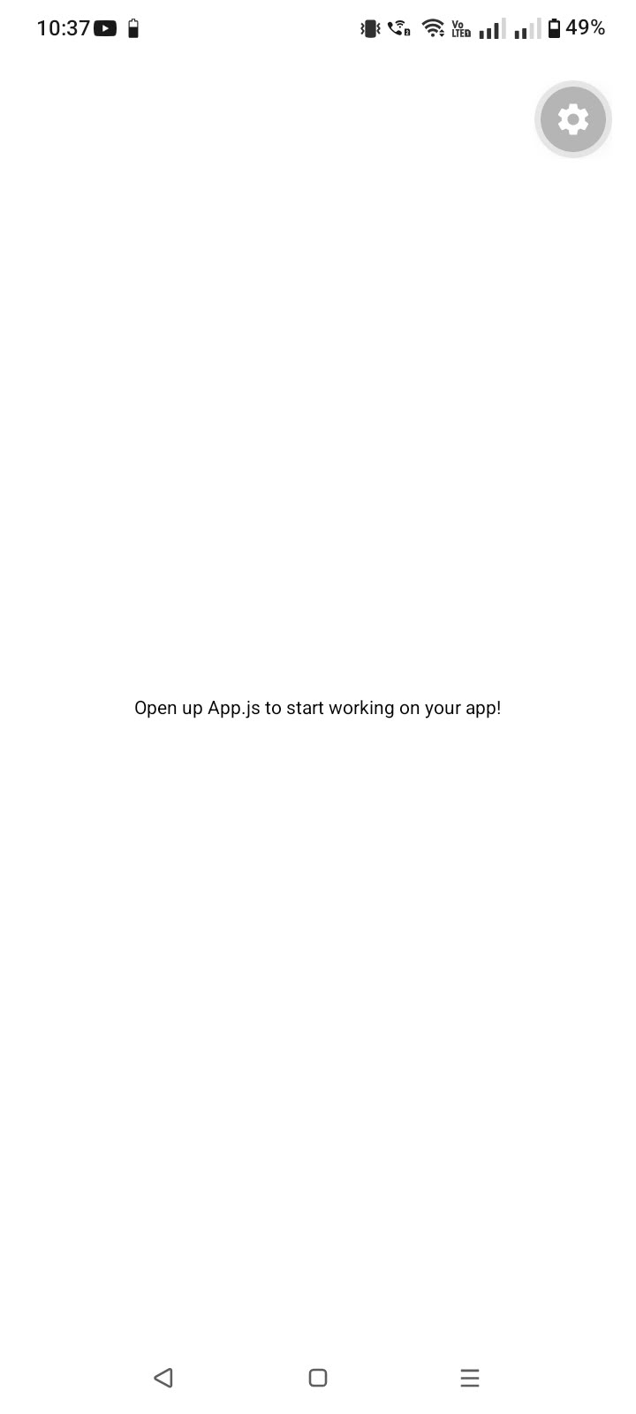
Run the command “npx expo start”, then open your Expo Go app and either scan the QR code or enter the URL, wait for it to load then you’ll see a blank app with some text in the middle.

Slide 5
Step 6 will only work if your laptop/computer and smartphone is on the same network(Wifi,Wifi/Data,Data), if not(Wifi/Data) then follow these steps:
In your terminal in VSCode run “npm install @expo/ngrok@4.1.0 --save-dev”.
Then run “npx expo start --tunnel”.
You will see the QR Code and URL which you can input in your Expo Go app, wait for it to load then you’ll see a blank app with some text in the middle.

Slide 6
Offline USB Tethering Alternative

Slide 7
Download the standalone Android SDK Platform-Tools for Windows from the official Android Developer website, link is https://developer.android.com/tools/releases/platform-tools.
  Scroll down then look for the option “Download SDK Platform-Tools for Windows” and click it.
  A terms and condition modal will pop up, just scroll down then click the check box “I have read and agree with the above terms and conditions”
  Click the button labeled “Download Android SDK Platform-Tools for Windows” to start the download
Once downloaded create a folder in your drive C and name it “Android”
  Inside the downloaded zip file you will see a folder labeled “platform-tools”, you must extract that folder to your newly created Android folder, once done the file path should look like this “C:\Android\platform-tools”.

Slide 8
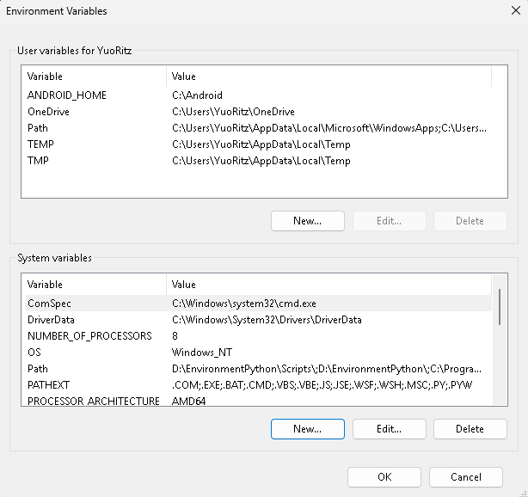
Press the Windows key, type “edit the system” and select the “Edit the system environment variables”
Click “Environment Variables” button at the bottom right and you’ll see User variables and System variables boxes
Under user variables click “New”
  Input in Variable name “ANDROID_HOME”
  Input in Variable value “C:\Android”
  Click “Ok”
Under System variables find “Path” then select it then click “Edit” button
  Click “New” then copy and paste this “C:\Android\platform-tools”
Click “Ok” on all windows to save
Restart Visual Studio Code

Slide 9
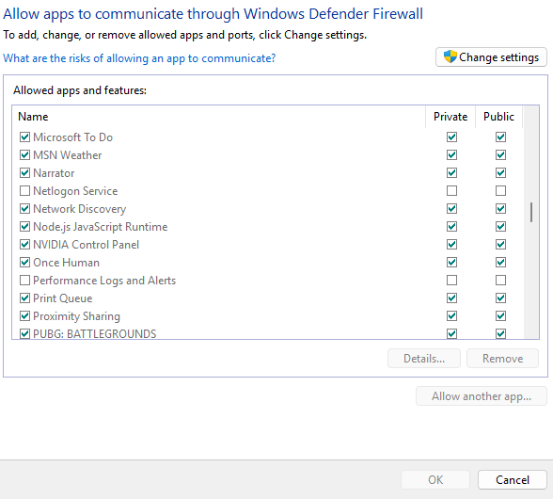
On Your Android Phone
  Developer Options: Go to Settings > About Phone > Tap Build Number 7 times.
  USB Debugging: Go to Settings > System > Developer Options > Turn on USB Debugging.
  USB Tethering: Go to Settings > Network & Internet (or Connection & Sharing) > Hotspot & Tethering > Turn on USB Tethering.
On Your Windows Laptop
  Press windows key then type “allow an app” then select “Allow an app through windows firewall”
  Make sure both Private and Public boxes are chek for Node.js

Slide 10
Connect your phone to your laptop using your USB cable, then turn on USB Tethering in your phone's settings.
Open your project folder in VS Code, open the terminal, then input “npx expo start --lan”
Open Expo Go application, scan the QR code or input the URL from the terminal.
Useful Diagnostic Commands
Command | Purpose | Expected Result
adb devices | Checks if your phone is recognized by your PC | Displays your device ID followed by device.
npx expo start --lan | Starts Expo server bound to your USB tether network | Outputs a LAN URL (exp://192.168.x.x:8081).
npx expo start --lan -c | Clears Metro bundler cache if updates fail | Rebuilds JavaScript bundle from scratch.

Slide 11
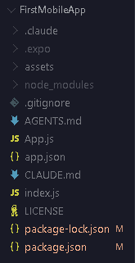
App.js: The entry point of your application and the root functional component
assets/: The directory for static visual resources like images, app icons, and fonts.
package.json: The configuration file that tracks your project's dependencies (like Expo and React Native versions).
node_modules/: The folder where all downloaded packages live (NEVER MANUALLY EDIT FILES INSIDE THIS FOLDER!!!).

Slide 12
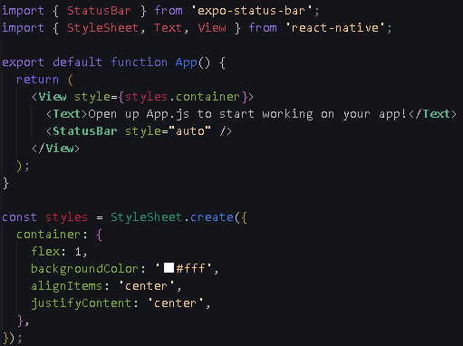
The Imports (Lines 1-2): ES modules pulling in core UI components (View, Text) and APIs (StyleSheet) from the 'react-native' library.
The Component Function (Lines 4-11): A standard JavaScript function exported by default so Expo can render it. Can also be written as an ES6 Arrow Function const App = () => {).
The JSX Return (Lines 5-10): The declarative UI layout. Emphasize the golden rule of JSX: it must return exactly one parent element (in this case, the wrapper <View>).
The StyleSheet (Lines 13-20): A JavaScript object defining the layout using Flexbox and camelCase properties.

Slide 13
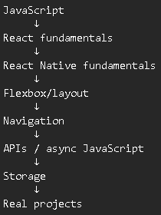
ADDITIONAL REFERENCES
ROADMAP
Introduction · React Native
Quick Start – React
MDN Web Docs
React Navigation
Expo Documentation
Flexbox Froggy - A game for learning CSS flexbox
Flexbox Labs

