Slide 1
Please use this coversheet for all coursework assignment submissions.
You should copy the coversheet into your assignment document as the first page, and save as one single document for submission.
Please see the Assessment Policy and Procedures for full guidance on coursework submission and associated penalties.
To complete this coversheet please provide the following information:
Module Code: OLDA5302M
Module Title: Capstone Project
Assessment title: Summative Assessment 2 – Narrated Poster
Your 9-digit Student ID Number: 201804870
Word count or minute count: 654, 4:28
Submission Date: December 18, 2025
Please note that by submitting this piece of work you are agreeing to the University’s Declaration of Academic Integrity. You can read the Declaration here.

Slide 2

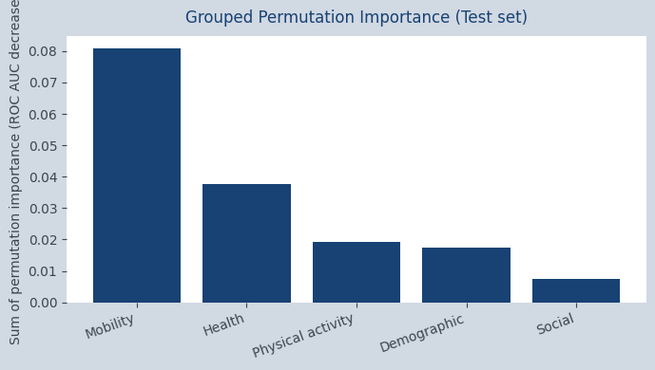
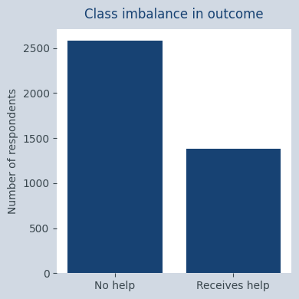
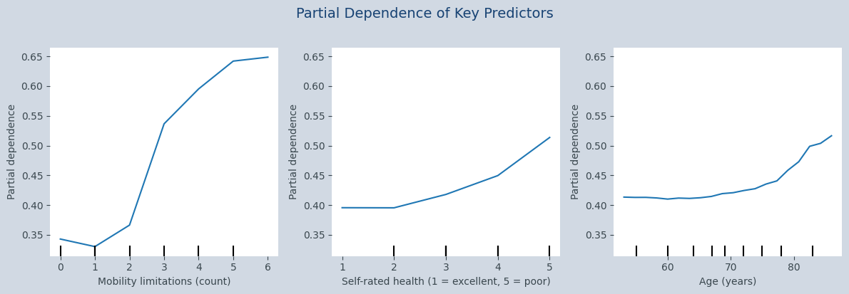
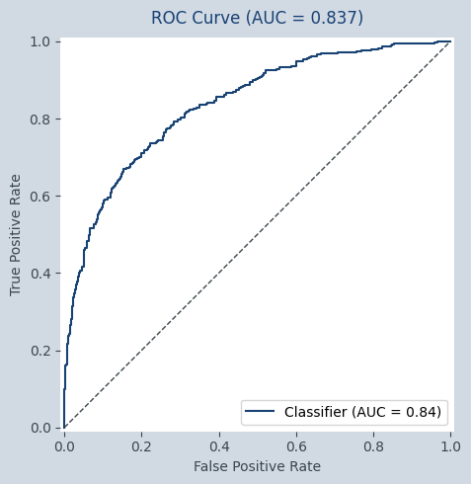
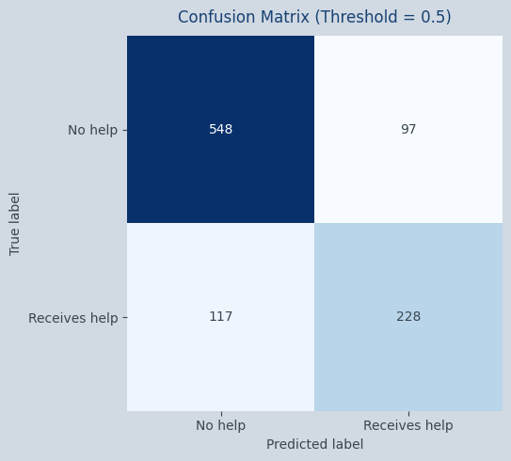
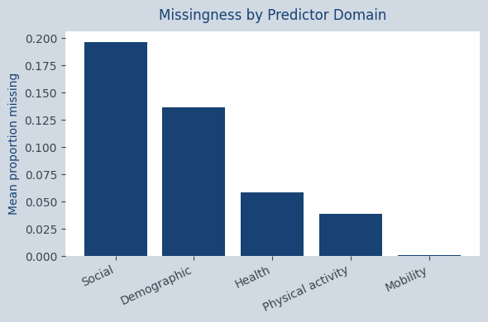
Predicting Receipt of Care Among Older Adults Using the English Longitudinal Study of Ageing
Insights into Health, Mobility, and Support Needs in Later Life
Kimberly Peever
1. Care receipt in later life reflects health, mobility, and social context
3a. A flexible predictive model is required to capture non-linear relationships
4. Mobility limitations dominate prediction of care receipt
As populations age, more older adults require help with everyday activities. Understanding who receives help is important for planning future care and support.
This project uses data from Wave 10 of the English Longitudinal Study of Ageing (ELSA), a nationally representative survey of adults aged 50 and over living in England (Steptoe et al., 2013).
Research question:
Which health, mobility, social, and demographic factors are most strongly associated with receiving any informal or formal help among older adults?
Exploratory analysis suggested non-linear relationships between health, mobility, and receipt of help, motivating the use of a flexible, tree-based modelling approach.
The modelling pipeline addressed structured patterns of non-response using median imputation within a cross-validated pipeline, alongside explicit missingness indicators to represent informative non-response.
Model interpretation indicates that mobility limitations are the strongest predictors of receiving help, contributing more to prediction than health, demographic, or social factors.
Model outputs indicate that functional ability contributes more strongly to predicted care receipt than age, consistent with prior work on disability and ageing(e.g. Katz et al., 1963).
Cross-validation guided hyperparameter tuning, and performance was evaluated on a held-out test set. Class imbalance was addressed through class-weighted estimation, with evaluation focused on discrimination and calibration, rather than accuracy alone.
Fig 5. Relative contribution of predictor domains to model performance
2. Survey structure and missingness shape modelling decisions
Fig 2. Distribution of the binary outcome.
Predictors were drawn from multiple domains, including mobility, health, physical activity, social contact, and demographic characteristics.
Exploratory analysis revealed structural challenges in the data, including uneven outcome prevalence and systematic patterns of non-response. In addition, non-response varied systematically by predictor domain, with higher missingness in social and demographic-related variables, due to survey design.
Fig 6. Estimated relationships between selected predictors and predicted probability of receiving help, averaged over the population.
3b. Model evaluation on a held-out test set
5. Predictions are informative at the population level but require careful interpretation
These patterns informed the modelling strategy, motivating the use of class-weighted models and the inclusion of explicit missingness indicators rather than assuming data were missing at random.
At a population level, these results suggest that functional limitations play a more important role in shaping care needs in later life than age or social characteristics. Reduced functional ability appears to underlie reliance on informal or formal support, highlighting mobility loss as a key mechanism linking ageing to care receipt.
While predictions reflect robust population-level patterns, uncertainty remains due to survey non-response and unobserved factors, limiting individual-level use. The findings nonetheless highlight the value of interventions that delay or prevent functional decline, with longitudinal data offering a clear direction for future work.
Fig 3. Discrimination performance of the model evaluated on unseen data.
Fig 4. Classification outcomes on the held-out test set,
Fig 1. Proportion of missing values varies systematically by predictor domain.
The model was evaluated on a held-out test set, with discrimination and classification outcomes shown to assess population-level predictive ability rather than individual decision-making.
References:
Banks, J., Batty, G.D., Nazroo, J. and Steptoe, A. (eds.) 2019. The dynamics of ageing: evidence from the English Longitudinal Study of Ageing 2002–2016. London: Institute for Fiscal Studies.
Breiman, L. 2001. Random forests. Machine learning. 45(1), pp.5–32.
Katz, S., Ford, A.B., Moskowitz, R.W., Jackson, B.A. and Jaffe, M.W. 1963. Studies of illness in the aged: the index of ADL. Journal of the American Medical Association. 185(12), pp.914–919.
Steptoe, A., Breeze, E., Banks, J. and Nazroo, J. 2013. Cohort profile: the English Longitudinal Study of Ageing. International journal of epidemiology. 42(6), pp.1640–1648.
World Health Organization. 2015. World report on ageing and health. Geneva: World Health Organization.

