Slide 1
NEWSBOT INTELLIGENCE SYSTEM
Kim Nguyen prof. Anna Devarakonda

Slide 2
INTEGRATION CHECKLIST
NLP applications and real-world context
Text preprocessing pipeline
TF-IDF feature extraction
POS tagging analysis
Syntax parsing and semantic analysis
Sentiment and emotion analysis
Text classification system
Named Entity Recognition

Slide 3
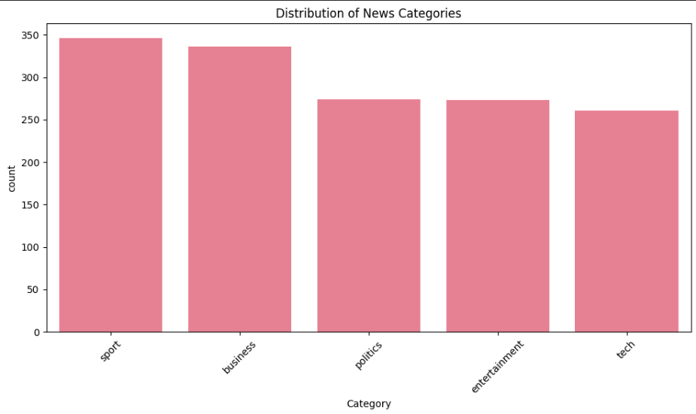
DATASET

Slide 4
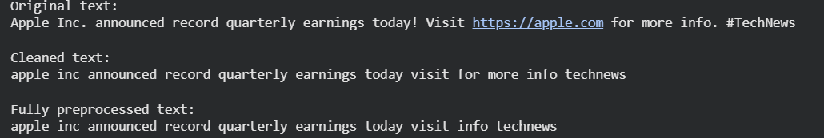
TEXT PREPROCESSIGN PIPELINE
Text Cleaning
Tokenization
Normalization
Stop word removal
Lemmatization

Slide 5
WHAT CHANGED DURING PREPROCESSING
Step | Description | Example
Lowercasing | All text converted to lowercase for consistency | Worldcom → worldcom
Removed punctuation, numbers, and symbols | Keeps only meaningful words | 2005 and - removed
Removed stopwords | Words like “in”, “for”, “the” removed | “in ten major” → “major”
Trimmed whitespace | Removed extra spaces | “ worldcom ” → “worldcom”

Slide 6
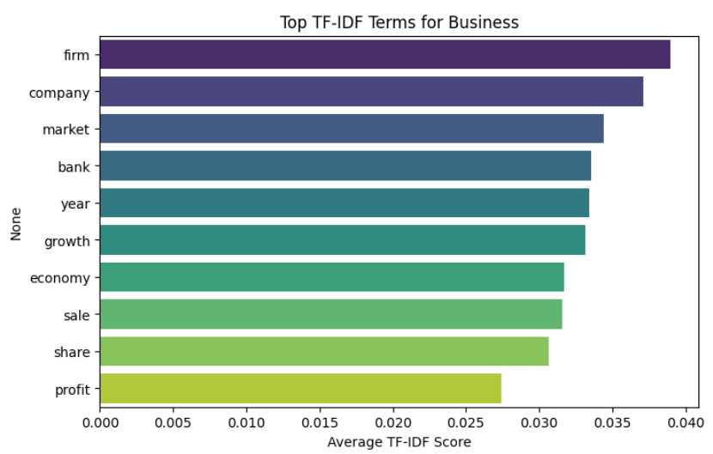
TF-IDF FEATURE EXTRACTION

Slide 7
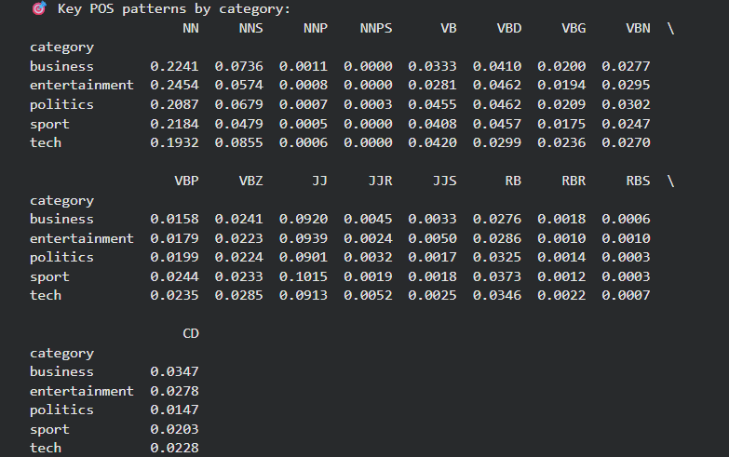
POS TAGGING ANALYSIS

Slide 8
POS TAGGING ANALYSIS
Nouns → NN, NNS, NNP, NNPS
Verbs → VB, VBD, VBG, VBN, VBP, VBZ
Adjectives → JJ, JJR, JJS
Adverbs → RB, RBR, RBS
Numbers → CD

Slide 9
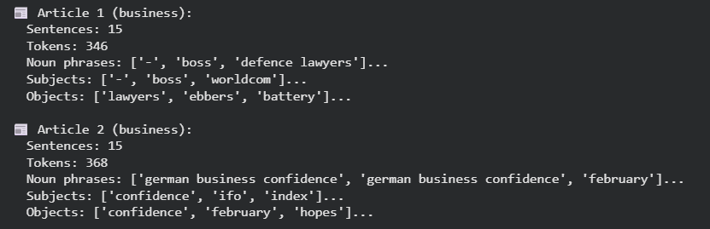
SYNTAX PARSING AND SEMANTIC ANALYSIS

Slide 10
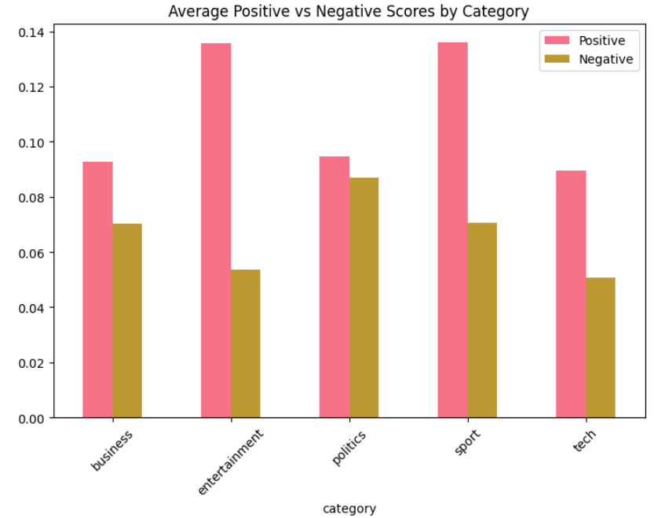
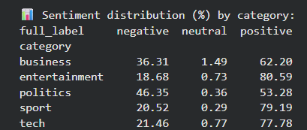
SENTIMENT AND EMOTION ANALYSIS

Slide 11
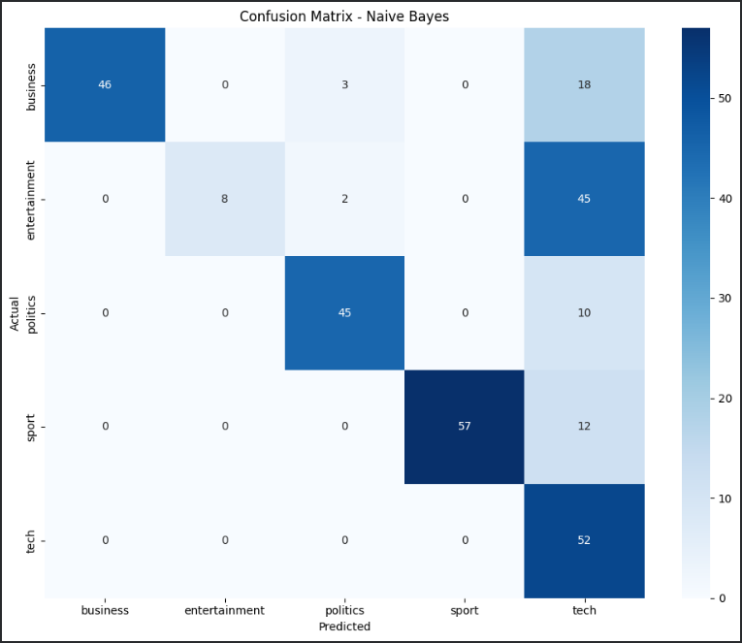
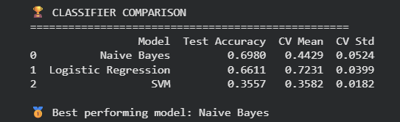
TEXT CLASSIFICATION SYSTEM

Slide 12
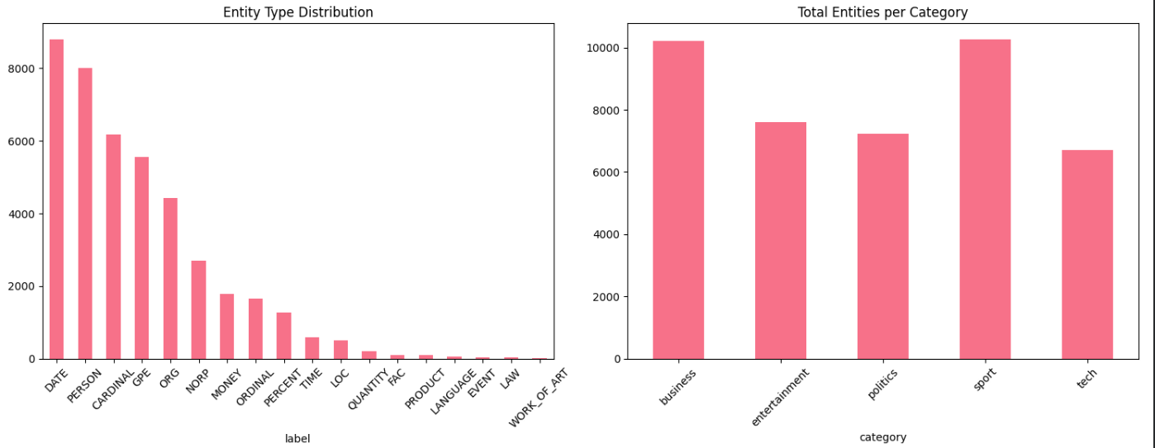
NAMED ENTITY RECOGNITION

Slide 13
THANK YOU

