Slide 1
Object Oriented Design Principles
March, 2010
Tin Bui

Slide 2
Principles of class design

Slide 3
SRP
The Single Responsibility Principle
  A class should have one, and only one, reason to change
☞
A class should only have one responsibility

Slide 4
OCP
The Open Closed Principle
  You should be able to extend a classes behavior, without modifying it
☞
Software entities (classes, modules, functions, etc) should be open for extension, but closed for modification.

Slide 5
SRP
The Open Closed Principle
  Open For Extension
    The behavior of the module can be extended
  Closed for Modification
    No one is allowed to make source code changes to it
☞
In a well designed program new features are added by adding new code, rather than by changing old, already working, code

Slide 6
LSP
The Liskov Substitution Principle
  Derived classes must be substitutable for their base classes
☞
If for each object o1 of type S there is an object o2 of type T such that for all programs P defined in terms of T, the behavior of P is unchanged when o1 is substituted for o2 then S is a subtype of T.

Slide 7
LSP
The Liskov Substitution Principle
  Violation of LSP example1
void drawShape(Shape s) {
if (s instanceof Square) {
drawSquare((Square) s);
} else if (s instanceof Circle) {
drawCircle((Circle) s);
}
}
void drawShape(Shape s) {
s.draw();
}

Slide 8
LSP
The Liskov Substitution Principle
  Violation of LSP example2
public class Rectangle {
private double width;
private double height;
public void setWidth(double w) {width=w;}
public void setHeight(double h) {height=h;}
public double getHeight()
{return height;}
public double getWidth()
{return width;}
}
class Square extends Rectangle {
public void setWidth(double w) {
super.setWidth(w); super.setHeight(w);
}
public void setHeight(double h) {
super.setWidth(h); super.setHeight(h);
}
}
void g(Rectangle r) {
r.setWidth(5);
r.setHeight(4);
assert(r.getWidth() * r.getHeight() ==20);
}
main (String[] arg) { g(new Square());
?

Slide 9
DIP
The Dependency Inversion Principle
  Depend on abstractions, not on concretions

Slide 10
DIP
The Dependency Inversion Principle
  Violation of DIP example
public class Switch {
private Lamp itsLamp;
public void detect() {
boolean buttonOn = getPhysicalState();
if (buttonOn) {
itsLamp.turnOn();
} else {
itsLamp.turnOff();
}
}
}
class Lamp {
public void turnOn() {
// turn the lamp on
}
public void turnOff() {
// turn the lamp off
}
}

Slide 11
DIP
The Dependency Inversion Principle
  Correct solution
public class Switch {
private SwitchClient itsLamp;
public void detect() {
boolean buttonOn = getPhysicalState();
if (buttonOn) {
itsLamp.turnOn();
} else {
itsLamp.turnOff();
}
}
}
interface SwitchClient {
public void turnOn();
public void turnOff();
}
class Lamp implements SwitchClient {
public void turnOn() {}
public void turnOff() {}
}

Slide 12
ISP
The Interface Segregation Principle
  Clients should not be forced to depend upon interfaces that they do not use
<<Interface>>
TimerClient
<<Interface>>
Door
<<Interface>>
TimerClient
<<Interface>>
Door
TimedDoor
TimedDoor

Slide 13
Package cohesion

Slide 14
What is really Reusability?
Does copy-paste mean reusability?
  Disadvantage: You own that copy!
    You must change it, fix bugs.
    Eventually the code diverges
  Maintenance is a nightmare
Martin’s Definition:
  I reuse code if, and only if, I never need to look at the source-code
  Treat reused code like a product ⇒ don’t have to maintain it
Clients (re-users) may decide on an appropriate time to use a newer version of a component release

Slide 15
REP
The Reuse/Release Equivalency Principle
  The granule of reuse is the granule of release
    There is no such thing as “reusable class”
  Only components that are released through a tracking system can be efficiently reused
    E.g. release numbers or names

Slide 16
CCP
The Common Closure Principle
  The classes in a package should be closed together against the same kinds of changes.
  A change that affects a package affects all the classes in that package
☞
Classes that change together are packaged together

Slide 17
CRP
The Common Reuse Principle
  The classes in a package are reused together
  If you reuse one of the classes in a package, you reuse them All
☞
Classes that are used together are packaged together

Slide 18
Couplings between packages

Slide 19
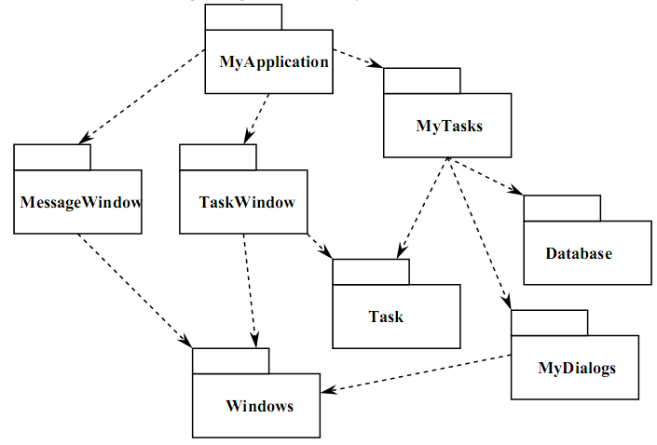
ADP
The Acyclic Dependencies Principle
  The dependency graph of packages must have no cycles

Slide 20
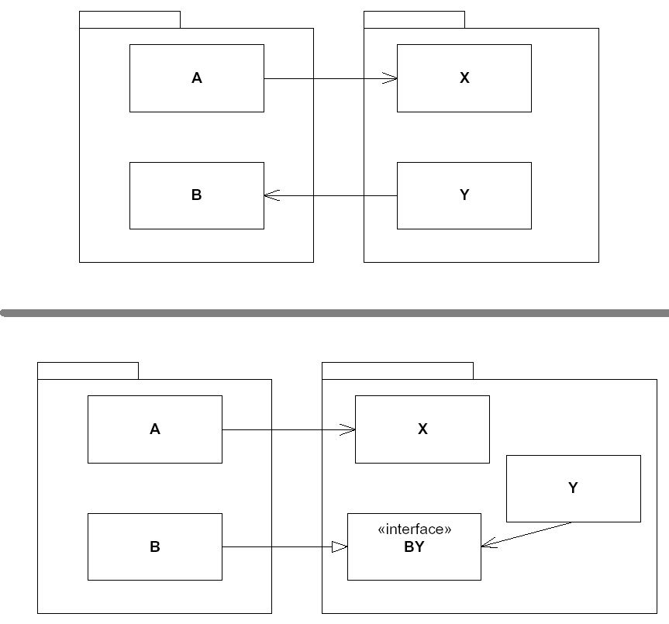
ADP
Breaking the Cycles

Slide 21
SDP
The Stable Dependencies Principle
  Depend in the direction of stability
☞
The dependencies between packages in a design should be in the direction of the stability of the packages
A package should only depend upon packages that are more stable that it is

Slide 22
SAP
The Stable Abstractions Principle
  Abstractness increases with stability
☞
Packages that are maximally stable should be maximally abstract
Instable packages should be concrete
The abstraction of a package should be in proportion to its stability

Slide 23
References
http://www.surfscranton.com/Architecture/ObjectOrientedDesignPrinciples.htm
Principles of High-Level Design.ppt (Dr. Radu Marinescu)

Slide 24
Thank you!

