Slide 1
JSP - Servlet
TMA VIOS Team
December, 2010

Slide 2
Content
Servlet
JavaServer Page (JSP)
Servet and JSP Integration
Web App structure and DD file

Slide 3
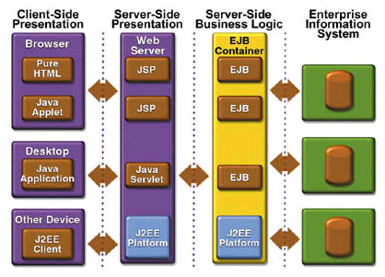
The JavaEE Architecture

Slide 4
Content
Servlet
JavaServer Page (JSP)
Servet and JSP Integration
Web App structure and DD file

Slide 5
Servlet
What is servlet?
  Servlet is a server-side class that handles requests from client (browser)

Slide 6
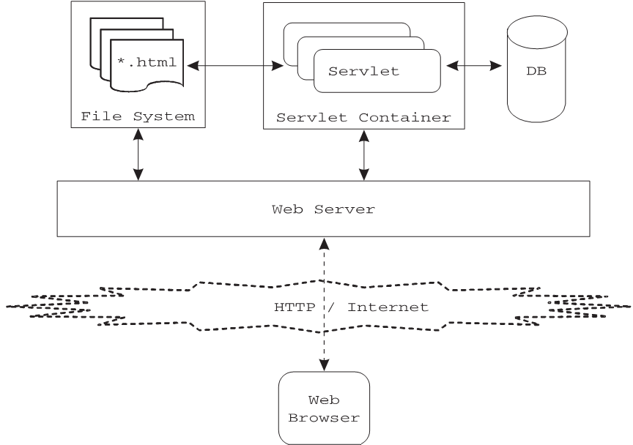
Servlet Container

Slide 7
Servlet Sample
import java.io.*;
import javax.servlet.*;
import javax.servlet.http.*;
public class HelloWorldServlet extends HttpServlet
{
public void service(HttpServletRequest request, HttpServletResponse response)
throws ServletException, IOException
{
String userName = request.getParameter("userName");
PrintWriter pw = response.getWriter();
pw.println("<html>");
pw.println("<head>");
pw.println("</head>");
pw.println("<body>");
pw.println("<h3>Hello " + userName + "</h3>");
pw.println("</body>");
pw.println("</html>");
}
}

Slide 8
Requests and Responses
What is a request?
  Information sent from client to a server
    Who made the request
    What data is sent
    Which HTTP headers are sent
What is a response?
  Information sent to client from a server
    Text(html, plain) or binary(image) data
    HTTP headers, cookies, etc

Slide 9
Requests and Responses
HttpServletRequest
  Encapsulates all request information
    Request headers
    Form data and query parameters
    Other client data {session info, cookies, path ...etc.}
  Some methods:
    String getParameter(String)
    Enumeration getParameters(String[])
    getContentType()

Slide 10
Requests and Responses
HttpServletResponse
  Encapsulates all data sent back to client
    Response headers
    OutputStream to write data to the client
    Setting cookies
  Some methods:
    Writer getWriter()
    ServletOutputStream getOutputStream()
    setContentType()

Slide 11
Servlet Life Cycle
init(ServletConfig);
doGet(HttpServletRequest,
HttpServletResponse);
service(ServletRequest, ServletResponse);
doPost(HttpServletRequest,
HttpServletResponse);
…….
destroy();

Slide 12
Servlet Life Cycle
Init
  Executed once when the servlet is first loaded.
  Not called for each request.
Service
  Called in a new thread by server for each request.
  Dispatches to doGet, doPost, etc.
  Do not override this method!
Destroy
  Called when server deletes servlet instance.
  Not called after each request.

Slide 13
HTTP Request
HTTP Request contains
  Header
  Method
    GET: Input form data is passed as part of URL
      E.g. http://www.google.com/search?text=TMA
    POST: Input form data is passed within message body
    PUT
    HEAD
  Data

Slide 14
GET and POST Methods
Are the most common client requests
GET requests:
  User entered information is appended to the URL in the query string
    E.g. http://www.google.com/search?text=TMA
  Can only send limited amount of data
  Process GET requests by overriding doGet() method
POST requests:
  User entered information is sent as data (not appended to URL)
  Can send any amount of data
  Process POST requests by overriding doPost() method

Slide 15
doGet() & doPost() Methods
doGet() & doPost() usually do:
  Get data from request
  Read/write attributes to/from Scope objects
  Perform some business logic or access database
  Optionally forward the request to other Web components (Servlet or JSP)
  Populate HTTP response message and send it to client

Slide 16
HTTP POST Example
HTML form:
  <FORM name='loginForm' method='POST' action='/loginServlet'>
  <input type='text' name='userid'>
  <input type='password' name='passwd'>
  <input type='submit' name='loginButton' value='Login'>
  </FORM>
Servlet code:
  public void doPost(HttpServletRequest req, HttpServletResponse res)
  {
  String user = req.getParameter("userid")
  String[] password = req.getParameter("passwd");
  //use the values and generate appropriate response
  }

Slide 17
Reading Request Headers
General
  getHeader (header name is not case sensitive)
  getHeaders
  getHeaderNames
Specialized
  getCookies
  getAuthType and getRemoteUser
  getContentLength
  getContentType
  getDateHeader
  getIntHeader
Related info
  getMethod, getRequestURI , getQueryString, getProtocol

Slide 18
Sharing Data between Servlets
Sharing data between servlets by using:
  ServletRequest
  HttpSession
  ServletContext
All of the classes above have these methods:
  Object getAttribute (String name)
  Enumeration getAttributeNames()
  void setAttribute (String name, Object value)

Slide 19
Redirecting
Resend the request to another server
Example
if("java".equals(request.getParameter("searchText"))) {
PrintWriter pw = response.getWriter();
pw.println("<html>head></head>body>");
pw.println("<h3> Java is an OOP programming language</h3>");
pw.println("</body></html>");
} else {
response.sendRedirect("http://www.google.com.vn/#q=" + searchText );
}

Slide 20
Forwarding
Forward the request to another component in the same server
Example
RequestDispatcher rd =
request.getRequestDispatcher("/servlet/AccountServlet");
rd.forward(request, response);

Slide 21
Session
Web app interacts with more than one user at the same time
Session is used to track the interaction between a user and the web app

Slide 22
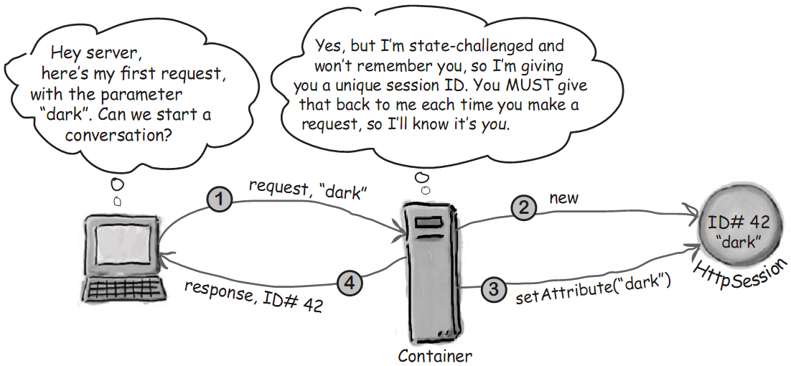
Session Management (1)

Slide 23
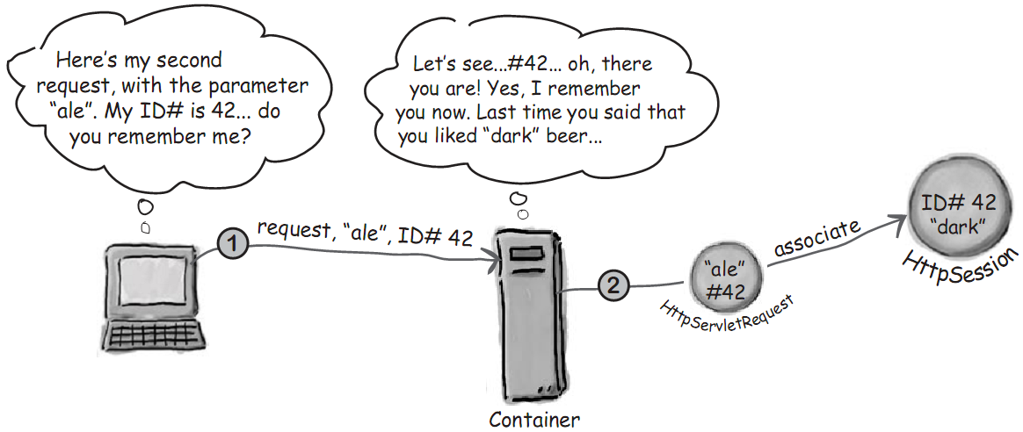
Session Management (2)

Slide 24
HttpSession class
Using HttpSession is usually a three-step process:
  1 Retrieve the session associated with the request
  2 Add or remove name-value pairs of attributes from the session
  3 Invalidate the session if required

Slide 25
HttpSession class
Example
//code for the doPost() method of ShoppingCartServlet
public void doPost(HttpServletRequest req, HttpServletResponse res){
HttpSession session = req.getSession(true);
List listOfItems = (List) session.getAttribute("listofitems");
if(listOfItems == null){
listOfItems = new ArrayList();
session.setAttribute("listofitems", listOfItems);
}
String itemcode = req.getParameter("itemcode");
String command = req.getParameter("command");
if("additem".equals(command) ) {
listOfItems.add(itemcode);
}else if("removeitem".equals(command) ) {
listOfItems.remove(itemcode);
}
}

Slide 26
Content
Servlet
JavaServer Page (JSP)
Servet and JSP Integration
Web App structure and DD file

Slide 27
JavaServer Pages
What is a JSP page?
  A web page that contains Java code along with the HTML tags

Slide 28
Example
<html>
  <body>
  Hello World!
  <br>Current time is <%= new java.util.Date() %>
  </body>
</html>

Slide 29
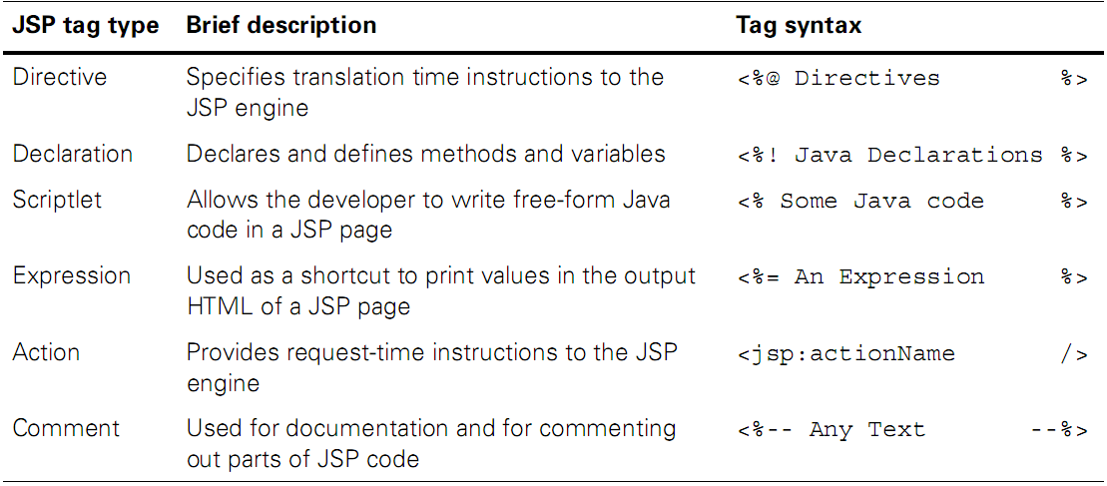
JSP Element Types

Slide 30
JSP Element Types
Example
<html><body>
<%@ page language="java" %> ← Directive
<%! int count = 0; %> ← Declaration
<% count++; %> ← Scriptlet
Welcome! You are visitor number
<%= count %> ← Expression
<jsp:include page="copyright.jsp" /> ← Action
</body></html>

Slide 31
JSP Element Types
Directives
  Provide general information about the JSP page to the JSP engine
  There are three types of directives:
    Page: overall properties of a JSP page
      E.g. <%@ page language="java" %>
    Include: include the contents of another file
      E.g. <%@ include file="copyright.html" %>
    Taglib: associate a prefix with a tag library
      E.g. <%@ taglib prefix="test" uri="taglib.tld" %>

Slide 32
JSP Element Types
Directive attributes:
  import: import other java classes
    E.g. <%@ page import="java.util.*, java.io" %>
  session: whether the JSP page takes part in
    Default is true
    E.g. <%@ page session="false" %>
  errorPage and isErrorPage
    <%@ page errorPage="errorHandler.html" %>
    <%@ page isErrorPage="true" %>
  extends: provide base class of the generated servlet
    E.g. <%@ page extends="mypackage.MySpecialBaseServlet" %>

Slide 33
errorPage/isErrorPage Example
errorPage
isErrorPage
<%@ page errorPage="errorHandler.jsp" %>
<html><body>
<%
if (request.getParameter("name")==null) {
throw new RuntimeException("Name not specified");
}
%>
Hello, <%=request.getParameter("name")%>
</body></html>
<%@ page isErrorPage="true" %>
<html><body>
Unable to process your request: <%=exception.getMessage()%><br>
Please try again.
</body></html>

Slide 34
JSP Element Types
Actions
  Are commands given to the JSP engine
  E.g. <jsp:include page="copyright.jsp" />
  There are six standard JSP actions:
    jsp:include
    jsp:forward
    jsp:useBean
    jsp:setProperty
    jsp:getProperty
    jsp:plugin
  Syntax of a JSP action:
    <jsp:actionName attribute-list />

Slide 35
JSP Pages Are Servlets
JSP page actually runs as a servlet
JSP engine
JSP page
Servlet

Slide 36
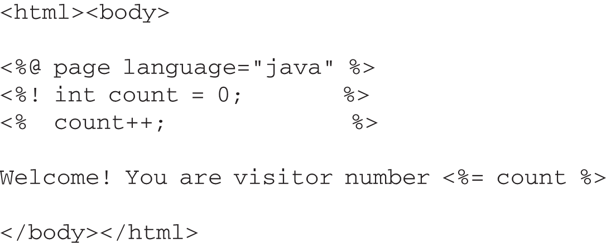
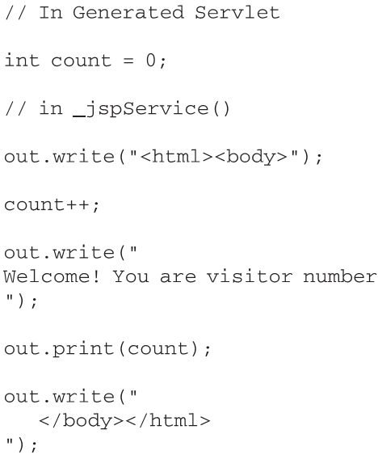
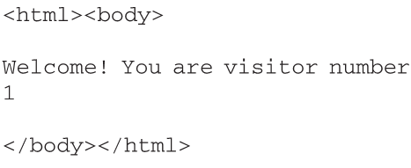
JSPs to Servlets
Translation
Time
Request
Time

Slide 37
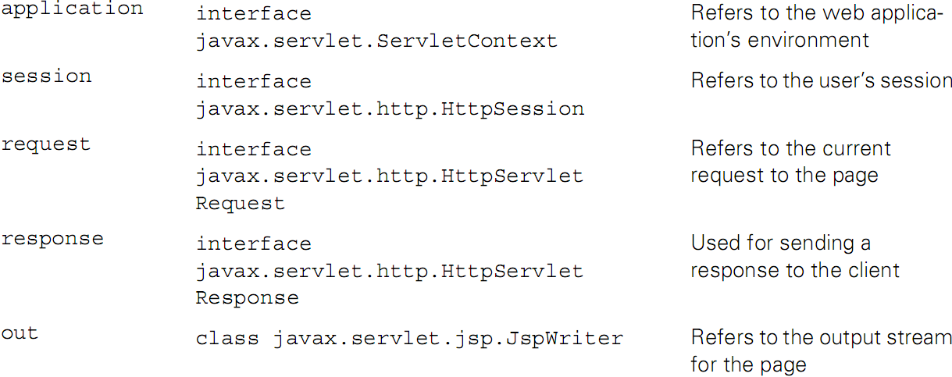
JSP Predefined Variables

Slide 38
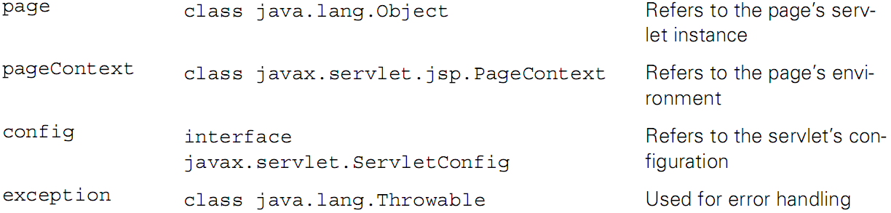
JSP Predefined Variables

Slide 39
Jsp Pages As XML Documents
JSP specification defines two sets of syntax:
  Standard JSP syntax
    We have already seen this syntax in previous slide
  XML syntax format
    The JSP file in this format called JSP documents

Slide 40
XML Syntax Example
<jsp:root
xmlns:jsp=http://java.sun.com/JSP/Page version="2.0"> ← XML name space
<html><body>
<jsp:directive.page language="java" />
<jsp:declaration>
int count = 0;
</jsp:declaration>
<jsp:scriptlet>count++; </jsp:scriptlet>
<jsp:text>Welcome! You are visitor number</jsp:text>
<jsp:expression>count</jsp:expression>
</body></html>
</jsp:root>

Slide 41
JSP Syntaxes
Two important points:
  The standard JSP tags and XML-based tags cannot be mixed within a single JSP page
  A page written in one syntax format can include or forward to a page in the other syntax format

Slide 42
EL: Expression Language
Why we use EL?
  Web page designers shouldn’t have to know Java
  Java code in a JSP is hard to change and maintain

Slide 43
Purpose of EL
Offer a simpler way to invoke Java code
Writing the actual functionality (method code) is not the purpose of EL
You write the Java methods somewhere else, and call them in your JSP using EL

Slide 44
EL Example
Please contact: ${applicationScope.mail}
Is the same as this Java expression:
Please contact: <%= application.getAttribute(“mail”) %>

Slide 45
Using Beans
Scripting
No scripting
<html><body>
<% foo.Person p = (foo.Person) request.getAttribute(“person”); %>
Person is: <%= p.getName() %>
</body></html>
<html><body>
<jsp:useBean id=”person” class=”foo.Person” scope=”request” />
Person created by servlet: <jsp:getProperty name=”person” property=”name” />
</body></html>

Slide 46
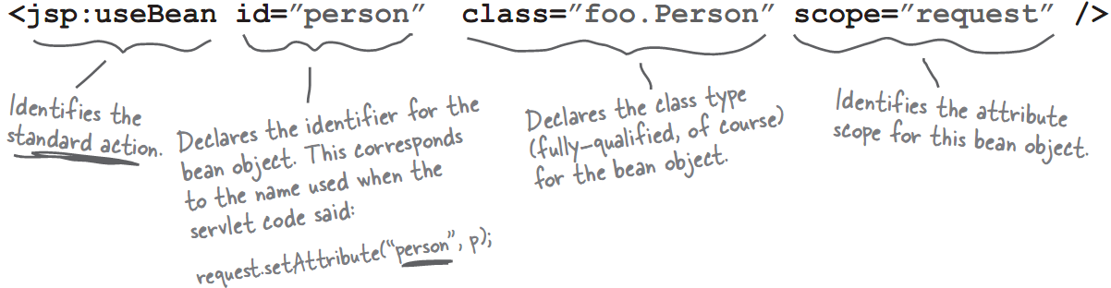
Using Beans
Explanation
<jsp:useBean> can also
CREATE a bean if it does
not exist!

Slide 47
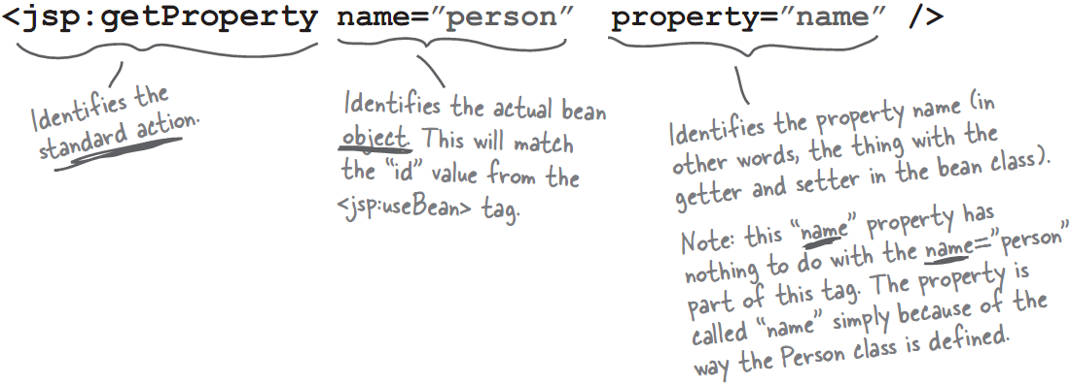
Using Beans
Explanation

Slide 48
Using Beans
Use setProperty action
<jsp:useBean id=”person” class=”foo.Person” scope=”page” >
<jsp:setProperty name=”person”
property=”name” value=”Fred” />
</jsp:useBean >

Slide 49
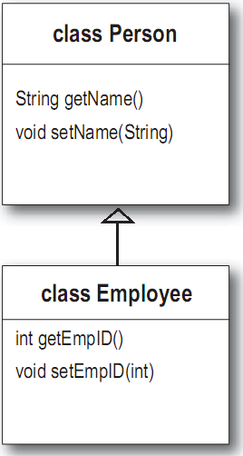
Using Beans
type ==reference type
class == object type
useBean with type attribute
  To make polymorphic bean references
<jsp:useBean id=”person” type=”foo.Person”
class=”foo.Employee” scope=”page”>
Will be
Translated to
foo.Person person = null;
// code to get the person attribute
if (person == null){
person = new foo.Employee();
}

Slide 50
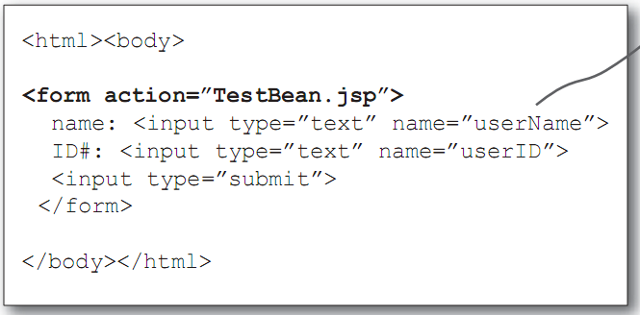
Using Beans
useBean with param attribute
<jsp:useBean id=”person” type=”foo.Person” class=”foo.Employee”>
<jsp:setProperty name=”person” property=”name” param=”userName” />
</jsp:useBean>
Param attribute can be removed if the property is the same as the field name in the form

Slide 51
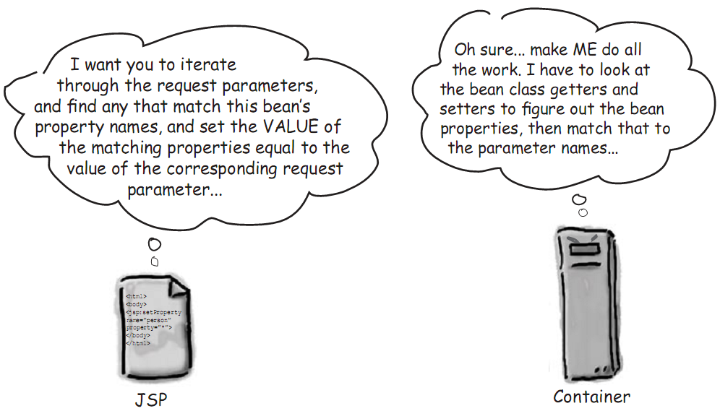
Using Beans
It gets even BETTER...
<jsp:useBean id=”person” type=”foo.Person” class=”foo.Employee”>
<jsp:setProperty name=”person” property=”*” />
</jsp:useBean>

Slide 52
JavaBean Advantage
With given form:
<html><body>
Please give your address:<br>
<form action="address.jsp">
Street: <input type="text" name="street"><br>
City: <input type="text" name="city"><br>
State: <input type="text" name="state"><br>
Zip: <input type="text" name="zip"><br>
<input type="submit"><br>
</form>
</body></html>

Slide 53
JavaBean Advantage
If don’t use bean, we have to:
  Check if an AddressBean object already exists in the session.
  If not, create a new AddressBean object and add it to the session.
  Call request.getParameter() for all the HTML FORM fields.
  Set the respective values into the AddressBean object.

Slide 54
JavaBean Advantage
The scriptlet will be:
<%@ page import="chapter14.AddressBean" %>
<% AddressBean address = null;
synchronized(session){
//Get an existing instance
address = (AddressBean) session.getAttribute("address");
//Create a new instance if required
if (address==null) {
address = new AddressBean();
session.setAttribute("address", address);
}
//Get the parameters and fill up the address object
address.setStreet(request.getParameter("street"));
address.setCity(request.getParameter("city"));
address.setState(request.getParameter("state"));
address.setZip(request.getParameter("zip"));
}%>

Slide 55
JavaBean Advantage
If we use bean, the code will be:
<%@ page import="chapter14.AddressBean" %>
<jsp:useBean id="address"
class="AddressBean"
scope="session" />
<jsp:setProperty name="address"
property="*" />

Slide 56
Content
Servlet
JavaServer Page (JSP)
Servet and JSP Integration
Web App structure and DD file

Slide 57
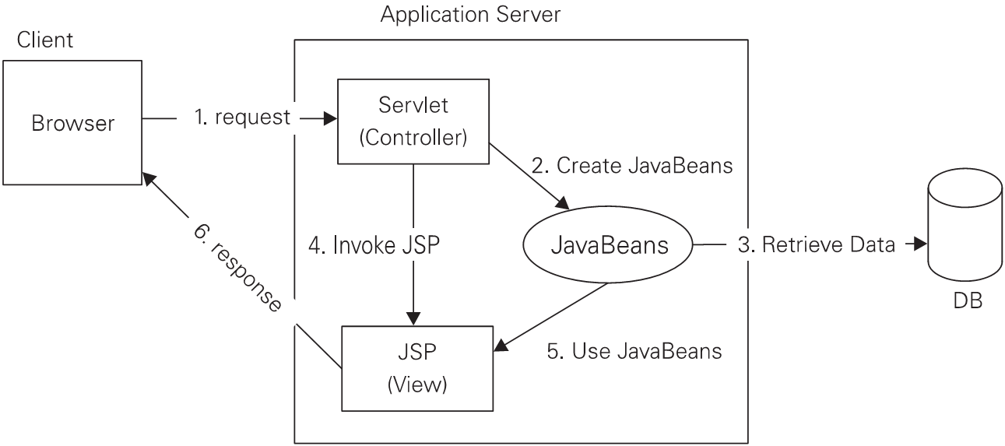
JSP and Servlet Integration
Why combine Servlets & JSP?
➔ MVC

Slide 58
JSP and Servlet Integration
Servlets
  Control the business logic
  Developed by Java programmers
JavaServer Pages
  Similar in structure to HTML pages
  Written by web page designers

Slide 59
JSP and Servlet Integration
Implementing MVC with RequestDispatcher:
  Define beans to represent the data
  Use a servlet to handle requests
  Populate the beans
  Store the bean in the request, session, or servlet context
  Forward the request to a JSP page.
  Extract the data from the beans.

Slide 60
JSP and Servlet Integration
Example
  Servlet
  JSP
  ValueObject value = new ValueObject(...);
  HttpSession session = request.getSession();
  session.setAttribute("key", value);
  RequestDispatcher dispatcher = request.getRequestDispatcher(
  "/WEB-INF/SomePage.jsp");
  dispatcher.forward(request, response);
  <jsp:useBean id="key" type="somePackage.ValueObject"
  scope="session" />
  <jsp:getProperty name="key" property="someProperty" />

Slide 61
Content
Servlet
JavaServer Page (JSP)
Servet and JSP Integration
Web App structure and DD file

Slide 62
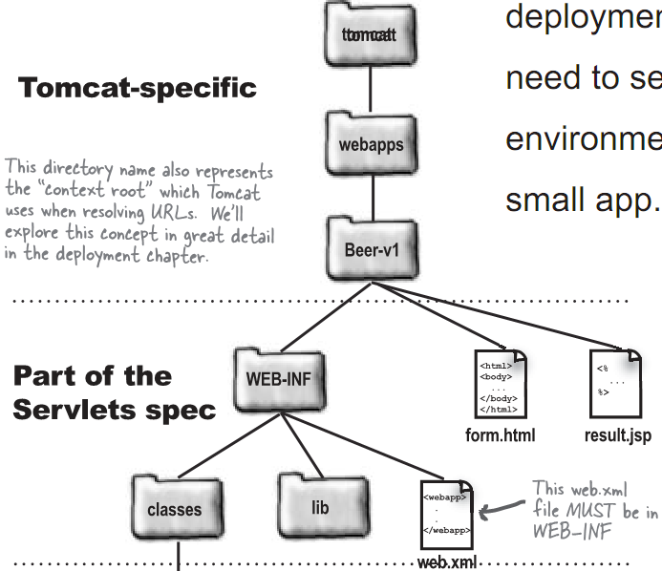

Web App Structure
Tomcat installed dir
Application dir

Slide 63
web.xml
Deployment Descriptor file (or DD file)
<?xml version=”1.0” encoding=”ISO-8851-1” ?>
<web-app xmlns=”http://java.sun.com/xml/ns/j2ee”
xmlns:xsi=”http://www.w3.org/2001/XMLSchema-instance”
xsi:schemaLocation=”http://java.sun.com/xml/ns/j2ee
http://java.sun.com/xml/ns/j2ee/web-app_2_4.xsd” version=”2.4”>
<servlet>
<servlet-name>Chapter1 Servlet</servlet-name>
<servlet-class>Ch1Servlet</servlet-class>
</servlet>
<servlet-mapping>
<servlet-name>Chapter1 Servlet</servlet-name>
<url-pattern>/Serv1</url-pattern>
</servlet-mapping>
</web-app>

Slide 64
References
SCWCD Exam Study Kit Second Edition (Manning)
Head First Servlets & JSP (O’Reilly)
Servlet-Jsp (TMA Training Center)
http://www.java2s.com/Tutorial/Java/0380__JSTL/Catalog0380__JSTL.htm

Slide 65
Q/A

Slide 66
Thank you!

