Slide 1

Java Generic Programming
Tin Bui
August 2009

Slide 2
Goals
To understand the objective of generic programming
To be able to implement generic classes and methods
To understand the execution of generic methods in the virtual machine
To know the limitations of generic programming in Java
To understand the relationship between generic types and inheritance
To learn how to constrain type variables

Slide 3
What is generic programming?
Generic programming: creation of programming constructs that can be used with many different types
  In Java, achieved with inheritance
  Or with type variables (i.e. generic)

Slide 4
Why generic?
Given method
  public void print(Integer aValue){
  System.out.println(aValue);
  }
Without generic, how to apply this method for any other type?
  public void print(Integer aValue){
  System.out.println(aValue);
  }
  public void print(String aValue){
  System.out.println(aValue);
  }
  public void print(JButton aValue){
  System.out.println(aValue);
  }
  ...

Slide 5
Why generic?
Without Generic
Vector v = new Vector();
// push in
v.add("One");
v.add(new Integer(2));
v.add(new JButton("Three"));
// pop out
String s = (String) v.get(0);
Integer i = (Integer) v.get(1);
JButton b = (JButton) v.get(2);
Integer ii = (Integer) v.get(0);// Exception
Generic → code safer
Vector<String> vStr = new Vector<String>();
vStr.add("Hello"); // Only accept string
String s2 = vStr.get(0);

Slide 6
Generic or Type Variable
Type is declared as a variable e.g. E, T
  public <T> void print(T aValue){
  System.out.println(aValue);
  }
  Public void callPrint() {
  Integer a = 5;
  this.<Integer>print(a);
  }

Slide 7
Generic in Classes
public class Pair<T, S> {
public Pair(T f, S s) {
first = f; second = s;
}
public Pair() {
}
public T getFirst() { return first; }
public S getSecond() { return second; }
private T first;
private S second;
public static void main(String[] args) {
Pair<String, Integer> p1;
Pair<Boolean, Short> p2;
p1 = new Pair<String, Integer>(“one”, 2);
p2 = new Pair<Boolean, Short>();
}
}

Slide 8
Syntax - Defining a Generic in Class
accessSpecifier class ClassName <TypeVariable1,
TypeVariable2, . . .>
{
constructors
methods
fields
}
Example:
public class Pair<T, S>
{
. . .
}
Purpose:
To define a generic class with methods and fields that
depend on type variables

Slide 9
Syntax - Instantiating a Generic Class
GenericClassName<Type1, Type2, . . .>
Example:
ArrayList<BankAccount> = new ArrayList<BankAccount>()
HashMap<String, Integer>
Purpose:
To supply specific types for the type variables of a
generic class

Slide 10
Generic in Methods
Generic method: method with type variables
Can be defined inside ordinary or generic classes
When calling a generic method, you need not instantiate the type variables:
public <E extends Number> int sum(E[] a) {
int ret = 0;
for (E e : a) {
ret += e.intValue();
}
return ret;
}
Integer a[] = new Integer[5]
…
int s = this.<Integer>sum(a);

Slide 11
Type Variables
Can be instantiated with class or interface types
Cannot use a primitive type as a type variable
Use corresponding wrapper class instead
ArrayList<BankAccount>
ArrayList<Measurable>
ArrayList<double> // Wrong!
ArrayList<Double>

Slide 12
Constraining Type Variables
Type variables can be constrained with bounds
  extends
  super
public static <E extends Comparable> E min(E[] a)
{
E smallest = a[0];
for (int i = 1; i < a.length; i++)
if (a[i].compareTo(smallest) < 0) smallest = a[i];
return smallest;
}

Slide 13
Constraining Type Variables
Very occasionally, you need to supply two
or more type bounds
extends, when applied to type variables,
actually means "extends or implements"
The bounds can be either classes or
interfaces
<E extends Comparable & Cloneable>

Slide 14
Wildcard Types
Name | Syntax | Meaning
Wildcard with lower bound | <? extends B> | Any subtype of B
Wildcard with upper bound | <? super B> | Any supertype of B
Unbounded wildcard | <?> | Any type
static void reverse(List<?> list)
=?
static <T> void reverse(List<T> list)

Slide 15
Polymorphism and Generics
Legal
Illegal
List<String> ls = new ArrayList<String>();
class Parent { }
class Child extends Parent { }
List<Parent> myList = new ArrayList<Child>();

Slide 16
Generic and Wildcard
Wildcard can be used to accept any type
Generic with wildcard is read only
But
List<String> ls = new ArrayList<String>();
List<? extends Object> l2 = ls; // OK
List<?> l3 = ls; // OK
List<?> lo = new ArrayList<String>();
lo.add(""); // Compile Error
List<? super String> lo = new ArrayList<String>();
lo.add(""); // OK

Slide 17
Generic and Non-generic
Legacy reference can legally refer to generic instance
Generic reference can legally refer to legacy instance
List<String> ls1=new ArrayList<String>();
List l1 = ls1;
l1.add(new Integer(10)); // still OK
String s = ls1.get(0); // Compiled,
// but cause cast exception
List l2 = new ArrayList();
List<String> ls2 = l2;

Slide 18
Raw Types
The virtual machine works with raw types, not with generic classes
Type variables are erased and replaced by their bounding types (or Object if no bounds)
This is done to provide backwards compatibility with older non generic Java code.

Slide 19
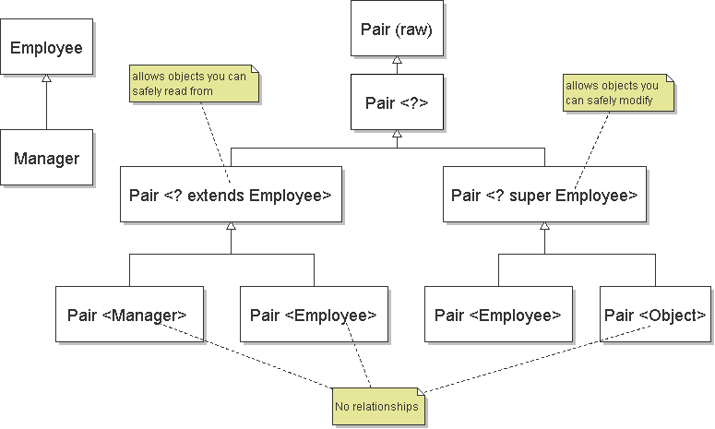
Inheritance rules for generic types

Slide 20
Restrictions and limitations
Instantiations of generic parameter T (or array of it) are not allowed
But this is OK
new T () // ERROR: whatever T to produce?
new T [10] // ERROR: Generic Array Creation
new Digit<Double>[] // ERROR: Generic Array Creation
Gen<Double>[] gs = new Gen[10];
gs[1] = new Gen1<Double>();

Slide 21
Sumary
Generic class
Generic method
public class Pair<T, S> {
…
}
➔
Pair<String, Integer> p1
= new Pair<String,Integer>(“one”, 2);
public <E> E sum(E[] a) {
…
}
➔
Integer[] a1;
Integer s = sum(a1);

Slide 22
???
huytin@gmail.com
Thank you!

