Slide 1
TMA Training Center (TTC)
Java Socket Programming
Course | Java Socket programming
Trainer | Tin Bui
Designed by | Tin Bui
Last updated | April 30, 2008

Slide 2
Course Objectives
Have ability of developing java network application using socket.

Slide 3
Contents
I/O handling and Multi-thread programming
  I/O streams
  Multi-thread
  Lab practice
Socket programming
  Stream Socket (TCP)
  Lab practice
  Datagram Socket (UDP)
  Lab practice
  Exercise
Non-Blocking socket programming with nio
  Nio (New I/O)
  Non-Blocking Socket Programming
  Lab Practice

Slide 4
Why trainees should learn this topic?
Socket is a good way to implements network protocols such as: telnet, ftp, http...
Java socket is one of the easiest way to program socket applications.

Slide 5
When trainees should apply this technique?
To understand the implementation of protocols.
To implement a protocol yourself.
To implement an application which requires low-level network communication
To develop a network application but web application.

Slide 6
Contents
I/O handling and Multi-thread programming
  I/O streams
  Multi-thread
  Lab practice
Socket programming
  Stream Socket (TCP)
  Lab practice
  Datagram Socket (UDP)
  Lab practice
  Exercise
Non-Blocking socket programming with nio
  Nio (New I/O)
  Non-Blocking Socket Programming
  Lab Practice

Slide 7
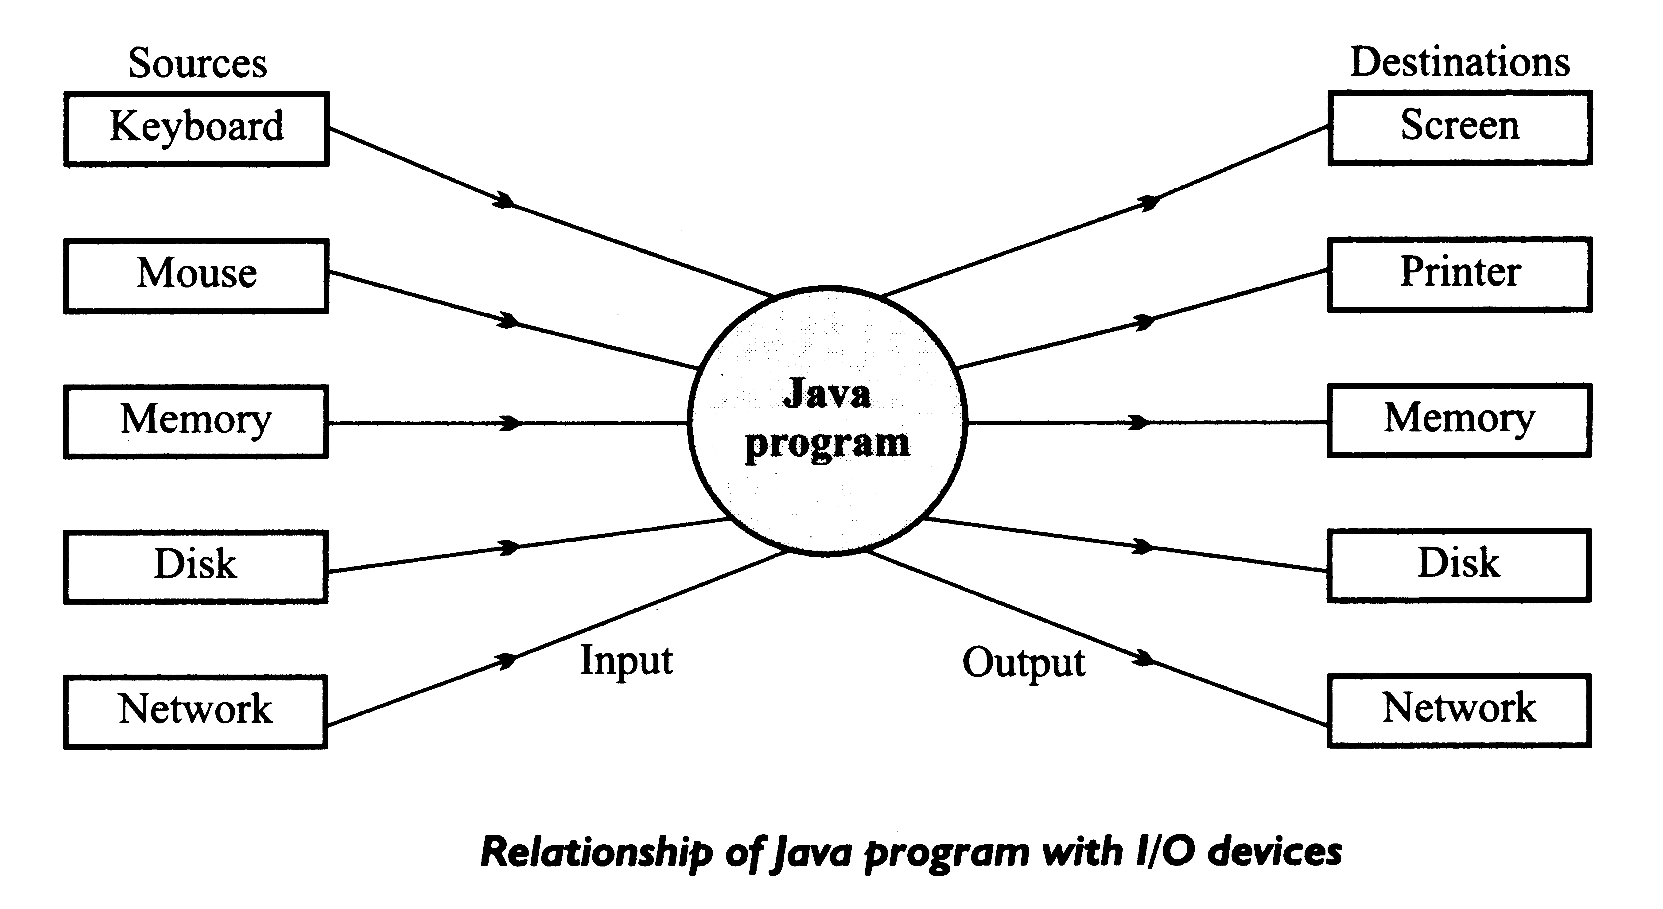
I/O and Data Movement
Data may come from different sources
Data may go to different destinations.

Slide 8
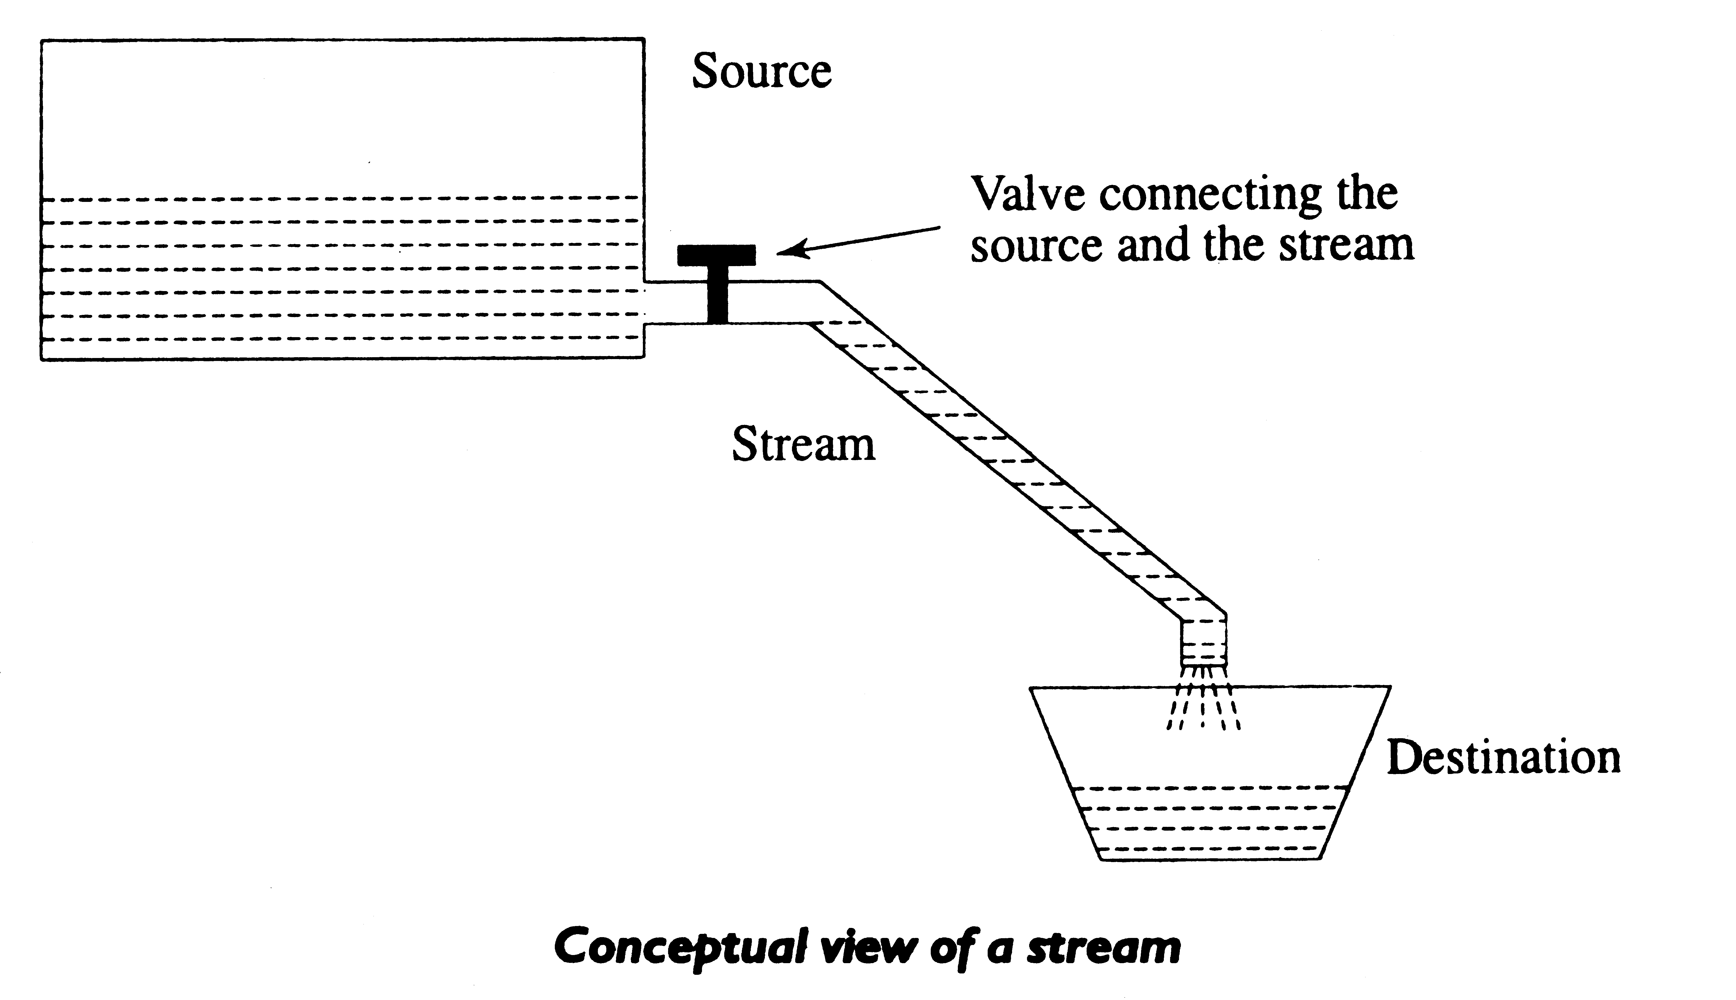
Stream
A stream is a sequence of data
Streams are designed to be platform-independent

Slide 9
Input streams – Output streams
Based on directional flow:
Input Streams:
  Through inheritance, all derivatives of InputStream class have the basic method “read()”
Output Streams:
  Through inheritance, all derivatives of OutputStream class have the basic method “write()”
reads
Source
Program
Program
Source
writes

Slide 10
Byte streams – Character streams
Based on the data type:
Byte Streams:
  Operated on 8 bit (1 byte) data
Basic classes
  java.io.InputStream
  java.io.OutputStream
Character Streams:
  Operates on 16-bit (2 byte) unicode characters.
Basic classes
  java.io.Reader
  java.io.Writer

Slide 11
Input Byte-Streams
java.io.InputStream
+ java.io.ByteArrayInputStream
+ java.io.FileInputStream
+ java.io.FilterInputStream
+ java.io.BufferedInputStream
+ java.io.DataInputStream
+ java.io.LineNumberInputStream
+ java.io.PushbackInputStream
+ java.io.ObjectInputStream
+ java.io.PipedInputStream
+ java.io.SequenceInputStream
+ java.io.StringBufferInputStream

Slide 12
Output Byte-Streams
java.io.OutputStream
+ java.io.ByteArrayOutputStream
+ java.io.FileOutputStream
+ java.io.FilterOutputStream
+ java.io.BufferedOutputStream
+ java.io.DataOutputStream
+ java.io.PrintStream
+ java.io.ObjectOutputStream
+ java.io.PipedOutputStream

Slide 13
Input Character-Streams
java.io.Reader
+ java.io.BufferedReader
+ java.io.LineNumberReader
+ java.io.CharArrayReader
+ java.io.FilterReader
+ java.io.PushbackReader
+ java.io.InputStreamReader
+ java.io.FileReader
+ java.io.PipedReader
+ java.io.StringReader
java.io.StreamTokenizer

Slide 14
Output Character-Streams
java.io.Writer
+ java.io.BufferedWriter
+ java.io.CharArrayWriter
+ java.io.FilterWriter
+ java.io.OutputStreamWriter
+ java.io.FileWriter
+ java.io.PipedWriter
+ java.io.PrintWriter
+ java.io.StringWriter

Slide 15
Stream Wrappers
Streams can be wrapped
by other streams
E.g.
InputStream inputStream = System.in;
BufferedReader keyboard = new BufferedReader(
new InputStreamReader(inputStream));
Byte Stream
BufferedReader
InputStream
InputStreamReader
Data
Character Stream

Slide 16
Stream – example 1
E.g. 1. Write object to file
public void writeObjectToFile(String fileName, Object object) {
FileOutputStream fos = new FileOutputStream(fileName);
ObjectOutputStream oos = new ObjectOutputStream(fos);
oos.writeObject(object);
oos.close();
}

Slide 17
Stream – example 2
E.g. 1. Read a text file
public String readTextFile2(String fileName) {
StringBuffer result = new StringBuffer("");
FileInputStream f1 = new FileInputStream(fileName);
BufferedReader reader = new BufferedReader(
new InputStreamReader(f1));
while (true) {
String line = reader.readLine();
if (line == null) {break;}
result.append(line + "\n");
}
}

Slide 18
Contents
I/O handling and Multi-thread programming
  I/O streams
  Multi-thread
  Lab practice
Socket programming
  Stream Socket (TCP)
  Lab practice
  Datagram Socket (UDP)
  Lab practice
  Exercise
Non-Blocking socket programming with nio
  Nio (New I/O)
  Non-Blocking Socket Programming
  Lab Practice

Slide 19
Multi-Thread Programming
Task1
Task 2
Task 3
Task 2 and task 3 are executed
concurrently

Slide 20
Creating a New Thread
There are two ways to create our own Thread object
  Extending the Thread class
  Implementing the Runnable interface
In both cases the run() method should be implemented
class RunnableExample implements Runnable {
public void run() {
for (int i= 1; i <= 50;i++) {
System.out.println(“Running: i= " + i);
Thread.currentThread().sleep(100);
}
System.out.println("Exited");
}
}

Slide 21
Starting a Thread
A thread object (extend Thread class)
public static void main (String argv[]) {
ThreadExample thread1 = new ThreadExample();
thread1.start ();
}
A Runnable object (implement Runnable interface).
public static void main (String argv[]) {
RunnableExample runnable1 = new RunnableExample();
Thread thread1 = new Thread(runnable1);
thread1.start ();
}

Slide 22
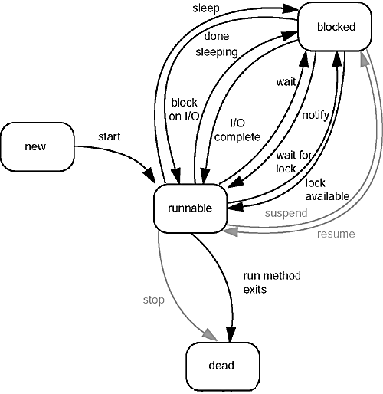
Thread States

Slide 23
Thread Priority
In Java, each thread is assigned priority, which affects the order in which it is scheduled for running.
Initial priority is the same as the creating thread.
Java allows users to change priority:
    threadName.setPriority(intNumber)
      MIN_PRIORITY = 1
      NORM_PRIORITY=5
      MAX_PRIORITY=10

Slide 24
Synchronization
If one thread tries to read the data and other thread tries to update the same data, it leads to inconsistent state.
This can be prevented by synchronizing access to the data.
Use “synchronized” keyword for statements or methods.
  Synchronized method:
public synchronized void update()
{
…
}
  Synchronized statement:
Object synOnThis = new Integer(10);
synchronized (synOnThis) {
x = x+10;
}

Slide 25
Wait for a thread to terminate
Thread.join()
Thread.join(long minutes)
Thread.join(long minutes, long nanos)
public static void main(String args[]) {
Thread a1 = new MyThread();
a1.start();
a1.join(2);
// wait until a1 stop or 2-minute waiting time is over.
// other tasks
...
}

Slide 26
Object class’s methods: wait(), notify(), notifyAll()
wait()
Lets one thread wait until some condition occurs
notify()
notifyAll()
notifyAll and notify tell waiting threads that something has occurred that might satisfy that condition

Slide 27
Example wait(), notify(), notifyAll()
static LinkedList queue;
public Object threadQueueDequeue() {
synchronized (queue) {
Object entry = null;
if (queue.isEmpty()) {
queue.wait();
}
if (!queue.isEmpty()) {
entry = queue.removeFirst();
}
return entry;
}
}
public static void threadQueueEnqueue(Object o) {
synchronized (queue) {
if (!queue.contains(o)) {
queue.addLast(o);
queue.notify();
}
}
}
The object must be synchronized before calling
wait(), notify() and notifyAll()

Slide 28
Thread example 1
class A extends Thread {
public void run() {
for (int i = 1; i <= 50; i++) {
System.out.println("Thread A running i=" + i);
try {
sleep(100);
} catch (InterruptedException e) {
e.printStackTrace();
}
}
System.out.println("Exit from A");
}
}
class B implements Runnable {
public void run() {
for (int j = 1; j <= 50; j++) {
System.out.println(“Thread B running j=" + j);
try {
Thread.currentThread().sleep(100);
} catch (InterruptedException e) {
e.printStackTrace();
}
}
System.out.println("Exit from B");
}
}
class ThreadTest {
public static void main(String args[]) {
new A().start();
new Thread(new B()).start();
}
}

Slide 29
Thread example 2 – Producer/Consumer
Producer: generate integers and put them into a queue.
  Do nothing if the queue is full.
Consumer: get the integers from the queue and process them.
  If the queue is empty, wait there until being notified.

Slide 30
Thread example 2 – Producer/Consumer
import java.util.LinkedList;
import java.util.Random;
public class SampleThread {
public static void main(String[] args) {
Producer p = new Producer();
Consumer c = new Consumer(p.getDataList());
p.start();
new Thread(c).start();
}
}

Slide 31
Producer
class Producer
extends Thread {
private LinkedList<Integer> dataList
= new LinkedList<Integer> ();
public LinkedList getDataList() {
return dataList;
}
public void run() {
final int MAX_DATA = 3;
int value = 100;
while (true) {
try {
sleep(400 + value);
} catch (InterruptedException ex) {
ex.printStackTrace();
}
int loopTime = (value % 3) + 1;
for (int i = 0; i < loopTime; i++) {
if (dataList.size() >= MAX_DATA) {
System.out.println("Data queue is full!");
continue;
}
Random rd = new Random();
value = rd.nextInt(100);
System.out.println("Generating next data: " + value);
synchronized (dataList) {
dataList.add(value);
dataList.notify();
}
}
}
}
}

Slide 32
Consumer
class Consumer implements Runnable {
public LinkedList<Integer> dataList;
public Consumer(LinkedList<Integer> dataList) {
this.dataList = dataList;
}
public void run() {
if (dataList == null) { return;}
while (true) {
int data = getData();
processData(data);
}
}
private void processData(int data) {
try {
Thread.currentThread().sleep(160 + new Random().nextInt(100));
} catch (InterruptedException ex) { }
System.out.println("Processing data: " + data);
}
private int getData() {
synchronized (dataList) {
int data = 0;
if (dataList.isEmpty()) {
try {
System.out.println("Data list is empty! waiting...");
dataList.wait();
}
catch (InterruptedException ex) {
ex.printStackTrace();
}
}
if (!dataList.isEmpty()) {
data = dataList.removeFirst();
}
return data;
}
}

Slide 33
Contents
I/O handling and Multi-thread programming
  I/O streams
  Multi-thread
  Lab practice
Socket programming
  Stream Socket (TCP)
  Lab practice
  Datagram Socket (UDP)
  Lab practice
  Exercise
Non-Blocking socket programming with nio
  Nio (New I/O)
  Non-Blocking Socket Programming
  Lab Practice

Slide 34
Lab practice
Write a program with 2 threads: one read keyboard input, one print data out to screen and save it to a file. The threads will terminate if user inputs “quit”

Slide 35
Contents
I/O handling and Multi-thread programming
  I/O streams
  Multi-thread
  Lab practice
Socket programming
  Stream Socket (TCP)
  Lab practice
  Datagram Socket (UDP)
  Lab practice
  Exercise
Non-Blocking socket programming with nio
  Nio (New I/O)
  Non-Blocking Socket Programming
  Lab Practice

Slide 36
What is socket?
The combination of an IP address and a port number. (RFC 793 ,original TCP specification)
APIs for applications using TCP/IP protocols
One end-point of a two-way communication link between two programs running on the network
Server
Client
Network
Sockets

Slide 37
Stream socket vs. Datagram socket
Stream Socket
(Connection oriented)
Datagram Socket
(Connectionless)
Application
Application
TCP
UDP
TCP/IP

Slide 38
Stream socket vs. Datagram socket
Stream socket
Client-server connection established
Data sent as stream
Client
Server
Datagram socket
No connection established
Data sent as individual packets
Client
Server

Slide 39
Stream socket vs. Datagram socket
Stream Socket
  Establishes a connection between client and server.
  TCP provides reliable, in-order transfer of bytes between client and server
Datagram Socket
  UDP: no “connection” between client and server
  No handshaking
  Data may be received out of order, or lost

Slide 40
java.net package
Classes for stream sockets
  ServerSocket
    Used for accepting connections
    Used for server side code.
  Socket
    Used for data transfer
    Used for both server side and client side code.
Classes for datagram sockets
  DatagramPacket - an encapsulation for a datagram, combing data and its source/destination address
  DatagramSocket - socket for data transfer

Slide 41
Contents
I/O handling and Multi-thread programming
  I/O streams
  Multi-thread
  Lab practice
Socket programming
  Stream Socket (TCP)
  Lab practice
  Datagram Socket (UDP)
  Lab practice
  Exercise
Non-Blocking socket programming with nio
  Nio (New I/O)
  Non-Blocking Socket Programming
  Lab Practice

Slide 42
Stream Socket
Server
Client
Create a server socket on port=x
serverSocket = new ServerSocket(x)
Create a socket connect
to server, port=x
Socket clientSocket =
new Socket(hostid, x)
TCP
connection setup
Wait for incoming connection request
Socket connSocket = serverSocket.accept()
read request from
connSocket
send request using
clientSocket
write reply to
connSocket
read reply from
clientSocket
close
connSocket
close
clientSocket

Slide 43
Stream Socket - Server
Server uses ServerSocket class to listen to connections from clients.
Server uses Socket class to serve clients.
Socket class handles data transferring between client and server

Slide 44
Stream Socket – Server (cont.)
Preparing for incoming connections
  Creating a ServerSocket object
  Constructors:
ServerSocket(int port)
    Creates a server socket on a specified port
ServerSocket(int port, int backlog)
    Creates a server socket and binds it to the specified local port number, with the specified backlog
ServerSocket(int port, int backlog, InetAddress bindAddr)
    Creates a sever with the specified port, listen backlog, and local IP address to bind to
  Hence bind() and listen() are being done during construction of a ServerSocket

Slide 45
Stream Socket – Server (cont.)
Accepting incoming connection
public Socket accept() throws IOException
    Listens for a connection to be made to this socket and accepts it
    The method blocks until a connection is made
    A new Socket is created for the accepted connection and returned to the caller
Closing a connection
public void close() throws IOException
    Closes this socket

Slide 46
Stream Socket - Client
Client uses Socket class to connect to server.
Socket class handles data transferring between client and server

Slide 47
Stream Socket – Client (cont.)
Initiating a connection
  Supplying the peer address when creating the Socket object
  Some Socket constructors:
Socket(InetAddress address, int port)
    Creates a stream socket and connects it to the specified port number at the specified IP address.
Socket(InetAddress address, int port,
InetAddress localAddr, int localPort)
    Creates a socket and connects it to the specified remote address on the specified remote port.
    The socket will also bind to the local address and port supplied.
Socket(String host, int port)
Socket(String host, int port,
InetAddress localAddr, int localPort)

Slide 48
Stream Socket – Client (cont.)
Preparing for data exchange
Setup an InputStream and an OutputStream:
public InputStream getInputStream() throws IOException
    Returns an input stream for this socket
public OutputStream getOutputStream() throws IOException
    Returns an output stream for this socket

Slide 49
An example: Socket Client
String msg = “Hi server!”;
int port = 7000;
// connect to server
Socket socket = new Socket(serverAddr, port);
BufferedReader in = new BufferedReader(new InputStreamReader(socket.getInputStream()));
PrintStream out = new PrintStream(socket.getOutputStream());
// send a message to server
out.println(msg);
// retrieve message from server
String receivedMsg = in.readLine();
System.out.println("Message from server : + receivedMsg);

Slide 50
An example: Socket Server
int port = 7000;
ServerSocket socket = new ServerSocket(port);
while (true) {
Socket incommingSocket = socket.accept();
// get input from socket
BufferedReader in = new BufferedReader(new InputStreamReader( incommingSocket.getInputStream()));
PrintStream out = new PrintStream(incommingSocket.getOutputStream());
// get the message from client
String msg = in.readLine();
System.out.println(“Message from client: “ + msg);
// Send the message back to the client
out.print(“Hello client”);
}

Slide 51
Contents
I/O handling and Multi-thread programming
  I/O streams
  Multi-thread
  Lab practice
Socket programming
  Stream Socket (TCP)
  Lab practice
  Datagram Socket (UDP)
  Lab practice
  Exercise
Non-Blocking socket programming with nio
  Nio (New I/O)
  Non-Blocking Socket Programming
  Lab Practice

Slide 52
Lab practice – Echo client
There is a service on Unix named echo running on port 7.
Write a socket client to use this service.
E.g. client console:
# Hello server
# Echoed: Hello server
# How are you?
# Echoed: How are you?
# bye
# Echoed: bye

Slide 53
Stream Socket –Further example
Calculator application:
Client sends a list of numbers to server.
E.g. “2|5|6|20|”
Server calculates the sum of these numbers and return the result to client.
The server will serves clients concurrently by using multi-thread.

Slide 54
Contents
I/O handling and Multi-thread programming
  I/O streams
  Multi-thread
  Lab practice
Socket programming
  Stream Socket (TCP)
  Lab practice
  Datagram Socket (UDP)
  Lab practice
  Exercise
Non-Blocking socket programming with nio
  Nio (New I/O)
  Non-Blocking Socket Programming
  Lab Practice

Slide 55
Datagram Socket
Server
Client
create socket,
port=x, for
incoming request:
create socket,
clientSocket =
DatagramSocket()
serverSocket =
DatagramSocket()
Create, address (hostid, port=x),
send datagram request
using clientSocket
read request from
serverSocket
write reply to
serverSocket
specifying client
host address,
port number
read reply from
clientSocket
close
clientSocket

Slide 56
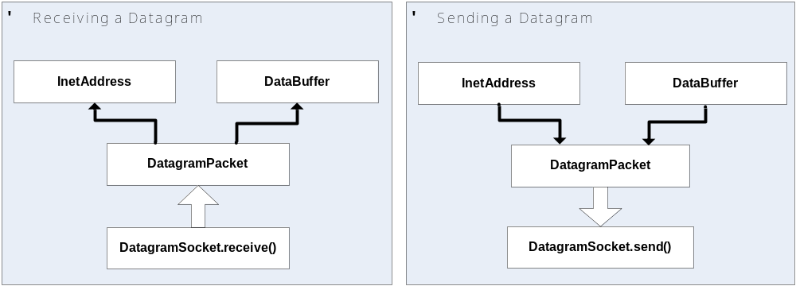
Datagram Socket

Slide 57
Datagram Socket
Setting up DatagramSocket
  Server side
DatagramSocket udpSocket = new DatagramSocket(port);
  Client side
DatagramSocket udpSocket = new DatagramSocket();

Slide 58
Datagram Socket
Sending a Datagram packet
byte[] buffer = new byte[packSize];
// Destination address
InetAddress addr = InetAddress.getByName(peerHostName);
DatagramPacket packet = new DatagramPacket(buffer, packSize, addr, peerPort);
// Send the datagram
udpSocket.send(packet);

Slide 59
Datagram Socket
Receiving a Datagram packet
byte[] buffer = new byte[packSize];
DatagramPacket receivePacket =
new DatagramPacket(buffer, packSize);
clientSocket.receive(receivePacket);

Slide 60
Example: Java client (UDP)
public class UDPClient {
public static void main(String args[]) throws Exception {
final int port = 9876;
BufferedReader keyboard =
new BufferedReader(new InputStreamReader(System.in));
DatagramSocket clientSocket = new DatagramSocket();
InetAddress addr = InetAddress.getByName("localhost");
byte[] sendData = new byte[1024];
byte[] receiveData = new byte[1024];
System.out.println("Input a message:");
String msg = keyboard.readLine();
sendData = msg.getBytes();

Slide 61
Example: Java client (UDP), cont.
DatagramPacket sendPacket =
new DatagramPacket(sendData, sendData.length, addr, port);
//Send data to server
clientSocket.send(sendPacket);
// Receive data from server
DatagramPacket receivePacket =
new DatagramPacket(receiveData, receiveData.length);
clientSocket.receive(receivePacket);
StringBuilder sb = new StringBuilder();
for (int i = 0; i < receiveData.length; i++) {
if (receiveData[i] == 0) {
break;
}
sb.append((char)receiveData[i]);
}
String serverMsg = sb.toString();
System.out.println("FROM SERVER:" + serverMsg);
clientSocket.close();
}
}

Slide 62
Example: Java server (UDP)
class UDPServer {
public static void main(String args[]) throws Exception {
final int serverPort = 9876;
DatagramSocket serverSocket = new DatagramSocket(serverPort);
System.out.println("Server started");
byte[] receiveData = new byte[1024];
byte[] sendData = new byte[1024];
while (true) {
DatagramPacket receivePacket =
new DatagramPacket(receiveData, receiveData.length);
serverSocket.receive(receivePacket);
// Get message from client
StringBuilder sb = new StringBuilder();
for (int i = 0; i < receiveData.length; i++) {
if (receiveData[i] == 0) {
break;
}
sb.append((char)receiveData[i]);
}
String msg = sb.toString();

Slide 63
Example: Java server (UDP), cont
// Extract address from the packet
InetAddress IPAddress = receivePacket.getAddress();
int clientPort = receivePacket.getPort();
// Prepare the msg for sending
String capitalized = msg.toUpperCase();
sendData = capitalized.getBytes();
DatagramPacket sendPacket =
new DatagramPacket(sendData, sendData.length, IPAddress,
clientPort);
serverSocket.send(sendPacket);
}
}
}

Slide 64
I/O Exceptions
BindException | → Signals that an error occurred while attempting to bind a socket to a local address and port.
ConnectException | → Signals that an error occurred while attempting to connect a socket to a remote address and port.
MalformedURLException | → Indicate that a malformed URL has occurred.
NoRouteToHostException | → Signals that an error occurred while attempting to connect a socket to a remote address and port.
ProtocolException | → Thrown to indicate that there is an error in the underlying protocol, such as a TCP error.
SocketException | → Thrown to indicate that there is an error in the underlying protocol, such as a TCP error.
UnknownHostException | → Thrown to indicate that the IP address of a host could not be determined.
UnknownServiceException | → Thrown to indicate that an unknown service exception has occurred.

Slide 65
Contents
I/O handling and Multi-thread programming
  I/O streams
  Multi-thread
  Lab practice
Socket programming
  Stream Socket (TCP)
  Lab practice
  Datagram Socket (UDP)
  Lab practice
  Exercise
Non-Blocking socket programming with nio
  Nio (New I/O)
  Non-Blocking Socket Programming
  Lab Practice

Slide 66
Lab practice – Time server
Write a time server application uses Datagram Socket
Client send request to server.
Server return its current time to client.
(Use new java.util.Date().toString() to get current time)

Slide 67
Contents
I/O handling and Multi-thread programming
  I/O streams
  Multi-thread
  Lab practice
Socket programming
  Stream Socket (TCP)
  Lab practice
  Datagram Socket (UDP)
  Lab practice
  Exercise
Non-Blocking socket programming with nio
  Nio (New I/O)
  Non-Blocking Socket Programming
  Lab Practice

Slide 68
Exercise – Echo Client/Server
Use Stream Socket to develop a client/server application:
Server listens on port 7
The server will wait for messages from clients.
Then echo the messages back to clients.
Close the connection of the client if its message is “bye”
Use multi-thread to serves clients concurrently.
E.g. client console:
# Hello server
# Echoed: Hello server
# How are you?
# Echoed: How are you?
# bye
# Echoed: bye

Slide 69
Contents
I/O handling and Multi-thread programming
  I/O streams
  Multi-thread
  Lab practice
Socket programming
  Stream Socket (TCP)
  Lab practice
  Datagram Socket (UDP)
  Lab practice
  Exercise
Non-Blocking socket programming with nio
  Non-Blocking Socket Programming
  Example

Slide 70
I/O programming before jre1.4
In the lifetime of a ServerSocket class, the important functions are as follows:
Accept incoming connections
Read requests from clients
Service those requests

Slide 71
Blocking Socket
First, create a new ServerSocket:
ServerSocket s = new ServerSocket();
Next, accept an incoming call.
Socket conn = s.accept( );
The call to accept() blocks until the server socket accepts a client request for connection.
Once a connection is established, the server reads the client requests, using LineNumberReader.
Because LineNumberReader reads data in chunks until the buffer is full, the call blocks on a read.

Slide 72
Blocking Socket
InputStream.read() is another way to read data. Unfortunately, the read method also blocks until data is available, as does the write method.

Slide 73
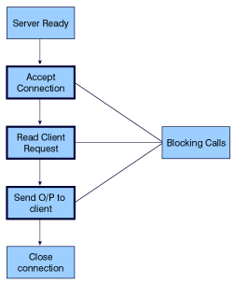
Blocking Socket

Slide 74
Getting Around Blocking
Prior to JDK 1.4, liberal use of threads was the most typical way of getting around blocking.
But this solution created its own problem -- namely thread overhead, which impacts both performance and scalability

Slide 75
NIO – New IO package
NIO's nonblocking I/O mechanism is built around selectors and channels

Slide 76
Channel
A channel represents an open connection to an entity such as a hardware device, a file, a network socket, or a program component that is capable of performing one or more distinct I/O operations, such as reading or writing.

Slide 77
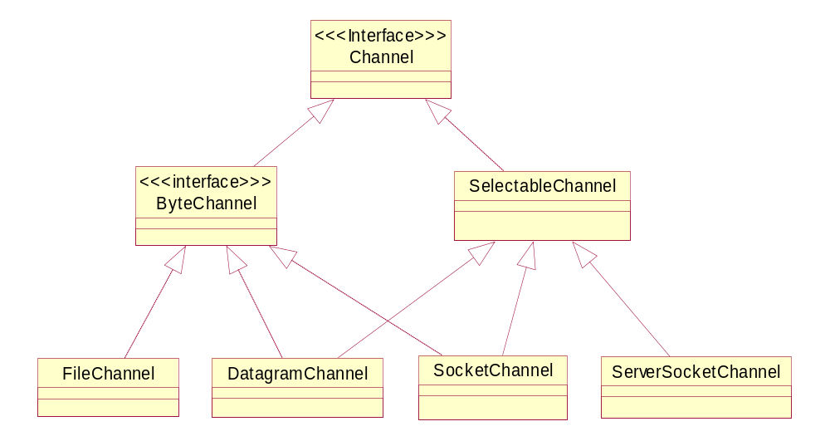
Class hierarchy for java.nio.channels
Some of the “inheritance” arcs here are indirect: we missed
out some interesting intervening classes and interfaces.

Slide 78
Socket Channels
java.nio.channels.SocketChannel interface
  Can be treated as replacements for java.net.Socket
java.nio.channels.ServerSocketChannel interface
  Can be treated as replacements java.net.ServerSocket,
Channels can be used in a blocking or a nonblocking mode

Slide 79
Basic Socket Channel Operations
Typical use of a server socket channel follows a pattern like:
ServerSocketChannel ssc = ServerSocketChannel.open() ;
ssc.socket().bind( new InetSocketAddress(port) ) ;
while(true) {
SocketChannel sc = ssc.accept() ;
… process a transaction with client through sc …
}
The client does something like:
SocketChannel sc = SocketChannel.open() ;
sc.connect( new InetSocketAddr(serverName, port) ) ;
… initiate a transaction with server through sc …
The elided code above will typically be using read() and write() calls on the SocketChannel to exchange data between client and server.
  So there are four important operations: accept(), connect(), write(), read() .

Slide 80
Creating a non-blocking channel
Creating a socket channel
String host = ......; InetSocketAddress socketAddress = new InetSocketAddress(host, 80);
SocketChannel channel = SocketChannel.open(); channel.connect(socketAddress);
Making the channel non-blocking
channel.configureBlockingMethod(false);

Slide 81
Blocking vs. Non-blocking
Blocking mode
  A thread will block on a read or a write until the operation is completely finished.
  If during a read, data has not completely arrived at the socket, the thread will block on the read operation until all the data is available.
Nonblocking mode
  The thread will read whatever amount of data is available and return to perform other tasks.
  If configureBlockingMethod() is passed true, the channel's behavior will be exactly the same as that of a blocking read or write on a Socket.

Slide 82
Selector
Selector class is a multiplexor of Channels
  A selector is analogous to a Windows message loop, in which the selector captures the various events from different clients and dispatches them to their respective event handlers

Slide 83
What the Selector does?
The Channel alone isn't enough to create a nonblocking I/O implementation. A Channel class must work in conjunction with the Selector class to achieve nonblocking I/O.
The Selector class plays the role of a Reactor in the Reactor pattern scenario.
The Selector multiplexes events on several SelectableChannels.
  Each Channel registers events with the Selector.
  When events arrive from clients, the Selector demutliplexes them and dispatches the events to the corresponding Channels.

Slide 84
Creating a selector
The simplest way to create a Selector is to use the open() method, as shown below:
Selector selector = Selector.open();

Slide 85
Classes Involved in Selection
Selection can be done on any channel extending SelectableChannel—amongst the standard channels this means the three kinds of socket channel.
The class that supports the select() operation itself is Selector. This is a sort of container class for the set of channels in which we are interested.
The last class involved is SelectionKey, which is said to represent the binding between a channel and a selector.
  In some sense it is part of the internal representation of the Selector, but the NIO designers decided to make it an explicit part of the API.

Slide 86
Setting Up Selectors
A selector is created by the open() factory method. This is naturally a static method of the Selector class.
A channel is added to a selector by calling the method:
SelectionKey register(Selector sel, int ops)
  Here ops is a bit-set representing the interest set for this channel: composed by oring together one or more of:
SelectionKey.OP_READ
SelectionKey.OP_WRITE
SelectionKey.OP_CONNECT
SelectionKey.OP_ACCEPT
  A channel added to a selector must be in nonblocking mode!
The register() method returns the SelectionKey created
  Since this automatically gets stored in the Selector, so in most cases you probably don’t need to save the result yourself.

Slide 87
Example
Here we create a selector, and register three pre-existing channels to the selector:
Selector selector = Selector.open() ;
channel1.register (selector, SelectionKey.OP_READ) ;
channel2.register (selector, SelectionKey.OP_WRITE) ;
channel3.register (selector, SelectionKey.OP_READ |
SelectionKey.OP_WRITE) ;
  For channel1 the interest set is reads only, for channel2 it is writes only, for channel3 it is reads and writes.
Note channel1, channel2, channel3 must all be in non-blocking mode at this time, and must remain in that mode as long as they are registered in any selector.
  You remove a channel from a selector by calling the cancel() method of the associated SelectionKey.

Slide 88
A Pattern for Using select()
… register some channels with selector …
while(true) {
selector.select() ;
Iterator it = selector.selectedKeys().iterator() ;
while( it.hasNext() ) {
SelectionKey key = it.next() ;
if( key.isReadable() )
… perform read() operation on key.channel() …
if( key.isWriteable() )
… perform write() operation on key.channel() …
if( key.isConnectable() )
… perform connect() operation on key.channel() …
if( key.isAcceptable() )
… perform accept() operation on key.channel() …
it.remove() ;
}
}

Slide 89
Remarks
This general pattern will probably serve for most uses of select():
  Perform select() and extract the new selected key set
  For each selected key, handle the actions in its ready set
  Remove the processed key from the selected key set
    Note the remove() operation on an Iterator removes the current item from the underlying container.
More generally, the code that handles a ready operation may also alter the set of channels registered with the selector
  e.g after doing an accept() you may want to register the returned SocketChannel with the selector, to wait for read() or write() operations.
In many cases only a subset of the possible operations read, write, accept, connect are ever in interest sets of keys registered with the selector, so you won’t need all 4 tests.

Slide 90
Key Attachments
One problem with the pattern above is that when it.next() returns a key, there is no convenient way of getting information about the context in which the associated channel was registered with the selector.
  For example channel1 and channel3 are both registered for OP_READ. But the action that should be taken when the read becomes ready may be quite different for the two channels.
  You need a convenient way to determine which channel the returned key is bound to.
You can specify an arbitrary object as an attachment to the key when you create it; later when you get the key from the selected set, you can extract the attachment, and use its content in to decide what to do.
  At its most basic the attachment might just be an index identifying the channel.

Slide 91
Simplistic Use of Key Attachments
channel1.register (selector, SelectionKey.OP_READ,
new Integer(1) ) ; // attachment
…
channel3.register (selector, SelectionKey.OP_READ |
SelectionKey.OP_WRITE,
new Integer(3) ) ; // attachment
…
while(true) {
…
Iterator it = selector.selectedKeys().iterator() ;
…
SelectionKey key = it.next() ;
if( key.isReadable() )
switch( ((Integer) key.channel().attachment() ).value() ) {
case 1 :
… action appropriate to channel1 …
case 3 :
… action appropriate to channel3 …
}
…
}

Slide 92
Buffers
The role of the buffer
An abstract class that contains data of a specific primitive data type. It is basically a wrapper around a fixed-size array with getter/setter methods that make its contents accessible.
The Buffer class has a number of subclasses, as follows:

Slide 93
Buffers
ByteBuffer
CharBuffer
DoubleBuffer
FloatBuffer
IntBuffer
LongBuffer
ShortBuffer
ByteBuffer
  ByteBuffer is the only class that supports reading and writing from and to the other types, since the other classes are type specific.
  Once connected, data can be read from or written to the channel with a ByteBuffer object

Slide 94
Example: Copying one Channel to Another
This example assumes a source channel src and a destination channel dest:
ByteBuffer buffer = ByteBuffer.allocateDirect(BUF_SIZE) ;
while(src.read(buffer) != -1) {
buffer.flip() ; // Prepare read buffer for “draining”
while(buffer.hasRemaining())
dest.write(buffer) ;
buffer.clear() ; // Empty buffer, ready to read next chunk.
}
  Note a write() call (or a read() call) may or may not succeed in transferring whole buffer in a single call. Hence need for inner while loop.

Slide 95
Contents
I/O handling and Multi-thread programming
  I/O streams
  Multi-thread
  Lab practice
Socket programming
  Stream Socket (TCP)
  Lab practice
  Datagram Socket (UDP)
  Lab practice
  Exercise
Non-Blocking socket programming with nio
  Non-Blocking Socket Programming
  Example

Slide 96
Example: Nio Echo server
Refer the socket.nio.echo.NioEchoServer.java file

Slide 97
Review

Slide 98
Summary

Slide 99
References
http://java.sun.com/docs/books/tutorial/networking/sockets/index.html
http://www.ibm.com/developerworks/java/library/j-javaio
http://java.sun.com/docs/books/tutorial/networking/sockets/index.html
http://java.sun.com/j2se/1.4.2/docs/guide/nio/example/index.html
http://rox-xmlrpc.sourceforge.net/niotut/index.html
http://www.ibm.com/developerworks/java/library/j-javaio/
http://mina.apache.org/
http://www.scribd.com/doc/267405/-Java-NIO-with-Grizzly
http://www.cs.brown.edu/courses/cs161/papers/j-nio-ltr.pdf

