Slide 1
A QUICK INTRODUCTION TO JAVADOC
AUTHOR
Long

Slide 2
Content
What is Javadoc ?
Overview of Javadoc
Tags of Javadoc
Example
Generate Javadoc by Eclipse IDE
Reference examples

Slide 3
1. What is Javadoc?
Traditionally, when you write a program you must write a separate document recording how the program works. When the program changes, the separate documentation must change as well
Javadoc is a documentation generator from Sun Microsystems for generating API documentation in HTML format from Java source code.

Slide 4
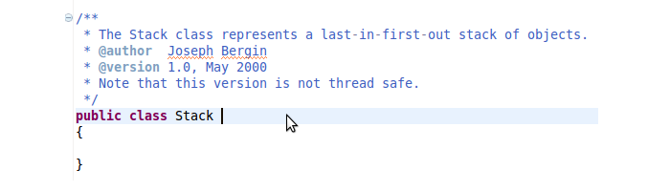
2. Overview of Javadoc
The basic structure of writing document comments is embed them inside /** ... */. The Javadoc is written next to the items without any separating newline.
The class declaration usually contains:

Slide 5
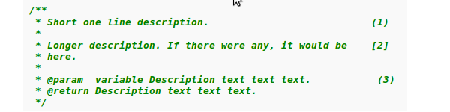
2. Overview of Javadoc
The Javadoc comment of method have the following format:

Slide 6
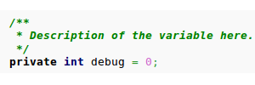
2. Overview of Javadoc
Variables are documented similarly to methods with the exception that part (3) is omitted
Here the variable contains only the short description:

Slide 7
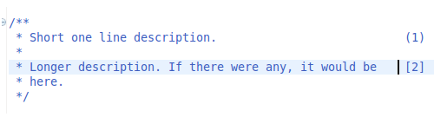
2. Overview of Javadoc
What should be included in the description

Slide 8
2. Overview of Javadoc
[1] should be a summary sentence, containing a concise but complete description of the API item. The Javadoc tool copies this first sentence to the appropriate member, class/interface or package summary. This makes it important to write crisp and informative initial sentences that can stand on their own
[2] a longer description that may span in multiple paragraphs. In those the details can be explained in full

Slide 9
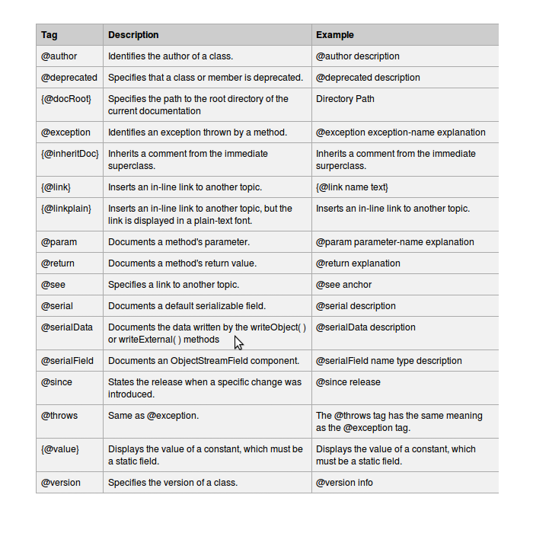
3. Tags of Javadoc
The javadoc utility recognizes the following tags:

Slide 10
3. Tags of Javadoc
Java also supports various inline tags of the form {@tag text_content} to handle special text inline. The most important ones are:
  {@literal text}
  Treat the text as literal, suppressing the processing of HTML markup and nested doc comment tags
  {@code text}
  Treat the text as literal, suppressing the processing of HTML markup and nested doc comment tags, and render the text in a code font

Slide 11
3. Tags of Javadoc
Example:
  {@literal a<B>c} displays in the generated HTML page unchanged: a<B>c
  {@code abc} is equivalent to
  <code>{@literal abc}</code>

Slide 12
3. Tags of Javadoc
HTML tags are also supported by Javadoc
@Return: is optional for private method but required in the protected, public and package level method

Slide 13
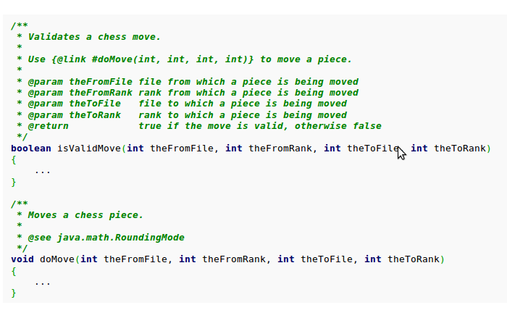
4. Example
An example of using Javadoc to document a method:

Slide 14
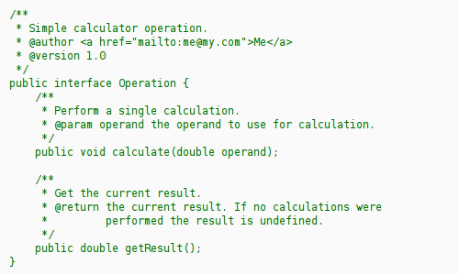
4. Example
An example of using Javadoc to document an interface:

Slide 15
4. Example
An example of using Javadoc to comment a class:

Slide 16
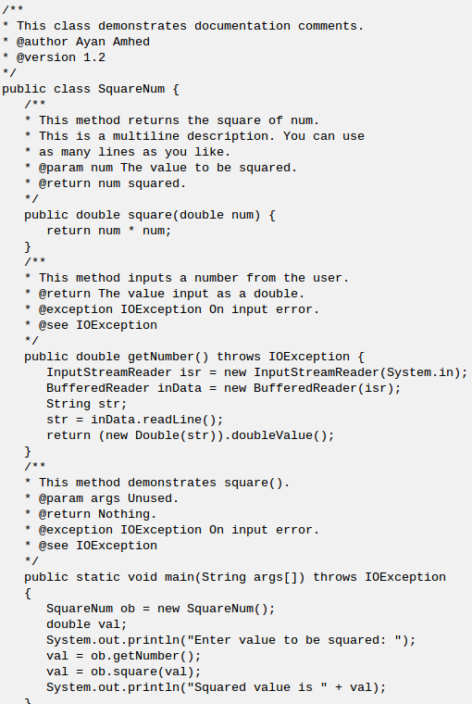

Slide 17
4. Example
You can view the result of the previous example in this link: http://www.tutorialspoint.com/java/index.html

Slide 18
5. Generate Javadoc by Eclipse IDE
The keyboard shortcut to write a Java doc comment is shift + alt + J
You can generate Java Documentation for a Project by the following steps:
  Open the project which you want to generate Java Documentation, then choose Project → Generate Javadoc in the menu bar
  Generate javadoc dialog will show

Slide 19
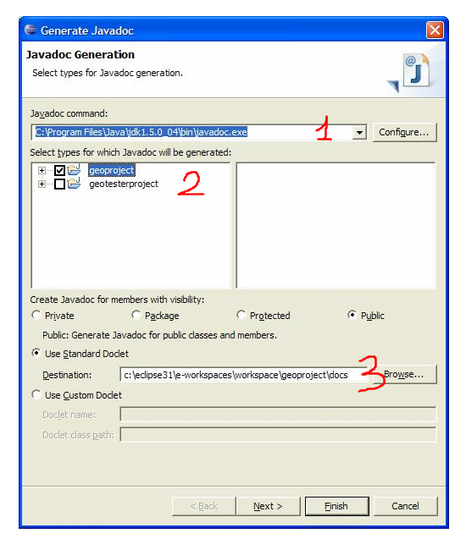
5. Generate Javadoc by Eclipse IDE

Slide 20

5. Generate Javadoc by Eclipse IDE
Step 1: click Configure, choose jdk\bin\javadoc.exe
Step 2: choose the project which want to generate javadoc
Step 3: click browse and choose the destination of javadoc
→ Click finish, and the javadoc will generate

Slide 21
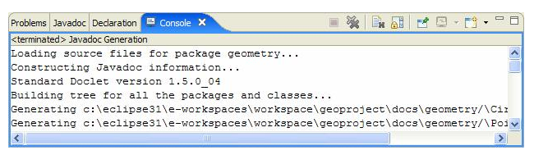
5. Generate Javadoc by Eclipse IDE

Slide 22
6. Reference examples
http://www.docjar.net/docs/api/java/util/package-index.html

Slide 23
THE END

