Slide 1
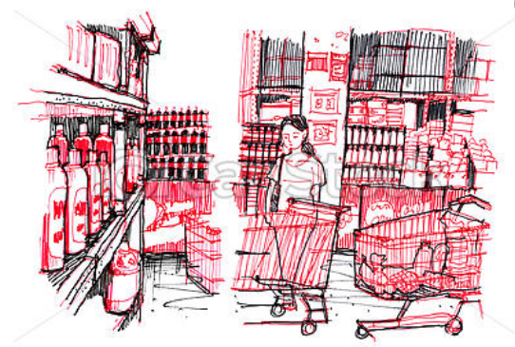
PREDICTING THE POTENTIAL LOCATION FOR AN ASIAN SUPERMARKET IN STUTTGART

Slide 2
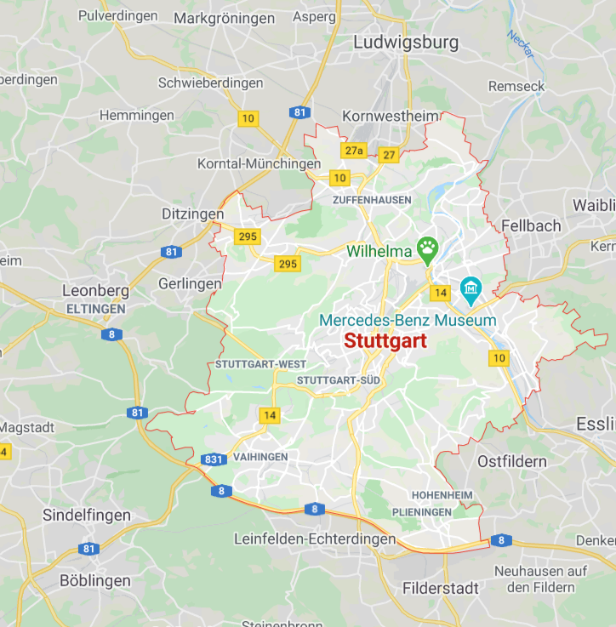
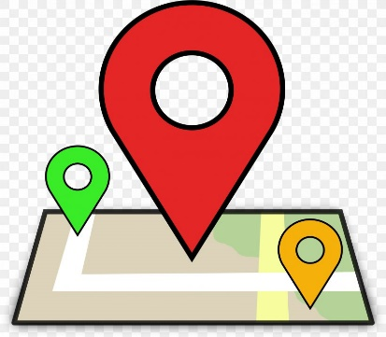


207.36 km²
Stuttgart’s area
634,830 thousand
2.8, 5.3 million
Population in urban area, in
administrative region, and in
metropolitan area respectively
106.4
Retail-relevant purchasing power index
2017 per inhabitant
3

Slide 3




Project Goals
Objective
Find the potential areas for an Asian Supermarket in Stuttgart
Constraints
The location is within 500m range from potential customer and public transportation
Asian Supermarket
Have no competitors in the radius of 2km

Slide 4

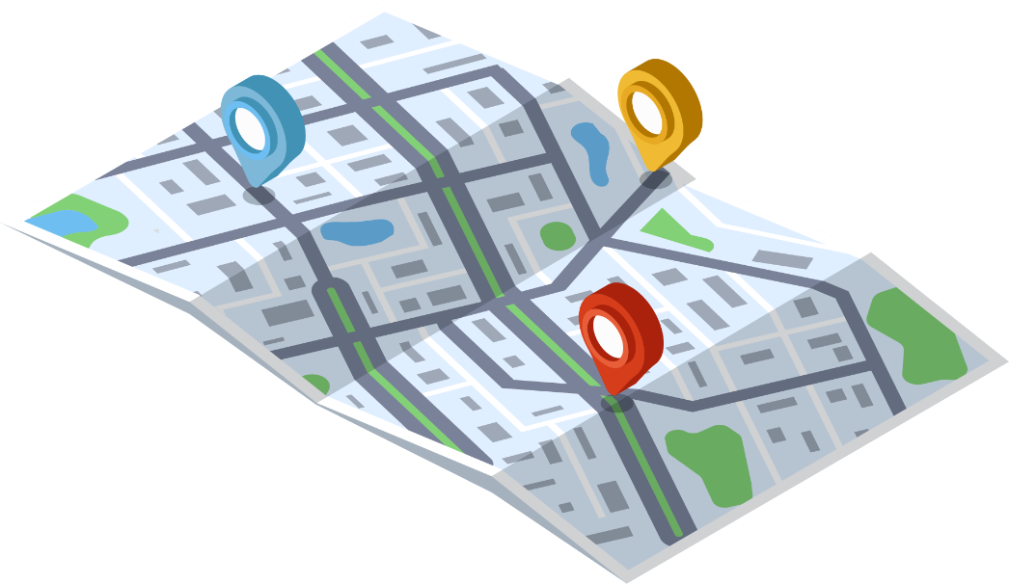
Data Preparation
STUTTGART
Coordinate requesting

Slide 5
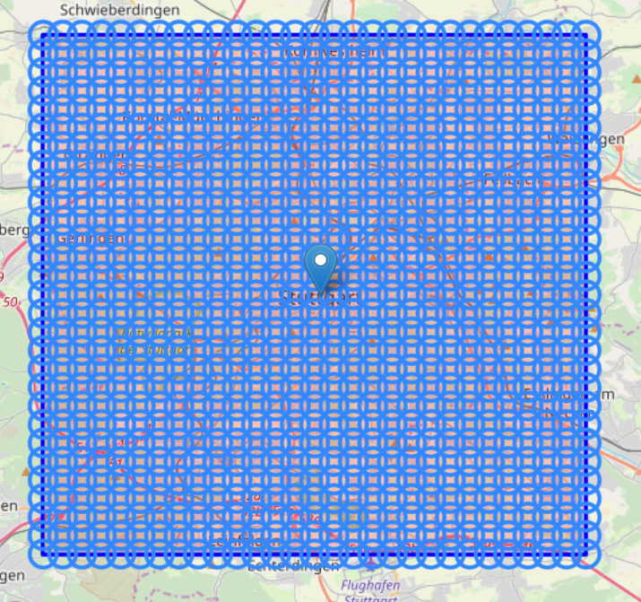
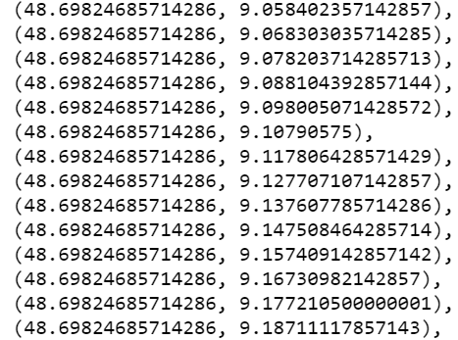
Data Preparation
Coordinate requesting
Dividing the bounding box to 840 neighbors

Slide 6

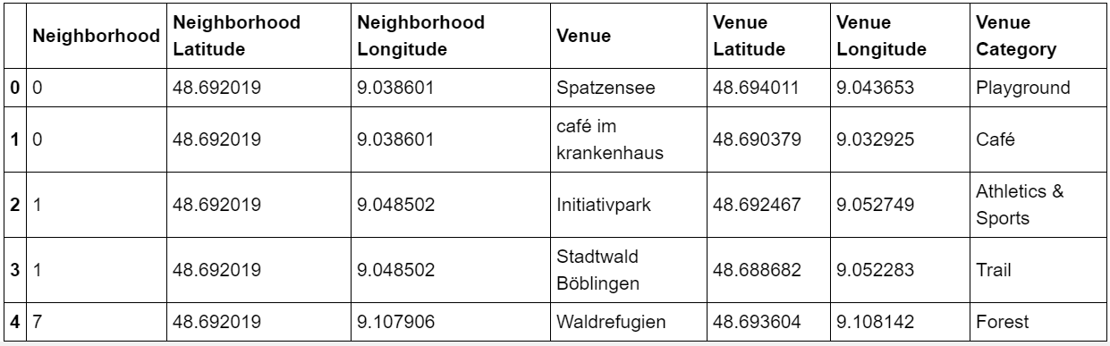
Data Preparation
Venue requesting

Slide 7



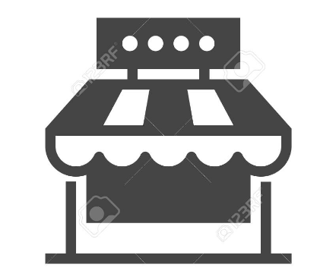
Divide the dataset into TWO SUB-DATASETS
Data Cleaning
FAVORITE PLACES
NON-FAVORITE PLACES
Supermarkets
Asian restaurants
Shopping malls
Public transportation
Food and Drink shops

Slide 8

Distance Calculation
Haversine
Neighborhood’s
centers
Haversine

Slide 9
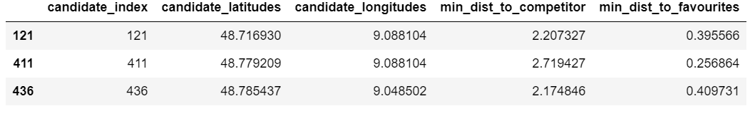
Location Finding
FAVORITE PLACES
NON-FAVORITE PLACES
Distance constraint: 500 meters
Distance constraint: 2000 meters

Slide 10
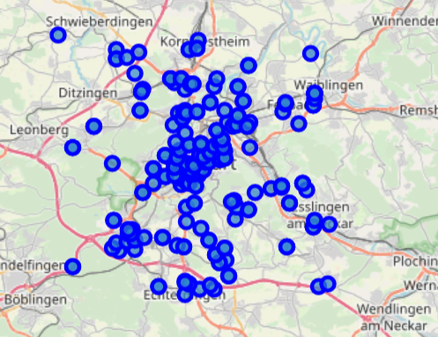
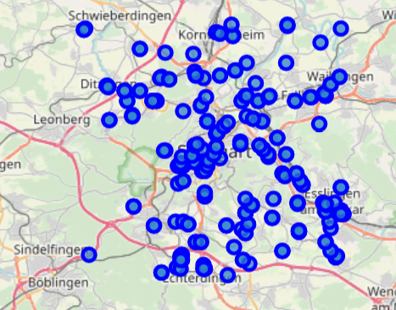
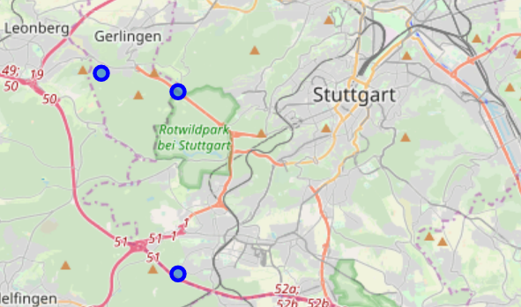
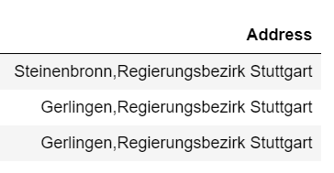
Favorite places
Non-favorite places
Potential
Locations

